Slide 1
Stage Netherlands + Spain
90-day validation before site commitment
• EUR268k base annual increment; EUR209k defined stress
• EUR270k capex; six FTE
• EUR16k less base than CZ + ES; EUR197k more under stress
• Release capex only after verified downside remains positive and payback ≤3y

Slide 2
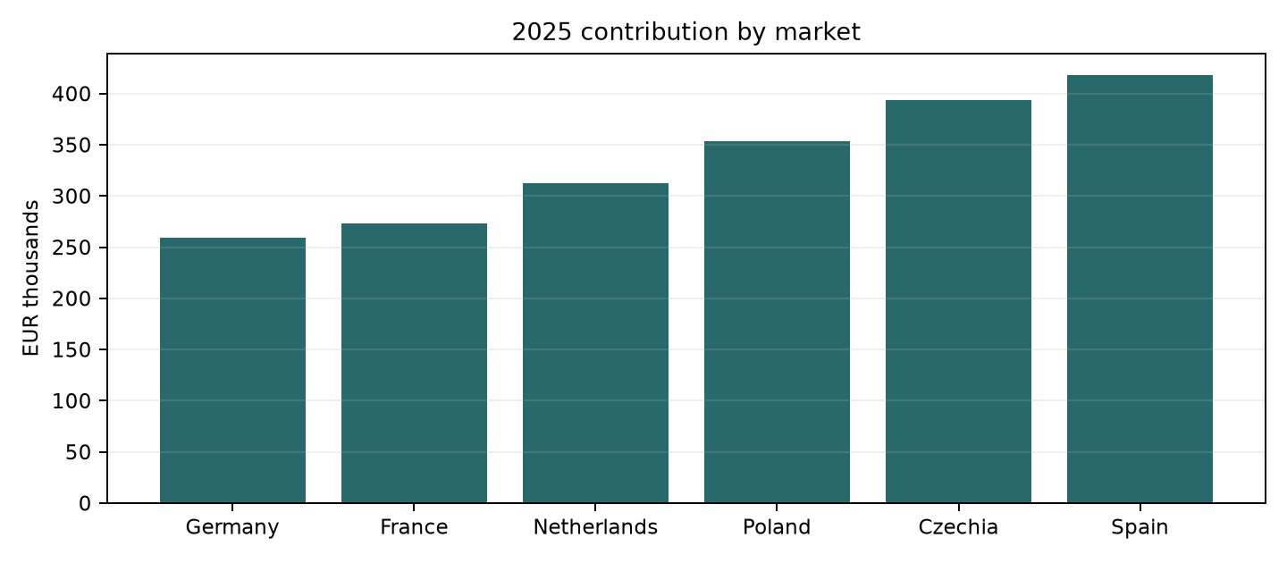
2025 synthetic contribution
1,254 eligible orders • 80,436 units
• Spain EUR418k
• Czechia EUR394k
• Poland EUR353k

Slide 3
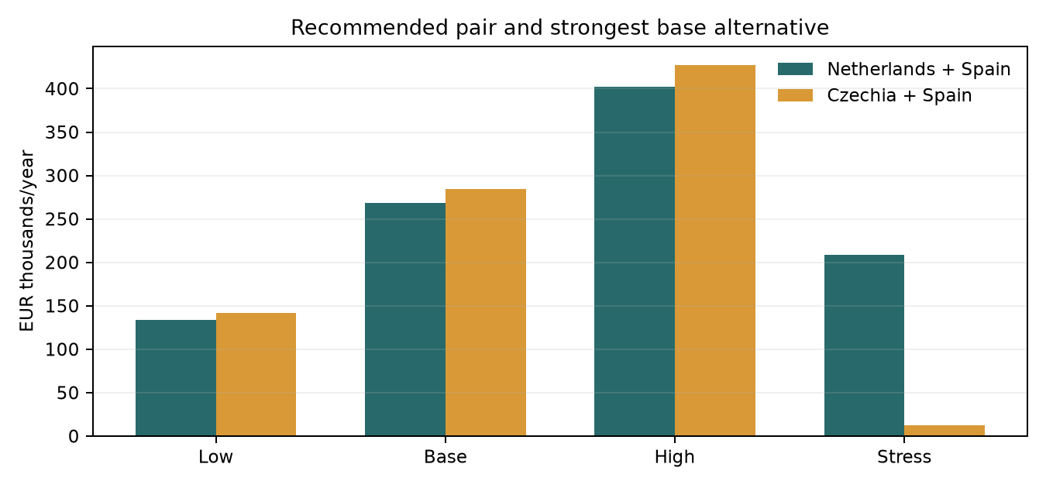
Downside changes the ranking
Client-defined scenarios; no probability assigned
• NL+ES: EUR268k base / EUR209k stress
• CZ+ES: EUR284k base / EUR12k stress
• CZ stress includes 10% CZK shock

Slide 4
Trade-off and switch conditions
Hard limits: EUR450k • seven FTE • two hubs
• NL + ES costs EUR45k more capex and one more FTE
• CZ + ES would lead stress if the modeled CZK shock were below about 0.55%
• If demand or savings fail validation: defer
• Stress is scenario arithmetic, not forecast probability

Slide 5
90-day gates
Owners are roles; assign people at kickoff
Days 0–15
COO + Finance
Reconcile baseline; define KPIs
Days 16–45
Commercial + Ops
Access customer/carrier data; validate demand, service and savings
Days 46–70
Finance + HR + Legal
After Gate 1: full costs/local diligence; downside >0; payback ≤3y
Days 71–90
COO + Board sponsor
After Gate 2, commit only if evidence passes; otherwise defer

Slide 6
KPI scorecard
Weekly by country/SKU vs measured baseline
• Delivery median/P90 down ≥20% by day 90
• On-time-in-full +5pp; returns no more than +0.5pp
• Realized savings ≥EUR3.10/unit; downside contribution >0
• Zero unresolved orphan/revision exceptions

Slide 7
Evidence boundary
• Client orders, returns, costs and option assumptions are synthetic
• Archived official ECB 2025 rates and WB 2022–24 observations
• Macro context is not proof of parts demand
• No causal effect, discounting, taxes or ramp modeled

