Slide 1
MERIDIAN PARTS
European service-hub expansion
Board recommendation: gated funding for CZE, ESP
€225,000 capex | 5 FTE | €198,099 base annual incremental contribution | 1.14-year payback
2025 shipped sales and returns through 2026-01-31
Synthetic client data; archived official World Bank and ECB context
27 September 2026

Slide 2
Decision in one view
Approve discovery now; release capex only after the 90-day gates.
Selected pair
Annual base
Year-zero capex
People
CZE + ESP
€198,099
€225,000
5 FTE
Highest base-case feasible pair
After recurring fixed cost
50% of EUR450k cap
Within seven-FTE cap
Hard constraints
≤2 hubs • ≤€450,000 capex • ≤7 FTE • defer all remains feasible
Flip before commitment if validated volume uplift is below 2.74%, realized savings do not cover fixed cost, service-level improvement is not verified, or the defined stress becomes negative.
Meridian Parts | Synthetic client inputs + archived official snapshots | Not a causal forecast
2

Slide 3
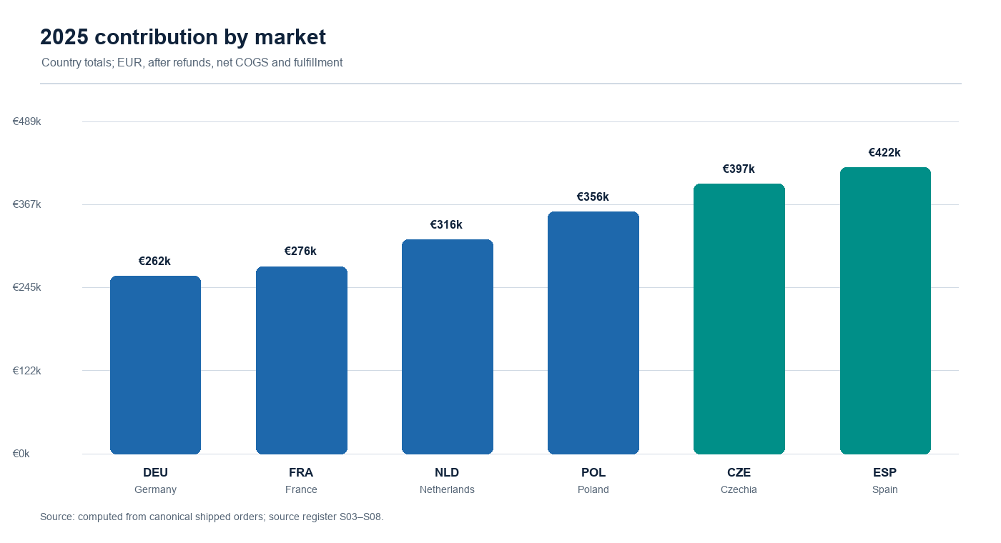
2025 baseline: where contribution is concentrated
Country totals from reconciled canonical orders; source register S03–S08.
Read-out
DEU: €262,366 contribution, 41.9% margin, 12,153 units
FRA: €276,271 contribution, 43.7% margin, 11,880 units
NLD: €315,644 contribution, 45.2% margin, 12,576 units
POL: €356,494 contribution, 46.8% margin, 13,163 units
CZE: €397,335 contribution, 48.7% margin, 13,733 units
ESP: €421,900 contribution, 49.6% margin, 13,931 units
Spain leads contribution; Czechia is second and has a low capex/FTE option. These are observed ledger facts, not proof that hubs cause demand.
Meridian Parts | Synthetic client inputs + archived official snapshots | Not a causal forecast
3

Slide 4
The base is controlled, not cosmetically cleaned
Edge cases were reconciled and disclosed in the workbook Quality sheet and metrics.json.
1,310
13
18
1,297
raw order rows
identical order rows removed
whole-row corrections applied
canonical order IDs
1,254
241
1
1
eligible 2025 shipped orders
included returns
orphan return quarantined
post-cutoff return excluded
Valid zero-price shipments remain in the base. January 2026 shipped rows do not enter 2025. Refunds use the original sale month's ECB mean; return units are physical units, not return orders.
Meridian Parts | Synthetic client inputs + archived official snapshots | Not a causal forecast
4

Slide 5
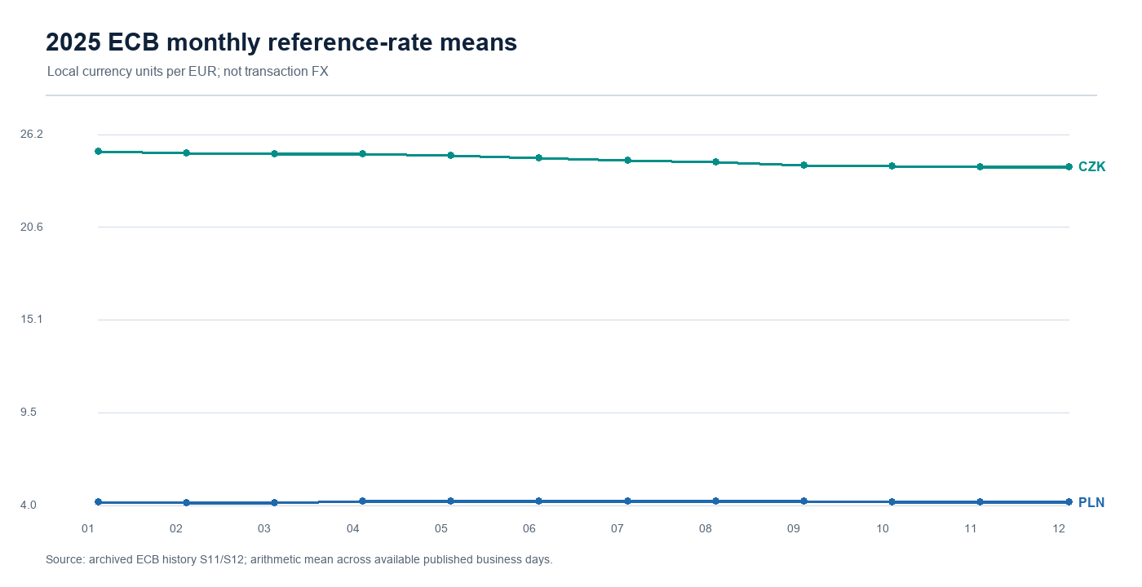
Market context informs execution, not demand proof
Archived World Bank series [S09–S10] and ECB rates [S11–S12].
Archived context
DEU: population +0.4% (2022–24); GDP pc $56,104 in 2024
FRA: population +0.5% (2022–24); GDP pc $46,103 in 2024
NLD: population +1.7% (2022–24); GDP pc $67,465 in 2024
POL: population -0.7% (2022–24); GDP pc $25,104 in 2024
CZE: population +2.2% (2022–24); GDP pc $31,828 in 2024
ESP: population +2.2% (2022–24); GDP pc $35,327 in 2024
FX means are translation assumptions for comparable reporting; they are not Meridian transaction rates or a forecast.
Meridian Parts | Synthetic client inputs + archived official snapshots | Not a causal forecast
5

Slide 6
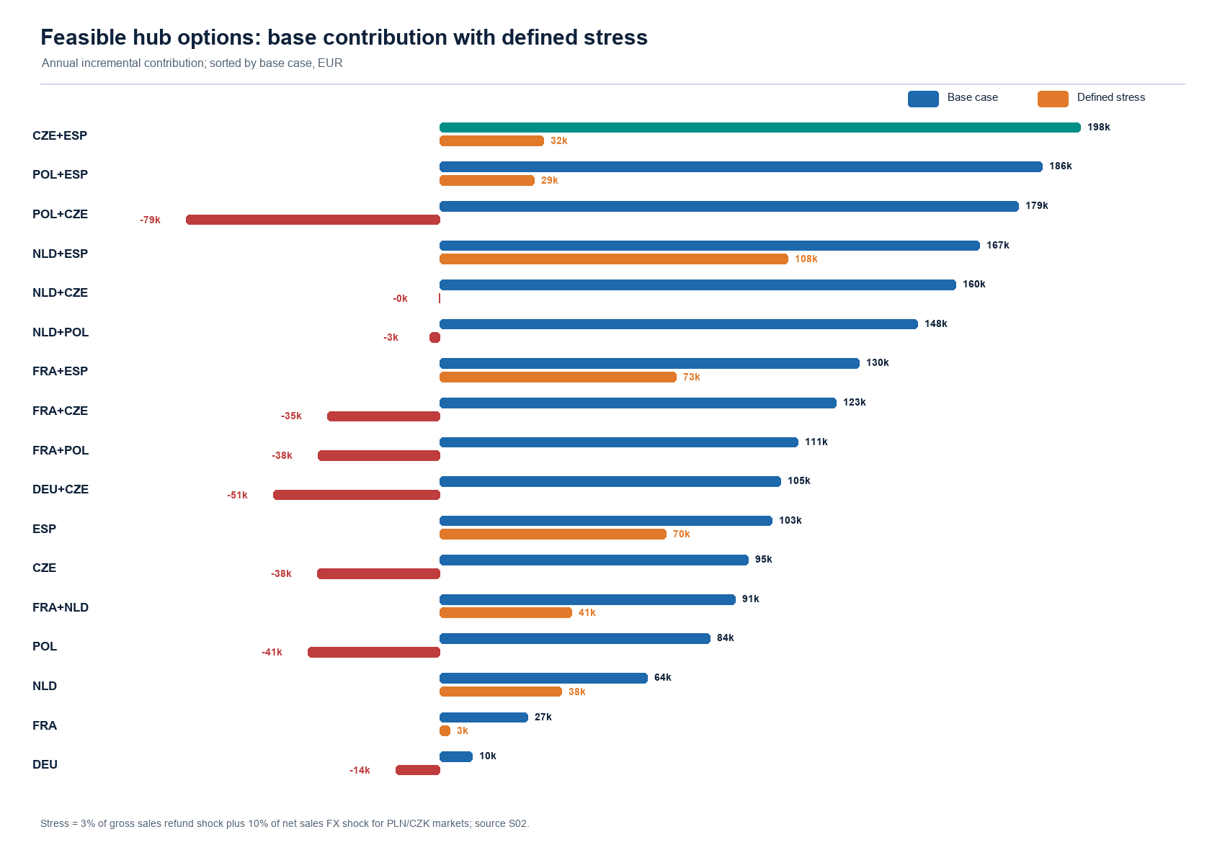
Options: CZE + ESP leads on the stated base metric
All feasible single hubs and pairs shown; pairs add country figures without synergy.
Base-case leaders
CZE+ESP: €198,099 base | €32,180 stress | 1.14y
POL+ESP: €186,329 base | €29,264 stress | 1.29y
POL+CZE: €178,995 base | €-78,570 stress | 1.15y
NLD+ESP: €166,931 base | €107,630 stress | 1.62y
NLD+CZE: €159,598 base | €-203 stress | 1.47y
CZE+ESP has a positive defined stress result but the smallest stress cushion among the top base options. This is why the recommendation is gated.
Meridian Parts | Synthetic client inputs + archived official snapshots | Not a causal forecast
6

Slide 7
Selected pair economics across scenarios
Scenario values are annual incremental contribution after recurring cost; capex is year-zero.
Scenario
Annual contribution
Payback
Break-even volume uplift: 2.74%
Selected pair capex: €225,000 | FTE: 5
Defined stress includes 3% gross-sales refund shock plus 10% net-sales FX shock for PLN/CZK only.
Low
€64,619
3.48 years
Base
€198,099
1.14 years
High
€331,580
0.68 years
Stress
€32,180
6.99 years
Do not read low/base/high as probabilities. They are planning cases from the synthetic policy.
Meridian Parts | Synthetic client inputs + archived official snapshots | Not a causal forecast
7

Slide 8
The decision is a trade-off, not a single-score proof
Base contribution, stress resilience, capex and staffing point in different directions.
Option
Base
Stress
Capex
FTE
Payback
CZE+ESP
€198,099
€32,180
€225,000
5
1.14y
POL+ESP
€186,329
€29,264
€240,000
6
1.29y
NLD+ESP
€166,931
€107,630
€270,000
6
1.62y
CZE+ESP wins the base metric; POL+ESP is the strongest base alternative; NLD+ESP is the stress-oriented alternative. The board's preference between upside and downside resilience should be made explicit at Gate 3.
Meridian Parts | Synthetic client inputs + archived official snapshots | Not a causal forecast
8

Slide 9
90-day implementation: validate before committing
Owners are operating roles; gates protect against assumption risk.
COO + CFO
Define KPI baseline, lane map, data owners; authorize discovery only.
0–15
Ops + Procurement
Validate freight, labor/partner quotes, returns routing and service promise.
16–45
Country leads
Run controlled pilot; report uplift, service, savings, refunds and fulfillment.
46–75
Board + COO
Go / defer / switch; release capex in tranches if evidence supports.
76–90
Gate: measured uplift ≥2.74% for selected pair, realized savings cover fixed cost, and service quality does not deteriorate versus baseline.
Meridian Parts | Synthetic client inputs + archived official snapshots | Not a causal forecast
9

Slide 10
Board ask and KPI control loop
Use the dashboard to turn a planning recommendation into an evidence-based release decision.
Weekly KPI dashboard
Board decision
•
Incremental shipped volume uplift
Authorize the 90-day validation envelope.
At Gate 3: release CZE + ESP capex, defer, or switch to POL + ESP / NLD + ESP based on measured economics and explicit risk preference.
•
Savings per shipped unit
•
Contribution per order
•
Return/refund rate
•
Promised-day hit rate
•
Capex and FTE burn
Recommendation: proceed, but make the capex release conditional.
Meridian Parts | Synthetic client inputs + archived official snapshots | Not a causal forecast
10

