Slide 1
Diagnosing Rainfall Variability Within A Series of Atmospheric Rivers over Northern California in February 2017
Parker Malek, Portland State University
Dr. Paul Loikith, Portland State University

Slide 2
Outline
Background
Research Questions
Study Area
Methods
Preliminary Results
Discussion
Future Research

Slide 3
Broad Background
High Intensity Precipitation (HIP)
Any unusually high precipitation rate given the duration of the precipitation event
Drivers of hydrometeorological hazards (flooding, erosion, landslides, etc) (IPCC, 2022)
HIP embedded within larger storm systems exacerbates hazards
Issues with understandings of HIP:
Poor representation of HIP in climatology (I.E. longer time-frame climate patterns)
Poor understanding of meteorological forcings that cause high-intensity precipitation
Poor simulation of small-scale high-intensity precipitation in atmospheric models

Slide 4
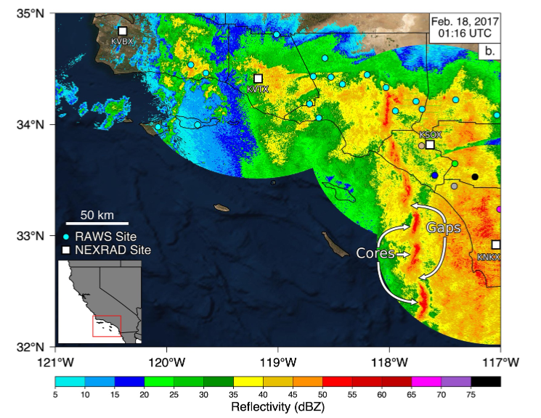
HIP on the West Coast
Usually associated with the presence of larger scale atmospheric rivers (AR)
Narrow cold frontal rainbands (NCFR)
Locations within storms with notably high rates of precipitation (Houze et al., 1976; Hobbs & Persson, 1982; Koch & Kocin, 1991)
Notable in destructive and costly events in Southern California (Cannon et al., 2018; Oakley et al., 2017; Sukup et al., 2016, de Orla-Barile, 2022).
Orographic enhancement
Source: de Orla-Barile, 2022

Slide 5
Research Questions
What specific characteristics (physical/statistical) can we find in HIP on the West Coast of the United States:
How synoptic (large-scale) drivers influence regional meteorology
How many are associated with unique mesoscale (small-scale) features (narrow cold frontal rain bands, etc)
Are there any interesting patterns in the variability of HIP pulses found within longer term events.

Slide 6
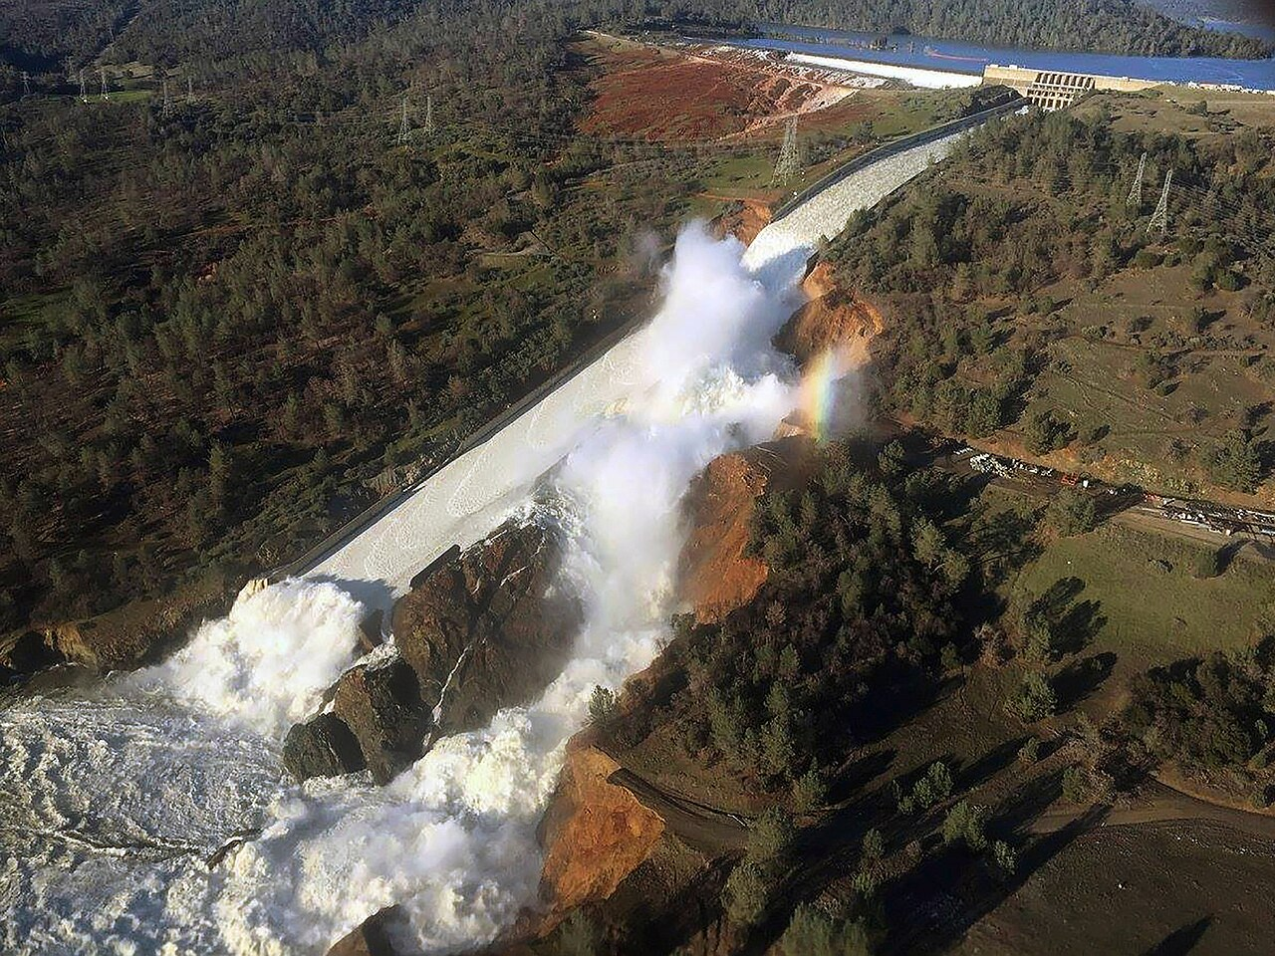
Case Study: 2017 Oroville Dam Crisis
Partially driven by a series of AR events during an exceptionally wet water year
Heavy damage to the primary and emergency spillway of the Oroville Dam
Over $1 billion dollars In damages
Mass evacuations

Slide 7
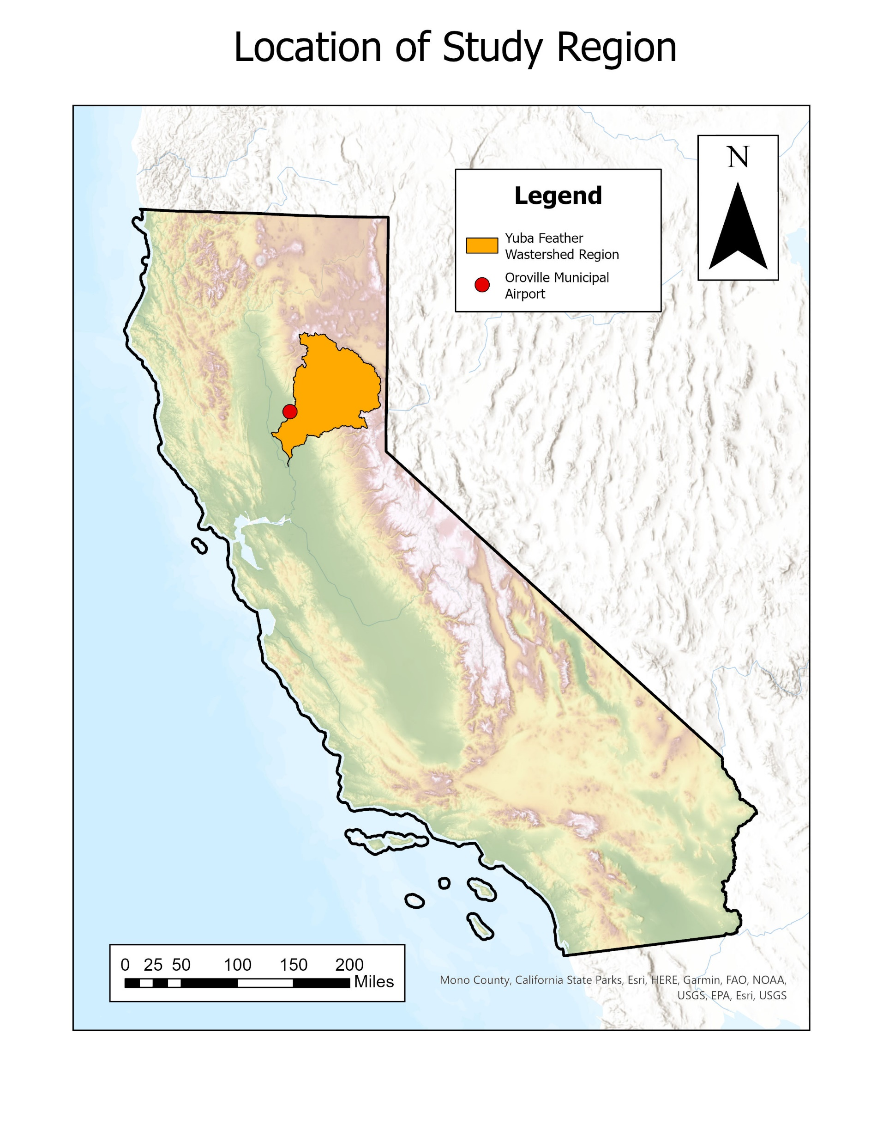
Study Area
In collaboration with the Center for Western Weather and Water Extremes as part of the Forecast-Informed Reservoir Operations (FIRO) project
Yuba-Feather watershed region

Slide 8
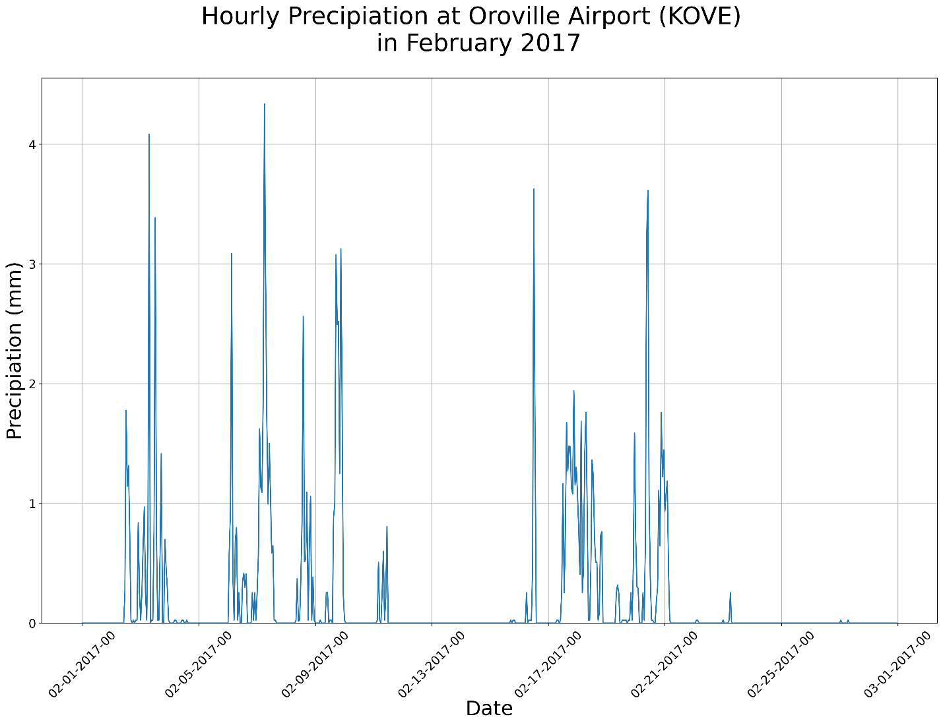
Methods – Identifying Synoptic-Level Events
Airport station data (MesoWest) Hourly precipitation amounts
Oroville Municipal Airport
Identify longer-term events
Period of nonzero precipitation separated by 12 hours of dryness with at least one hourly rainfall reading of 3mm or above
Synoptic-Scale Event
Source: MesoWest (https://mesowest.utah.edu/)

Slide 9
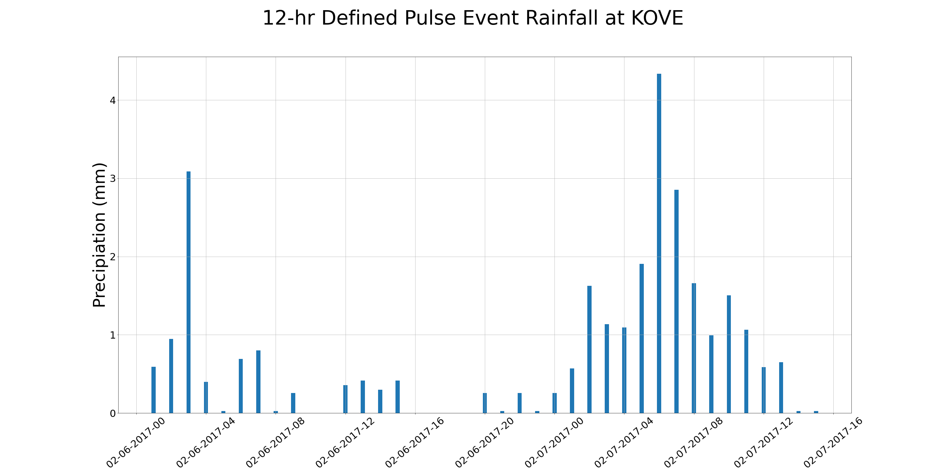
Methods – Identifying within-event precipitation pulses
Visual inspection
Distinct waves of precipitation within longer duration events
What are the meteorological forcings behind these HIP event
Interested in these hourly spikes in precipitation

Slide 10
Methods – Characterize Events
Large scale (synoptic: 1000 km+)
Integrated water vapor transport (IVT)
Directional components of storm systems
Small scale (mesoscale: 1 - 1000 km)
Using radar products to inspect structure of systems (NOAA’s Multi-Radar/Multi-Sensor System data)
Does the event contain an NCFR
Is there orographic forcing?
Basic Characteristics
Event start/end

Slide 11
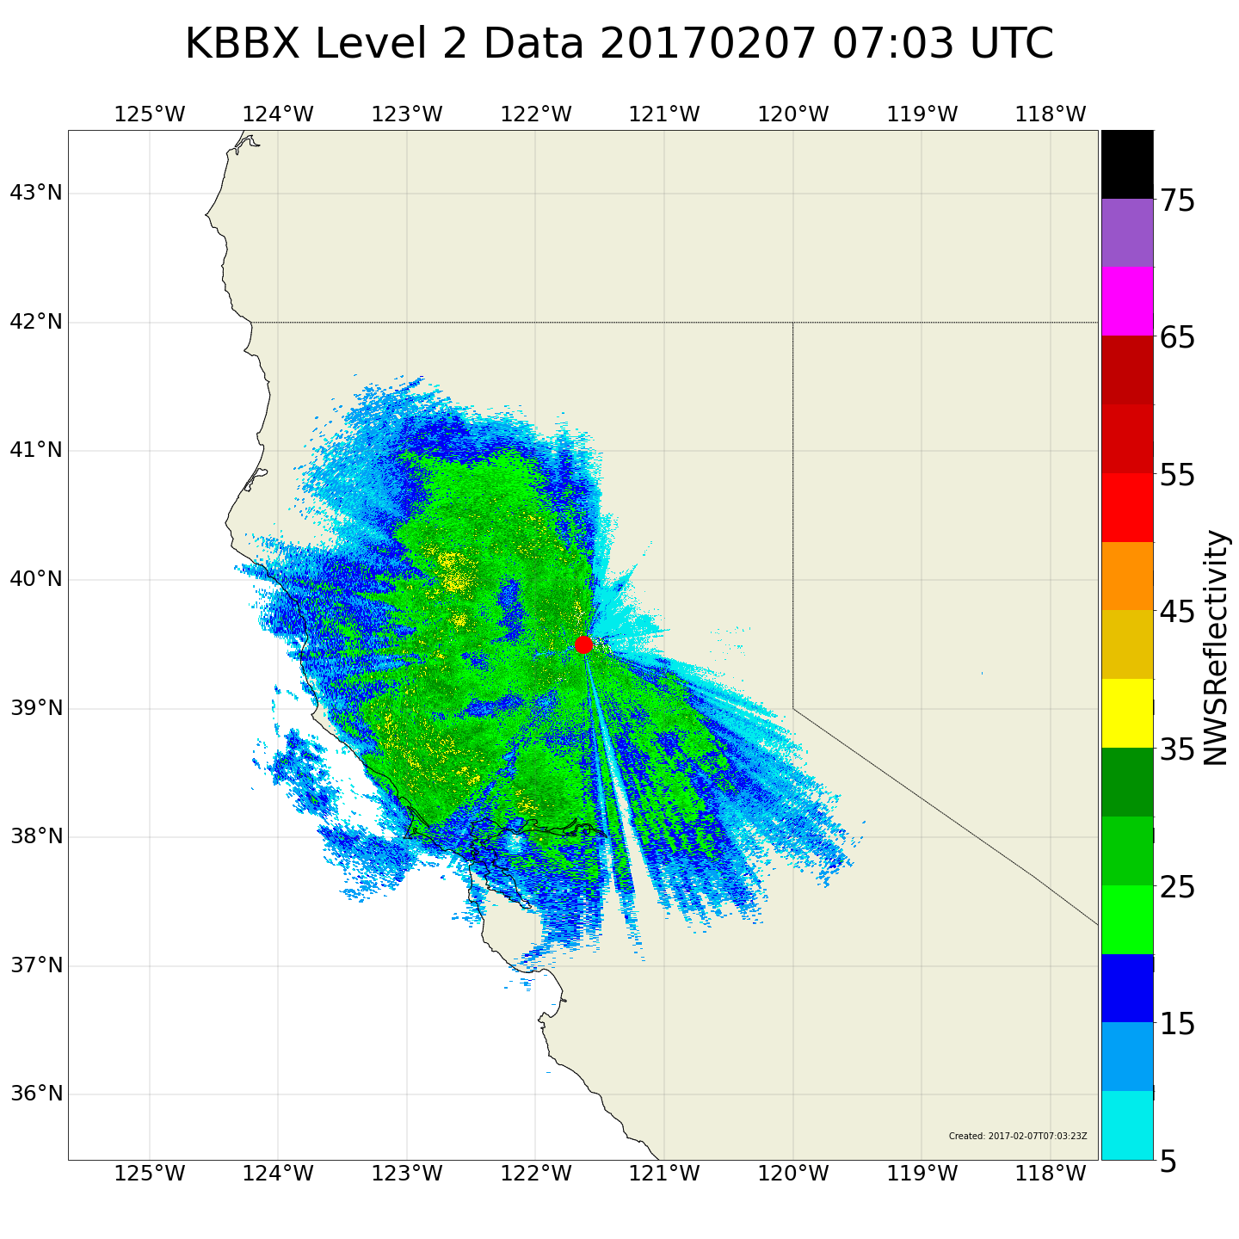
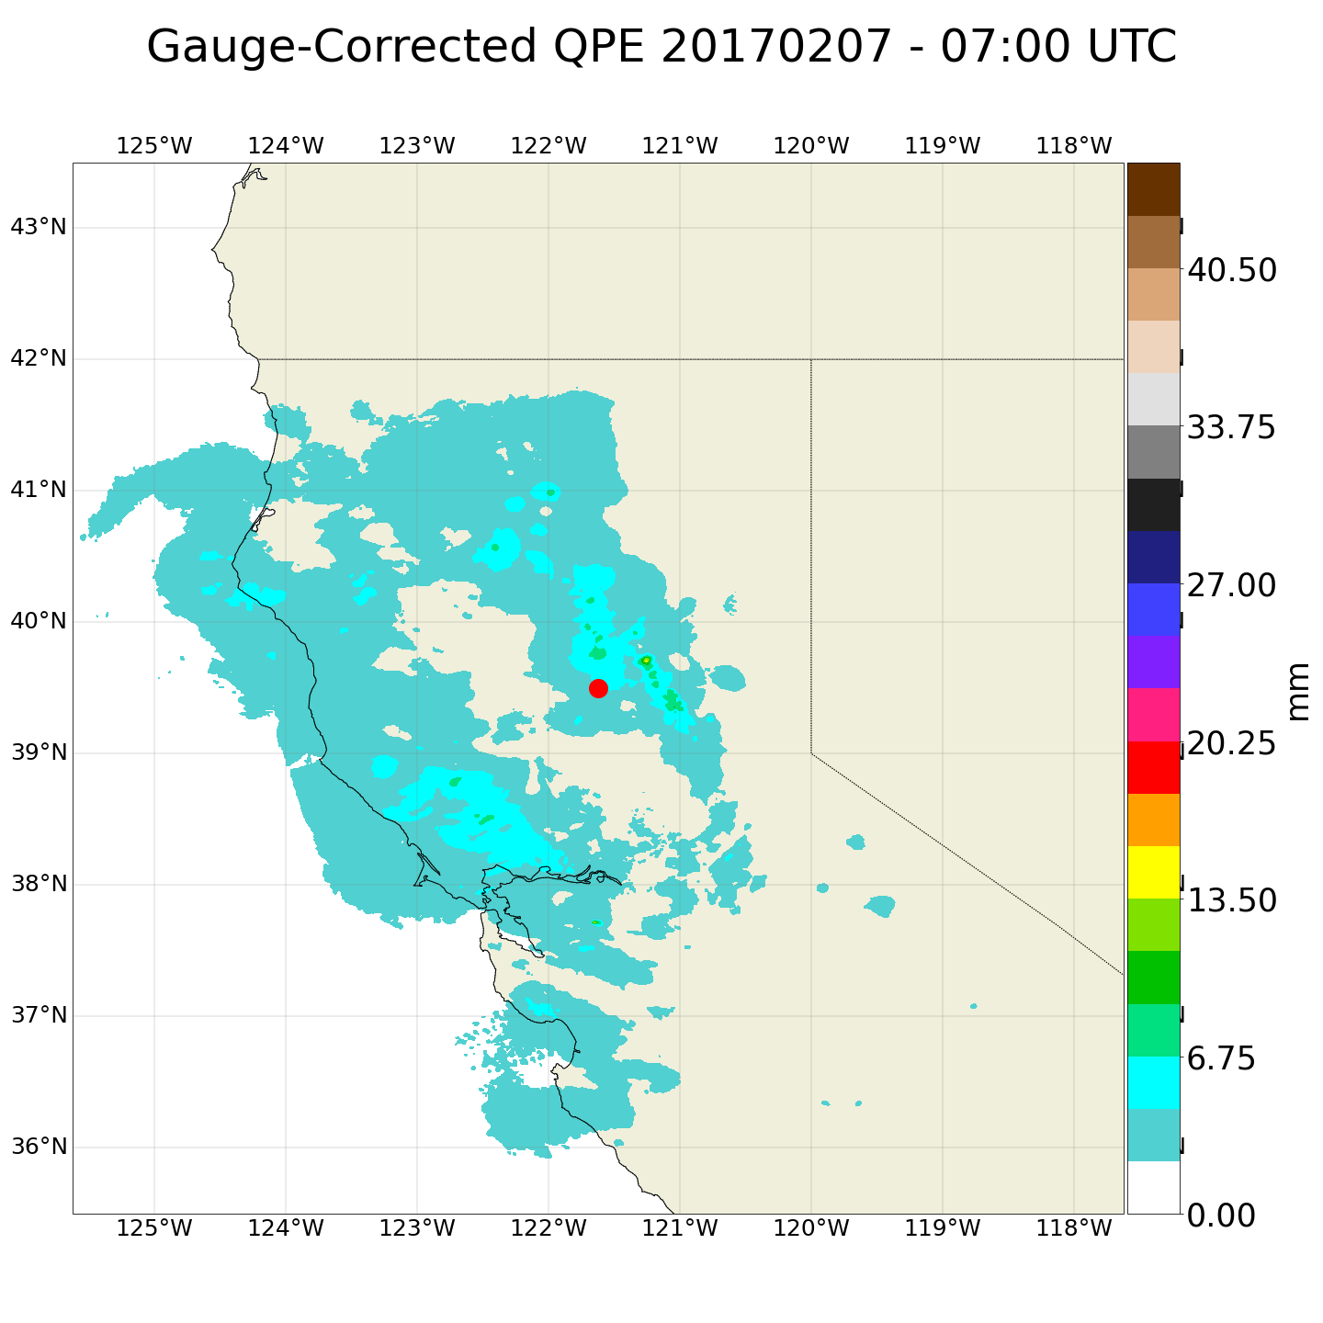
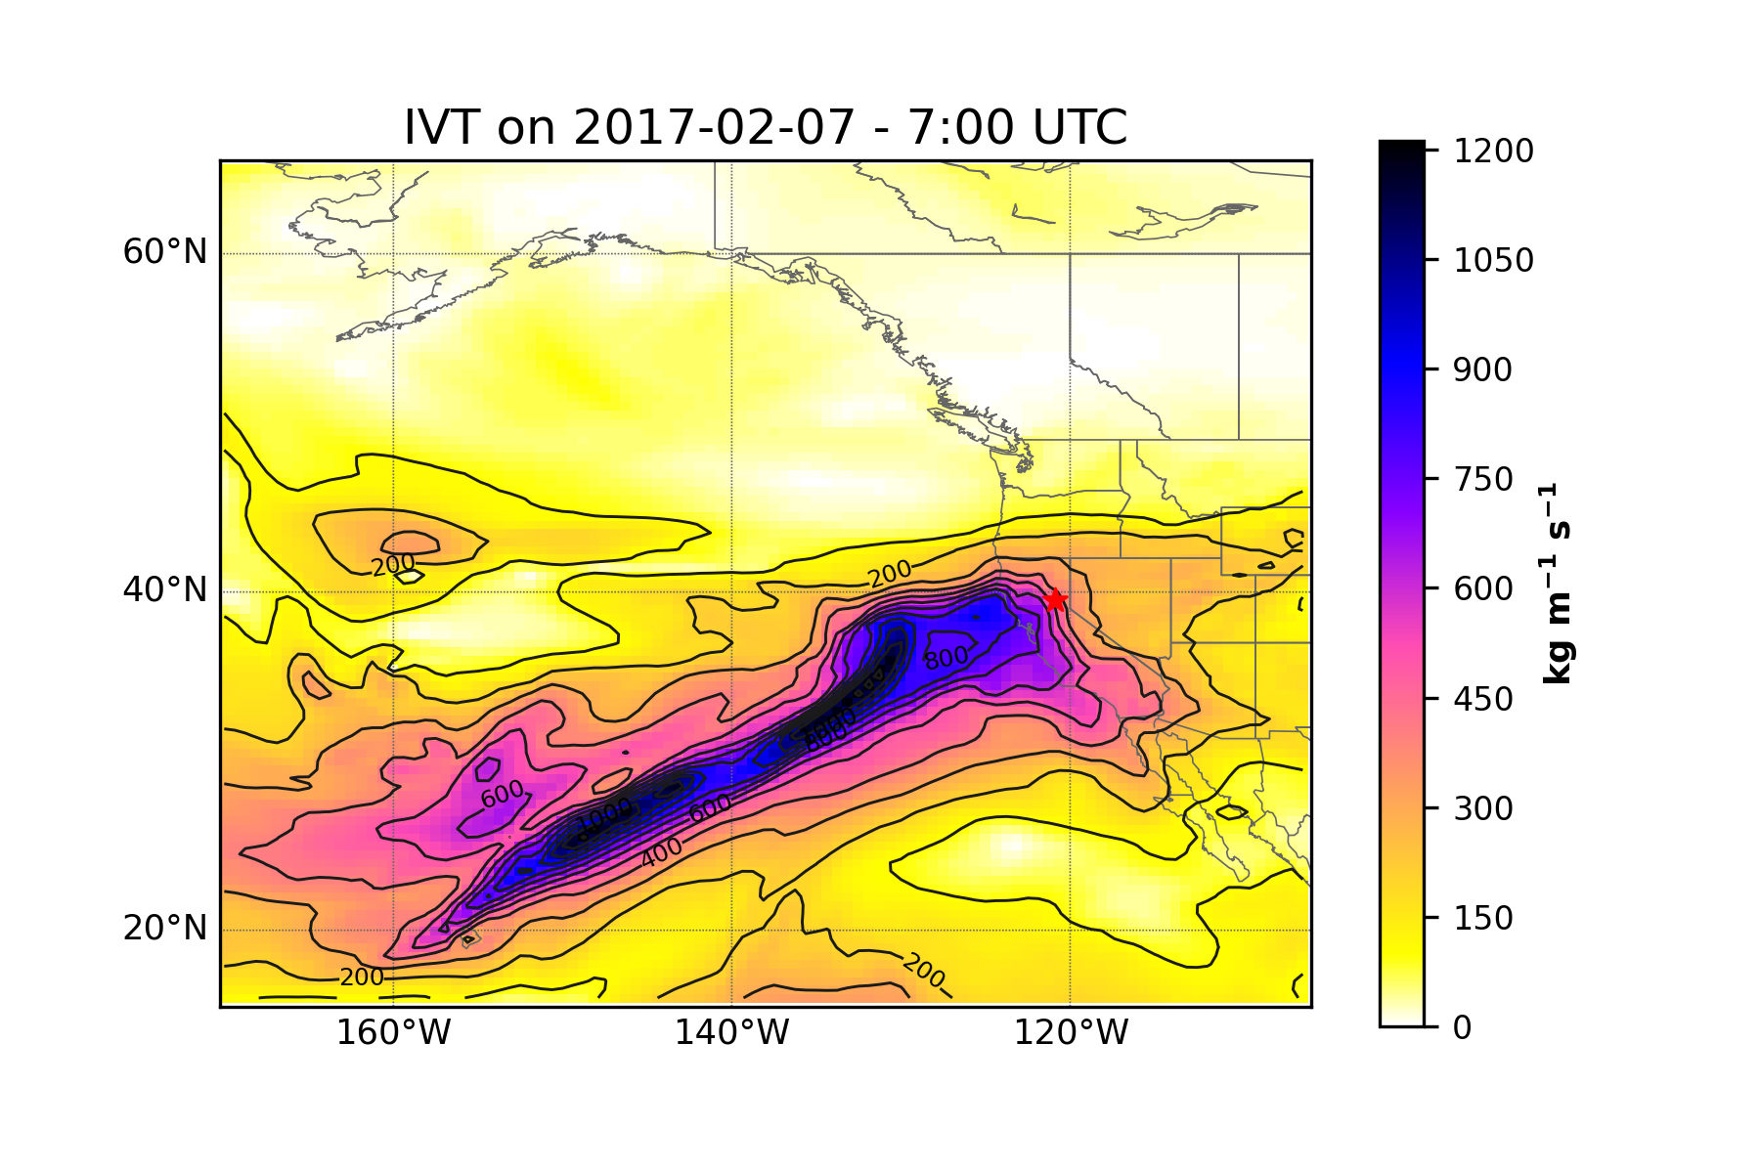
Preliminary Satellite and Radar data

Slide 12
Discussion and Broader Impact
Extreme precipitation events are likely to increase in frequency as the climate warms
Known drivers of landscape shaping processes such as flash flooding, erosion, snowmelt, landsliding and debris flows.
Mitigation strategies
Disaster management
Improve climate/weather models

Slide 13
Future Research
Data being used in this study is available for most of the United States
Opportunities to scale
Identification process of within-event HIP can be used as the basis for algorithm development

Slide 14
Project Timeline
MS in Geography objective timeline | Summer 2023 | Fall 2024 (Defend Thesis Proposal) | Winter 2024 | Spring 2024 or Fall 2025 (Defend Thesis)
Credits to take (research and thesis credits) | 4 | 4 | 4 | 2

Slide 15
Thanks!

