Slide 1
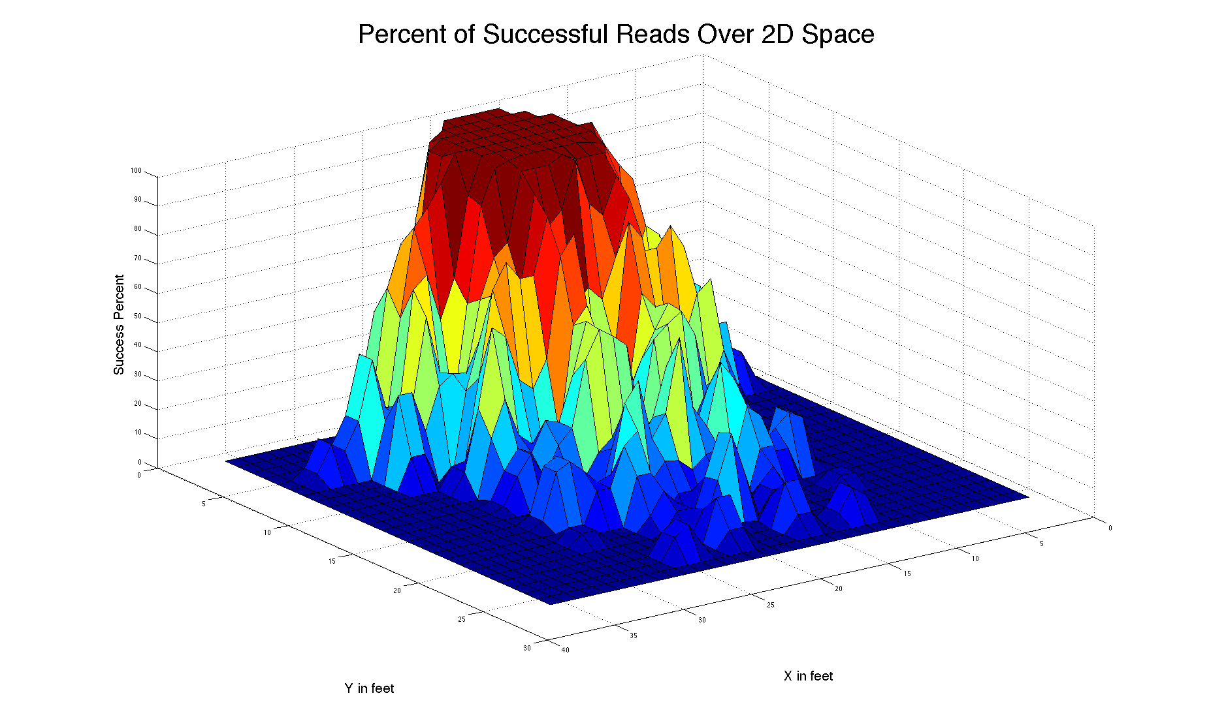
RFID Reader
Located Here

Slide 2
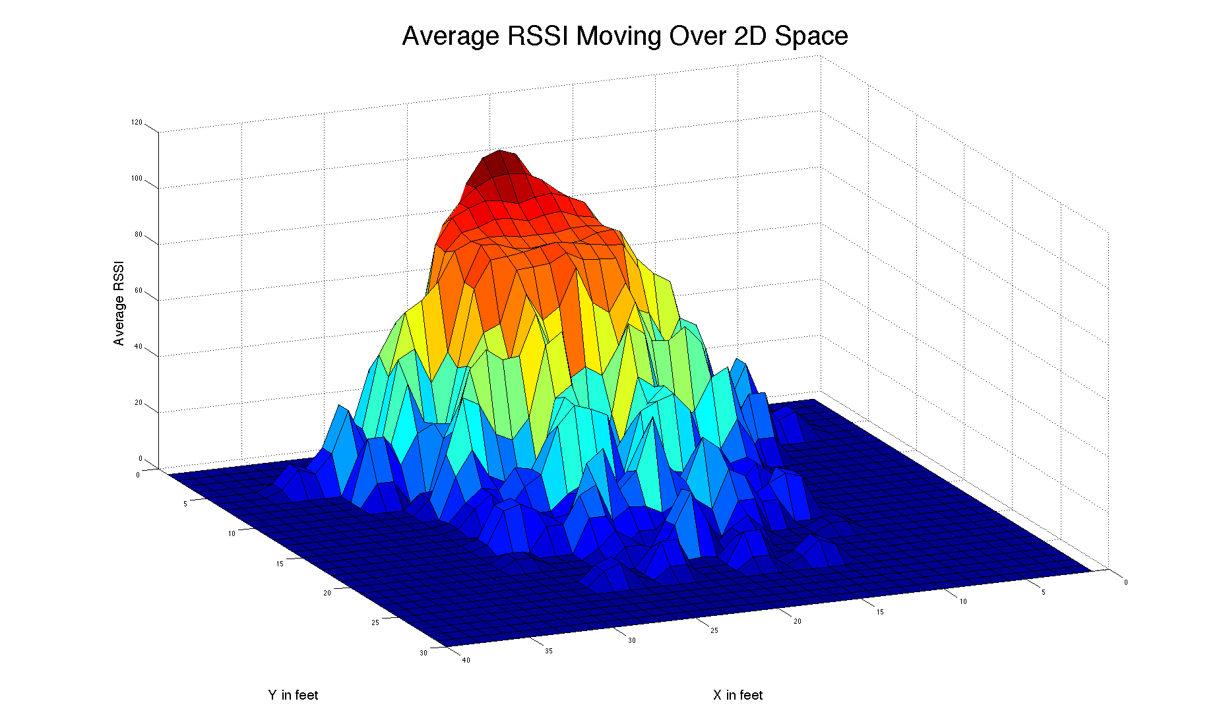
RFID Reader
Located Here

Slide 3
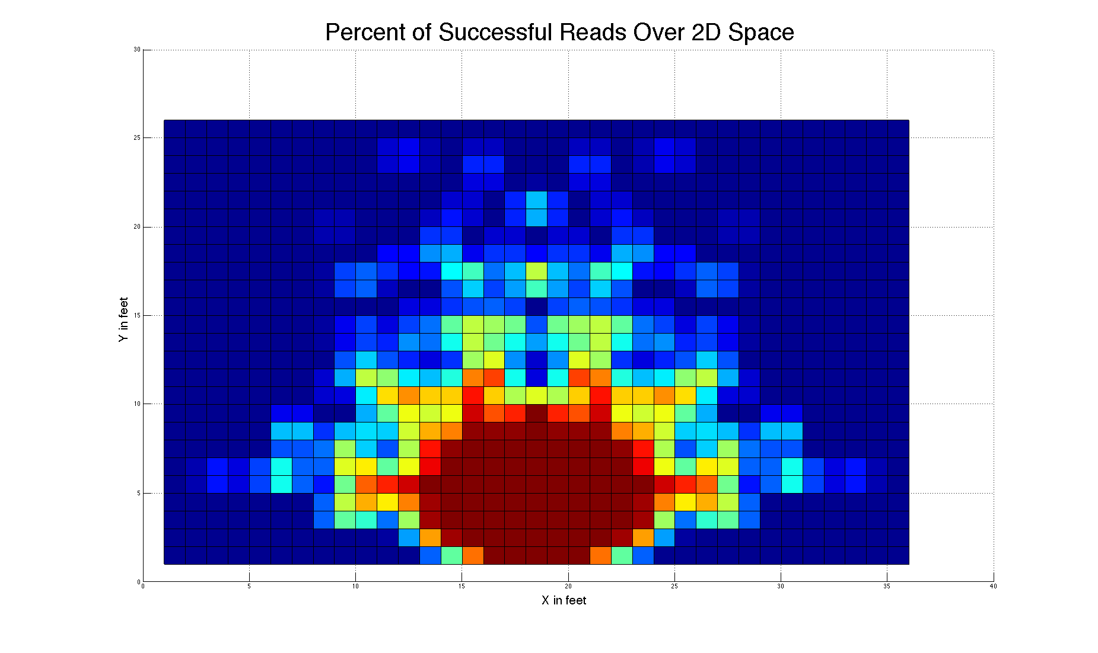
RFID Reader
Located Here

