Slide 1
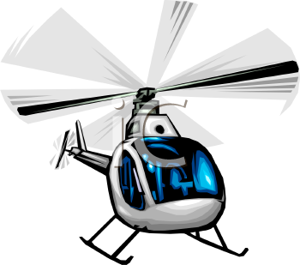

Question
How can long-range RFID be used on an aerial platform to perform tasks either too dangerous or too tedious for humans to do, such as inventorying or remote sensing in difficult environments.
Background
Previous RFID research assumes:
A known environment
Thousands of calibration readings
A known grid of RFID tags
Broader Impact
We are trying to solve this problem, on-line, very quickly, by using a minimal amount of data. This will allow:
Improved data collection in remote areas.
Remote sensing for things like volcanoes and other harsh environments

Slide 2
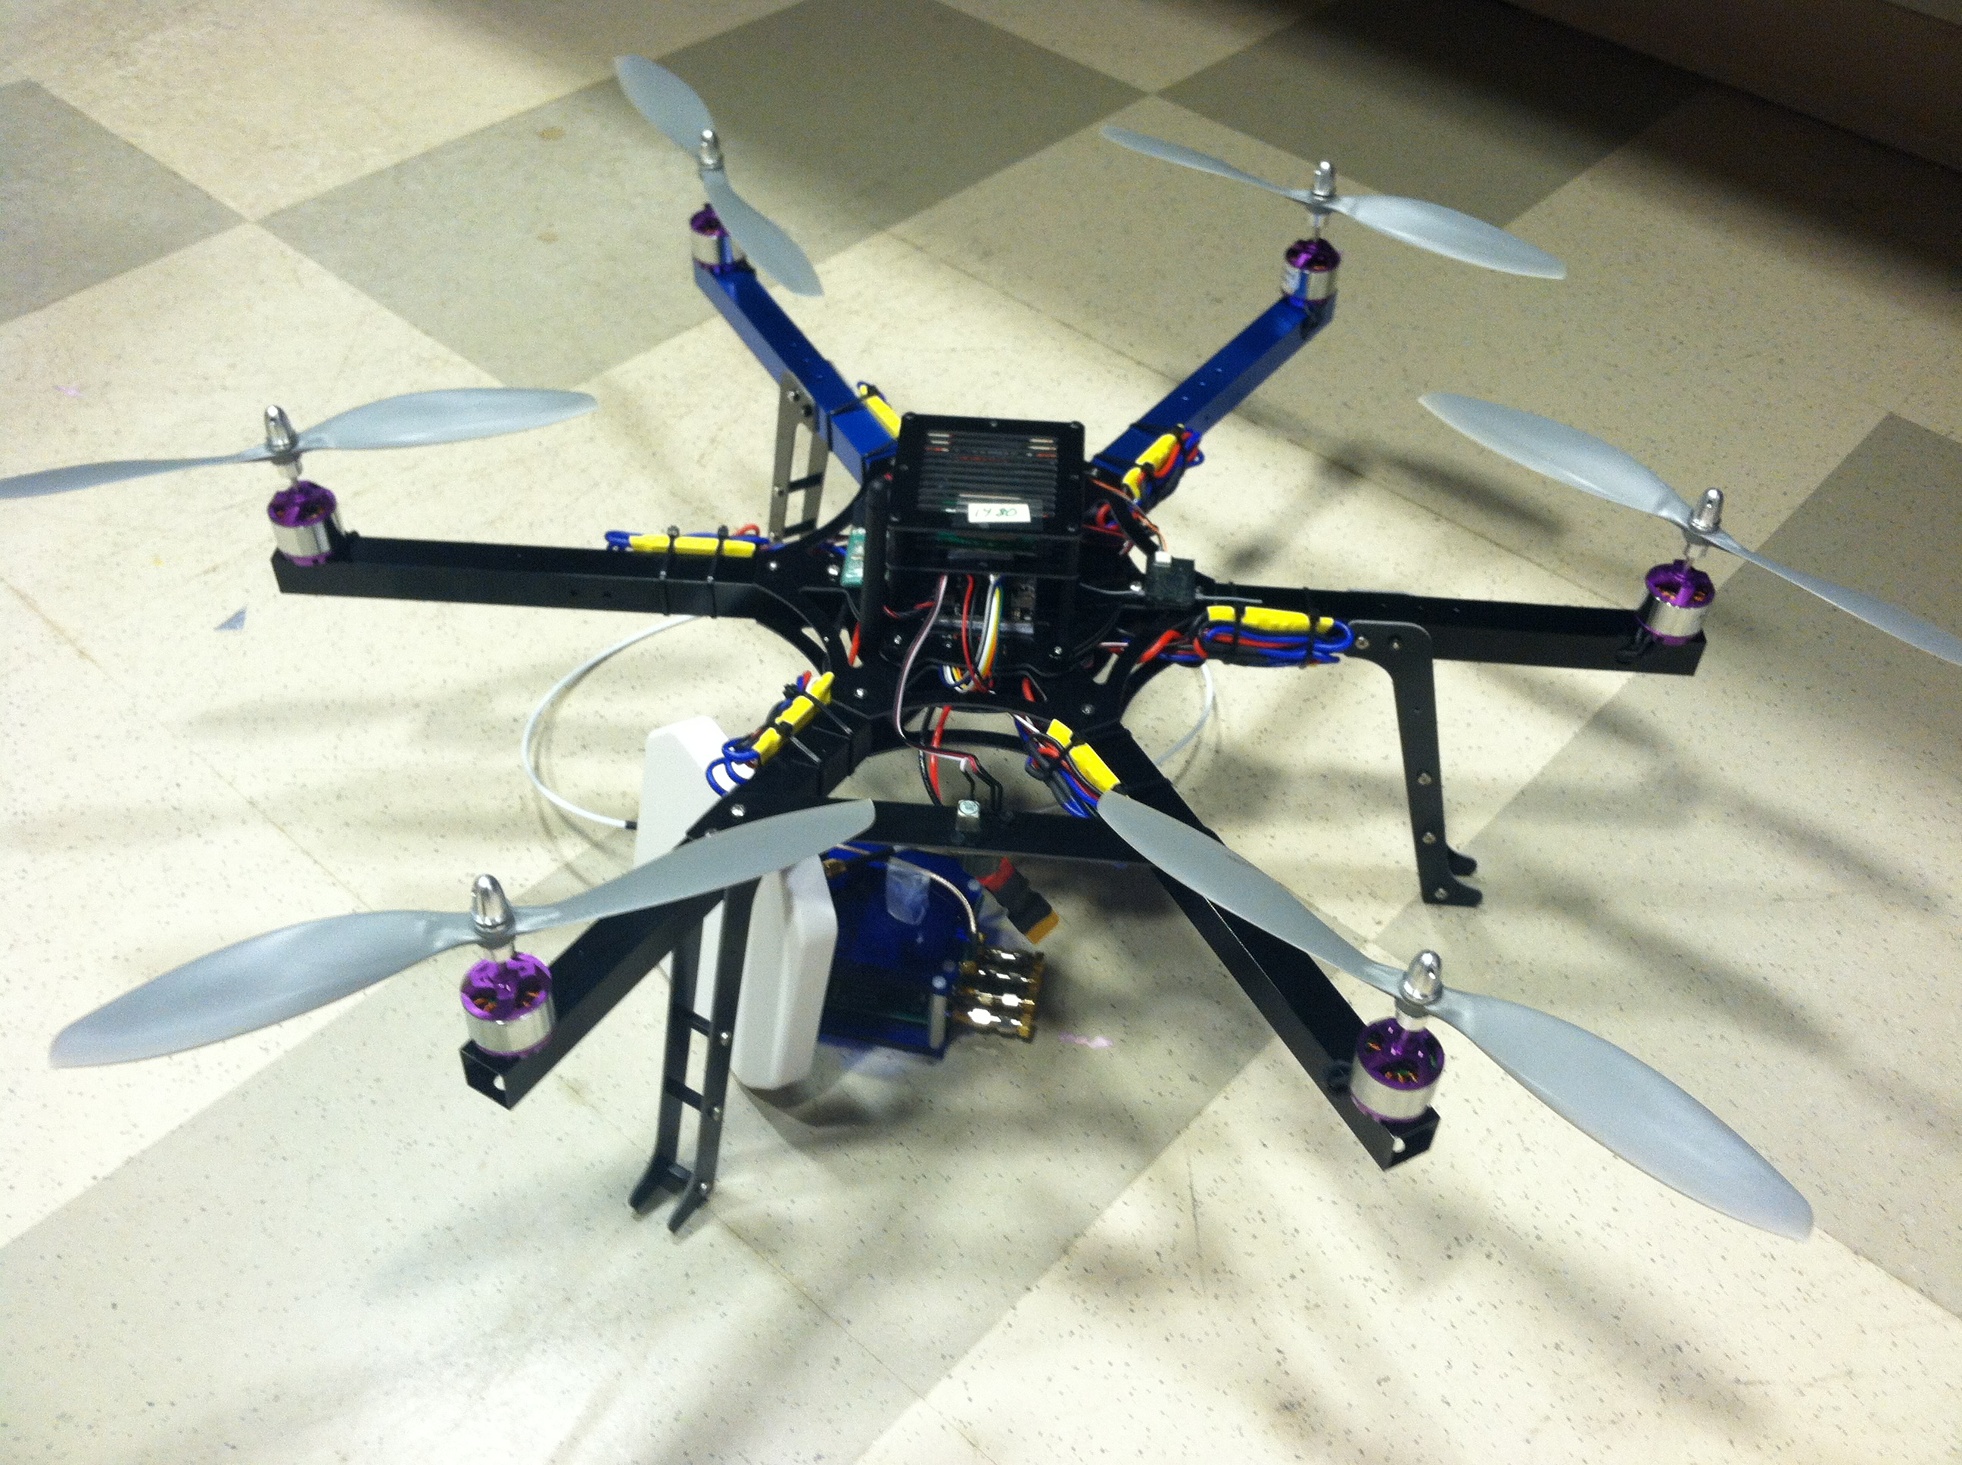
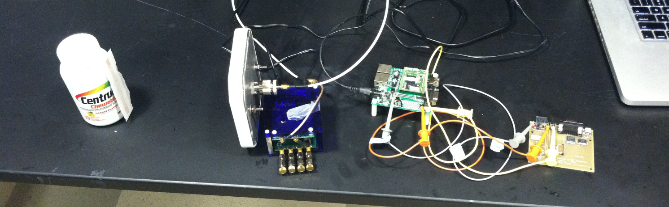
Hexarotor
RFID Reader
Mini Computer
RFID Tag
Serial Converter

