Slide 1
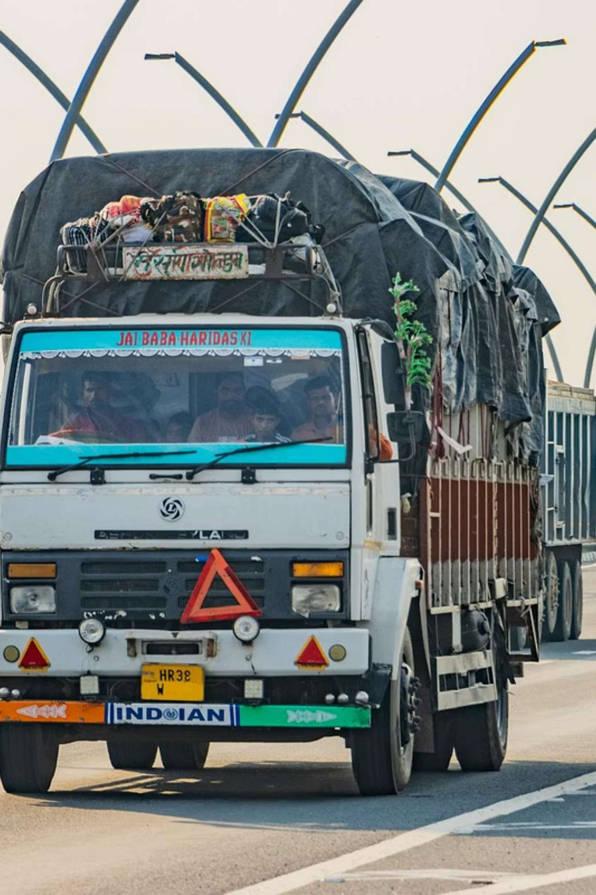
LogineX
HYPER - LOCAL TRUCK, MACHINERY & PROJECT CARGO PLATFORM
Team Leader
Manomay Shukla
Team Member
Soumya Singh
Team Member
Snehil Raj
Team Member
Khalid Khalil Ali

Slide 2
Why LogineX? The Market Opportunity
🚛 Massive Market
⛽ Empty Return Trips
📋 Spot - Driven Market
India's road freight market is one of the largest and fastest - growing in the world, with enormous untapped digital potential.
Trucks frequently return empty after delivery burning fuel and earning nothing on the return journey.
Most freight bookings in India are spot - based, not long - term contracts creating volatility and inefficiency for fleet owners.
We connect truck owners, machinery movers, cargo owners, and verified drivers in one trusted platform built for India's real logistics reality.
LogineX

Slide 3
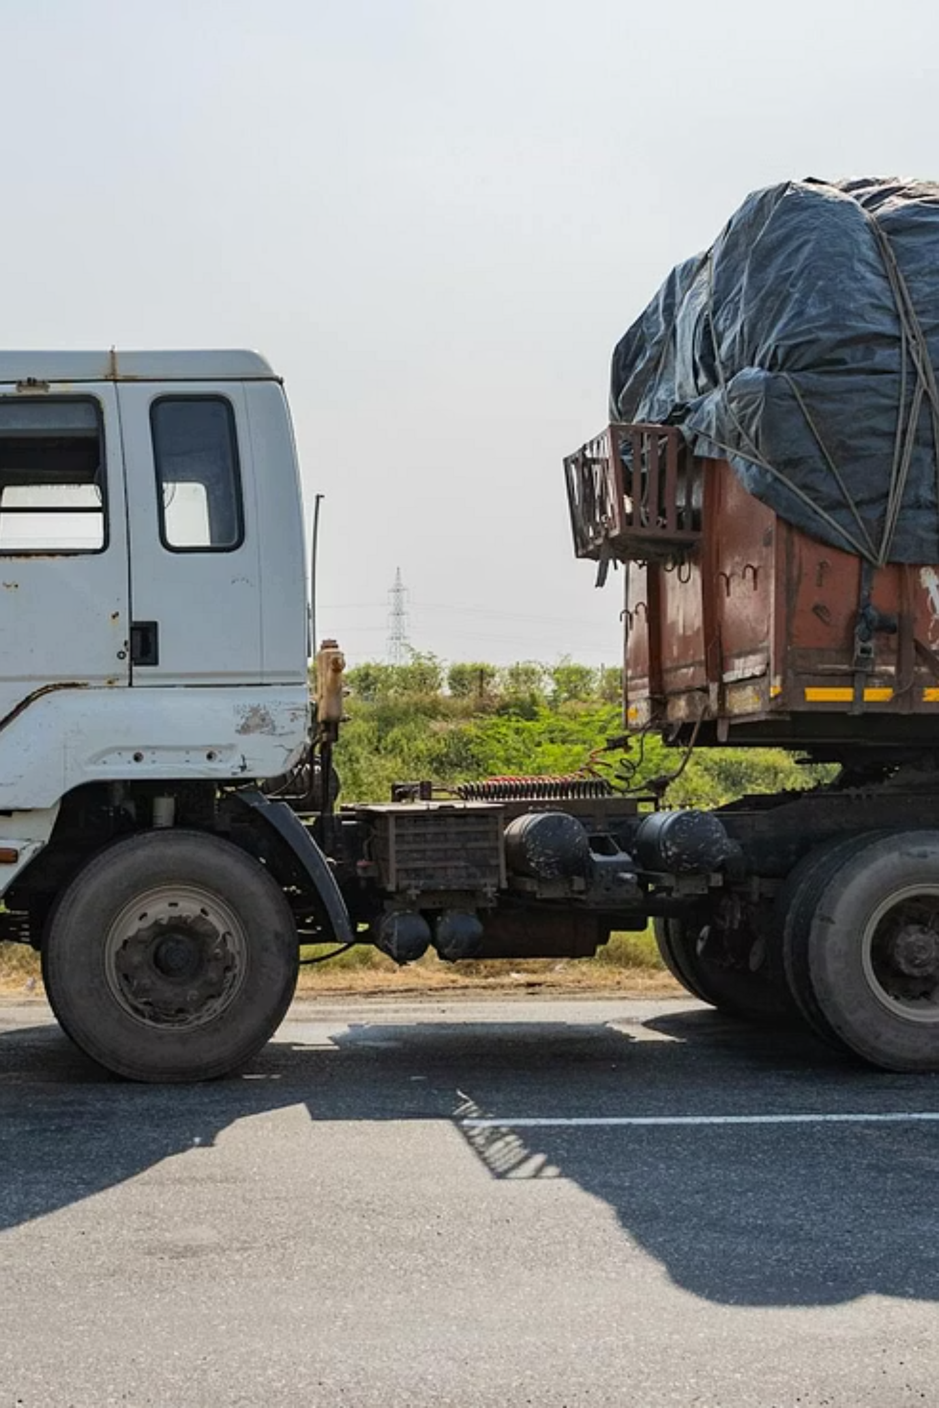
PROBLEM 1
Empty Trips Drain Every Rupee
The Core Waste
What This Means for Owners
A truck that moves without a load is money lost. Fuel is consumed, the engine wears down, and the driver's time is spent all with zero revenue to show for it.
Trucks return without load after delivery a widespread, daily occurrence
Fuel costs are incurred on empty return legs with no offsetting income
Vehicle efficiency drops, maintenance costs rise, and earnings shrink
The truck is moving, but the owner simply is not earning enough
LogineX

Slide 4



PROBLEM 2
The Market Is Still Unorganised
1. BROKER DEPENDENCY
2. OPAQUE PRICING
Rates negotiated informally with no information or transparency.
Owners rely on middlemen, phone calls, and WhatsApp groups.
The Real Gap
The transport infrastructure exists across India. Trucks are on the road. Cargo needs to move. But the connection between supply and demand is still messy, fragmented across brokers, informal networks, and phone calls.
3. LOW TRUST
4. DIGITAL EXCLUSION
Small fleet owners, who form the backbone of India's freight economy, receive virtually no structured digital support today.
Small fleet owners lack tools.
No verification system between cargo owners and drivers.
Nothing built for their scale.
LogineX

Slide 5

SOLUTION
One Platform for Private Logistics
All Vehicle Types
Trucks, machinery movers, and project cargo all in one place.
Spot & Contract
Supports both one - time spot trips and long - term contract logistics.
No Broker Needed
Direct connections between cargo owners, drivers, and fleet owners.
Return Load Matching
Smart suggestions for return loads reduce empty trips and idle vehicles.
LogineX

Slide 6
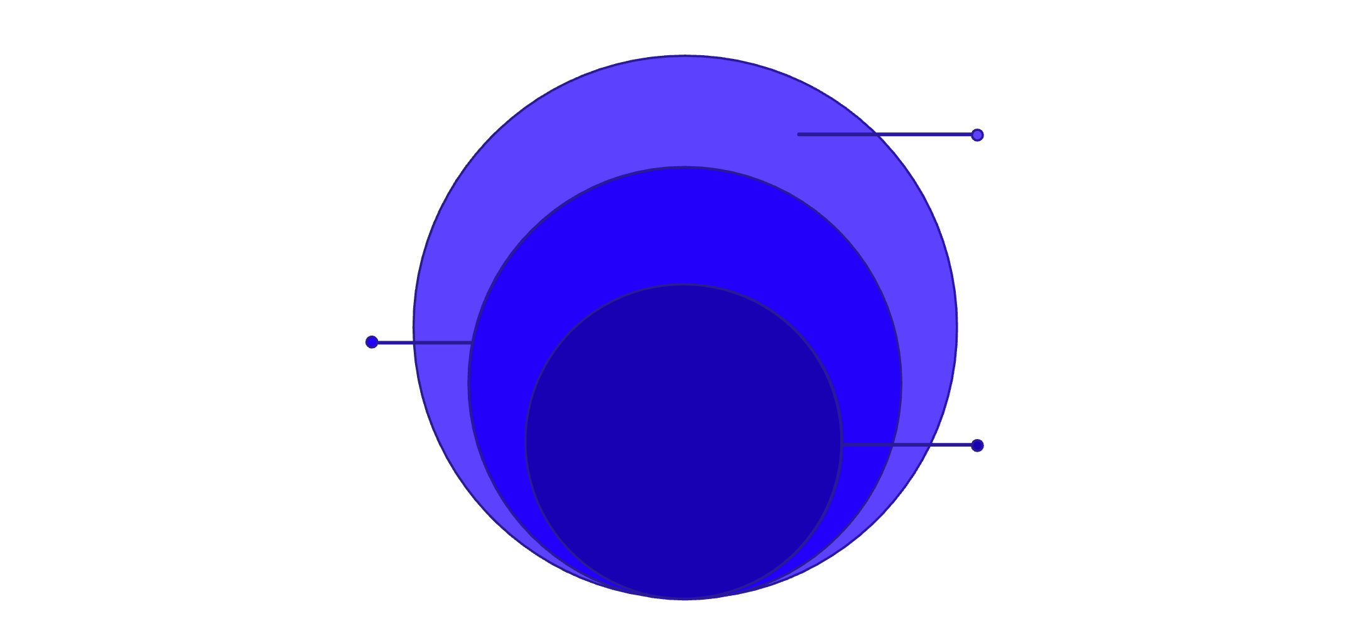

SOLUTION
Trust, Tracking & Control
Why It Matters
Real-Time Control
People trust the system when they can see who is moving their load and exactly where it is. Verified profiles, transparent Trust Scores, and digital contracts raise the professional standard of every trip.
Live tracking and digital contracts
Trust Score
Reliability rating from completed trips
Verified Identity
KYC and OTP driver verification
Digital contracts reduce disputes and create an auditable record for every transaction on the platform.
LogineX builds confidence at every step from who picks up the load to where it is right now and how the agreement is structured.
LogineX

Slide 7
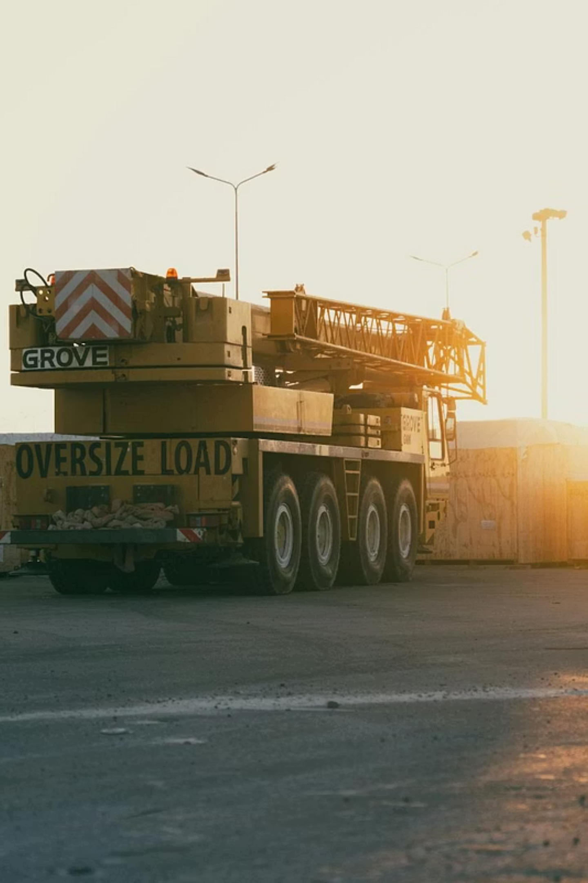
WHAT MAKES US DIFFERENT
More Than a Truck App
Beyond Trucks
Most platforms stop at truck bookings. LogineX extends to machinery haulage and project cargo a largely unserved and high value segment.
Spot + Contract Together
We serve both the immediate spot market and long - term contract logistics giving fleet owners and cargo owners flexibility on one platform.
Inclusive by Design
Small fleets get the same powerful tools as large operators. LogineX is wider than a truck app, yet more focused than a generic logistics platform.

Slide 8
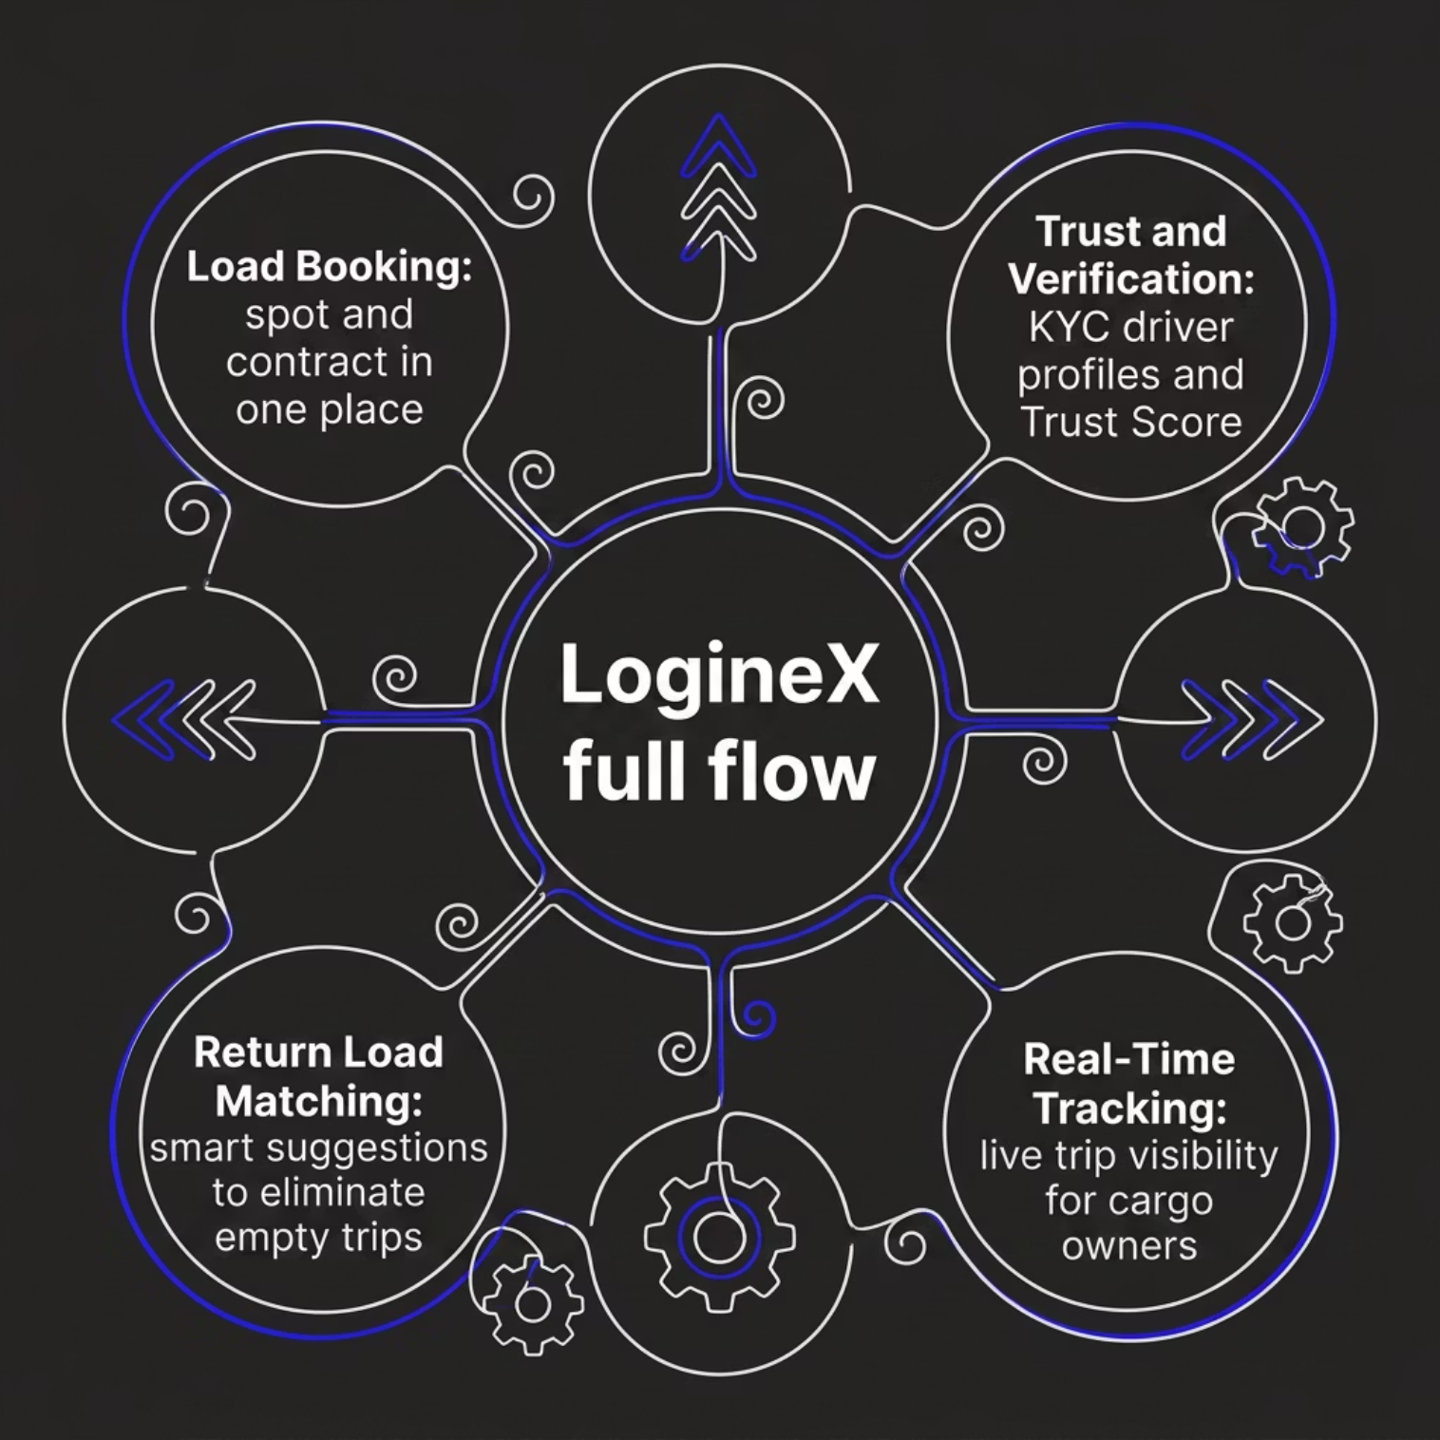

DIFFERENTIATION
LogineX Solves the Full Flow
The Competition Solves One Piece
Most platforms handle load booking or driver verification or tracking. Very few connect all of these into a single, seamless experience built for India's private - goods logistics market.
LogineX is engineered for long - term, repeat use not just one time bookings. Every feature is designed to keep owners and drivers coming back.
LogineX

Slide 9
TECHNOLOGY
Technology Behind LogineX
Frontend
Backend
React · Next.js · Tailwind CSS
Node.js + Express / NestJS · REST + WebSockets
Database
Mapping & GPS
SQLite - MySQL / PostgreSQL with ORM (e.g. Prisma)
Google Maps API + Device GPS - connected to backend for live tracking
Mobile App
Auth & Payments
Flutter - sharing the same backend as the web platform
NextAuth · Twilio OTP · RazorPay UPI
Hosting
Design & Ops
Azure / AWS / Render - scalable cloud infrastructure
Figma · Notion / Airtable · Jira · Zoho Books · Git & GitHub
LogineX

Slide 10
PLATFORM FEATURES
Features That Make LogineX Special
Load Posting
Verified Drivers & Trust Score
Real-Time Tracking
Post spot or contract loads in seconds with vehicle type, route, and rate details.
Live GPS visibility for cargo owners throughout the journey.
KYC - verified profiles and a reputation score built trip by trip.
Return Load Matching
Digital Contracts & Fleet Dashboard
Smart suggestions to fill the return leg and eliminate costly empty trips.
Structured agreements, route filters, post - trip ratings, and dispute support all in one place.
LogineX

