Slide 1
Capstone Project 2 Final Report Text Mash
Parker Williamson
5/9/2018
Springboard Data Science Career Track

Slide 2
Problem
Use text to assign Meyers Briggs personality types in order to improve interactions between people and improve user experience

Slide 3
Client
Apps could use text history to make recommendations based on personality type

Slide 4
Datasets
The main dataset isKaggle’s Myers Briggs dataset (https://www.kaggle.com/datasnaek/mbti-type)
Reddit data from (https://www.reddit.com/r/mbti/) was also collected using the reddit API PRAW
Text data was normalized using (http://www.dt.fee.unicamp.br/~tiago/smsspamcollection/).

Slide 5
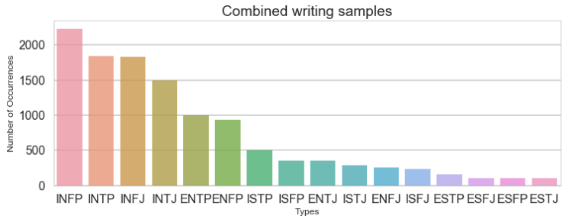
Findings
The personality datasets are very biased, because personality types such as introverts are much more likely to post
The Reddit and Kaggle dataset distribution combined is shown below

Slide 6
Findings
To clean the text data I removed English stop words, replaced URLs with <URL> and replaced all the 4 letter personality types with <MBTI>. For the existing Kaggle dataset sample the <MBTI> replacement factored in at about 20% of some of the models, so eliminating that means there may need more data or better initial text analysis. The accuracy general accuracy of predicting the test type from the original data without the Myers Brigg class in the text is shown below.

Slide 7
Findings
I tested stemming as well but its effect on the results was negligible (two of the types went up and two went down by nearly the same amount)
Since stemming is also slower I excluded it from my models after this test

Slide 8
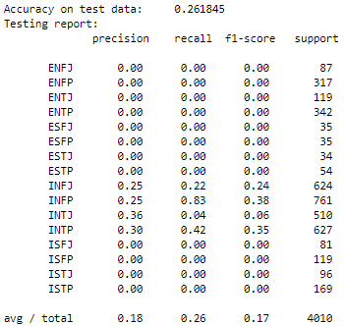
Findings
Predicting all the personality types at once is not possible, because the bias of the dataset overwrites the information extracted from the text.

Slide 9
Findings
Numerous different models were tested:
MultinomialNB
LinearSVC
LogisticRegression
SGDClassifier
XGBClassifier
CNN
RNN
The different classifiers varied from ~63%-73% on IE
They were similar for the other types
In order of smallest F1 score: LogReg, MultNB, SGD, XGboost, LinearSVC

Slide 10
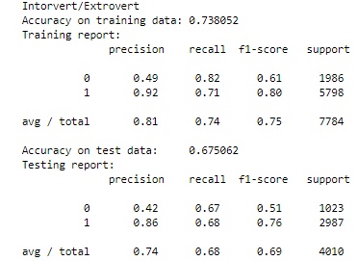
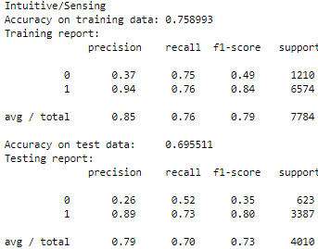
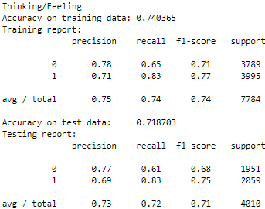
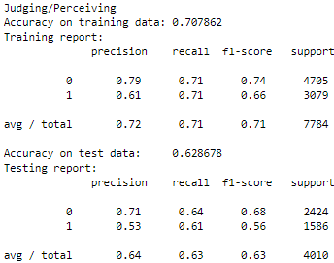
Findings
The test accuracy of the personality types are ~65-70% using MultinomialNB

Slide 11
Adding the Reddit Data
Including the reddit data decreased the test accuracy by about 2%, but the Kaggle MBTI data was not as applicable to average texting, because it is based on text where people are talking about their personalities. Adding the Reddit data helps prevent overfitting, for example, one of the most strongly weighted words (towards extroversion) is socionics. Socionics is not a word used in many texting conversations, but it was used fairly commonly in the MBTI forum drawn from for the Kaggle dataset.

Slide 12
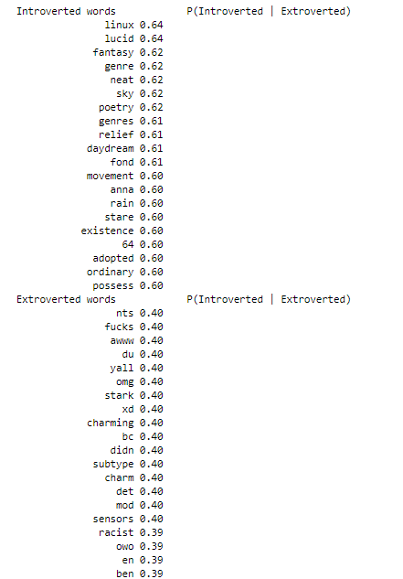
The word that are the most polarized

Slide 13
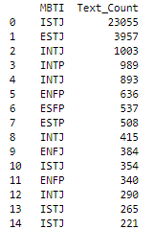
Findings
There is clear variance in assigned personality types once the texts had been normalized

