Slide 1
Capstone Project 2 Final Report Text Mash
Parker Williamson
5/9/2018
Springboard Data Science Career Track

Slide 2
Problem
Use text to assign Meyers Briggs personality types in order to improve interactions between people and improve user experience

Slide 3
Client
Apps could use text history to make recommendations based on personality type

Slide 4
Datasets
The main dataset isKaggle’s Myers Briggs dataset (https://www.kaggle.com/datasnaek/mbti-type)
Reddit data from (https://www.reddit.com/r/mbti/) was also collected using the reddit API PRAW
Text data was normalized using (http://www.dt.fee.unicamp.br/~tiago/smsspamcollection/).

Slide 5
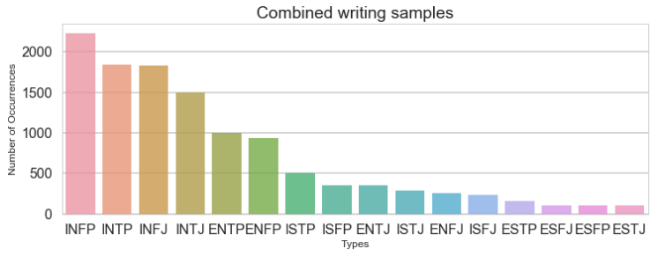
Findings
The personality datasets are very biased, because personality types such as introverts are much more likely to post
The Reddit and Kaggle dataset distribution combined is shown below

Slide 6
Findings
To clean the text data I removed English stop words, replaced URLs with <URL> and replaced all the 4 letter personality types with <MBTI>. For the existing Kaggle dataset sample the <MBTI> replacement factored in at about 20% of some of the models, so eliminating that means there may need more data or better initial text analysis. The accuracy general accuracy of predicting the test type from the original data without the Myers Brigg class in the text is shown below.

Slide 7
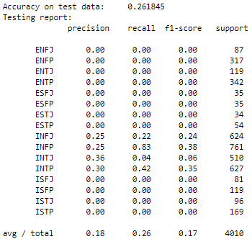
Findings
Predicting all the personality types at once is not possible, because the bias of the dataset overwrites the information extracted from the text.

Slide 8
Findings
Numerous different models were tested:
MultinomialNB
LinearSVC
LogisticRegression
SGDClassifier
XGBClassifier
CNN
RNN

Slide 9
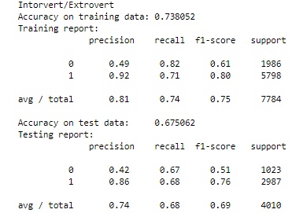
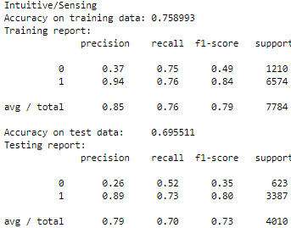
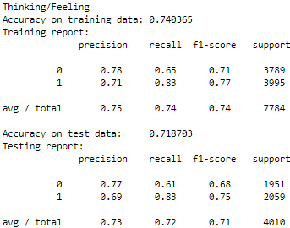
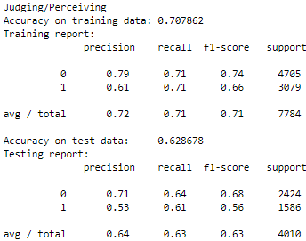
Findings
The test accuracy of the personality types are ~65-70% using MultinomialNB

Slide 10
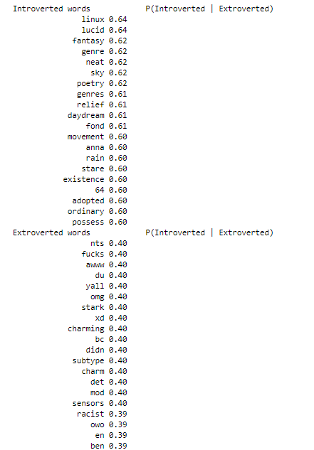
The word that are the most polarized

Slide 11
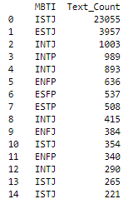
Findings
There is clear variance in assigned personality types once the texts had been normalized

