Slide 1
Capstone Project 1 Final Report Clothing Categorization
Parker Williamson 3/7/2018 Springboard Data Science Career Track

Slide 2
Goal
Correctly categorize clothing images

Slide 3
Benefits/Customers
Online sellers of clothing
Eventually clothing folding/sorting

Slide 4
Datasets
Fashion.mnist
A Kaggle clothing dataset was the dataset I used to train and compare the classifiers
https://www.kaggle.com/zalando-research/fashionmnist/data

Slide 5
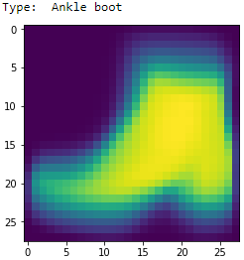
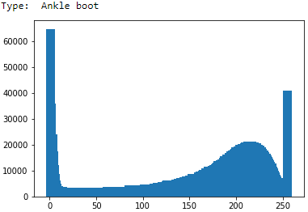
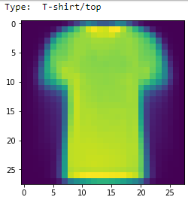
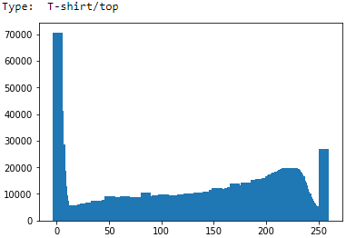
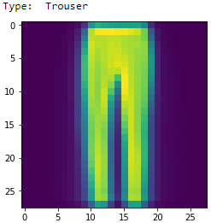
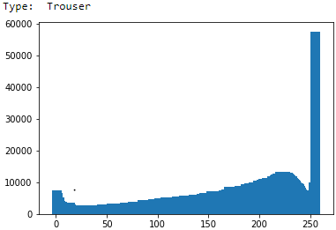
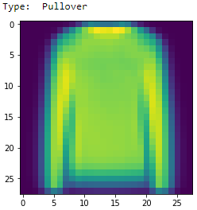
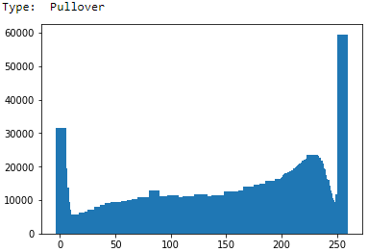
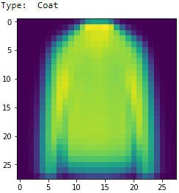
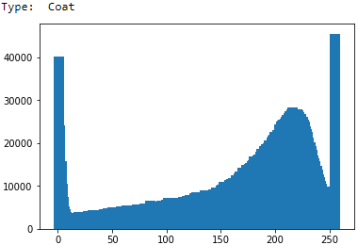
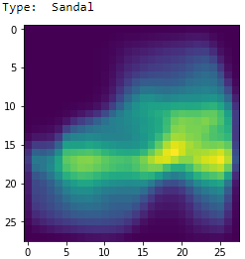
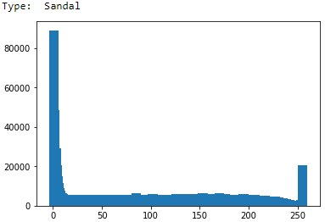
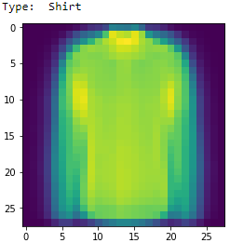
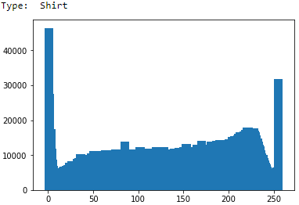
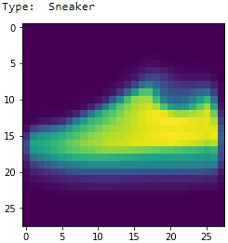
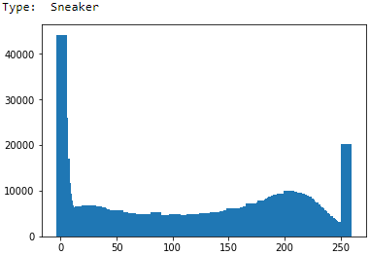
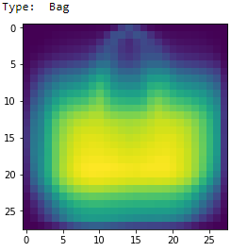
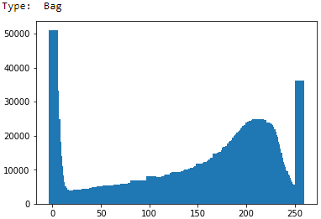
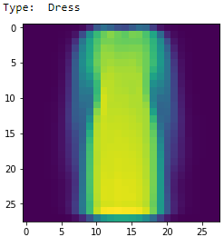
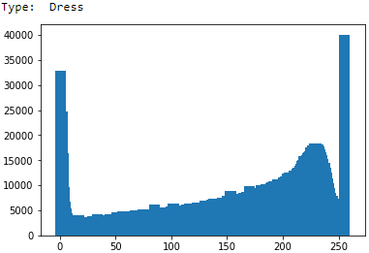
Data Wrangling
Average images and histograms of each of the image classes are shown

Slide 6
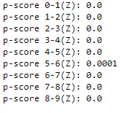
Statistical Analysis
Compared the order means to see if any of them were statistically similar using a paired z-test
If the means could be the same the p-score would be about .05

Slide 7
Preprocessing
Normalization (with a range of 0-1)
Make the range of values fill and be between 0-1
Standardization
Spread out the data more evenly by scaling it using the standard deviation and mean
(Data –mean(Data))/standard deviation

Slide 8
Analysis
MLP (size of hidden layers 784-100-100):
With no preprocessing – 87.65% accuracy
Normalized(0-1) – 90.37% accuracy
Standardized(0-1) – 90.09% accuracy
SVC:
With no preprocessing – 70.67% accuracy
Normalized(0-1) – 85.57% accuracy
Standardized(0-1) – 81.87%
Logistic Regression:
With no preprocessing – supposed to be normalized
Normalized(0-1) – 84.45% accuracy
Standardized(0-1) – 85.19% accuracy
CNN:
Normalized(0-255) – 92.25% accuracy
Standardized – 92.32% accuracy
Ensemble the above models (Random Forest with 20 trees):
90.56% accuracy
Ensemble the above models (Random Forest with 20 trees):
91.25% accuracy
Use VGG19 as a feature extractor before a neural net:
85.71% accuracy

Slide 9
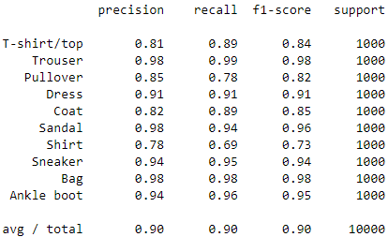
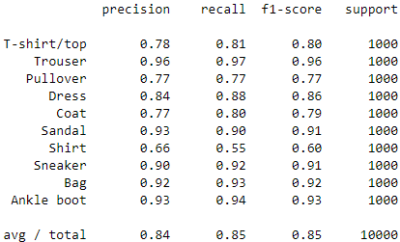
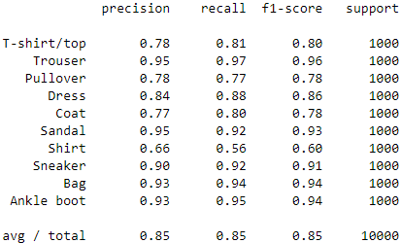
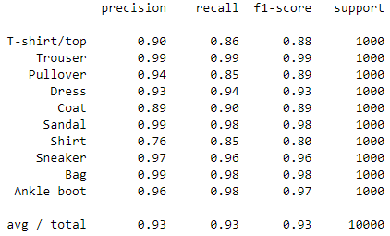
Analysis- Precision/Recall
MLP
SVC
Logistic Regression
CNN

Slide 10
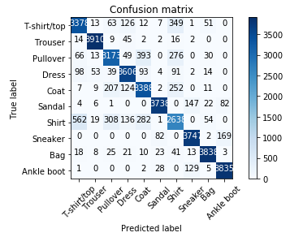
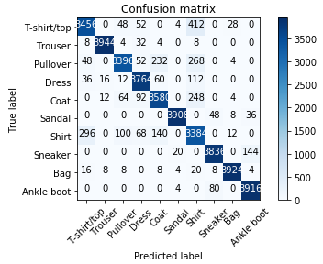
Analysis – Confusion Matrices
Combined
CNN*4

Slide 11
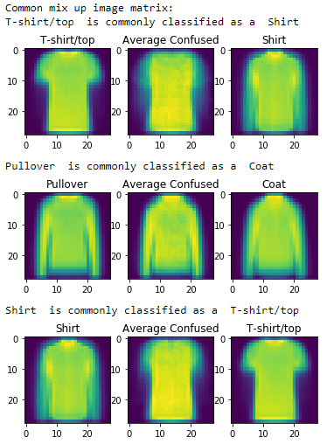
Visualizations
The commonly confused categories (above 95 percentile) are show with an average of the correct class on the right the average of all the confused images in the middle and the average image of the class it was classified as

Slide 12
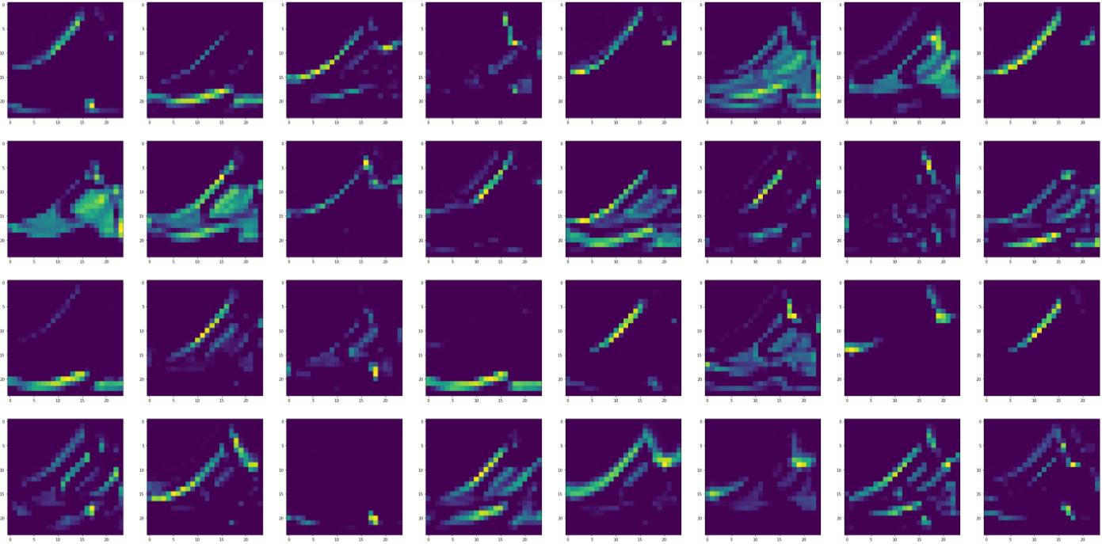
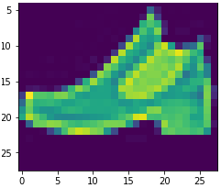
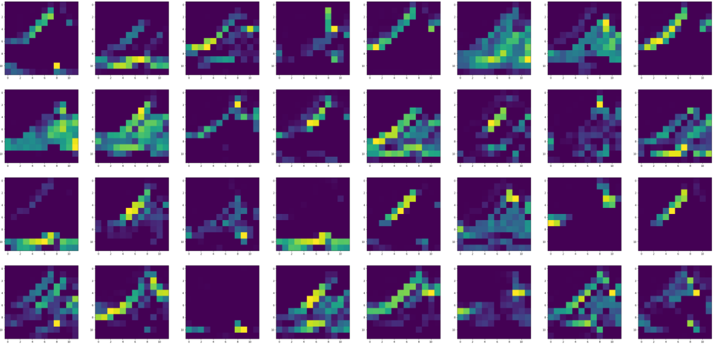
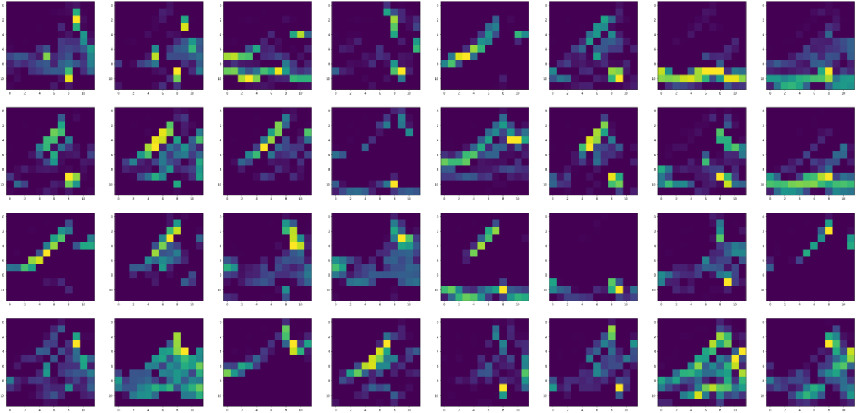
Visualizations – CNN in progress
PHASE 1
Original image
PHASE 2

Slide 13
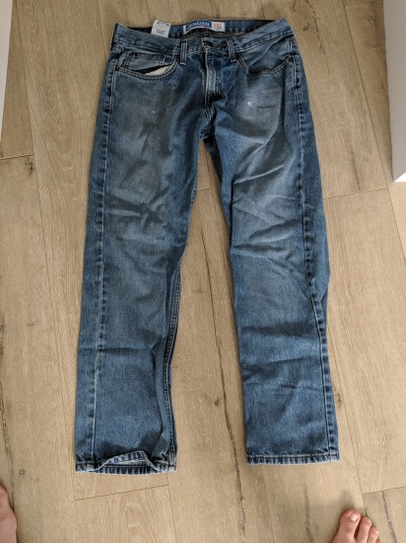
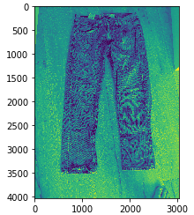
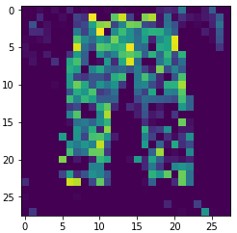
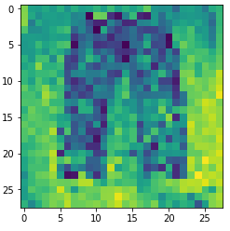
Testing with my Photos
MLP classified it as a coat, SVM and LogReg both correctly said trousers and CNN said shirt

Slide 14
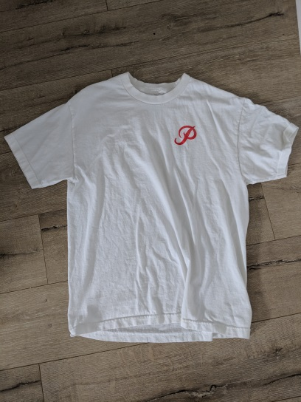
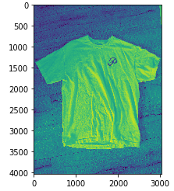
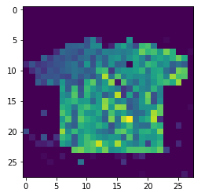
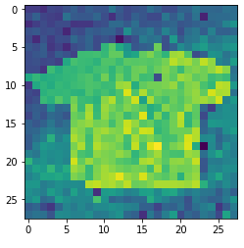
Testing with my Photos
MLP classified it as a bag, whereas SVM, LogReg and CNN classified it as a shirt

Slide 15
Testing with my Photos
Either make sure to train on images filtered in the same way or look out for overfitting with MLP and CNN (MLP is the main classifier that seems it could be overfitting)
If training on slightly different images, SVM and LogReg may have more robust results

