Slide 1



Summer Training Project at Techvision Technologies
BOOKVAULT
-YOUR GATEWAY TO KNOWLEDGE
Presentation by Parkhi (2200140100074)
B.Tech CSE, SRMS-CET Bareilly
Notes:
Create a professional 40-slide presentation for my Summer Training Internship Project.
Presentation Title:
BookVault – Your Gateway to Knowledge
Context:
Internship project completed during Summer Training in College at Techvision Technologies (July–August 2025).
Duration: 45 days.
Training: Full Stack Web Development (MERN Stack).
Project: BookVault, a digital bookstore platform.
Structure the slides as follows:
Section 1: Opening
Title Slide (Project name, training info, my details)
Agenda of the presentation
About Me (Final Year B.Tech CSE, skills, interests)
Section 2: Organization
Company Profile – Techvision Technologies (founded 2008, Bareilly)
Vision & Mission
Training Programs offered
Training Methodology
Section 3: Industry Context
Industry at a Glance (IT training + software dev)
Training & Development Department
Campus Training Programs
Summer Training Program (45-day, MERN, project-based)
Section 4: Technologies
Modern IT Toolkit (LMS, VLE, GitHub, etc.)
MERN Stack Overview
MongoDB (features & use)
React.js (features & use)
Express.js (features & use)
Node.js (features & use)
Section 5: The Project (BookVault)
Project Overview
Problem Statement
Objectives of BookVault
System Architecture (MERN client-server model)
ER Diagram
Use Case Diagram
Key Features
Section 6: Project Screens
Home & Explore Books page
Sign Up & Login pages
Categories & Course page
Free vs Paid Books
Contact, About Us, Team pages
Backend & Frontend Deployment (Render + Netlify + GitHub)
Section 7: Outcomes
Skills Gained (MERN, JWT, Tailwind, GitHub, Deployment)
Practical Applications (CRUD, APIs, responsive UI)
Teamwork & Collaboration (Agile, GitHub, reviews)
Industry Standards Followed (validation, error handling, env variables)
Section 8: Closing
Training Outcome Summary
Future Scope (AI book recommendations, mobile app, cloud)
Personal Reflections
Acknowledgements
Q&A Slide
Thank You Slide (contact details, LinkedIn/GitHub)
Tone & Style Guidelines:
Professional, simple, and panel-friendly
Use short bullet points (not long paragraphs)
Clean modern design with visuals & icons
Include placeholders for ER diagram, use case diagram, and project screenshots
Use a corporate theme with blue/white or light gradient background
Keep content concise but elaborate enough for technical discussion

Slide 2

WHAT WE WILL TALK ABOUT
About the Company
Industry Overview
Tools & Technologies
BookVault Project
Outcomes & Skills Learned
Future Scope
Conclusion & Q/A

Slide 3
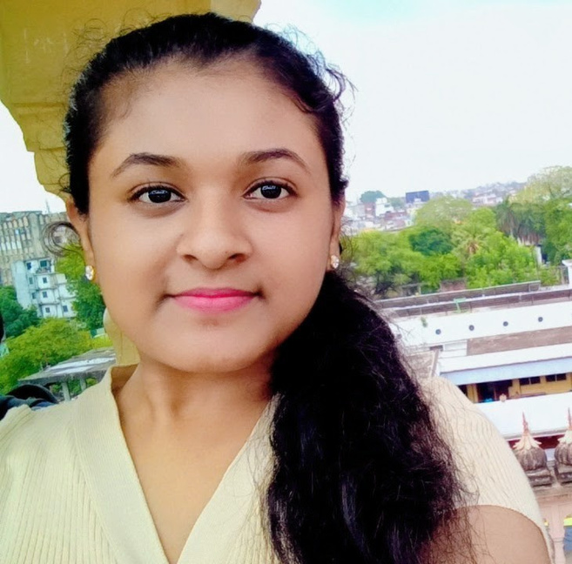
HELLO, EVERYONE!
Final Year B.Tech CSE Student
Completed Summer Training in Full Stack Development
Skilled in: HTML, CSS, JS, React, MERN
Interests: Web Development & Software Engineering

Slide 4

ABOUT THE ORGANIZATION
Company Profile
Vision & Mission
Training Programs
Training Methodology

Slide 5

ORGANIZATION
Company Profile
Founded in 2008, Bareilly
IT Training & Development Company
Expertise: Full Stack, AI/ML, Cloud, Data Science
Vision & Mission
Vision: Become a global leader in IT training
Mission: Provide practical, industry-ready skills

Slide 6
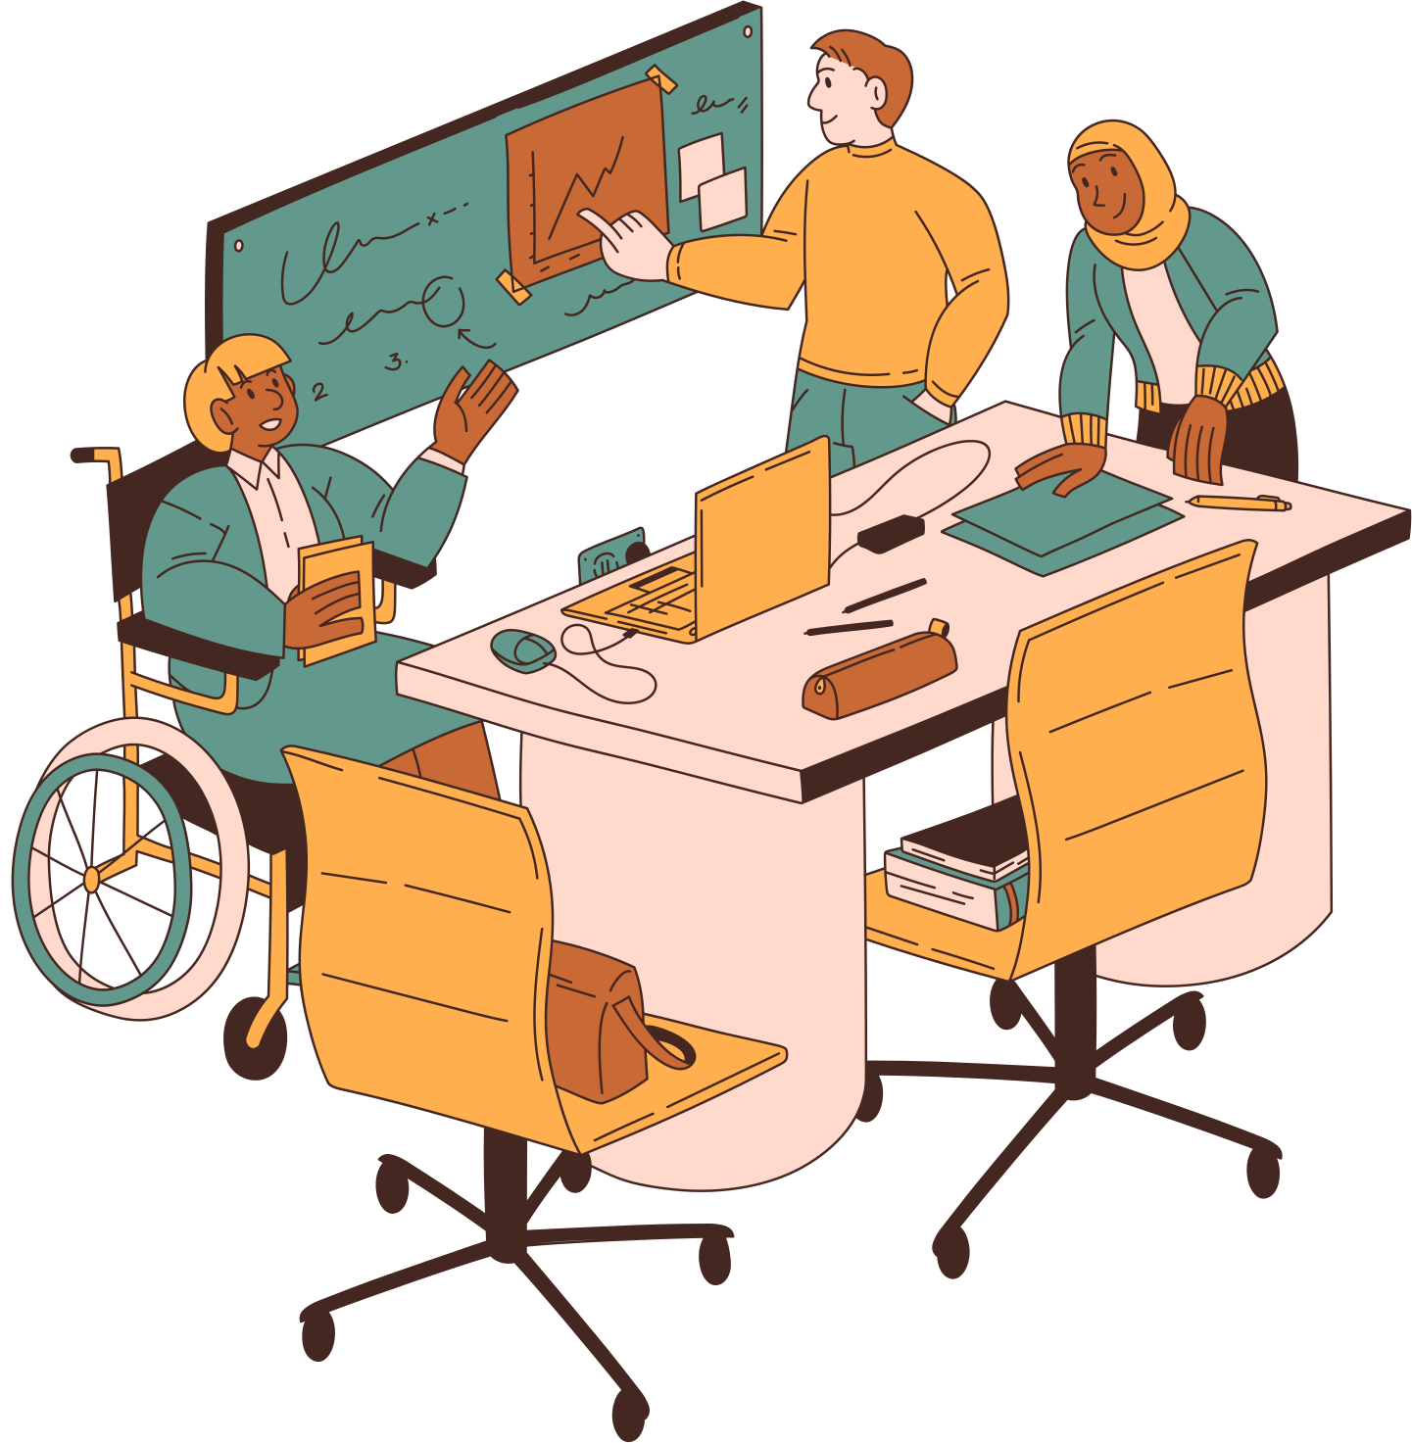
TRAINING BENEFITS
Training Programs
Full Stack Development
Database Management
Cloud, AI/ML, Data Science
Industrial & Summer Training
Training Methodology
Hands-on projects
Live workshops & mentoring
Industry-recognized certifications
Placement & career support

Slide 7
INDUSTRY CONTEXT
INDUSTRY AT A GLANCE
TRAINING & DEVELOPMENT DEPT.
CAMPUS SUMMTRAINING
IT + Training Services
Software development & placements
Focus: bridging academics with industry
Expertise: AWS, DevOps, MERN
Blend of technical + soft skills
Strong placement assistance
Exposure to real development practices
Practical training inside college campus
Affordable & industry-focused
Project-based learning approach
45-day program in collaboration with college
Hands-on Full Stack MERN training

Slide 8

TECHNOLOGIES
MODERN IT TOOLKIT
MERN STACK
MONGODB
Virtual Learning Environments
Learning Management Systems
Collaboration Tools such as GitHub
MongoDB – Database
Express.js – Server Framework
React.js – Frontend UI
Node.js – Runtime Environment
NoSQL Database
Flexible schema
Scalable & reliable

Slide 9
TECHNOLOGIES
REACT.JS
EXPRESS.JS
NODE.JS
Component-based UI
Virtual DOM → faster rendering
Hooks & Router for SPA
Lightweight web framework
Simplifies APIs & routing
Supports middleware
JavaScript runtime on server
Non-blocking I/O → high performance
Cross-platform scalability

Slide 10

THE PROJECT (BOOKVAULT)
PROJECT OVERVIEW
PROBLEM STATEMENT
OBJECTIVES
BookVault – A digital bookstore app
Free + paid books access
Built using MERN stack
Students lack a single platform for digital books
Need for accessible & affordable resources
Provide free & premium books online
Secure login system
Responsive, user-friendly design

Slide 11
THE PROJECT (BOOKVAULT)
SYSTEM ARCHITECTURE
ER DIAGRAM
USE CASE DIAGRAM
Client: React.js
Server: Express + Node.js
Database: MongoDB
Connected via REST APIs
Entities: Users, Books, Categories, Contacts, Admin
Relationships ensure structured database
User: Register, search, explore, access free/paid books
Admin: Manage users, books, categories, queries

Slide 12
THE PROJECT (BOOKVAULT)
KEY FEATURES
Search & category filters
Free vs. paid content
Dark theme option
Contact support system

Slide 13

PROJECT SCREENS
HOME & EXPLORE BOOKS
SIGN UP & LOGIN PAGES
CATEGORIES & COURSE
Homepage with featured books
Explore section for categories
Secure authentication
Role-based access (User/Admin)
Book categories for easy navigation
Course & subject-based access

Slide 14
PROJECT SCREENS
FREE & PAID BOOKS
CONTACT & ABOUT US
DEPLOYMENT
Free book previews
Purchase option for premium books
Submit queries
Learn about mission, team, and journey
Backend: Express + Node on Render
Frontend: React on Netlify
Source Code: GitHub repository

Slide 15
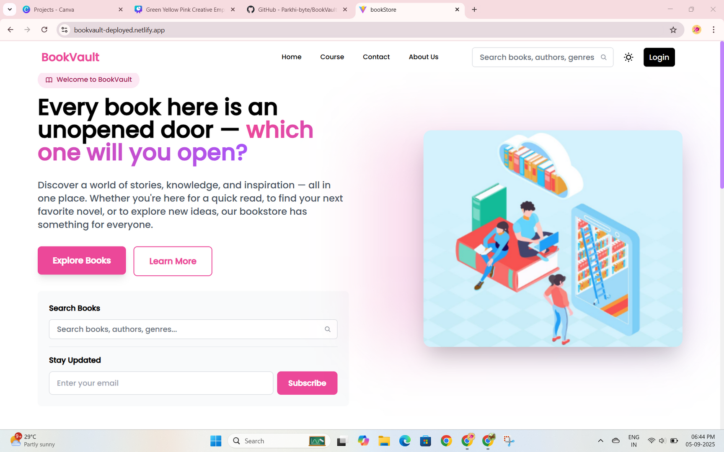
HOME PAGE

Slide 16
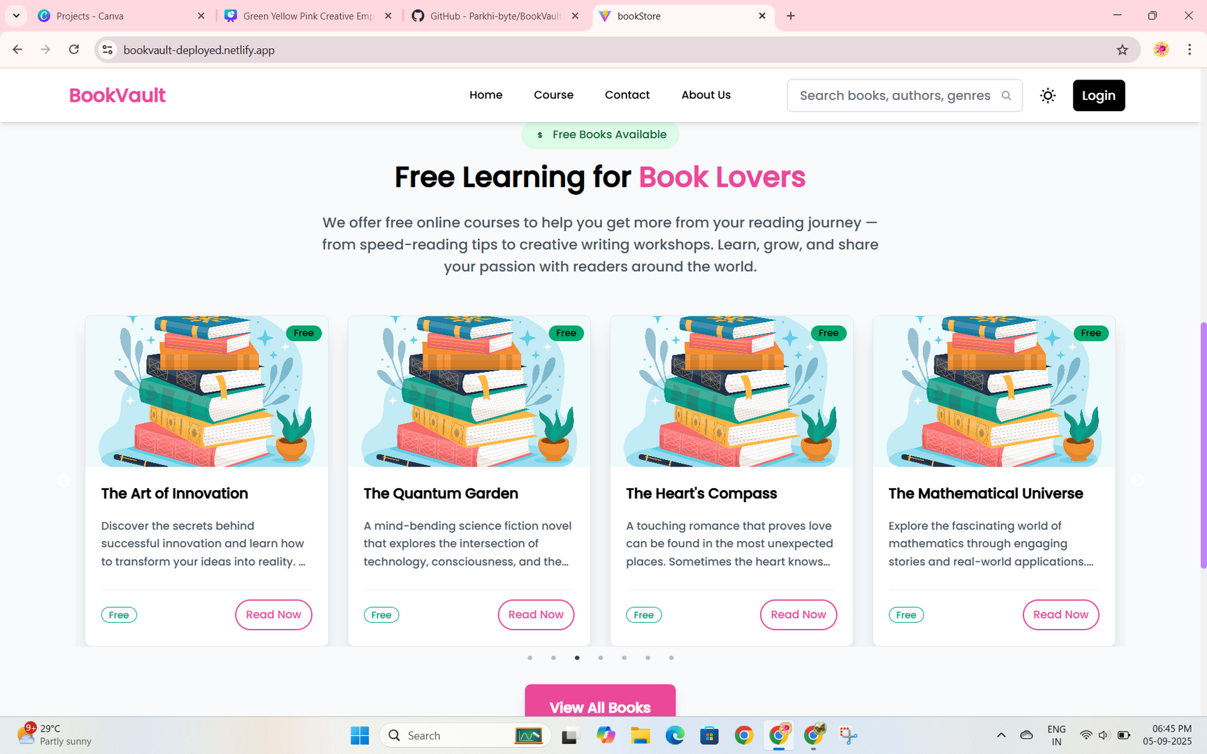
HOME & EXPLORE BOOKS

Slide 17
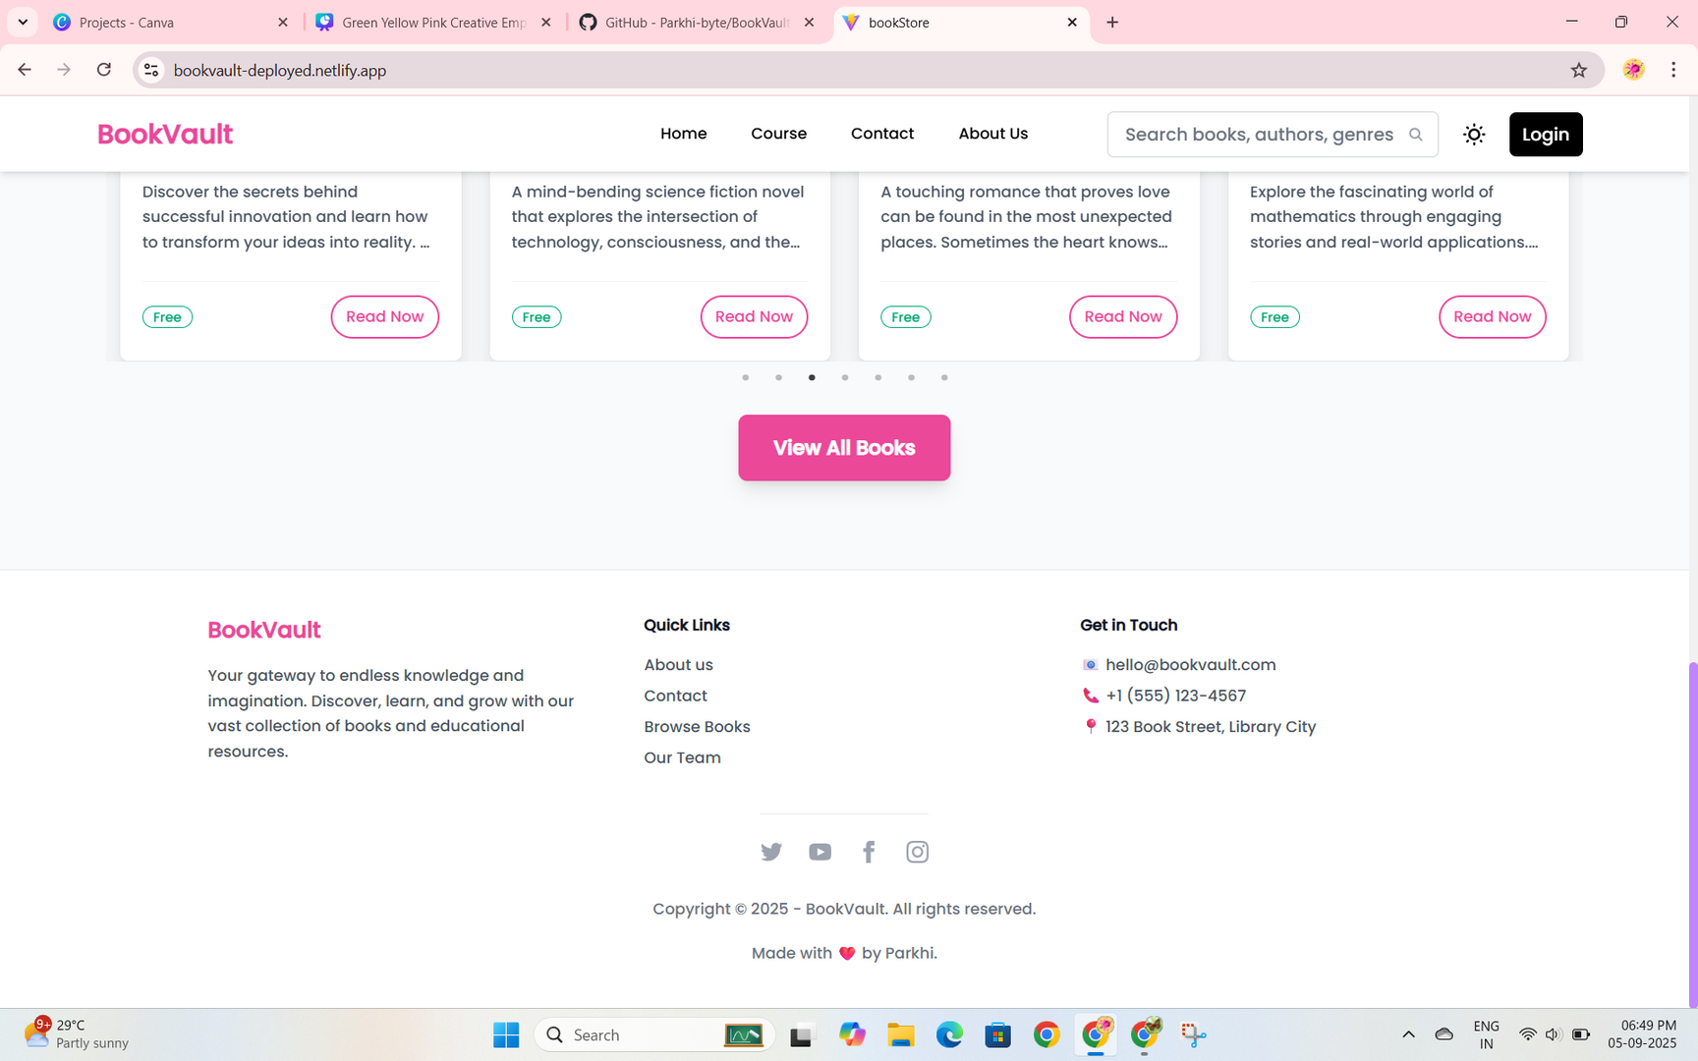
HOME PAGE FOOTER

Slide 18
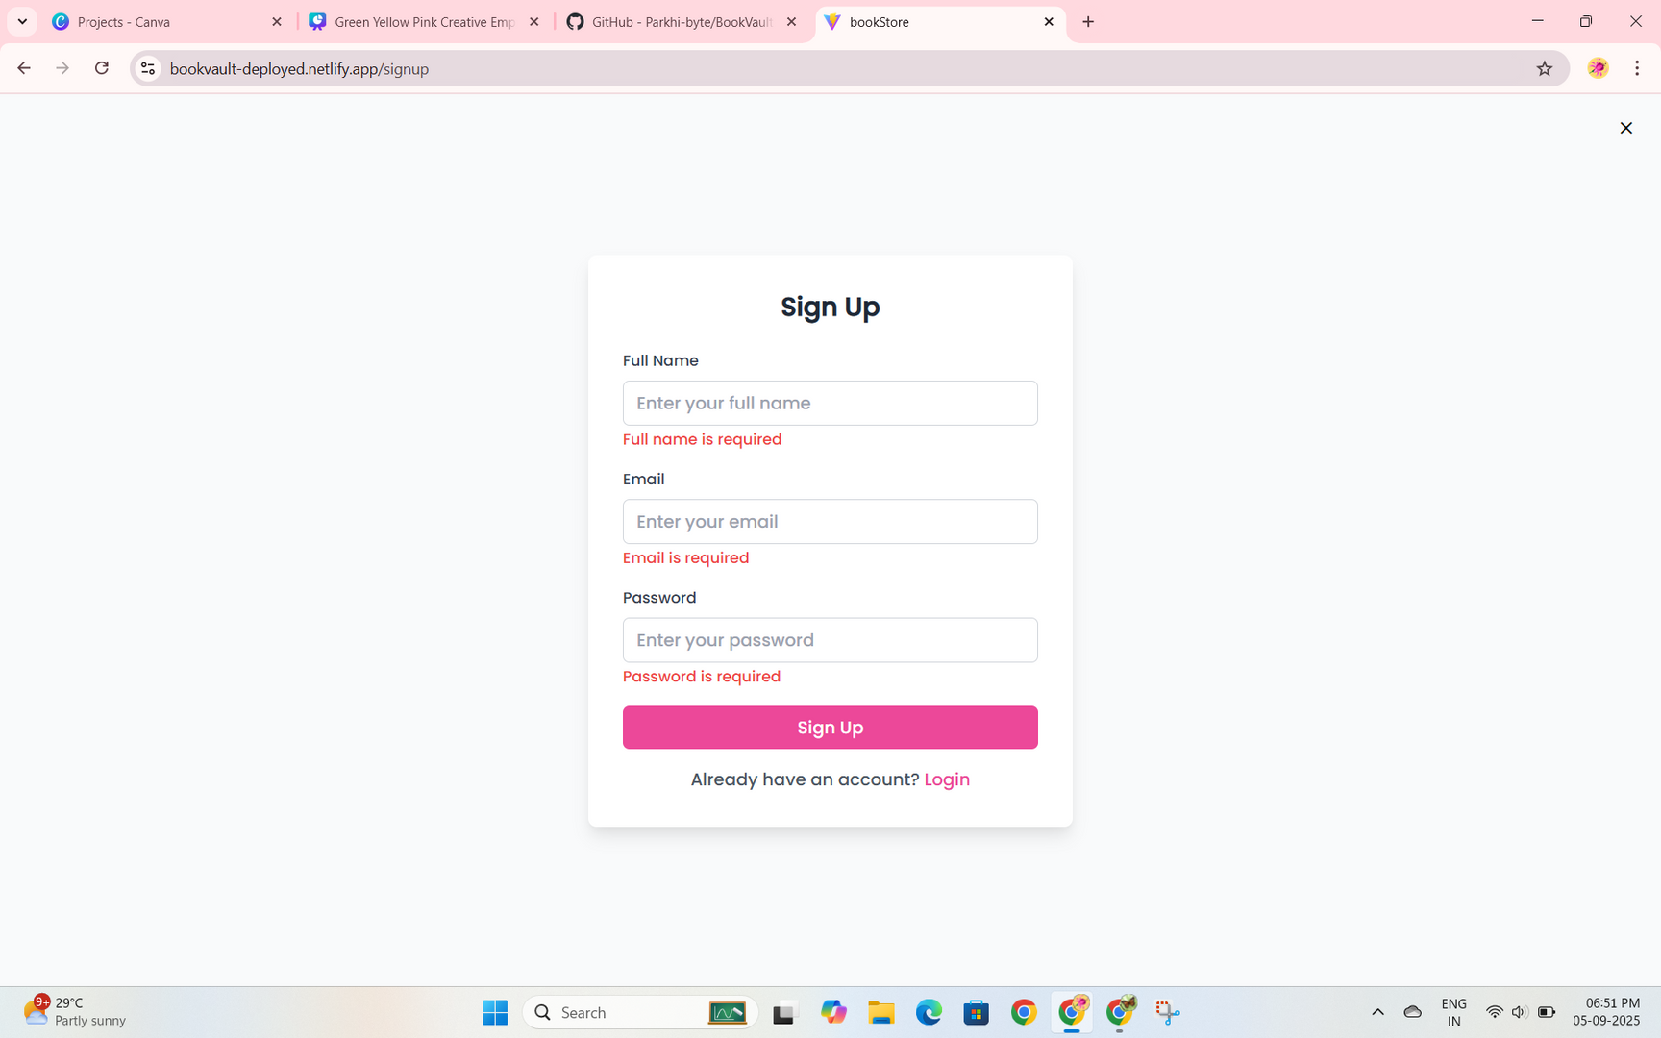
SIGN UP PAGE

Slide 19
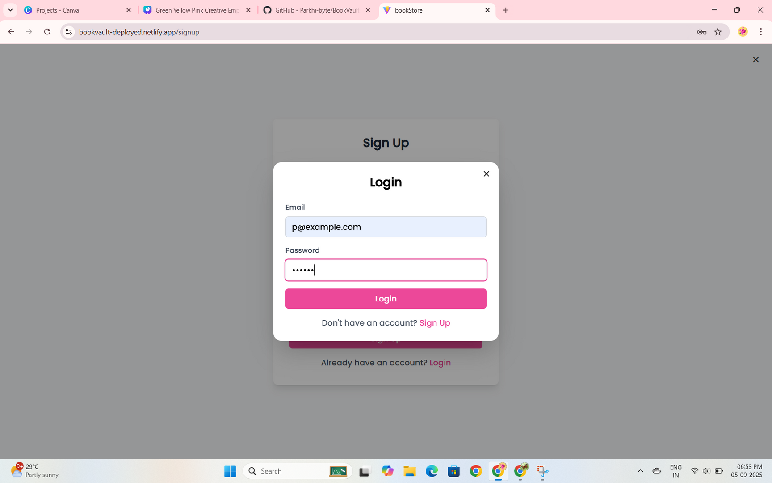
LOGIN PAGE

Slide 20
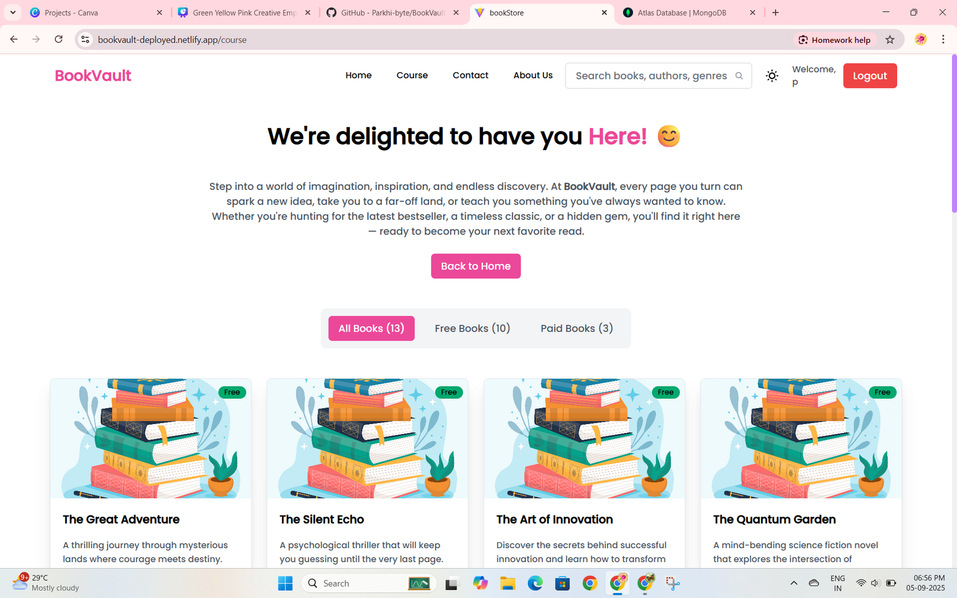
CATEGORIES & COURSE PAGE

Slide 21
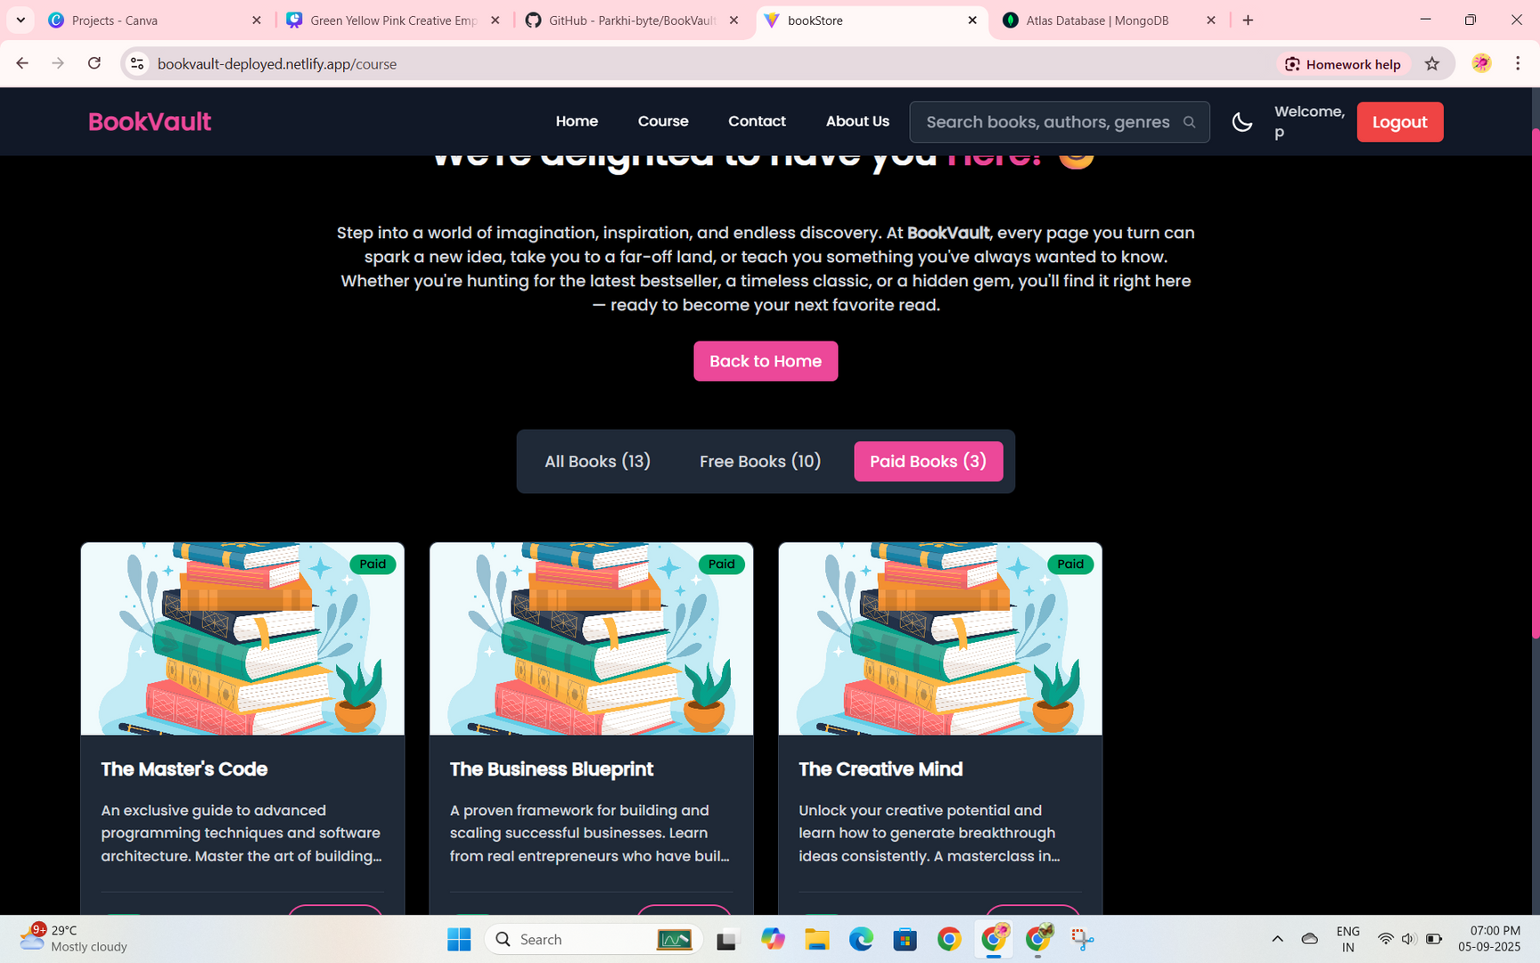
DARK THEME AVAILABLE

Slide 22
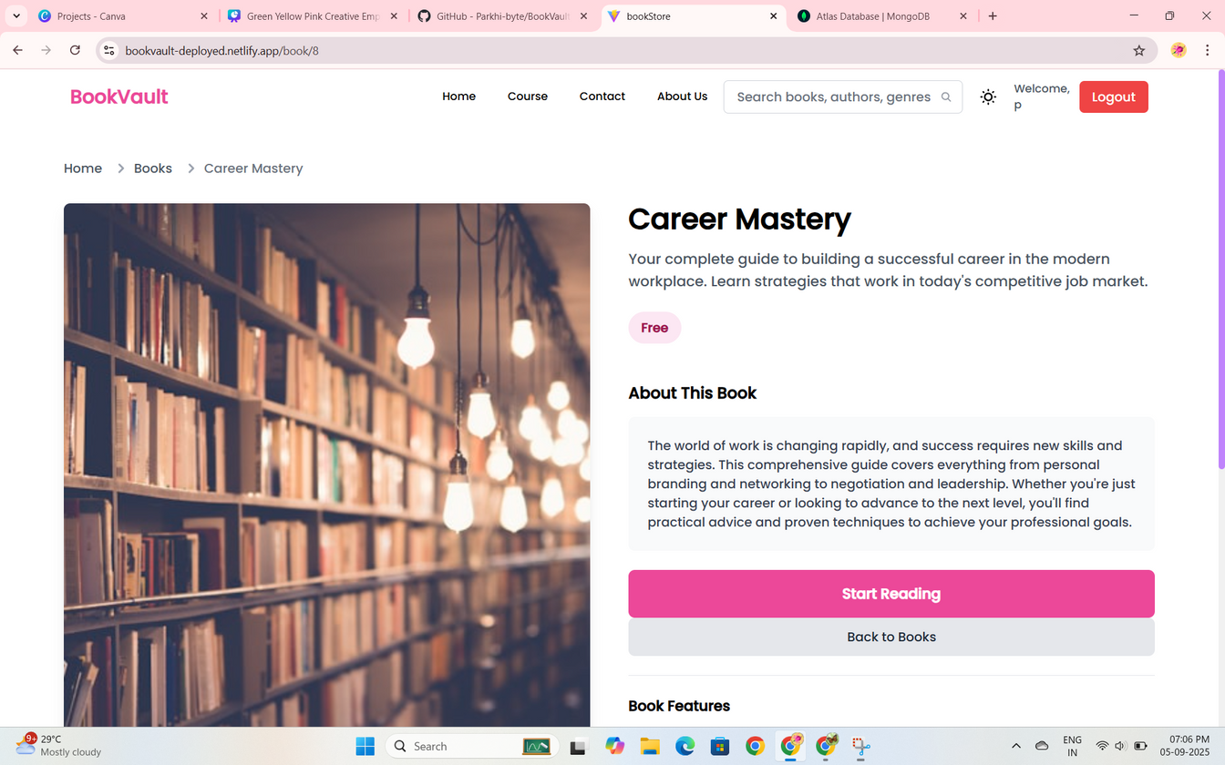
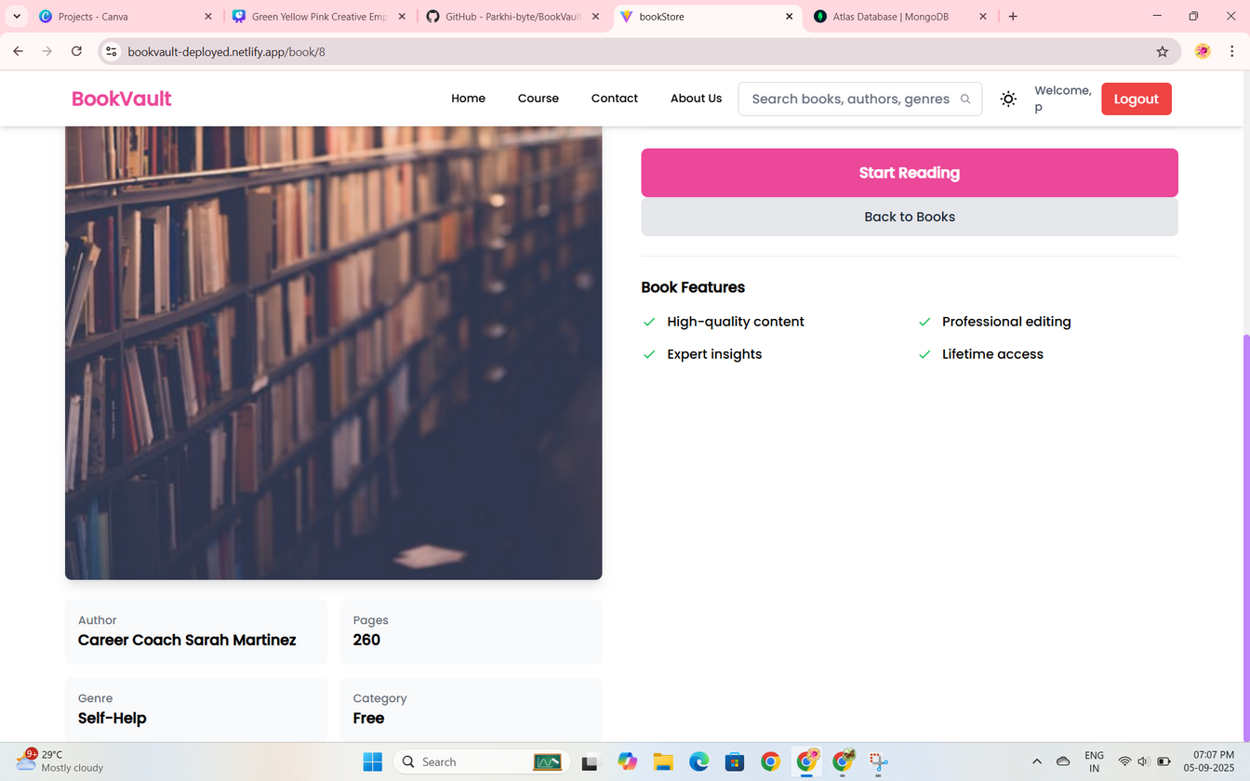
FREE BOOKS WHEN OPENED

Slide 23
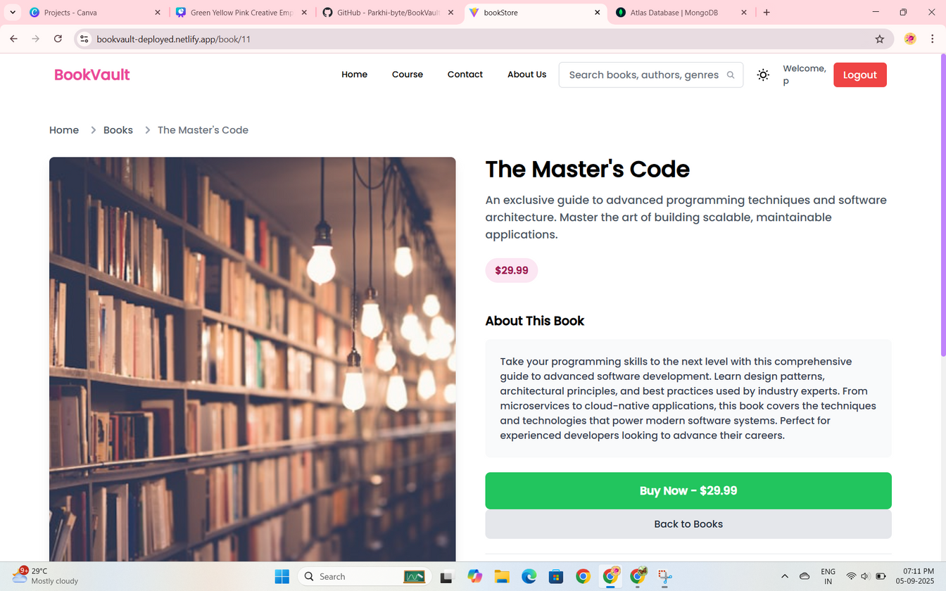
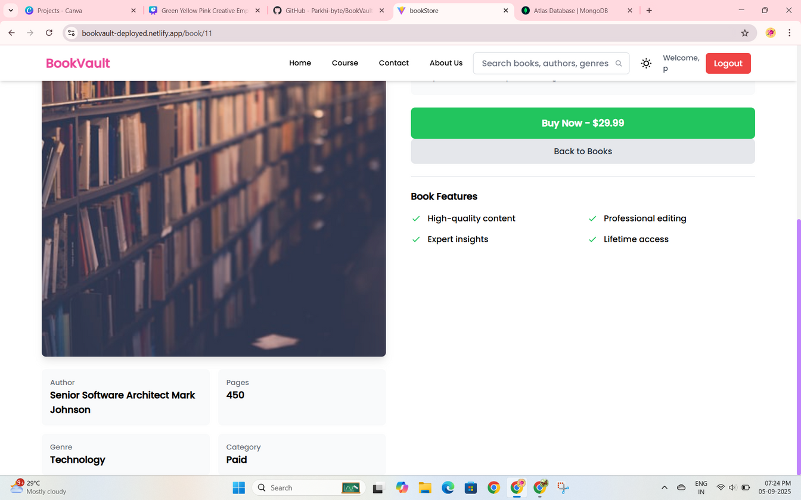
PAID BOOKS WHEN OPENED

Slide 24
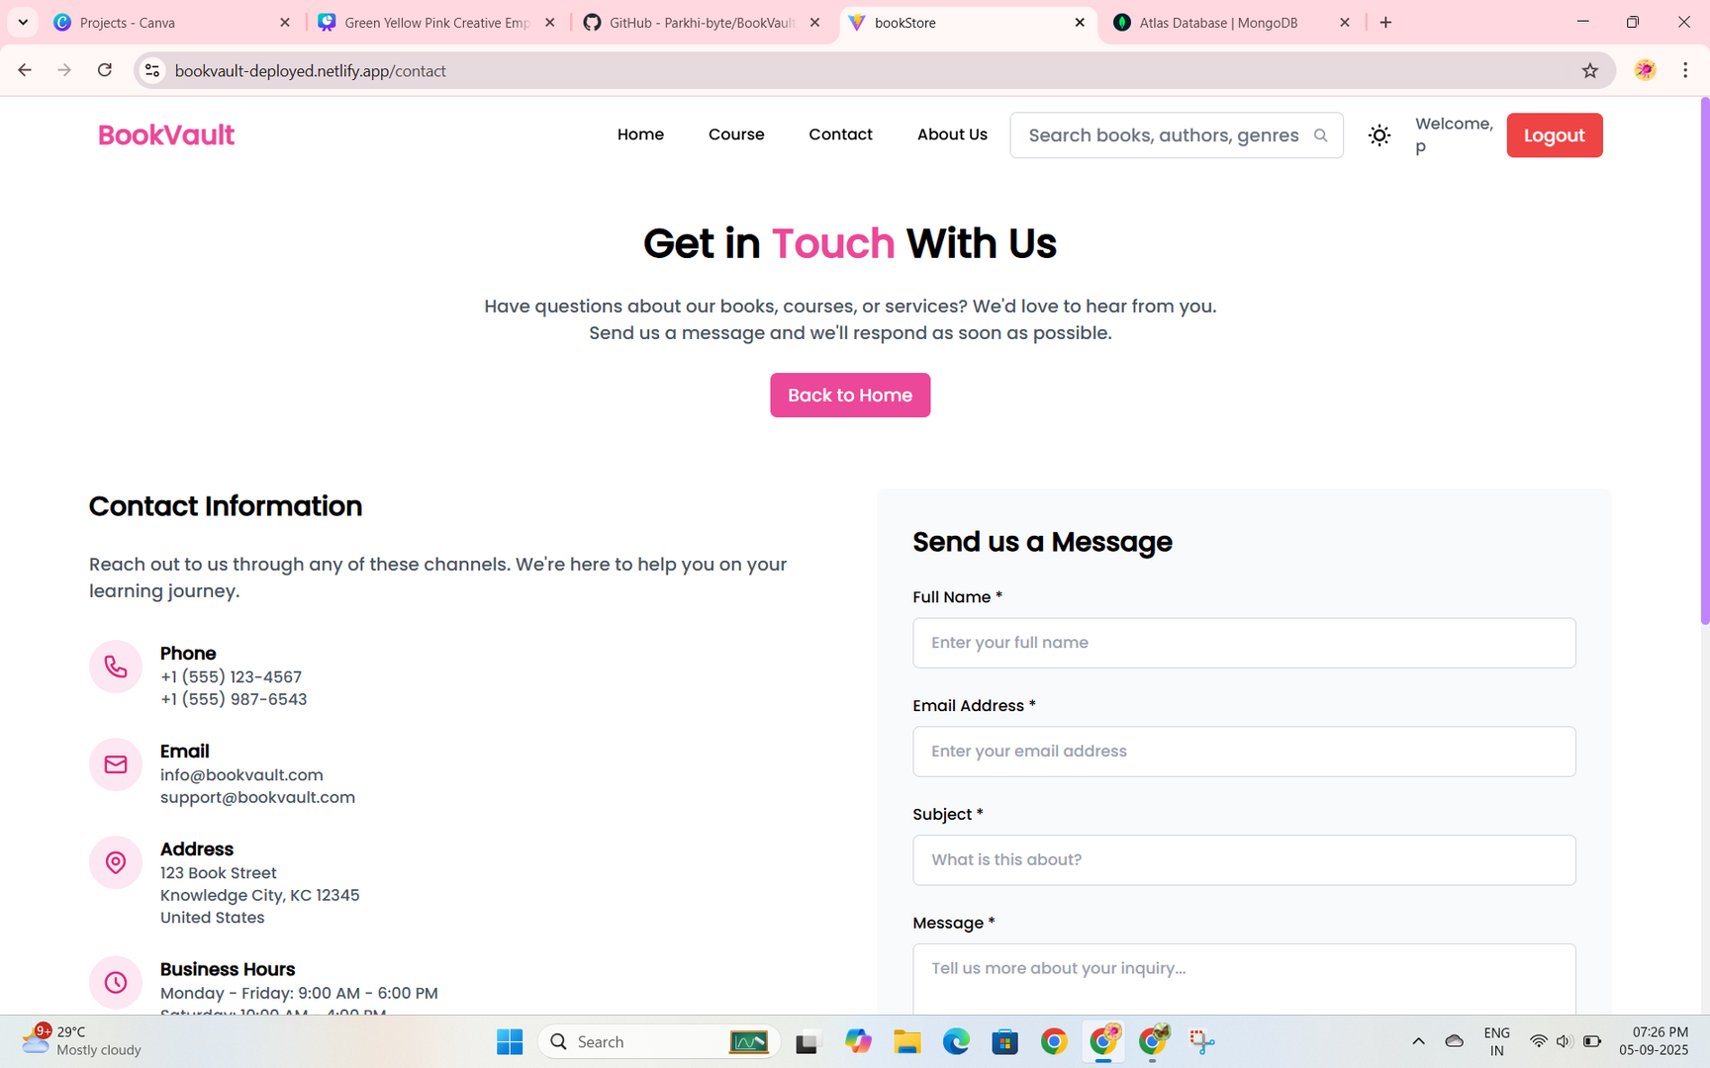
CONTACT PAGE

Slide 25
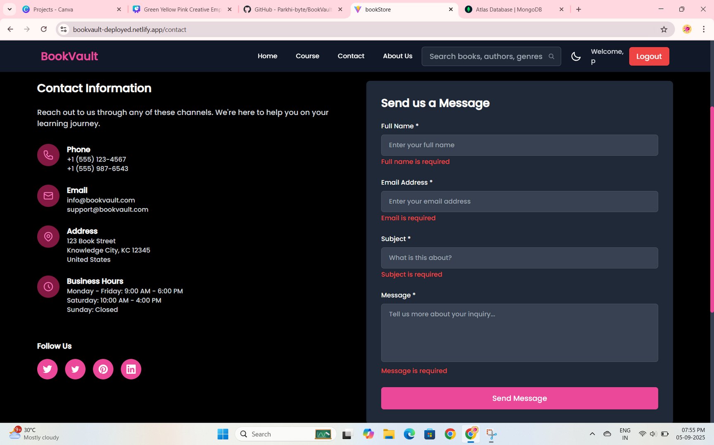
CONTACT PAGE

Slide 26
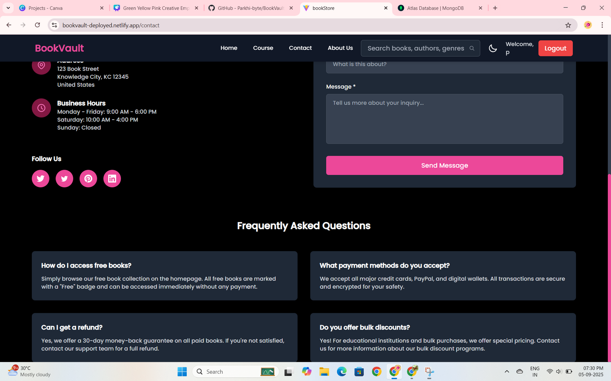
CONTACT PAGE

Slide 27
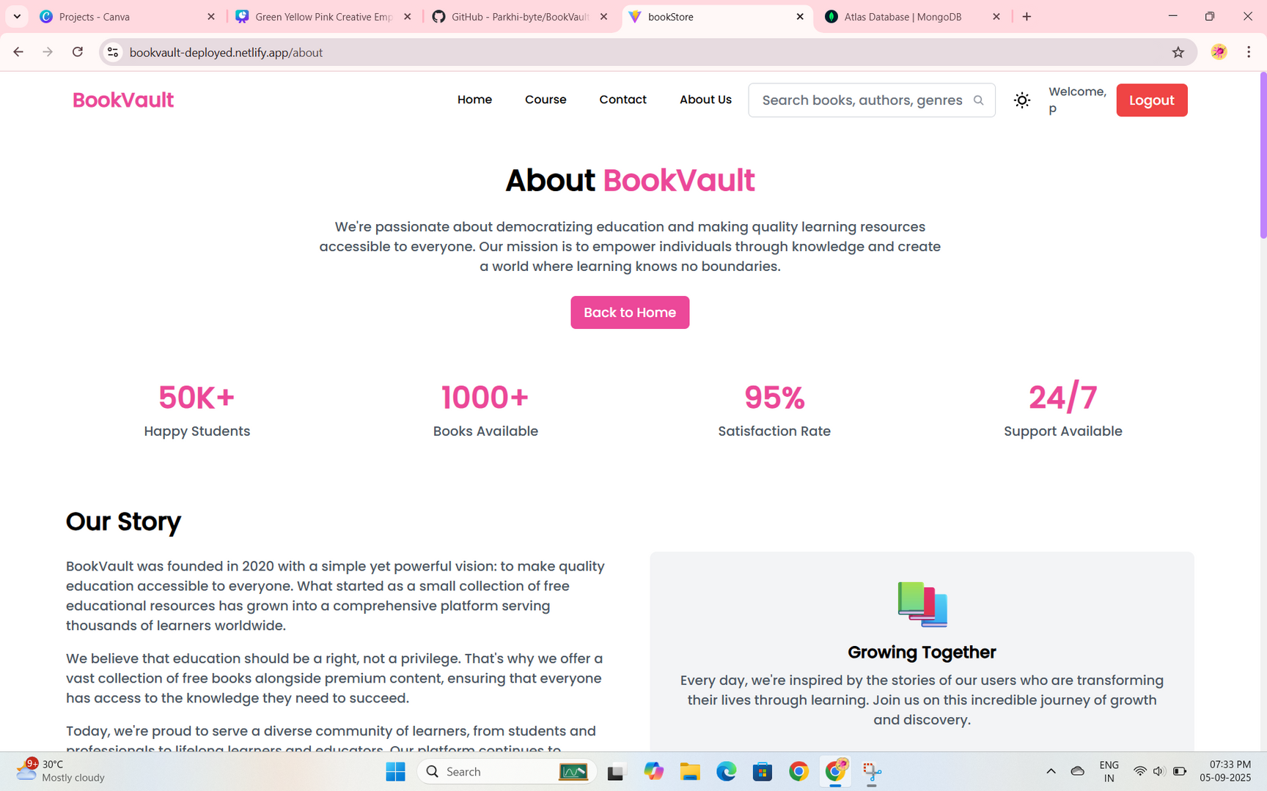
ABOUT US PAGE

Slide 28
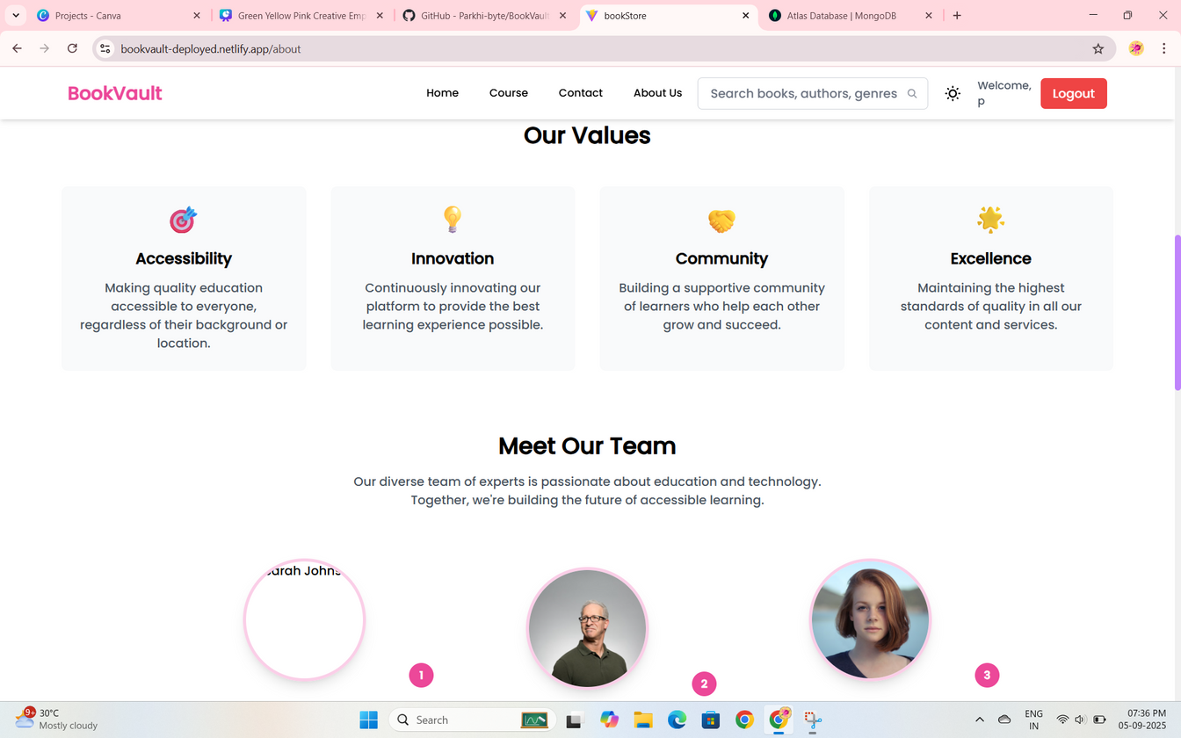
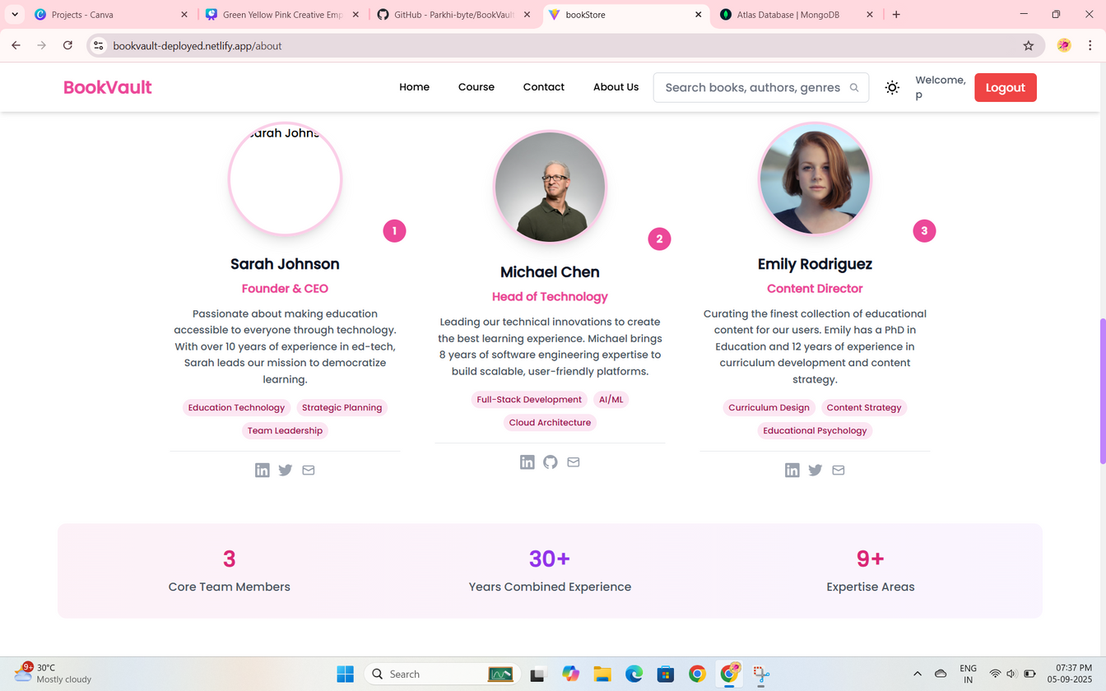
ABOUT US PAGE
HAVING OUR VALUES AND OUR TEAM BOOKVAULT

Slide 29
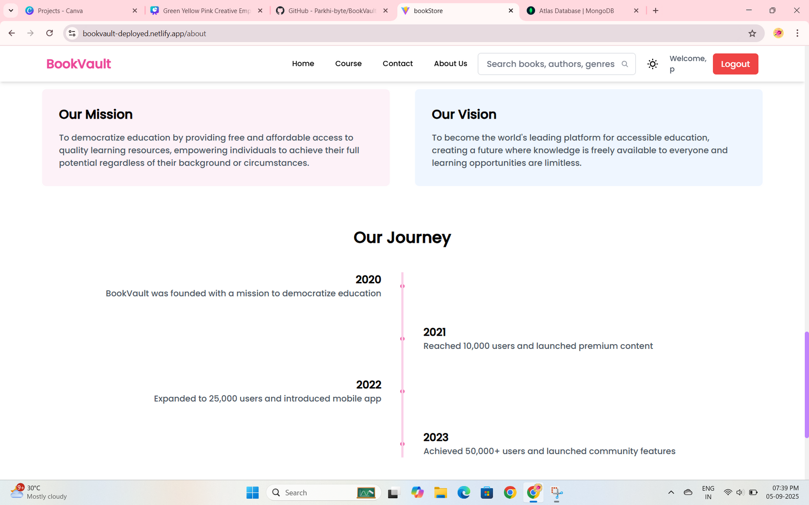
ABOUT US PAGE
HAVING VISION , MISSION , & JOURNEY

Slide 30
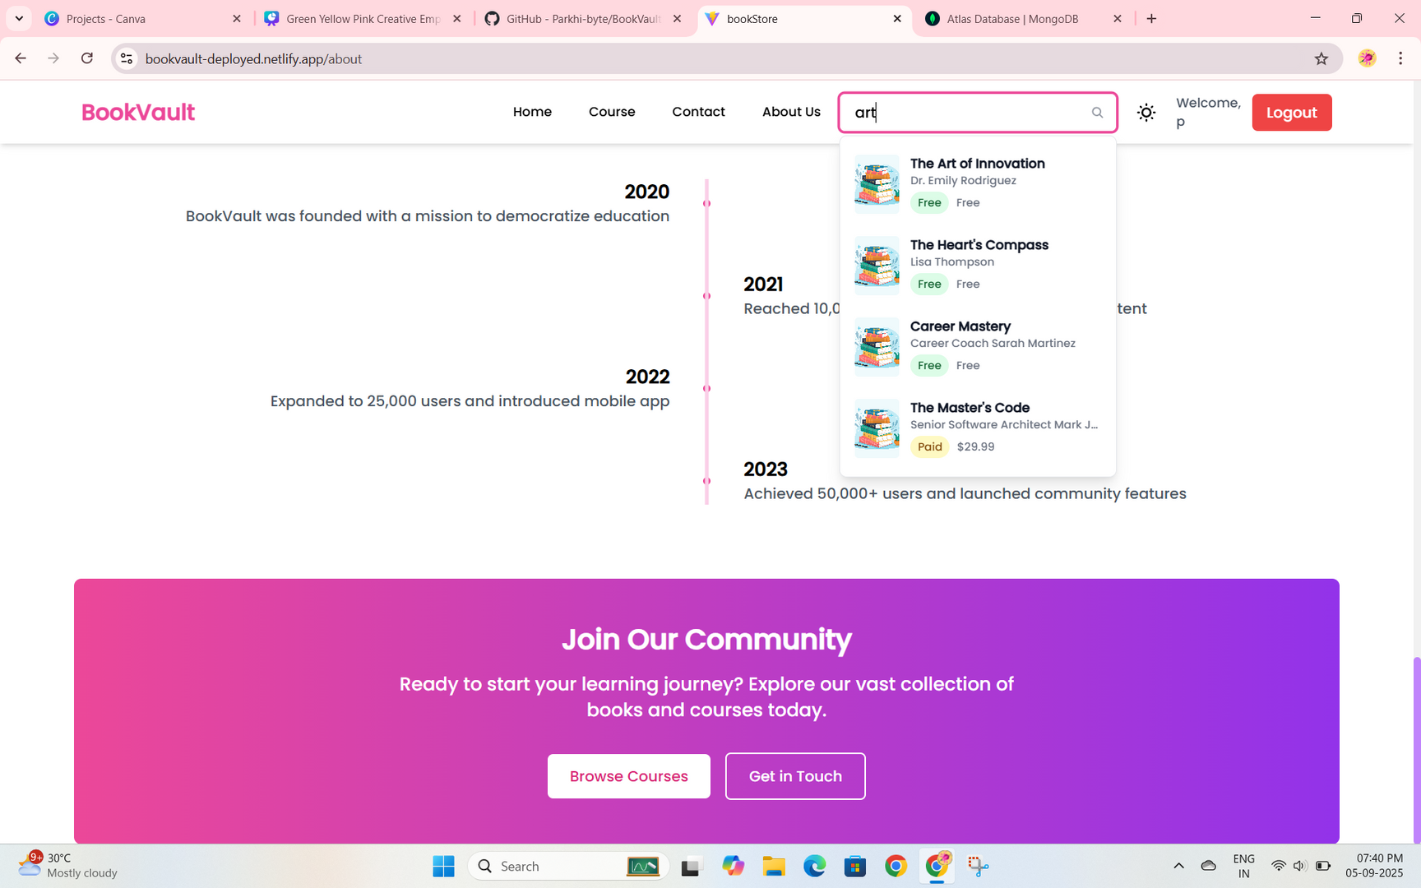
WORKING SEARCH BAR FOR BOOKS

Slide 31
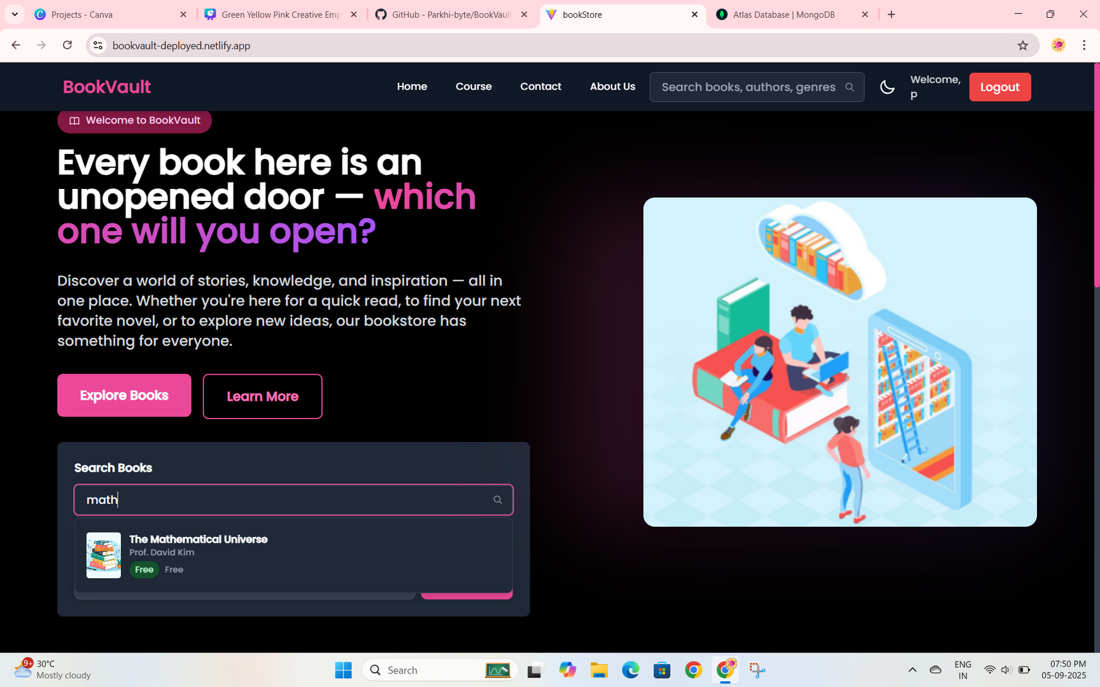
WORKING SEARCH BAR FOR BOOKS

Slide 32
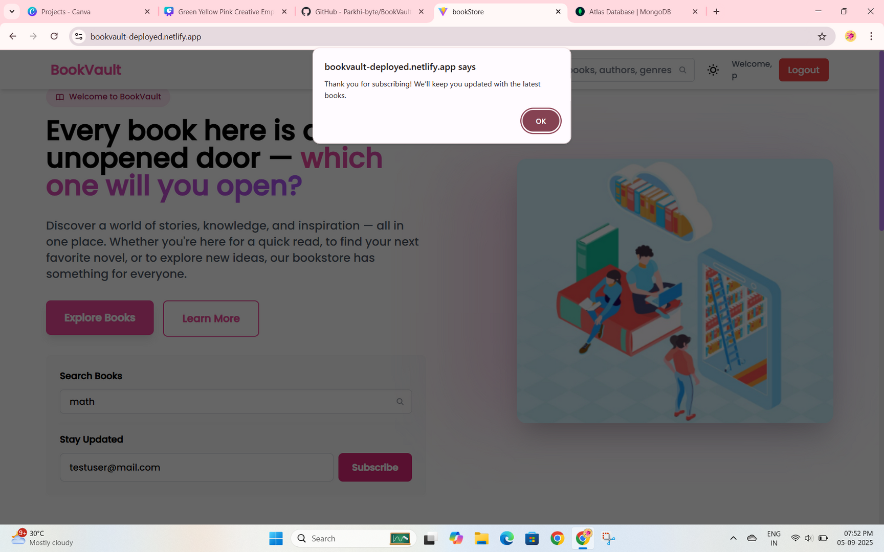
SUBSCRIBE TO BOOKVAULT

Slide 33
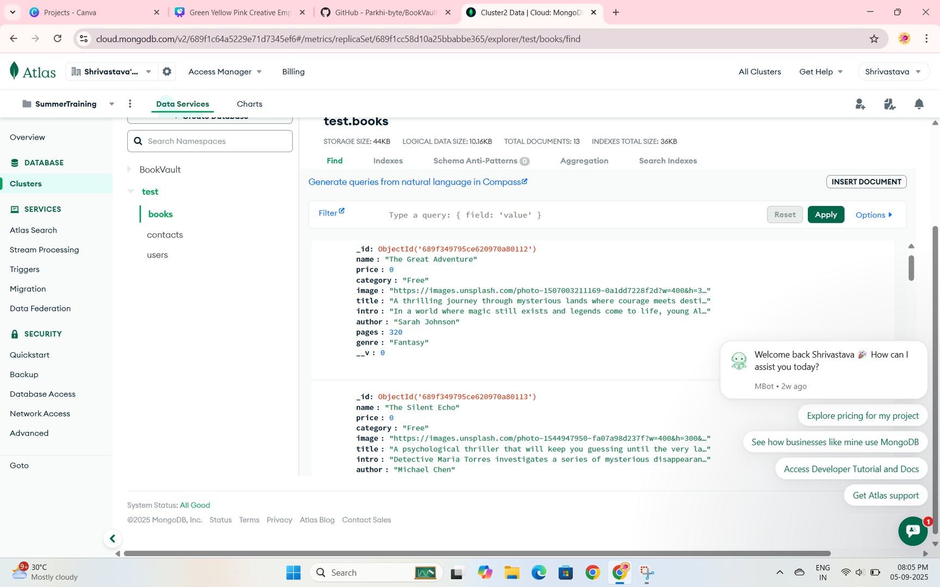
BOOKS IN DATABASE

Slide 34
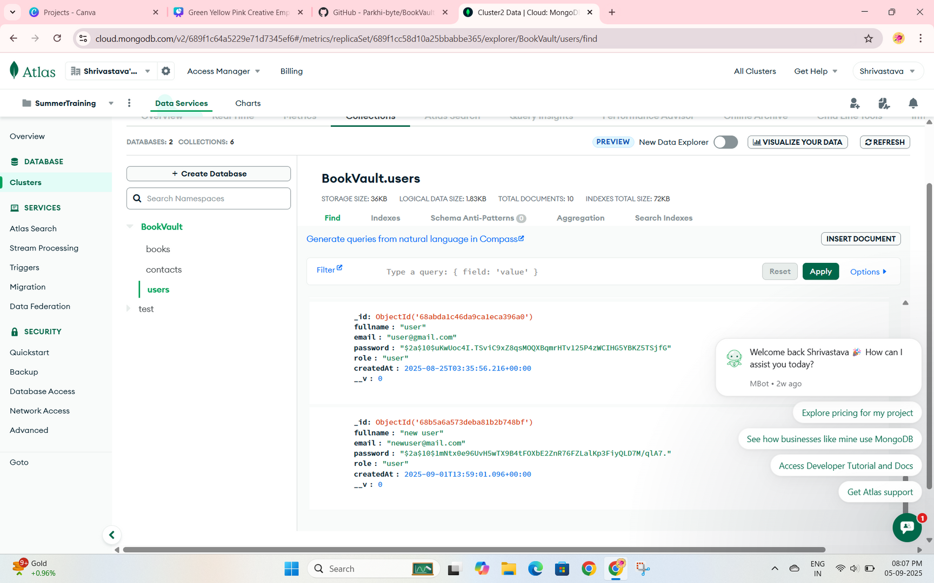
USERS SIGNED IN DATABASE

Slide 35
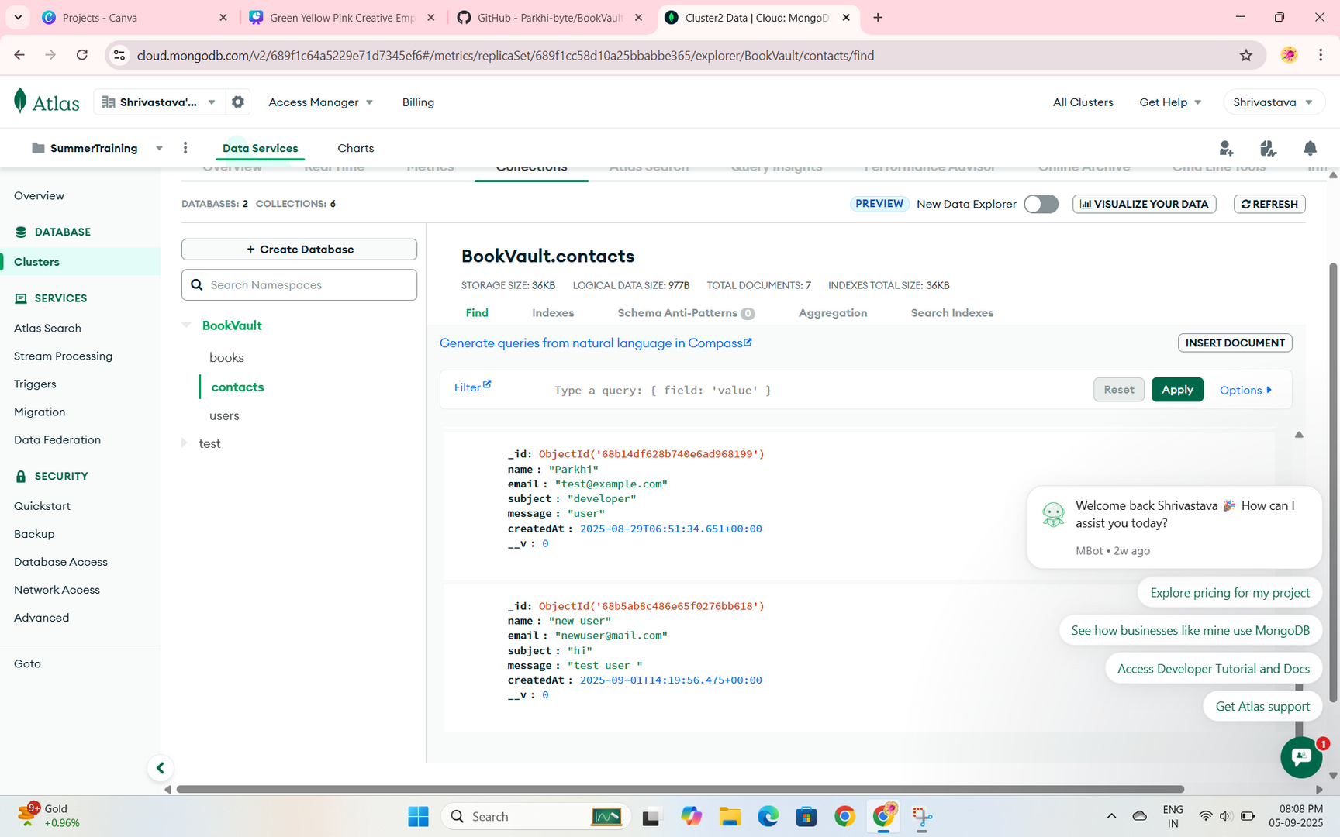
CONTACT QUERIES IN DATABASE

Slide 36

OUTCOMES
TRAINING COURSE OBJECTIVE:
To gain hands-on experience in MERN full stack development through a real-world project.
SKILLS ACQUIRED:
MERN Full Stack Development
JWT authentication & security
Tailwind CSS for UI
GitHub collaboration
Deployment on Netlify & Render

Slide 37

OUTCOMES
PRACTICAL APPLICATIONS & INDUSTRY STANDARDS FOLLOWED
Built CRUD operations
Code reviews & documentation
Implemented secure login system
Environment variables for security
Developed responsive UI
Error handling & validation
GitHub version control
Responsive, mobile-first design

Slide 38
SUMMARY OF THE SUMMER TRAINING
Successful completion of College Summer Training
Practical full-stack project delivered
Improved problem-solving

Slide 39

FUTURE SCOPE
AI-based book recommendations
Mobile app version
Cloud scalability & analytics
PERSONAL REFLECTIONS
Boosted technical confidence
Hands-on real-world exposure
Stronger career readiness

Slide 40
ACKNOWLEDGEMENT
Techvision Technologies mentors
College faculty & training team
Support from peers & family
Q&A
“I welcome your questions.”

Slide 41
THANK YOU FOR LISTENING!
WEBSITE IS LIVE AT
https://bookvault-deployed.netlify.app/
GITHUB
https://github.com/Parkhi-byte/BookVault-Deployment
LINKED IN
www.linkedin.com/in/parkhi-3a62a1315

