Slide 1
New Metatranscriptomics Pipeline
Billy Taj, MaSC
(Software Eng)
(McMaster University)

Slide 2
The 5 Ws of Docker
Mini systems stored as containers
(think mini Vms, but fewer steps)
No need to setup, just plug and play
Useful for sharing dev environments
Also useful for distributing toolchains
Can be deployed anywhere, on anything

Slide 3
Why Docker?
Bioinformatics pipelines (BPs) are tool collections tied with glue-logic code
Distributing bioinformatics pipelines is often messy (download, setup, install dependencies, matching versions of software)
Docker packages it all for you. You just run the container.
Can form clusters of other docker containers

Slide 4
Why automate the pipeline?
Bio Pipelines contain many moving parts
Without automation, these parts tend to be manually executed
Tools are often slow, due to data sizes, lack of immediately-available computing resources

Slide 5
The new pipeline
We have created a new pipeline
Modelled after our lab’s existing internal processes
Features:
One-button-press operation
Analysis of interim data at every step
Auto-resume at failed stages on subsequent runs
Parallel computing capabilities (through docker cluster)

Slide 6
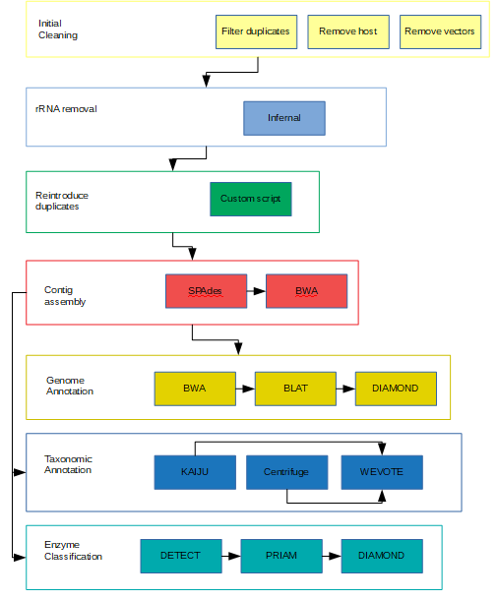

Slide 7
Next steps
Pipeline currently runs up to Genome Annotation
Needs to include other analysis stages to be fully complete
Exploit additional possible parallel tweaks
Investigate Jordan Ang’s Colitis datasets
Expand analytics stages

Slide 8
Thank you
Thank you to:
John Parkinson
Xuejian Xiong
Jordan Ang
Mobolaji Adeolu
Medicine by Design
Sick Kids Hospital

