Slide 1
New Metatranscriptomics
Pipeline
Billy Taj, MASc
(Software Eng, McMaster University)
June 1, 2018

Slide 2
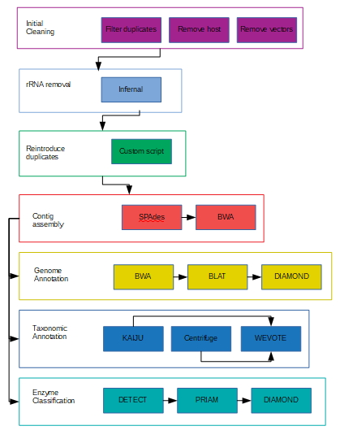
Our Bioinformatics Pipeline

Slide 3
Why automate?
Bioinformatics pipelines (BP) are complex (many tools, and many stages)
BP stages are slow (performance bound by data size)
BP stages typically run in serial (one at a time)
BP stages may fail unexpectedly on Niagara due to timeout
Relying on manual human operation is inefficient.

Slide 4
The What and Why of Docker
Docker: a platform for turning your computer into another computer (Mini VM)
Useful for distributing toolchains (many programs, strung together)
Docker packages it all for you. You just hit run
Can form Docker Clusters for parallel computing

Slide 5
The new pipeline
We have created a new pipeline on Docker
Modeled after our original pipeline, but with augmentations
Features:
  One-button operation
  Auto-resume at failed stages
  Stages run in Parallel (where possible)

Slide 6
Next phase
New pipeline runs up to Genome Annotation
  Needs to include other analysis stages to be fully complete
  Further exploit parallelism
Investigate Jordan Ang’s Colitis Datasets
Expand analysis stages

Slide 7
Acknowledgments
Thank you to:
  John Parkinson
  Xuejian Xiong
  Jordan Ang
  Mobolaji Adeolu
  Medicine by Design
  The Hospital for Sick Children
  University of Toronto

