Slide 1
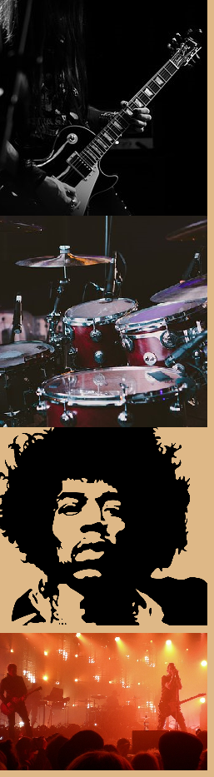
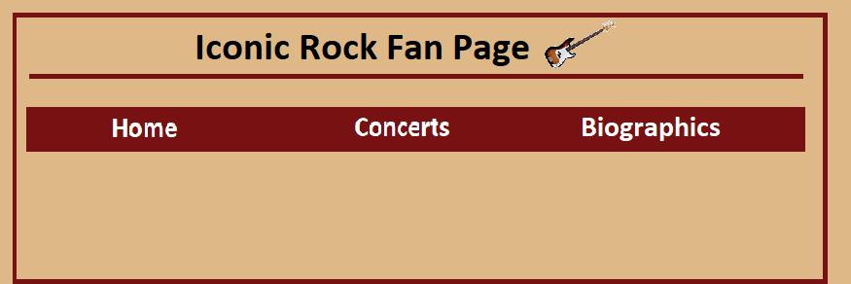
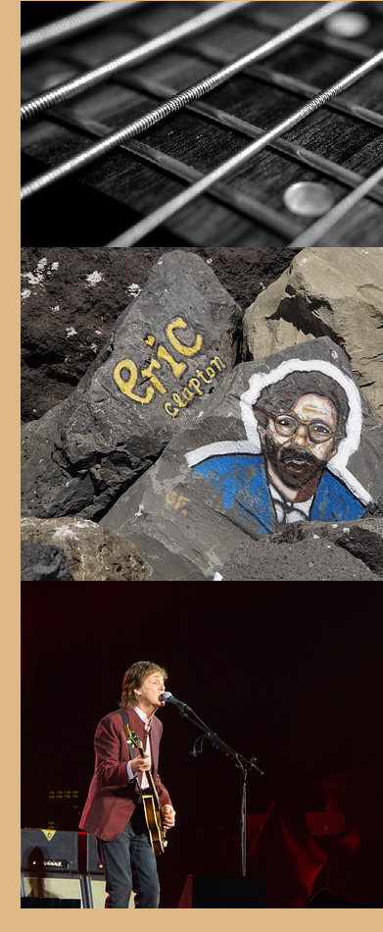
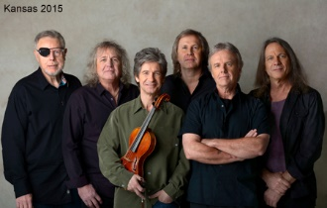
Concerts
Kansas
November 10, 2018
Indianapolis, IN (Point of Know Return Tour)
Murat Theatre at Old National Centre
502 N. New Jersey Street, Indianapolis, IN 46204
^
Other Band
V
Other Band
V
Other Band
V
Other Band
V
Peyton Miller – Concert/Time Organizer Author
© Aden Litwiller and Peyton Miller October 25th 2018

