Slide 1
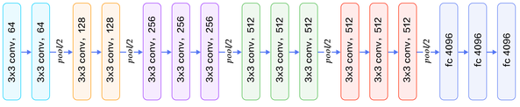
Global Average Pool
3*3. conv, 32
3*3. conv, 32
3*3. conv, 64
3*3. conv, 64
3*3. conv, 128
fc 128
fc 5
Pool 1/2
Pool 1/2

Slide 2
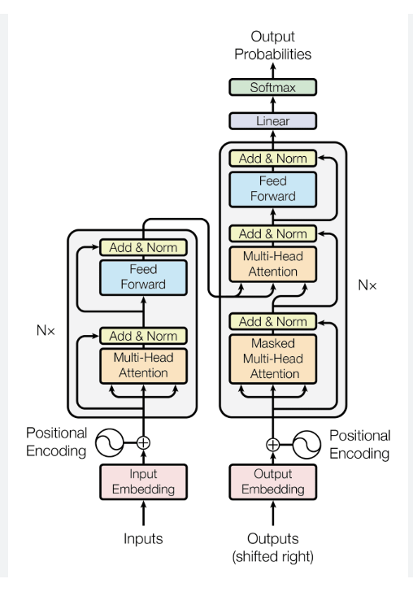
Feed Forward
Hidden dim = 4*input dim
Outputs
Layer Norm
Add
Multi-Head Attention
12 Heads, 64 dim
Add
Layer Norm
Inputs

