Slide 1

A Global Look At Salaries for Full-time Data Scientists
With a focus on addressing the following:
What does a globally competitive salary pay range for a full-time data scientist look like for use in our company’s hiring process?
What is the pay difference between US-based data scientist employees in comparison to Offshore employees?

Slide 2
Full-time Data Scientists Global Salary Statistics
Mean | $108,923.00
Median | $104,796.00
Lower Distribution (1st Quartile) | $55,490.00
Upper Distribution (3rd Quartile) | $141,975.00
Midspread Distribution (Interquartile Range) | $86,485.00
Proposed Data Scientist Salaries By Company Size and Using Global Scope
While the table on the left is inclusive of data from small, medium, and large sized companies to give a broader overview, the table below separates out our two main focus groups of small sized companies (what we currently are) and then medium sized companies (in anticipation of current growth trajectory).
Full-time Data Scientists Global Salary Statistics by Company Size
Company Size | Mean | Median | Lower Distribution (1st Quartile) | Upper Distribution (3rd Quartile) | Midspread Distribution (Interquartile Range) | Proposed Competitive Salary Range
Small | $53,439.00 | $50,295.00 | $23,375.00 | $83,810.00 | $60,435.00 | $50,295.00 to $83,810.00
Medium | $127,084.00 | $130,000.00 | $88,352.00 | $165,110.00 | $76,758.00 | $130,000.00 to $165,110.00

Slide 3
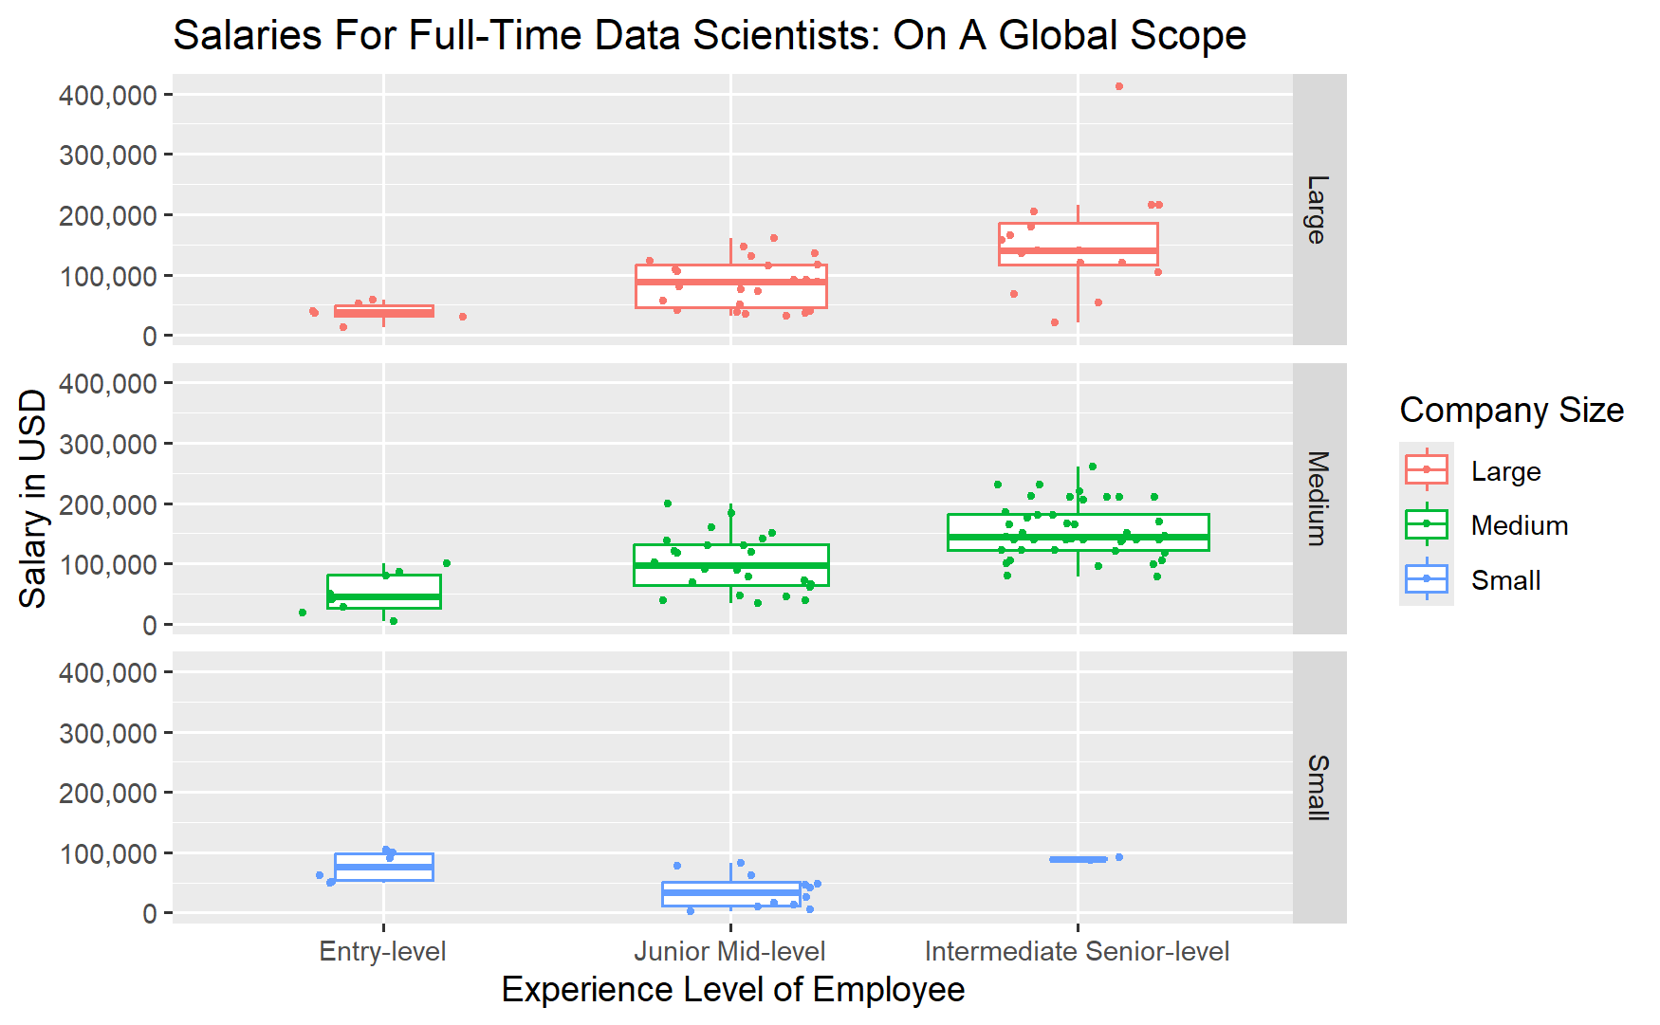
Breakdown of Data Scientist Salaries By Experience Level
This plot serves to show the difference in pay by company size and also broken down by experience levels of the employee. Although Junior Mid-level position for Small Companies has a median less than that of Entry-level, I believe with more data the trend of more experienced positions having a higher salary and median pay than the prior position would be reflected there as well.

Slide 4
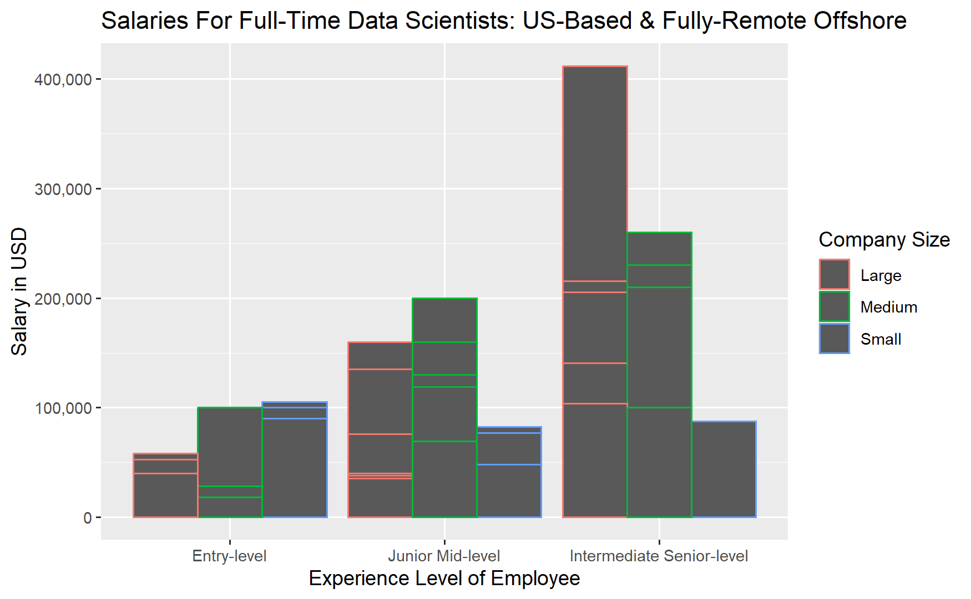
US-Based versus Offshore Employees
The table below provides a comparison between the above-mentioned groups with the final line being reflective of our target group of employee candidates: US-based employees and Fully Remote Offshore employees. The chart to the left shows our target employee candidate group broken down by both company size and position in regards to salaries.
Full-time Data Scientists Global Salary Statistics by Employee Location
Data Scientists Employee Group | Mean | Median | Lower Distribution (1st Quartile) | Upper Distribution (3rd Quartile) | Midspread Distribution (Interquartile Range) | Proposed Competitive Salary Range
US-Based Only Data Scientists | $149,408.00 | $140,000.00 | $120,000.00 | $174,500.00 | $54,500.00 | $140,000.00 to $174,500.00
Non-US Based Data Scientists | $57,989.00 | $49,823.00 | $35,962.00 | $79,296.00 | $43,334.00 | $49,823.00 to $79,296.00
US-Based & Offshore Fully Remote Data Scientists | $125,534.00 | $130,000.00 | $81,250.00 | $160,000.00 | $78,750.00 | $130,000.00 to $160,000.00

Slide 5
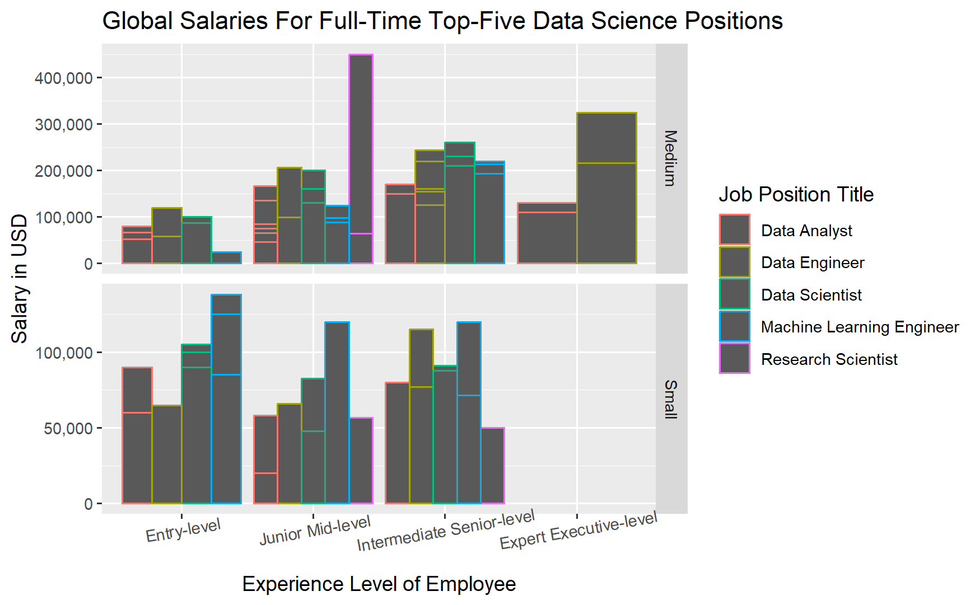
Additional Information to Consider and Looking Ahead
As the company grows, we’ll likely be looking for more roles than just Data Scientists so the chart to the left is reflective of the top five positions shown in the salary data set and also has them broken down into experience levels as well as a reference for current salaries for those roles in comparison to Data Scientists. Besides simply just looking at experience levels we may also want to consider education levels of potential employee candidates.

