Slide 1
MACHINE LEARNING • AUTOMOTIVE INTELLIGENCE
CarLens
Know Your Car’s True Value
A web-based platform for estimating used-car market value using machine learning.
DATA → MODEL → INSIGHT
PROJECT PRESENTED BY
Khushi Desai • 2410112020
Durgesh Parmar • 2410112048
01

Slide 2
01 / CONTEXT
Why used-car valuation needs better signals
Car prices depend on several vehicle characteristics, making consistent estimation challenging.
THE CHALLENGE
THE NEED
THE RESPONSE
Prices can vary by brand, model variant, age, mileage and fuel type.
Buyers and sellers need a quick reference estimate to support decisions.
CarLens applies a trained regression model to the vehicle details provided.
Project problem: build a usable web application that converts selected vehicle attributes into an estimated market value.
02

Slide 3
02 / SOLUTION
A practical valuation workflow
CarLens connects a simple interface to a trained machine learning model.
01 ENTER DETAILS
02 MODEL INFERENCE
03 VIEW ESTIMATE
Brand • Variant
Model year • Kilometres
Fuel type
→
Flask validates the input and sends it through the saved Scikit-learn pipeline.
→
The application displays a predicted price and the vehicle details.
Core features: prediction • side-by-side comparison • dashboard and local prediction history • registration/login interface
03

Slide 4
03 / ARCHITECTURE
How the application components work together
The frontend collects inputs; the backend validates and returns model predictions.
React + Vite
Flask API
Preprocessing
ML Model
JSON Response
→
→
→
→
User interface
/options • /predict
Categorical encoding
Linear Regression
Estimated value
Frontend: React | Backend: Python + Flask | ML: Scikit-learn | Data handling: Pandas + NumPy
The browser communicates with the Flask API; the trained model runs on the backend.
04

Slide 5
04 / DATA
Dataset and input features
The model learns patterns from historical used-car listings.
3,073
11
2008–2025
TARGET VARIABLE
records
brands
model years
Final_Price — the value the model is trained to estimate.
MODEL INPUT FEATURES
Dataset coverage and feature availability limit how well the model can generalize to every vehicle.
Brand
Variant
Model Year
Kilometres
Fuel Type
05

Slide 6
05 / METHOD
From raw records to a trained model
Categorical and numeric features are prepared before fitting the regression model.
01
Inspect & clean
Standardize categorical text and convert numeric columns.
02
Encode categories
OneHotEncoder converts categories into model-readable features.
03
Split data
80% training set and 20% test set.
04
Train & evaluate
Fit Linear Regression, then evaluate on held-out data.
A saved preprocessing + model pipeline is used to transform new inputs consistently.
06

Slide 7
06 / MODEL
Why Linear Regression?
A supervised regression method predicts a continuous numerical target.
INPUTS
LEARNING
PREDICTION
Brand and variant
Model year
Kilometres driven
Fuel type
The model estimates relationships between encoded vehicle features and historical prices.
For a new vehicle, the fitted model returns an estimated price in rupees.
Why this baseline? It is relatively simple and interpretable. Its suitability must be judged by held-out evaluation—not assumed in advance.
Regression predicts numbers; classification predicts categories.
07

Slide 8
07 / EVALUATION
Model results: useful baseline, meaningful limitations
Evaluation on the held-out test split indicates room for improvement.
R² ≈ 0.48
MAE ≈ ₹1.89 lakh
RMSE ≈ ₹4.10 lakh
Measures explained variation relative to a baseline; it is not 48% accuracy.
Average absolute difference between predicted and actual prices.
Penalizes larger errors more strongly than MAE.
Interpretation: the model captures some price patterns, but individual estimates can deviate substantially.
Potential reasons: omitted factors such as vehicle condition, location, ownership history, and market demand; limited dataset coverage; model assumptions.
08

Slide 9
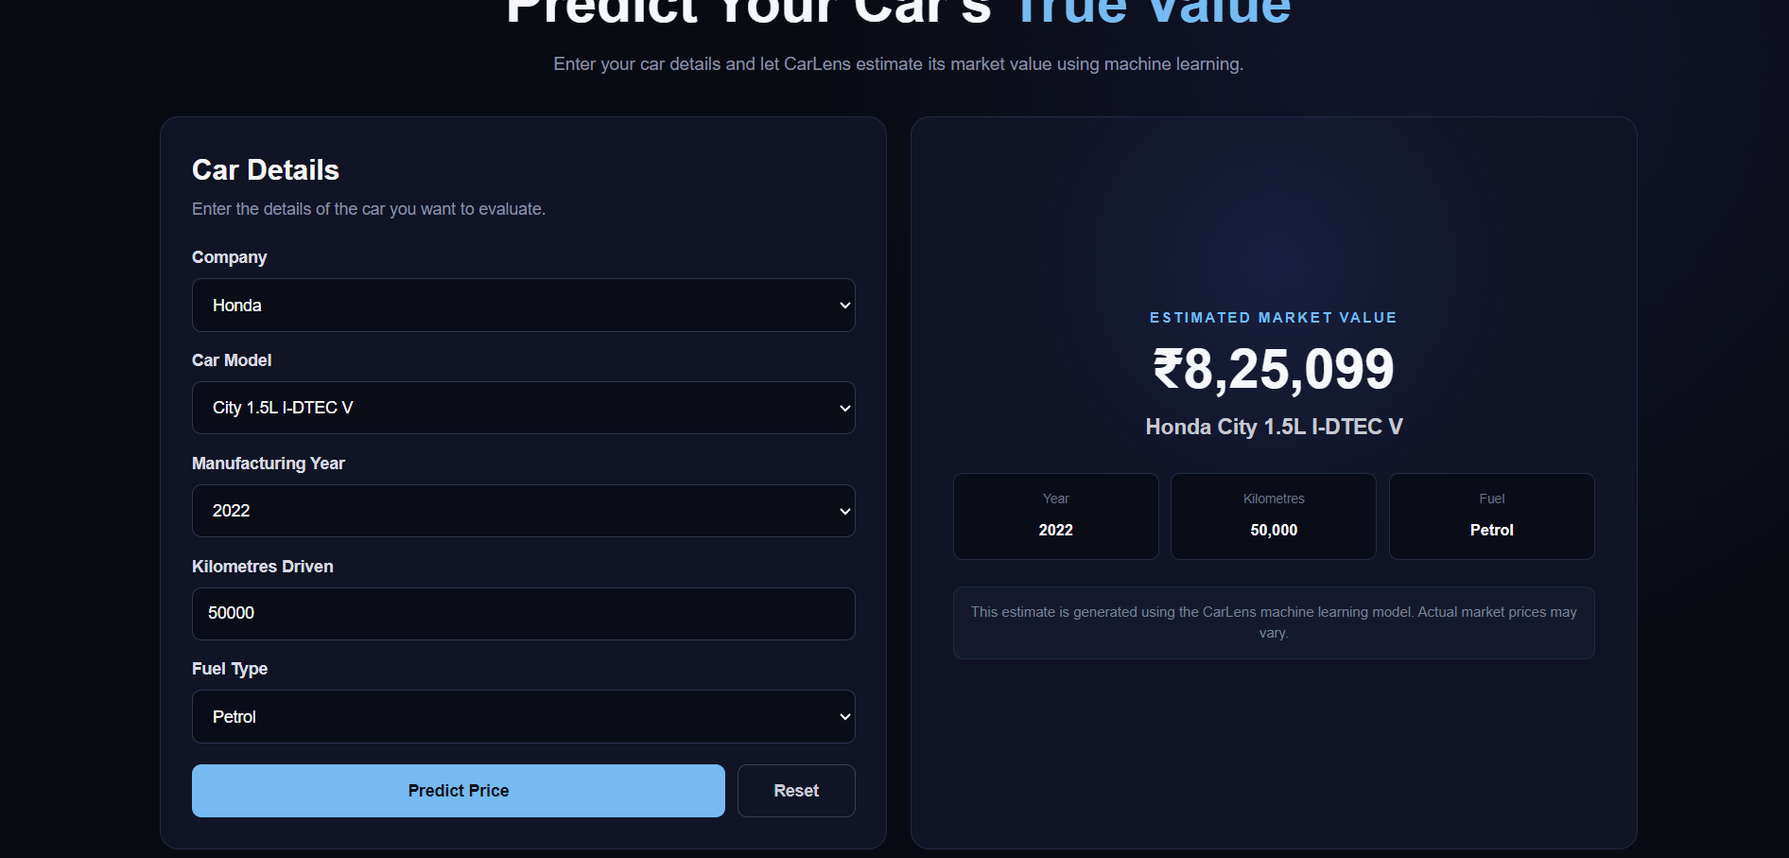
08 / LIVE PRODUCT
CarLens prediction interface
A real application screenshot showing the completed prediction flow.
EXAMPLE VEHICLE
2022 Honda City
50,000 km • Petrol
MODEL ESTIMATE
₹8,25,099
An illustrative model output—not a verified selling price.
09

Slide 10
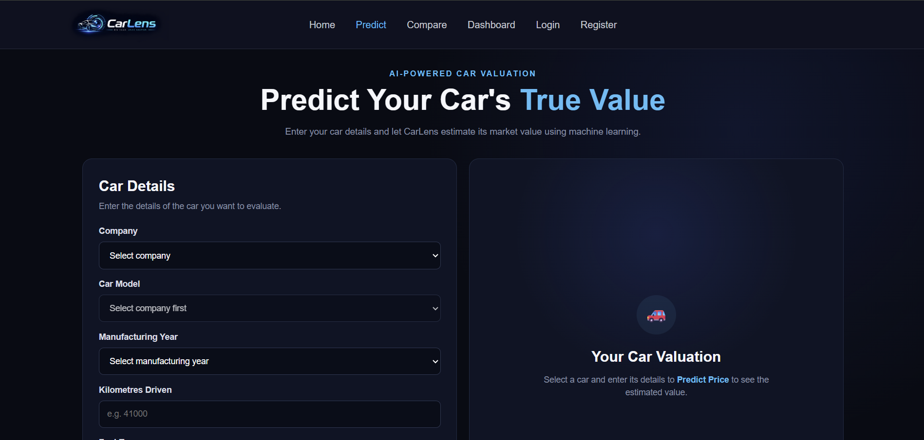
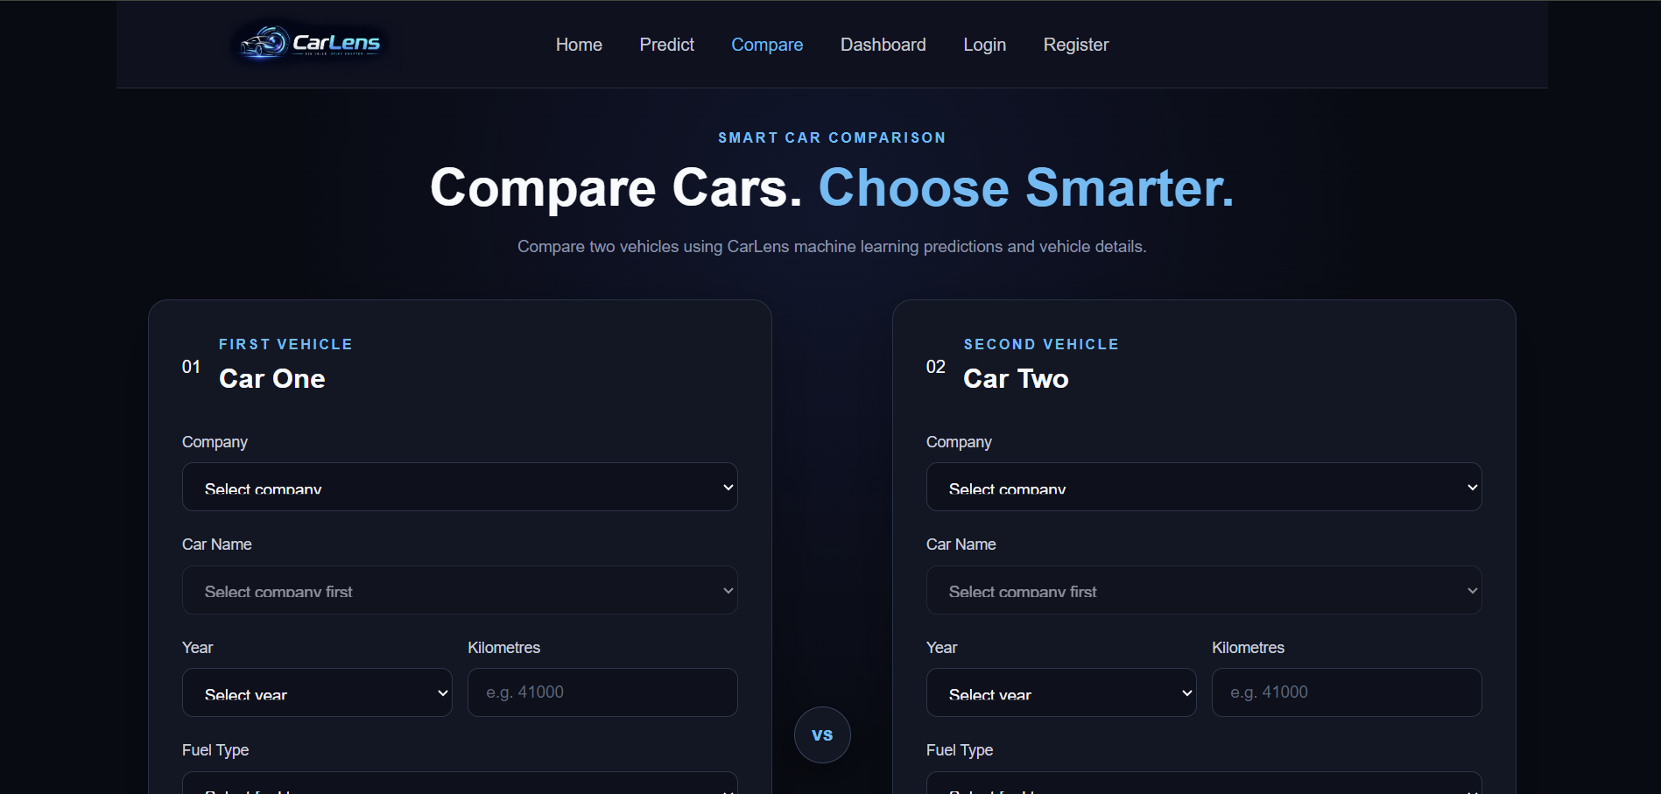
09 / APPLICATION FEATURES
Comparison, dashboard and account flow
The interface includes more than a single prediction form.
COMPARE CARS • Estimate two vehicles side by side
DASHBOARD • Statistics and recent prediction history
10

Slide 11
10 / REFLECTION
Limitations, future scope and conclusion
CarLens demonstrates end-to-end integration of a regression model with a web interface.
CURRENT LIMITATIONS
FUTURE IMPROVEMENTS
• Model estimates can differ from real prices
• Vehicle condition and city are not inputs
• Historical data may not represent every segment
• Current model is a baseline
• Expand and refresh dataset
• Add condition and location features
• Compare tree-based regression models
• Evaluate generalization and recalibrate
Conclusion: CarLens provides a working demonstration of how historical vehicle data and machine learning can support used-car valuation decisions.
11

Slide 12
11 / SYSTEM ARCHITECTURE
How a prediction travels through CarLens
React handles the interface; Flask coordinates model inference and persistence.
1 React + Vite
2 Flask API
3 ML Pipeline
4 MySQL (carlens_db)
Collects vehicle inputs
Displays API responses
Routes: Login, Register, Predict, Dashboard
→
Validates requests
Handles /register, /login
Runs /predict and /history
→
Loads linear.pkl
Preprocesses features
Returns estimated price
↔
users: account profile + password hash
prediction_history: inputs, estimate, timestamp, user_id
Prediction request
Important distinction
React sends JSON to Flask → model predicts → Flask saves the result → JSON response returns to React.
The training dataset and linear.pkl are project files on the backend; MySQL stores registered users and prediction history.
Local demo endpoints use http://127.0.0.1:5000; React development server typically runs at http://localhost:5173.

Slide 13
12 / DATA STORAGE
Where is each kind of data stored?
CarLens uses local project files for machine learning and MySQL for application records.
Training dataset
Trained model
MySQL database
File: Cars24_Used_Cars_Clean_Data.xls
CSV-formatted data despite the .xls extension
Used to train/evaluate the model; not the live user database.
File: linear.pkl
Saved Scikit-learn regression pipeline
Loaded by app.py to estimate prices for new inputs.
Database: carlens_db
users: id, name, email, password_hash
prediction_history: car details, predicted_price, user_id, created_at
Browser-side session
Why link predictions to users?
The React app stores the signed login token and non-sensitive user profile in localStorage. The password is not stored there.
prediction_history.user_id associates each saved estimate with its account. The Dashboard requests /history and shows records for the authenticated user.
Database credentials belong in the backend .env file; do not put MySQL credentials in React or expose them in slides.

Slide 14
13 / REQUEST & TESTING FLOW
What happens when a user registers, logs in, and predicts?
A concise walkthrough for the live demonstration and technical viva.
A Register
B Login
C Predict
React sends name, email and password to POST /register. Flask hashes the password and saves the user in MySQL.
POST /login checks the stored password hash. On success, Flask returns a signed token and user profile.
POST /predict receives vehicle inputs and the bearer token. Flask runs the model and saves the estimate with user_id.
D Dashboard
Tests completed
GET /history verifies the bearer token and returns prediction history for that user, newest first.
Fresh registration → login → prediction → MySQL row → Dashboard history → logout/re-login → history persisted after refresh.
Demo limitation: the signed-token approach is suitable for a student prototype; production use needs stronger session lifecycle controls, HTTPS, rate limiting and deployment secrets management.

Slide 15
CARLENS / REFERENCES
Thank You.
TECHNICAL REFERENCES
React documentation — react.dev
Flask documentation — flask.palletsprojects.com
Scikit-learn User Guide — scikit-learn.org
Pandas documentation — pandas.pydata.org
Dataset: Cars24 used-car dataset used for model development.
Questions & Discussion
PROJECT TEAM
Khushi Desai • 2410112020
Durgesh Parmar • 2410112048
15

