Slide 1


Raahi
A way forward
Intelligent travel disruption recovery
PS ID 2
Hackathon prototype
Notes:
A flight delay can threaten everything a traveler booked around it. Raahi understands that connected trip and helps the traveler recover it around their budget and the experiences they care about. Our prototype takes that journey all the way through review and a saved itinerary.
Evidence / source: https://github.com/ParmiGohil/Raahi/tree/main; original decorative Goa-inspired artwork: public/images/goa-coast.png. Generated artwork, not a real booking or current destination condition.

Slide 2
One delay puts the whole day at risk
+3h
Booking | What breaks
Airport shuttle | 11:50 cutoff missed
Hotel check-in | Arrival plan disrupted
16:00 concert | Original plan no longer fits
Mumbai–Goa flight delay
The traveler must rebuild the day across separate bookings.
Illustrative trip: ready at the airport at 14:30 after the delay.
RAAHI
02
Notes:
In our fictional Mumbai–Goa trip, the flight arrives three hours late. The traveler is ready at 14:30, well after the 11:50 shuttle cutoff. That breaks the hotel transfer and threatens the concert. The difficult task is checking the consequences across bookings while also understanding what another plan will cost.
Evidence / source: https://github.com/ParmiGohil/Raahi/tree/main/src/fixtures/trip.ts and src/engine/recover.ts. All times IST on 26 September 2026; authored scenario, not live travel data.

Slide 3
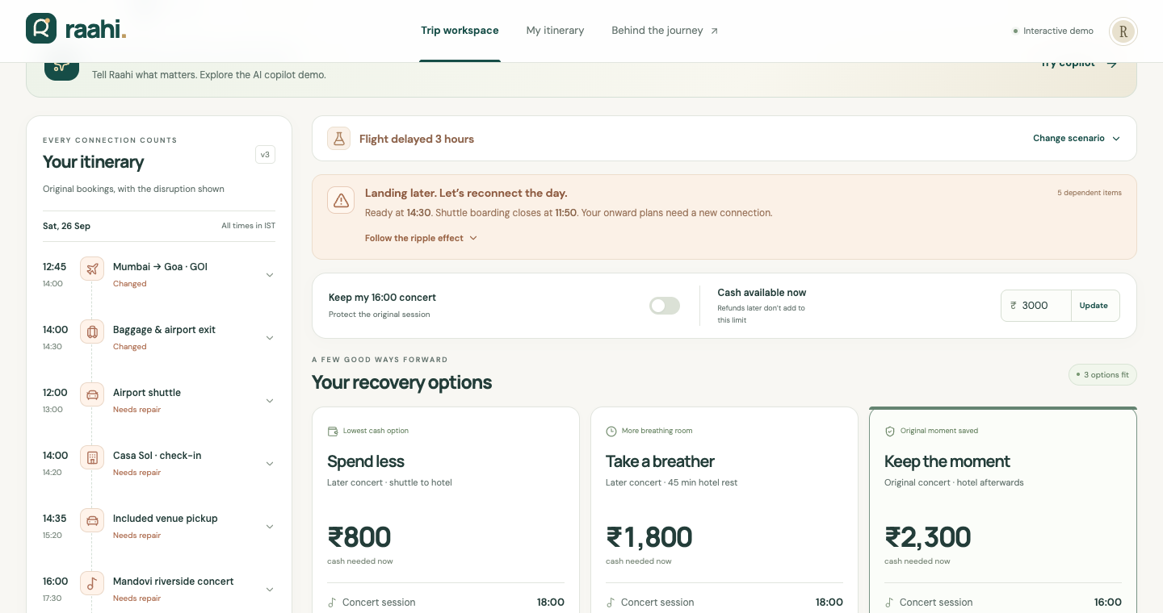
One workspace for the recovery
See the impact. Compare feasible plans. Review every change.
CONNECTED
ITINERARY
Visible dependencies
and affected bookings
CLEAR CHOICES
Cash, event timing
and time to rest
RAAHI
03
Notes:
This is the working Raahi interface. The itinerary stays alongside the recovery options so the traveler sees what changes and why. Each option makes the cash needed now and the event tradeoff visible. The traveler reviews the full route and cost ledger before accepting anything.
Evidence / source: https://github.com/ParmiGohil/Raahi/tree/main/src/components/workspace.tsx. Screenshot captured from the local working prototype.

Slide 4
Connected bookings reveal the ripple effect
Each segment carries timing, location and dependency constraints.
Segment | Depends on | Constraint Raahi checks
Airport shuttle | Flight and airport exit | Ready before the pickup cutoff
Hotel check-in | Transfer to the hotel | Arrival inside the check-in window
Concert arrival | Transfers and luggage plan | At the venue before 15:45
A feasible replacement must work across the entire route.
RAAHI
04
Notes:
The engine represents bookings and their dependencies explicitly. It propagates impacts from the disrupted segment, then validates complete replacement routes. Timing alone is not enough: locations must connect, supplier permissions must be available, and completed travel must stay unchanged. This lets the system reject plans that look plausible but cannot actually work.
Evidence / source: https://github.com/ParmiGohil/Raahi/tree/main/src/domain/types.ts, src/engine/recover.ts and src/engine/validate.ts. Bounded authored candidate plans with deterministic validation; no global optimization claim.

Slide 5
Three feasible plans for different priorities
Illustrative flight-delay scenario. Fixture prices in INR.
Recovery | Cash needed now | Concert | Hotel rest
Spend less | ₹800 | 18:00 session | 0 min
More breathing room | ₹1,800 | 18:00 session | 45 min
Keep the original concert | ₹2,300 | 16:00 session | 0 min
₹400 prepaid loss stays separate from new cash needed. Future refund: ₹0.
RAAHI
05
Notes:
The delay has three validated choices. Eight hundred rupees gets a later shuttle and later concert session, with no time to rest. Eighteen hundred adds a cab and 45 minutes at the hotel. Twenty-three hundred protects the original concert with luggage storage and explicit late check-in permission. Four hundred rupees of prepaid loss is separate, not cash the traveler must pay again.
Evidence / source: https://github.com/ParmiGohil/Raahi/tree/main/src/engine/recover.ts and tests/engine.test.ts. All amounts are exact fictional fixture amounts in INR. No refund entitlement or live inventory claim.

Slide 6
The traveler’s priorities stay protected
“I must make the 4 PM concert.”
₹2,000
₹2,500
No feasible recovery
Original concert protected
The engine preserves the hard limit
and explains the conflict.
A valid plan needs ₹2,300.
The traveler can review it.
RAAHI
06
Notes:
Here is the trust test. Protect the original 4 PM concert and cap extra cash at two thousand rupees. Raahi returns no feasible plan. It does not quietly move the event or exceed the budget. With a two-thousand-five-hundred-rupee limit, the validated twenty-three-hundred-rupee plan becomes available. The same engine also handles concert cancellation and combined disruptions.
Evidence / source: https://github.com/ParmiGohil/Raahi/tree/main/tests/engine.test.ts and src/demo/copilot.ts. The user must explicitly change the budget or protection setting.

Slide 7
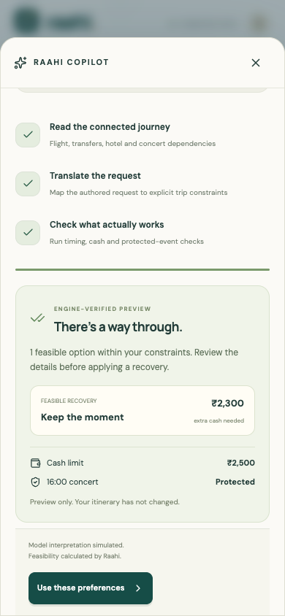
A conversational copilot,
with an engine behind it
“Keep my 4 PM concert
and stay under ₹2,500.”
The demo maps this request to an explicit
budget and protected event.
The engine validates the options.
The traveler confirms the preferences.
AI interpretation is simulated. Feasibility calculations are real.
RAAHI
07
Notes:
The copilot demonstrates how natural-language recovery could feel. Today it uses three clearly labeled authored requests and an animated walkthrough. The costs and feasibility come from the real engine. Previewing does not change the itinerary. The traveler confirms preferences, then separately reviews and applies a recovery. A future model adapter could replace interpretation while leaving validation intact.
Evidence / source: https://github.com/ParmiGohil/Raahi/tree/main/src/components/copilot.tsx, src/demo/copilot.ts and src/domain/requests.ts. No LLM or supplier API call occurs. Screenshot from the working prototype.

Slide 8
A clear boundary between advice and action
01
Interpret
Authored demo requests map to structured preferences.
02
Validate
Pure TypeScript checks time, location, cash and availability.
03
Review
The API regenerates the plan and checks its signed review.
04
Apply
Confirmation saves the itinerary. Supplier actions stay simulated.
Next.js + React UI Zod command validation Independent recovery engine
RAAHI
08
Notes:
We keep interpretation separate from decisions and execution. The user interface sends validated commands. The independent engine calculates complete routes and exact ledgers. The server regenerates the selected plan before application and uses signed reviews with revision and retry checks. Local sessions persist to disk. The prepared Vercel mode uses encrypted browser cookies for an isolated demo, not collaborative production storage.
Evidence / source: https://github.com/ParmiGohil/Raahi/tree/main/src/app/api/trip/route.ts, src/repositories/trip.ts, src/repositories/browser-session.ts, docs/HOSTING.md and package.json. Vercel publication is pending.

Slide 9
Ready for the prototype round
3
COMPLETE RECOVERY LOOP
Dependency impacts and risk warnings
Recovery comparison and cost review
Saved itinerary after confirmation
disruption scenarios
Flight delay
Concert cancellation
Combined disruption
NEXT INTEGRATIONS
Live inventory and policy evidence
Model interpretation and supplier execution
13 tests passed. Production build and mobile recovery flow verified.
RAAHI
09
Notes:
The working prototype covers the end-to-end recovery loop and three disruption scenarios. Thirteen focused tests pass, as does the production build. We also verified the mobile confirmation, review, application and refresh flow. We are explicit about the boundary: inventory and policies are fixtures, and model interpretation and supplier execution are simulated. Live provider evidence is the next integration step.
Evidence / source: https://github.com/ParmiGohil/Raahi/tree/main/docs/VERIFICATION.md and CURRENT_STATUS.md. These are engineering checks, not user adoption, benchmark performance or production readiness metrics. Public deployment remains pending.

Slide 10
Raahi
A way forward
for the whole trip
Next round: a complete recovery, live
Change the disruption or budget.
Watch the engine adapt, then save the plan.
github.com/ParmiGohil/Raahi
Notes:
In the prototype round, you can change the disruption, protect the original concert or tighten the cash limit, and see the engine adapt. We will take the selected route through review, application and refresh. Raahi brings the entire trip into the recovery decision, while keeping the traveler in control.
Evidence / source: https://github.com/ParmiGohil/Raahi/tree/main; decorative background reuses the original generated project artwork.

