Slide 1
CySecBERT: A Domain-Adapted Language Model for the Cybersecurity Domain
SUBMITTED BY: Name: Parom Guha Neogi
ID: 20101562
Group: 18
Student Tutor: EHSANUR RAHMAN RHYTHM
Research Assistant: Md. Sabbir Hossain
1
Notes:
s

Slide 2
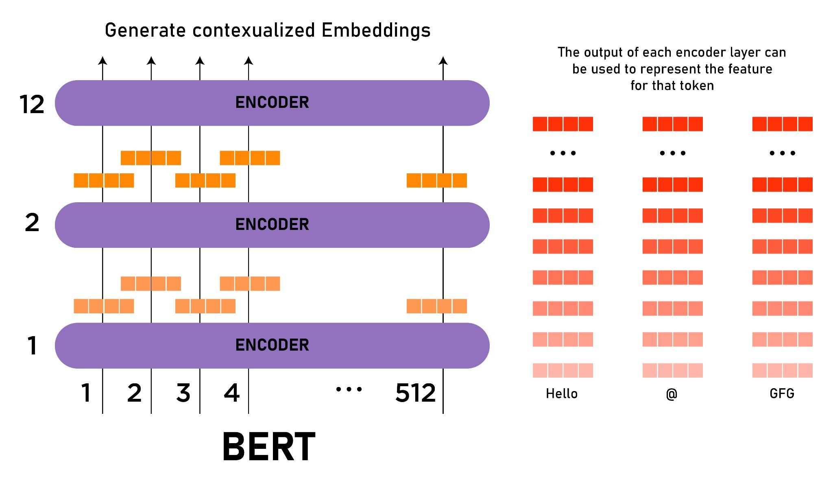
INTRODUCTION:
Analyzing cybersecurity attacks manually is a time consuming process and here comes the introduction of Natural Language Processing(NLP) where the information is extracted from the dataset.
BERT has already been applied to a variety of fields, giving rise to domain-specific models like BioBERT, SciBERT, and even certain fields in the cybersecurity field, giving rise to models like MalBERT or CatBERT.
2

Slide 3
Research Problems:
Using models for tasks outside their area of expertise hinders their full potential.
Models try to cover a broad range of domains, leading to the loss of specialized domain knowledge due to capacity issues or omissions in training data.
Normal-sized models may not be able to recognize words with diverse meanings in different domains.
Domain-specific phrases, such as new vulnerability names, may not be recognized by models if they have never encountered them before.
3

Slide 4
Research objective:
Models can be trained on domain-specific data to gain specialized knowledge and produce better results in that area.
A word embedding approach based on BERT is being used to assess cybersecurity documents.
The goal is to create a model suitable for real-world cybersecurity use cases and as a basis for future research.
The approach aims to improve model performance by achieving higher accuracy on downstream tasks and shorter training times with fewer datasets required.
4

Slide 5
Methodology
A model is pre-trained on a carefully selected cybersecurity corpus, consisting of various datasets such as scholarly articles, tweets, websites, and the national vulnerability database.
The training is performed on the Lichtenberg Cluster, and the final pre-trained model is based on BERT-base-uncased using the masked language modelling (MLM) goal.
The quality of the text corpus is crucial, and several sub-corpora were used to create it.
Cosine similarity cannot be used to score words encoded with BERT since BERT is context-dependent.
A novel word similarity evaluation approach is used, which involves a cloze challenge where the model fills in a masked word in a phrase to answer the similarity question.
This approach is similar to studies on zero-shot learning.
5

Slide 6
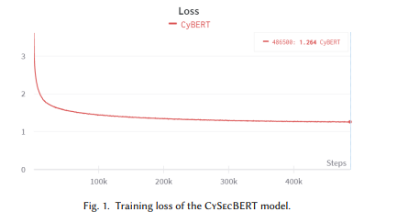
Result
The cybersecurity-specific model was trained with a learning rate of 2 × 10^−5 for 30 epochs on a dataset that is 10% the size of the original BERT dataset.
The model was trained using four Nvidia Tesla V100 GPUs, with a batch size of 64, weight decay of 0.01, dropout rate of 0.1, and ADAM optimization method.
The model followed the original BERT work for the remaining hyperparameters, including 10,000 warm-up steps.
6

Slide 7
Conclusion
CySecBERT outperforms Ranade et al's cybersecurity model with consistent gains
The model shows the greatest improvement after establishing nine clusters
CySecBERT has a higher word similarity score than BERT
The model accurately represents cybersecurity terms and data
CySecBERT is better suited for downstream machine learning tasks
CVSS NER software version software names attack complexities
BERT 0.9247 (0.0064) 0.8837 (0.0037) 0.3323 (0.0135)
Ranade’s model 0.9298 (0.0019) 0.8834 (0.0029) 0.3336 (0.0214)
CySecBERT 0.9302 (0.0066) 0.8871 (0.0025) 0.3472 (0.0116)
7

Slide 8


