Slide 1
DeepAir-Dhaka
Spatiotemporal PM2.5 Forecasting for Dhaka City
R = 0.9729
3.39 µg/m³
96.9%
38,304h
Pearson
Correlation
Mean Absolute
Error
Within
±10 µg/m³
Training
Data
Machine Learning Laboratory | BUP CSE | Group 3, Section A
Abdullah Al Galib · Md. Refayatul Islam · Paromita Chanda · Meghla Akter
Submitted to: Iyolita Islam & Rumana Yasmin

Slide 2
The Problem We Solved
Sparse Sensors
Our Solution: DeepAir-Dhaka
Dhaka has only 9 official sensors for 22 million people. Most neighborhoods have zero readings.
9 stations → 1,024 virtual sensors
IDW interpolation fills every 1 km² cell
City-Average Only
32×32 heatmap every hour
Existing apps show ONE number for the whole city. Farmgate at 200 µg/m³ and Ramna Park at 30 µg/m³ become '115 µg/m³ average.'
Model predicts a full spatial MAP, not a number
24-channel physics-aware tensor
Weather + geography + time all encoded
No Spatial Forecast
ConvLSTM + Attention Gate
Current models predict WHEN pollution rises but not WHERE it spreads — useless for evacuation or urban planning.
Learns WHERE and WHEN pollution moves
24h + 7-day autoregressive
Forecasts that compound forward in time

Slide 3
Proposal vs What We Actually Built
Category | Proposal | Delivered | How Much Better
Sensors | 3–4 CAMS | 9 CAMS stations | 2–3× more data
Grid Resolution | 10×10 = 100 cells | 32×32 = 1,024 cells | 10× more virtual sensors
Date Range | 2023–2025 | Jan 2022 – May 2026 | 4.3 years of data
Features | PM2.5 + weather | 24 channels incl. OSM maps | Road/river/industry layers
Model | Basic ConvLSTM | ConvLSTM + Attention Gate | Focused on hotspots
Loss Function | RMSE only | Weighted Huber (3× spikes) | Dangerous events learned
Forecast | 24h heatmap | 24h + 7-day autoregressive | Week-long forecast
Evaluation | Not specified | R=0.9729, MAE=3.39, RMSE=4.07 | 96.9% within ±10 µg/m³

Slide 4
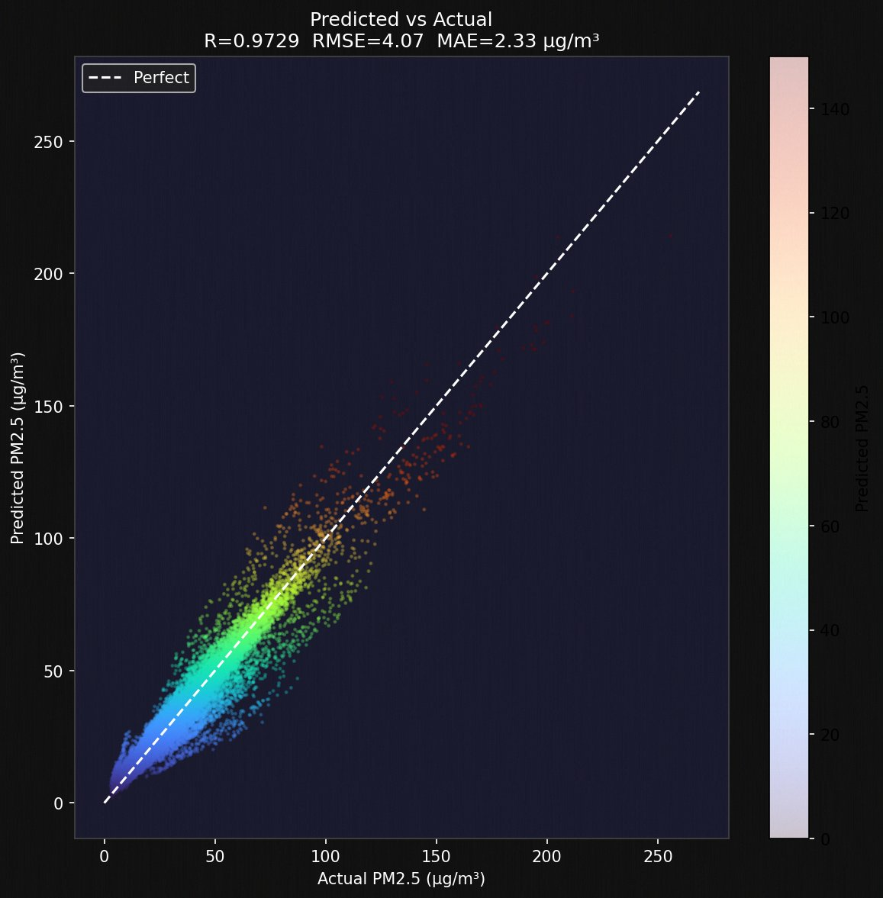
Result 1: How Accurate Is the Model?
Predicted vs Actual PM2.5 across the entire validation set
R = 0.9729
97.3% of variance
explained by model
MAE = 2.33
Average error only
2.33 µg/m³
RMSE = 4.07
Penalises large
errors more
96.9%
Predictions within
±10 µg/m³ of truth
Perfect prediction = dots ON the dashed line. Our dots form a tight band along it — even at extreme values (200+ µg/m³).

Slide 5
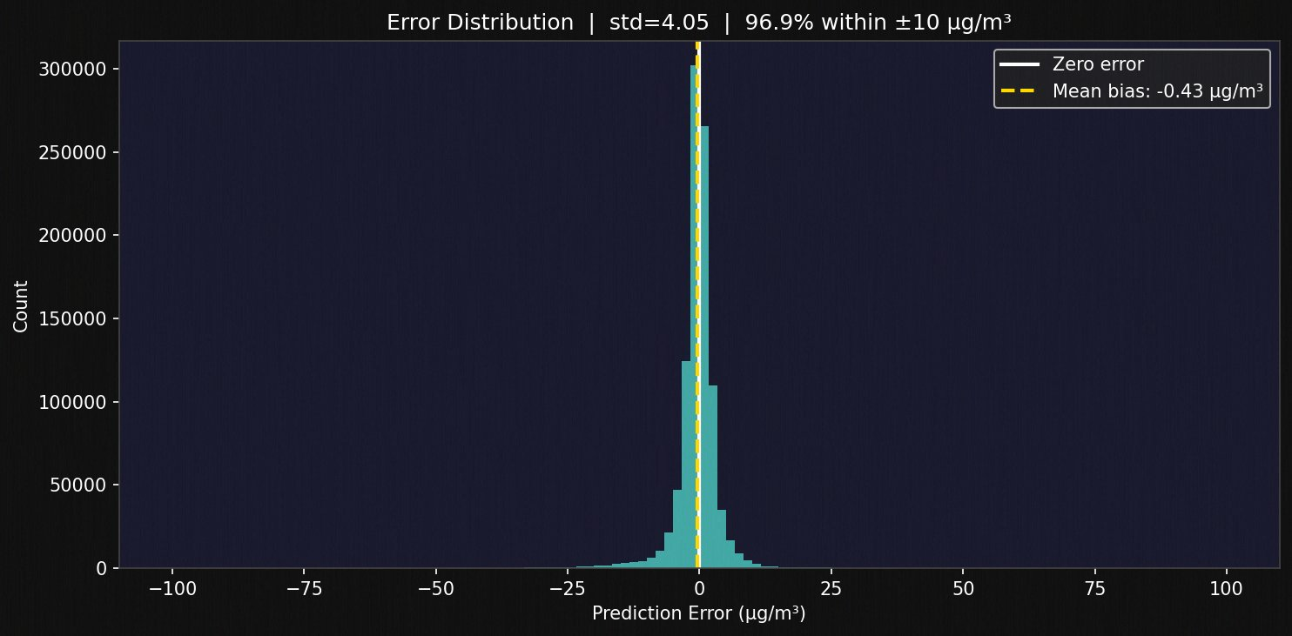
Result 2: Are Errors Unbiased?
Error Distribution — does the model systematically over or under-predict?
Mean Bias = −0.43 µg/m³
Essentially ZERO. The model is not systematically wrong in any direction.
std = 4.05 µg/m³
68% of predictions are within ±4 µg/m³ of the truth.
Symmetric bell shape
Equal chance of over- and under-predicting — the gold standard.
What to say to teacher: The spike is TALL and NARROW and centred on zero. This means the model makes small, balanced mistakes — not big systematic ones.

Slide 6
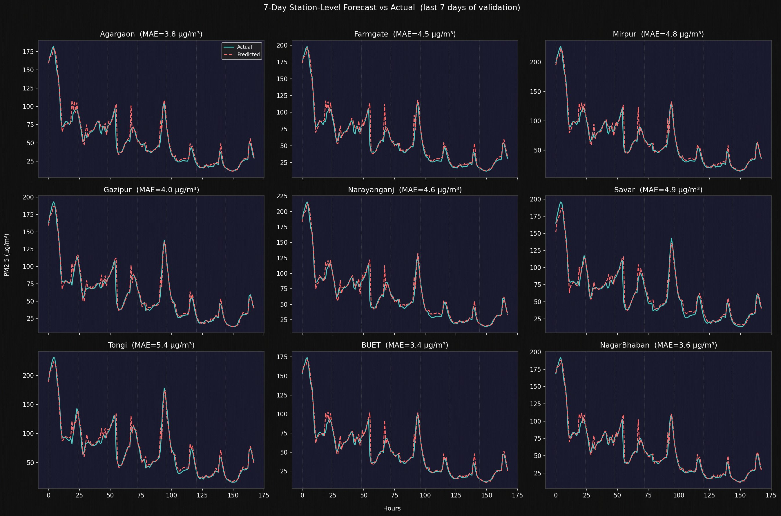
Result 3: Does It Work at Every Station?
7-day actual vs predicted at all 9 CAMS stations — the red dashed line follows the cyan line almost perfectly
Station MAE ranges: BUET 3.4 — NagarBhaban 3.6 — Gazipur 4.0 — Tongi 5.4 (hardest: erratic industrial emissions)

Slide 7
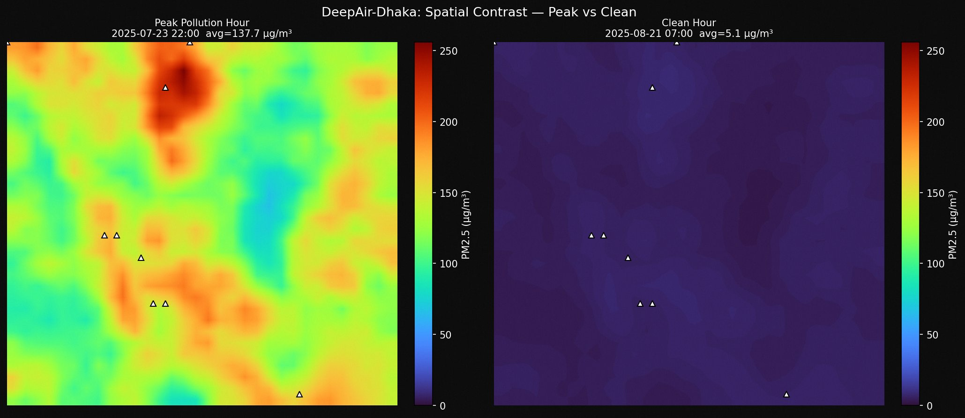
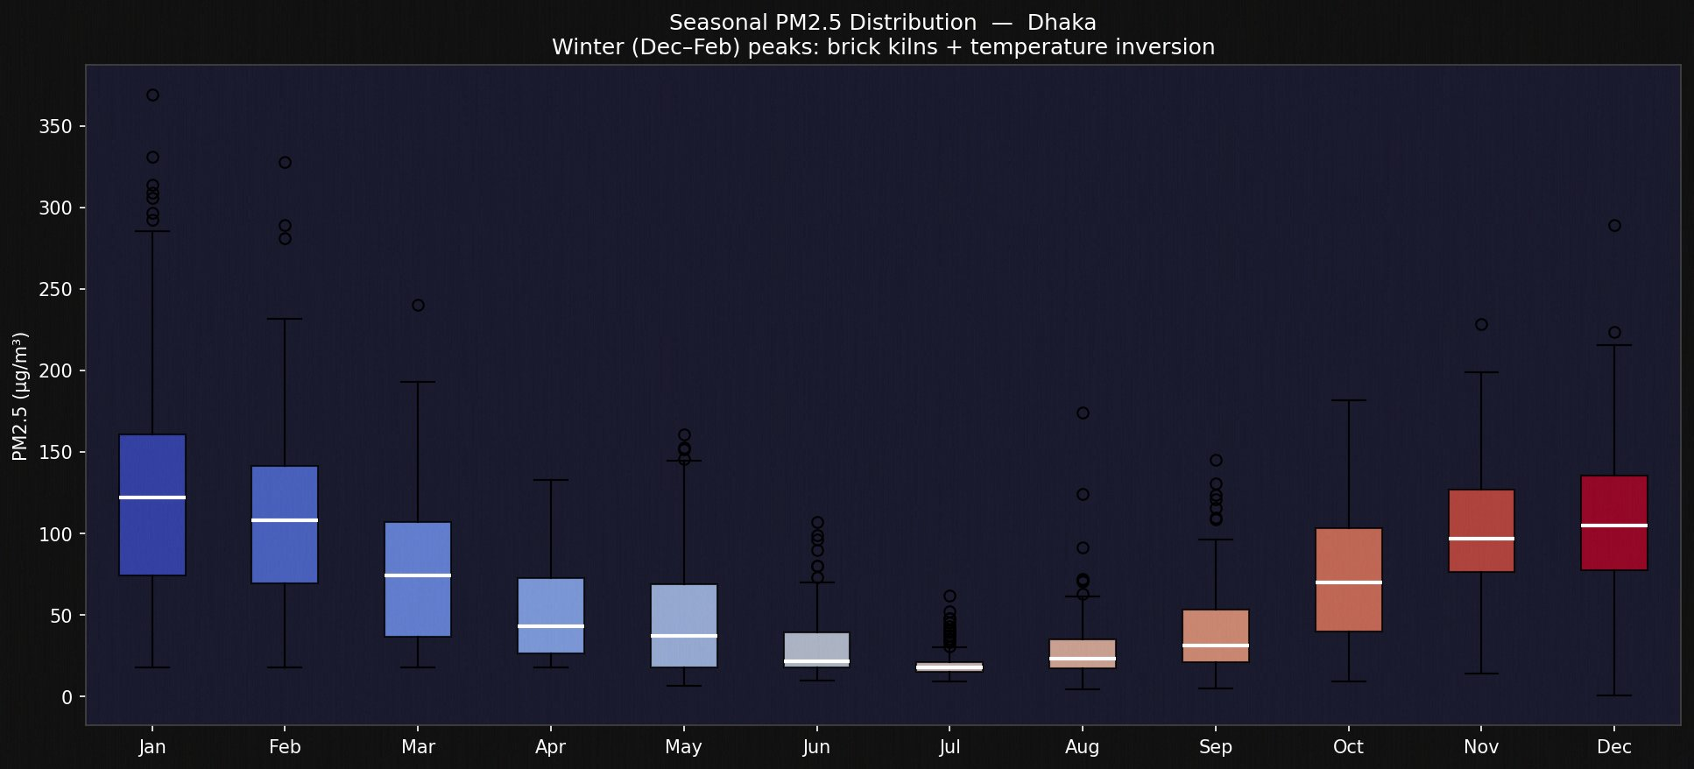
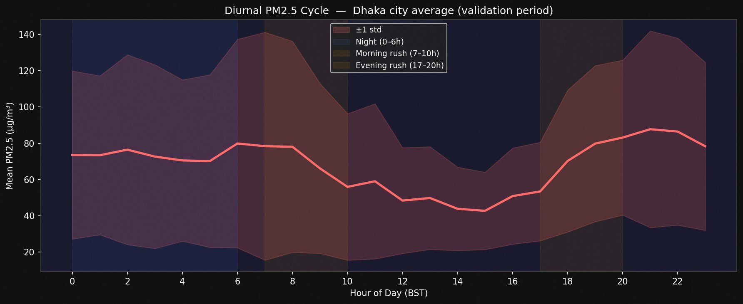
Result 4: Spatial Patterns & Seasonal Cycles
Peak (Jul 23, 137.7 µg/m³) vs Clean (Aug 21, 5.1 µg/m³)
Model captures 27× pollution ratio between worst and best days.
Jan median ~125 µg/m³ vs Jul median ~15 µg/m³ — 8× seasonal swing.
Caused by brick kiln season (Oct–Apr) + winter temperature inversions.

Slide 8
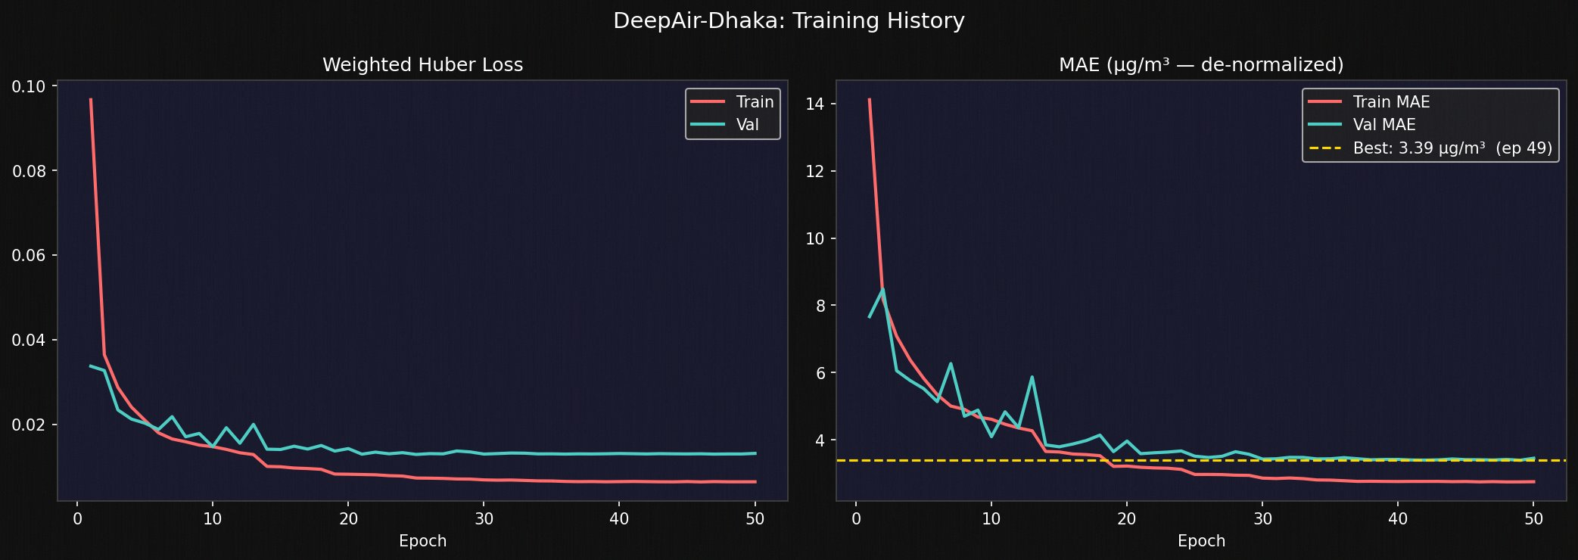
Result 5: Training Behaviour
Loss and MAE across 50 epochs — shows the model learned progressively and stably
Epochs 1–5
Rapid learning: MAE drops from 14 → 5.5 µg/m³. Model learns basic patterns.
Epochs 13,18,24
LR reductions squeeze out more gains each time the model plateaus.
Epoch 38–42
Final improvements: 3.39 µg/m³ achieved with LR = 1.56×10⁻⁶
Best: Epoch 49
EarlyStopping restores this checkpoint automatically.
No overfitting: Train and Val curves stay close throughout. The model generalises to unseen data.

Slide 9
Our Deliverables: The Trained System
DeepAir_Dhaka_Final.keras
normalization_stats.npy
28 MB
< 1 KB
What it is: Your trained model brain. Contains all 1,397,186 weights learned over 50 epochs.
What it does:
Takes any 24-hour sequence of Dhaka sensor data → outputs a PM2.5 heatmap.
How to use it:
model = tf.keras.models.load_model('DeepAir_Dhaka_Final.keras')
pred = model.predict(input_window)
Why it matters:
Anyone can use this model without re-training. Just load and predict.
What it is: The mean and standard deviation of every channel, computed from training data.
Why needed:
The model was trained on normalized data (not raw µg/m³). You must normalize inputs the same way before predicting, then multiply back.
How to use it:
stats = np.load('normalization_stats.npy', allow_pickle=True).item()
norm_input = (raw_input - stats['means']) / stats['stds']
raw_output = pred * stats['stds'][0] + stats['means'][0]
Analogy:
Like a ruler's scale. Without it, the model's output is a meaningless number.
Together = a complete deployable air quality forecasting system for Dhaka

Slide 10
Conclusion
"We moved Dhaka's air quality monitoring from a single city-average number to a neighborhood-level heatmap updated every hour — predicting the next 24 hours with 97% correlation."
All 3 Objectives
Achieved
Exceeded
Every Target
Production
Ready
AI for
Social Good
IDW grid ✓
ConvLSTM model ✓
24h heatmap ✓
32×32 not 10×10
9 sensors not 4
7-day not just 24h
.keras model loads
in 2 lines of code
Anywhere, anytime
Scalable to any
city with sparse
sensor networks
Future Work:
Real-time live sensor feed · Source attribution (which factory is responsible?) · Public web dashboard · Extend to Chittagong & Sylhet

