Slide 1
RECOMMENDATION SYSTEM USING NLP AND NN ON AMAZON PRODUCT REVIEWS ROOPASREE KUNJAR
THANKS TO MY SPRINGBOARD MENTOR
David Lara Arango

Slide 2
CONTEXT AND PROBLEM STATEMENT
When we see a list of movies, we like, suggested on Netflix, when our favorite apps show us all the products we like and would love to purchase, when YouTube shows you a list of videos to watch next, you wonder is it magic that these apps or websites read you so well.
All the e-commerce websites use recommendation system to better their services and customer satisfaction.
Recommendation systems can be made more effective if we could analyze the sentiment behind the review given by the customer for the product, and not just the ratings.
I propose to develop a recommendation system using sentiment analysis score to recommend products.

Slide 3
WHO BENEFITS?
The e-commerce websites which has rating and review writing system for customer reviews for their products.

Slide 4
DATA SOURCE
Amazon Review Data (2018) https://nijianmo.github.io/amazon/index.html#sample-review
Since the data is large, I will be planning to use review data, where a product has 5 or more reviews ("Small" subsets for experimentation – 5-core).
There are two datasets to consider, one is the review and ratings information for a product by a customer, with primary key as the product ID.
The product details is present in a meta dataset with the primary key of product ID and other product details. We will be merging these two datasets for the project.

Slide 5
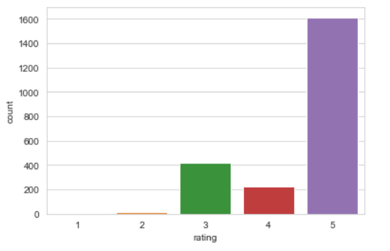
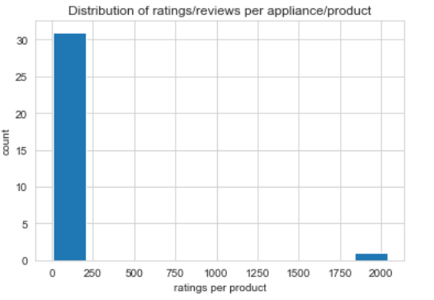
There are hardly 1- and 2-star ratings and 5 start rating make more than half the number of ratings given by the customer for amazon appliances.
Looks like only one product has got more than 1750 number of ratings and other products have got between 0-250 number of ratings.

Slide 6
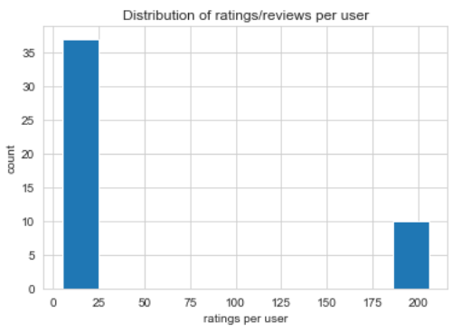
Around 10 users have given more than 185 number of ratings. The rest of the users have given between 0-25 ratings.

Slide 7
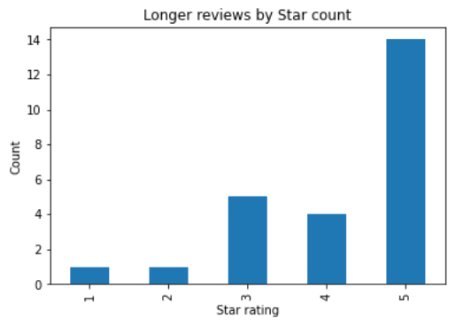
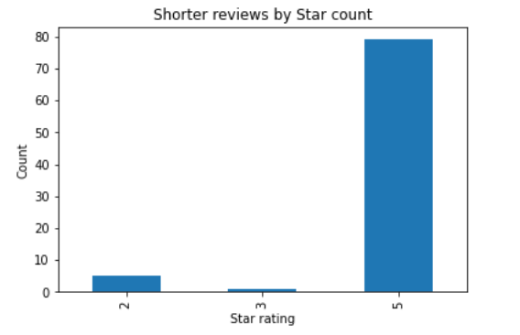
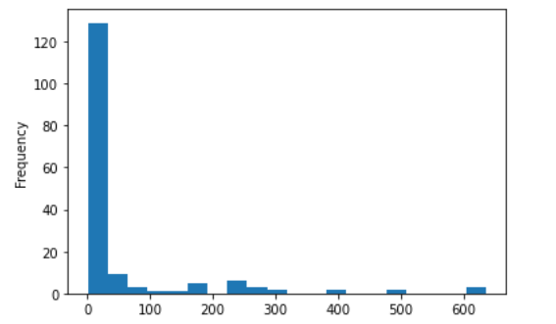
The above graph shows that the most of the reviews are at < 50-word count. The 5-star rating being highest in both shorter and longer reviews, has a large count with less words in the review text.

Slide 8
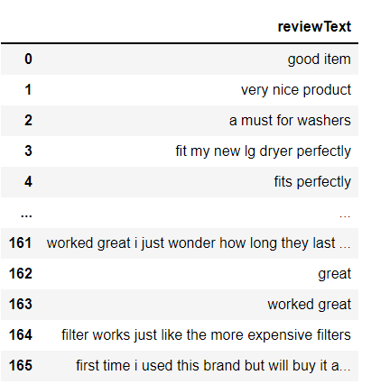
The review text is used in sentiment analysis and hence requires cleaning. I converted text to lowercase, removed text in square brackets, removed punctuation and removed words containing numbers and new line character in text.

Slide 9
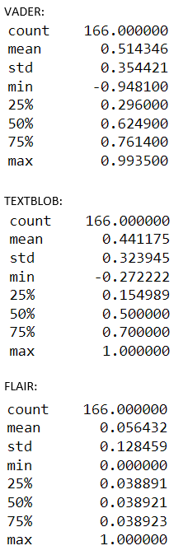
SENTIMENT ANALYSIS
The Vader, TextBlob and Flair scores when compared with the ratings, the Vader and TextBlob sentiment analysis looks pretty decent compared to flair sentiment analysis. The range of sentiment score for flair is large. The former 2 packages look more promising.
I used TextBlob and Vader score for recommendation model training.

Slide 10
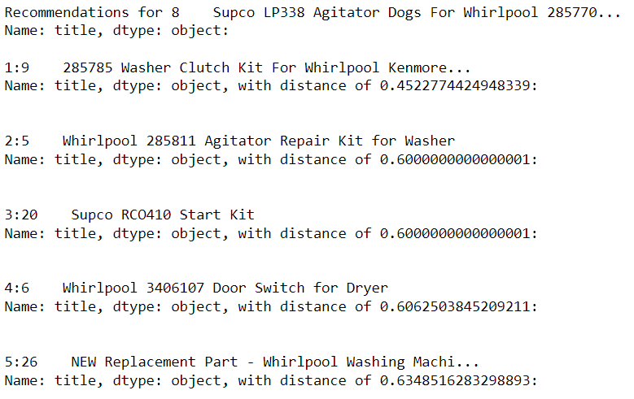
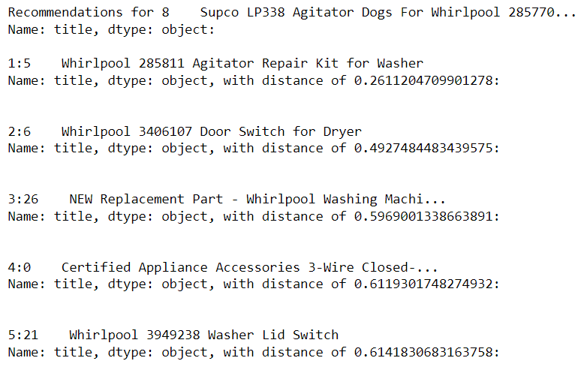
MACHINE LEARNING MODEL TAINING AND PREDICTION
The recommendations using the KNN looks good. We can see that the product recommendations have been given from the company mostly (Whirlpool).
The topmost predictions was with the customer ratings and the bottom one with TextBlob polarity score. Both looks pretty good in recommending similar products.

Slide 11
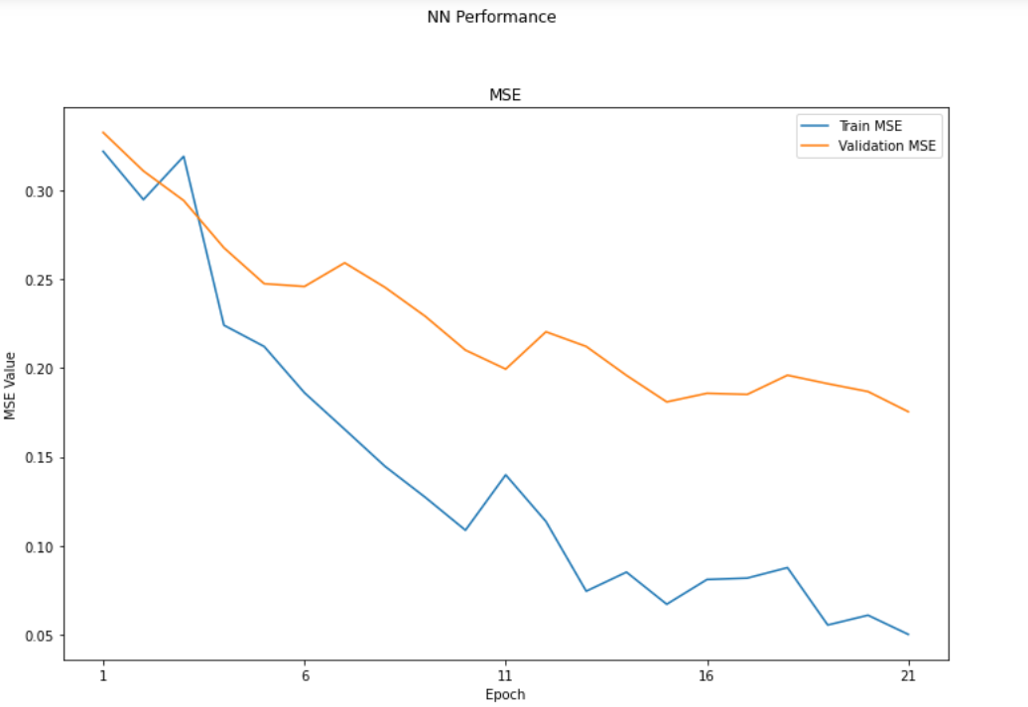
MATRIX FACTORIZATION AND NEURAL NETWORK
MODEL | MSE for Vader polarity and predicted rating | MSE for TextBlob compound and predicted rating
MATRIX FACTORIZATION | 0.33886 | 0.28554
NEURAL NETWORK |  | 0.08104
The short model with 3 layers, gives us a better MSE compared to baseline model with 5 dense layers for neural network model. This can also be seen in the above NN performance graph. The base line model seemed to overfit even when dropout layers were added. Also, when compared to Matrix factorization, the MSE for Neural network model is small.
KNN and NN model can be used to predict the recommendation of products.

Slide 12
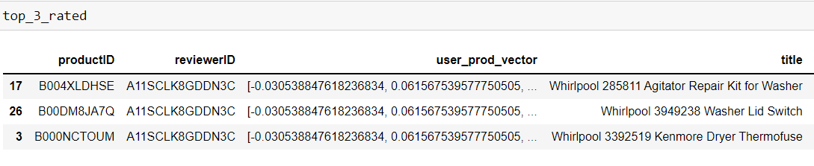
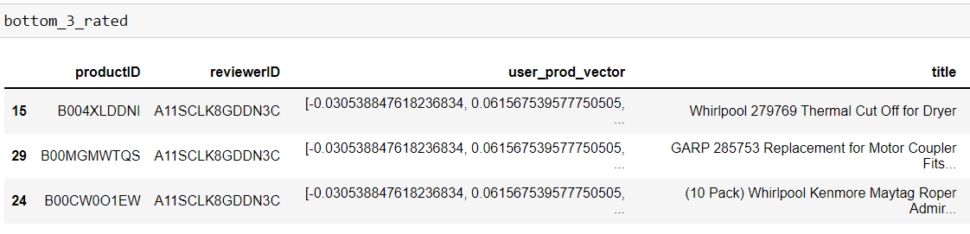
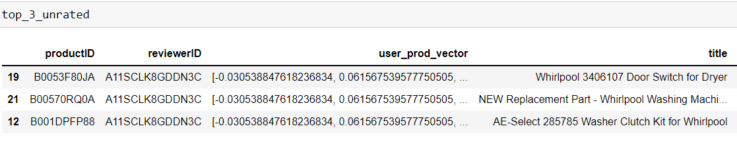
PREDICTIONS OF NN MODEL
The top 3 rated gives the highest 3 ratings given by the reviewer “mrclobhead”, bottom 3 rated is the lowest 3 ratings given and the top 3 unrated are the recommendations.
Looks like the model has done pretty well with the predictions.

Slide 13
LEARNINGS AND FUTURE WORK
The neural network model would work better with big data. Even adding a dropout layer, did not let us recommend products perfectly. I would like to work with a bigger amazon review dataset.
The review text is a combination of satisfaction with the product, deliver, condition of the product. I would like to see these impact on the ratings given for the product.

