Slide 1
IMPACT OF COVID- 19 CASES ON HOUSING PRICES IN TOP 5 STATES IN THE USA
Roopasree Kunjar
THANKS TO my SPRINGBOARD MENTORS
David Lara Arango
Ken Cavagnolo

Slide 2
CONTEXT AND PROBLEM STATEMENT
As the COVID-19 hit the USA during mid-March 2020 heavily, there was a widespread fear of another recession. This project focuses on analyzing the relationship between the COVID-19 and the housing market.
The main focus is to:
Visualize if the number of covid-19 cases in a particular area have an effect on the housing prices.
Later a model can be developed to predict the future median housing price.
The idea is to concentrate more on the top real estate market states in the USA: California, Colorado, Texas, Virginia, Washington.

Slide 3
WHO BENEFITS?
Helps people to plan to buy house
Allows investors to learn about the trend of the prices in a certain location.

Slide 4
DATA SOURCE
The data is collected from the following sources:
COVID Data - https://www.kaggle.com/antgoldbloom/covid19-data-from-john-hopkins-university?select=RAW_us_confirmed_cases.csv
Housing Data - list and sale prices from https://www.zillow.com/research/data/
Since COVID data is aggregated by Counties and the Housing data is aggregated by Metro area, city and county mapping data is required. This is collected from https://simplemaps.com/data/us-cities
Interest rates from: https://fred.stlouisfed.org/series/MORTGAGE30US

Slide 5
DATA Information
Covid data : drop all columns and keep date, covid case numbers, county and state Id. Convert wide date format to long format to include covid cases as a single feature and filter out only end of month covid cases.
Housing data : Drop all columns and keep state, region, date and housing price. Convert wide date format to long format to include housing data as a single feature.
County data : Use county and state data to join the above 2 data.
Interest rate data : Annual state-wise interest rates are only present. Hence save it accordingly across the 5 selected US states.

Slide 6
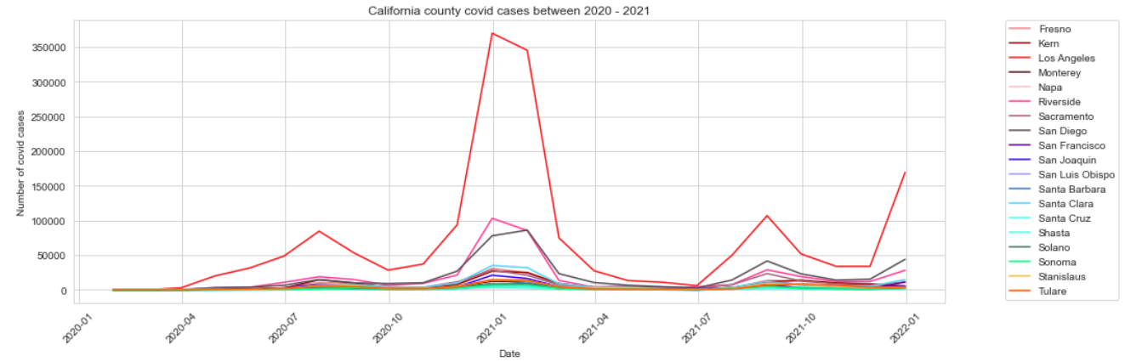
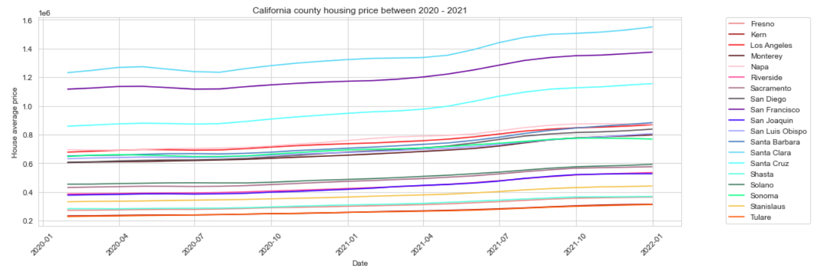
EDA: STATE-COUNTY COVID CASES FOR 2000 AND 2021 COMPARED TO STATE -COUNTY HOUSING PRICES DURING COVID-19 PANDEMIC for California
Clearly there seems to be no much correlation between them. The number of recorded covid cases did not have any kind of impact on buying houses. In fact, around this time, the rate of increase in the housing prices has increased steadily. Same applies for other 4 states.

Slide 7
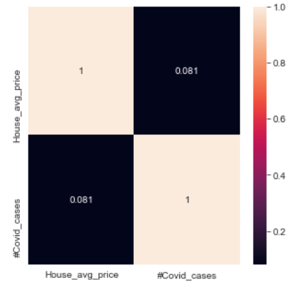
EDA: STATE-COUNTY COVID CASES FOR 2000 AND 2021 COMPARED TO STATE -COUNTY HOUSING PRICES DURING COVID-19 PANDEMIC for California
This Pearson's correlation map also shows that there is no drastic correlation between housing prices and # covid cases.

Slide 8
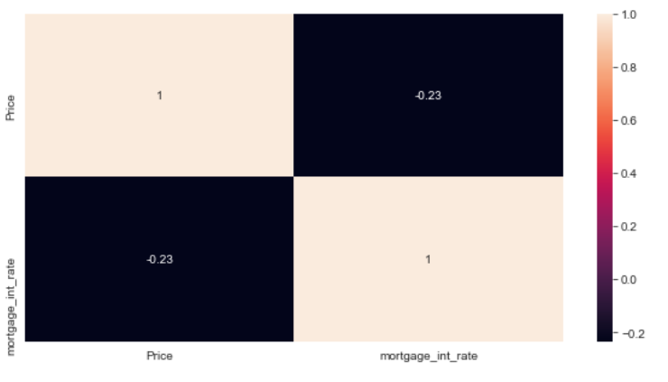
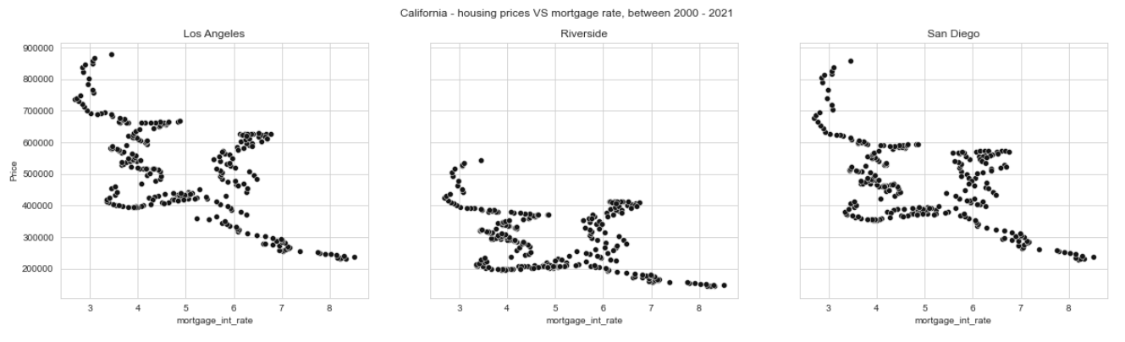
EDA: STATE-COUNTY housing prices FOR 2000 AND 2021 COMPARED TO STATE -COUNTY interest rates DURING COVID-19 PANDEMIC for California
The correlation between interest rates and housing price is negative, but there is a small correlation. For random 3 California counties in each state below, we can conclude that there is not so strong but a small negative correlation. The same results were seen for other state counties.

Slide 9
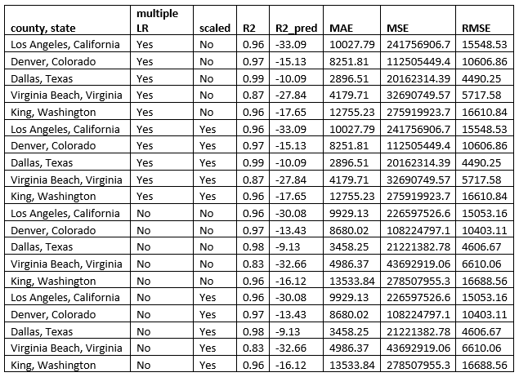
Machine learning : Linear regression
Since covid cases do not seem to impact housing price data, we only use interest rates and date as the feature to train the model and predict housing prices.
The R2 score is good for training data but model performs really bad in prediction. If we consider more features we might be able to improve the R2 score. We could also try other non-linear models like Random Forest.

Slide 10
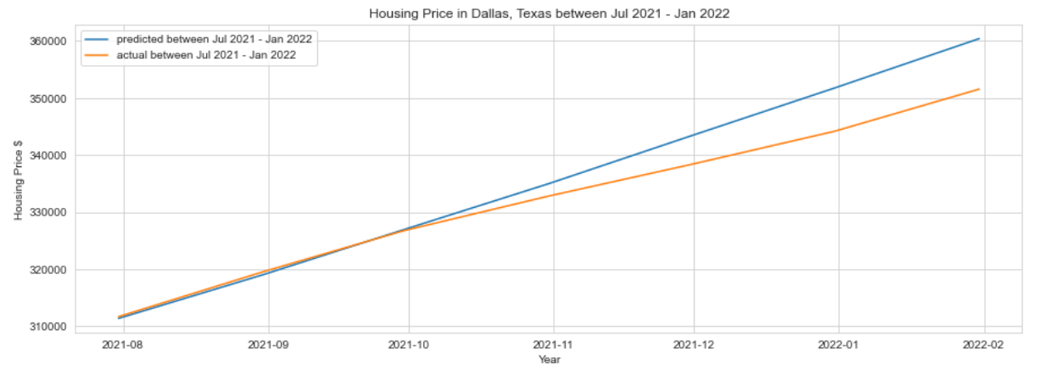
Machine learning : Time series – Dallas, texas
The prediction R2 score is 0.93 for Dallas, Texas. Time series model predicts pretty well for Dallas, Texas data.
The time series model seems to work okay for Dallas, Texas. We can try this model for all states.

Slide 11
Thank you!
The project details, data, report can be accessed through the GitHub repository:
https://github.com/Paroo2422/COVID-19-impact-on-Housing-Market

