Slide 1
Big Mountain Resort – Ticket Pricing Strategy
Roopasree Kunjar

Slide 2
Introduction
Big Mountain Resort - ski resort located in Montana.
Offers views of Glacier National Park and Flathead National Forest.
Facilities and features - 105 trails, 11 lifts, 2 T-bars, 1 magic carpet, base elevation is 4,464 ft, summit is 6,817 ft with a vertical drop of 2,353 ft.
Number of people skiing or snowboarding Over the season - 350,000.

Slide 3
Problem identification
Following are the business proposal required to be addressed:
Installation of an additional chair lift increased operating costs by $1,540,000 this season. Best way to develop ticket pricing strategy to compensate the above cost.
How best to capitalize on resort’s facilities without undermining the ticket price or support a higher ticket price for this season.
Check for any dependency of other resorts in the market segment in developing pricing strategy.

Slide 4
Recommendation and key findings
Two of the Business option best answered the Ticket pricing problem.
Scenario 1 : Closing 1 run will not impact the ticket price much, but closing any further runs will add loss in the ticket price and hence the revenue.
Scenario 2: Increase the vertical drop - 150 feet lower down and installation of 1 chair lift increases the ticket price by $1.99 and revenue generated is $3,474,638.
Best solution would be to go with scenario 2. Scenario 1 can also be considered with caution.

Slide 5
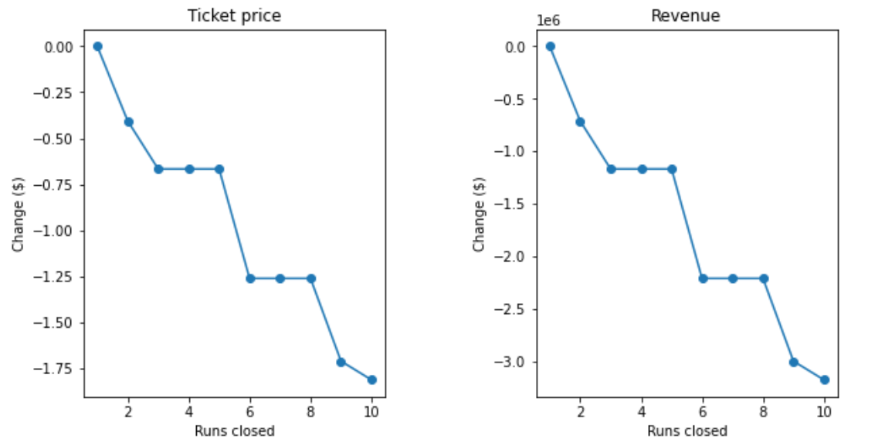
Modeling results and analysis
1. Ticket price generated by the model – 95.87 $ and actual price – 81 $.
Model may be lacking some data like operating cost. Hence the vast difference in the price.
2. Scenario 1: Permanently closing down up to 10 of the least used runs.
Closing 1 run will not impact the ticket price much, but closing any further runs will add loss in the ticket price and hence the revenue.

Slide 6
Modeling results and analysis
3. Scenario 2: Increase the vertical drop - 150 feet lower down and installation of 1 chair lift
Increases the ticket price by $1.99 and revenue generated is $3,474,638.
4. Scenario 3: Same as Scenario 2 but adding 2 acres of snow making cover.
The output is same as Scenario 2. Therefore no point adding extra 2 acres.
5. Scenario 4: Increase the longest run by 0.2 mile by adding snow making coverage of 4 acres.
No changes in the ticket pricing or revenue generated.

Slide 7
Summary and conclusion
Best model for pricing strategy is the Random forest model.
Predicted ticket price for Big Mountain resort was almost 15 dollars higher than the actual price of their tickets, may mean that resorts are mispricing or missing some data, like operational costs of the resorts.
Scope of improvement: creating more user friendly model function, which lets the business to test any new combination of features in future scenarios.
As per the potential business scenarios provided, increasing vertical drop by 150 feet by adding a run and adding a chair lift and by increasing the ticket price to around 2 dollars, helps increase the revenue of the resort by a little over 1.9 million dollars for the season.

