Slide 1

Movie Insights Revenue Dashboard Project
An advanced Power BI implementation focused on transforming raw cinematic datasets into actionable financial intelligence.

Slide 2

Project Overview
Abstract
The Objective
The Approach
Develop a robust Power BI dashboard to analyze global movie revenue, cost structures, and overall profitability across decades of cinematic history.
Utilizing advanced ETL (Extract, Transform, Load) processes to clean raw, inconsistent movie data and generate high-fidelity visualizations.
The Outcome
Empowering industry stakeholders with data-driven evidence to optimize movie investments and mitigate financial risks in production.

Slide 3

Introduction
The movie industry generates billions in revenue annually, but understanding the underlying drivers of success requires a deep dive into complex datasets.
Comprehensive Dataset: Includes titles, release dates, budgets, genres, directors, and cast members.
Industry Importance: Identifying ROI trends and genre-specific performance is critical for studio survival.
Technology Stack: Leveraging Power BI’s powerful engine for data cleaning, modeling, and interactive storytelling.

Slide 4





Problem Statement
Raw data is rarely "analysis-ready." This project addresses the significant hurdles found in unrefined cinematic databases.
Data Inconsistency
Raw files contain mismatched naming conventions, missing financial values, and duplicate entries that skew ROI calculations.
Reliability Gap
Without thorough data preparation, extracting reliable insights is impossible, leading to flawed investment strategies.
Visual Stagnation
Static reports fail to capture the dynamic nature of genre performance and seasonal trends over time.

Slide 5



Literature Survey
Existing research underscores the necessity of sophisticated ETL processes in Power BI.
Emalumhe (2023)
Rajesh-DataAnalyst (2025)
iqbal1526 (2024)
Focused on cleaning techniques, specifically extracting consistent movie titles from Wikipedia URLs using string manipulation.
Analyzed 40 years of box office trends, highlighting the critical role of profitability ratios in determining studio success.
Correlated IMDB ratings with runtime and revenue, proving that audience sentiment is a key financial indicator.

Slide 6




Proposed Methodology
Our systematic approach ensures data integrity from raw ingestion to the final dashboard.
1. Data Cleaning
Standardizing URLs into clean titles and handling null financial values.
2. Transformation
Creating DAX measures for ROI and categorizing complex genres.
3. Development
Designing interactive slicers for years, directors, and genres.

Slide 7
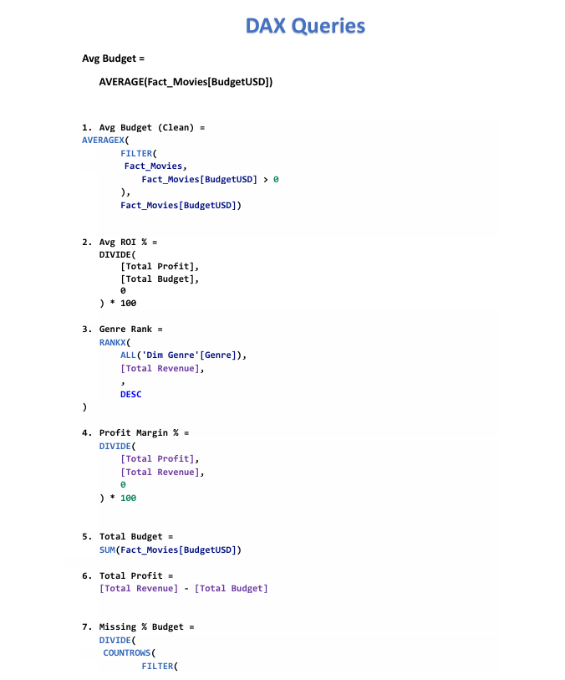

DAX Queries

Slide 8
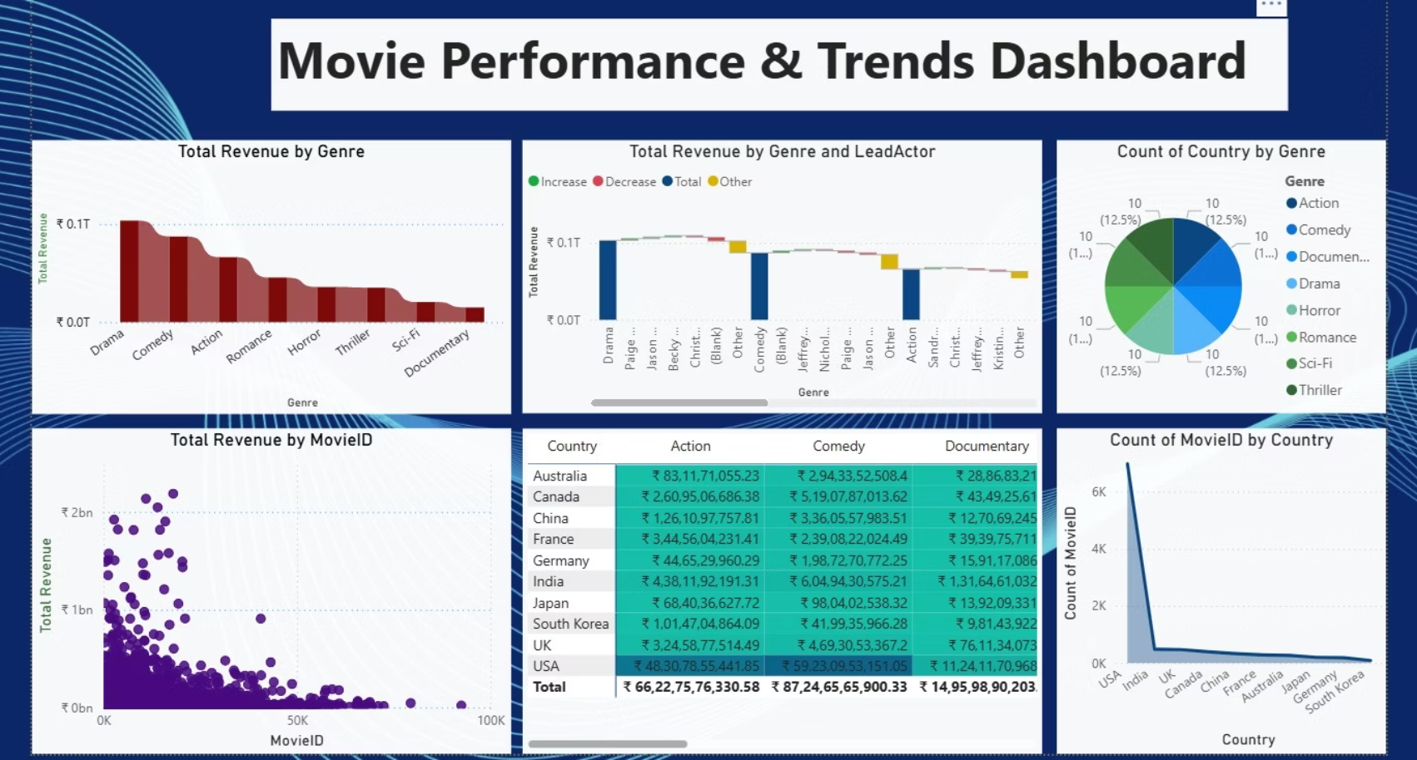
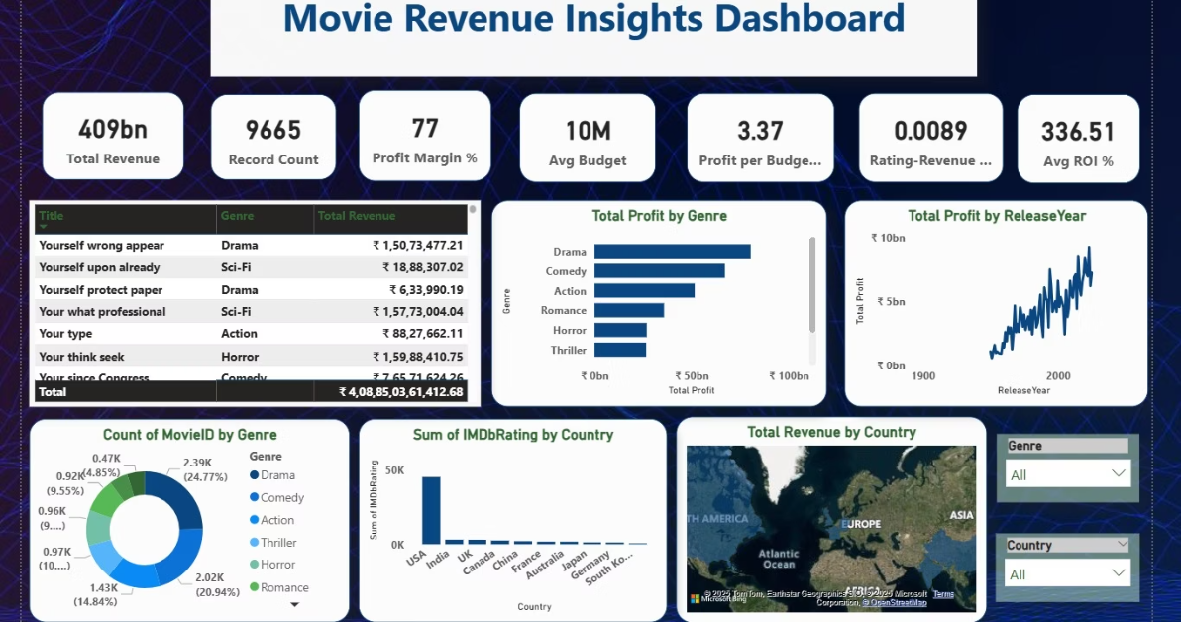
Results & Key Insights
Findings Summary
Strong Overall Performance:₹409B total revenue from 9,665 movies with an average ROI of 336% and 77% profit margin, showing high industry profitability.
Top-Performing Genres:Drama leads in revenue and profit, followed by Comedy and Action. Sci-Fi and Documentary contribute the least, indicating niche demand.
Market Leaders by Country:USA dominates in revenue, movie count, and ratings contribution, while India ranks second, excelling in Comedy and Drama.
Growth Over Time:Movie profits show a steady upward trend, especially after the 1990s, reflecting industry expansion and increasing demand.
Key Revenue Drivers:Genre selection and lead actors strongly influence revenue, while IMDb ratings have minimal impact on box-office success.
📌 Strategic Takeaway
Focus investments on Drama, Comedy, and Action, target USA and Indian markets, and prioritize star power and audience appeal over ratings.

Slide 9

Conclusion & Recommendations
Strategic Focus
Tool Efficiency
Future Horizon
Investors should prioritize high-ROI genres like Action and target peak release windows in Q2/Q4.
Power BI proved essential for turning 40 years of messy data into a single source of truth.
Integrate social media sentiment and real-time review scraping for predictive analytics.
Data Collection
Cleaning & Prep
Visualization & Insight
Transformation

Slide 10
References
Source
Details
Emalumhe (2023)
"Analyzing A Movie Data Using Power BI" - Medium publication on ETL techniques.
Rajesh (2025)
"Box Office Trends (1980-2020)" - GitHub repository for historical visualization.
iqbal1526 (2024)
"IMDB Top 1000 Movies" - Analysis of ratings vs. financial success.
ZoomCharts
Custom Visuals documentation for Power BI dashboard optimization.

Slide 11




Thank You
Movie Insights Revenue Dashboard
For further inquiries or collaboration on data visualization projects, please reach out to our project team.

