Slide 1
Learn Pilot
A Conversation-Centric Personal Assistant-as-a-Service for Academic Workflows
Gu Shucheng U2220288L
SC4052 Cloud Computing Course Project
Topic2: Personal Assistant-as-a-Service

Slide 2
Problem and Motivation
Objectives
Create a modular PAaaS system
Use LLM conversation as the main entry point
Use tool calling to support integrated academic task management
Support a continuous workflow for:
documents
notes
calendars
exports
cloud backup
Academic PDFs contain summaries, schedules, deadlines, and revision content
Useful outputs usually require several disconnected steps
Common tasks include:
understanding the document
extracting key dates
writing study notes
exporting notes
backing up artifacts
Existing tools do not provide an integrated academic workflow
LearnPilot addresses this by combining conversation, document understanding, note generation, calendar support, export, and cloud upload in one assistant system.

Slide 3
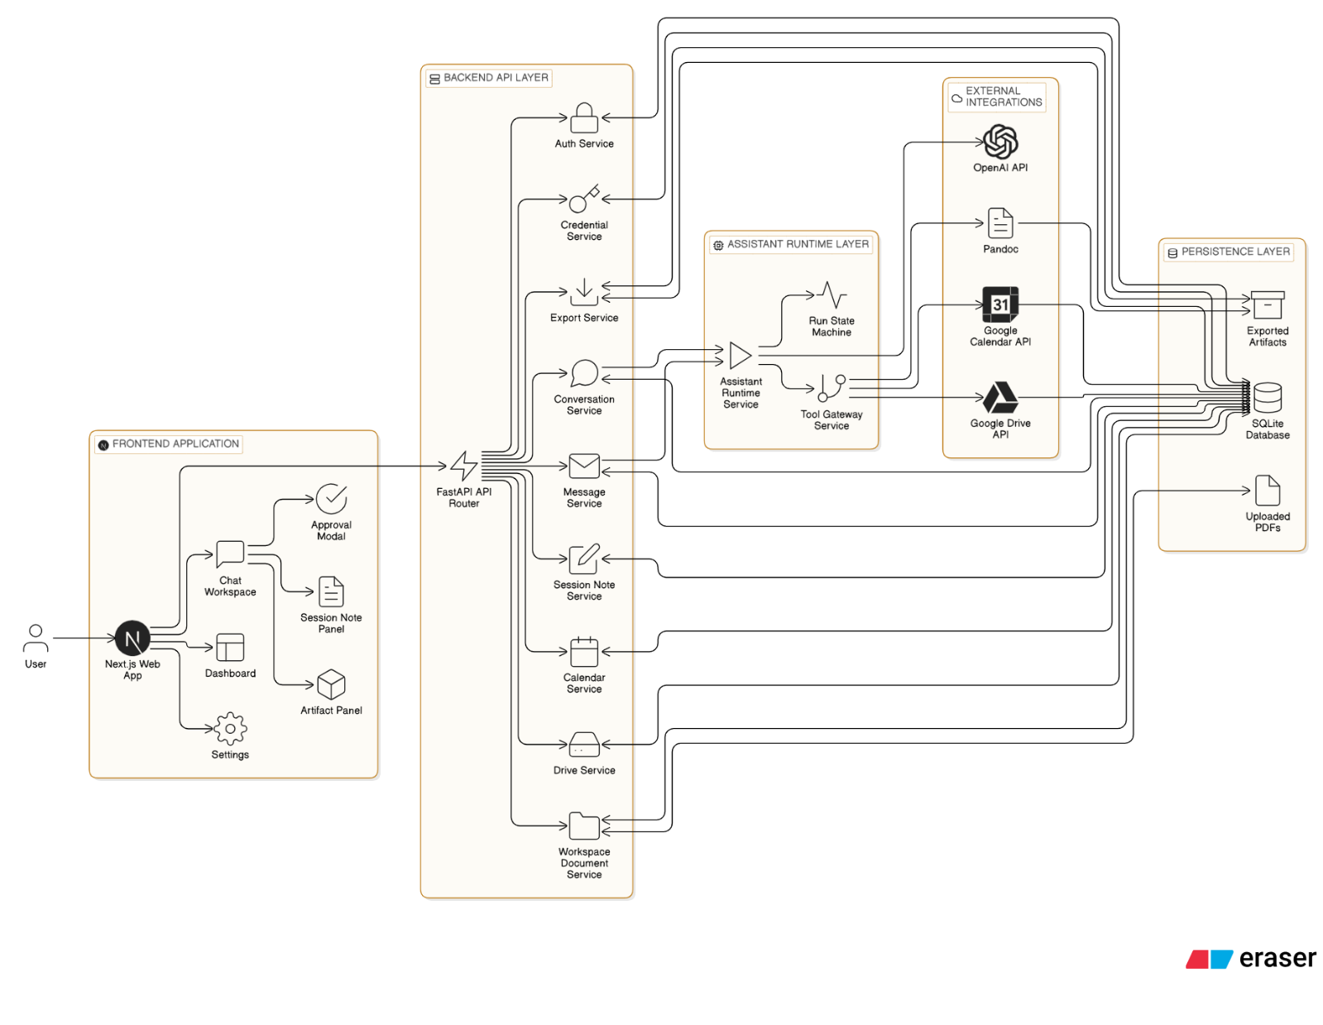
System Architecture
Frontend layer:
Next.js web application
chat workspace
note panel
artifact panel
approval modal
Backend API layer:
FastAPI route modules
RESTful communication surface
Assistant runtime layer:
assistant runs
tool selection
approval pause/resume
Persistence and integration layer:
SQLite
filesystem storage
OpenAI
Google Calendar
Google Drive
Pandoc

Slide 4




External Tools and Integrations
OpenAI
LLM provider
supports document understanding, intent recognition, and tool-request generation
configured with a user-provided API key
called during assistant-run processing
Google Calendar
calendar-event platform
supports scheduling and event creation
configured through Google OAuth
called after approval to create extracted date events
Google Drive
cloud file-storage platform
supports file upload and metadata management
configured through Google OAuth
called to archive PDFs and upload export artifacts
Pandoc
document-conversion tool
supports Markdown to docx and pptx
configured as a local or container binary
called by the export service

Slide 5
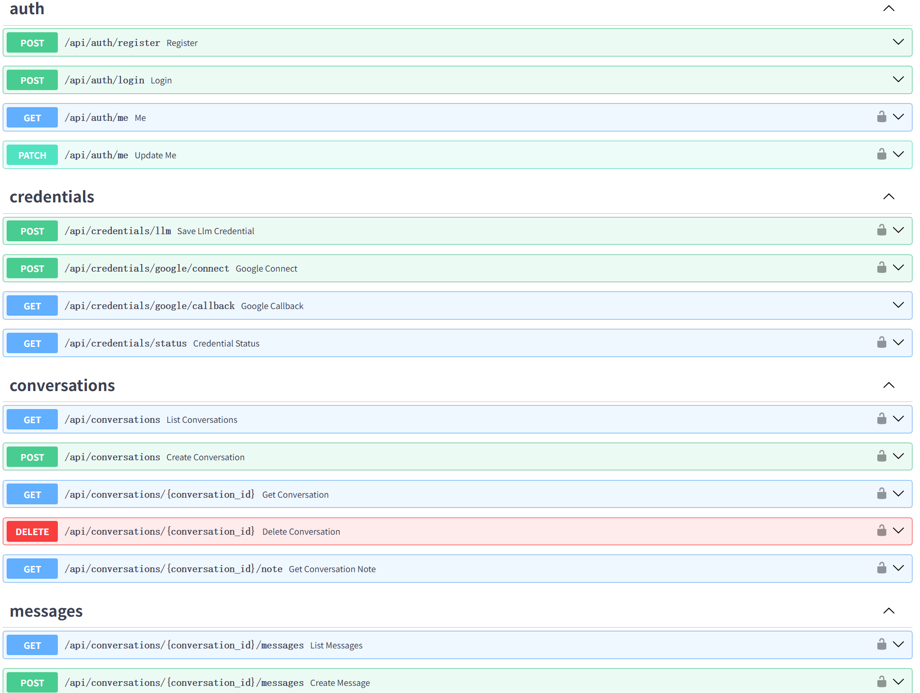
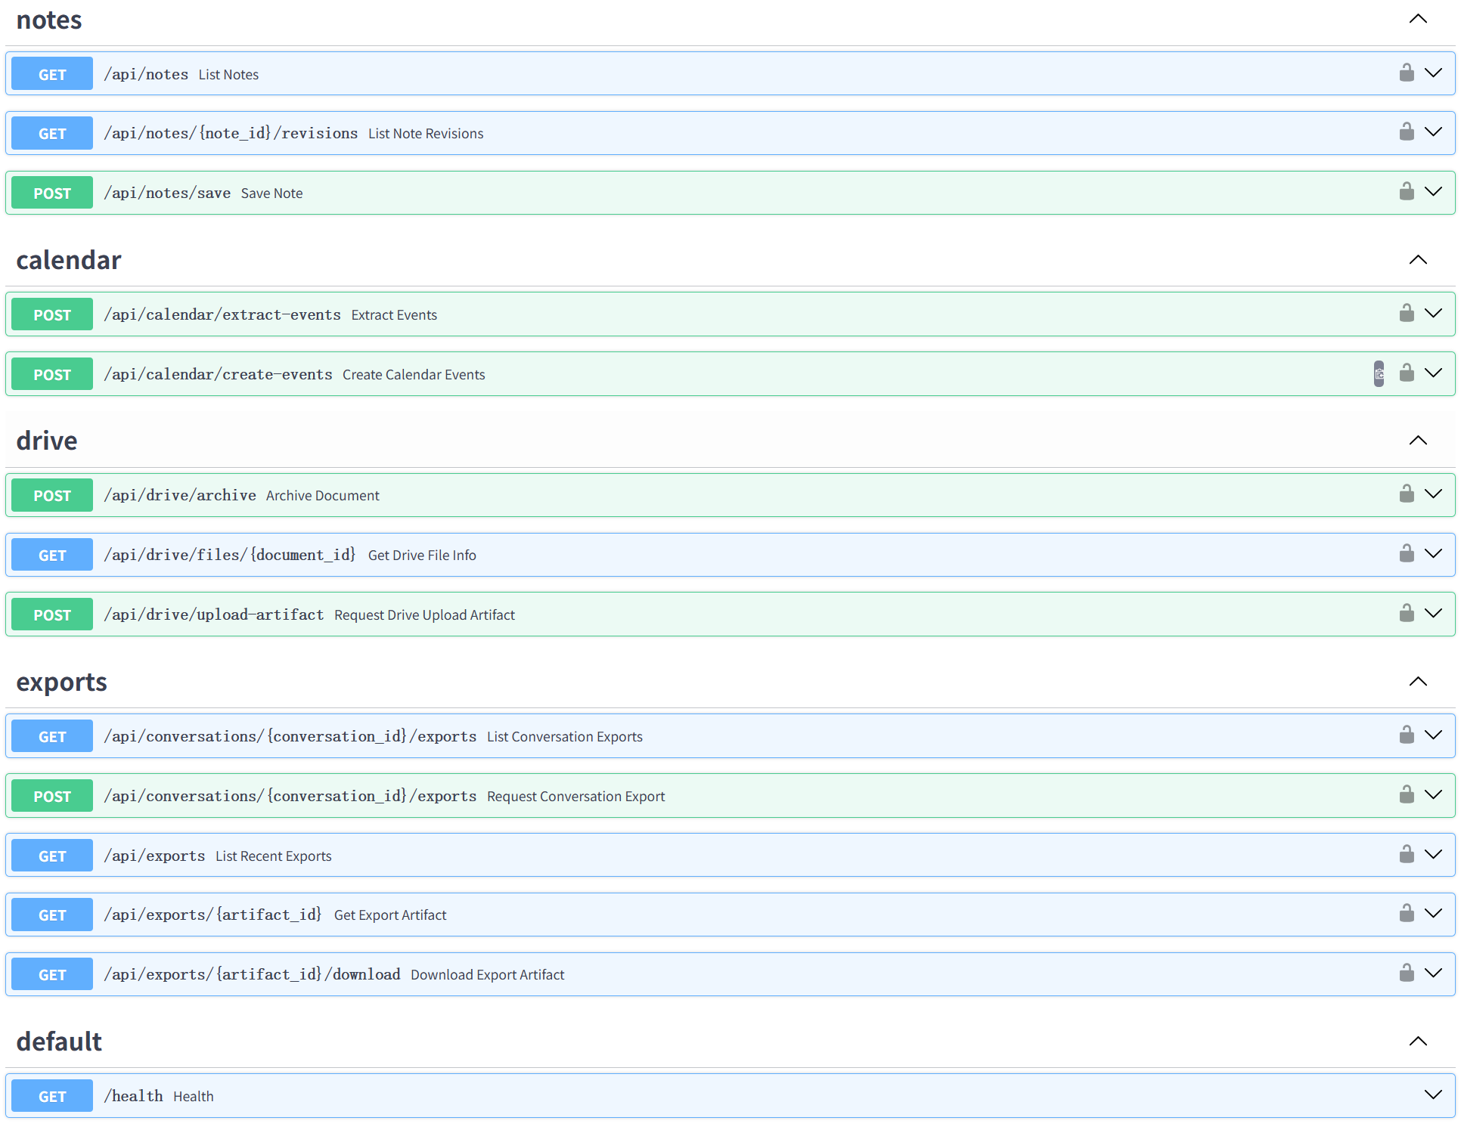
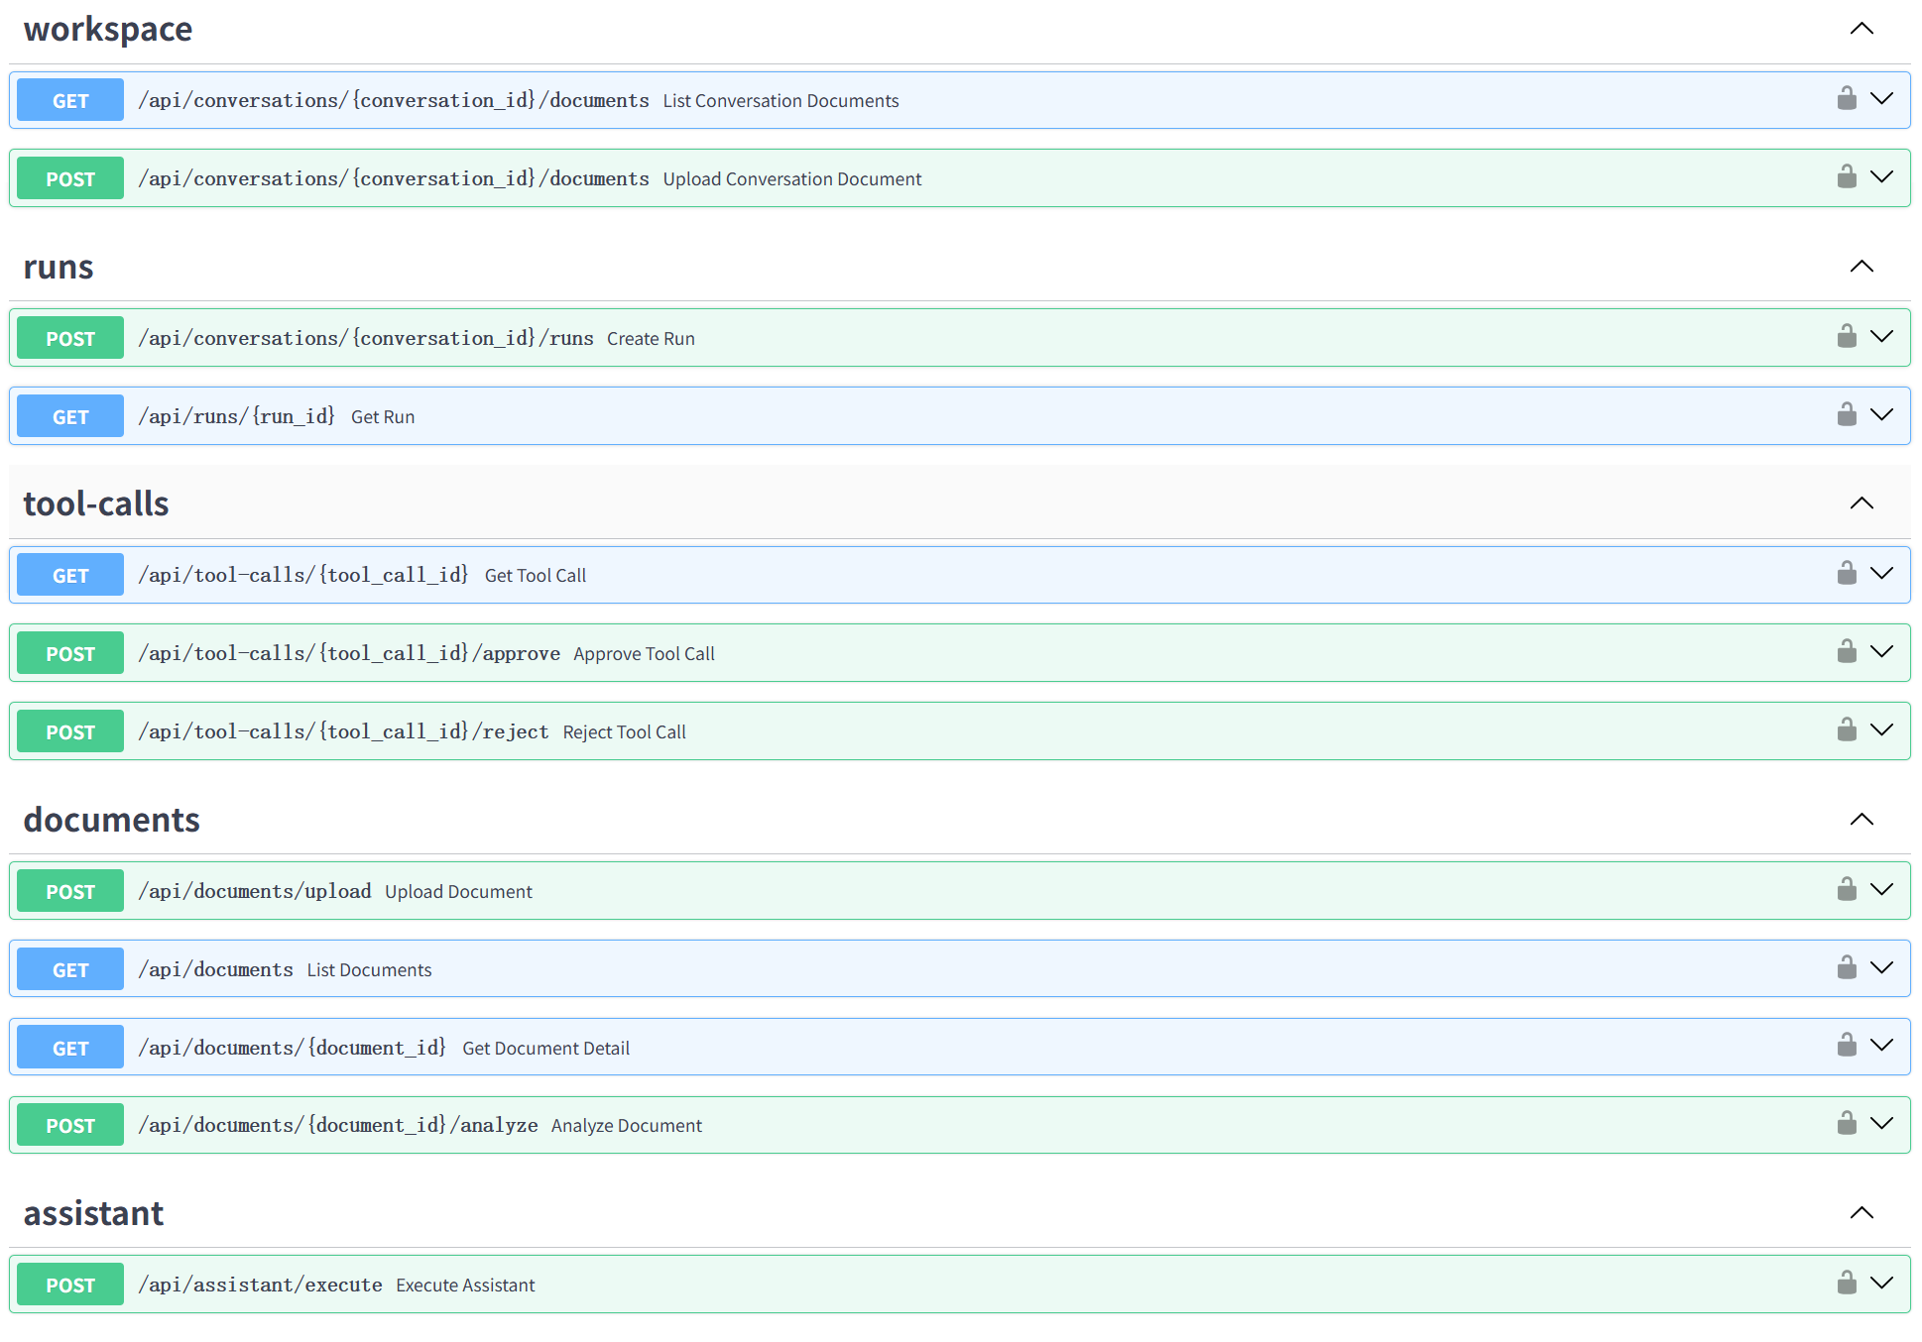
Backend Design
Backend organized as modular services
Major services include:
Auth service
Credential service
Conversation service
Message service
Assistant runtime service
Tool gateway service
Session note service
Calendar service
Drive service
Export service
Document service
Services communicate through RESTful APIs exposed by FastAPI route groups
API modules visible in Swagger at localhost:8000/docs

Slide 6
API Modules
auth
register, login, current user, profile update
credentials
save LLM key, start Google OAuth, callback, status
conversations
create, list, detail, note lookup, delete
messages
list and create conversation messages
workspace
list and upload conversation documents
runs
create assistant run, query run state
tool-calls
get tool call, approve, reject
documents
upload, list, detail, analyze
assistant
execute document-centric assistant flow
notes
list session notes, list revisions, save document note
calendar
extract candidate events, create events
drive
archive document, query drive file info, upload export artifact
exports
list conversation exports, request export, list recent exports, artifact detail, download
default
health endpoint

Slide 7
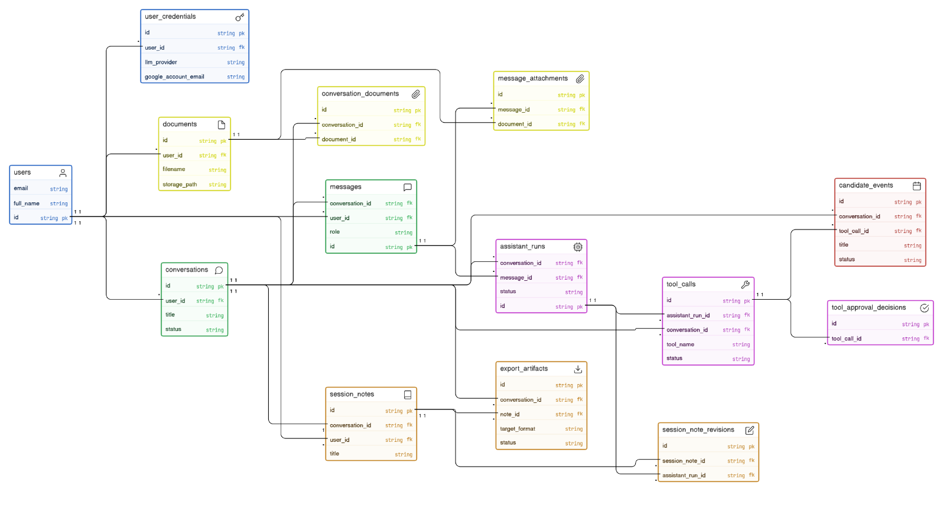
Database Design
SQLite chosen for:
simple local setup
lightweight deployment
good integration with SQLAlchemy and Alembic
sufficient persistence for coursework-scale evaluation
Persisted data includes:
users
credentials
documents
conversations
messages
assistant runs
tool calls and approvals
session notes and note revisions
candidate events
export artifacts

Slide 8
Frontend Design
Main UI regions:
sidebar with navigation and conversation history
central message timeline
bottom composer for text input and PDF upload
note panel
artifact panel
approval modal
Assistant messages and notes use Markdown rendering
Export artifacts support direct download and Drive-upload requests

Slide 9
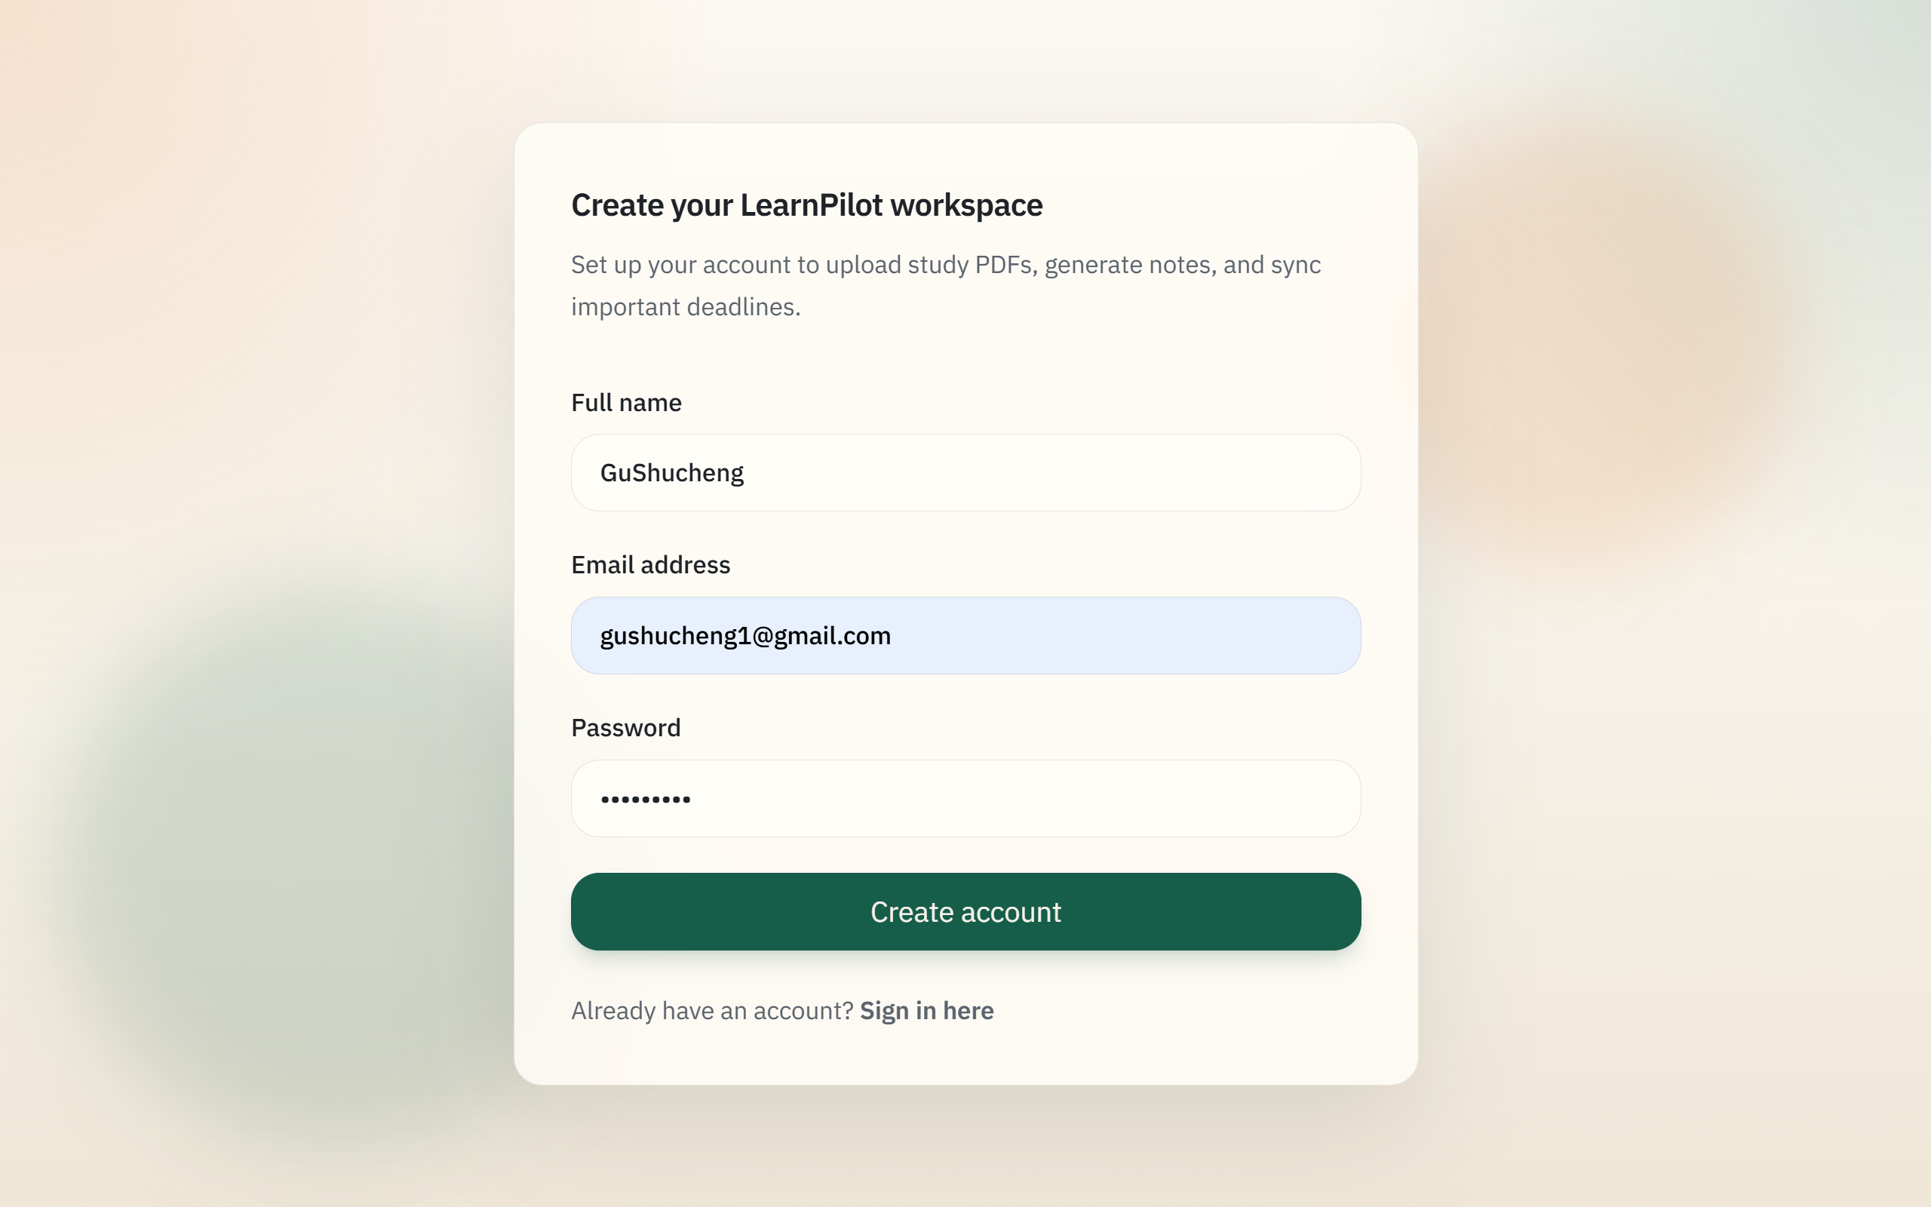
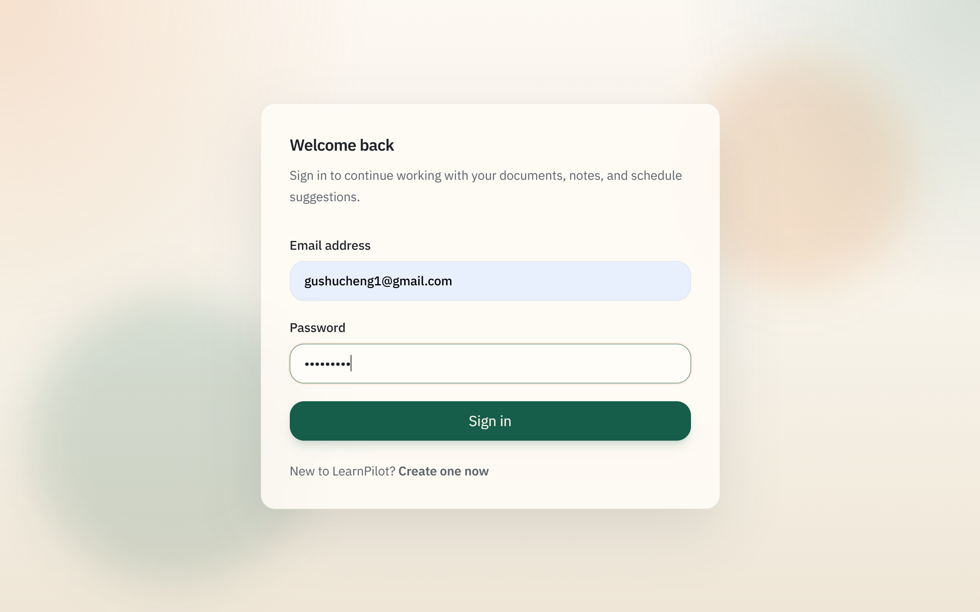
Example Workflow 1: Sign Up and Login
The workflow begins by creating an account and signing into the system. Once authenticated, the user gains access to the protected workspace, including the dashboard, chat page, and settings page.

Slide 10
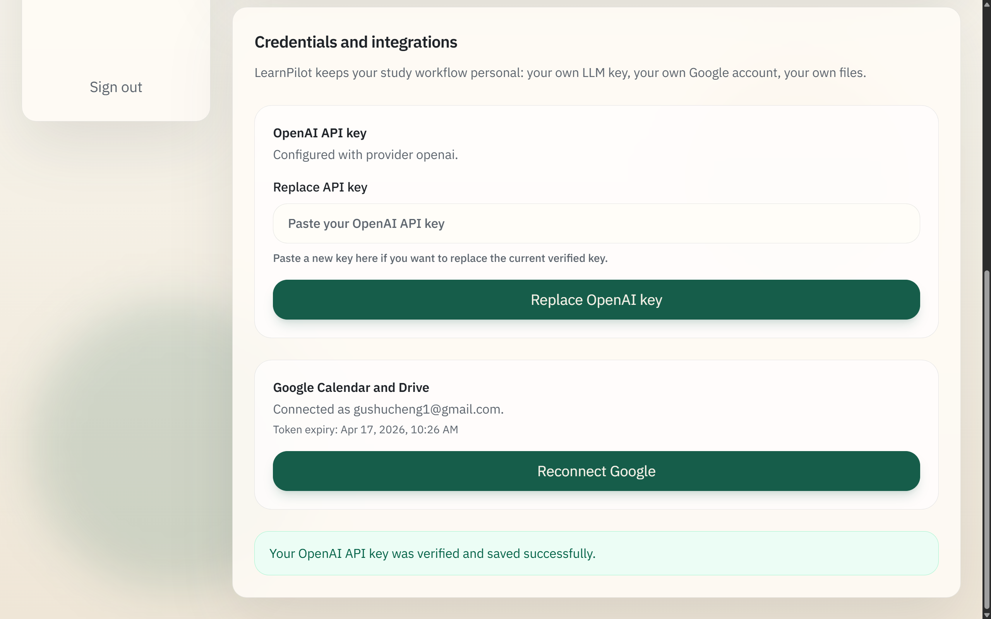
Example Workflow 2: OpenAI & Google config
After login, the Settings page is used to configure the OpenAI API key and connect the Google account through OAuth. This step is necessary because assistant reasoning and external actions depend on per-user credentials.

Slide 11
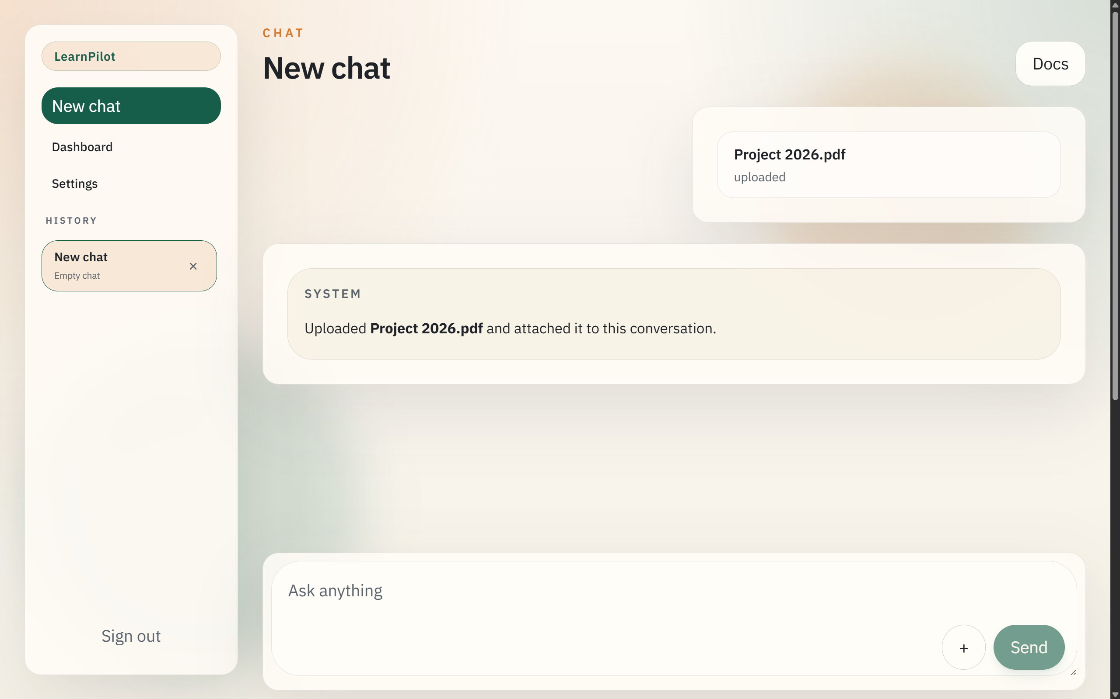
Example Workflow 3: New chat
A new conversation is created from the chat workspace, and a PDF document is uploaded directly within that conversation. The uploaded document is stored in the workspace, linked to the session, and made available to the assistant as contextual input.

Slide 12
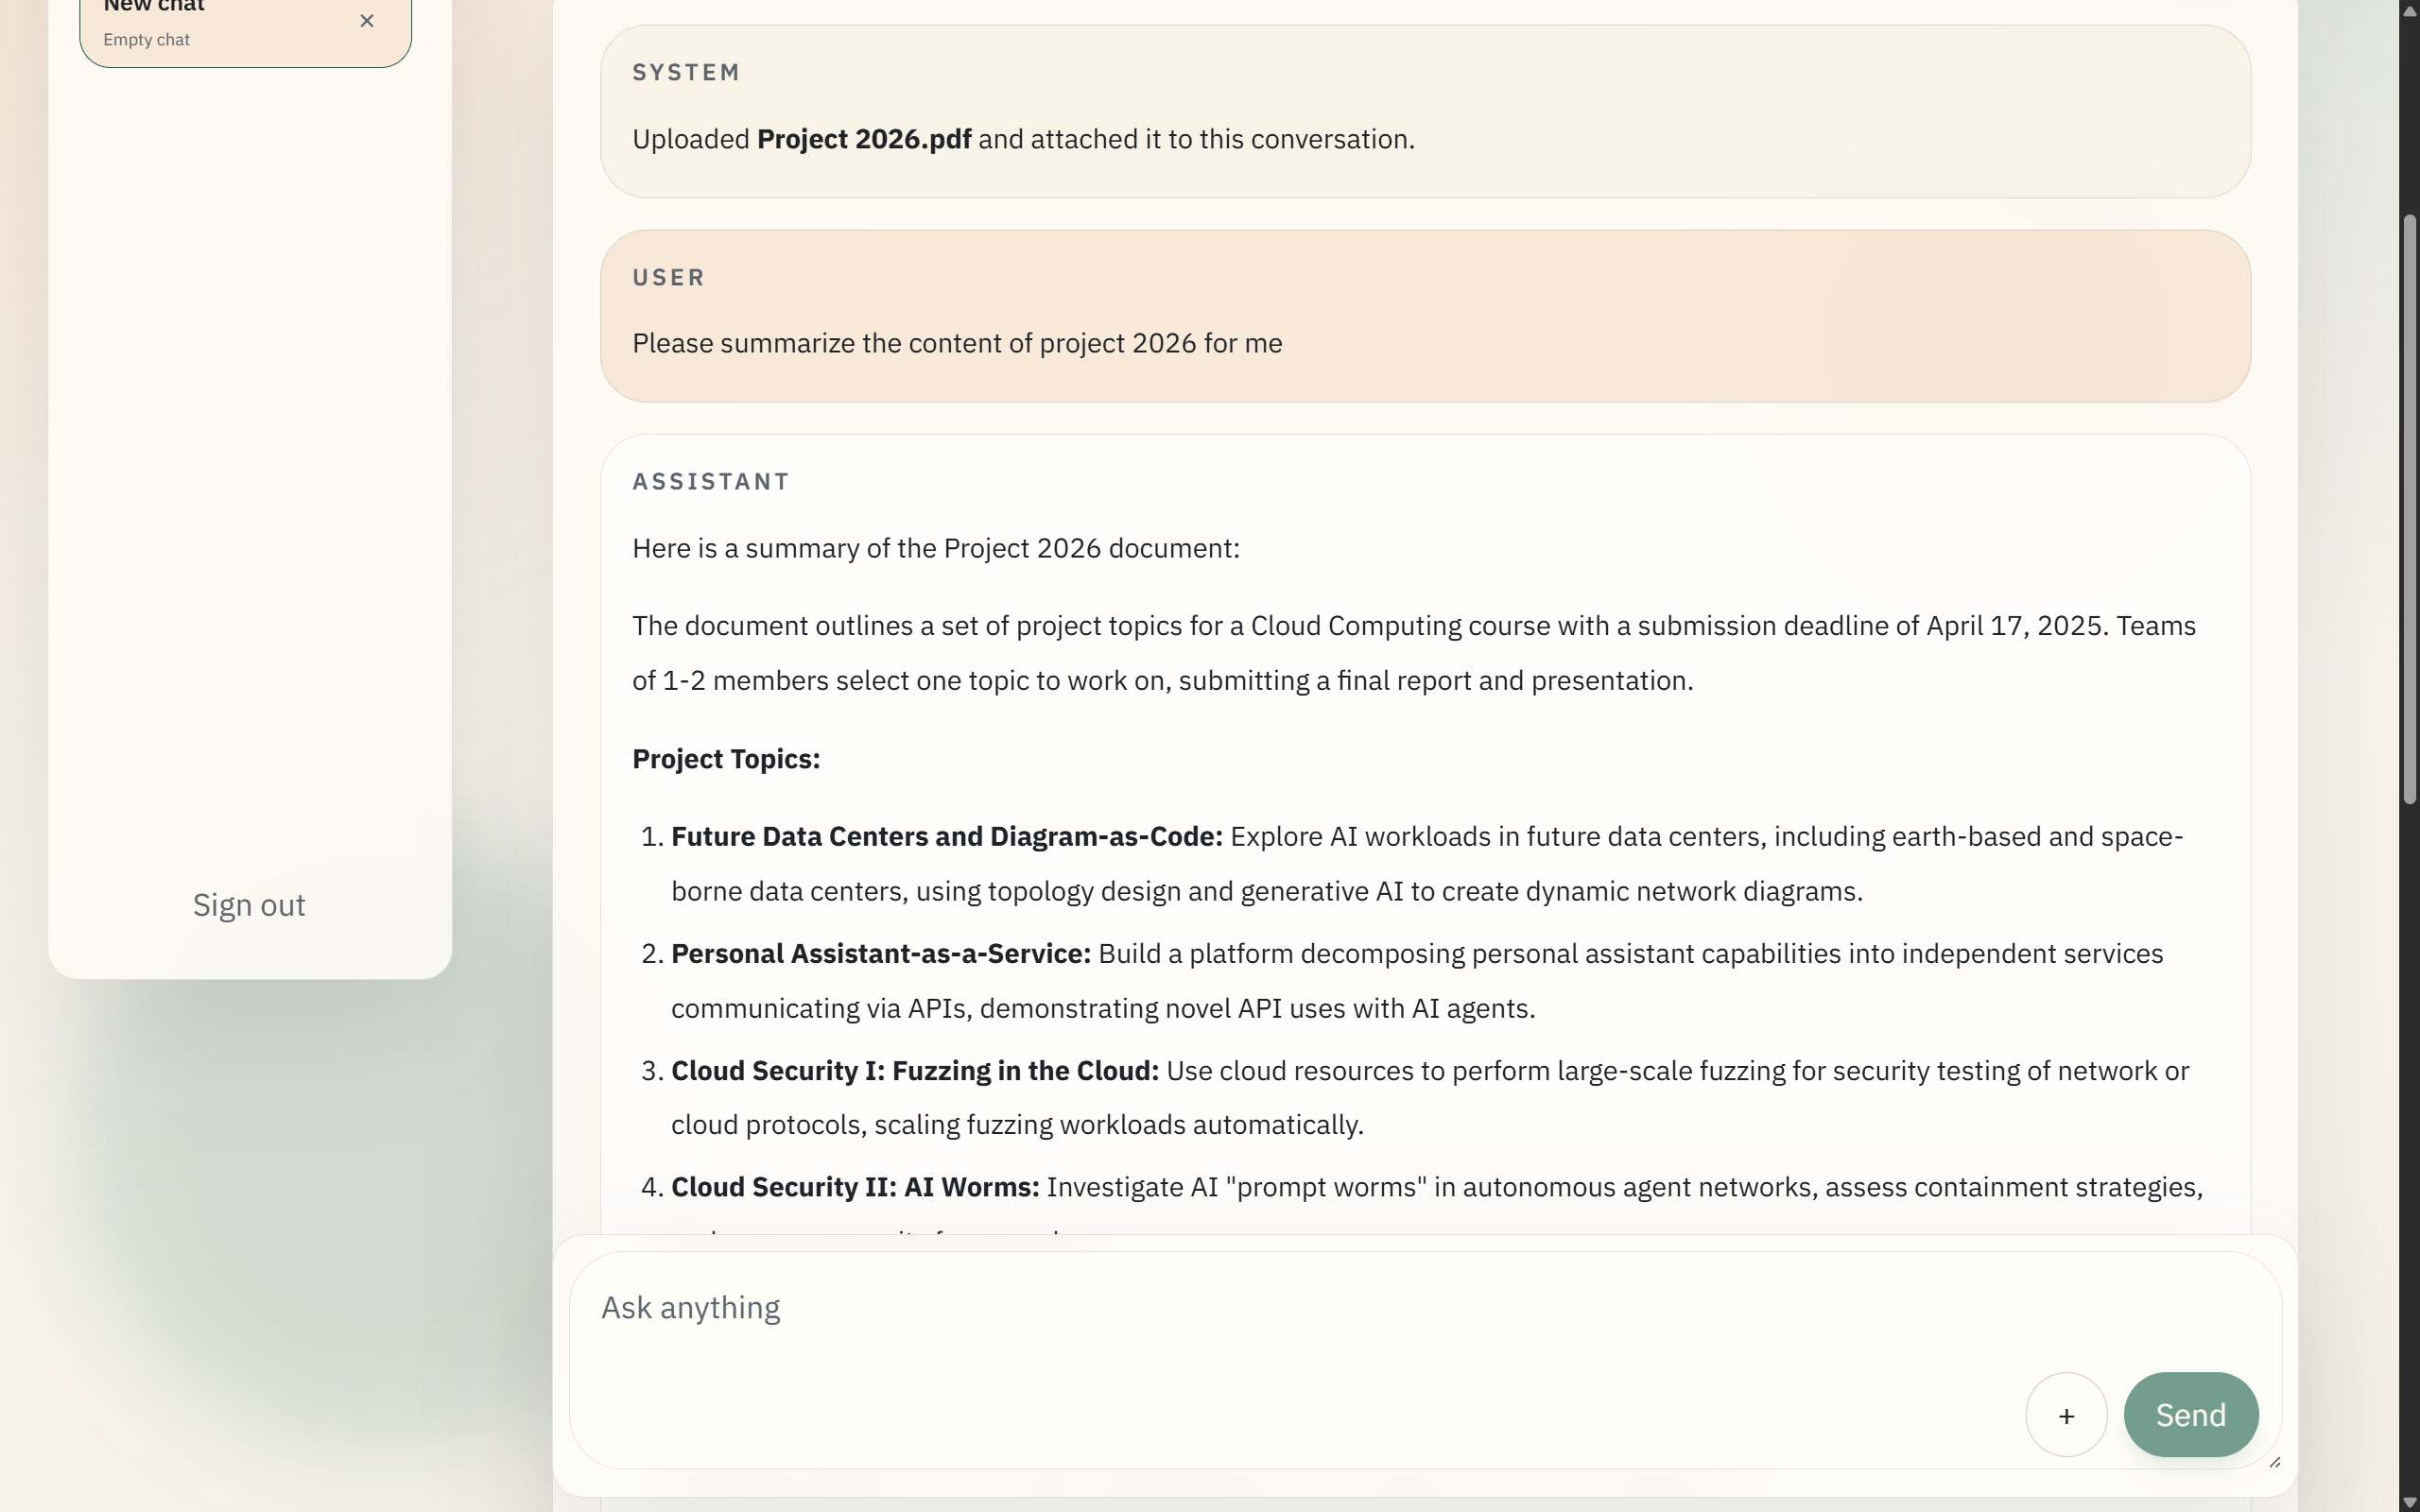
Example Workflow 4: Document Summary
The user then asks the assistant to summarize the uploaded PDF. The assistant reads the conversation context together with the attached document excerpt and returns a Markdown-formatted summary in the message timeline.

Slide 13
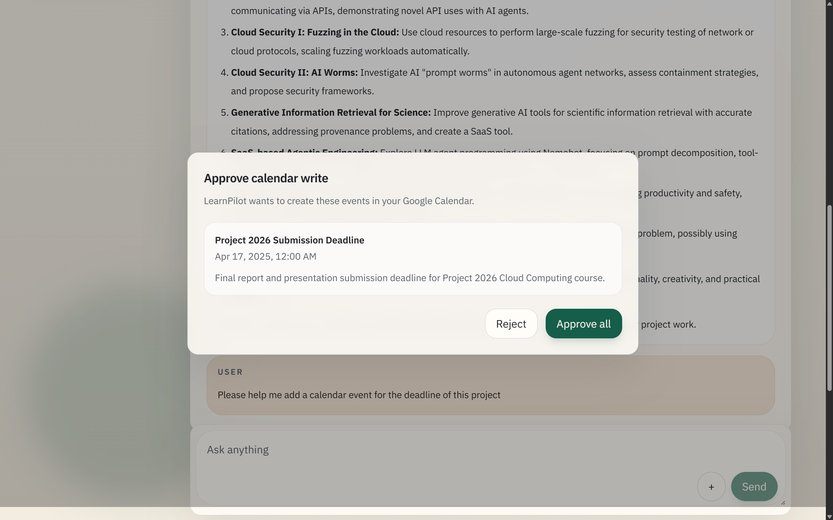
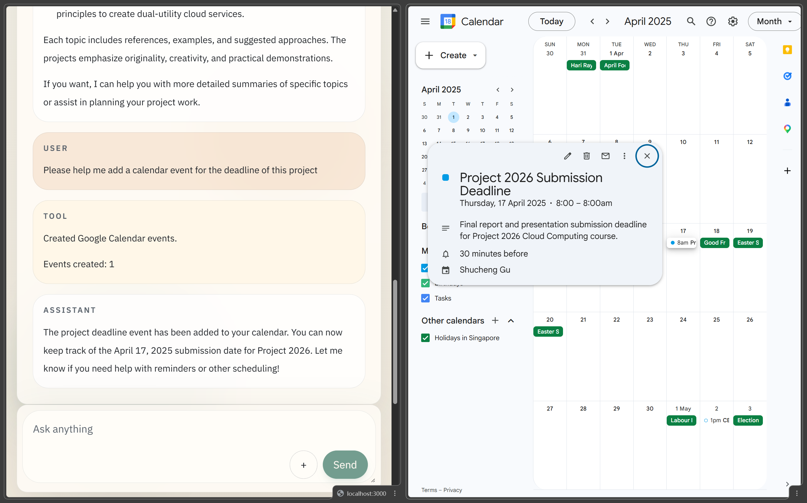
Example Workflow 5: Calendar Events
Next, the user asks the assistant to identify important dates in the PDF and create corresponding Google Calendar events. The assistant extracts candidate events, pauses for approval, and displays the request through the tool-approval modal. After approval, the events are written to Google Calendar and the result is persisted in the conversation history.

Slide 14
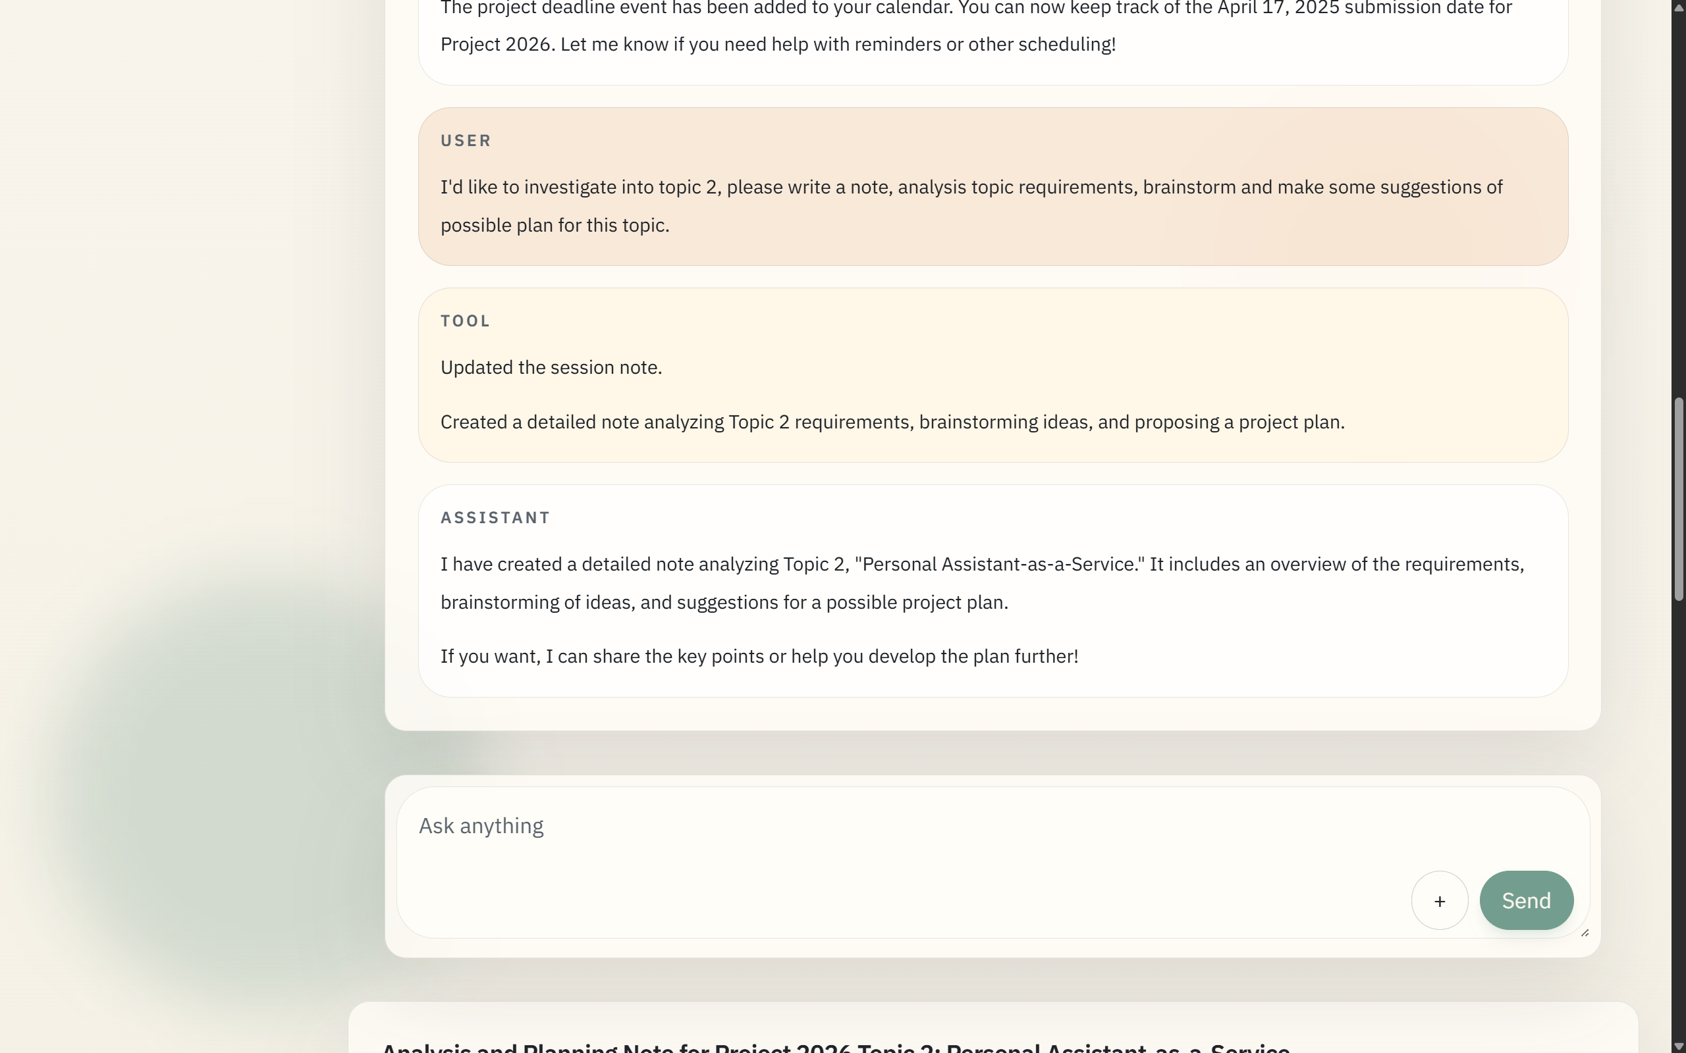
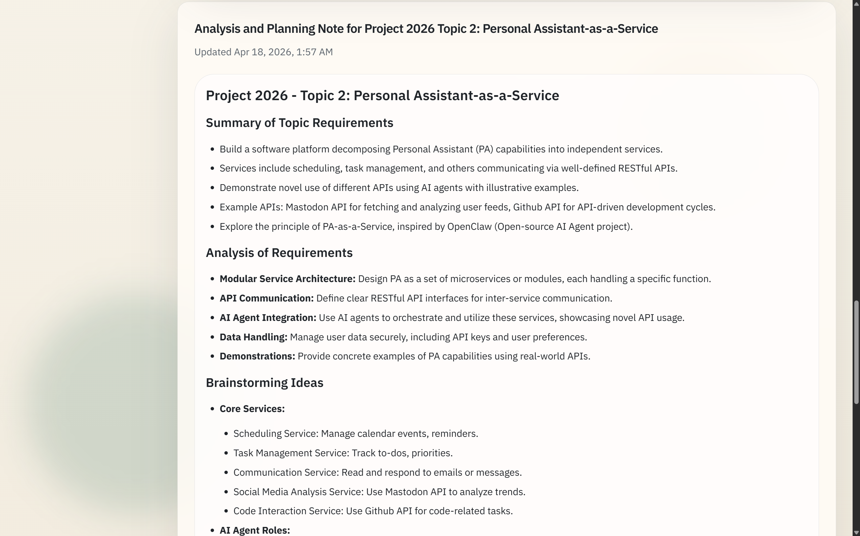
Example Workflow 6: Generate Note
The user then asks the assistant to generate a note from the document according to a study-oriented instruction. The assistant creates or updates the session note, and the resulting note appears in the right-side note panel as a persistent Markdown artifact.

Slide 15
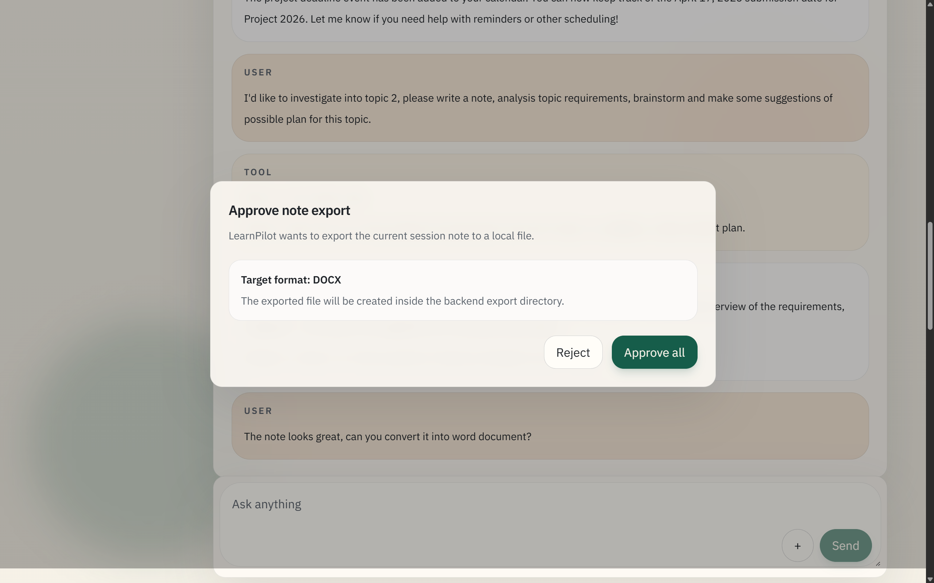
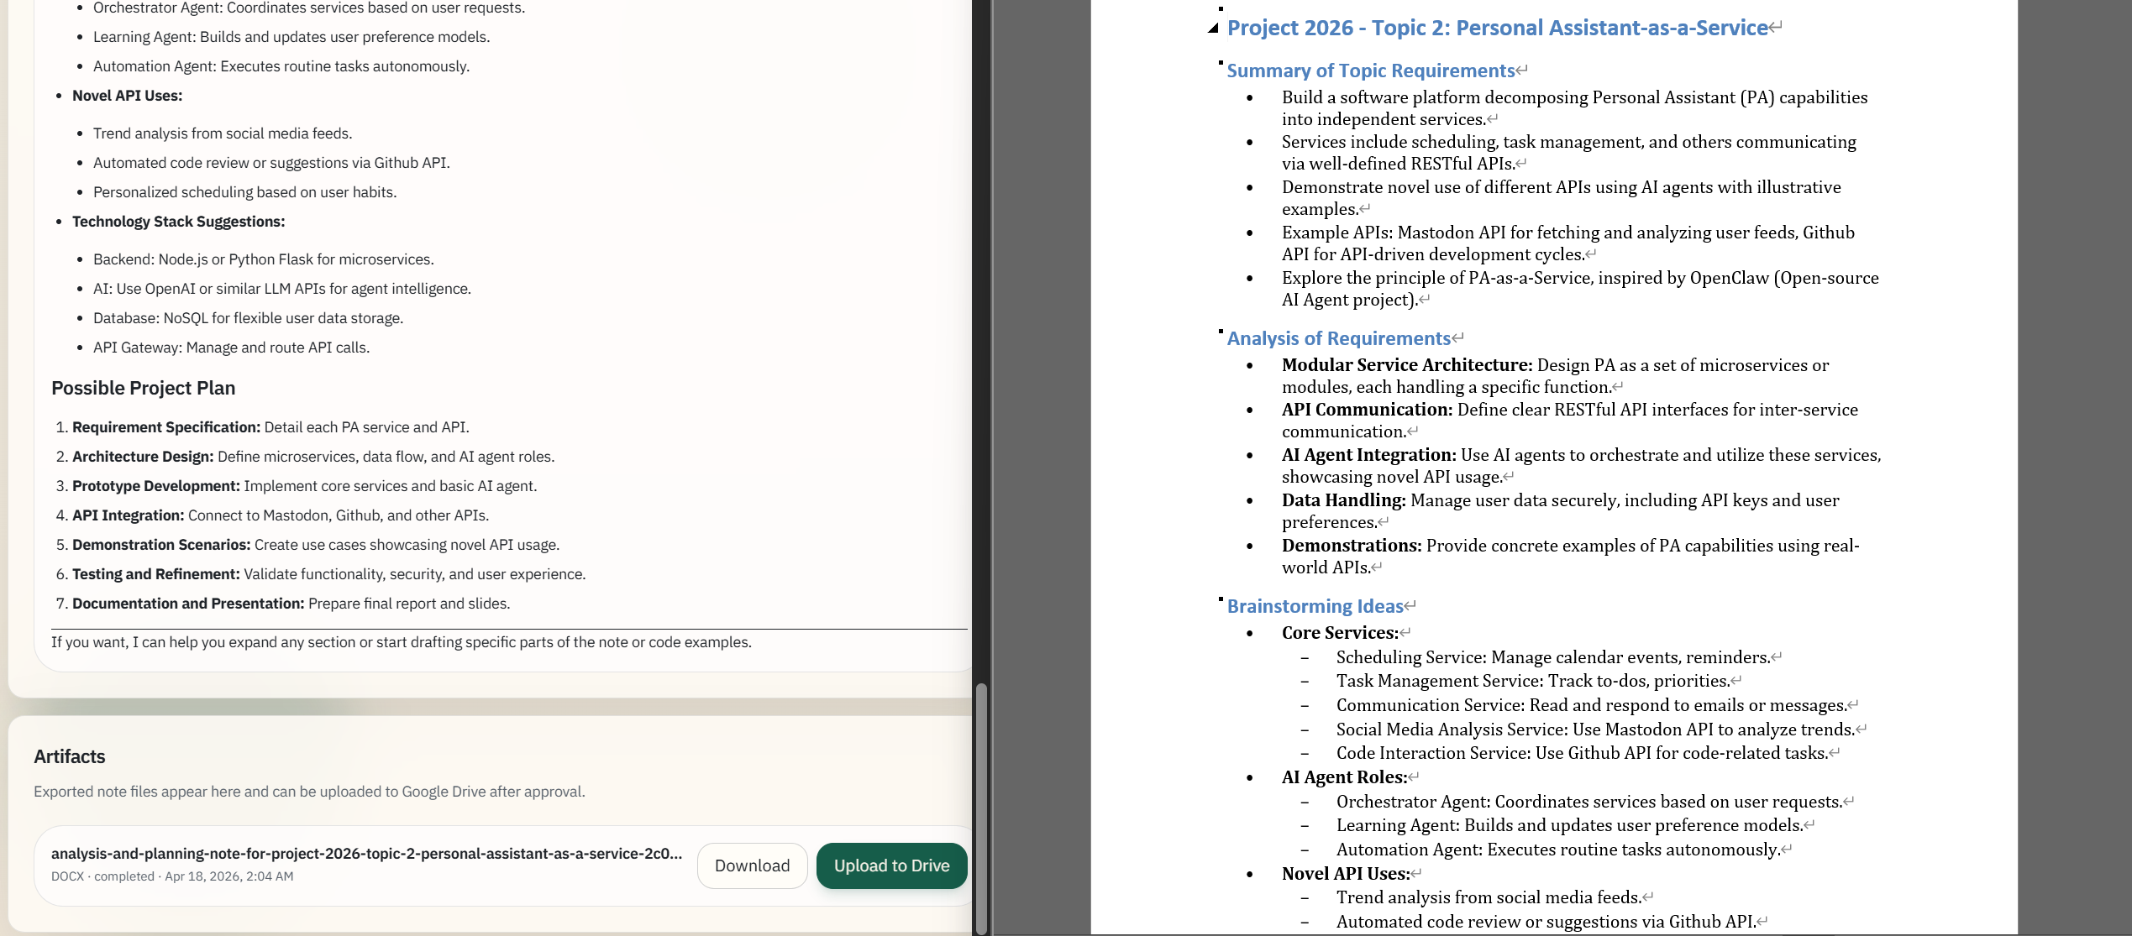
Example Workflow 7: Note to DOCX
After the note is generated, the user requests that it be converted into docx format. The assistant creates an export tool request, the system asks for approval, and once approved, Pandoc generates the office-document artifact. The generated docx file then appears in the artifact panel.

Slide 16
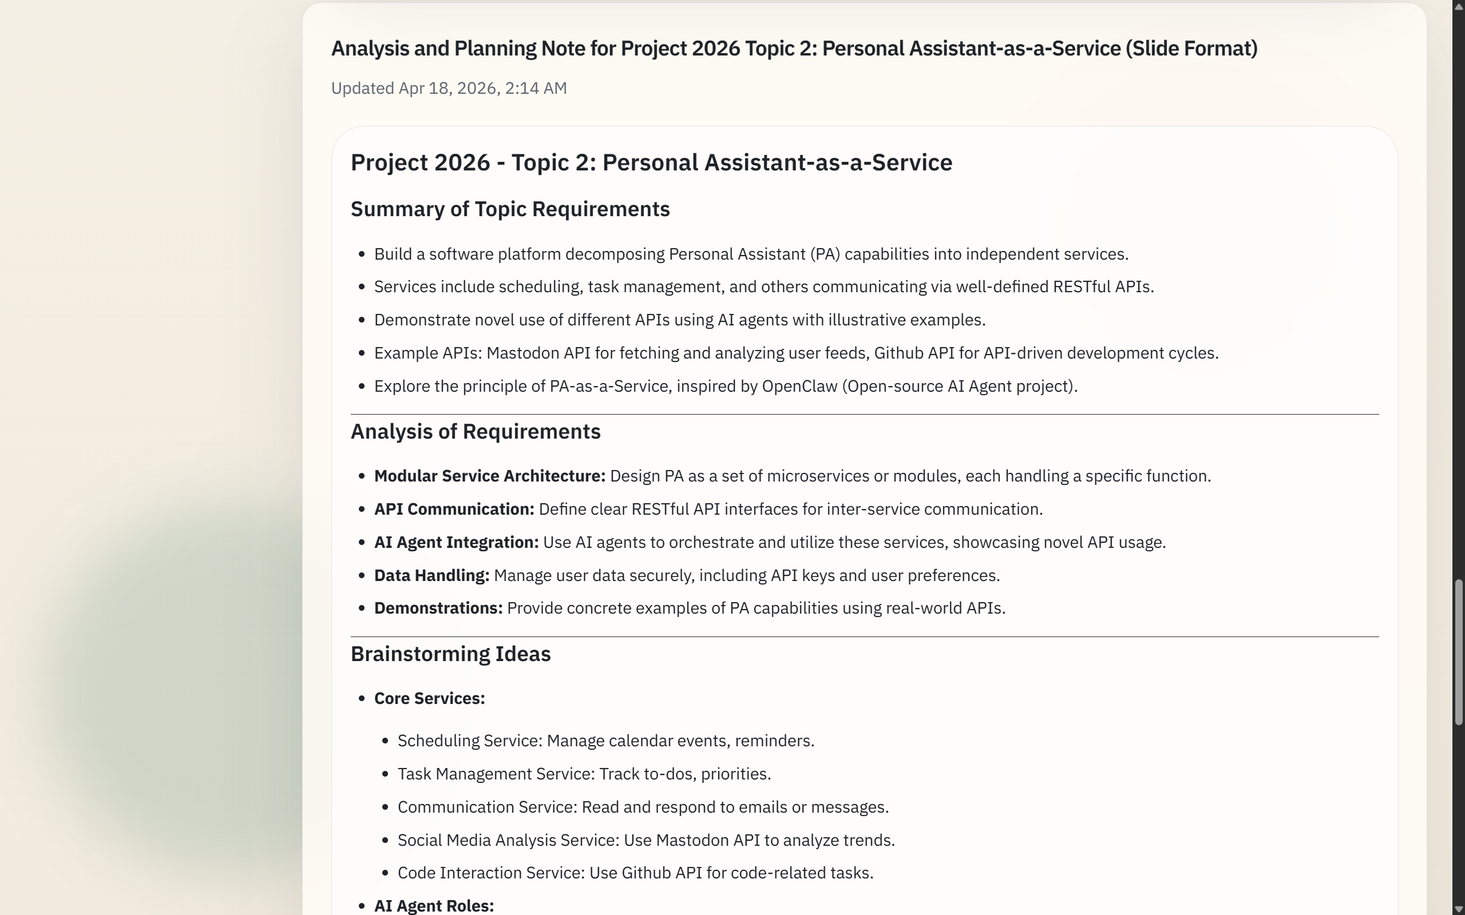
Example Workflow 8: Presentable Note
The workflow continues with a second instruction that asks the assistant to produce a more concise note suitable for presentation slides, including explicit page-break markers and a shorter, presentation-friendly structure. The assistant updates the session note accordingly so that the content becomes suitable for subsequent slide export.

Slide 17
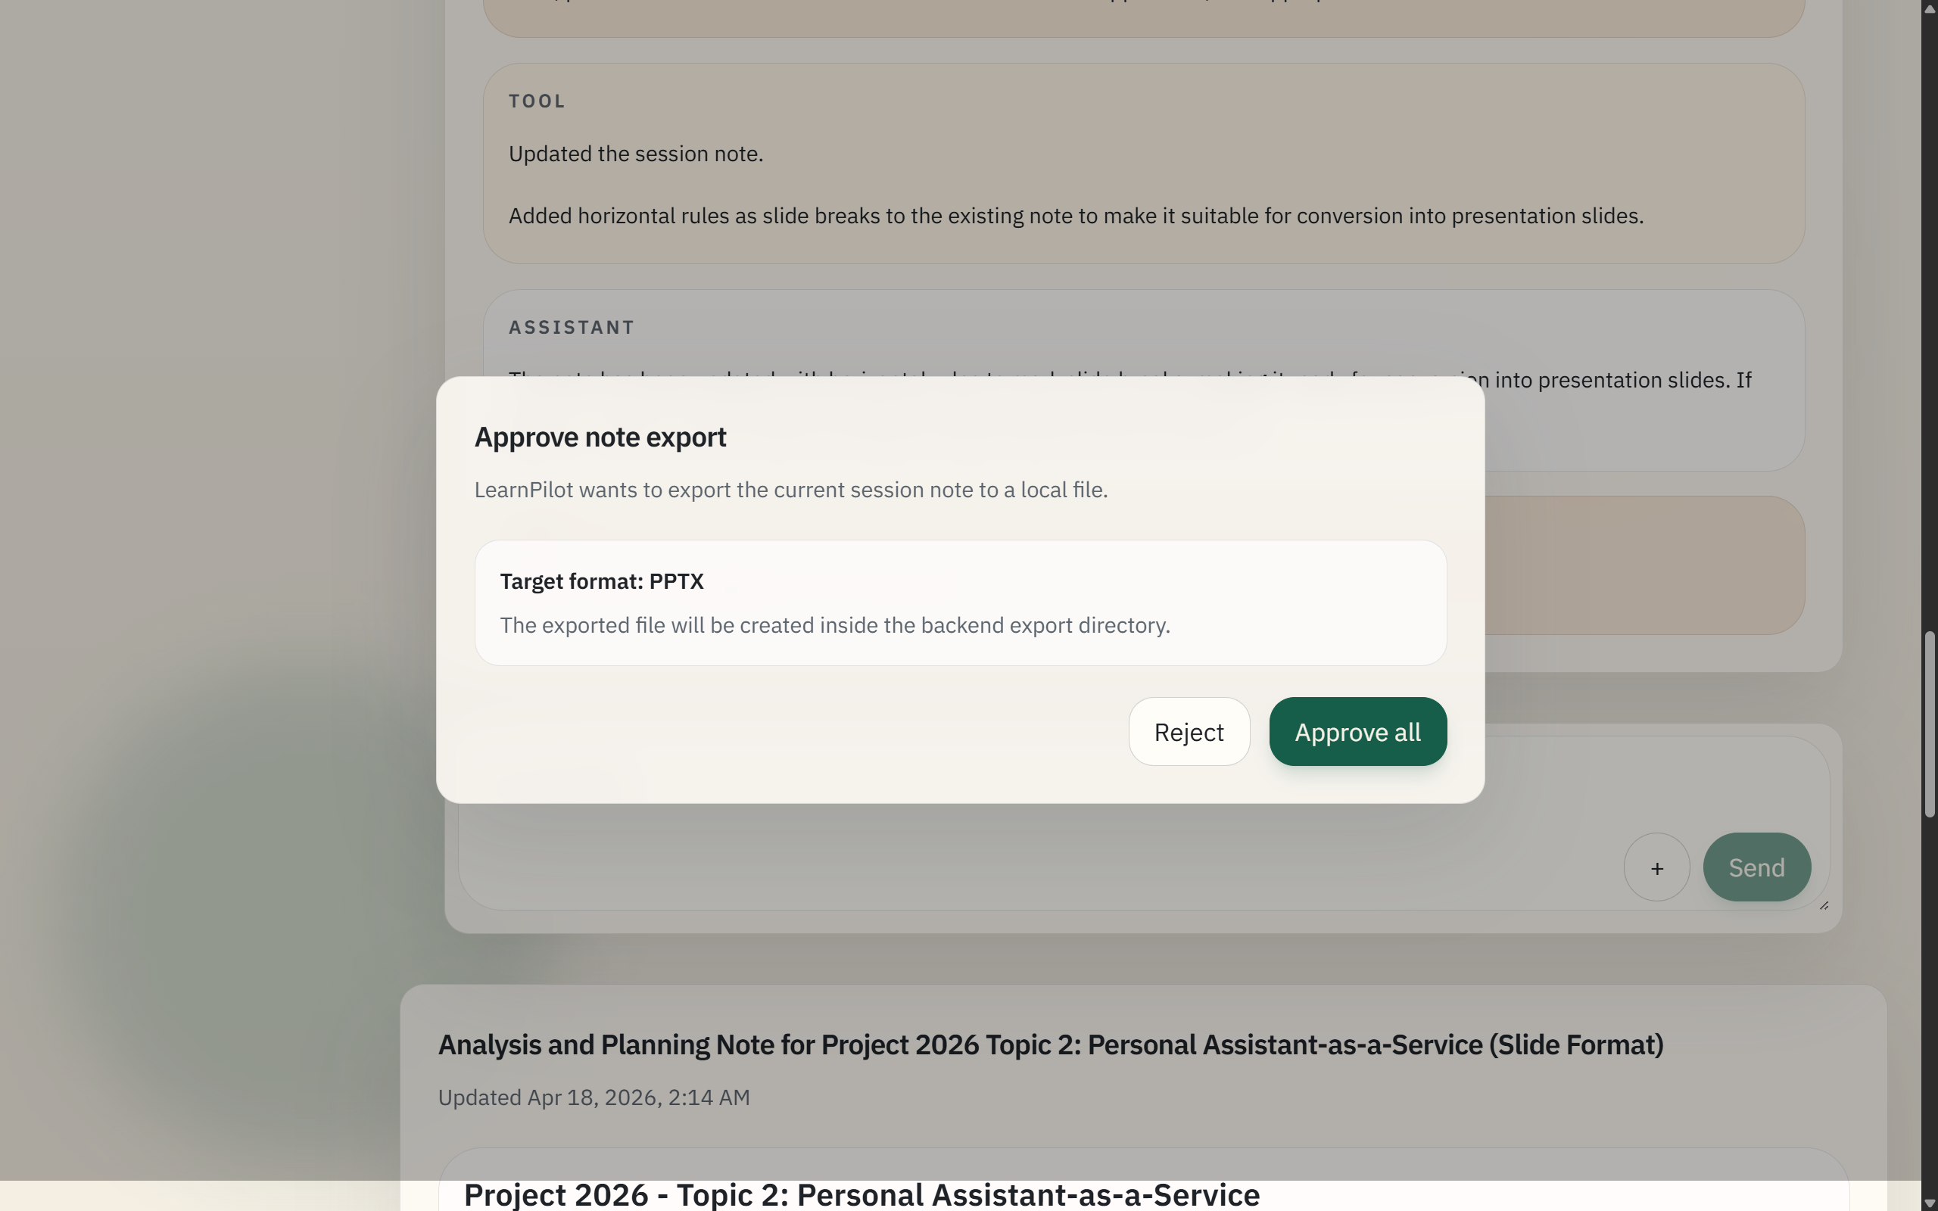
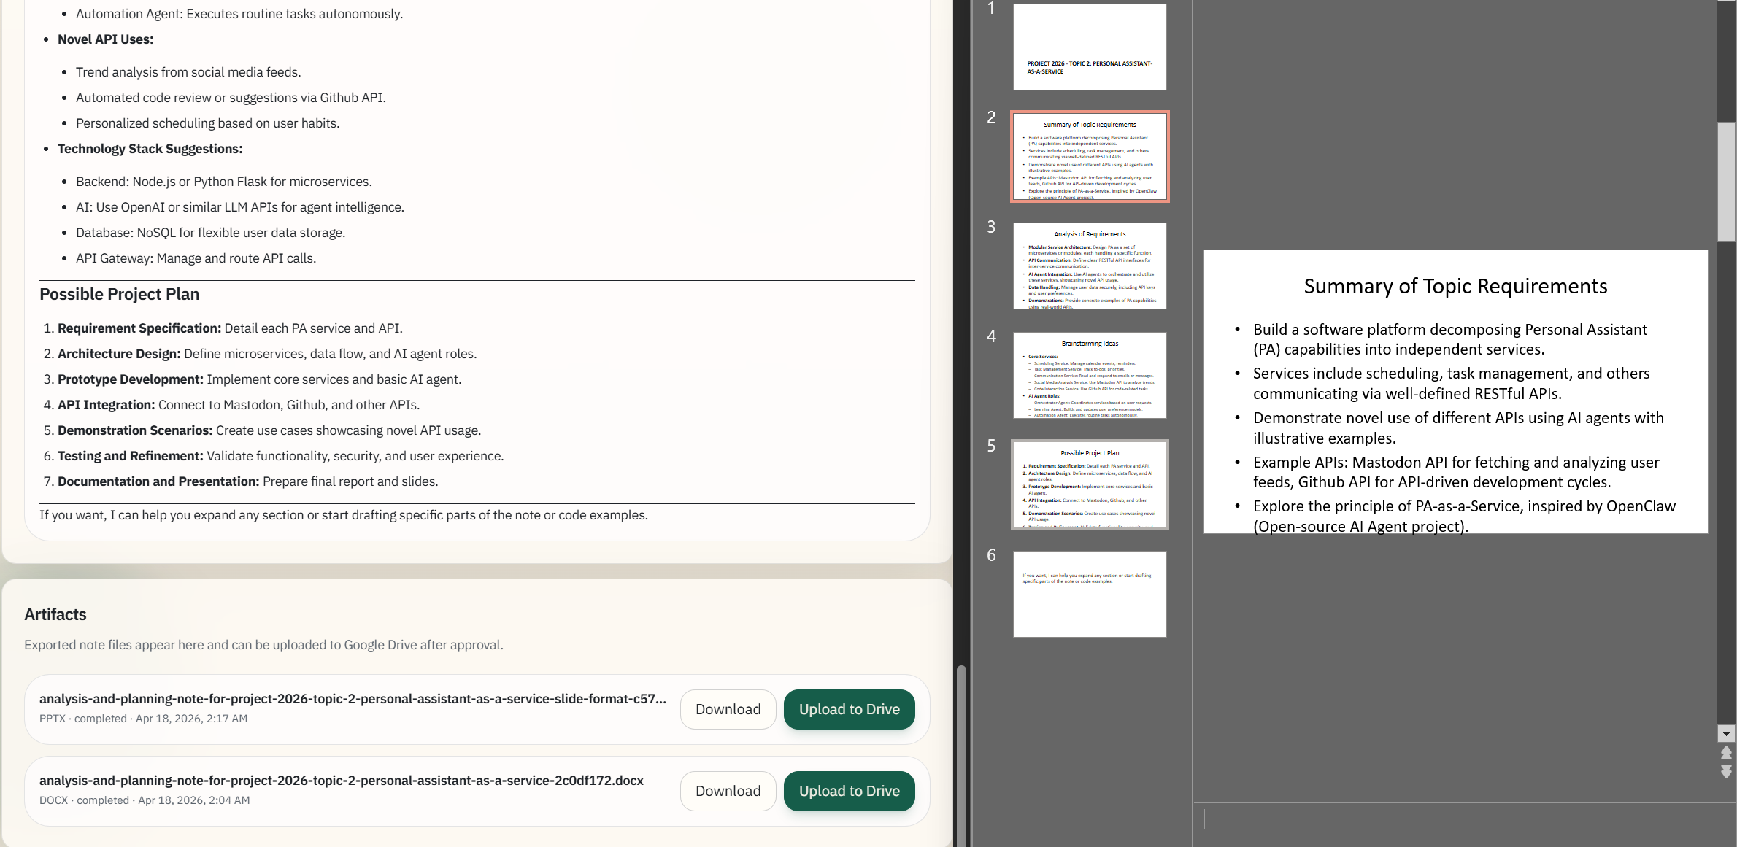
Example Workflow 9: Note to PPTX
Once the note has been rewritten in a slide-friendly structure, the user requests conversion to pptx. As with the docx export, the assistant requests approval, the export is executed through Pandoc, and the resulting presentation file appears as a second artifact in the artifact panel.

Slide 18
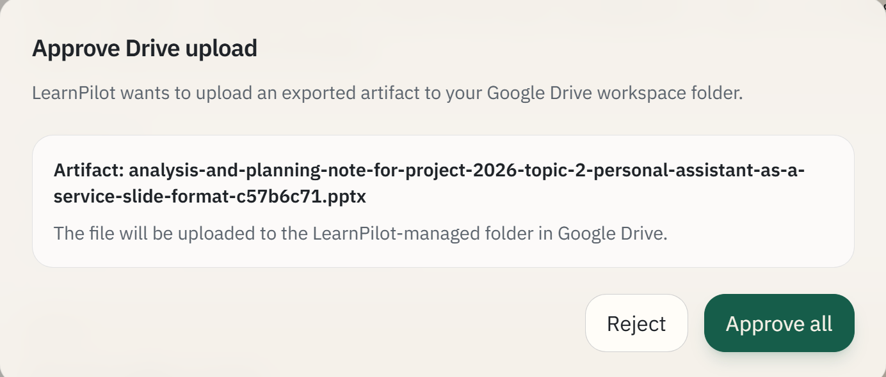
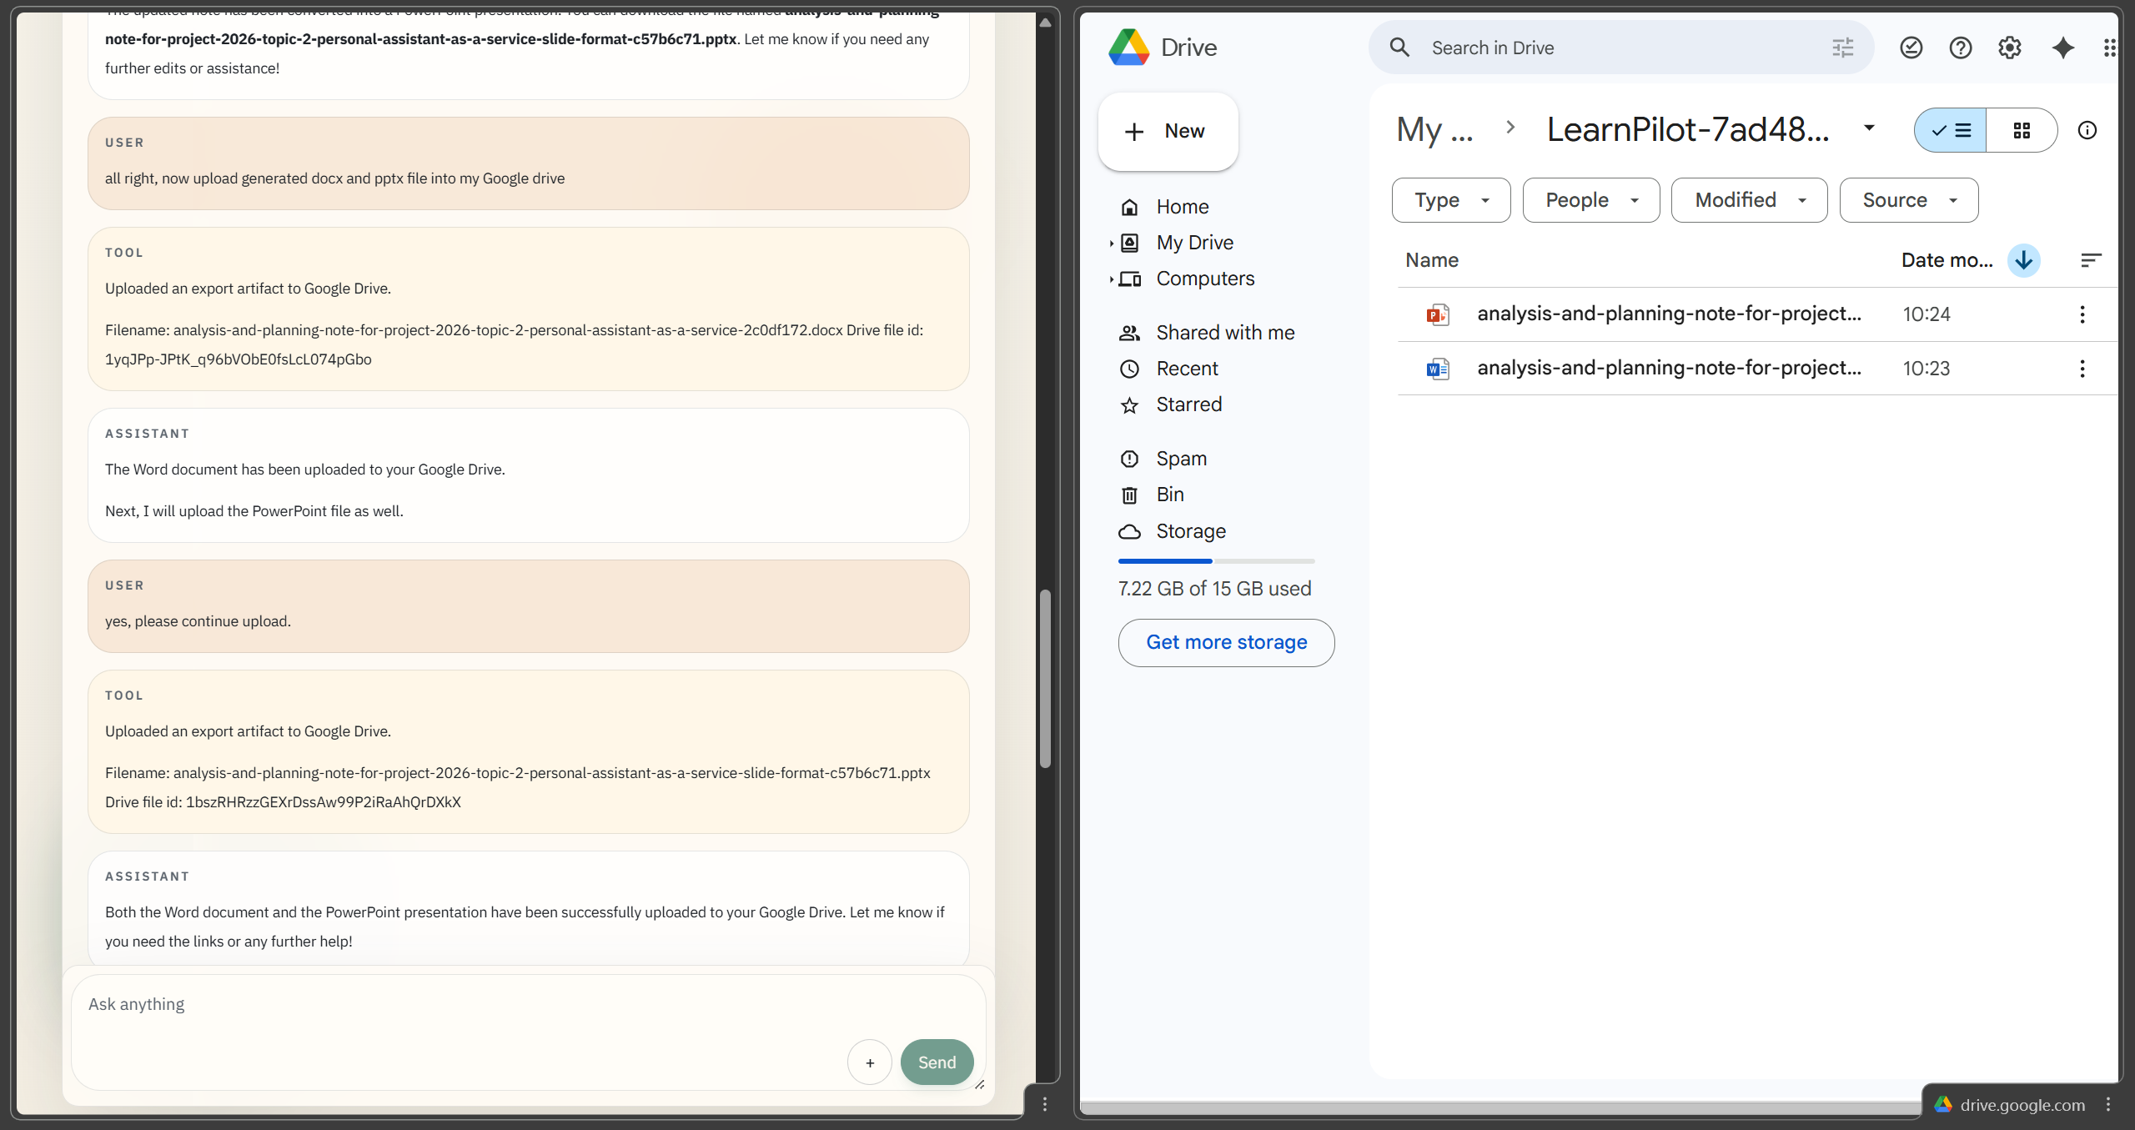
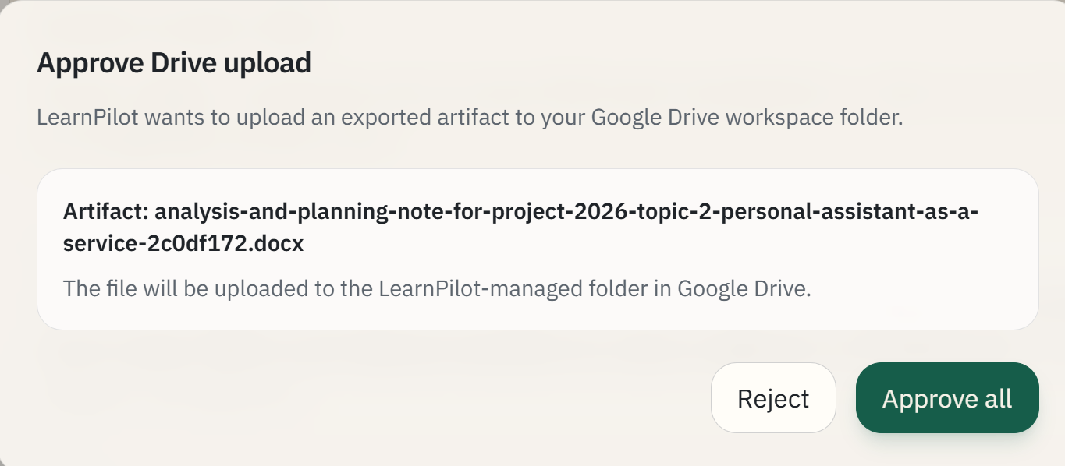
Example Workflow 10: Upload to Drive
Finally, the user requests backup of both generated artifacts to Google Drive. Each upload request is approval-controlled, and after approval the files are written into the app-managed Drive folder. The artifact panel then reflects the uploaded state for both files.

Slide 19
Conclusion
LearnPilot demonstrates a working PAaaS platform for academic workflows
Core delivered capabilities:
persistent chat
document-aware assistance
session notes
approval-aware tool execution
office-document export
cloud backup
Possible improvements: - OCR-based recognition for scanned inputs - support for more input and output file formats - more asynchronous API execution for more concurrent tasks - template-based formatting support for docx and pptx

