Slide 1




A Multiclass Age-Related Macular Degeneration Classification
ISME2025 – IC1270
Mahkame Sharbatdar
Mostafa Amiri
Parsa Aghaei
13-15 May 2025

Slide 2

contents
Introduction & Literature review
Eye diseases
Dataset & Methods
Results & Discussion
Conclusion

Slide 3

Introduction
Problem Statement:
Diagnosis of dry and wet AMD eye diseases compared to normal eye using OCT images
Significance of the research:
Initial diagnosis
Acceleration of the diagnosis process
Purpose of the research:
Providing a practical tool for researchers, doctors, and patients
Educational tool for medical students
Reducing human errors
Introduction
Eye diseases
Dataset & Methods
Results & Discussion
Conclusion

Slide 4
Literature review
Reference | Disease classes | No. of images | F1 Score
Kermany et al. | DRUSEN, DME, CNV, NORMAL | >100000 | 0.976
B. Nejad et al. | DRUSEN, DME, CNV, NORMAL | >80000 | 0.99
Serener et al. | Dry AMD, Wet AMD | >10000 | 0.98
Prahs et al. | Treatment AMD with anti-VEGF | >150000 | 0.93
Introduction
Eye diseases
Dataset & Methods
Results & Discussion
Conclusion

Slide 5
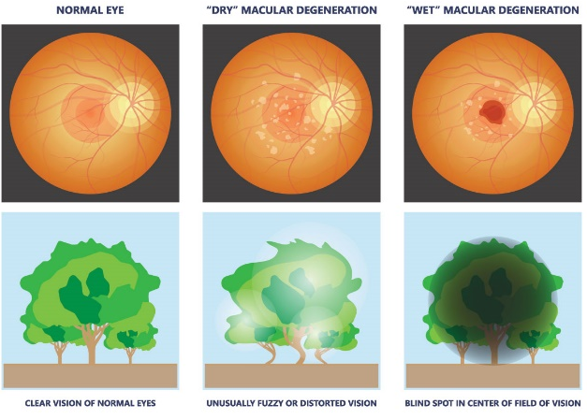
Eye diseases
Dry AMD
Normal
Examined eye conditions
Wet AMD
from https://oliviaread.co.za/general-eye-conditions/age-related-macular-degeneration/
Introduction
Eye diseases
Dataset & Methods
Results & Discussion
Conclusion

Slide 6
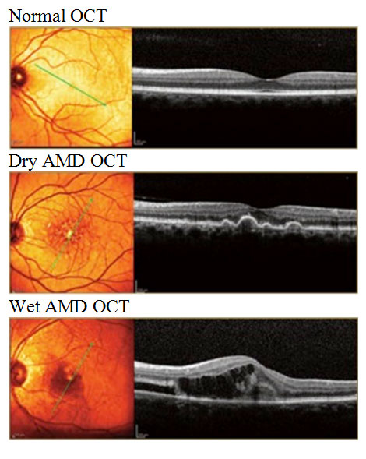
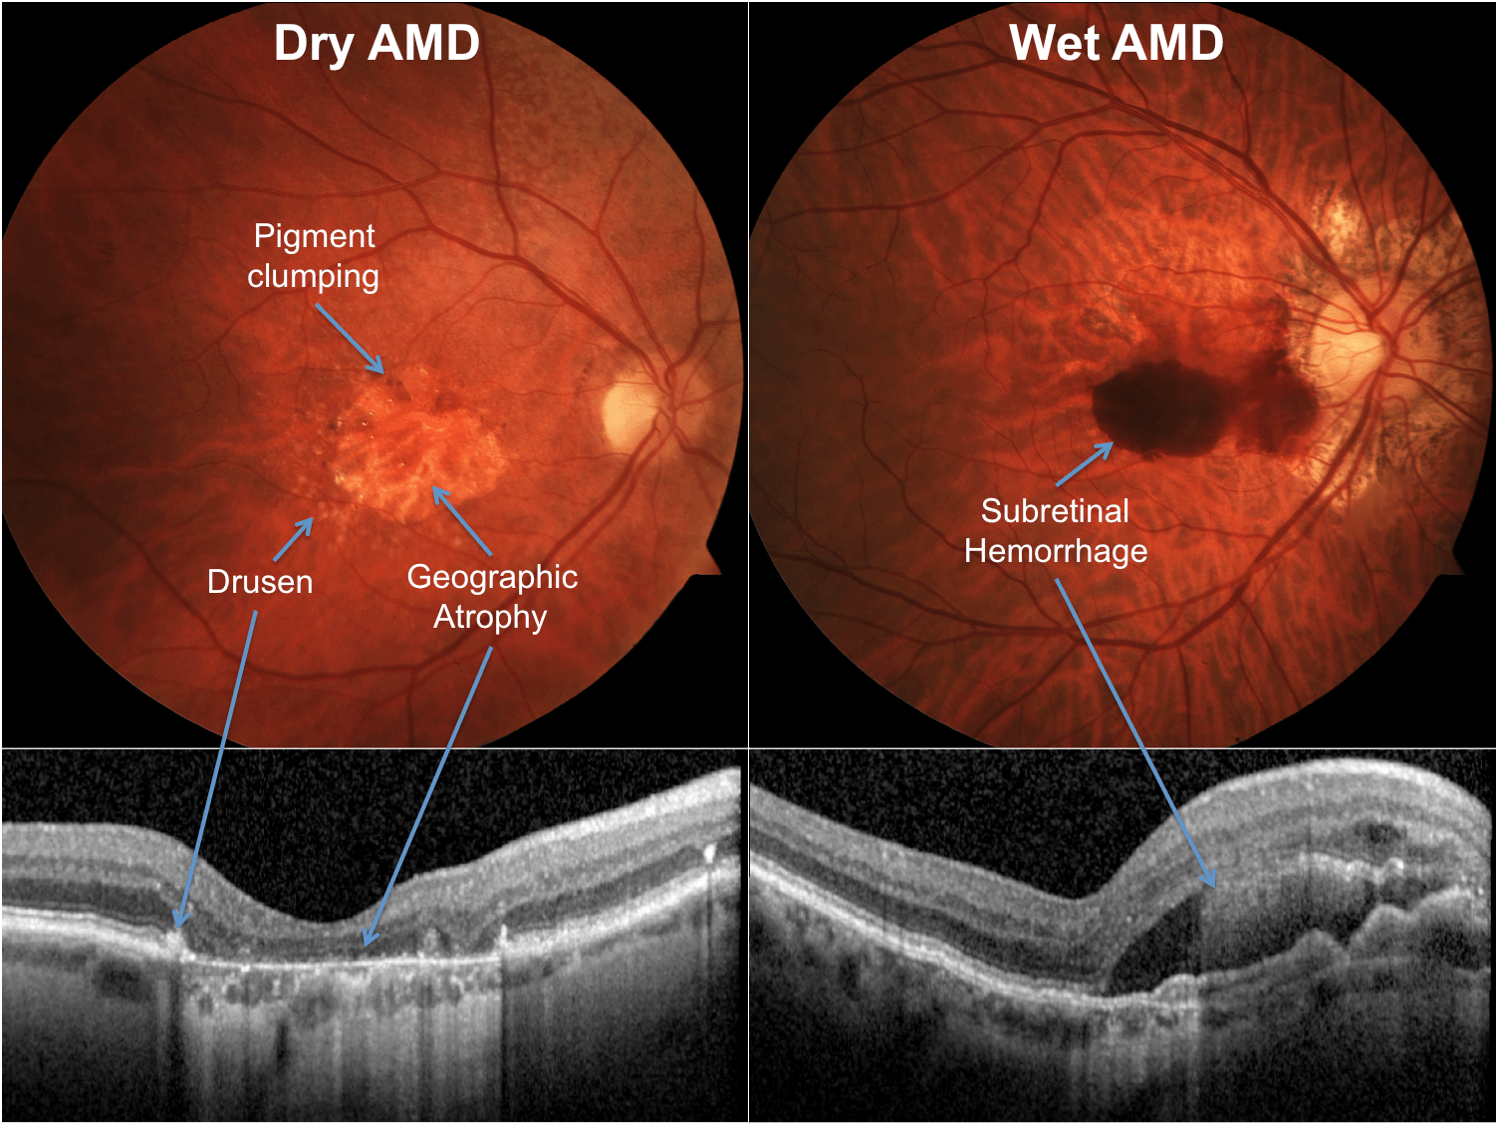
Eye diseases
from https://fvhospital.com/learn-more/age-related-macular-degeneration/
from https://myeyespecialist.com.au/macular-degeneration
Introduction
Eye diseases
Dataset & Methods
Results & Discussion
Conclusion

Slide 7
Eye diseases
Signs & Symptoms of AMD:
Limited visibility in low light
Blurred central vision
Seeing straight lines as wavy
Causes & Risk factors of AMD
Poor nutrition
Overweight and Lack of physical activity
High blood pressure
Introduction
Eye diseases
Dataset & Methods
Results & Discussion
Conclusion

Slide 8
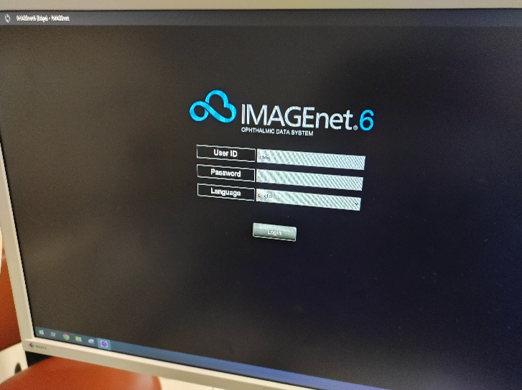
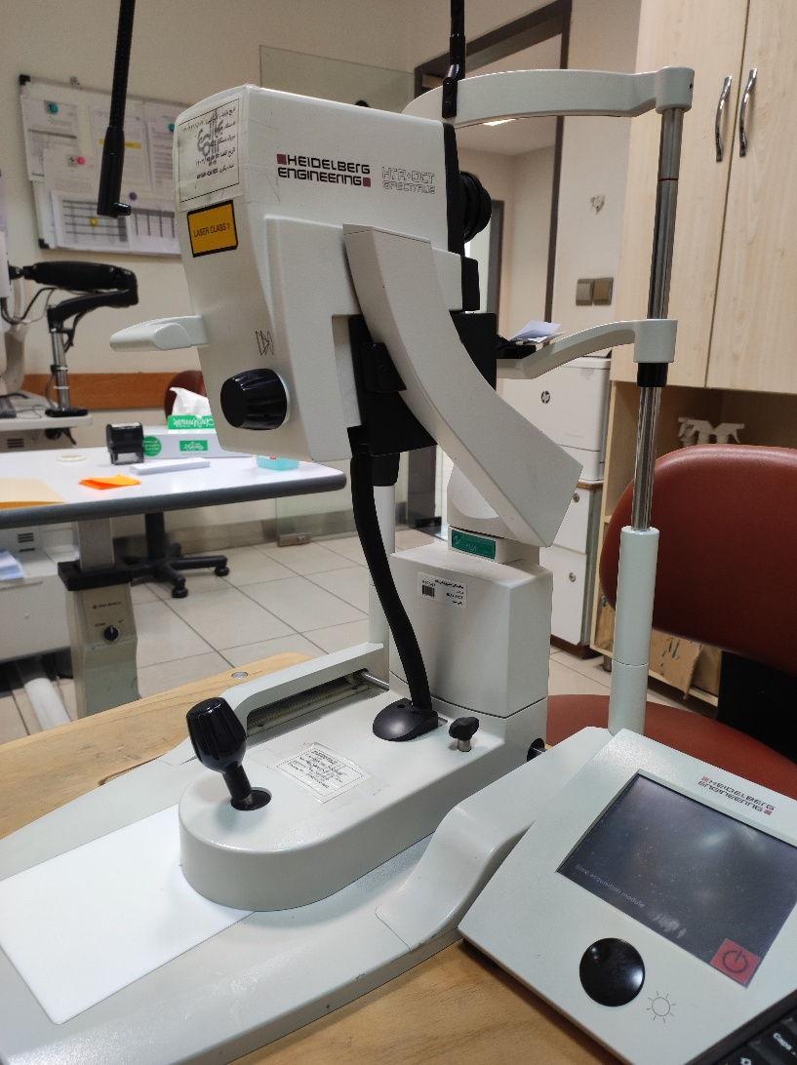
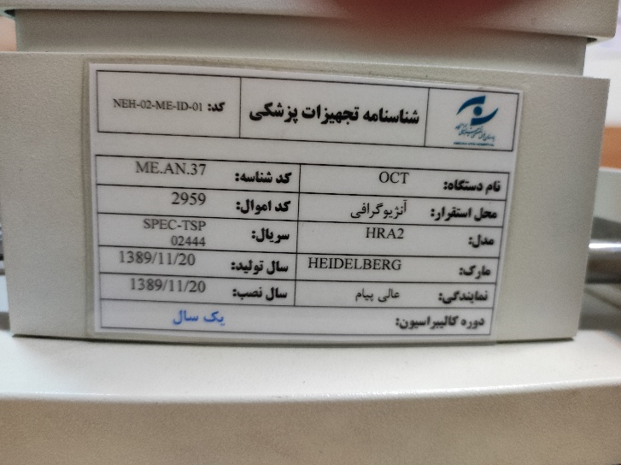
Optical Coherence Tomography
Introduction
Eye diseases
Dataset & Methods
Results & Discussion
Conclusion

Slide 9
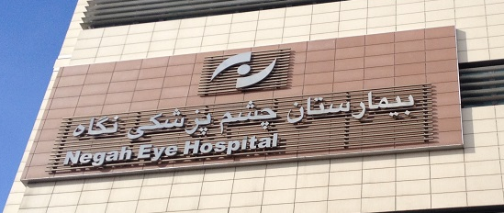
Dataset
The collected dataset contains 1240 OCT images in jpg format.
This dataset was collected from Negah Eye Hospital.
The data classification and labeling process was done with the help of Dr. Anoushirvan Rahimi.
Introduction
Eye diseases
Dataset & Methods
Results & Discussion
Conclusion

Slide 10
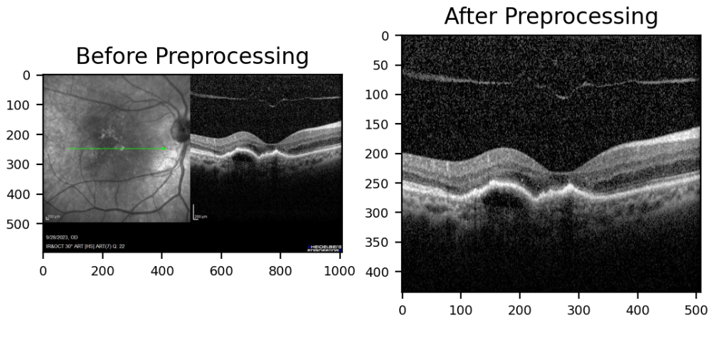
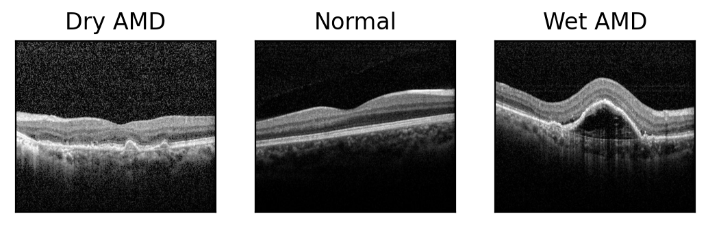
Dataset
Data preprocessing
Introduction
Eye diseases
Dataset & Methods
Results & Discussion
Conclusion

Slide 11
Dataset
Dry AMD
Train: 256
Test: 100
Total: 356
Normal
Train: 358
Test: 100
Total: 458
Wet AMD
Train: 326
Test: 100
Total: 426
Introduction
Eye diseases
Dataset & Methods
Results & Discussion
Conclusion

Slide 12
Transfer Learning
Three pre-trained Convolutional Neural Networks (CNN) were used in this research:
VGG19
InceptionV3
Xception
In these models, all layers except the last 5 layers of the pre-trained models are frozen.
Three fully connected layers, referred to as MLP classifier are also added at the end of them.
Fully connected layers
Layer’s Number | Activation function | Number of neurons
1 | Relu | 300
2 | Relu | 200
3 | Softmax | 3
Introduction
Eye diseases
Dataset & Methods
Results & Discussion
Conclusion

Slide 13
Methods
Batch size and numbers of epochs were 8 and 20 respectively.
Learning rate, which gradually decreases, starts at 0.0001 using the Adam optimizer.
The models were trained on Google Colab’s GPU T4.
Implementing training regulators, such as the gradual reduction of learning rate and EarlyStopping, greatly helped our results.
Number of trainable parameters in each model:
Architecture | Train params
VGG19 | 17,026,735
InceptionV3 | 39,382,703
Xception | 64,667,823
Introduction
Eye diseases
Dataset & Methods
Results & Discussion
Conclusion

Slide 14
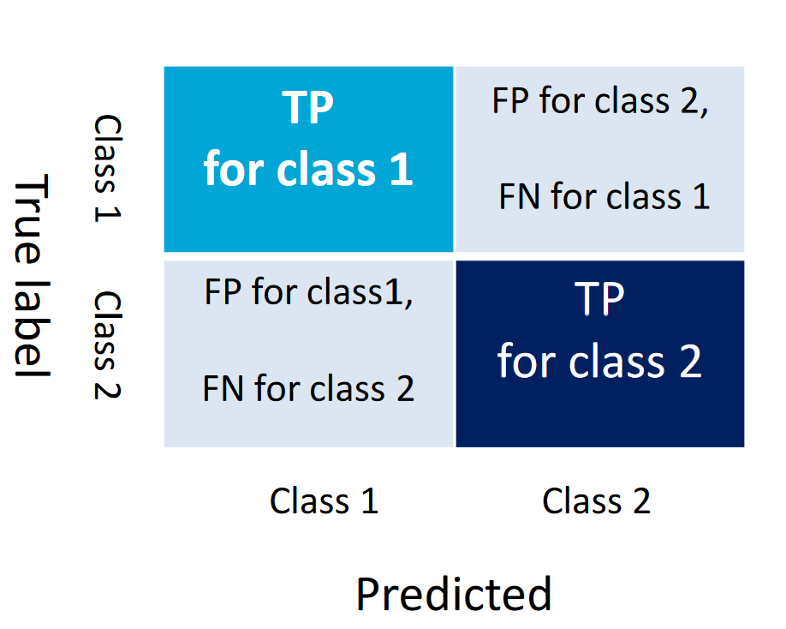
Metrics
Confusion Matrix:
Introduction
Eye diseases
Dataset & Methods
Results & Discussion
Conclusion

Slide 15
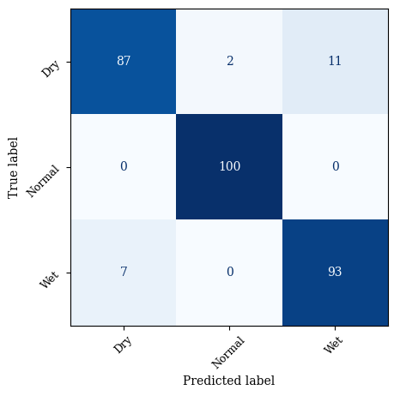
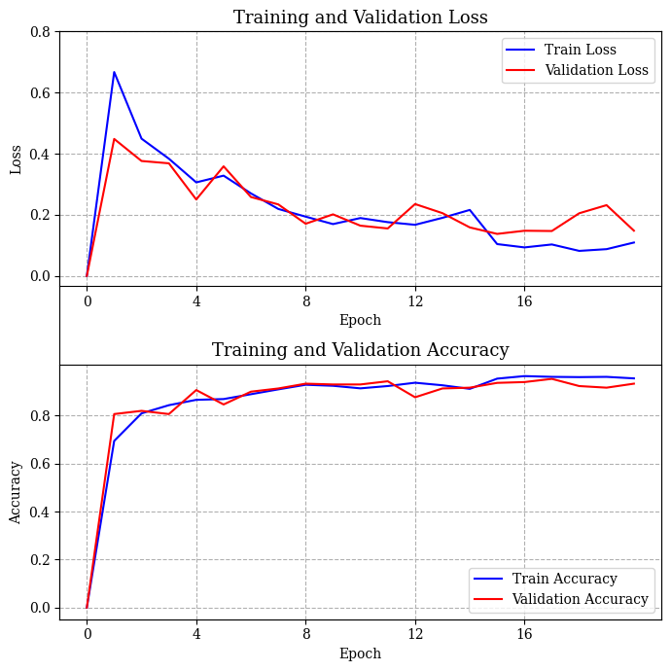
Results
VGG19
Introduction
Eye diseases
Dataset & Methods
Results & Discussion
Conclusion

Slide 16
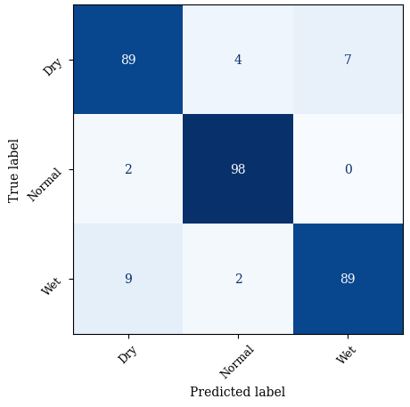
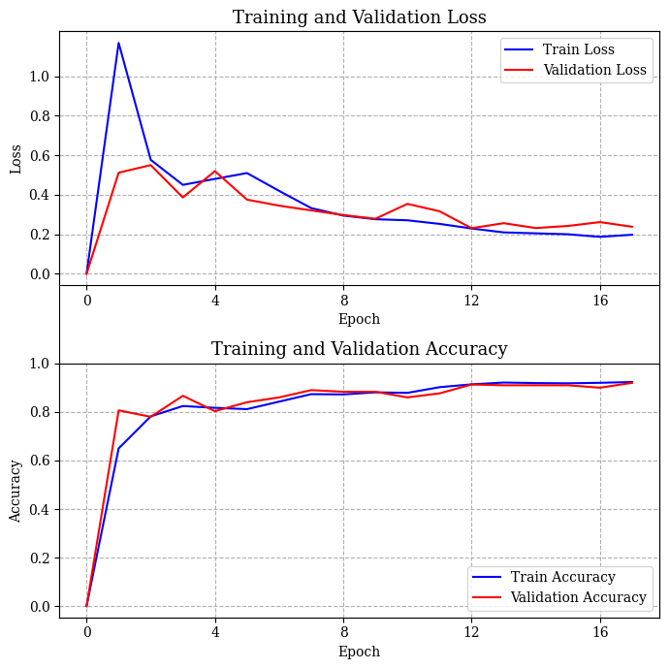
Results
InceptionV3
Introduction
Eye diseases
Dataset & Methods
Results & Discussion
Conclusion

Slide 17

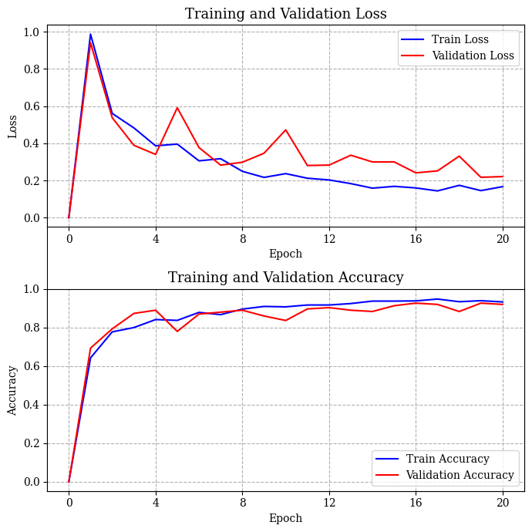
Results
Xception
Introduction
Eye diseases
Dataset & Methods
Results & Discussion
Conclusion

Slide 18
Discussion
VGG19 architecture has the best accuracy with some overfitting.
Xception architecture offers a more balanced model that prevents overfitting.
Training regulators (Learning Rate gradual reduction / EarlyStopping) greatly helped.
Prediction accuracy of Dry AMD is lower compared to other classes.
Normal class achieved benchmarks above 95%.
Architecture | Precision | Recall | F1 Score
VGG19 | 0.93 | 0.93 | 0.93
InceptionV3 | 0.92 | 0.92 | 0.92
Xception | 0.92 | 0.92 | 0.92
Introduction
Eye diseases
Dataset & Methods
Results & Discussion
Conclusion

Slide 19
Discussion
Challenges
Difference in the quantity of data available for each disease (more Wet Screening)
More challenging and time-consuming to collect data for Dry AMD or similar data-poor diseases due to less imaging
No online or systematic patient archive based on disease in local hospitals visited
Change in the condition of one eye from Dry to Wet AMD makes observation difficult
Opportunities
Archiving and categorizing data using CNN models, especially for research purposes
Educational aid tool for disease diagnosis practice in the learning or teaching process
Auxiliary tool to recognize challenging disease samples and clear doubts
Simultaneous and seamless diagnosis with imaging
Introduction
Eye diseases
Dataset & Methods
Results & Discussion
Conclusion

Slide 20
Conclusion
This article examined the classification of normal, Dry AMD, and Wet AMD eyes using Transfer Learning.
The results showed that despite limited and self-conducted data, desired accuracy can be achieved by utilizing pre-trained models.
Models with higher accuracy and better performance can be built by collecting more OCT images and using advanced artificial intelligence algorithms.
Future Vision:
Solving the problems in data collection and labeling
Archiving patient information, especially disease classification
Providing a practical tool for doctors and patients
Introduction
Eye diseases
Dataset & Methods
Results & Discussion
Conclusion

Slide 21

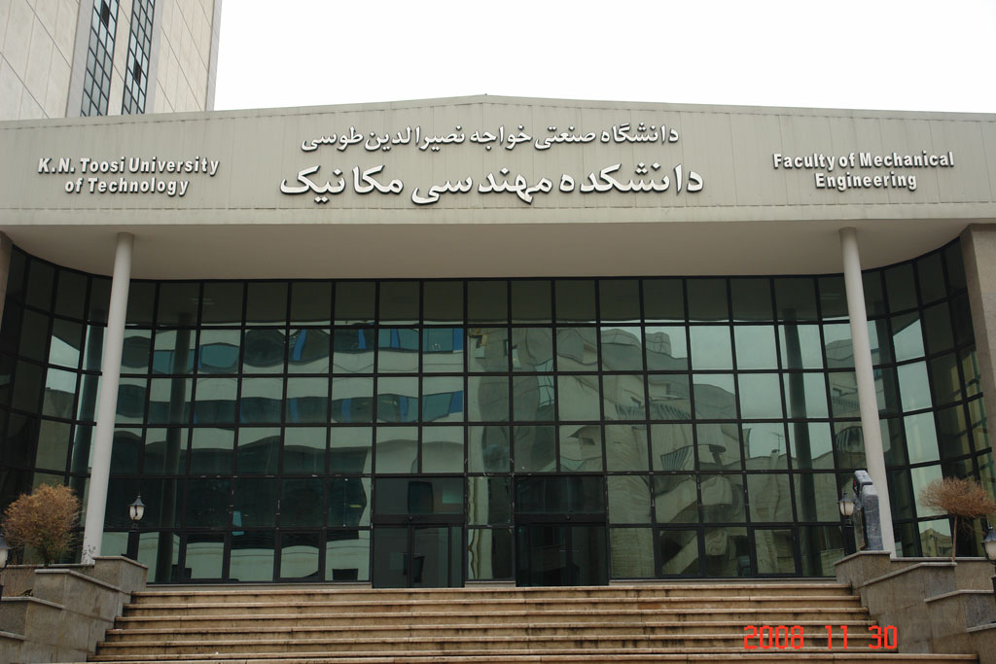
Thank you for your attention
--------------
ISME2025 – IC1270
Mahkame Sharbatdar: Assistant Professor, Faculty of Mechanical Engineering, K. N. Toosi University of Technology, Tehran; m.sharbatdar@kntu.ac.ir
Mostafa Amiri: Student, Faculty of Mechanical Engineering, K. N. Toosi University of Technology, Tehran; mostafa.a.568010@gmail.com
Parsa Aghaei: Student, Faculty of Mechanical Engineering, K. N. Toosi University of Technology, Tehran; p.aghaei.pa@gmail.com

