Slide 1

Integrating the imaging and diagnosis process of AMD with the help of artificial intelligence
Author: Parsa Aghaei
Prof. 1: Dr. Mahdi Moghimi Zand
Prof. 2: Dr Ehsan Hosseinian

Slide 2
contents
Introduction
Background & Literature review
Dataset & Methods
Results & Discussion
Conclusion

Slide 3
Introduction
Problem Statement:
Diagnosis of dry and wet AMD eye diseases compared to normal eye using OCT images
Significance of the research:
Initial diagnosis
Acceleration of the diagnosis process
Purpose of the research:
Providing a practical tool for researchers, doctors, and patients
Educational tool for medical students
Reducing human errors
Introduction
Background
Dataset & Methods
Results & Discussion
Conclusion

Slide 4
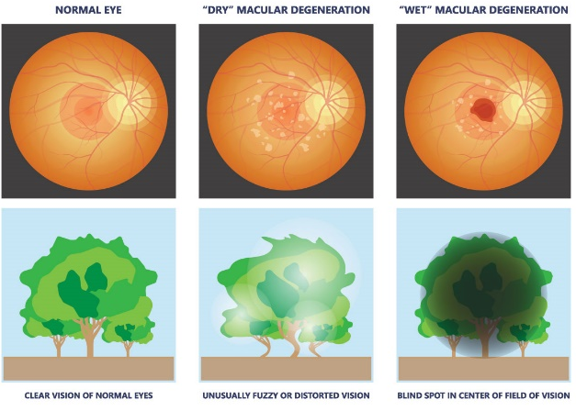
Background
Dry AMD
Normal
Examined eye conditions
Wet AMD
Introduction
Background
Dataset & Methods
Results & Discussion
Conclusion

Slide 5
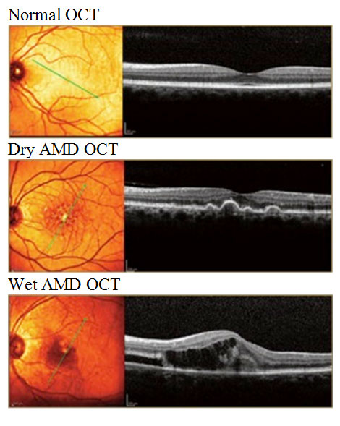
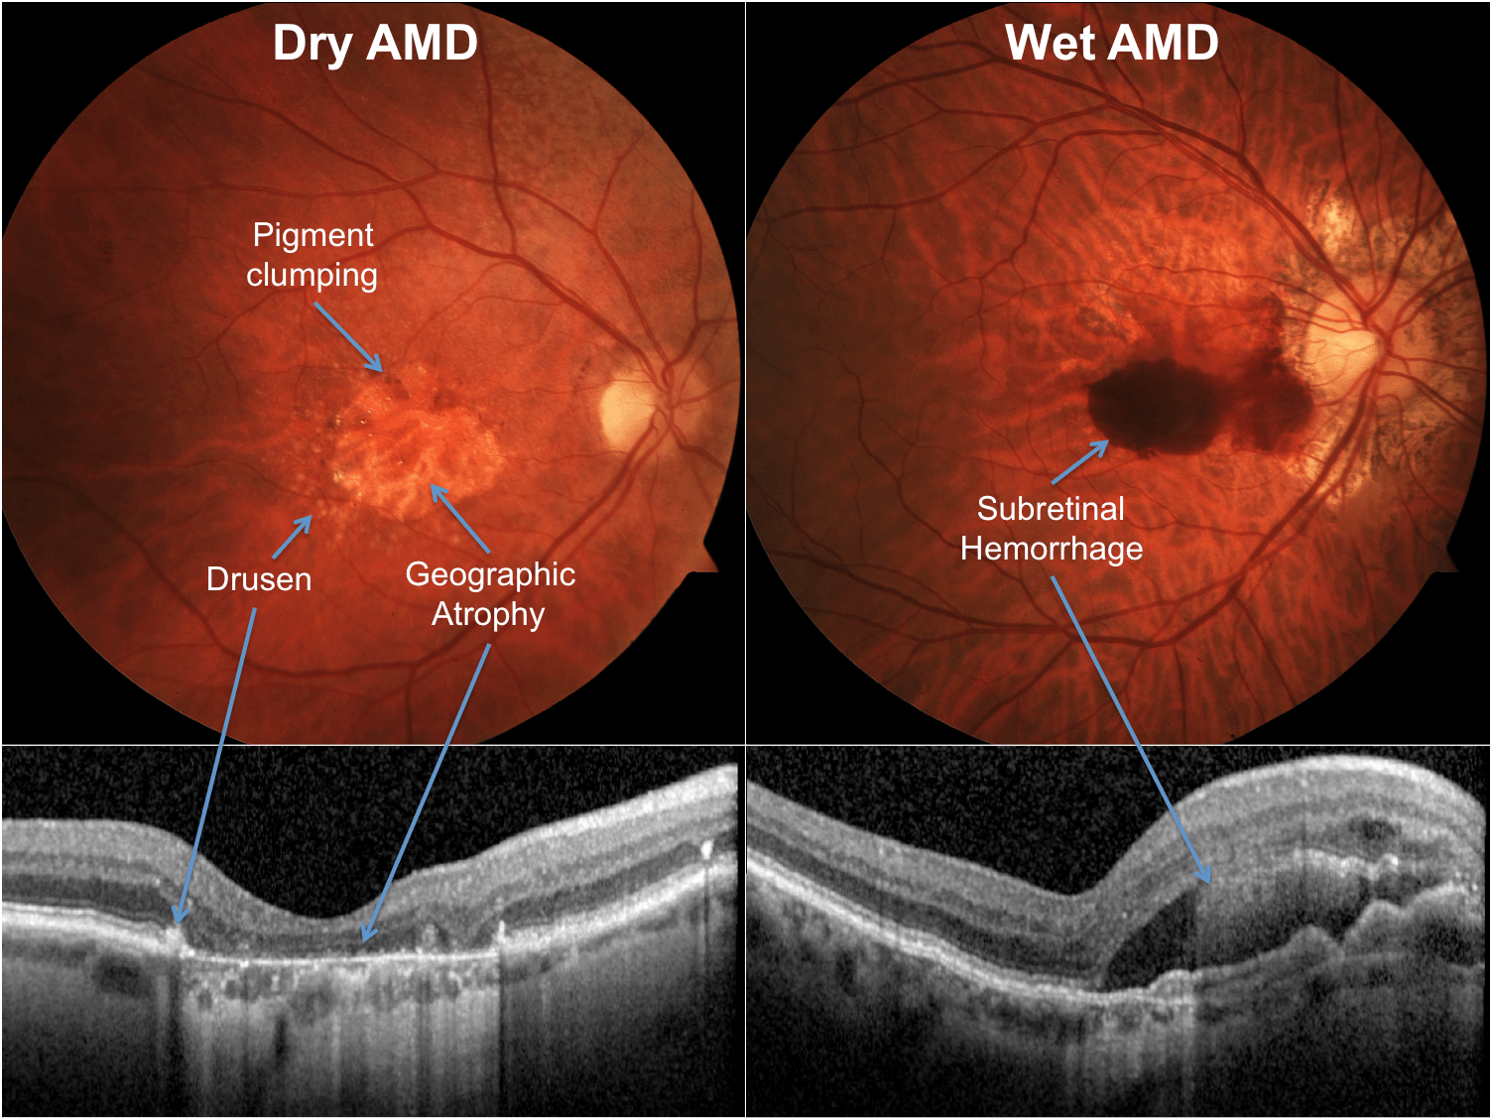
Background
Introduction
Background
Dataset & Methods
Results & Discussion
Conclusion

Slide 6
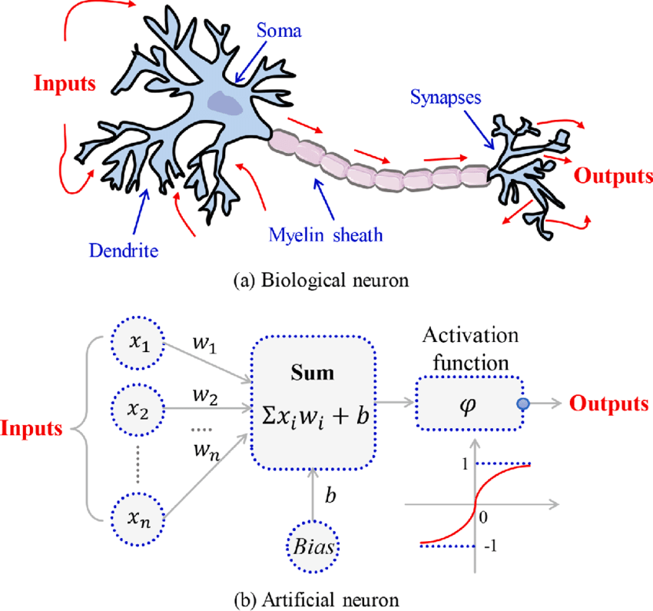
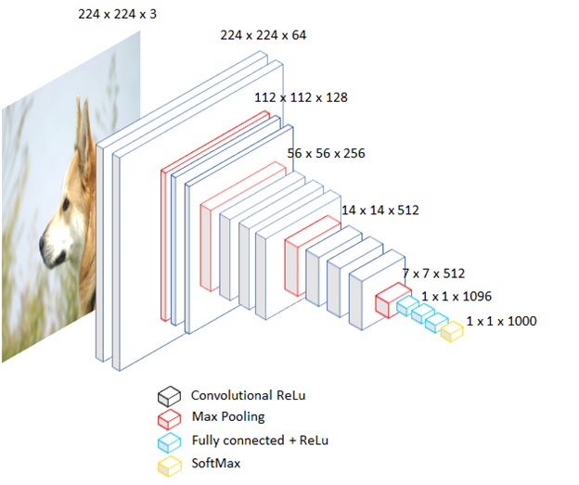
ANN & CNN
Introduction
Background
Dataset & Methods
Results & Discussion
Conclusion

Slide 7
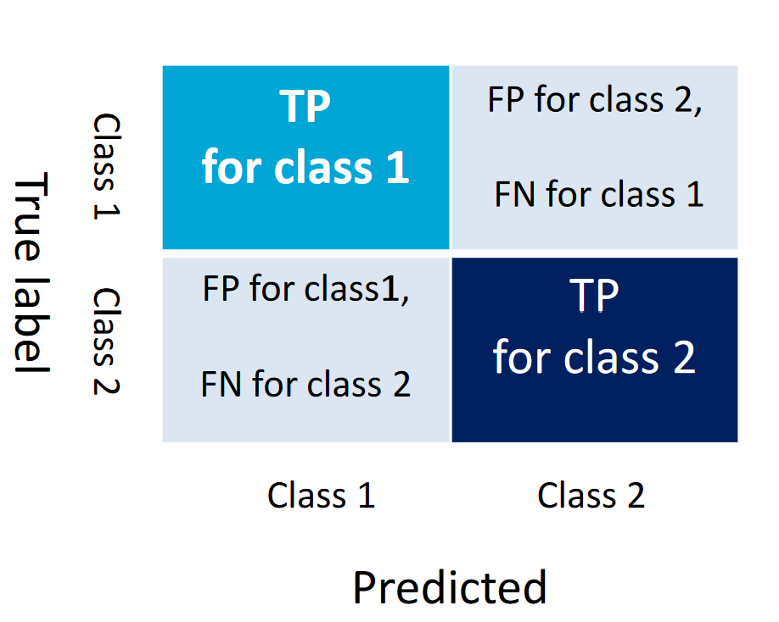
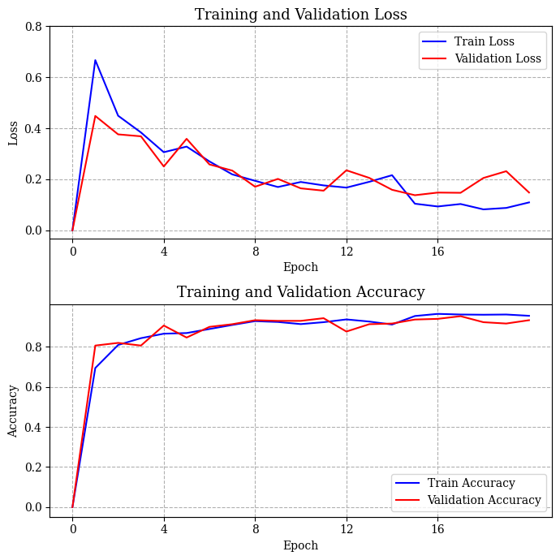
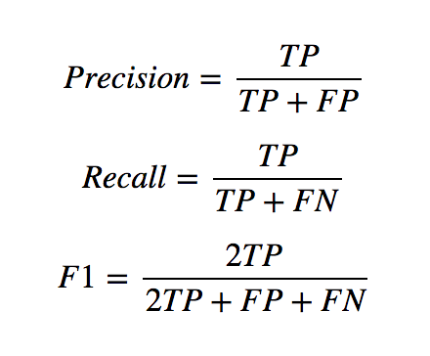
Metrics
Introduction
Background
Dataset & Methods
Results & Discussion
Conclusion

Slide 8
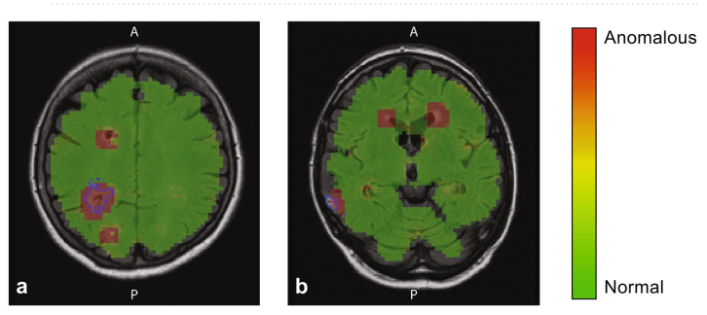
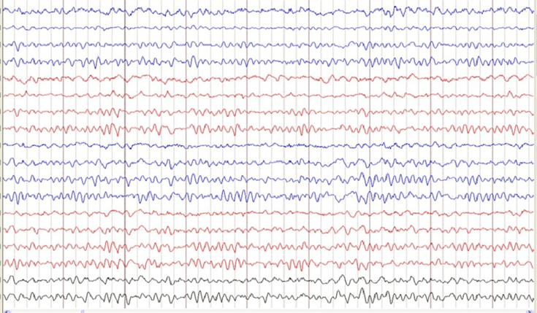
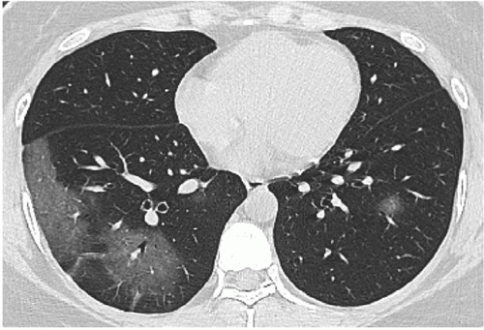
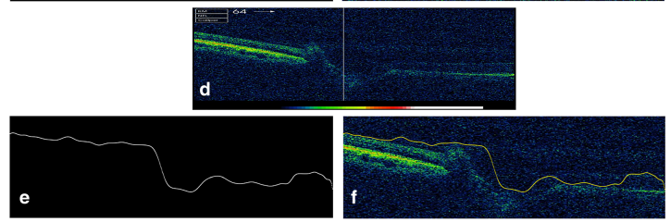
CNN Cases
Introduction
Background
Dataset & Methods
Results & Discussion
Conclusion

Slide 9
Literature review
Sample Size | Task | Performance Metrics
2795 patients | Prediction within a 6-month window | AUC=0.74 (conversion scan) and 0.886 (1st injection)
671 AMD fellow eyes | Predict progression to wet AMD | AUC=0.96±0.02 (3 months); 0.97±0.02 (21 months)
686 fellow eyes | Predict conversion from non-neovascular to neovascular AMD | Drusen within 3 mm of fovea (HR=1.45); mean drusen reflectivity (HR=3.97)
495 eyes | Predictive model to assess risk of conversion to advanced AMD | AUC=0.68 for CNV and 0.8 for geographic atrophy
2712 OCT B-scans | Segmentation of features associated with AMD | Dice=0.63±0.15; ICC=0.66±0.22
Introduction
Background
Dataset & Methods
Results & Discussion
Conclusion

Slide 10
Literature review
Reference | Disease classes | No. of images | F1 Score
Kermany et al. | DRUSEN, DME, CNV, NORMAL | >100000 | 0.976
B. Nejad et al. | DRUSEN, DME, CNV, NORMAL | >80000 | 0.99
Serener et al. | Dry AMD, Wet AMD | >10000 | 0.98
Prahs et al. | Treatment AMD with anti-VEGF | >150000 | 0.93
Introduction
Background
Dataset & Methods
Results & Discussion
Conclusion

Slide 11
Challenges
Training
Class imbalance
Intra-class imbalance
Wet AMD = imaging & injections
Archiving (Hospitals)
Changes in eye condition
Low contrast and signal to noise ratio
Effective implementation
Introduction
Background
Dataset & Methods
Results & Discussion
Conclusion

Slide 12
Transfer Learning
Fully connected layers
Layer’s Number | Activation function | Number of neurons
1 | Relu | 300
2 | Relu | 200
3 | Softmax | 3
Pre-trained models used:
VGG19
InceptionV3
Xception
Frozen layers except the last 5
Three fully connected layers as MLP classifier
Introduction
Background
Dataset & Methods
Results & Discussion
Conclusion

Slide 13
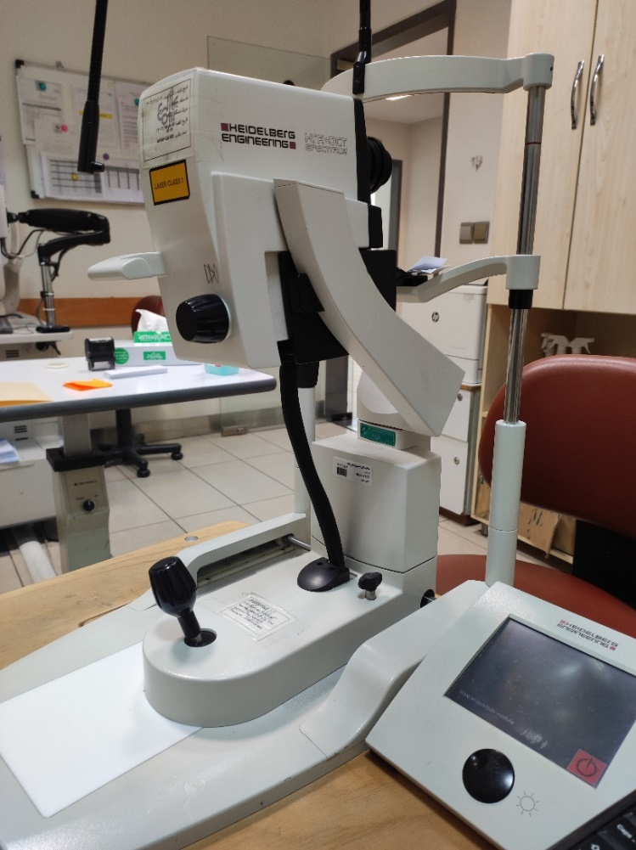
Challenges
Cooperation
Local hospitals’ archiving
Operators (Nurses)
Different hardware & software
Labeling
Introduction
Background
Dataset & Methods
Results & Discussion
Conclusion

Slide 14
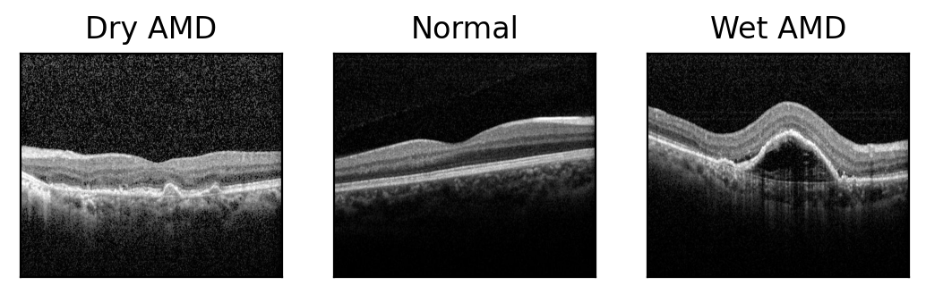
Dataset
Train: 256
Test: 100
Total: 356
Train: 326
Test: 100
Total: 426
Train: 358
Test: 100
Total: 458
Introduction
Background
Dataset & Methods
Results & Discussion
Conclusion

Slide 15
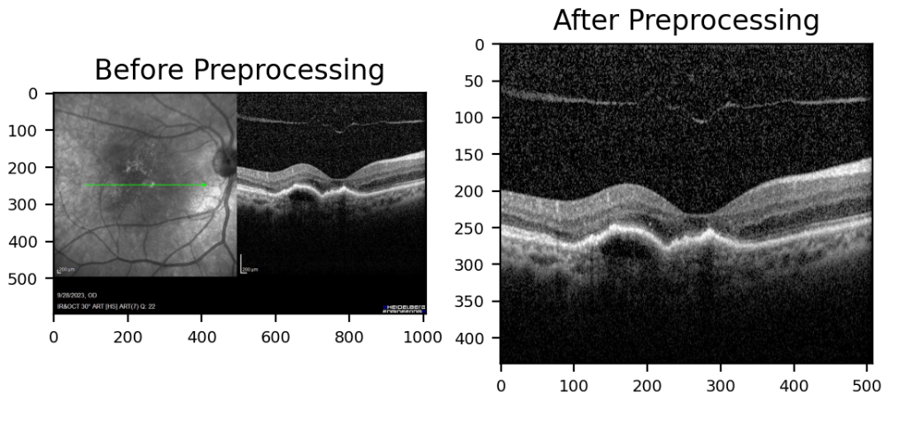
Methods
Batch size 8
Numbers of epochs 20
Adam optimizer
Trained on Google Colab’s GPU T4
Training Regulators: EarlyStopping & learning rate reduction
Introduction
Background
Dataset & Methods
Results & Discussion
Conclusion

Slide 16
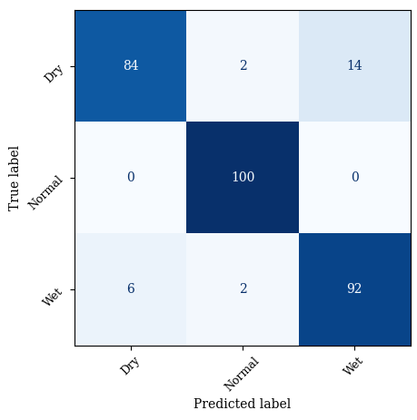
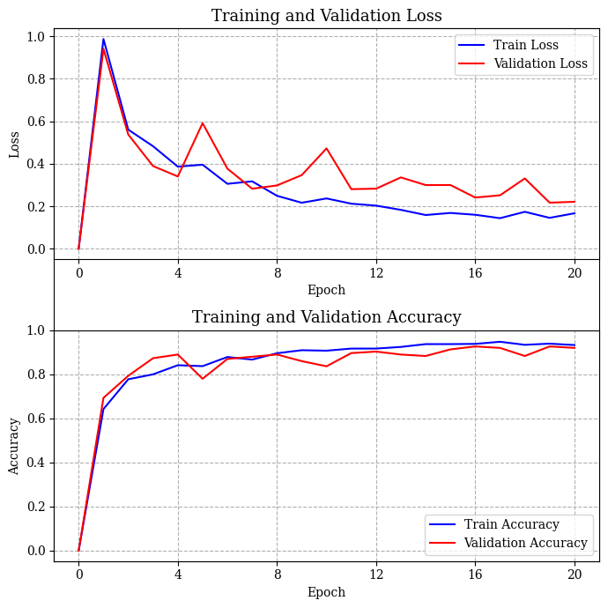
Results
Xception Model
Introduction
Background
Dataset & Methods
Results & Discussion
Conclusion

Slide 17
Results
Best accuracy: VGG19 architecture
Normal class above 95%
Most balanced: Xception
Challenging Class: Dry AMD
Architecture | Precision | Recall | F1 Score | Train params
VGG19 | 0.93 | 0.93 | 0.93 | 17,026,735
InceptionV3 | 0.92 | 0.92 | 0.92 | 39,382,703
Xception | 0.92 | 0.92 | 0.92 | 64,667,823
Introduction
Background
Dataset & Methods
Results & Discussion
Conclusion

Slide 18
Schedule
Tir – Shahrivar 1404
Patient-Based
Data Collection
Mehr – Azar 1404
Dr verification
Labelling
Dey – Bahman 1404
Limited Data
Exploring ML Structures
Bahman 1404 – Farvardin 1405
95-99% Accuracy
Training
Dey 1404 – Ordibehesht 1405
Fast & Simple
App Design
Ordibehesht – Shahrivar 1405
Automatic Diagnosis
Clinical Utilization
Bahman 1404 – Khordad 1405
Monthly report
Writing Thesis
Introduction
Background
Dataset & Methods
Results & Discussion
Conclusion

Slide 19
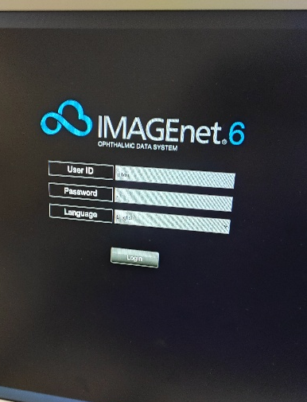
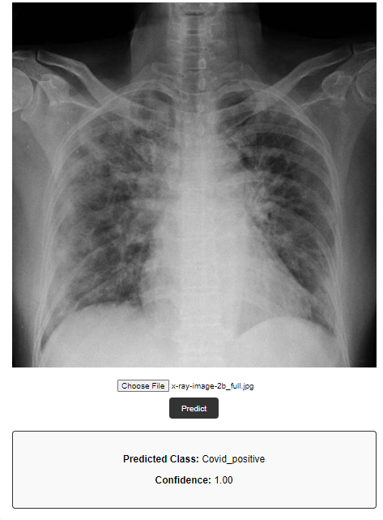
Future Works
Introduction
Background
Dataset & Methods
Results & Discussion
Conclusion

Slide 20
Conclusion
Works done
Classification of normal, Dry AMD, and Wet AMD eyes.
Limited and self-conducted data
Desired accuracy using Transfer Learning
Future Works
Faster data collection and labeling
More data & better performance
Simple app
Introduction
Background
Dataset & Methods
Results & Discussion
Conclusion

Slide 21
Advantages
Researchers
Patients
Hospital & Staff
Limited data training
Research relevance
Local data
Reducing human errors
Early diagnosis
Time / Cost burdens
Disease-based archiving
Educational aid tool
Clinical relevance
Introduction
Background
Dataset & Methods
Results & Discussion
Conclusion

Slide 22

Thank you for your attention
Parsa Aghaei: Student, Faculty of Mechanical Engineering, University of Tehran, Tehran; p.aghaei.pa@gmail.com

