Slide 1

Introduction to fMRI Data Analysis
Presenter: Mohammad Nili
Course: Introduction to Cognitive Neuroscience

Slide 2
Outlines
Big picture of fMRI and BOLD signal (from pre-processing to processing)
Python toolkits overview (nilearn, nibabel, numpy, …)
Anatomical image visualization
Time series extraction and ROI definition
Basics of GLM pipeline
Functional Connectivity
Multivariate Pattern Analysis (MVPA)
Open-Access datasets

Slide 3

Understanding fMRI and the BOLD Signal
Functional Magnetic Resonance Imaging (fMRI) measures brain activity by detecting changes in blood flow. When neurons become active, they require more oxygen, leading to an increase in localized blood flow. This phenomenon is known as the BOLD (Blood-Oxygen-Level Dependent) signal.
The BOLD signal is an indirect measure of neural activity. It relies on the difference in magnetic properties between oxygenated and deoxygenated hemoglobin. Active brain regions show a higher ratio of oxygenated to deoxygenated blood, which is what the fMRI scanner detects.

Slide 4

The Python Toolkit for fMRI Analysis
Python offers a powerful and flexible ecosystem for fMRI data analysis. Key libraries provide specialized tools for handling neuroimaging data, numerical operations, and visualization.
Nilearn
NumPy
A Python module for efficient and user-friendly neuroimaging data analysis, providing tools for statistical analysis, machine learning, and visualization.
The fundamental package for numerical computation in Python, essential for array operations and mathematical functions on imaging data.
NiBabel
Matplotlib
Handles various neuroimaging file formats (like NIfTI) in Python, allowing for robust data loading, manipulation, and saving.
A comprehensive library for creating static, animated, and interactive visualizations in Python, crucial for plotting fMRI results.

Slide 5
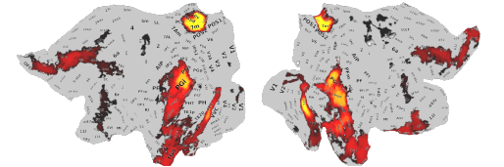
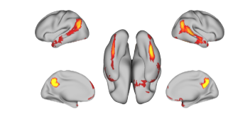
Visualizing fMRI Images
Anatomical images provide a high-resolution structural reference of the brain. They are typically T1-weighted scans and are crucial for understanding the location of functional activations.
Visualizing anatomical data in different planes (sagittal, coronal, axial) helps in understanding the brain's 3D structure and orienting yourself within the dataset.
These slices represent different perspectives: sagittal (side view), coronal (front view), and axial (top-down view). Understanding these orientations is fundamental for accurate neuroimaging analysis.

Slide 6
Functional Overlay on Anatomy
Once functional activity is analyzed, the results (e.g., statistical maps) are often overlaid on the anatomical image to contextualize the findings within the brain's structure.
This process allows researchers to pinpoint exactly where brain activity is occurring in relation to specific anatomical landmarks. Nilearn provides excellent tools for this visualization, often showing activity as a heatmap.
The heatmap indicates regions of significant activity, with different colors often representing varying levels of statistical significance or activation intensity.

Slide 7
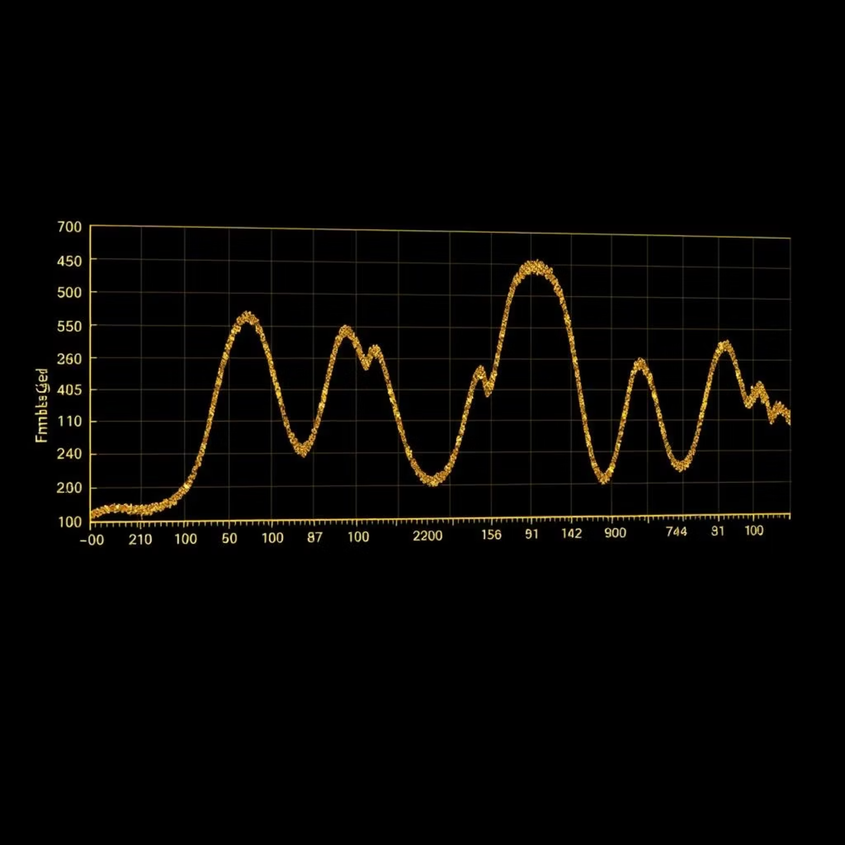
Time Series Extraction with NiftiMasker
The BOLD signal is a time series, representing changes in blood flow over the duration of the scan. Extracting these time courses from specific brain regions is a crucial step for further analysis.
Nilearn's NiftiMasker simplifies this process, allowing you to extract signals from specified masks (e.g., whole brain, specific regions of interest) and prepare them for statistical modeling.
from nilearn.maskers import NiftiMasker
import matplotlib.pyplot as plt
masker = NiftiMasker(mask_img=haxby_dataset.mask_vt[0], standardize="True", memory="nilearn_cache", memory_level=1)
fmri_masked = masker.fit_transform(haxby_dataset.func[0])
plt.figure(figsize=(10, 4))
plt.plot(fmri_masked[0])
plt.title("Extracted Time Course")
plt.xlabel("Time Points")
plt.ylabel("BOLD Signal (Normalized)")
plt.show()

Slide 8
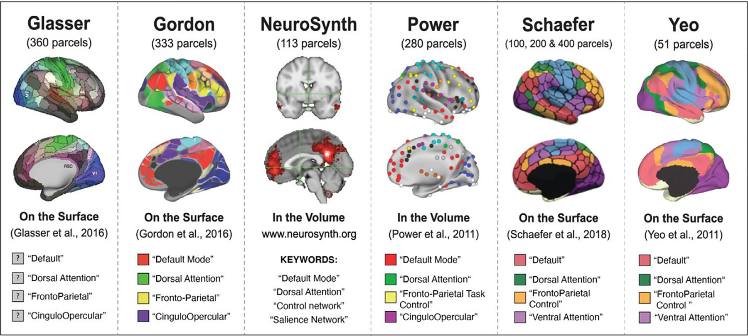
ROI Definition and Masking
Regions of Interest (ROIs) are specific brain areas defined by anatomical boundaries or functional characteristics. Masking allows you to isolate and analyze activity within these predefined regions.
Defining ROIs using MNI (Montreal Neurological Institute) coordinates is common, especially when working with normalized brain data. Spherical masks are often used for simple ROI definitions around a central coordinate.
Defining ROIs using MNI (Montreal Neurological Institute) coordinates is common, especially when working with normalized brain data. Spherical masks are often used for simple ROI definitions around a central coordinate.

Slide 9
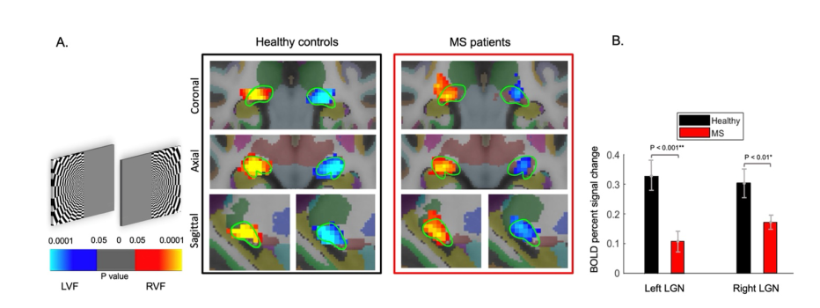
Basic General Linear Model (GLM) Pipeline
The General Linear Model (GLM) is the most common statistical framework used to analyze fMRI data. It models the BOLD response to experimental conditions.
A key component is the design matrix, which specifies the timing and amplitude of experimental events. The GLM then estimates beta coefficients (β-maps) for each regressor, indicating the strength of the relationship between the experimental condition and the BOLD signal, often visualized as z-maps.
The design matrix visualizes the experimental paradigm, with different columns representing various conditions or nuisance regressors (e.g., head motion).
The β-map or z-map displays statistical results, where hot colors typically indicate significant activation in response to a particular experimental condition.

