Slide 1
LONGEST PATH PROBLEM
Parsa Mohammadpour
Hesam Mumivand Fard
Saeed Terik
Mohammad Rahbari Moghadam
20 November 2024

Slide 2
OUTLINE
INTRODUCTION TO GRAPH
HAMILTON PATH PROBLEM
DEFENITION OF LONGEST PATH
TIME COMPLEXITY ANALYSIS
APPLICATION & CHALLENGES
TRAVELING SALESMAN PROBLEM
ALGORITHM FOR LONGEST PATH
TIME COMPLEXITY ANALYSIS
TIME COMPLEXITY ANALYSIS
CONCLUSION
LONGEST PATH IN GRAPH

Slide 3
INTRODUCTION TO GRAPH
GRAPHS:
NODES (VERTICES)
EDGES (CONNECT NODES)
Types of Graphs:
Directed vs. Undirected
Undirected to Directed
Weighted vs. Unweighted
UNWEIGHTED to weighted
CYCLIC VS. ACYCLIC
LONGEST PATH IN GRAPH

Slide 4
INTRODUCTION TO GRAPHS
REPRESENTATION:
ADJACENCY MATRIX
ADJACENCY LIST Edges
DAG:
DIRECTED ACYCLIC GRAPH
TOPOLOGICAL ORDER
NOT UNIQUE
LONGEST PATH IN GRAPH

Slide 5
OUTLINE
DEFENITION OF LONGEST PATH
INTRODUCTION TO GRAPH
LONGEST PATH IN GRAPH

Slide 6

DEFENITION OF LONGEST PATH
PATH:
SEQUENCE OF EDGES
LIKE $v_{1} v_{2} v_{5} …v_{k}$
V ARE VERTICES OF GRAPH
NO REPETITION
PATH WEIGHT:
SUMMATION OF ALL EDGES WEIGHT IN PATH
Longest path:
WEIGHTED:
Path between two vertices with highest PATH WIGHT
UNWEIGHTED
Path between two vertices with highest VERTICES COUNT
LONGEST PATH IN GRAPH

Slide 7
OUTLINE
INTRODUCTION TO GRAPH
DEFENITION OF LONGEST PATH
APPLICATION & CHALLENGES
LONGEST PATH IN GRAPH

Slide 8
APPLICATION & CHALLENGES
APPLICATIONS:
HAMILTON PATH PROBLEM:
IS THERE ANY PATH WITH ALL N VERTICES IN IT
GENERALIZATION FOR LONGEST PATH
TRAVELING SALESMAN PROBLEM:
WEIGHTED COMPLETE Graph
NONE NEGATIVE INTEGERS
LONGEST PATH CONTAINS ALL VERTICES
GENERALIZATION FOR LONGEST PATH
CHALLENGES:
LONGEST PATH PROBLEM IS NP-HARD
Np-hard vs. np-complete
LONGEST PATH IN GRAPH

Slide 9
OUTLINE
INTRODUCTION TO GRAPH
DEFENITION OF LONGEST PATH
APPLICATION & CHALLENGES
ALGORITHM FOR LONGEST PATH
LONGEST PATH IN GRAPH

Slide 10

PSUEDOCODE:
ALGORITHM FOR LONGEST PATH
Function longest_path(graph):
Initialize path_len to -1
Initialize path_list to None
For each node `i` in the graph:
Call longest_path_recursive(graph, i, [], 0)
If i_path_len > path_len:
Update path_len to i_path_len
Update path_list to i_path_list
Return path_len, path_list
Function longest_path_recursive(graph, node, visited,
curr_path_len):
Initialize path_len to -1
Initialize path_list to None
Add the current node to the visited list
For each vertic i in the graph:
If i = node or i is in visited or (node, i) $∉$ Edges:
Continue to the next iteration
new_visited = visited.append(i)
edge_weight = weight of edge (node, i)
longest_path_recursive(graph, i,
new_visited, curr_path_len + edge_weight)
If i_path_len > path_len:
Update path_len to i_path_len
Update path_list to i_path_list
If path_len = -1 then:
Return curr_path_len and visited
Return path_len, path_list
LONGEST PATH IN GRAPH

Slide 11
SPECIAL CASE:
ALGORITHM FOR LONGEST PATH
DAG (DIRECTED ACYCLIC GRAPH)
FIND TOPOLOGICAL ORDER
STORED IN STACK
FOR ALL NODES DO:
INITI DISTANCE LIST TO -INF
POP TOPOLOGICAL ORDER STACK
UPDATE DISTANCE LIST
LONGEST PATH IN GRAPH

Slide 12
DAG PSUEDOCODE
ALGORITHM FOR LONGEST PATH
topologicalSort(node, V, Stack, visited):
visited[node] = True
for u in node’s out-neighbors:
if (not visited[u]):
topologicalSort(u, V, Stack, visited)
Stack.append(node)
longestPath(V, Stack, visited):
for i in V:
if (visited[i] = False):
topologicalSortUtil(i, V, Stack, visited)
max_path = -1
for node in V:
node_max_path = longestPathNode(node)
max_path = max(max_path, node_max_path)
return max_path
longestPathNode(node, V, Stack, visited):
dist = [-infinity for each node in V]
dist[node] = 0
while (len(Stack) > 0):
u = Stack.pop()
if (dist[u] != -infinity):
for v in u’s in-neighbour:
if (dist[v]] < dist[u] + weight(v, u)):
dist[v] = dist[u] + weight(v, u)
return max(dist)
LONGEST PATH IN GRAPH

Slide 13
OUTLINE
INTRODUCTION TO GRAPH
DEFENITION OF LONGEST PATH
APPLICATION & CHALLENGES
ALGORITHM FOR LONGEST PATH
TIME COMPLEXITY ANALYSIS
LONGEST PATH IN GRAPH

Slide 14
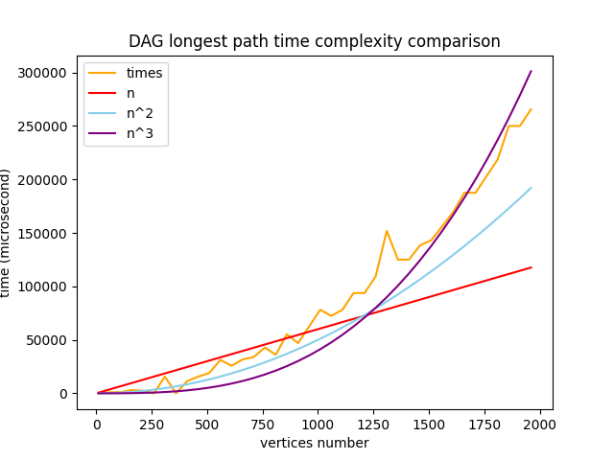
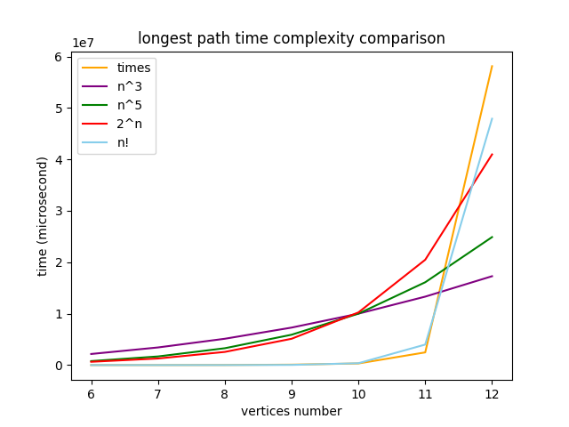
TIME COMPLEXITY:
TIME COMPLEXITY ANALYSIS
NOT DAG
BRUTE FORCE
N!
NP-HARD
DAG
POLYNOMIAL
NP-COMPLETE
UPDATE DISTANCE LIST
LONGEST PATH IN GRAPH

Slide 15
OUTLINE
INTRODUCTION TO GRAPH
HAMILTON PATH PROBLEM
DEFENITION OF LONGEST PATH
TIME COMPLEXITY ANALYSIS
APPLICATION & CHALLENGES
ALGORITHM FOR LONGEST PATH
LONGEST PATH IN GRAPH

