Slide 1
LONGEST PATH PROBLEM
Parsa Mohammadpour
Hesam Mumivand Fard
Saeed Terik
Mohammad Rahbari Moghadam
20 November 2024

Slide 2
OUTLINE
INTRODUCTION TO GRAPH
HAMILTON PATH PROBLEM
DEFENITION OF LONGEST PATH
TIME COMPLEXITY ANALYSIS
APPLICATION & CHALLENGES
TRAVELING SALESMAN PROBLEM
ALGORITHM FOR LONGEST PATH
TIME COMPLEXITY ANALYSIS
TIME COMPLEXITY ANALYSIS
CONCLUSION
LONGEST PATH IN GRAPH

Slide 3
INTRODUCTION TO GRAPH
GRAPHS:
NODES (VERTICES)
EDGES (CONNECT NODES)
Types of Graphs:
Directed vs. Undirected
Undirected to Directed
Weighted vs. Unweighted
UNWEIGHTED to weighted
CYCLIC VS. ACYCLIC
LONGEST PATH IN GRAPH

Slide 4
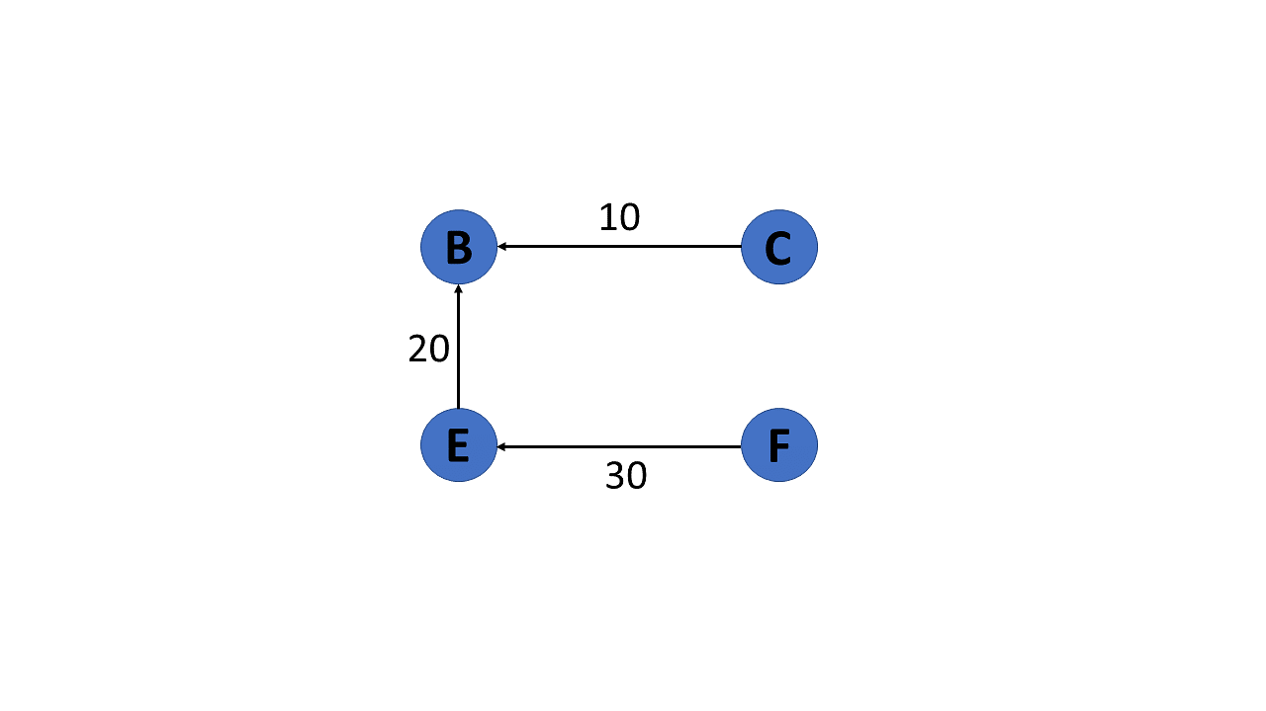
INTRODUCTION TO GRAPHS
REPRESENTATION:
ADJACENCY MATRIX
ADJACENCY LIST
DAG:
DIRECTED ACYCLIC GRAPH
TOPOLOGICAL ORDER
NOT UNIQUE
LONGEST PATH IN GRAPH

Slide 5
OUTLINE
DEFENITION OF LONGEST PATH
INTRODUCTION TO GRAPH
LONGEST PATH IN GRAPH

Slide 6

DEFENITION OF LONGEST PATH
PATH:
SEQUENCE OF NODES
LIKE $v_{1} v_{2} v_{5} …v_{k}$
V ARE VERTICES OF GRAPH
NO REPETITION FOR SIMPLE PATH
AN EDGE BETWEEN TWO CONSECUTIVE NODE
PATH WEIGHT:
SUMMATION OF ALL EDGES WEIGHT IN PATH
Longest path:
WEIGHTED:
Path between two vertices with highest PATH WIGHT
UNWEIGHTED
Path between two vertices with highest VERTICES COUNT
CONVERT TO WEIGHTED
LONGEST PATH IN GRAPH

Slide 7
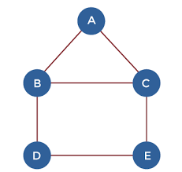
DEFENITION OF LONGEST PATH
Definition
SIMPLE PATH WITH LONGEST LENGTH
NOT SIMPLE
LOOP
INFINIT
Example
For the following graph
Longest Simple path:
A, B, C, E, d
Length is 4
NOT SIMPLE
INFINITY
LONGEST PATH IN GRAPH

Slide 8
OUTLINE
INTRODUCTION TO GRAPH
DEFENITION OF LONGEST PATH
APPLICATION & CHALLENGES
LONGEST PATH IN GRAPH

Slide 9
APPLICATION & CHALLENGES
APPLICATIONS:
HAMILTON PATH PROBLEM:
IS THERE ANY PATH WITH ALL N VERTICES IN IT
GENERALIZATION FOR LONGEST PATH
TRAVELING SALESMAN PROBLEM:
WEIGHTED COMPLETE Graph
NONE NEGATIVE INTEGERS
LONGEST PATH CONTAINS ALL VERTICES
GENERALIZATION FOR LONGEST PATH
CHALLENGES:
LONGEST PATH PROBLEM IS NP-HARD
Np-hard vs. np-complete
Book focus
LONGEST PATH IN GRAPH

Slide 10
OUTLINE
INTRODUCTION TO GRAPH
DEFENITION OF LONGEST PATH
APPLICATION & CHALLENGES
ALGORITHM FOR LONGEST PATH
LONGEST PATH IN GRAPH

Slide 11

PSUEDOCODE:
ALGORITHM FOR LONGEST PATH
Function longest_path(graph):
Initialize path_len to -1
Initialize path_list to None
For each node `i` in the vertices:
Call longest_path_recursive(graph, i, [], 0)
If i_path_len > path_len:
Update path_len to i_path_len
Update path_list to i_path_list
Return path_len, path_list
Function longest_path_recursive(graph, node, visited,
curr_path_len):
Initialize path_len to -1
Initialize path_list to None
Add the current node to the visited list
For each vertic i in the graph:
If i = node or i is in visited or (node, i) $∉$ Edges:
Continue to the next iteration
new_visited = visited.append(i)
edge_weight = weight of edge (node, i)
longest_path_recursive(graph, i,
new_visited, curr_path_len + edge_weight)
If i_path_len > path_len:
Update path_len to i_path_len
Update path_list to i_path_list
If path_len = -1 then:
Return curr_path_len and visited
Return path_len, path_list
LONGEST PATH IN GRAPH

Slide 12
SPECIAL CASE:
ALGORITHM FOR LONGEST PATH
DAG (DIRECTED ACYCLIC GRAPH)
FIND TOPOLOGICAL ORDER
STORED IN STACK
FOR ALL NODES DO:
INITI DISTANCE LIST TO -INF
POP TOPOLOGICAL ORDER STACK
UPDATE DISTANCE LIST
LONGEST PATH IN GRAPH

Slide 13
DAG PSUEDOCODE
ALGORITHM FOR LONGEST PATH
topologicalSort(node, V, Stack, visited):
visited[node] = True
for u in node’s out-neighbors:
if (not visited[u]):
topologicalSort(u, V, Stack, visited)
Stack.append(node)
longestPath(V, Stack, visited):
for i in V:
if (visited[i] = False):
topologicalSortUtil(i, V, Stack, visited)
max_path = -1
for node in V:
node_max_path = longestPathNode(node)
max_path = max(max_path, node_max_path)
return max_path
longestPathNode(node, V, Stack, visited):
dist = [-infinity for each node in V]
dist[node] = 0
while (len(Stack) > 0):
u = Stack.pop()
if (dist[u] != -infinity):
for v in u’s in-neighbour:
if (dist[v]] < dist[u] + weight(v, u)):
dist[v] = dist[u] + weight(v, u)
return max(dist)
LONGEST PATH IN GRAPH

Slide 14
OUTLINE
INTRODUCTION TO GRAPH
DEFENITION OF LONGEST PATH
APPLICATION & CHALLENGES
ALGORITHM FOR LONGEST PATH
TIME COMPLEXITY ANALYSIS
LONGEST PATH IN GRAPH

Slide 15
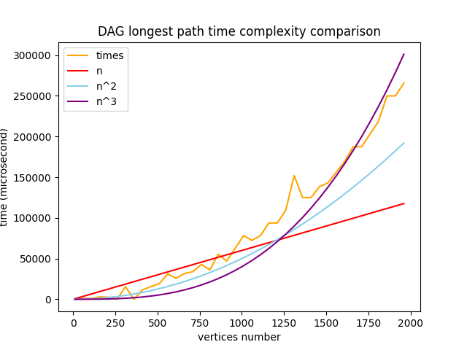
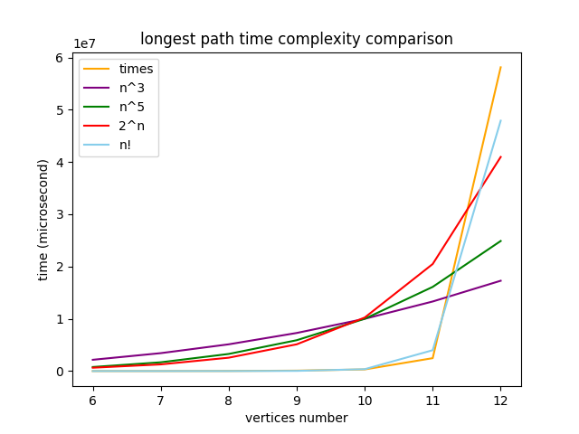
TIME COMPLEXITY:
TIME COMPLEXITY ANALYSIS
NOT DAG
BRUTE FORCE
N!
NP-HARD
DAG
POLYNOMIAL
NP-COMPLETE
LONGEST PATH IN GRAPH

Slide 16
OUTLINE
INTRODUCTION TO GRAPH
HAMILTON PATH PROBLEM
DEFENITION OF LONGEST PATH
TIME COMPLEXITY ANALYSIS
APPLICATION & CHALLENGES
ALGORITHM FOR LONGEST PATH
LONGEST PATH IN GRAPH

Slide 17
Hamiltonian path problem
Definition(Informal):
A sequence of edges connecting a set of vertices in a graph with the condition that each vertex is visited exactly once and none is revisited
Example:
Imagine a graph with vertices labelled A, B, C, and D, forming a shape of a square.
An example of a Hamiltonian path would be beginning at A, then moving to B, C, and finally to D
This path has touched every vertex exactly once, fulfilling the criteria for a Hamiltonian path
LONGEST PATH IN GRAPH

Slide 18
Hamiltonian path problem
Definition(Formal):
Given an undirected graph G = (V, E), where V is the set of vertices and E is the set of edges, a Hamiltonian path is a path that visits each vertex v ∈ V exactly once.
Decision Problem:
The decision version of the problem asks: "Given a graph G, does there exist a Hamiltonian path from vertex u to vertex v?" This results in a yes/no answer.
Optimization Problem
The optimization version seeks to find a Hamiltonian path by adding additional constraints. (eg. find the Hamiltonian path with the minimum total edge weight)
Hamilton cycle:
A Hamiltonian cycle is similar to a Hamiltonian path with an added requirement: the path must return to the starting vertex, forming a loop.
LONGEST PATH IN GRAPH

Slide 19
Hamiltonian path problem
(Applications)
Genomics and DNA Sequencing
finding a Hamiltonian path through overlapping segments
can help reconstruct the original DNA sequence
Logistics and Route Planning
optimizing delivery routes: each location must be visited exactly once.
improving efficiency in transportation and supply chain management.
Circuit Design in Electronics
optimize the layout of components and minimize wire length (Critical path)
leading to more efficient and compact electronic devices.
LONGEST PATH IN GRAPH

Slide 20
Hamiltonian path problem
(Challenges/Solutions)
Challenge:
NP-Complete
No known algorithm To find the path with polynomial order
All the paths must be checked
Solutions:
Backtracking:
For small graphs, to check all the paths
Using heuristics (for larger scale):
Not guaranteed to find the longest path
Like nearest neighbor
For special graphs:
Complete graphs: Longest path is of length 1
For DAG:
Equivalent with longest path problem
LONGEST PATH IN GRAPH

Slide 21
CODE:
BACKTRACKING ALGORITHM FOR HAMILTONIAN PATH
def is_hamiltonian_path(graph, path, pos, visited):
if pos == len(graph):
return True
for neighbor in graph[path[pos - 1]]:
if not visited[neighbor]:
visited[neighbor] = True
path[pos] = neighbor
if is_hamiltonian_path(graph, path, pos + 1, visited):
return True
# turn back
visited[neighbor] = False
return False
def find_hamiltonian_path(graph, n):
path = [-1] * n
visited = [False] * n
for start in range(n):
path[0] = start
visited[start] = True
if is_hamiltonian_path(graph, path, 1, visited):
return path
visited[start] = False
return None
LONGEST PATH IN GRAPH

Slide 22
INTRODUCTION TO GRAPH
DEFENITION OF LONGEST PATH
TIME COMPLEXITY ANALYSIS
HAMILTON PATH PROBLEM
APPLICATION & CHALLENGES
ALGORITHM FOR LONGEST PATH
TIME COMPLEXITY ANALYSIS
LONGEST PATH IN GRAPH

Slide 23
TIME COMPLEXITY ANALYSIS
NOT DAG
BRUTE FORCE: N!
Check all permutations of vertices
BRUTE FORCE(OPTIMIZED): (N-1)!
If we fix the starting node
NP-COMPLETE
DAG
LIKE LONGEST PATH PROBLEM
polynomial
LONGEST PATH IN GRAPH

Slide 24
INTRODUCTION TO GRAPH
HAMILTON PATH PROBLEM
DEFENITION OF LONGEST PATH
TIME COMPLEXITY ANALYSIS
APPLICATION & CHALLENGES
TRAVELING SALESMAN PROBLEM
ALGORITHM FOR LONGEST PATH
TIME COMPLEXITY ANALYSIS
LONGEST PATH IN GRAPH

Slide 25
Definition:
The TSP is a combinatorial optimization problem that seeks to find the shortest possible route that visits a set of cities and returns to the starting point.
Characteristics:
The TSP is characterized by a weighted graph, where each node represents a city and the edges represent the distances between them.
Objective:
The goal is to find the Hamiltonian cycle (a tour that visits each city exactly once) with the minimum total distance.
TRAVELING SALESMAN PROBLEM
LONGEST PATH IN GRAPH

Slide 26
Christofides Algorithm:
Used for approximating the TSP on metric graphs, guaranteeing a solution within 1.5 times the optimal.
Pseudocode:
function Christofides(G):
MST = MinimumSpanningTree(G)
O = FindOddDegreeVertices(MST)
M = MinimumWeightPerfectMatching(G, O)
MultiGraph = CombineGraphs(MST, M)
EulerianCycle = FindEulerianCycle(MultiGraph)
HamiltonianCycle = RemoveRepeatedVertices(EulerianCycle)
return HamiltonianCycle
LONGEST PATH IN GRAPH

Slide 27
2-opt Algorithm:
A local search algorithm for improving TSP tours.
Pseudocode:
function TwoOpt(tour):
improvement = true
while improvement:
improvement = false
for i in range(0, length(tour) - 1):
for j in range(i + 1, length(tour)):
if Cost(2optSwap(tour, i, j)) < Cost(tour):
tour = 2optSwap(tour, i, j)
improvement = true
return tour
function 2optSwap(tour, i, j):
newTour = tour[0:i]
newTour.extend(reversed(tour[i:j + 1]))
newTour.extend(tour[j + 1:])
return newTour
LONGEST PATH IN GRAPH

Slide 28
Lin-Kernighan:
A more complex local search heuristic for the TSP, generally producing better results than 2-opt.
Pseudocode (simplified):
function Gain(x, y, z):
return d(x, y) - d(x, z)
function LinKernighan(tour):
while improvement possible:
for each edge (x, y) in tour:
for each vertex z not adjacent to x in tour:
if Gain(x, y, z) > 0:
tour = Swap(tour, x, y, z)
return tour
function Swap(tour, x, y, z):
Remove edge (x, y) and add edge (x, z)
Reverse part of the tour to maintain validity
Return the new tour
LONGEST PATH IN GRAPH

Slide 29
Nearest Neighbor:
A simple greedy algorithm for constructing a TSP tour.
Pseudocode:
function NearestNeighbor(G):
start = random vertex in G
tour = [start]
unvisited = all vertices in G except start
while unvisited is not empty:
last = tour[-1]
nearest = FindNearest(last, unvisited)
tour.append(nearest)
unvisited.remove(nearest)
tour.append(start) // Return to start
return tour
function FindNearest(v, vertices):
return vertex in vertices with minimum distance to v
LONGEST PATH IN GRAPH

Slide 30
INTRODUCTION TO GRAPH
HAMILTON PATH PROBLEM
DEFENITION OF LONGEST PATH
TIME COMPLEXITY ANALYSIS
TRAVELING SALESMAN PROBLEM
APPLICATION & CHALLENGES
ALGORITHM FOR LONGEST PATH
TIME COMPLEXITY ANALYSIS
TIME COMPLEXITY ANALYSIS
LONGEST PATH IN GRAPH

Slide 31
Christofides:
Guaranteed polynomial time
O(n^3)
2-opt:
Can be very slow in worst case, but often practical
O(n^2) – worst case (n!) rarely happens
Lin-Kernighan:
Generally faster than 2-opt, slower than Nearest Neighbor
O(n^2.2) – worst case (n!) rarely happens
Nearest Neighbor:
Fastest among these, but solution quality can be poor
(O(n^2))
TIME COMPLEXITY ANALYSIS
LONGEST PATH IN GRAPH

Slide 32
INTRODUCTION TO GRAPH
HAMILTON PATH PROBLEM
DEFENITION OF LONGEST PATH
TIME COMPLEXITY ANALYSIS
TIME COMPLEXITY ANALYSIS
APPLICATION & CHALLENGES
TRAVELING SALESMAN PROBLEM
ALGORITHM FOR LONGEST PATH
TIME COMPLEXITY ANALYSIS
CONCLUSION
LONGEST PATH IN GRAPH

Slide 33
Challenges in Solving Longest Path:
Scalability issues with large graphs.
Real-time computation challenges.
Future research:
Better heuristics
large-scale graph processing
CONCLUSION
LONGEST PATH IN GRAPH

Slide 34
Questions & Answers
?
LONGEST PATH IN GRAPH

