Slide 1
Affect of Socioeconomic factor on Average ACT/SAT score
Parsa Rahimiderimi

Slide 2
iNTRODUCTION
This presentation investigates the relationship between socioeconomic factors and student performance on the ACT exam. Specifically, we will explore whether factors like income levels and access to resources influence ACT scores.

Slide 3
Data Source
Primary: EdGap.org (2016 data) Secondary: National Center for Education Statistics (NCES) EdGap Data: This dataset provides information about schools and includes: Average ACT scores (or SAT scores) Several socioeconomic characteristics of the school district (e.g., median income, free lunch percentage) School_Info Data: This dataset provides supplemental information about each school

Slide 4
Analysis Approach
Two Main Methods:
Correlation Analysis: Used to examine the strength and direction of relationships between socioeconomic factors (e.g., median income, percentage of students on free lunch) and average ACT scores.
Linear Regression: Employed to build a predictive model. This model aimed to predict ACT scores based on the socioeconomic factors identified in the dataset.
Random Forest Regression

Slide 5
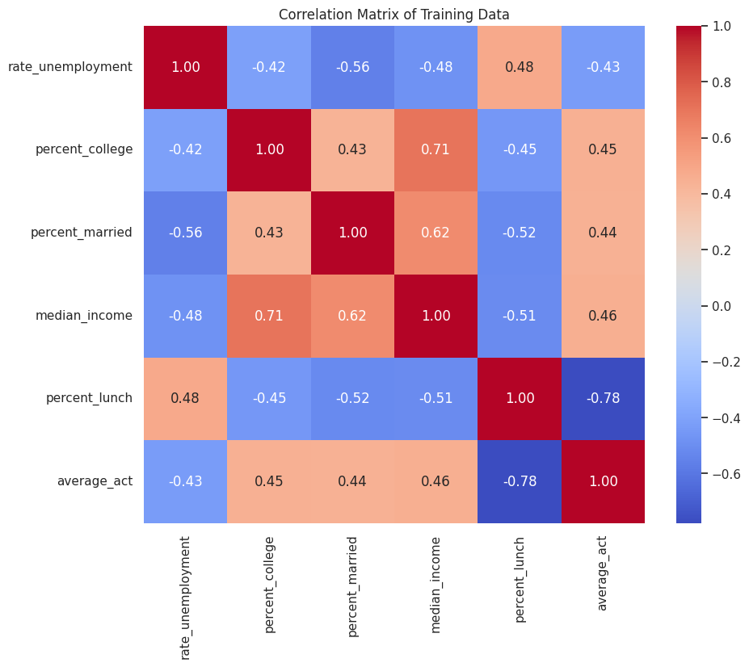
Results
A strong negative correlation was identified between the percentage of students receiving free or reduced-price lunch and average ACT scores. This suggests that schools with higher poverty levels tend to have lower average ACT performance.
The correlation coefficient (r) between free lunch percentage and ACT scores was -0.78. This indicates a strong negative relationship.

Slide 6
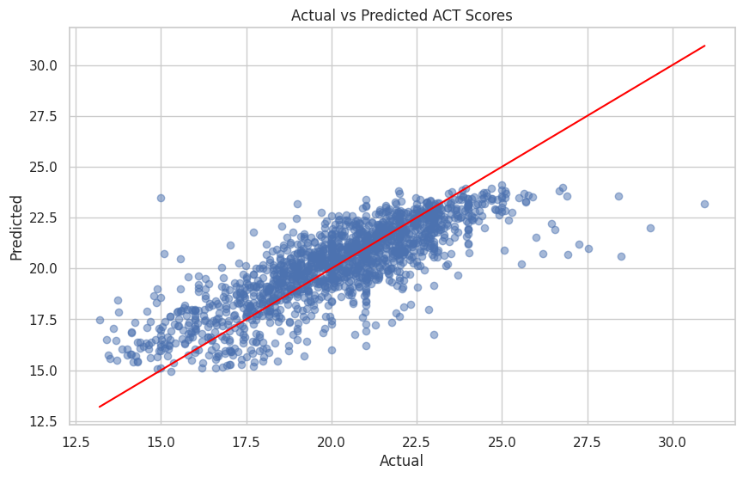
Results
Model Insights: A linear regression model was developed to predict ACT scores based on socioeconomic factors. The model explained a moderate amount of the variation in ACT scores (R-squared = 0.65). While socioeconomic factors can be used for prediction, this suggests that other factors also play a significant role in student performance on the ACT.

Slide 7
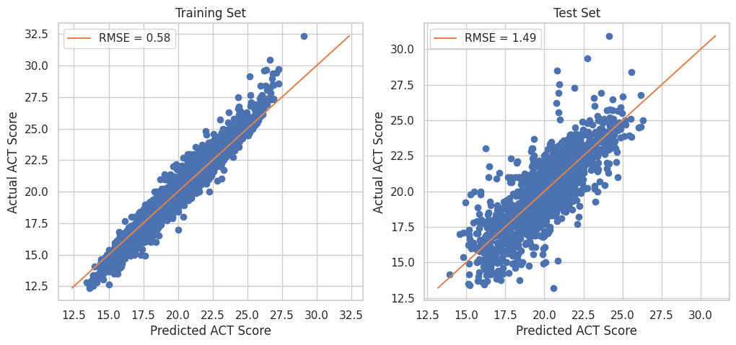
Results
The results obtained from the Random Forest Regression model, while requiring refinement due to overfitting, support a correlation between socioeconomic variables and average ACT scores

Slide 8
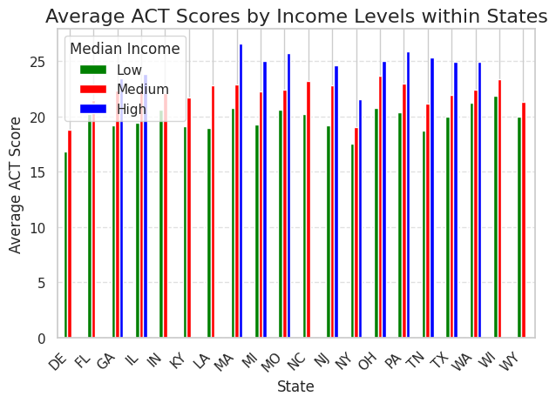
Results
In most states, there's a visible trend where schools located in areas with higher median income exhibit higher average ACT scores compared to lower-income areas.

Slide 9
conclusion
This analysis demonstrates a significant link between socioeconomic status and ACT performance. The presence of a strong negative correlation between free lunch participation rates and ACT scores highlights a potential disparity in educational outcomes. Furthermore, while the linear regression model indicates the predictive capacity of socioeconomic factors, its moderate explanatory power suggests that other influential elements remain to be explored.
This analysis demonstrates a significant link between socioeconomic status and ACT performance. The presence of a strong negative correlation between free lunch participation rates and ACT scores highlights a potential disparity in educational outcomes. Furthermore, while the linear regression model indicates the predictive capacity of socioeconomic factors, its moderate explanatory power suggests that other influential elements remain to be explored.
This analysis demonstrates a significant link between socioeconomic status and ACT performance. The presence of a strong negative correlation between free lunch participation rates and ACT scores highlights a potential disparity in educational outcomes. Furthermore, while the linear regression and Random Forest model indicates the predictive capacity of socioeconomic factors, its moderate explanatory power suggests that other influential elements remain to be explored.

