Slide 1
DATA × LOGISTICS
Supply Chain Visibility System and Optimization Analytics
End-to-End Logistics Dashboard
Built on Power BI · DataCo Global Supply Chain Dataset
Infosys Springboard

Slide 2
01 / WHY THIS EXISTS
02
From fragmented data to one operating view
01
02
03
360°
ONE VIEW
KPI-LED
Visibility across 5 supply chain modules
Centralized executive dashboard
Decisions instead of guesswork
A single Power BI experience that connects the moving parts of a supply chain.
INFOSYS SPRINGBOARD

Slide 3
02 / THE CHALLENGE
03
Where supply-chain visibility breaks down
01
Inventory inefficiencies
02
Delayed deliveries
Slow-moving and dead stock go unnoticed until it is costly.
No consolidated tracking of on-time performance.
03
Rising transportation cost
04
Supplier-related risk
Route and carrier spend isn't compared systematically.
Reliability and quality issues surface too late.
INFOSYS SPRINGBOARD

Slide 4
03 / THE MISSION
04
Six objectives. One decision layer.
1
Unify supply-chain sources into one data model
2
Flag slow-moving vs. fast-moving inventory
3
Track on-time delivery and lead times
4
Score supplier reliability and quality
5
Monitor transport cost and warehouse utilization
6
Enable interactive, KPI-driven decisions
INFOSYS SPRINGBOARD

Slide 5
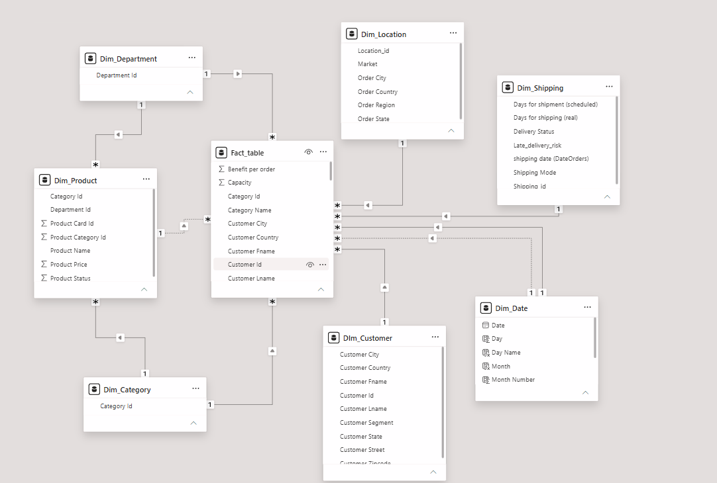
04 / DATA FOUNDATION
05
The model behind the dashboard
DataCo Supply Chain Dataset
Dataset: DataCo Supply Chain Dataset from kaggle
7,000+
118
Orders analyzed
Suppliers profiled
10
GLOBAL
Warehouses tracked
Multi-region coverage
Delivery
INFOSYS SPRINGBOARD

Slide 6
05 / PIPELINE
06
From source systems to executive decisions
1
2
3
4
5
6
DATA SOURCES
INGESTION
ETL
MODEL
ANALYSIS
PRESENT
Inventory · Orders · Supplier Warehouse · Transport · Delivery
PostgreSQL + Excel
Clean · Transform · Standardize
Star schema + relationships
DAX measures
Interactive Power BI
ONE PIPELINE
Raw logistics data → trusted KPIs → faster decisions
INFOSYS SPRINGBOARD

Slide 7
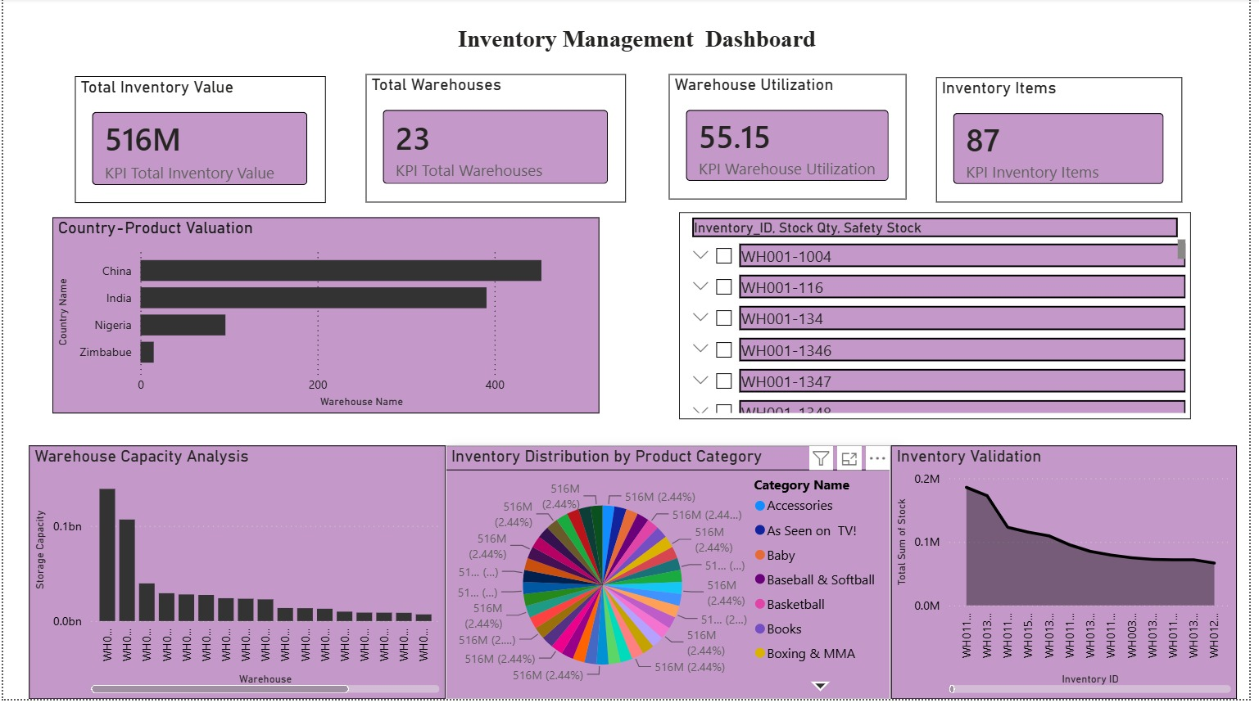
06 / MODULE 01
07
Inventory Analytics
✓
Inventory turnover highlights how efficiently stock is being converted into sales.
✓
Reorder and safety-stock analysis helps identify products requiring replenishment.
01
✓
Slow-moving and dead-stock products indicate opportunities to reduce excess inventory.
✓
Warehouse and regional analysis highlights differences in inventory utilization.
✓
Inventory trends help monitor changes in stock value over time.
INFOSYS SPRINGBOARD

Slide 8
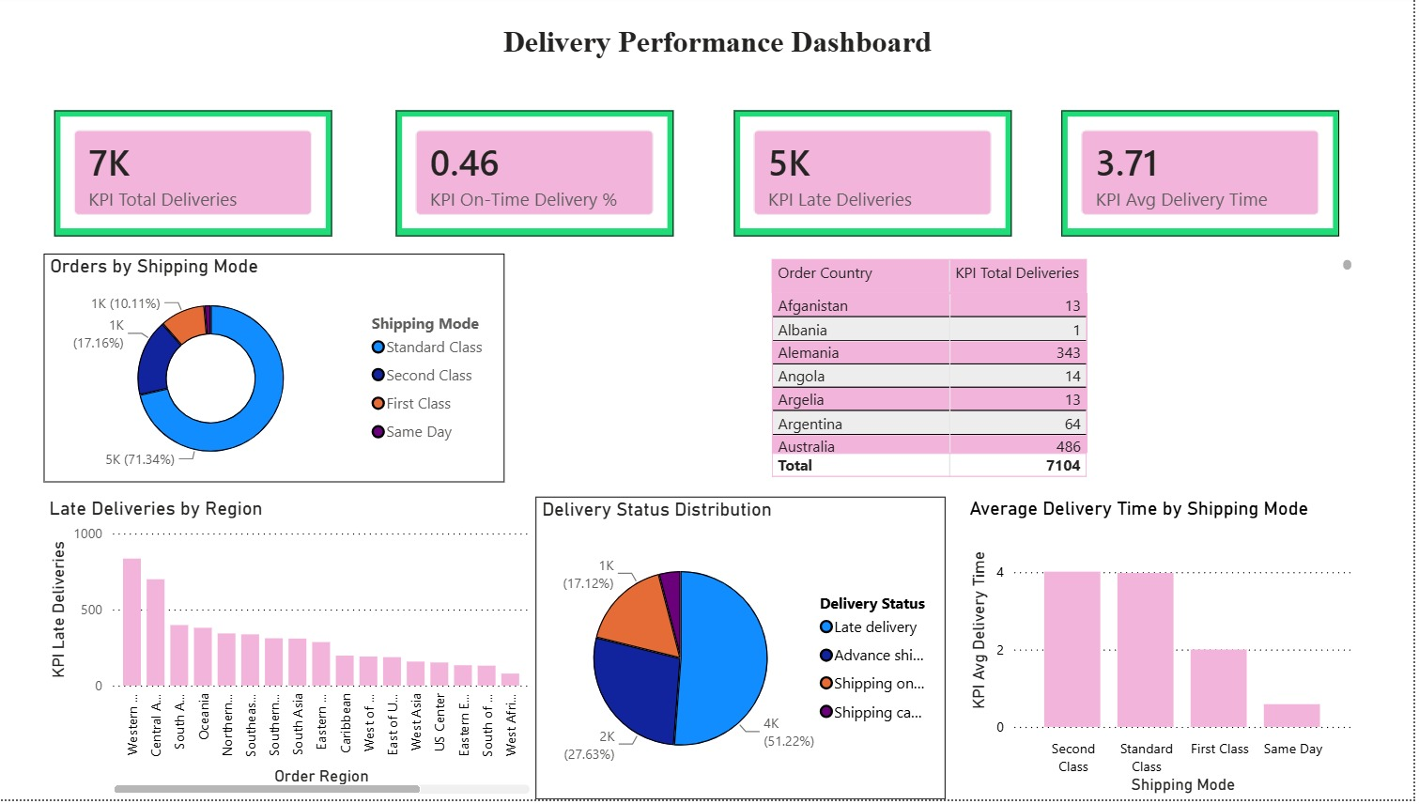
07 / MODULE 02
08
Delivery Performance
Delivery performance can be compared using on-time, late, and advance-shipping rates.
Late Delivery Risk % highlights regions with a higher probability of delivery delays. .
02
✓
✓
Lead-time variance shows where actual shipping time differs from scheduled shipping time
Regional analysis helps identify areas requiring delivery-performance improvement.
✓
✓
✓
Shipping-mode analysis helps compare delivery efficiency across transportation methods.
✓
INFOSYS SPRINGBOARD

Slide 9
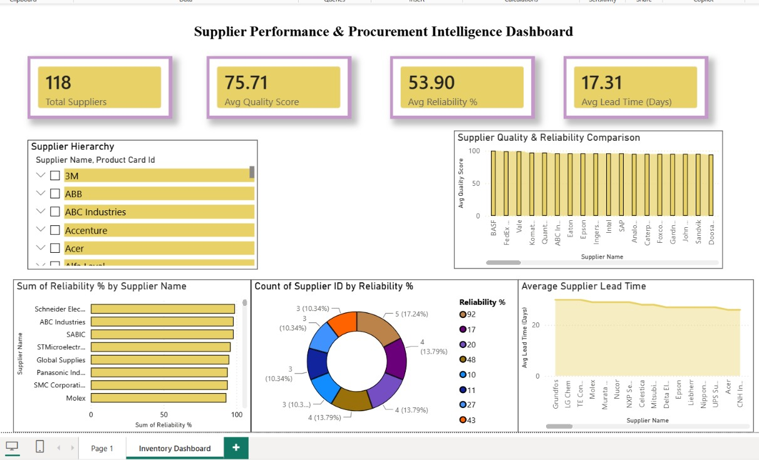
08 / MODULE 03
09
Supplier Performance
Supplier performance can be evaluated using quality, reliability, and lead time.
Suppliers with higher quality and reliability and lower lead time represent stronger performers.
✓
✓
The supplier scorecard helps identify suppliers requiring closer monitoring.
Comparing suppliers supports better supplier-selection and relationship-management decisions.
✓
✓
INFOSYS SPRINGBOARD

Slide 10
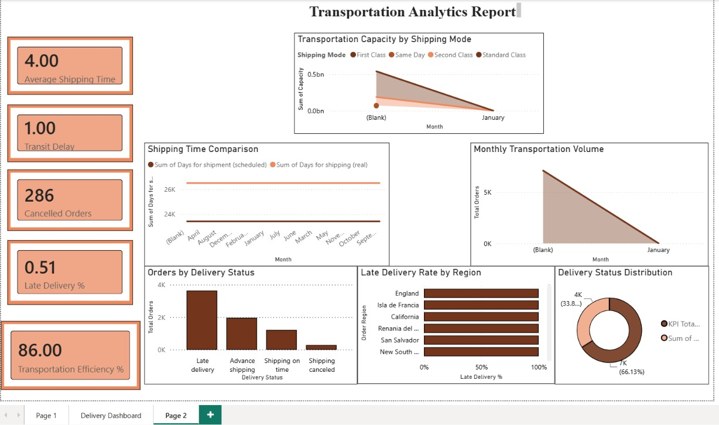
09 / MODULE 04
10
Transportation Analytics
Shipping-mode analysis highlights differences in order volume and delivery performance.
Late-rate analysis helps identify shipping modes associated with higher delivery risk
✓
✓
Discount analysis shows how discounts are distributed across shipping modes. .
Profit-per-order comparison helps evaluate the financial performance of different shipping modes.
✓
✓
Regional analysis highlights areas where transportation performance can be improved.
✓
INFOSYS SPRINGBOARD

Slide 11
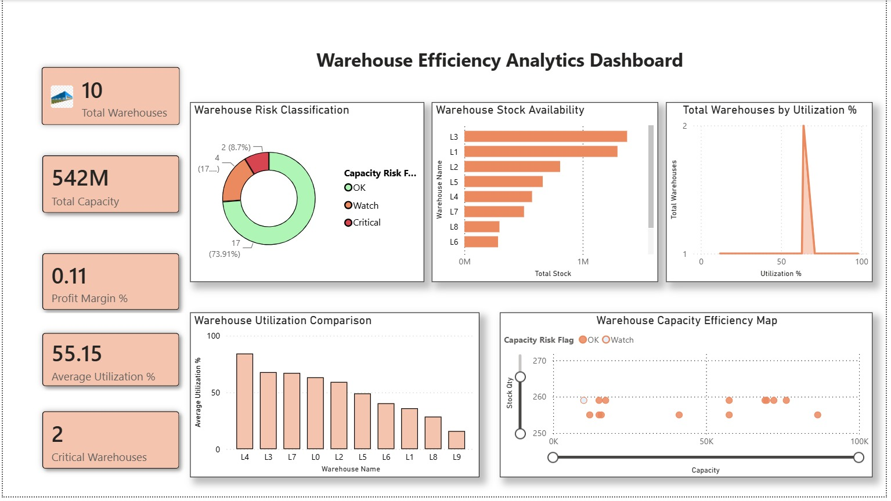
10 / MODULE 05
11
Warehouse Analytics
Warehouse utilization comparison identifies highly and under-utilized facilities.
Capacity and stock analysis helps identify potential warehouse capacity risks.
✓
✓
Units shipped comparison highlights warehouse workload and operational differences
Warehouse-level analysis helps support better capacity allocation and inventory distribution.
✓
✓
✓
Utilization and shipment metrics together provide a clearer view of warehouse efficiency.
INFOSYS SPRINGBOARD

Slide 12
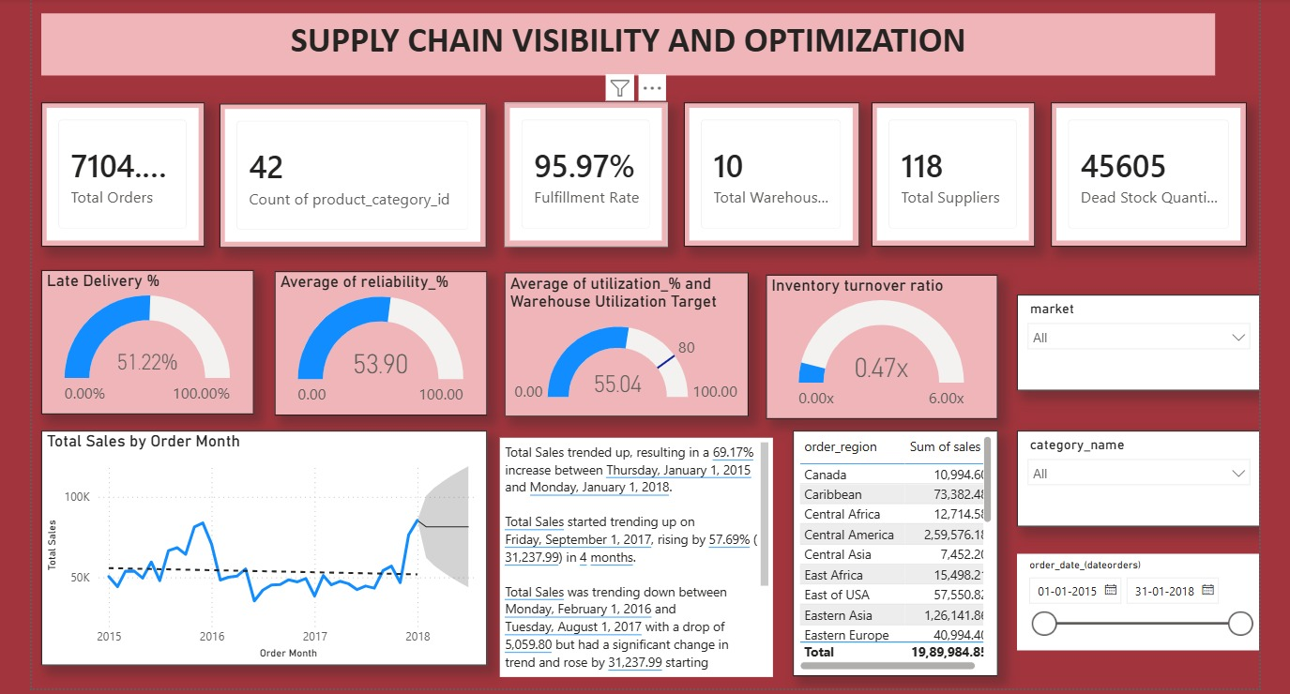
11 / LEADERSHIP VIEW
12
One screen. Five operational lenses.
All five modules roll up into one executive-level Power BI dashboard — giving leadership total sales, profit, orders, inventory, warehouses, and delivery health on a single screen, with drill-through into every module behind it.
INFOSYS SPRINGBOARD

Slide 13
12 / THE TAKEAWAY
14
A dashboard that turns visibility into action
CONCLUSION
FUTURE SCOPE
One centralized, interactive Power BI dashboard across inventory, supplier, delivery, transportation and warehouse data.
Predictive demand & delay forecasting
Real-time refresh + KPI alerts
Global LPI benchmarking
One KPI-driven source of truth for faster, data-backed decisions.
ML-based supplier risk scoring
INFOSYS SPRINGBOARD

Slide 14
13 / THE TEAM
Built by
PM
AS
PY
AS
MS
Pranavi Mitta
Anumalla Shwethan Kumar
Parsh Yadav
Ahmed Syed
Maragada Sirisha
Developed Inventory analysis dashboard and executive dashboard
Developed delivery Performance dashboard and executive dashboard
Developed Supplier Performance dashboard and executive dashboard
Developed Transport Analytics dashboard and executive dashboard
Developed Warehouse Analytics dashboard and executive dashboard
Thank you.
INFOSYS SPRINGBOARD

