Slide 1
IntelliCredit
AI-Powered Corporate Credit Appraisal Engine
From weeks to minutes. From guesswork to explainable AI.
1. Data Ingestor
2. Research Agent
3. CAM Engine

Slide 2




THE PROBLEM
India's Corporate Credit — The Data Paradox
Fragmented Data
Missed Early Warnings
GST filings, ITRs, bank statements, PDFs — all siloed and unlinked
Buried signals in 200-page annual reports go unnoticed until default
3–6
WEEKS to process one loan application
Human Bias
No External Intelligence
Subjective analyst judgement with no audit trail or explainability
Litigation, MCA flags & sector news manually googled — or skipped

Slide 3


OUR SOLUTION
IntelliCredit — End-to-End AI Credit Decisioning
01
02
03
Data Ingestor
Research Agent
CAM Engine
Multi-Format Parsing
Digital Credit Manager
Recommendation & Report
› PDF / XLSX / scanned OCR
→
› Web crawl: promoters, sector
› Five Cs scoring model
→
› GST ↔ Bank reconciliation
› eCourts + MCA + SFIO
› SHAP explainability
› Circular trading detection
› Qualitative notes portal
› PDF / DOCX CAM output
OUTPUT: Comprehensive Credit Appraisal Memo (CAM) • Loan Amount • Risk-Adjusted Interest Rate • Explainable Decision Logic

Slide 4




PILLAR 1
Data Ingestor — Multi-Format Intelligence
Annual Reports (PDF)
GST Reconciliation Engine
Key commitments, risk factors, MD&A
GSTR-3B vs GSTR-2A vs Bank Credits
GST Returns (3B vs 2A)
Month
3B (₹L)
2A (₹L)
Bank
Flag
Circular trading & inflation detection
Jan 24
48.2
46.5
47.0
✓ Clear
Bank Statements
Feb 24
51.0
49.0
48.0
✓ Clear
Cash flow patterns & anomaly flags
Mar 24
89.0
42.0
45.0
⚠ +112%
Legal / DRT Notices
Jun 24
92.0
41.0
43.0
⚠ +124%
Recovery suits, wilful default flags
AI Finding: GSTR-3B in Mar & Jun show revenue 112–124% above GSTR-2A purchase data — strong indicator of circular trading / revenue inflation.
MCA Filings
Director history, charge records
Credit Officer notes (site visit, DD) auto-parsed into risk score

Slide 5



PILLAR 2
Research Agent — The Digital Credit Manager
Sample Findings — Sharma Chemicals Ltd.
Economic Times / Moneycontrol
eCourts Portal — Litigation History
HIGH RISK
DRT Mumbai: Recovery suit ₹4.2 Cr (PNB)
eCourts Portal
MCA21 — Director & Charge Data
SFIO Enforcement Database
CAUTION
Promoter named in SFIO probe — related-party txns
Economic Times
ICRA / CRISIL Sector Reports
CIBIL Commercial Reports
POSITIVE
Sector: Specialty chemicals +18% FY26 — ICRA
Qualitative Portal
Business Standard
Credit officers enter site visit observations → AI adjusts risk score in real-time based on NLP sentiment + key triggers
CAUTION
GST penalty ₹12L for missed Q2 deadline
Moneycontrol

Slide 6
PILLAR 03 · CAM & DECISION ENGINE
Credit Appraisal Memo & AI Recommendation
Five Cs Scoring
DECISION OUTPUT
Character
52
CONDITIONAL APPROVAL
Capacity
71
Loan Limit:
₹8.5 Crore (vs ₹15 Cr requested · 57% of ask)
Interest Rate:
MCLR + 2.75% (~11.5% p.a.)
Capital
68
Tenor:
36 months
Security:
Factory property (₹38 Cr) + Promoter personal guarantee
Collateral
74
SHAP Explainability
Approval Conditions
Conditions
66
Promoter litigation
−18 pts
→ Quarterly stock audit (bank-appointed)
GST inflation anomaly
−11 pts
→ Monthly GST reconciliation submission
Factory utilisation
−8 pts
→ Promoter personal guarantee mandatory
Composite Score:
63/100 — MEDIUM-HIGH RISK
Collateral coverage
+14 pts
→ No dividend without bank NOC
Sector outlook (ICRA)
+9 pts
→ Trigger review if DSCR < 1.20x

Slide 7
TECHNICAL ARCHITECTURE
System Design & Technology Stack
Tech: React · Claude API (Anthropic) · FastAPI · Databricks · LangChain · XGBoost · SHAP · Tavily · FAISS · python-docx

Slide 8
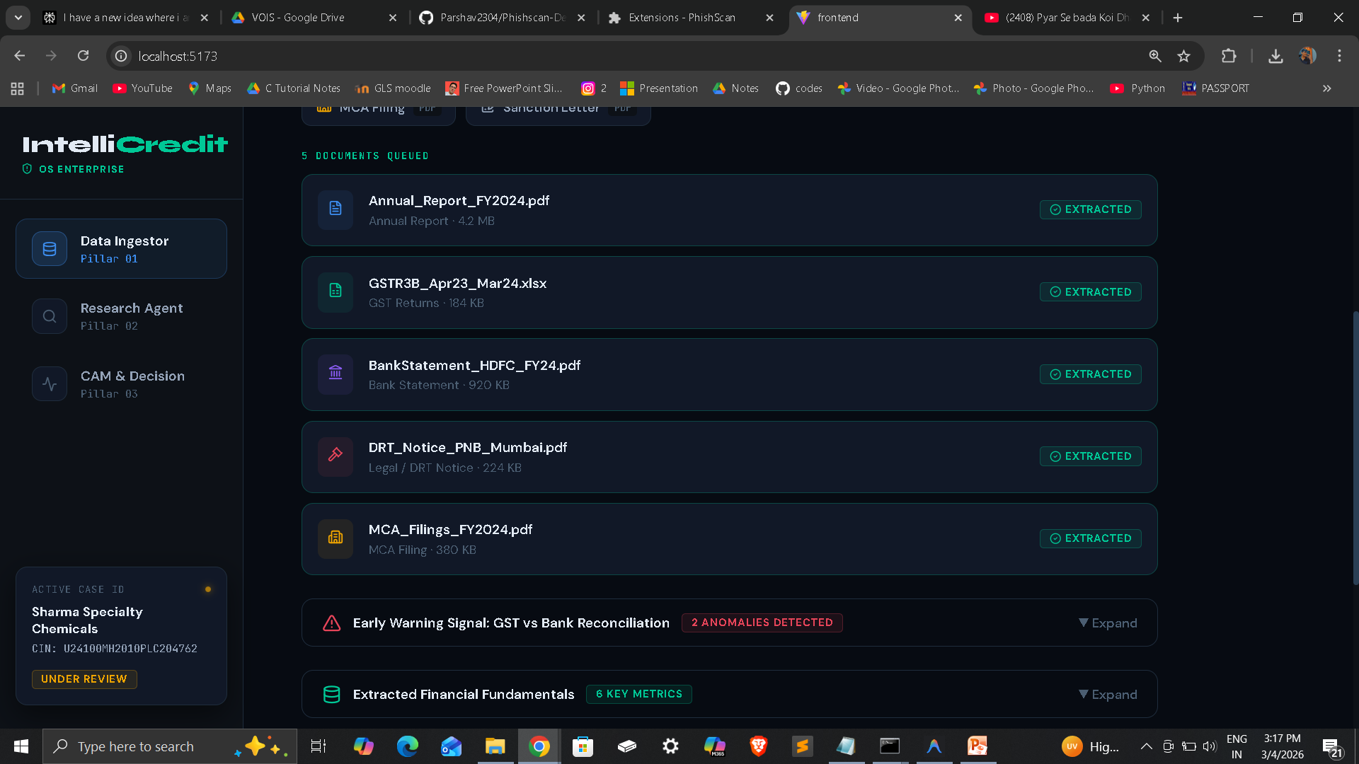
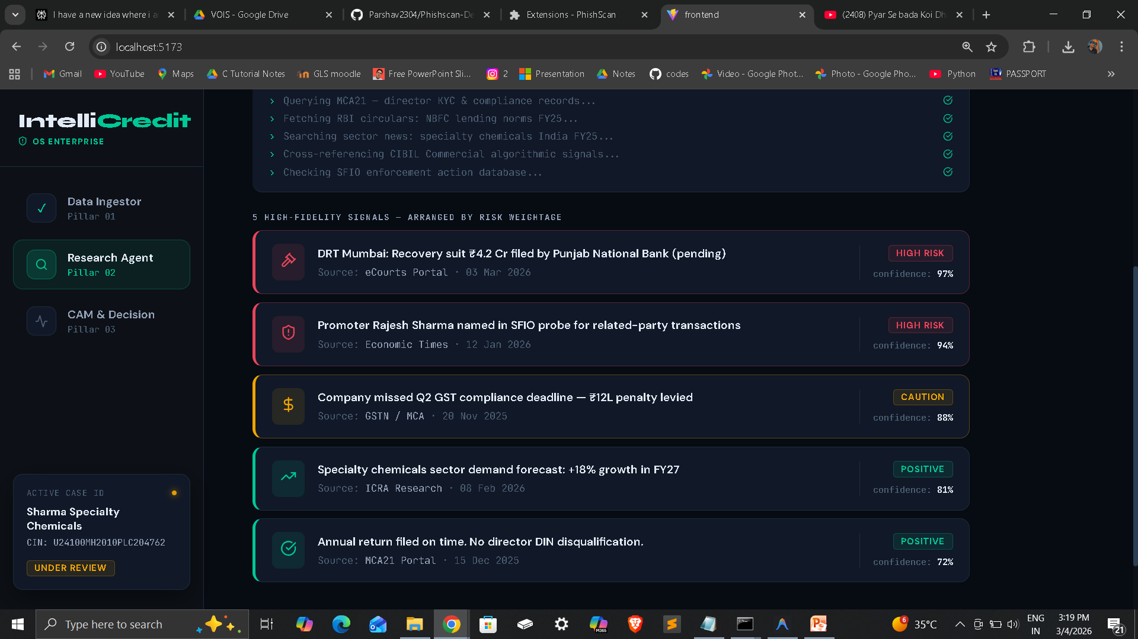
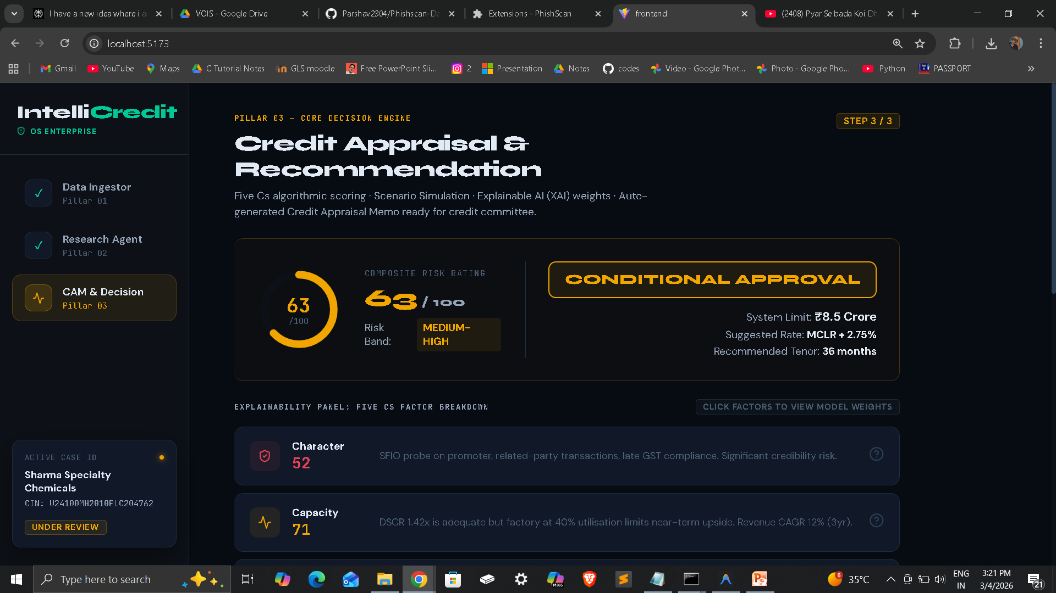
LIVE DEMO
Prototype — Working End-to-End Demo
Step 1: Upload & Extract
Step 2: Research Agent
Step 3: CAM & Decision
Drop PDFs, GST files & bank statements → AI extraction with GST reconciliation table showing circular trading flags
Watch agent crawl eCourts, MCA, news in real-time → Findings ranked by risk relevance with source attribution
Five Cs scoring cards + SHAP explainability + full Credit Appraisal Memo downloadable as PDF/DOCX

Slide 9




KEY FEATURES & FUNCTIONALITY
What the Prototype Can Do — Right Now
Multi-Doc Ingestion
GST Cross-Validation
Upload PDFs, XLSX, scanned images. AI extracts structured fields from unstructured documents using LLM+OCR pipeline.
Automatically reconciles GSTR-3B vs GSTR-2A vs bank credits. Flags revenue inflation anomalies with exact % deviation.
Autonomous Research
Qualitative Adjustment
AI agent crawls 7 sources in <90 seconds: eCourts, MCA21, SFIO, news, ICRA. All findings ranked by risk relevance.
Credit officers input site-visit notes. NLP parses sentiment and re-calibrates the risk score in real-time with full transparency.
Explainable Decisions
One-Click CAM Output
SHAP-based factor attribution for every decision. No black box — each point added/deducted is shown with source and reason.
Claude AI generates a bank-grade Credit Appraisal Memo covering Five Cs. Downloadable as PDF or DOCX in seconds.

Slide 10



DIFFERENTIATORS
Why IntelliCredit Wins
India-First Design
Explainable AI, Not a Black Box
Built specifically for GSTR-2A vs 3B, CIBIL Commercial, DRT recovery, MCA21, and RBI regulatory parsing — not a generic global tool.
Every decision comes with SHAP-based factor attribution. Judges, regulators and borrowers can see exactly why a limit was set.
End-to-End in One Platform
Multi-Source Synthesis
From raw scanned PDFs to a signed-off Credit Appraisal Memo — no human hand-offs, no spreadsheet exports, no tool-switching.
Uniquely cross-links GST data with bank flows, corroborates with eCourts and MCA filings, and validates against live news — all automatically.
Human-in-the-Loop
CAM-Ready Output
Credit officers can inject qualitative site-visit notes at any point. The AI recalibrates the risk score transparently around human insight.
Generates a bank-grade Credit Appraisal Memo (Word/PDF) meeting RBI guidelines — ready to submit to credit committee on Day 1.

Slide 11
REAL-WORLD APPLICATIONS & SCALABILITY
Market Opportunity & Deployment Path
₹18.2L Cr
3–6 wks
<3 min
₹850 Cr+
Indian corporate loan book (FY24)
Current average appraisal time
IntelliCredit end-to-end time
Annual cost savings potential (est.)
Who Can Use It
Scalability Design
India Compliance
› Public sector banks
› Microservices architecture
› RBI data localisation ready
› Private sector banks
› Horizontal scaling on cloud
› Compliant with DPDP Act 2023
› NBFCs & HFCs
› Multi-tenant SaaS model
› Audit trail for every decision
› Fintech lenders
› API-first for CBS integration
› SOC-2 Type II roadmap
› RBI supervisors
› Databricks for big data
› RBI Regulatory Sandbox eligible

Slide 12
COMPETITIVE DIFFERENTIATORS
Why IntelliCredit — vs. Manual Process & Existing Tools
Feature
Manual Process
Generic AI Tools
IntelliCredit ✓
Appraisal Time
3–6 weeks
2–3 days
< 3 minutes
India-Specific Data
✗ Partial
✗ Global only
✓ Full (GST/MCA/DRT)
GST Reconciliation
✗ Manual
✗ Not included
✓ Automated + flags
Explainability
✗ Opaque
✗ Black box
✓ SHAP per factor
CAM Output
✓ Manual doc
✗ None
✓ AI-generated PDF/DOCX
Human-in-the-Loop
✓ Always
✗ No portal
✓ Qualitative portal
Web Research
✗ Ad hoc
✗ No
✓ 7-source autonomous
Regulatory Compliance
✓ Banker
✗ Unknown
✓ RBI-aligned design

Slide 13
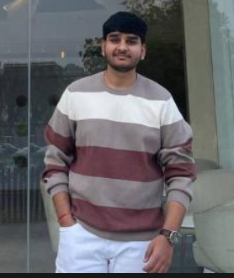
TEAM & ROADMAP
The Team Behind IntelliCredit
Roadmap
Team Member
Parshav Shah
B.Tech Sem-6
GLS University, Ahmedabad, Gujarat
Phase 1 ✓
Hackathon MVP
3-pillar prototype, React UI, mock data demo
Phase 2
Banking Integration
Live CBS APIs, real GST portal, Finbox/CKYC
Phase 3
GITHUB:
https://github.com/Parshav2304/IntelliCredit
LinkedIn:
https://www.linkedin.com/in/parshav-shah-485739284/
Pilot Deployment
NBFC / regional bank pilot — 50 live cases
Phase 4
Scale & Compliance
RBI sandbox, SOC-2 audit, multi-bank rollout

Slide 14
IntelliCredit
Thank You
Bridging India's Credit Intelligence Gap — with AI

