Slide 1
EEGScaler: A Network to scale EEG electrodes and samples for MI Speed Decoding
Praveen K Parashiva, Sagila K Gangadharan and A. P. Vinod

Slide 2
Motivation
Decoding kinematics information such as speed and direction from imagined hand movement results in a more natural control of BCI.
Challenges:
EEG offers poor spatial resolution
For decoding speed, the spatial overlap between two actions (fast and slow) is large.
Objective: Propose a deep learning based method to decode MI actions imagined at two speed – fast and slow.

Slide 3
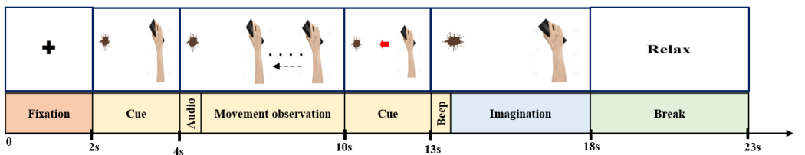
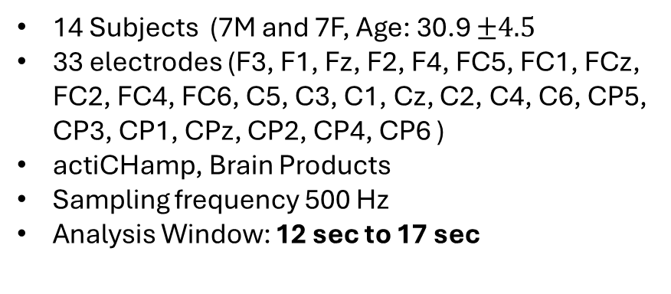
Dataset
14 Subjects (7M and 7F, Age: 30.9 $±4.5$
33 electrodes (F3, F1, Fz, F2, F4, FC5, FC1, FCz, FC2, FC4, FC6, C5, C3, C1, Cz, C2, C4, C6, CP5, CP3, CP1, CPz, CP2, CP4, CP6 )
actiCHamp, Brain Products
Sampling frequency 500 Hz
Analysis Window: 12 sec to 17 sec
Preprocessing:
Baseline Removal : 1sec cue data is baseline
CAR
Bandpass filtering : 0.1 to 90 Hz, 5th order butterworth
Notch filter : IIR filter with Q-factor 20

Slide 4
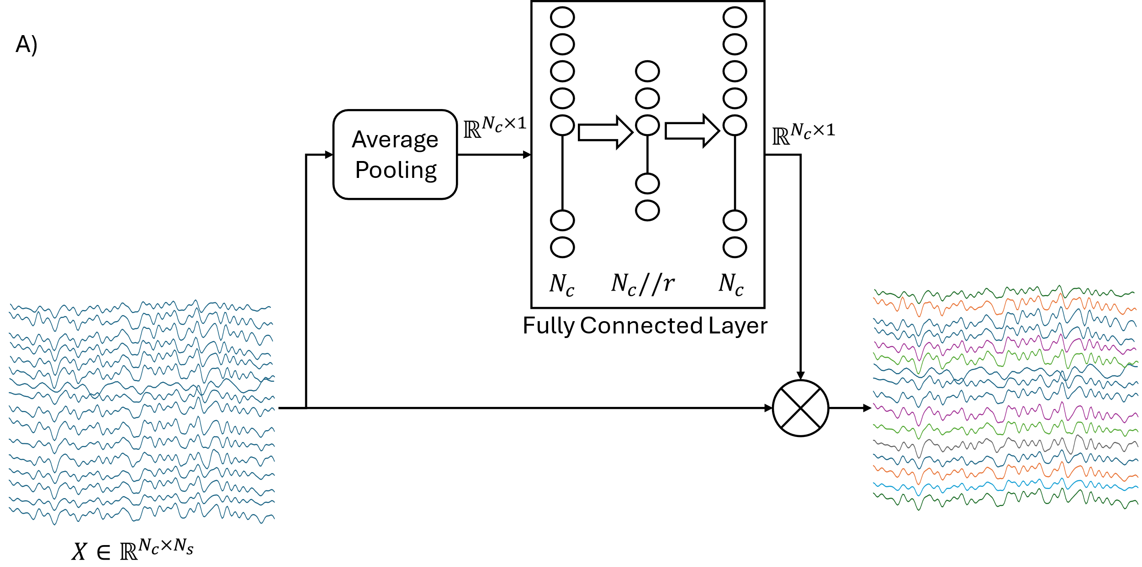
Proposed Method : Electrode Scaling
A

Slide 5
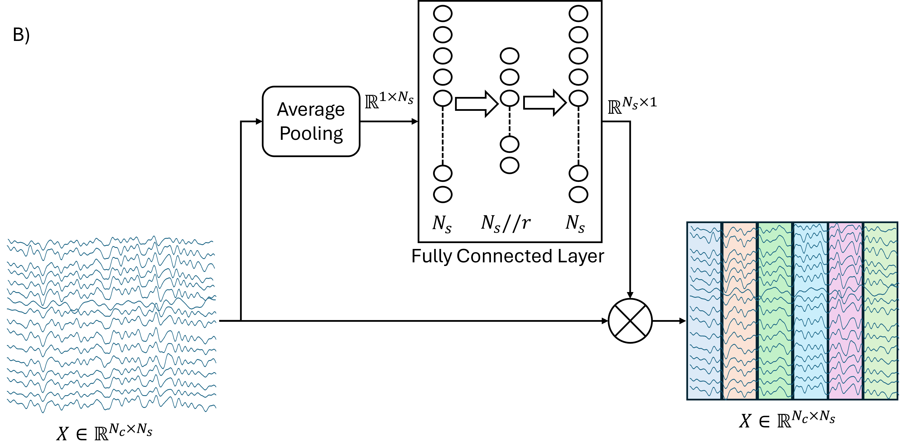
Proposed Method : Sample Scaling
B

Slide 6
Proposed Method
EEG Trial (33 x 2000)
Electrode-Scaling Block
Sample-Scaling Block
A
B
A
B
Conv2D : 33 x 1 Kernel, padding, filters = 16 Output: 16 x 1 x 2000
Conv2D : 1x16 kernel, padding = same, bias = False Output: 16 x 1 x 500
Flatten Layer
Conv2D : 1 x 64 Kernel, padding, filters = 8 Output: 8 x 33 x 2000
Batch Normalization
Batch Normalization
Dense Layer
Batch Normalization
Exponential Linear Unit Activation
Exponential Linear Unit Activation
SoftMax
A
B
B
Average Pooling (size = 8)
Dropout
Average Pooling (size = 8)
Dropout

Slide 7
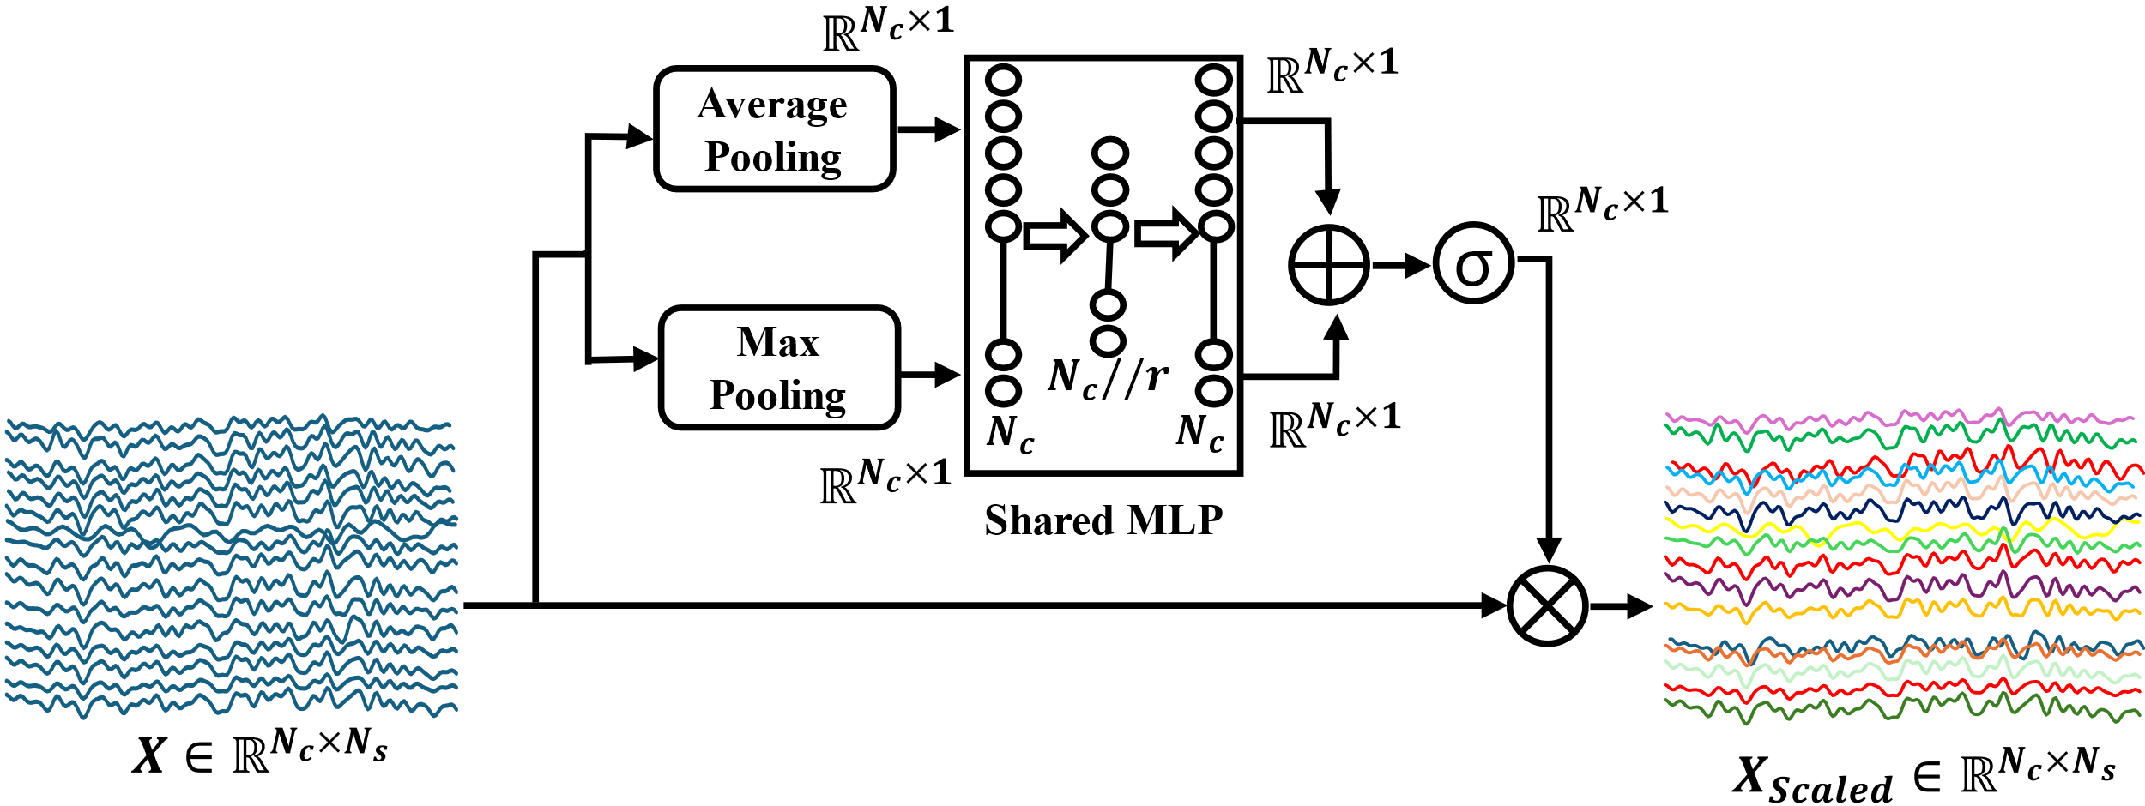
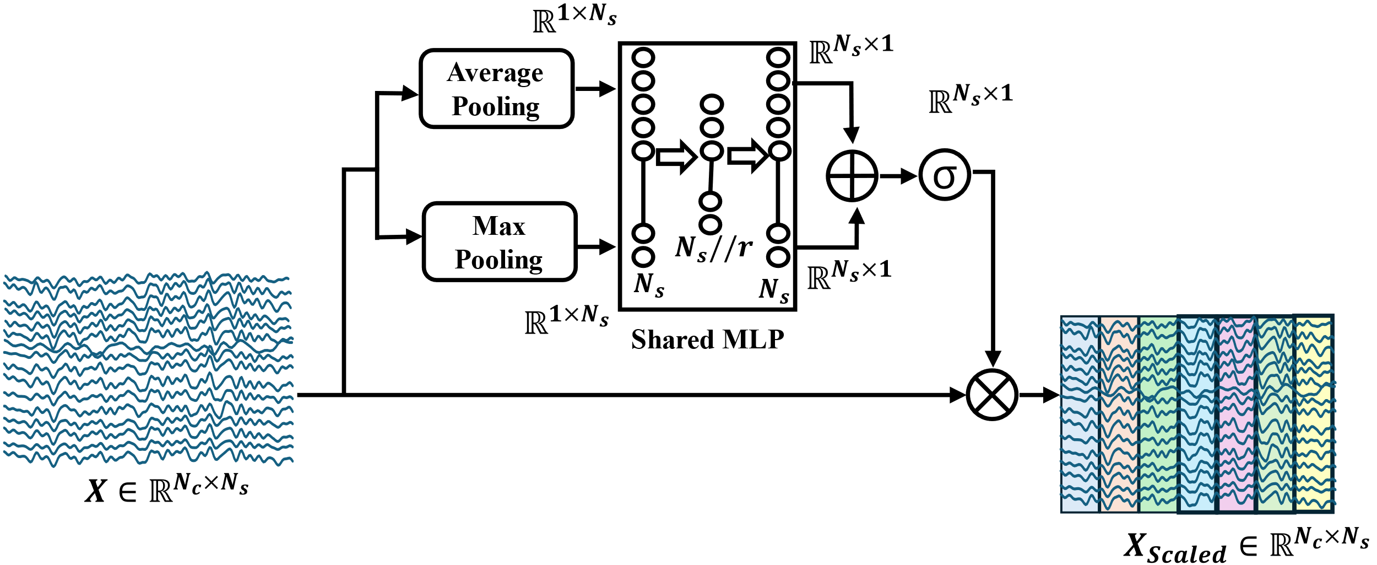




A)
B)
$$A$$
$$B$$
$$e$$
$$s$$

Slide 8
Results
SubID | SMC 2024 [1] | Proposed Method
S01 | 54.17 | 54
S02 | 52.08 | 56.22
S03 | 64.58 | 62.66
S04 | 60.42 | 68.88
S05 | 66.67 | 58.88
S06 | 58.33 | 60.66
S07 | 52.08 | 64.66
S08 | 56.25 | 73.55
S09 | 58.33 | 58.88
S10 | 60.42 | 65.11
S11 | 68.75 | 52.44
S12 | 60.42 | 71.11
S13 | 54.17 | 60
S14 | 66.67 | 56.88
Average | 59.52428571 | 61.70928571
[1] Sagila and A. P. Vinod, “Decoding Speed and Direction of Imagined Hand Movement from EEG-BCI”, IEEE SMC October 2024, Malaysia

Slide 9
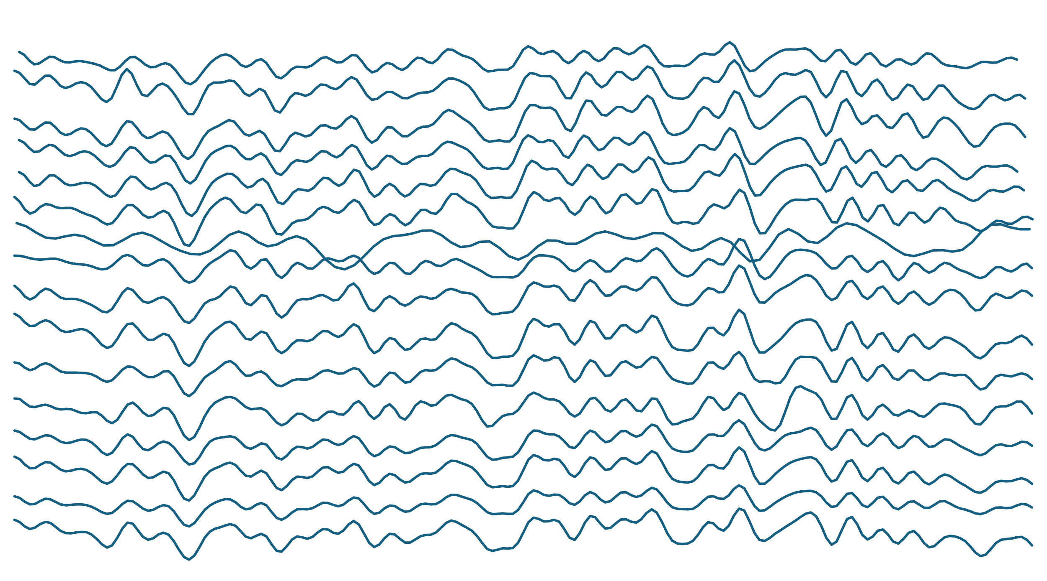






B)
Average Pooling
$$ℝ^{1×N_{s}}$$
$$ℝ^{N_{s}×1}$$
$$N_{s}$$
$$N_{s}//r$$
$$N_{s}$$
Fully Connected Layer
$$X∈ℝ^{N_{c}×N_{s}}$$
$$X∈ℝ^{N_{c}×N_{s}}$$

Slide 10
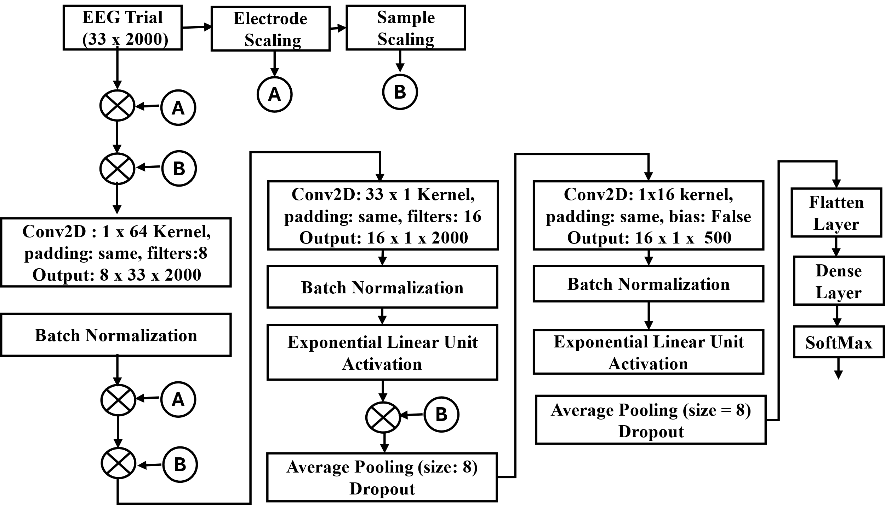
a)
b)
c)

Slide 11
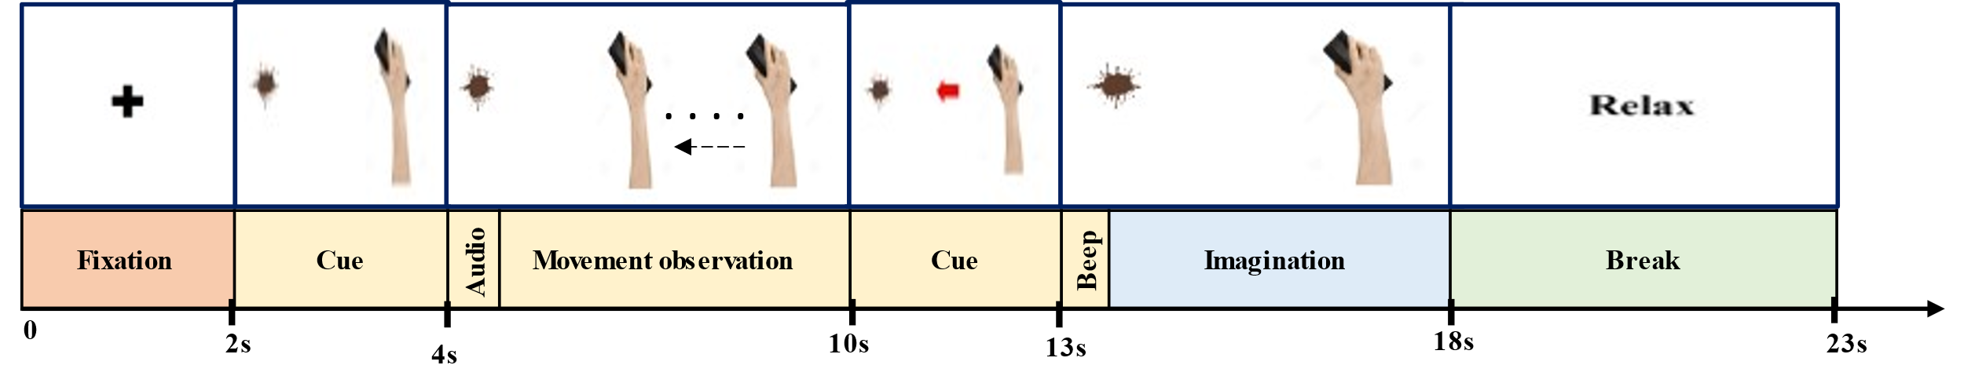

Slide 13
EEGNet [3]
W-CSP and MRSP [10]
Electrode-Scaling Only
Sample-Scaling Only
Both Electrode and Sample Scaling
Cross-Validated Classification Accuracy (%)
Subject ID

