Slide 1
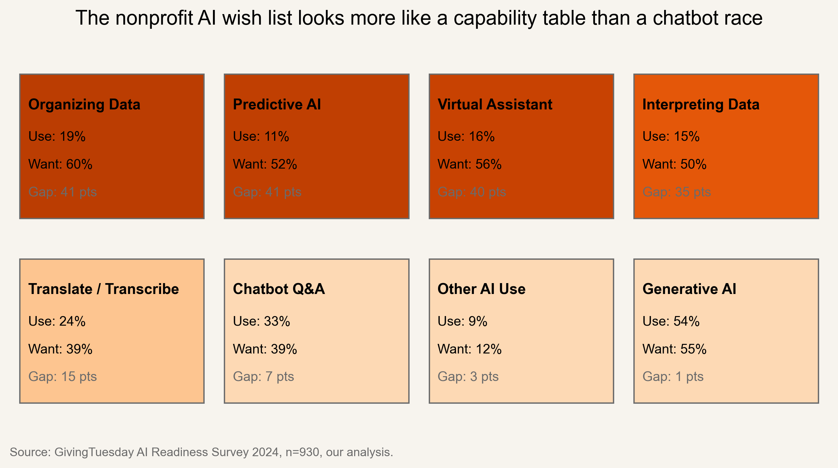
Why Nonprofits Want AI but Can't Use It
A data infrastructure story from 930 nonprofit survey responses worldwide
Bay Area Data Analytics Case Competition
GivingTuesday x Gates Foundation track
Source: GivingTuesday AI Readiness Survey 2024, n=930, our analysis.

Slide 2
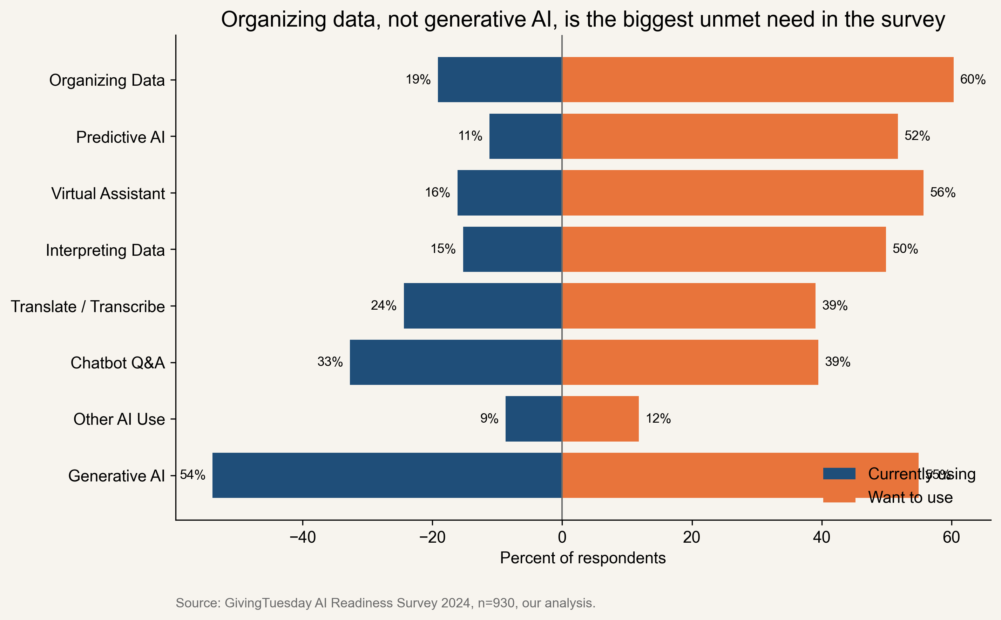
The headline is simple: nonprofits do not need more AI hype, they need better data plumbing
60%
19%
22%
want AI help organizing data
already use AI for that
Foundation-needed segment
Organizing data has the biggest unmet need in the whole survey, with a 41-point want-use gap.
36.99% of respondents want at least three more AI use cases than they currently use.
209 nonprofits fall into the Foundation-needed segment, meaning demand is real but the basics are not ready yet.
Source: GivingTuesday AI Readiness Survey 2024, n=930, our analysis.

Slide 3
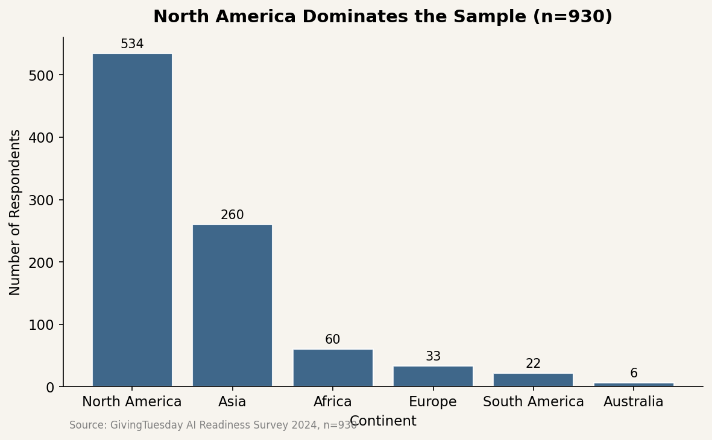
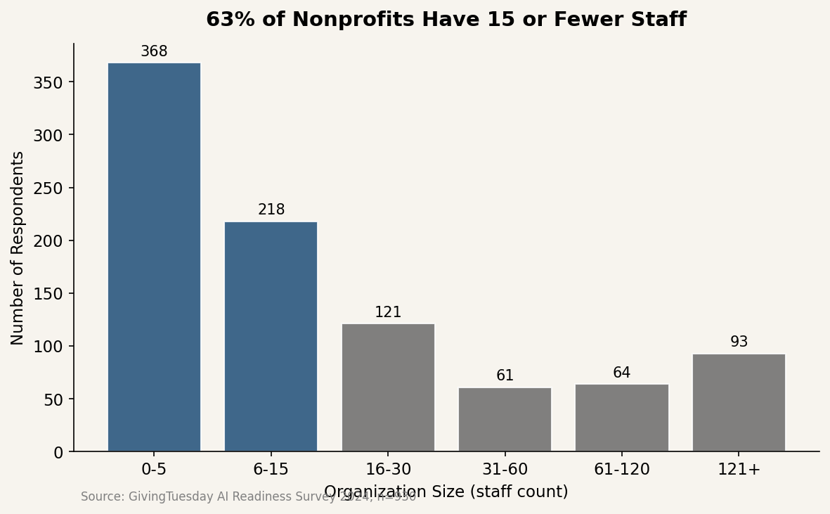
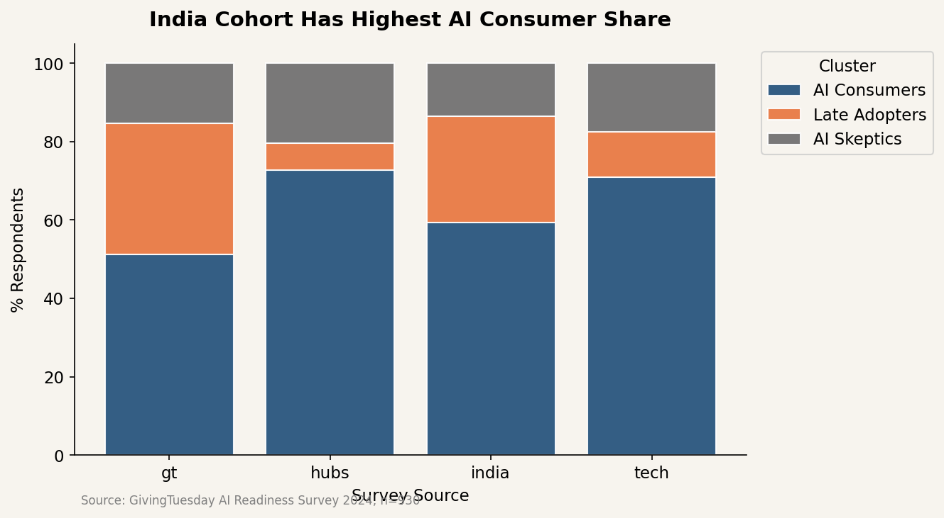
The sample is global, but it is still a small-org dataset with North America and India doing most of the talking
930
63%
62.6%
56%
survey responses
15 staff or fewer
Global North
AI Consumers
Source: GivingTuesday AI Readiness Survey 2024, n=930, our analysis.

Slide 4
The official report found three personas, and our analysis goes further on where demand and readiness come apart
What the official report already established
Where this deck adds something new
AI Consumers are the largest cluster (56%), Late Adopters are next (28%), and Skeptics are smallest (15%).
Organizational capacity is a weak readiness proxy.
Those with technical backgrounds tend to be more wary of AI risks.
The biggest unmet AI need is help organizing data.
It turns the want-use gap into a funder-ready segmentation.
It shows India and Africa are not interchangeable inside the Global South story.
It challenges the tidy 15-staff threshold by showing the steepest staffing jump happens earlier.
It uses open text to show hope and fear living side by side.
Sources: GivingTuesday AI Readiness and Adoption in the Nonprofit Sector in 2024; our analysis.

Slide 5
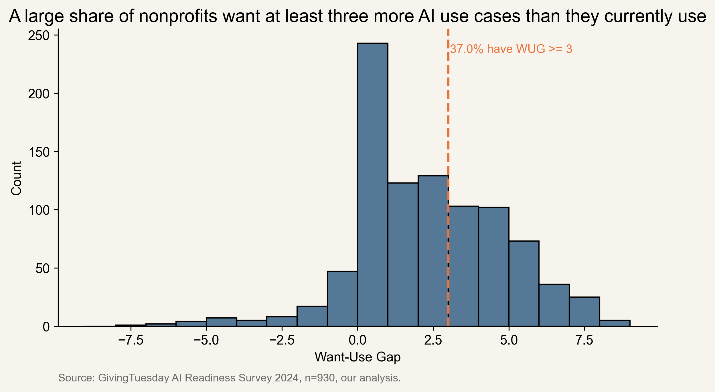
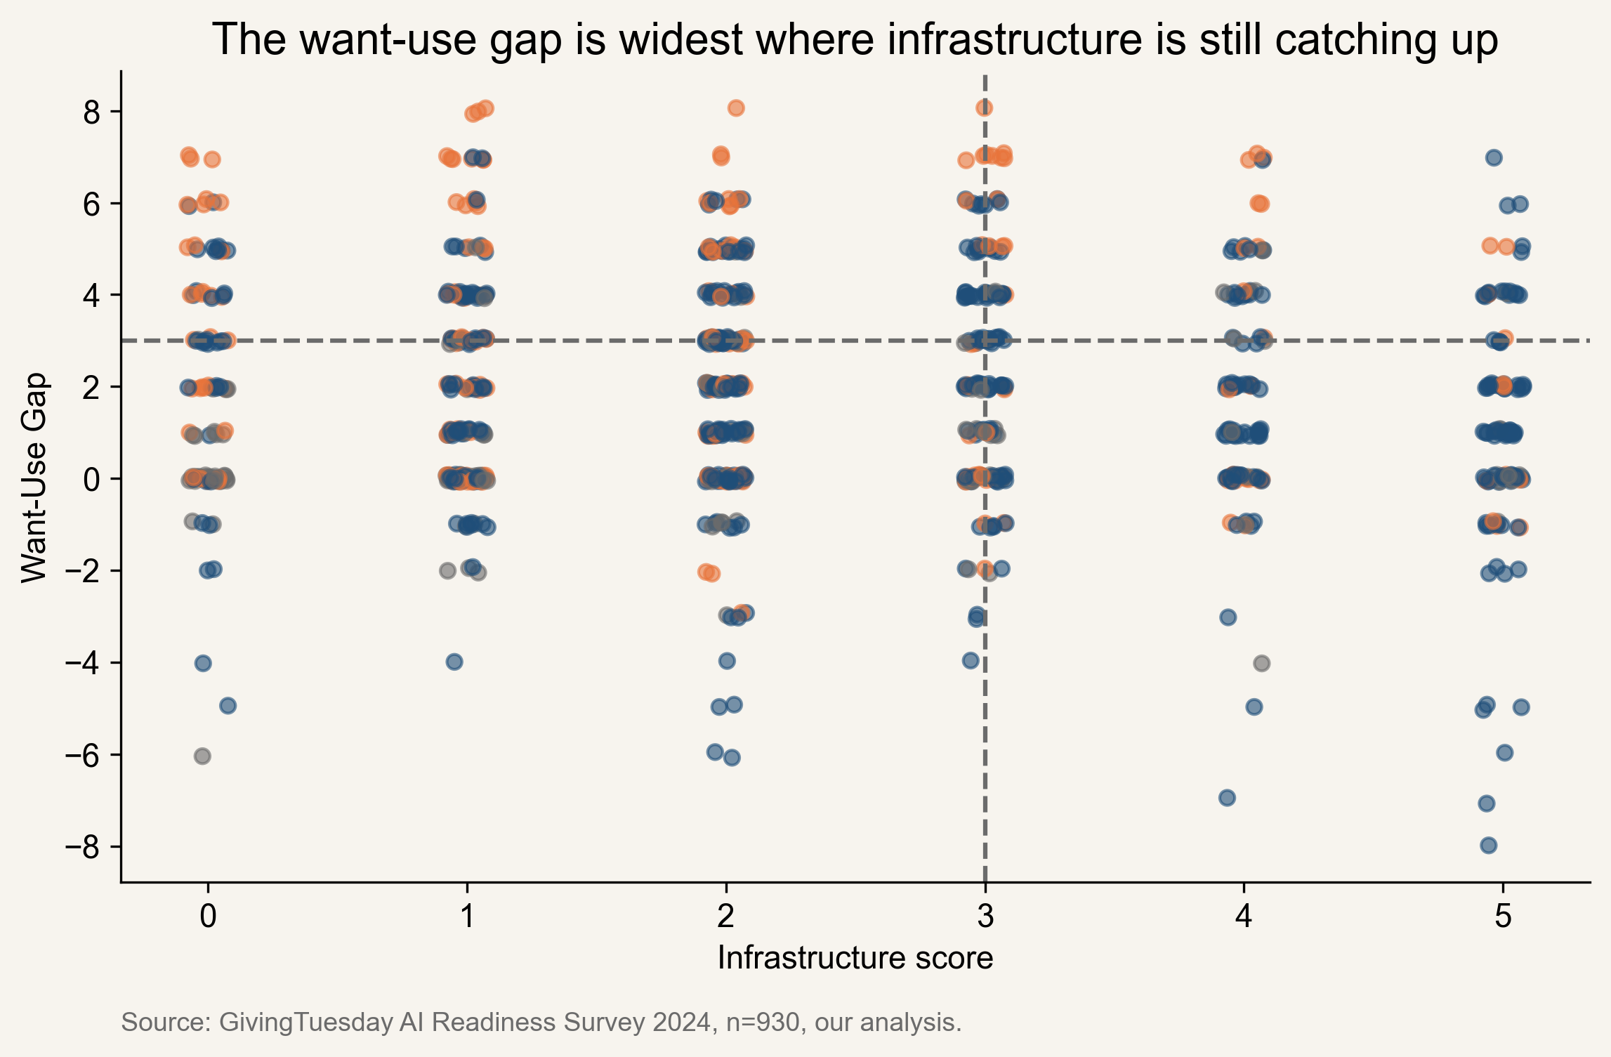
Late Adopters have the biggest Want-Use Gap, which makes them the most important intervention group
Late Adopters average a 2.41-point gap, versus 1.81 for Consumers and 0.74 for Skeptics.
Source: GivingTuesday AI Readiness Survey 2024, n=930, our analysis.

Slide 6
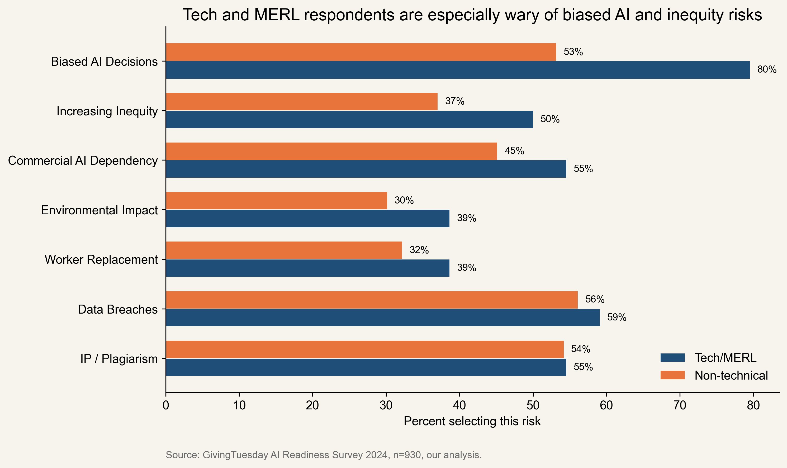
Technical respondents are not calmer about AI, they are much more likely to worry about bias
79.5% of Tech/MERL respondents flagged biased AI decisions, versus 53.2% of non-technical peers.
That was the only risk difference that stayed significant after Holm correction (adjusted p = 0.007).
This pushes against the idea that more technical literacy simply reduces fear.
Source: GivingTuesday AI Readiness Survey 2024, n=930, our analysis.

Slide 7
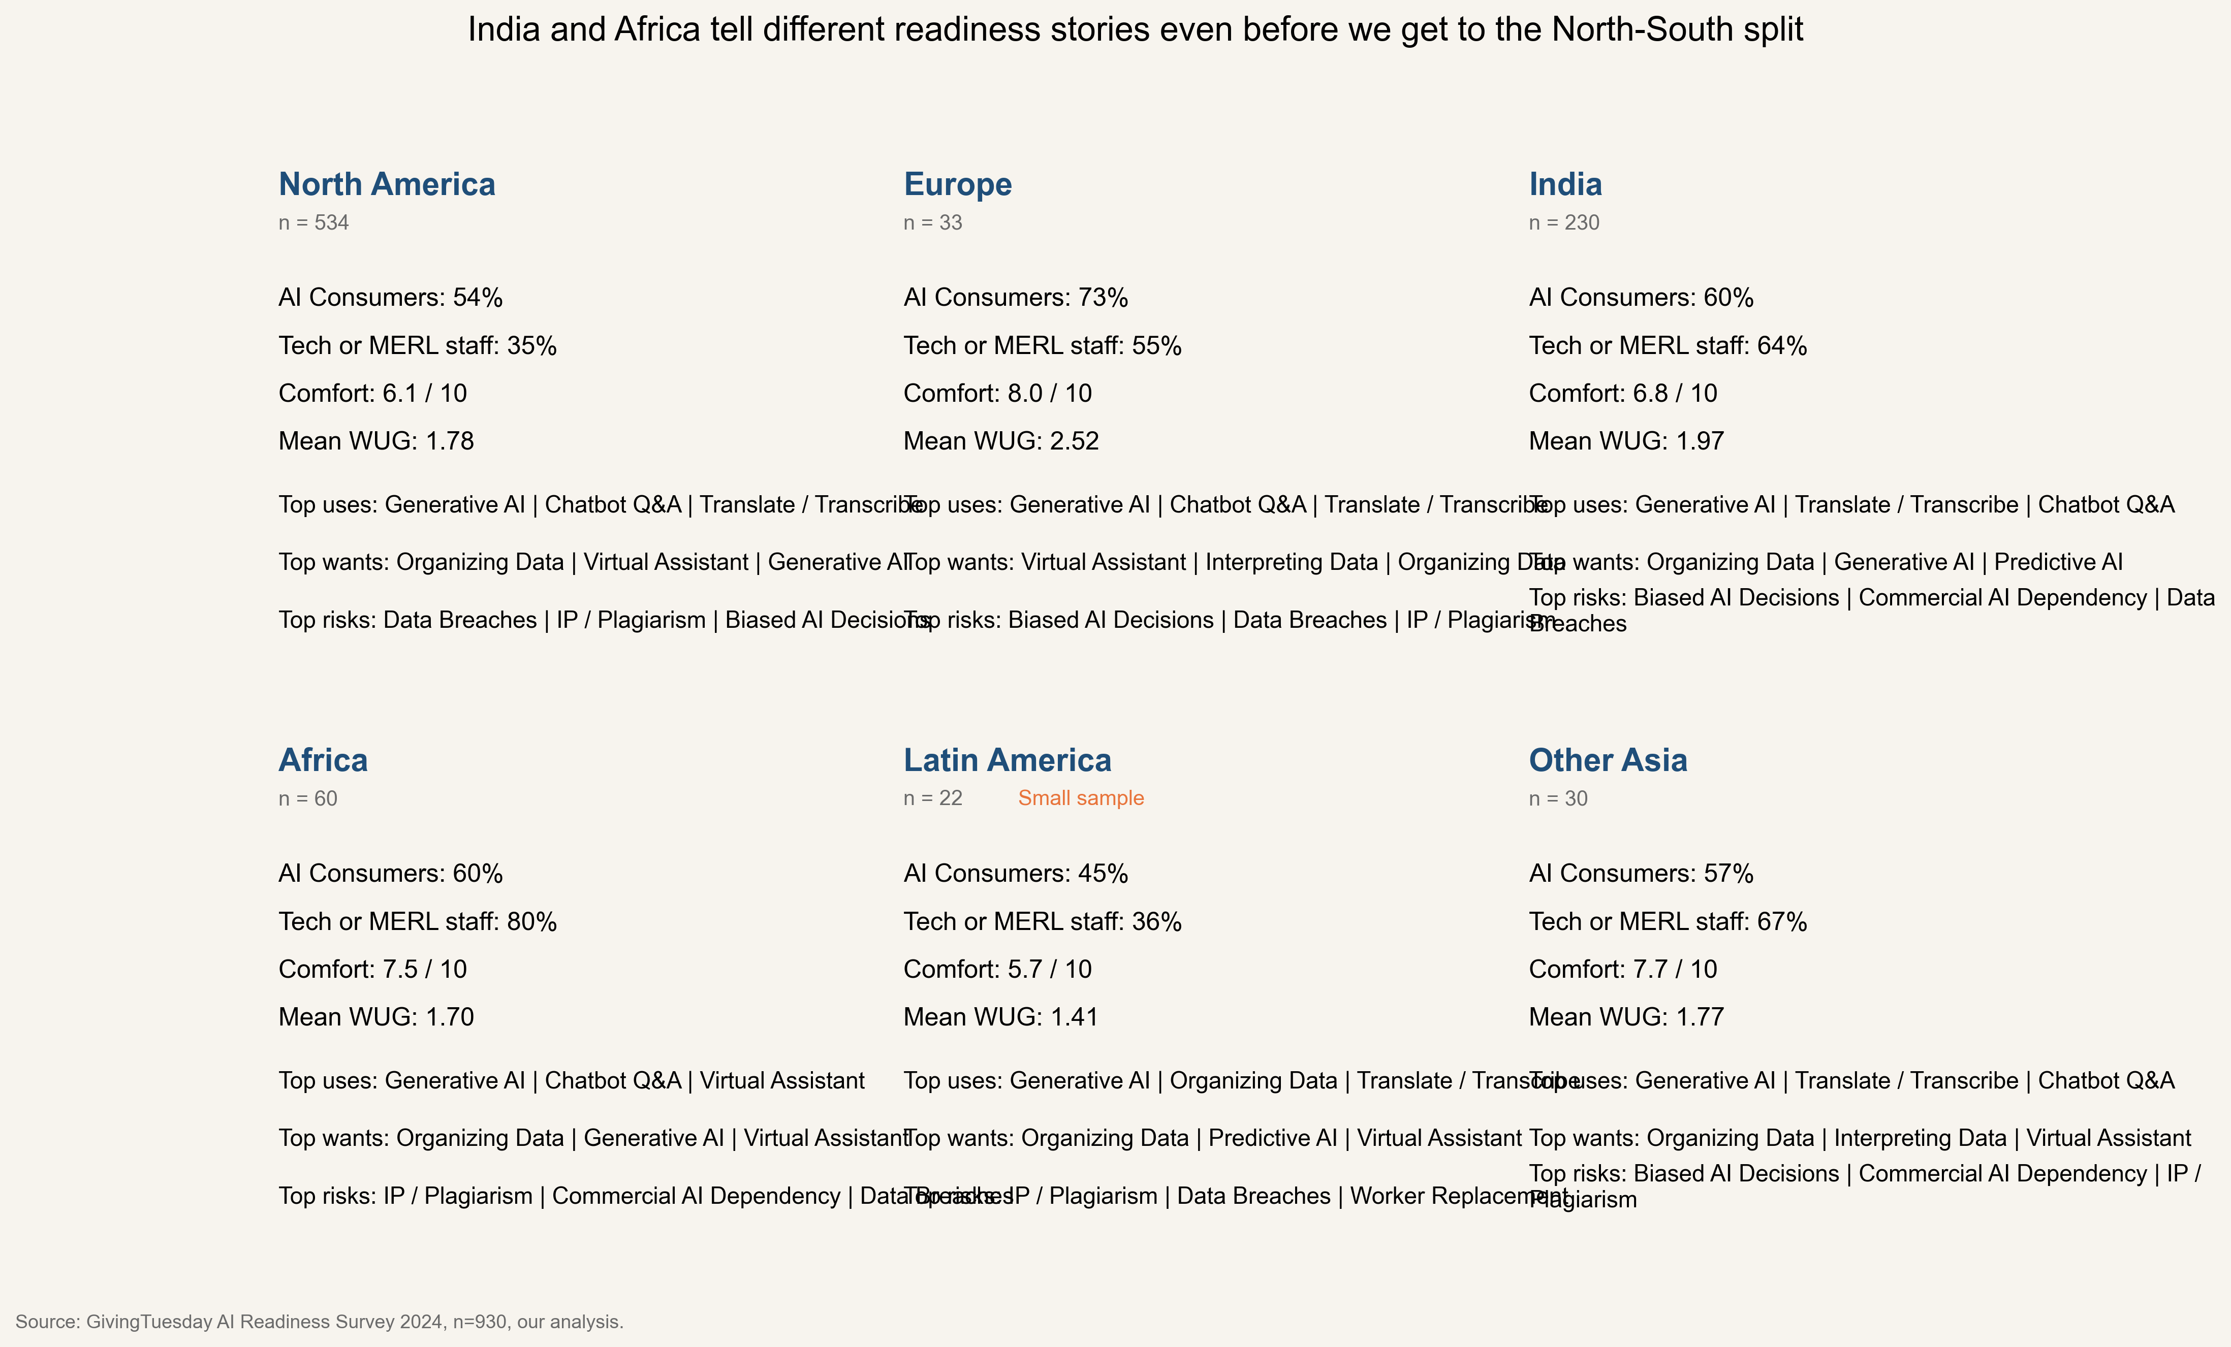
India and Africa tell different readiness stories even before we compare the Global South to the North
Source: GivingTuesday AI Readiness Survey 2024, n=930, our analysis. Treat Latin America and Europe cautiously due to small samples.

Slide 8
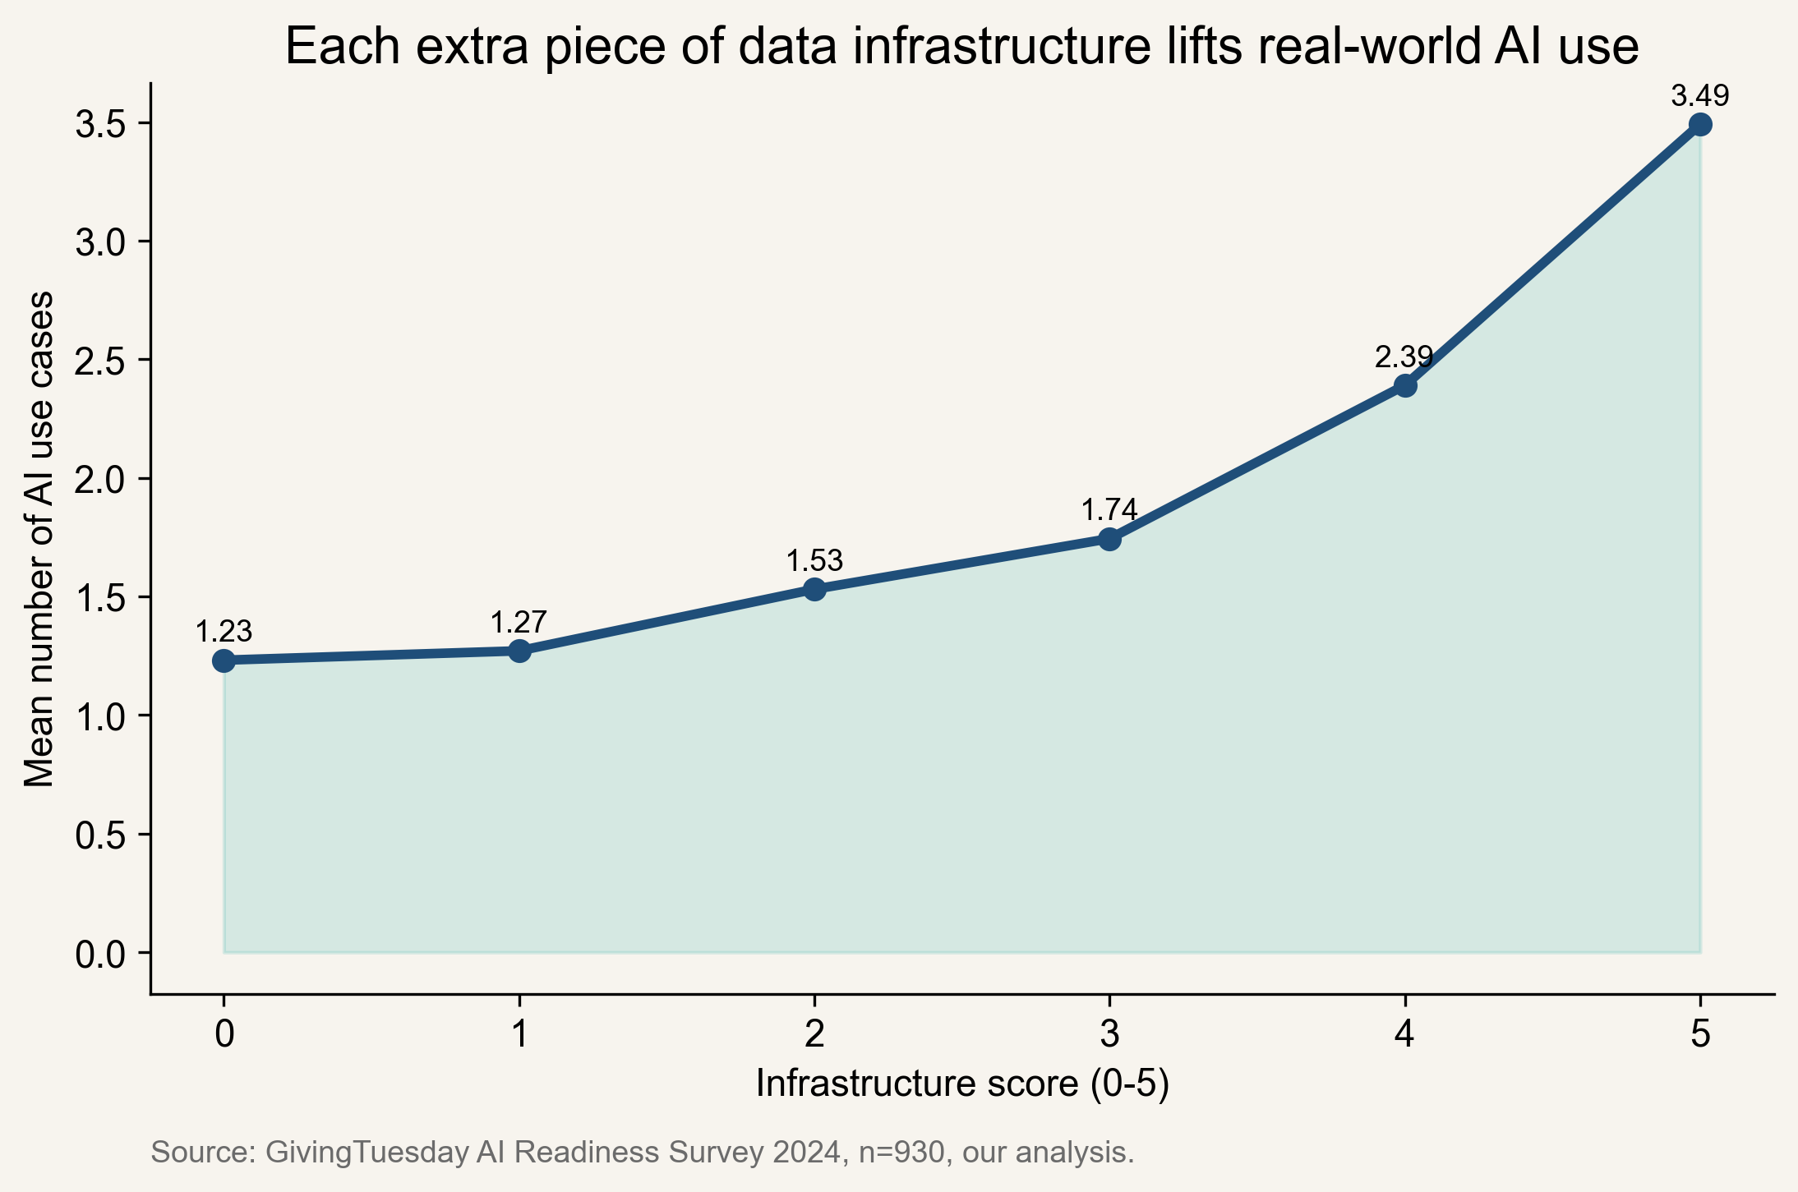
Each extra piece of data infrastructure lifts real-world AI use, even before we get fancy about modeling
Organizations with an infrastructure score of 0 average 1.23 AI use cases.
At a score of 5, that rises to 3.49 use cases.
In the controlled logistic model, cloud storage still carries an odds ratio of 1.93 and data agreements 1.58.
Org age and the broad North-South split stop mattering once those operational signals are in the model.
Source: GivingTuesday AI Readiness Survey 2024, n=930, our analysis.

Slide 9
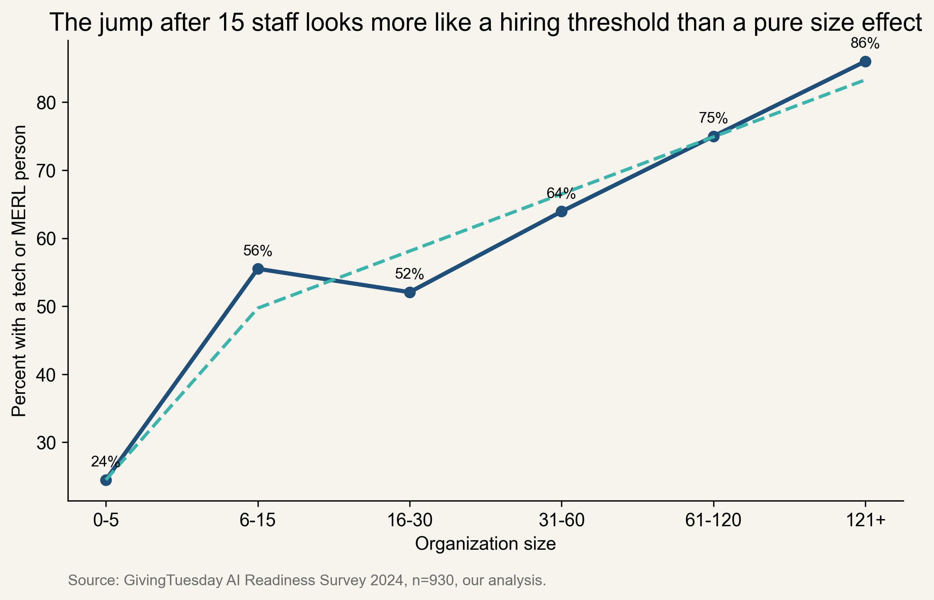
The 15-staff threshold is not magic, because the first major staffing jump happens earlier
The biggest staffing jump is from 0-5 staff to 6-15 staff, not from 6-15 to 16-30.
That tells us the threshold story is really about when the first technical hire becomes possible.
So '15 staff' is a rough planning heuristic, not a law of nonprofit readiness.
Source: GivingTuesday AI Readiness Survey 2024, n=930, our analysis.

Slide 10
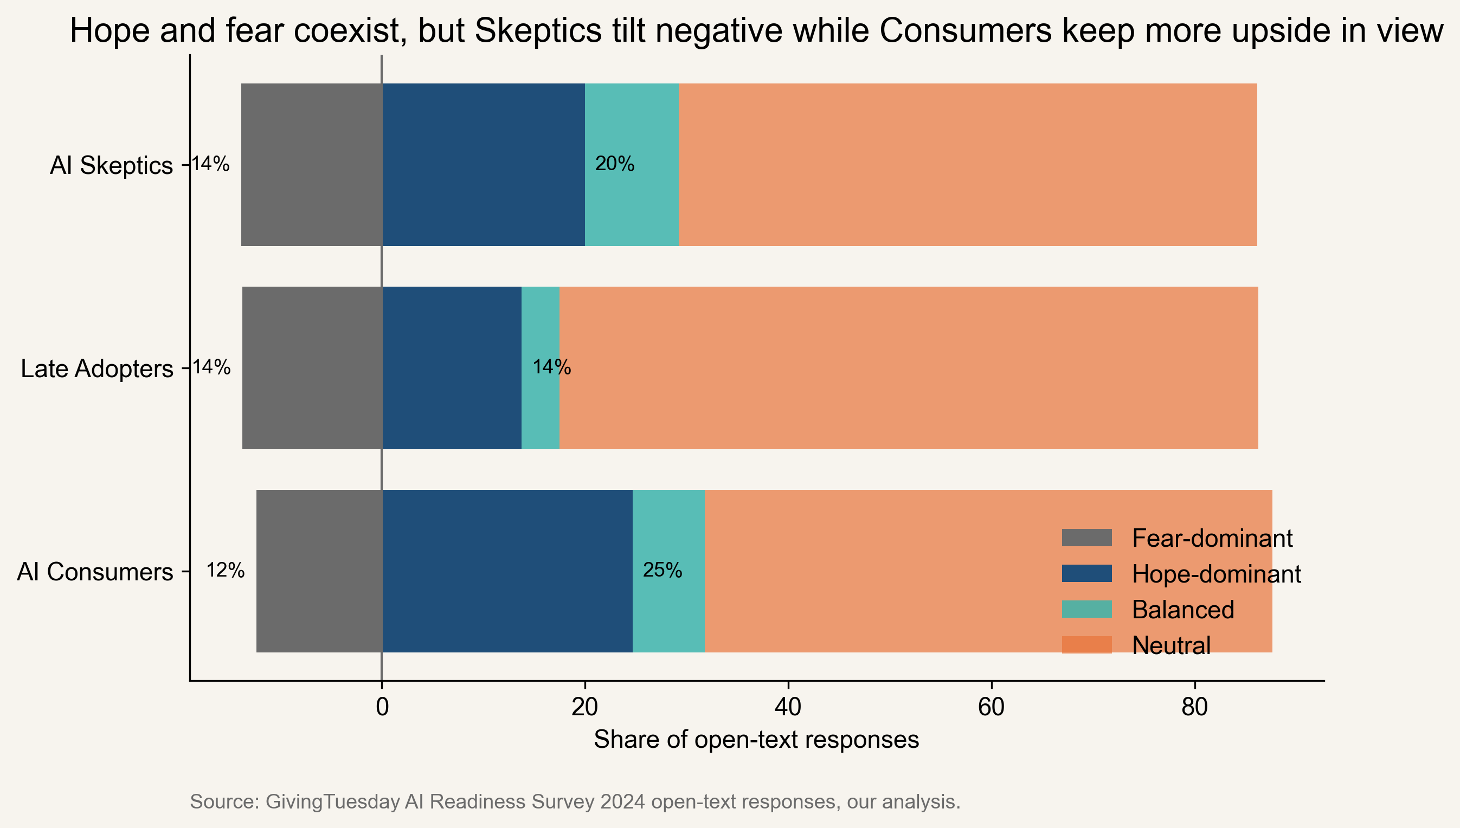
Hope and fear coexist in the open text, and Skeptics sound both more negative and more varied
Verified quotes from respondents
"This can help bridge the educational gap in rural areas by offering high-quality resources that are otherwise inaccessible"
AI Consumers, India, Admin
"However, this potential is accompanied by significant challenges and risks that we must navigate carefully"
AI Consumers, India, Governance
"Working in journalism, a great fear is abusing AI in the creation of trustworthy information & relaying data"
AI Consumers, North America, Fundraiser
"I fear that AI will take the human-ness out of our work, that people will further disconnect from others"
AI Consumers, North America, Leader
Source: GivingTuesday AI Readiness Survey 2024 open-text responses, our analysis.

Slide 11
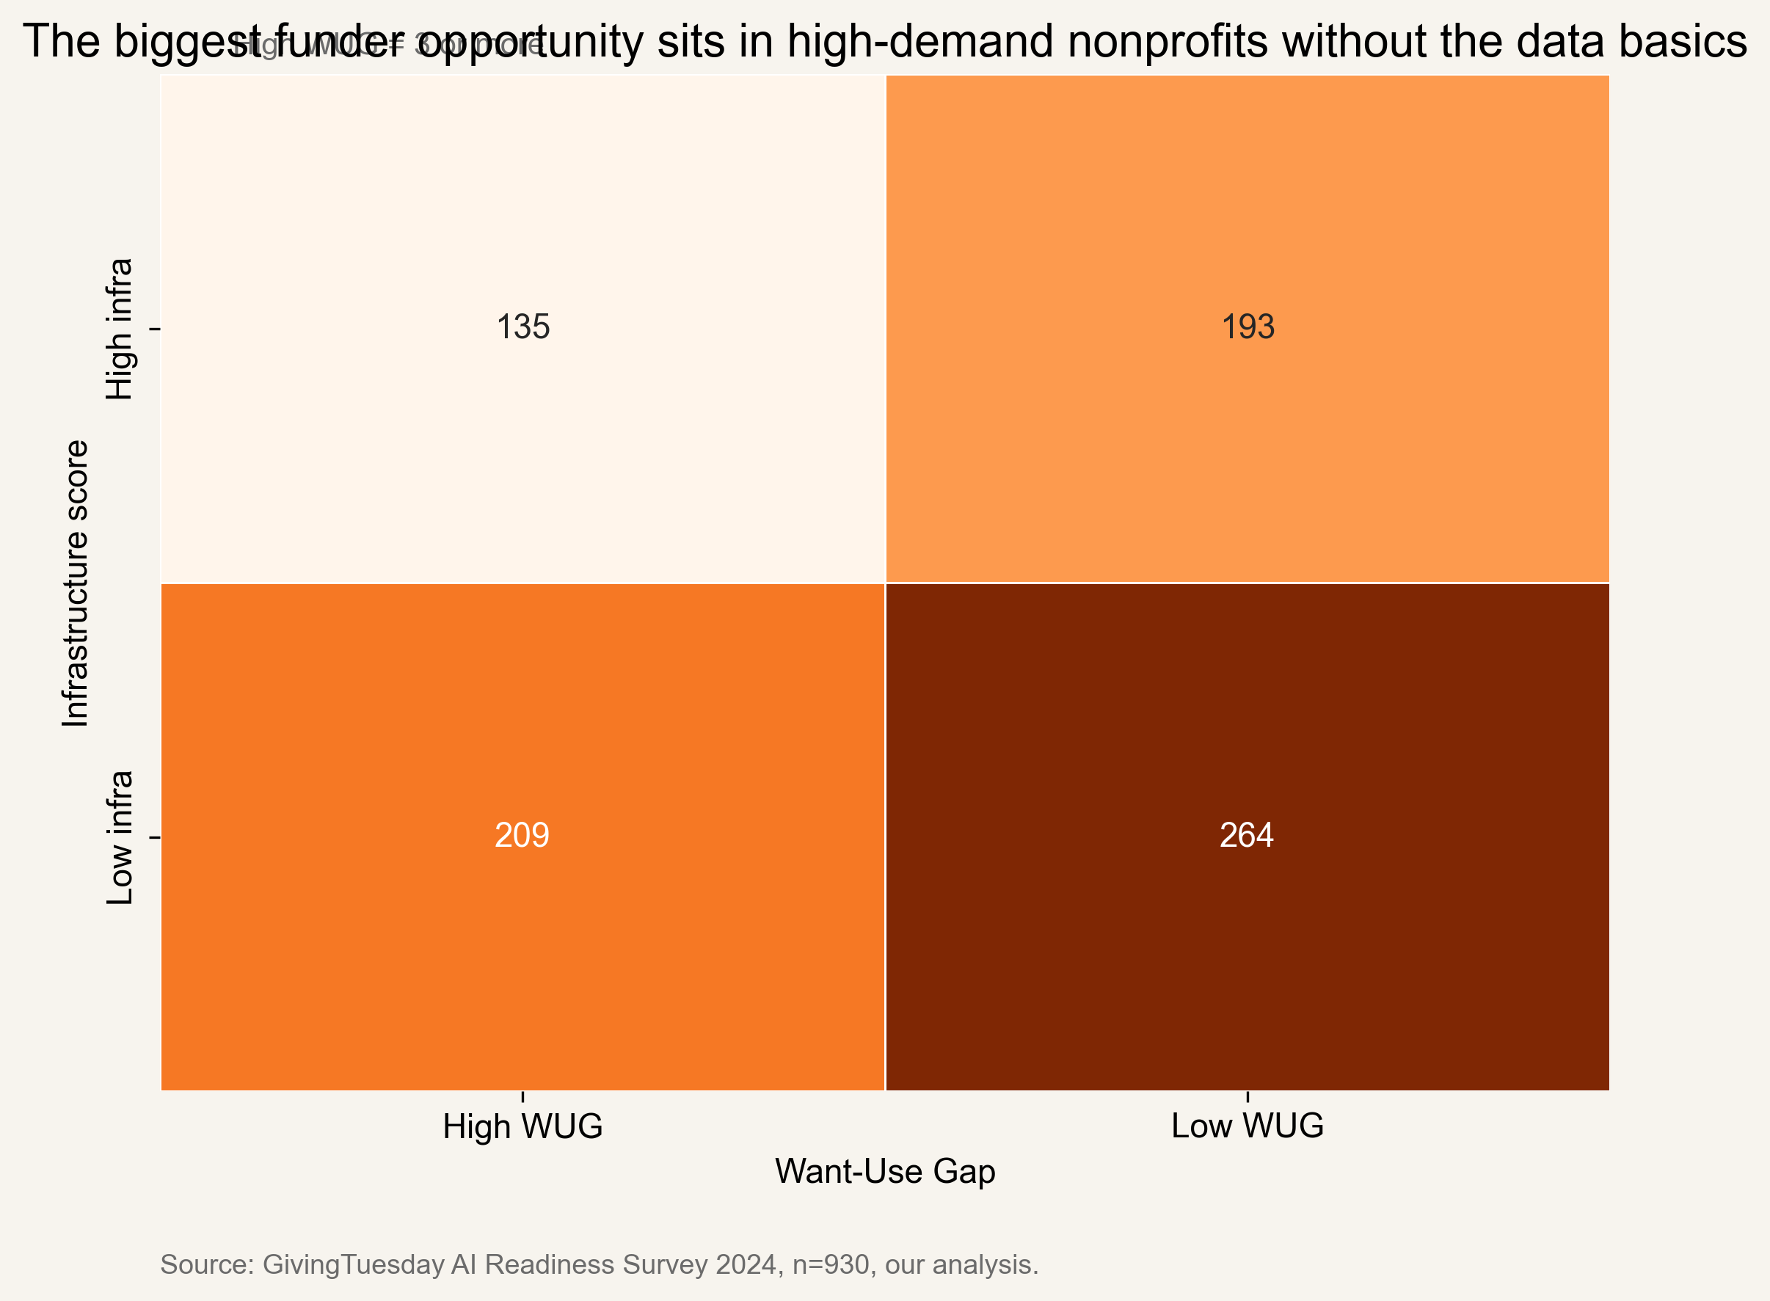
The most actionable quadrant is the nonprofits that want more AI but still need their foundation built first
Foundation-needed includes 209 nonprofits, or 22.47% of the sample.
Activation-ready groups can absorb pilots now.
Disengaged groups need AI literacy and low-stakes data practice, not a new product demo.
Already-well-served groups can become peer mentors and testbeds.
Source: GivingTuesday AI Readiness Survey 2024, n=930, our analysis.

Slide 12
Our recommendation is to fund data infrastructure first, tailor tools by segment second, and treat AI readiness as an operating problem
For funders
For tool builders
For nonprofits
Shift grant dollars from shiny AI pilots toward cloud storage, policies, and data staffing for Foundation-needed nonprofits.
Design separate journeys for Activation-ready, Foundation-needed, and Disengaged organizations instead of shipping one generic nonprofit AI offer.
Use the infrastructure score as a self-check before adopting more tools. If the plumbing is weak, fix that before scaling AI.
Source: GivingTuesday AI Readiness Survey 2024, n=930, our analysis.

Slide 13
The story is useful, but it still comes with sample and method limits we should say out loud
This is cross-sectional self-report data, so we can rank associations but not claim causation.
North America and India dominate the sample, while Africa, Latin America, Europe, and Australia are much smaller.
The open-text analysis is transparent and reproducible, but the lexicon rules are still simplifications.
Our fresh HDBSCAN rerun only partially recreates the published clusters, which means the original parameter choices matter.
The predictive model is modest (AUC around 0.64), so it is an explanation tool, not a deployment tool.
Source: GivingTuesday AI Readiness Survey 2024, n=930, our analysis.

Slide 14
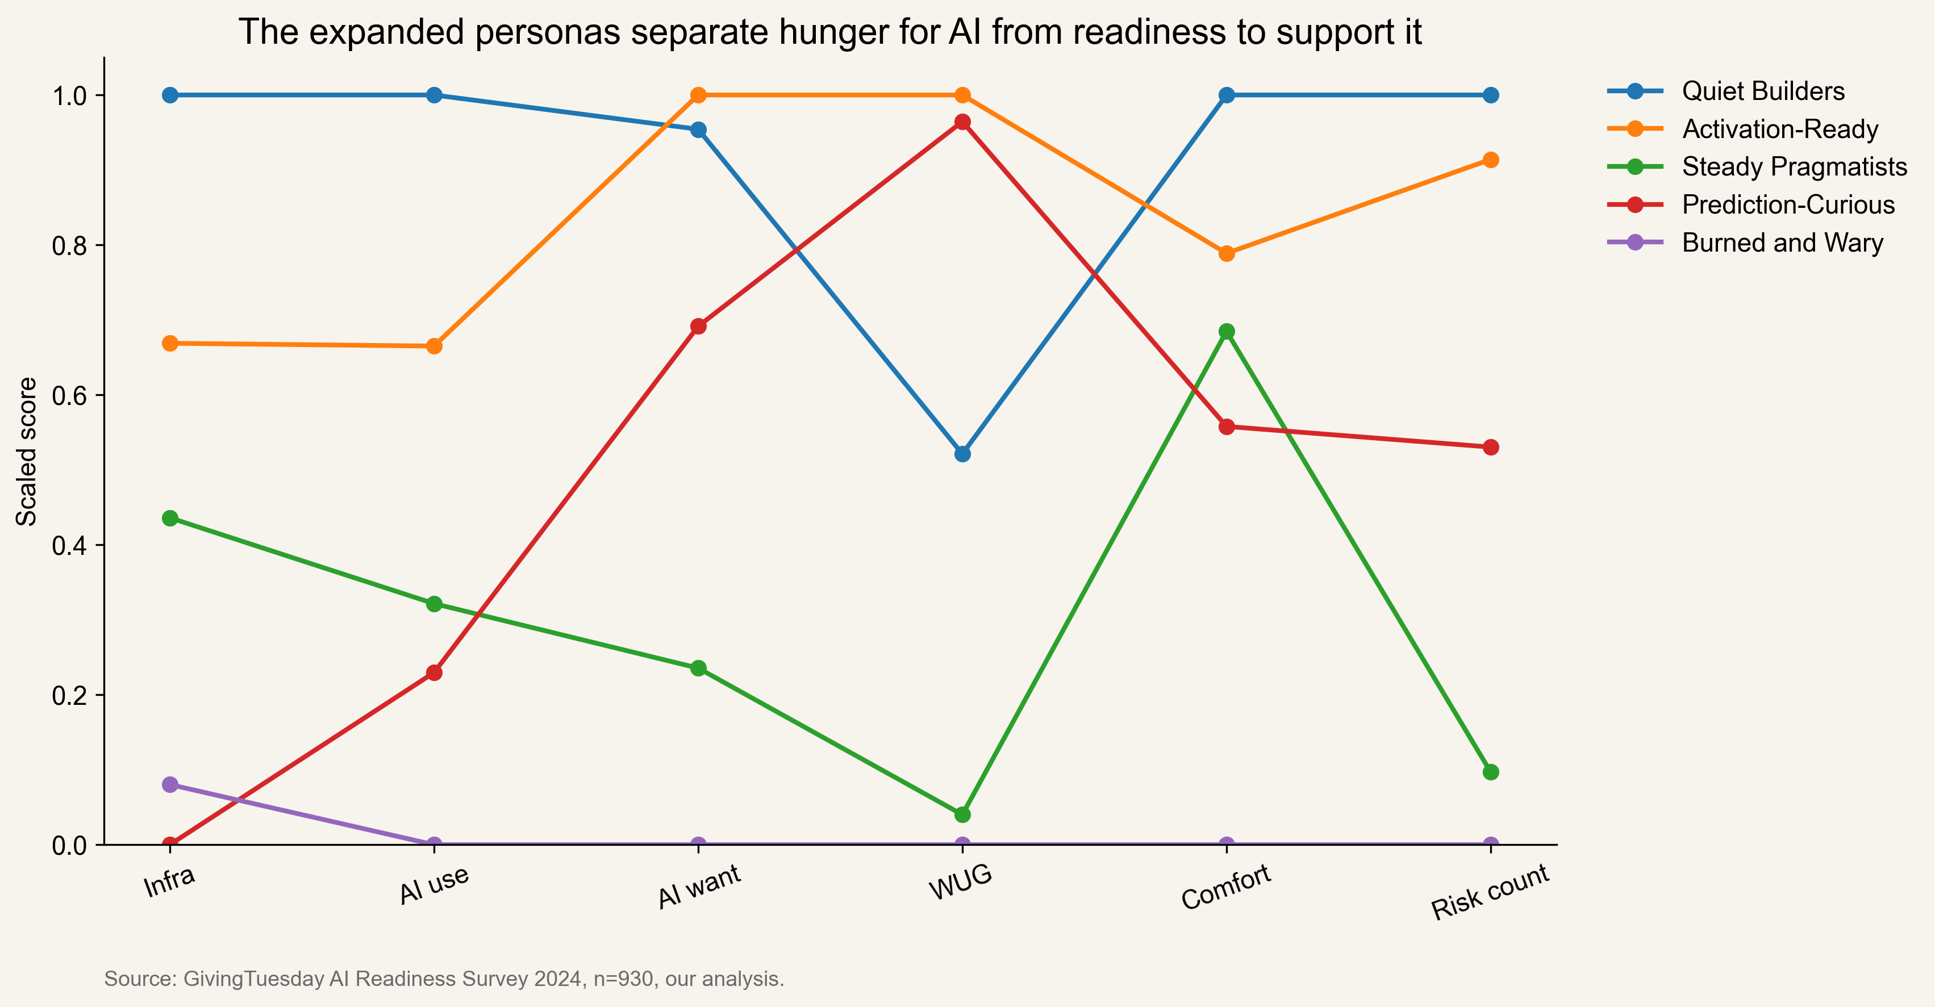
Appendix: a five-persona lens helps split demand-rich nonprofits from true skeptics
persona_name story
Quiet Builders These groups already have the basics, so their readiness shows up in actual daily use.
Activation-Ready This group moves steadily, with moderate demand, moderate use, and no single dominant pattern.
Steady Pragmatists This group moves steadily, with moderate demand, moderate use, and no single dominant pattern.
Prediction-Curious They are aiming at advanced use cases before the underlying data foundation looks ready.
Burned and Wary Skepticism here looks learned, not abstract, with lower comfort and higher risk salience.
Source: GivingTuesday AI Readiness Survey 2024, n=930, our analysis.

Slide 15
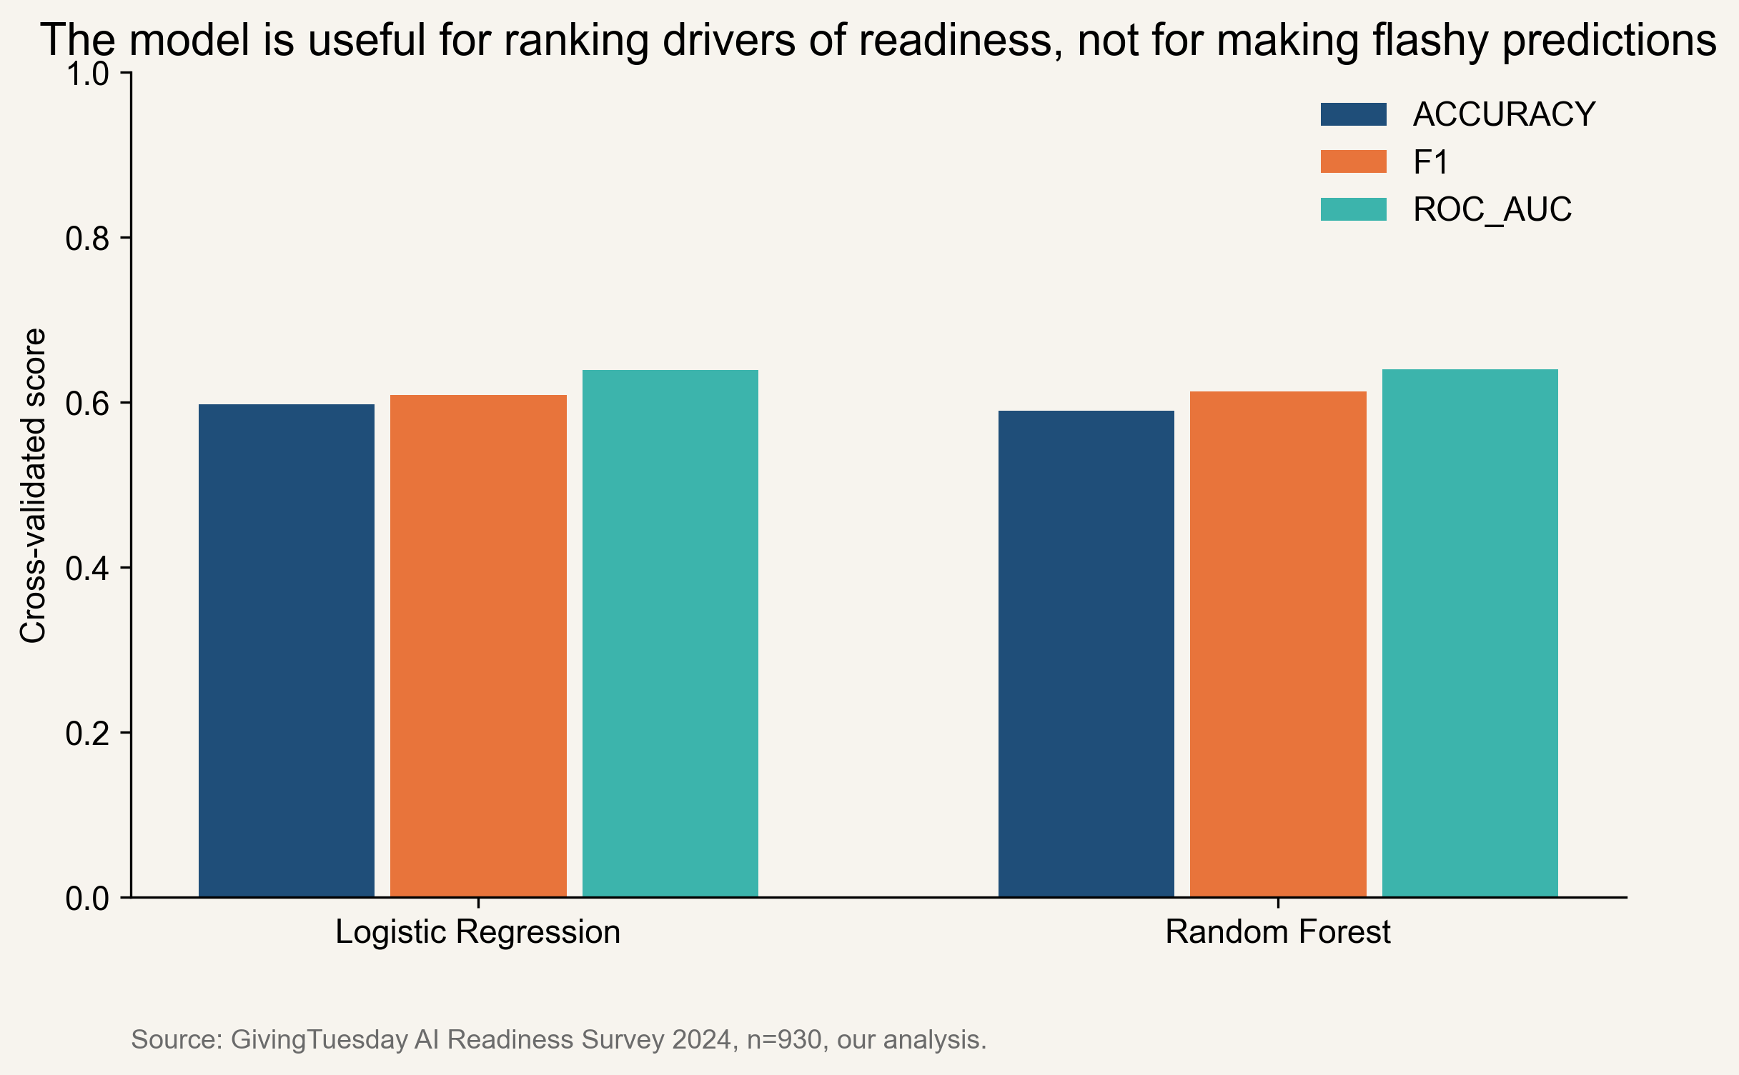
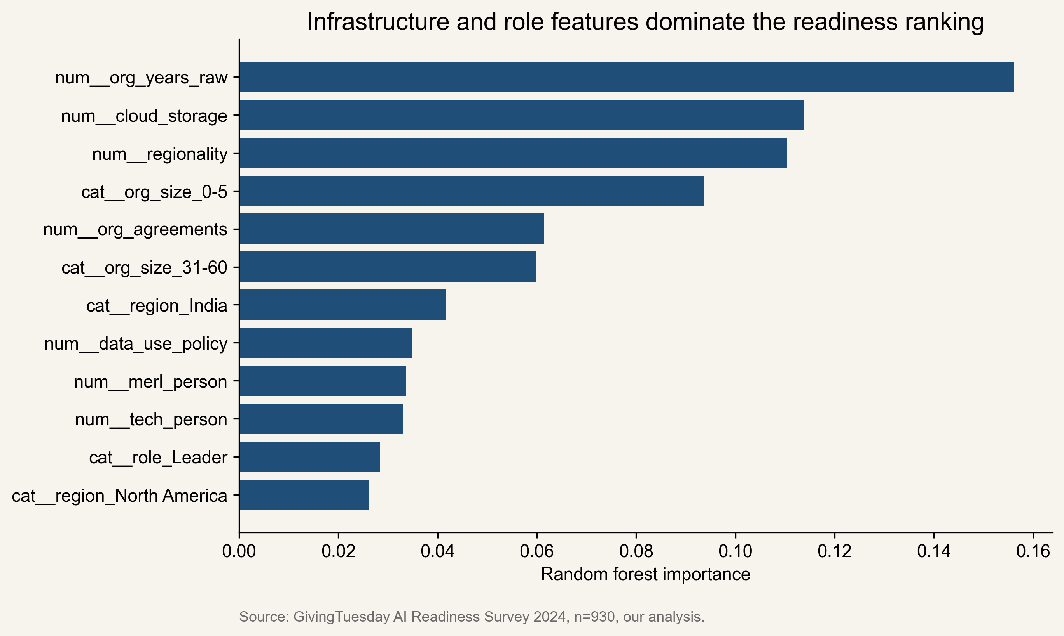
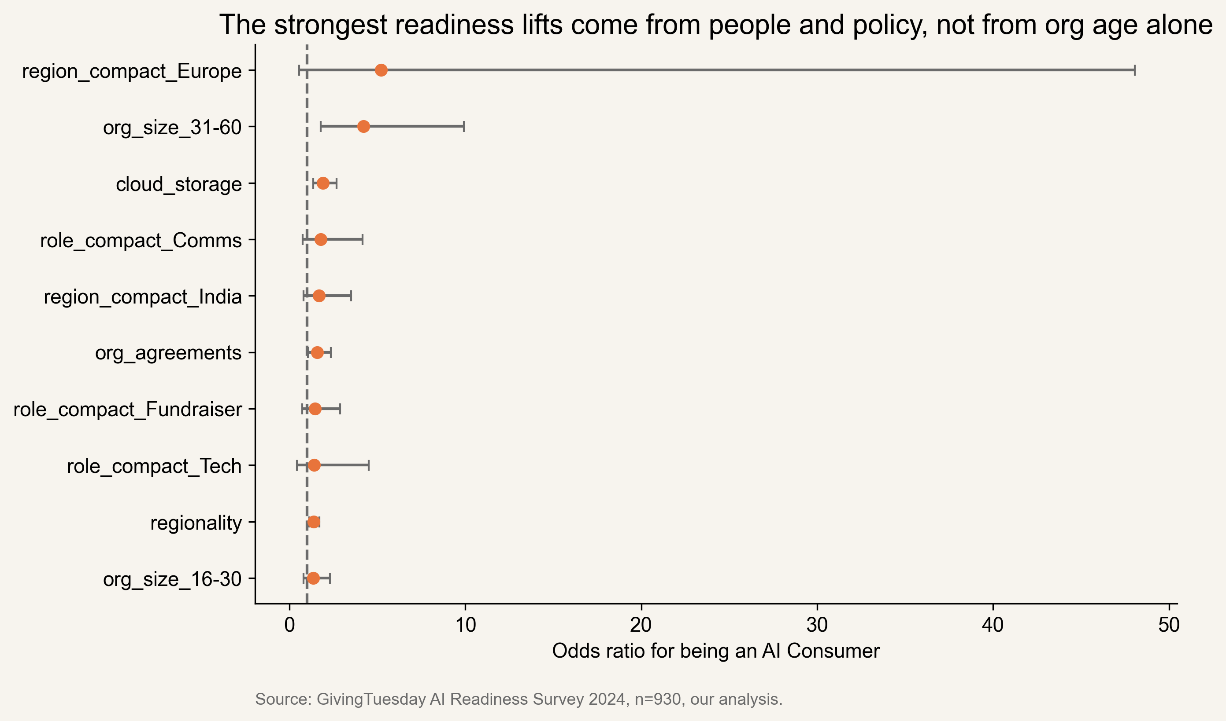
Appendix: the predictive model is modest, which is exactly why we use it for explanation instead of forecasting
model accuracy_mean accuracy_std f1_mean f1_std roc_auc_mean roc_auc_std
Logistic Regression 0.598 0.038 0.608 0.039 0.639 0.042
Random Forest 0.590 0.023 0.613 0.022 0.640 0.029
Source: GivingTuesday AI Readiness Survey 2024, n=930, our analysis.

