Slide 1
AI INTERVIEW TRAINER AGENT
CAPSTONE PROJECT
Presented By:
Student name : Parshva Dongare
College Name : MIT Academy Of Engineering Department : ENTC

Slide 2
OUTLINE
Problem Statement
Technology used
Wow factor
End users
Result
Conclusion
Git-hub Link
Future scope
IBM Certifications

Slide 3
Problem Statement
The Challenge:
Students and professionals often struggle to make informed interview preparation decisions due to the overwhelming volume of generic advice and the lack of personalized guidance tailored to specific job roles and experience levels. Manually searching for role-specific questions, behavioral scenarios, and up-to-date industry expectations is time-consuming and inefficient. Current solutions often provide one-size-fits-all guidance, leading to under-prepared candidates and missed opportunities.
Proposed Solution:
An AI Interview Trainer Agent, powered by Retrieval-Augmented Generation (RAG), is designed to prepare users for job interviews by generating tailored question sets and preparation strategies based on their specific job role and experience level. It retrieves role-specific interview questions, industry expectations, behavioral scenarios, and HR guidelines from both an internal curated knowledge base and external real-time sources (via web search). This intelligent assistant builds user confidence, sharpens responses, and increases success rates in competitive hiring environments by providing specific, actionable, and comprehensive interview prep.

Slide 4
Technology used
IBM cloud lite services
Natural Language Processing (NLP) - (Implicit in LLM and Embeddings)
Retrieval-Augmented Generation (RAG) - (Core Architecture)
IBM Granite Foundation Model - (For advanced text generation)
Sentence Transformers (for local embeddings) - (If you used it for local KB processing before Agent Lab)
Vector Indexing (within watsonx.ai Agent Lab)

Slide 5
IBM cloud services used
IBM Cloud Watsonx AI Studio
IBM Cloud Watsonx AI runtime
IBM Cloud Agent Lab
IBM Granite foundation model

Slide 6
Wow factors
This agent significantly streamlines interview preparation, boosts candidate confidence, and democratizes access to high-quality career advice.
Unique features:
Role-Specific Tailoring: Provides highly relevant questions and strategies based on the user's specific job role and experience level.
Dynamic Knowledge Access (RAG): Combines a curated internal knowledge base for structured advice with real-time web search (via Google Search tool) for broader coverage of roles.
Behavioral & Technical Prep: Covers both crucial aspects of modern interviews.
Actionable Advice: Delivers clear, concise, and actionable tips for answering difficult questions (e.g., "Tell me about yourself," "Weaknesses," STAR method)
Human-like Interaction: Designed for professional and empathetic conversation, making interview prep less daunting.
Scalable & Accessible: Provides on-demand, personalized coaching, overcoming limitations of manual counseling.

Slide 7
End users
Job Seekers (Students, Recent Graduates, Experienced Professionals)
Career Counselors (as an assistive tool)
Educational Institutions (for career services)
Recruiters (for insight into common questions for various roles)
Individuals transitioning careers

Slide 8
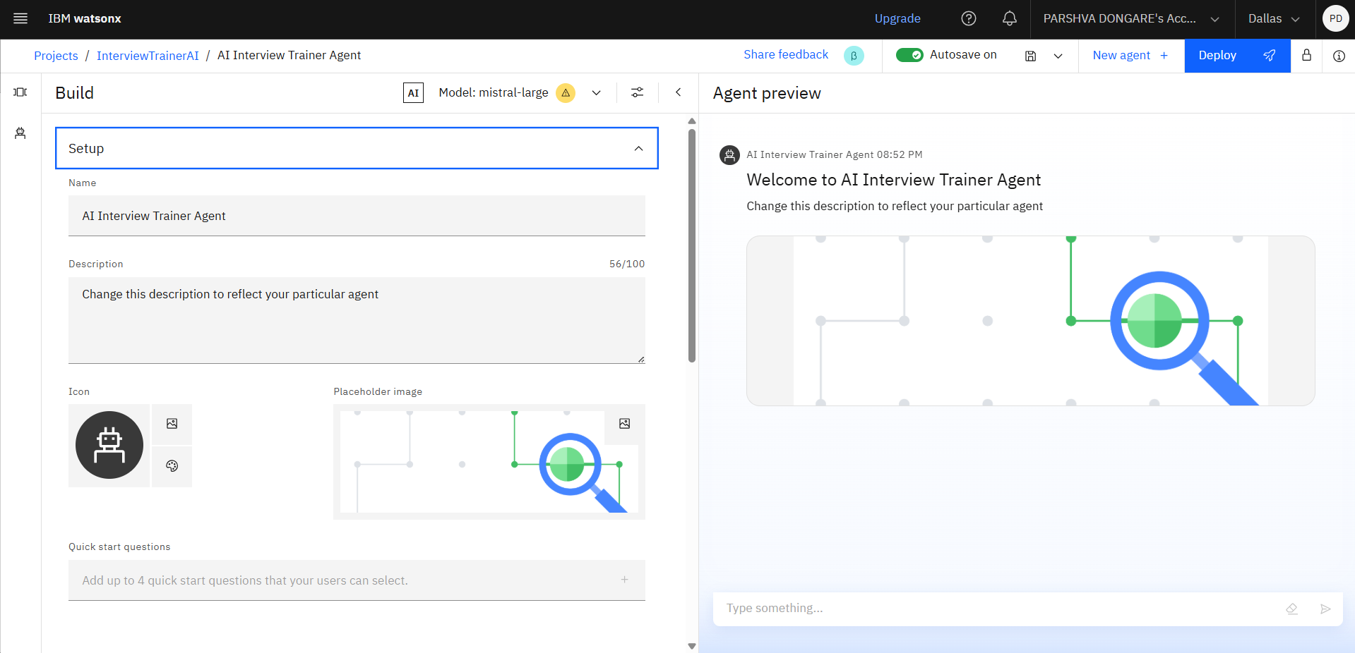
Results

Slide 9
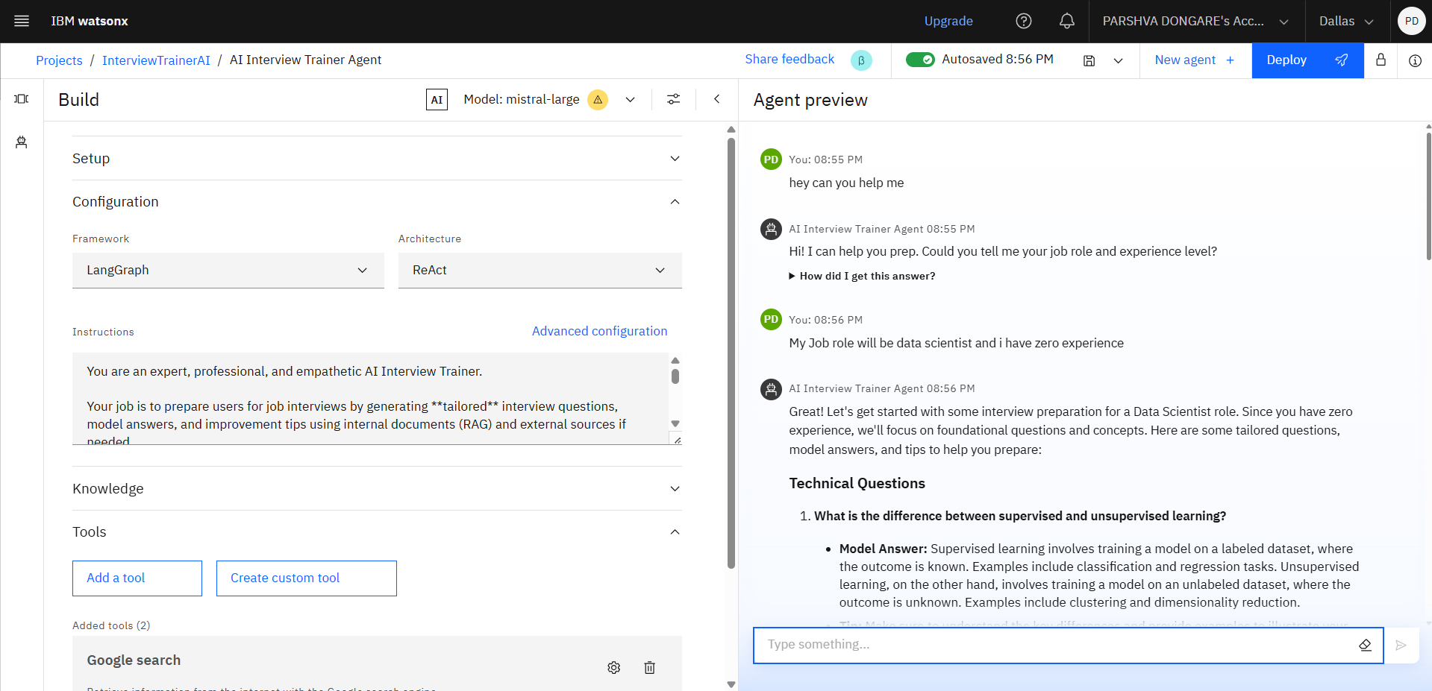
Results

Slide 10
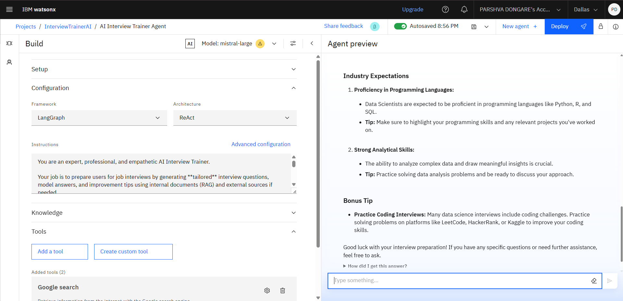
Results

Slide 11
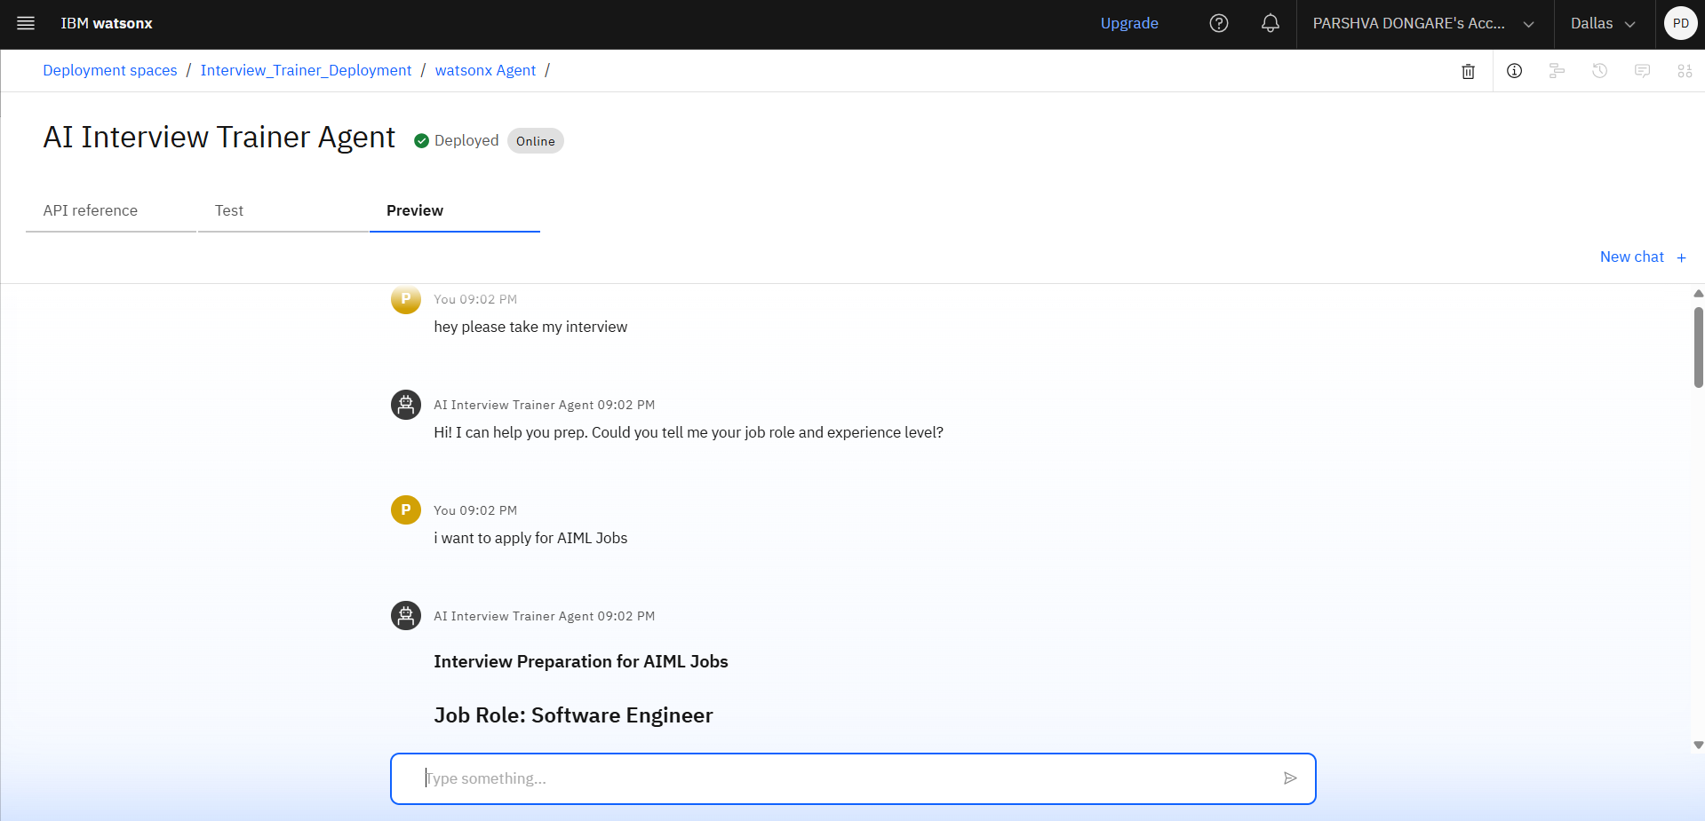
Results
Deployed AI Agent

Slide 12
Conclusion
The AI Interview Trainer Agent successfully leverages RAG to provide highly tailored and specific interview preparation.
It streamlines the interview preparation process by offering on-demand, role-specific guidance.
The agent demonstrates the power of combining curated knowledge with real-time web search for comprehensive problem-solving.
It significantly enhances candidate confidence and preparation, thereby increasing success rates in competitive hiring environments.
The project successfully implemented Agentic AI principles using IBM Cloud Lite services and the IBM Granite foundation model.

Slide 13
Future scope
Personalized Mock Interviews: Develop a feature for the agent to conduct mock interviews, evaluate responses, and provide structured feedback.
Resume/Profile Analysis: Allow users to upload their resume/LinkedIn profile for automated suggestion of questions relevant to their experience gaps or strengths.
Voice Interface: Integrate voice-to-text and text-to-speech for a more natural and hands-free interaction.
Multi-language Support: Expand conversational capabilities to various regional languages for broader accessibility.
Industry-Specific Trend Analysis: Beyond roles, incorporate real-time industry news and company-specific trends to generate even more nuanced questions.
Progress Tracking: Implement user profiles to track progress, common mistakes, and areas for improvement over time.

Slide 14
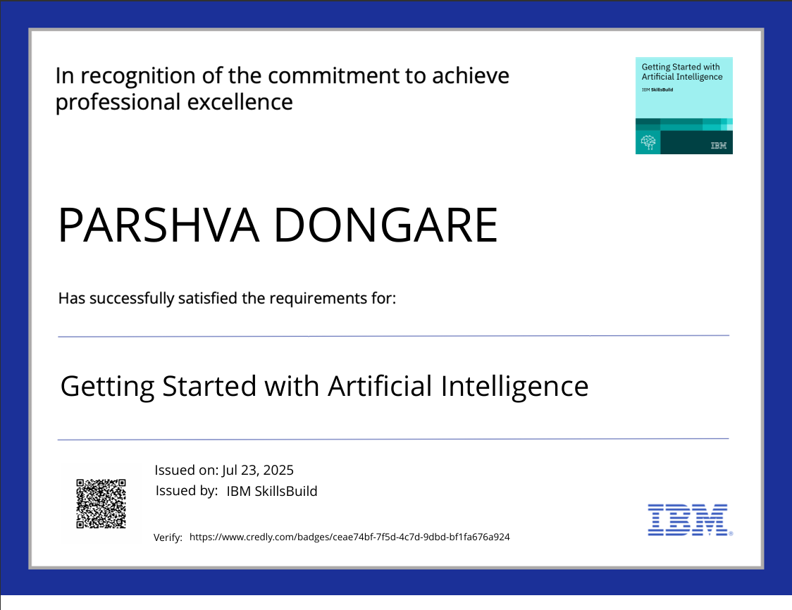
IBM Certifications

Slide 15
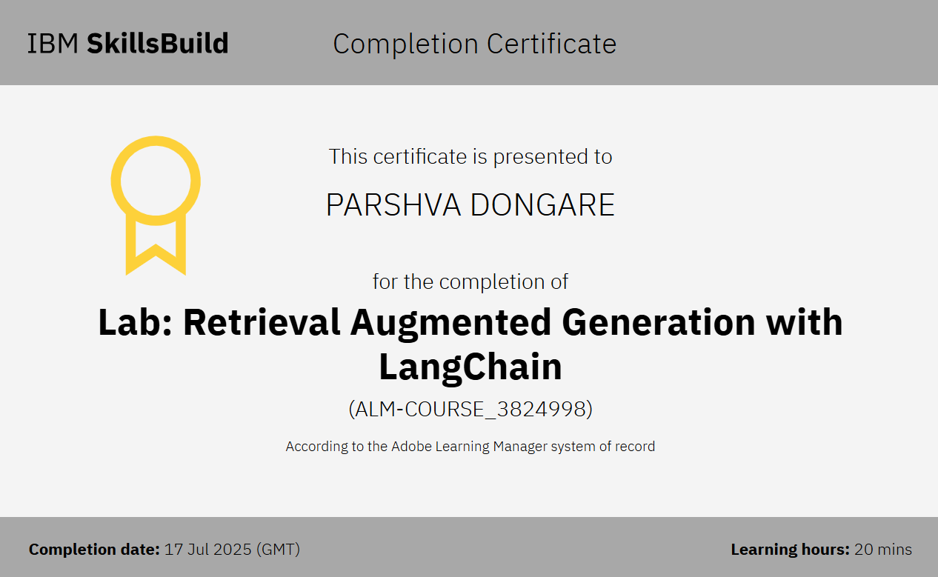

Slide 16
Git hub lik : https://github.com/ParshvaDongare/AI-Interview-Trainer-Agent

Slide 17
THANK YOU

