Slide 1


Diwali Sales Data Analysis Project
Exploratory Data Analysis (EDA) and Insights
By : Parshwa Jain

Slide 2
Introduction
Objective :
The objective of this project is to conduct an in-depth analysis of Diwali sales data to uncover key insights into consumer behavior, regional trends, and product preferences during this festive period.
Importance :
Diwali, the festival of lights, marks a significant period of increased consumer spending across various product categories. Understanding the dynamics of consumer behavior during this festive season is crucial for businesses to optimize their marketing strategies and offerings.
Dataset Overview :
Dataset: Diwali_Sales_Data.csv
Source: GitHub Link

Slide 3
Dataset Overview

Slide 4
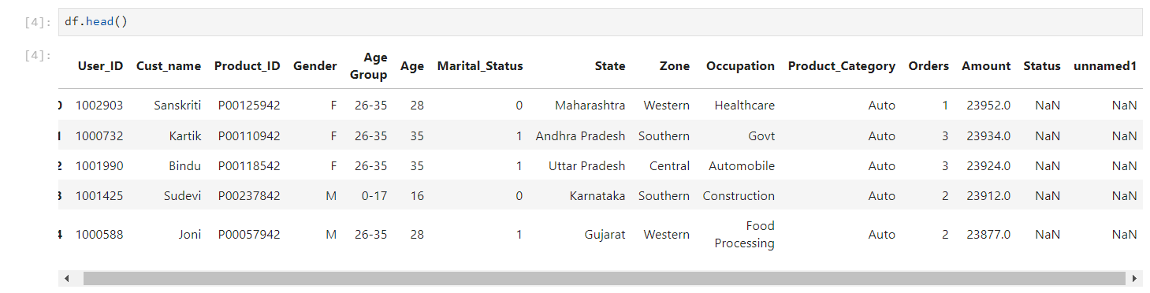

This is the Dataset before the Data cleaning.
It contains total 11251 rows and 15 columns.

Slide 5
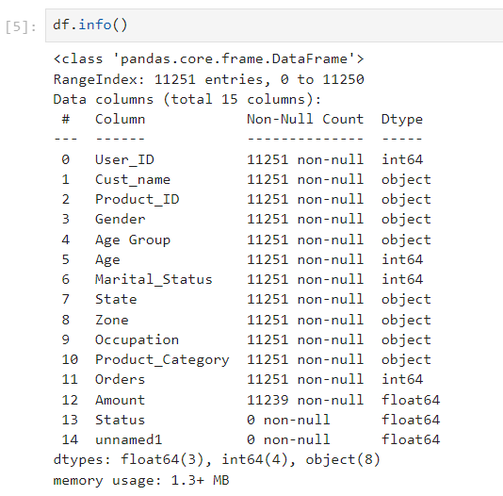
This is the information about dataset before the data cleaning.
It displays column name, Non-Null values in our data and Data-Type for each column.

Slide 6
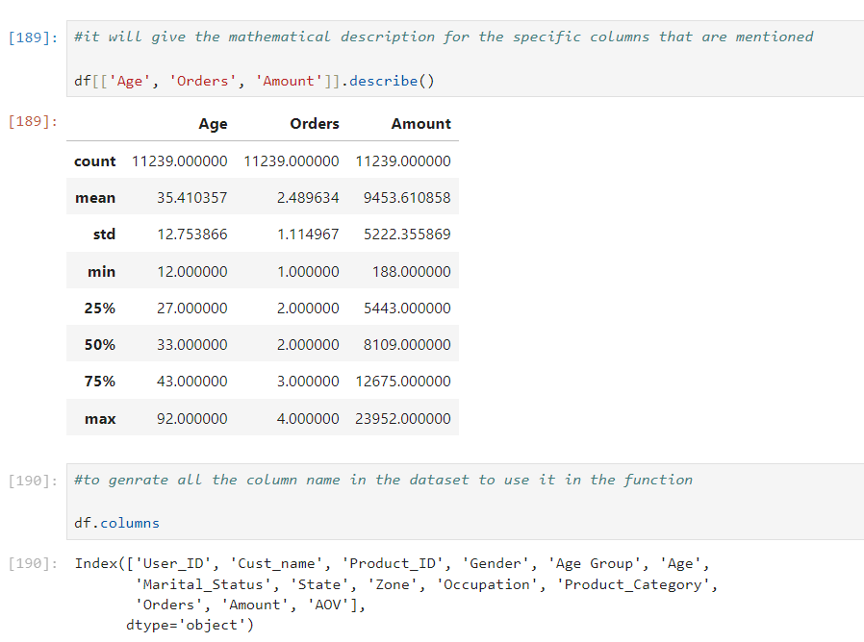
It will give the mathematical description for the specific columns that are mentioned.

Slide 7
Data Cleaning
Prepare the dataset for analysis by ensuring data quality.

Slide 8
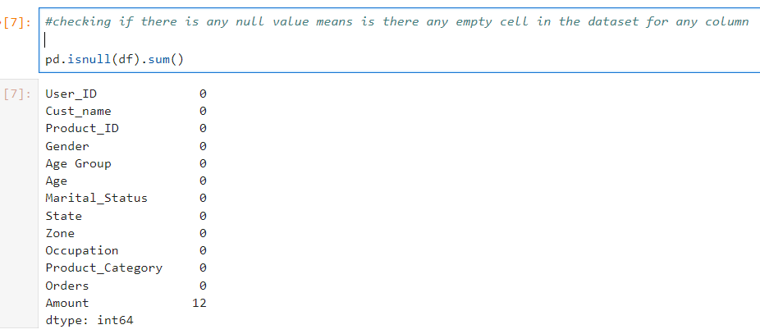
This will drop unrelated/blank/unwanted columns from the dataset.

Slide 9
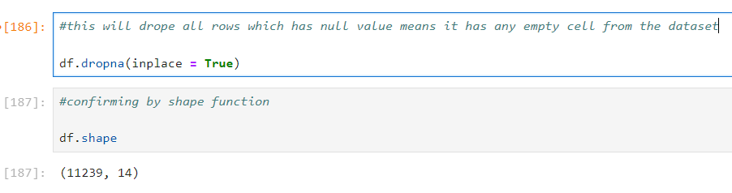
This will drop all rows which has null value means it has any empty cell from the dataset.

Slide 10
Exploratory Data Analysis (EDA) Overview
Explore relationships, patterns, and distributions in the dataset.

Slide 11
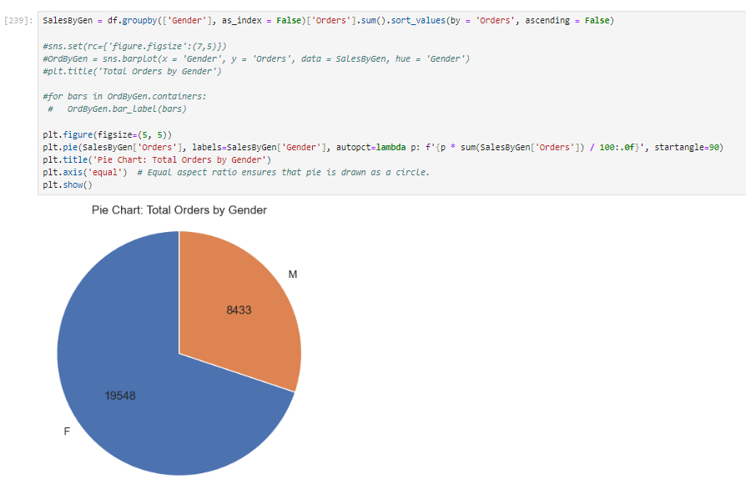
Total Orders by Gender

Slide 12
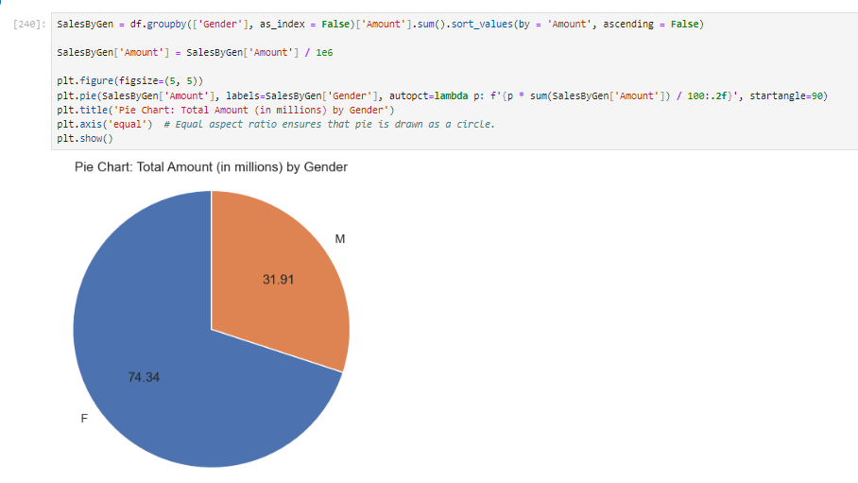
Total Amount (in millions) by Gender

Slide 13
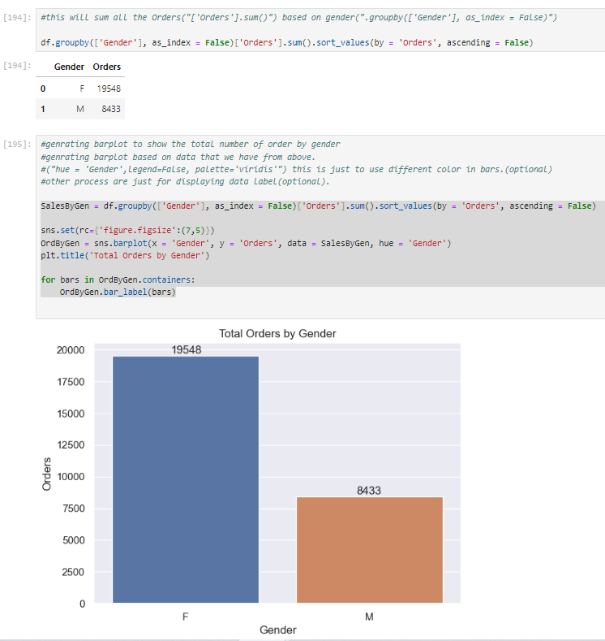
Total Orders By Gender
INSIGHTS :
From the above graphs, it is clear that females constitute the majority of buyers. Moreover, both the number of orders and the purchasing power of females are higher compared to males.

Slide 14
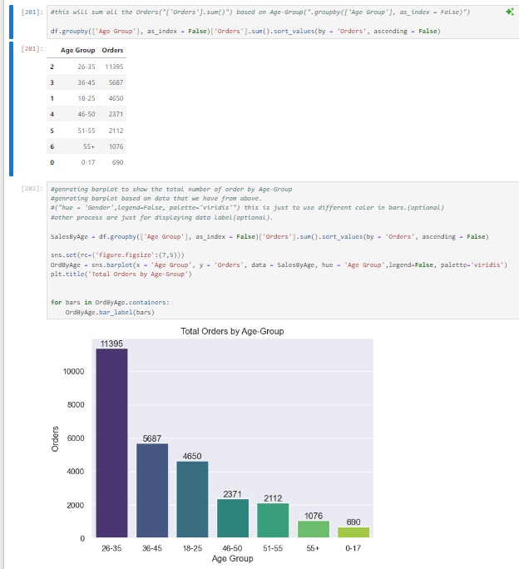
Total Orders By Age - Group
INSIGHTS :
From the above graphs, it is evident that most buyers are females belonging to the age group of 26-35 years. This age group not only dominates in terms of the number of orders but also exhibits higher purchasing power compared to other age groups.

Slide 15
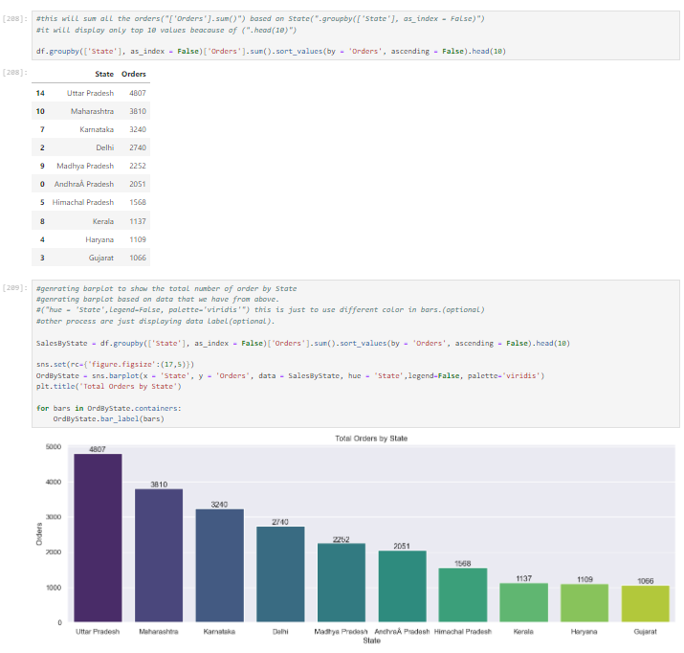
Total Orders By Top 10 States
INSIGHTS :
From the above graphs, it is evident that most buyers come from the top three states:
Uttar Pradesh
Maharashtra
Karnataka.
These states also exhibit the highest number of orders and total purchase amounts in that order.
However, there are notable exceptions when examining specific states:
Haryana has fewer orders compared to Kerala, yet its total purchase amount surpasses that of Kerala.
Kerala's total purchase amount is significantly lower than Bihar and Gujarat.

Slide 16
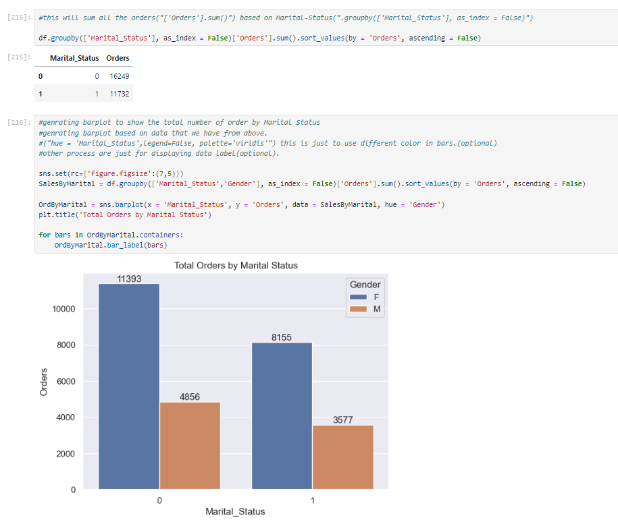
Total Orders By Marital Status
INSIGHTS :
From the above graphs, we can see that most of the buyers are unmarried females. Additionally, both the number of orders and the purchasing power are higher for unmarried individuals compared to married individuals.

Slide 17
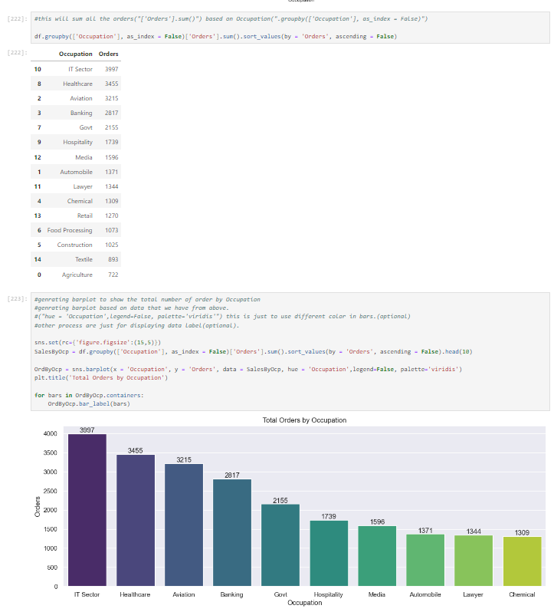
Total Orders By Top 10 Occupation
INSIGHTS :
From the above graphs, we can see that most of the buyers are from the following top 3 occupation fields:
IT Sector
Healthcare
Aviation
These occupation fields also have the highest number of orders and purchasing power compared to other occupation fields. Additionally, there are certain differences within particular occupation fields where:
The number of orders is lower, but the total amount spent is higher. Conversely, the number of orders is higher, but the total amount spent is lower.
This indicates varying purchasing behaviors and spending capacities across different occupation fields.

Slide 18
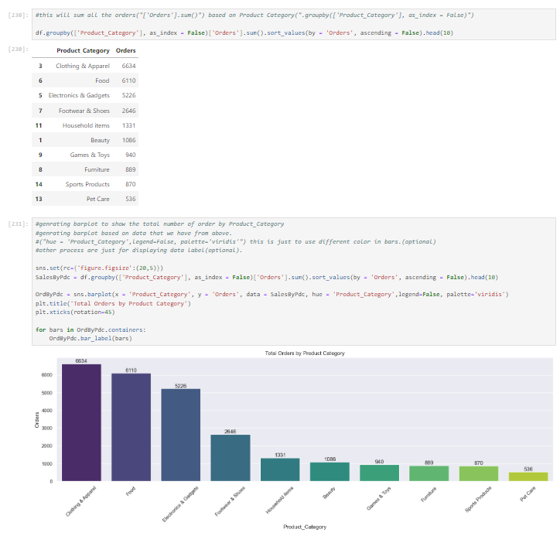
Total Orders By Top 10 Category
INSIGHTS :
From the graphs, we can see that most of the buyers are females, and they primarily order from the following top 3 product categories:
Clothing & Apparel
Electronics & Gadgets
Food
However, the number of orders is highest in the following product categories:
Clothing & Apparel
Food
Electronics & Gadgets
And the total amount spent is highest in the following product categories:
Food
Clothing & Apparel
Electronics & Gadgets

Slide 19
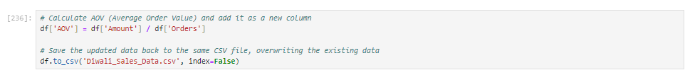
Creating new Column for "Average Order Value (AOV)" using python in our dataset

Slide 20
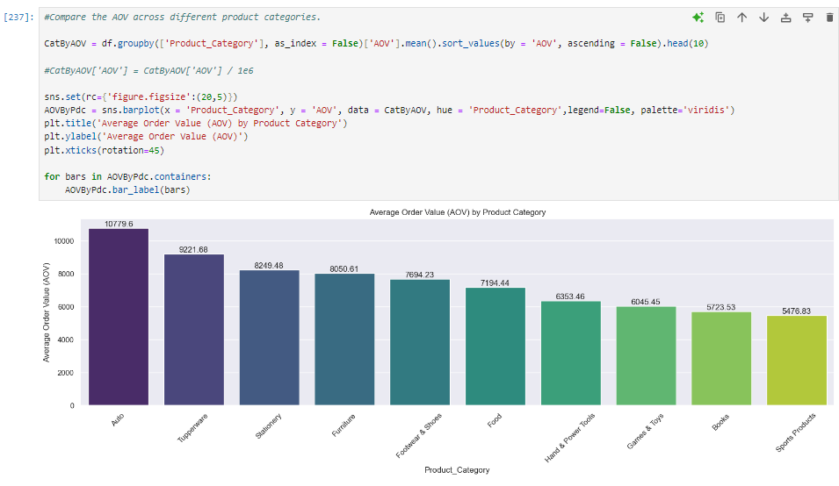
Compare the Average Order Value (AOV) across different product categories.

Slide 21
Conclusion
Gender Analysis:
Females dominate as buyers, with higher numbers of orders and greater purchasing power compared to males.
Age Group Analysis:
The age group of 26-35 years shows the highest number of orders and significant purchasing power, indicating strong consumer activity during Diwali.
State-wise Analysis:
Uttar Pradesh, Maharashtra, and Karnataka are the top states in terms of both number of orders and total purchase amounts.
Notable exceptions include Haryana, which despite fewer orders, exhibits higher total purchase amounts compared to Kerala.

Slide 22
Conclusion
4) Marital Status Analysis:
Unmarried individuals, especially females, account for the majority of buyers, with higher orders and purchasing power than married individuals.
5) Occupation Analysis:
The IT sector, Healthcare, and Aviation are the primary occupation fields with the highest number of orders and significant purchasing power.
Variances within occupation fields highlight differing spending behaviors and capacities.
6) Product Category Analysis:
Clothing & Apparel, Electronics & Gadgets, and Food are the top product categories in terms of buyer preference.
While Clothing & Apparel and Food lead in number of orders, Food surpasses in total purchase amounts.

Slide 23
THANK YOU !

