Slide 1

Pizza Sales Analysis Using SQL
Unlocking Insights from Pizza Sales Data Through SQL Queries
By : Parshwa Jain

Slide 2
Introduction
In this project, we dive into the realm of pizza sales data to uncover valuable insights using SQL queries.
Our dataset comprises detailed sales information, including various types of pizzas, customer preferences, and sales trends.
By applying SQL techniques, we aim to address specific business questions and provide actionable insights that can help in strategic decision-making.
This presentation will guide you through the process, highlighting key findings and demonstrating the power of SQL in data analysis.
Source : GitHub Link

Slide 3
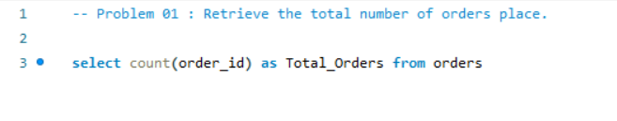
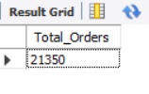
Problem 01 : Retrieve the total number of orders place.
Query :
Result :

Slide 4
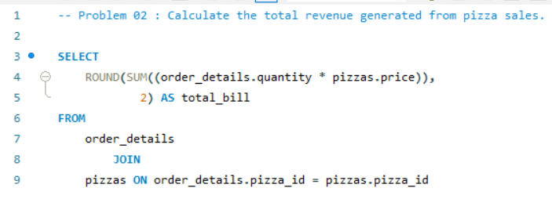
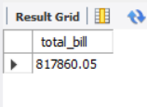
Problem 02 : Calculate the total revenue generated from pizza sales.
Query :
Result :

Slide 5
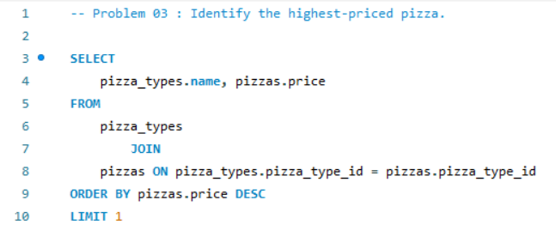
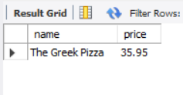
Problem 03 : Identify the highest-priced pizza.
Query :
Result :

Slide 6
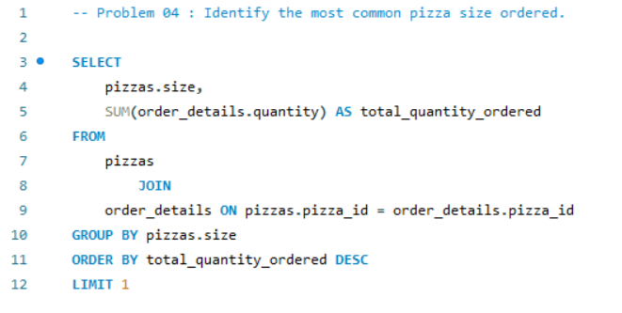

Problem 04 : Identify the most common pizza size ordered.
Query :
Result :

Slide 7
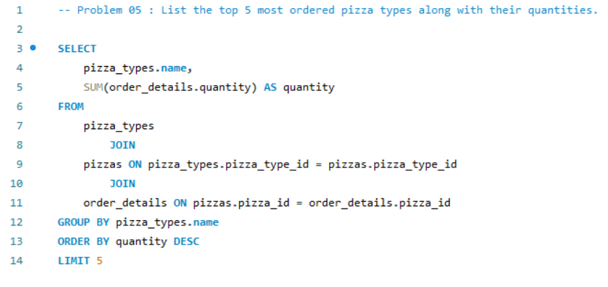
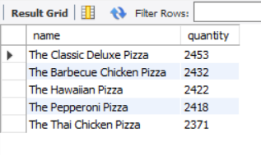
Problem 05 : List the top 5 most ordered pizza types along with their quantities.
Query :
Result :

Slide 8
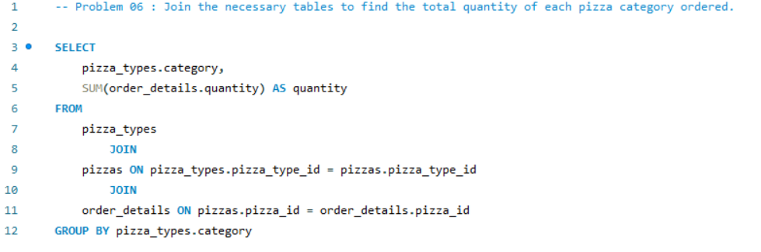
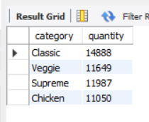
Problem 06 : Join the necessary tables to find the total quantity of each pizza category ordered.
Query :
Result :

Slide 9
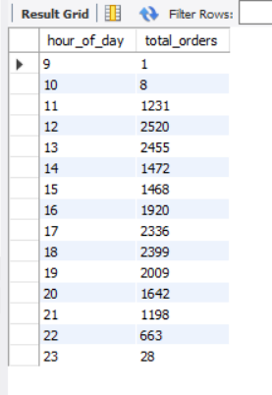
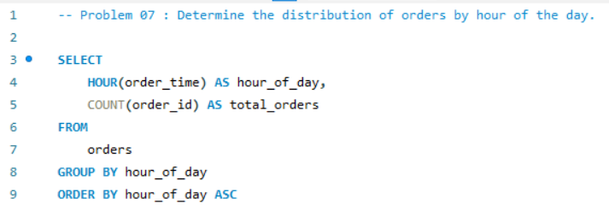
Problem 07 : Determine the distribution of orders by hour of the day.
Query :
Result :

Slide 10
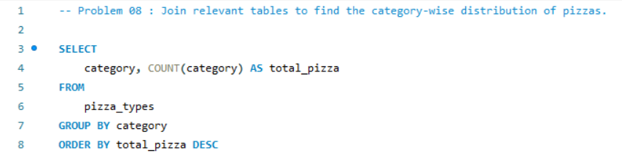
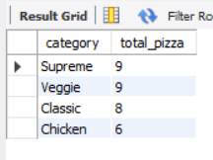
Problem 08 : Join relevant tables to find the category-wise distribution of pizzas.
Query :
Result :

Slide 11
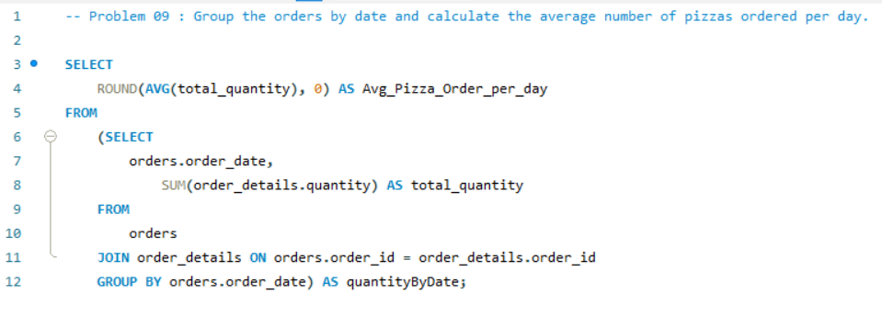
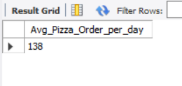
Problem 09 : Group the orders by date and calculate the average number of pizzas ordered per day.
Query :
Result :

Slide 12
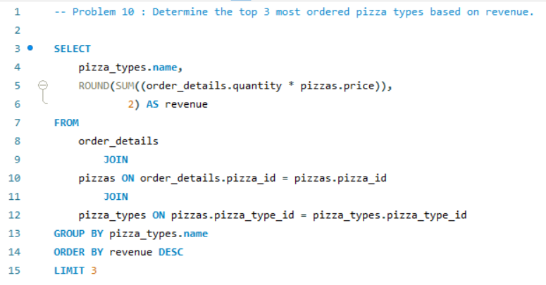
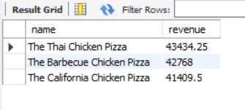
Problem 10 : Determine the top 3 most ordered pizza types based on revenue.
Query :
Result :

Slide 13
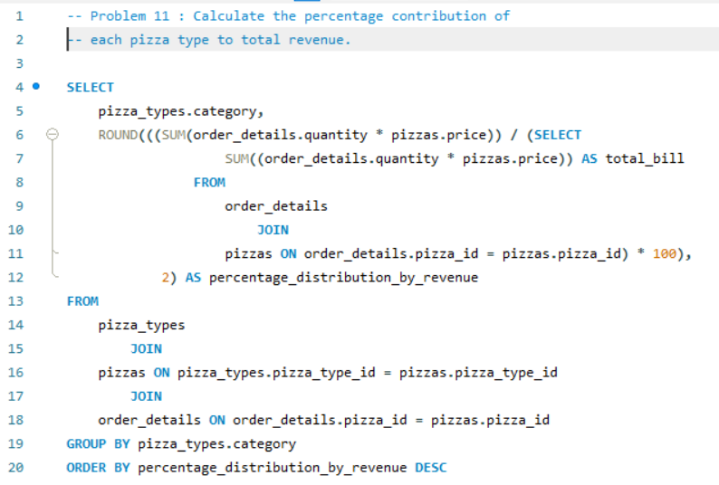
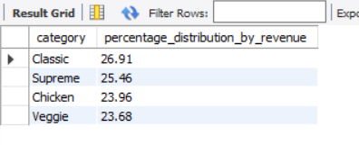
Problem 11 : Calculate the percentage contribution of each pizza type to total revenue.
Query :
Result :

Slide 14
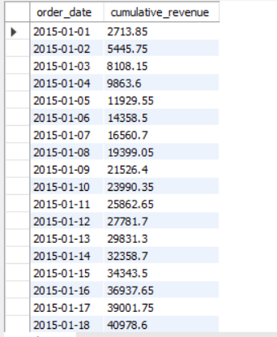
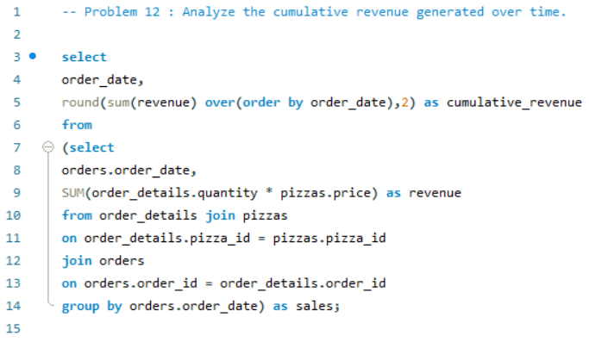
Problem 12 : Analyze the cumulative revenue generated over time.
Query :
Result :

Slide 15
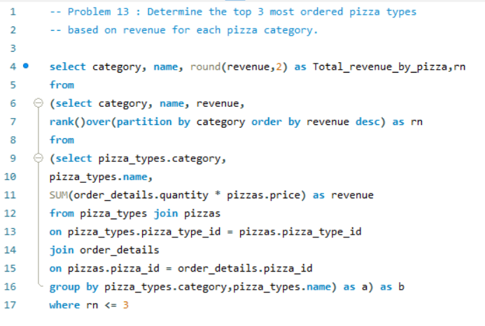
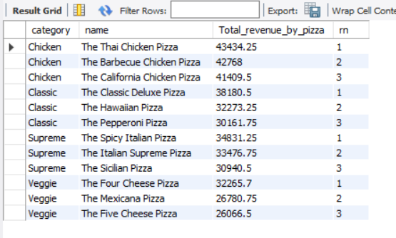
Problem 13 : Determine the top 3 most ordered pizza types based on revenue for each pizza category.
Query :
Result :

Slide 16
Conclusion
The analysis of pizza sales data using SQL has provided us with a comprehensive understanding of the business's performance and customer preferences. Through basic, intermediate, and advanced queries, we were able to uncover significant insights that can guide strategic decisions:
Total Orders and Revenue: We quantified the total number of orders placed and the total revenue generated, establishing a baseline for sales performance.
Product Insights: By identifying the highest-priced pizza and the most common pizza size ordered, we gained insights into pricing strategies and customer preferences.
Top Performing Pizzas: Listing the top 5 most ordered pizza types along with their quantities highlighted the best-sellers and potential focus areas for promotions.

Slide 17
Conclusion
Category and Temporal Analysis: Joining tables to find the total quantity of each pizza category ordered and the distribution of orders by hour of the day provided a deeper understanding of sales patterns.
Revenue Insights: Grouping orders by date and determining the top 3 most ordered pizza types based on revenue helped identify peak sales periods and high-performing products.
Advanced Metrics: Calculating the percentage contribution of each pizza type to total revenue and analyzing cumulative revenue over time offered a detailed view of financial performance.
Category-wise Performance: Identifying the top 3 most ordered pizza types based on revenue for each category provided actionable insights for targeted marketing and inventory management.

Slide 18
THANK YOU !

