Slide 1

Enhancing Software Evolution Reliability
through Neurosymbolic Reasoning
Xiufeng Xu
PhD Thesis Defense · Nanyang Technological University
Supervisor: Prof. Yi Li · 2026
Notes:
Good afternoon, distinguished members of the committee, professors, colleagues, friends, and everyone joining us today. Thank you very much for being here.
Before I begin, I would like to thank my supervisor, Professor Yi Li, for his invaluable guidance and support throughout my PhD journey.
My name is Xiufeng Xu, and it is my great honor to present my doctoral research entitled “Enhancing Software Evolution Reliability through Neurosymbolic Reasoning.”

Slide 2
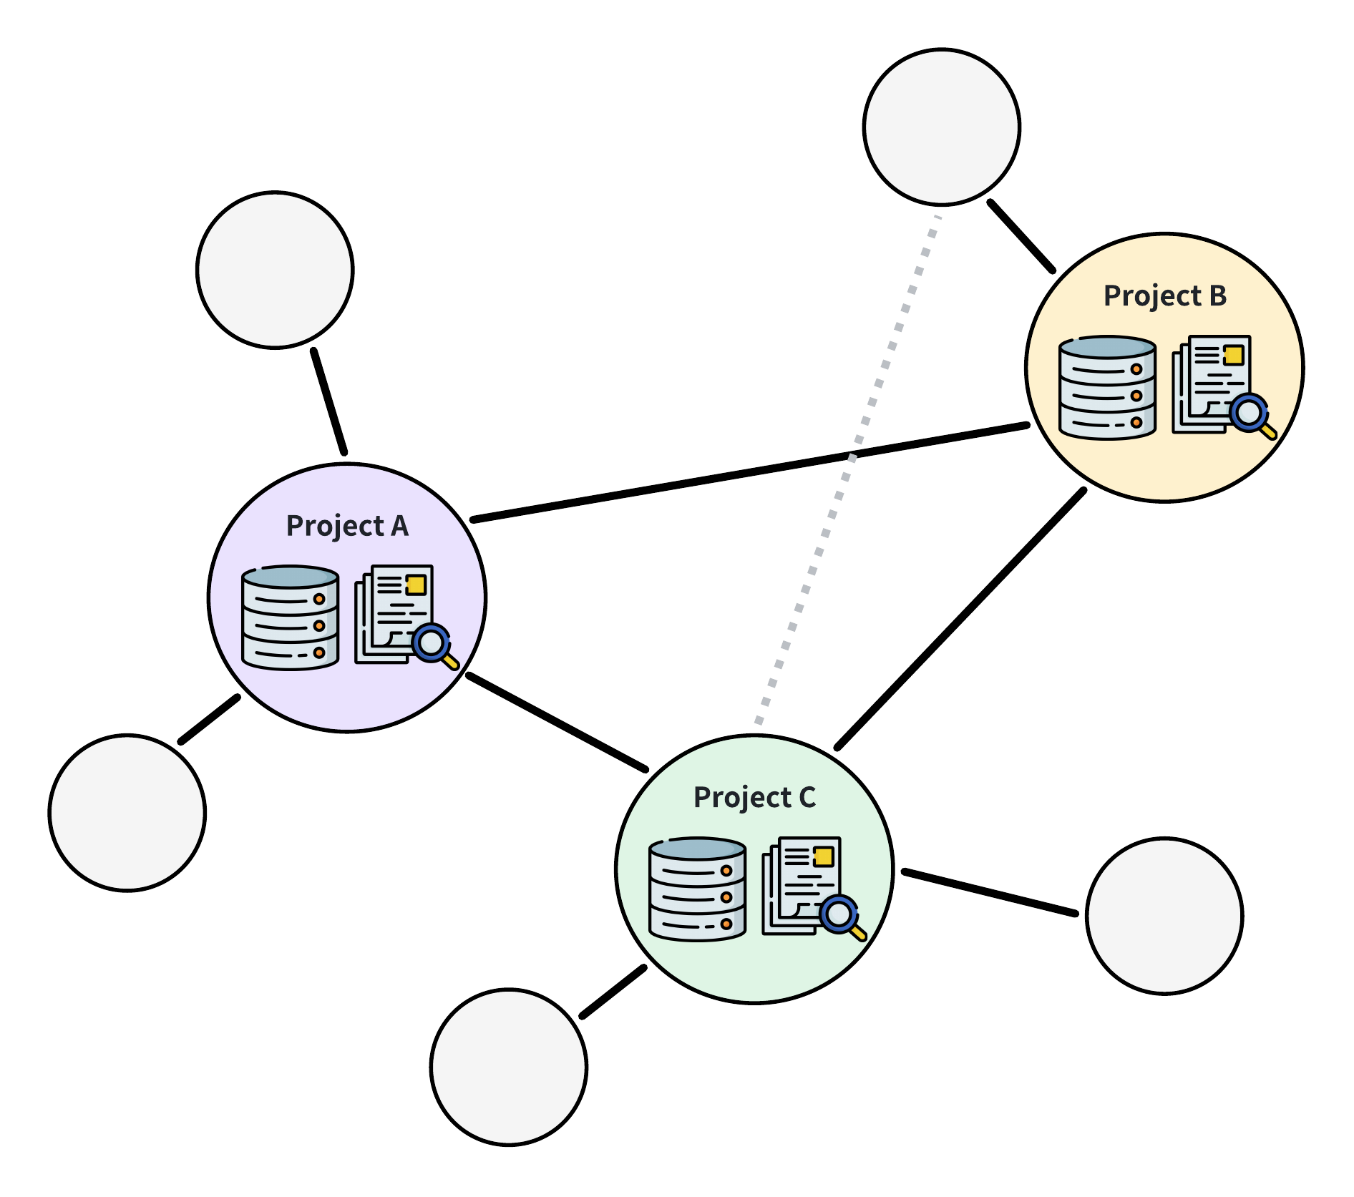
THESIS / MOTIVATION
How to evolve software without losing control of its behavior?
Software now evolves as a dependency network
Modern systems are large, complex, and interconnected.
Transitive dependencies amplify every change
A PyPI package averages 2.6 direct and 129.6 transitive dependencies.
Reliable evolution must address two pressures
React to external change while improving internal quality.
Notes:
Software systems are not built once and finished forever. A useful and reliable system must continuously evolve to meet new requirements, address security threats, fix defects, and adapt to changing environments. This continuous process is known as software evolution.
However, modern software systems have become increasingly large and complex. More importantly, They are no longer isolated nodes but are deeply embedded in a highly interconnected software ecosystems. While this level of interconnection enables rapid development through code reuse, it also introduces significant challenges for software evolution. A study of 380,000 PyPI packages reveals that each package has 2.6 direct dependencies and 129.6 transitive dependencies on average. Which means, a small change in one component can propagate through complex dependency chains, potentially causing compatibility issues, performance degradation, or security vulnerabilities across numerous downstream projects.
So, long-term reliable evolution depends on continuous maintainance. It primarily includes two ways: reactive adaptation to external changes and proactive improvement of internal quality. Both of them create the same reliability question: how to evolve software without losing control of its behavior?

Slide 3
THESIS / EVOLUTION
Three phases of software evolution
1. Perceive risks and define the change
Manage external risk and identify evolution needs.
2. Implement logic and verify behavior
Locate the relevant code, make the change, and validate the outcome.
3. Deliver artifacts and preserve alignment
Release the evolved system and keep documentation consistent with code.
Notes:
I model this process in three phases. First, perceive its environment changes, manage risks from external changes like API deprecations and security vulnerabilities, and enhance internal quality like bug fixing and new features. Second, locate relevant code snippets and implement logic modification, and then validate its behavior. Third, deliver the evolved artifacts and keep the documentation describing the code accurately.
First, the system must perceive its environment and identify the need for evolution. Second, it must locate and modify the relevant logic, and then validate behavior. Third, it must deliver the evolved artifacts, including documentation that accurately communicates the new behavior.

Slide 4
THESIS / REVOLUTION
AI redefines everything: Does symbol still matter?
AI alone cannot guarantee reliable evolution
Hallucination and weak deterministic reasoning remain fundamental limits.
Symbolic reasoning restores omitted structure
Explicit logic compensates for information lost when models simplify reality.
Neurosymbolic systems combine flexibility with rigor
LLMs interpret ambiguity; symbolic methods constrain and verify behavior.
Notes:
Large language models have transformed software evolution. They can interpret natural-language requirements, generate code, explore repositories, and update documentation. These capabilities reduce the manual burden of maintenance and make increasingly autonomous evolution possible.
However, capability is not the same as reliability. A plausible generated answer is not a correctness guarantee. There are two core limitations that make reliable fully AI-driven software evolution a challenging task: First, the inevitable hallucination problem; Second, The lack of genuine logical reasoning capabilities. The reason behind is that every computational model is a simplified representation of reality. And Explicit symbolic reasoning compensates for information omitted during model construction.
This motivates a neurosymbolic approach that combines the adaptive learning capabilities of Large Language Models with the formal rigor of symbolic reasoning. By integrating these complementary strengths, we aim to enable reliable AI-driven software evolution, where software modifications are not only context-aware but also logically verifiable.

Slide 5
THESIS / ROADMAP
Contributions
01 CompSuite
Reproducible real-world client-library incompatibility dataset
02 DataLoc
Keyword shortcut bias and diagnostic benchmark
Neurosymbolic agent framework for repository-level code localization
03 MPChecker
Multi-parameter code-documentation inconsistency detection
Notes:
The central research question of this thesis is: how can we combine empirical software data, large language models, and formal reasoning to improve the reliability of software evolution throughout its lifecycle?
To answer this question, I will present three core studies.
The first study is CompSuite. It focuses on environment perception by transforming external evolution risks into executable evidence through reproducible client–library incompatibilities.
The second study is DataLoc. It addresses the logic implementation phase. We first reveal the issue of keyword shortcut bias and introduce a diagnostic benchmark. Based on these findings, we further propose a neurosymbolic agent framework for repository-level code localization.
The third study is MPChecker. It focuses on artifact delivery and documentation alignment by proposing an automated approach to detect inconsistencies between multi-parameter code behavior and documentation.

Slide 6
01 / PERCEIVE
CompSuite
ENVIRONMENT PERCEPTION
How can a library-upgrade failure become reproducible evidence?
PERCEIVE → Locate → Verify
Notes:
Reliable evolution begins before repair: we first need evidence that an external change has broken a client. The first core study, CompSuite, asks how a client-specific library-upgrade failure can become an isolated, manually validated, reproducible, and executable benchmark instance.
[Timing] 5:20–5:40
[Sources]
- PhD thesis, Chapter 3, Sections 3.1–3.2.

Slide 7
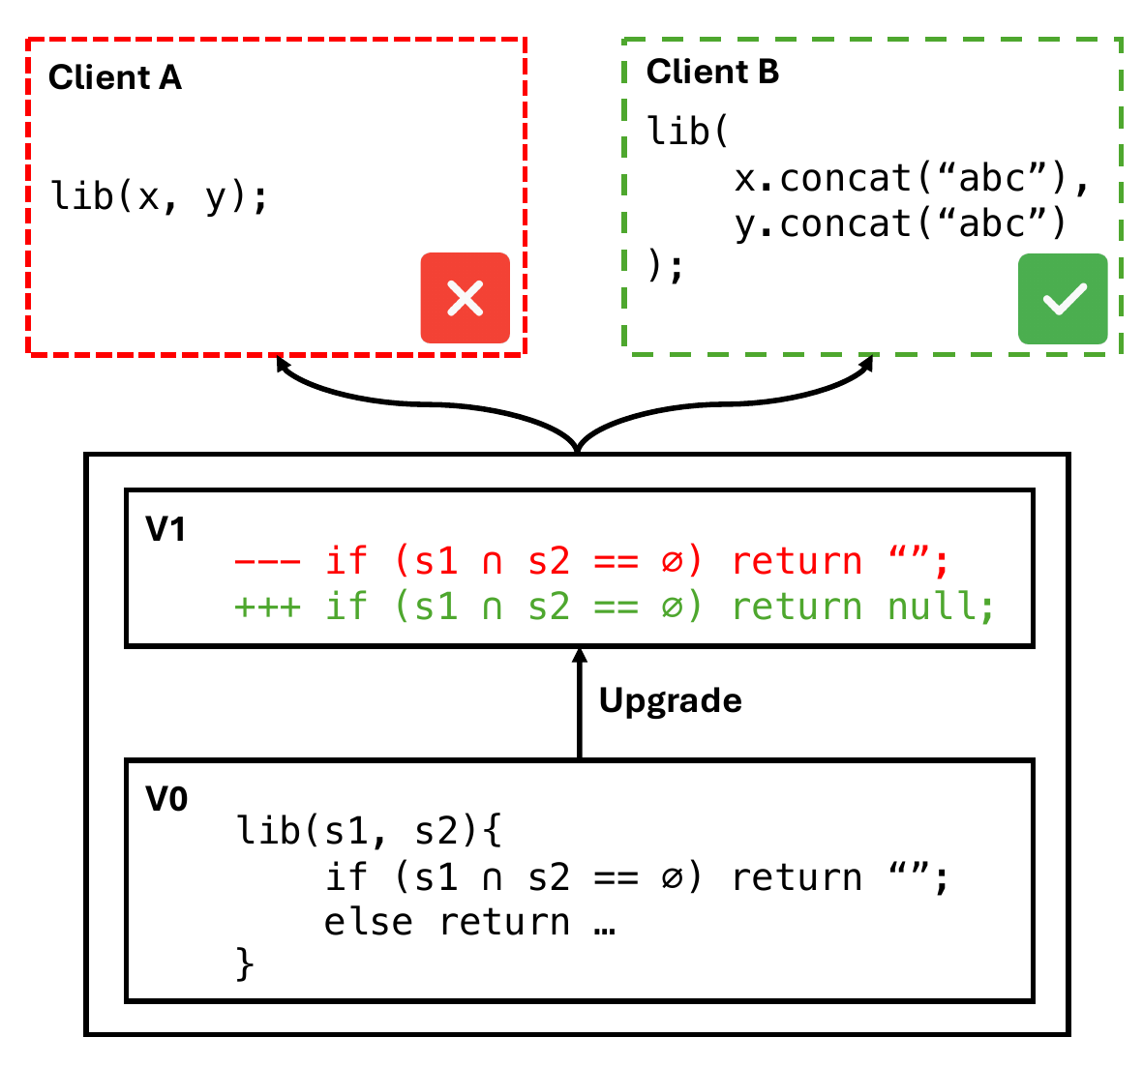
01 / COMPSUITE · PROBLEM
Upgrades fail at the client side
A stable API can hide behavior change
The same call can behave differently after an upgrade.
Compatibility is client-specific
One downstream project may fail while another remains compatible.
Signatures are not enough
Compilation can succeed even when behavior changes.
Notes:
A reliable evolutionary process must first know what can break. Library upgrades are an important but difficult example.
An upgrade may preserve every public method name and type signature while changing behavior. For example, a library function may return an empty string in one version and null in the next version. One client may safely handle both values, while another triggers a null-pointer exception. The incompatibility is therefore behavioral and client-specific; it may not be visible through API comparison or compilation.
Existing datasets mainly capture defects internal to one project. Upgrade failures are harder to collect because they involve two independently evolving components, a particular dependency version pair, a specific environment, and a test that exposes the changed behavior.
Without reproducible examples, it is difficult to train or compare compatibility checkers, debugging methods, regression-test selection tools, or future AI repair systems.

Slide 8
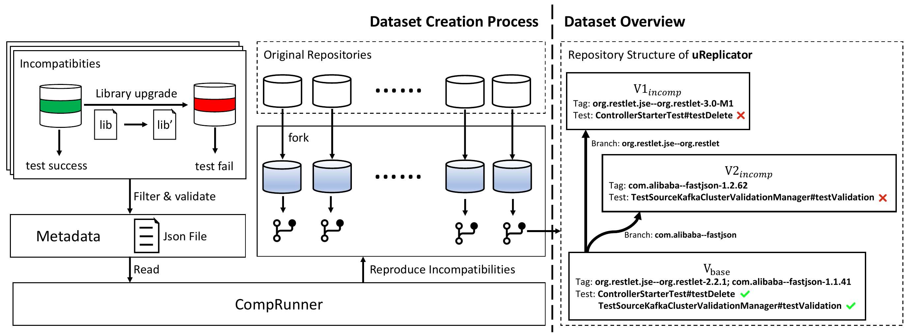
01 / COMPSUITE · METHOD
CompSuite isolates one upgrade and one test
1. Freeze a passing baseline
Pin the client to a fixed commit.
2. Upgrade one dependency
Change only the library version.
3. Replay the same test
Confirm that the original passing test now fails.
Notes:
CompSuite turns upgrade failures into controlled experiments.
We first selected popular open-source Java clients that use Maven, because Maven provides standardized dependency declarations, compilation, and test execution. We retained projects only when a fixed base commit compiled successfully and all tests passed.
For each eligible client, we identified dependencies with newer versions available on Maven Central. We upgraded one library at a time and reran the client’s tests. This isolation is important: if several libraries were upgraded together, we could not attribute a failure to one dependency.
When a test changed from passing to failing, we treated it as a candidate incompatibility-revealing test. We then manually examined the failure report and execution behavior to verify that the upgrade was the cause.

Slide 9
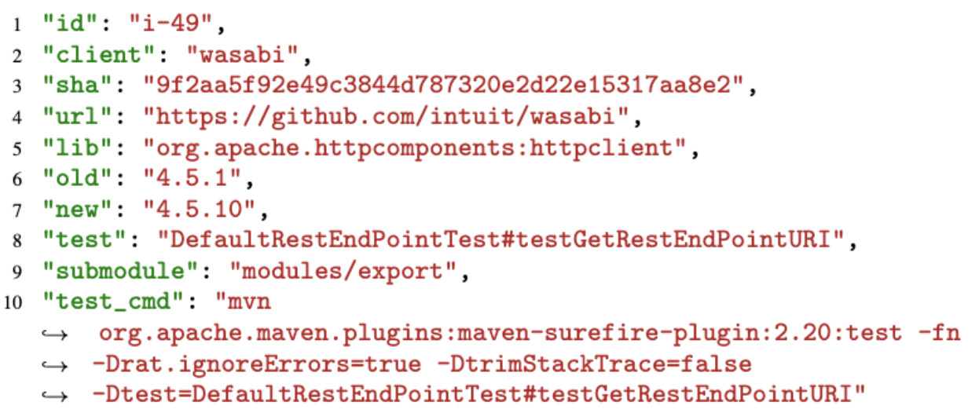
01 / COMPSUITE · DATA
Data schema
Notes:
For every accepted client–library pair, the data schema includes the ID of the issue, client project name, SHA of the client base version, URL of the client project, library name, versions of the old and new libraries, the name of the incompatibility-revealing test, the submodule containing the test, and the command to run the test.

Slide 10
01 / COMPSUITE · METHOD
Each pair packages the pass → fail evidence
The pair fixes the upgrade context
Repository, commit, library, and versions.
The test becomes the oracle
It passes before and fails after.
The evidence stays replayable
One record captures the whole transition.
Notes:
We create separate branch with library name and tagged base version and incompatible version with library name and version. It is worth noting that we have isolated each versions, which means the only difference between the two tagged versions is the library version.
CompRunner automates downloading, checkout, compilation, testing, upgrading, retesting, and log collection.

Slide 11
01 / COMPSUITE
Executable evidence makes upgrade risk measurable
123
reproducible client–library pairs
88 clients
104 libraries
All 123 manually validated
One command replays the pass → fail transition.
Notes:
The final dataset contains 123 reproducible, real-world client–library pairs, drawn from 88 distinct clients and 104 libraries. Every accepted instance was manually validated. The key contribution is not only the number 123. It is the experimental contract attached to every instance: a known-good state, a single controlled dependency change, an incompatible state, and a developer-authored test that demonstrates the failure.
This supports several uses. Compatibility tools can measure whether they detect known upgrade failures. Regression-test selection techniques can check whether they select the revealing test. Debugging tools can try to identify the responsible library change. AI systems can be evaluated on diagnosis and repair while using a real executable test as the oracle.
CompSuite provides the empirical foundation of the thesis: it makes external evolution risk reproducible and measurable before AI reasoning begins.

Slide 12
02 / LOCATE
DataLoc
LOGIC IMPLEMENTATION
How can we locate code without relying on
naming hints?
Perceive → LOCATE → Verify
Notes:
The second core study, DataLoc, addresses that localization problem without relying on naming hints.

Slide 13
02 / DATALOC · PROBLEM
Why does code localization matter?
Localization gates autonomous software engineering
An agent must map high-level intent to the correct implementation logic.
Natural Language
Mapping
Programming Language
High-level Intent
Mapping
Implementation Logic
Notes:
code localization asks: given a natural language request, where is the relevant code exactly in a large repository?
This question is becoming increasingly important because modern AI coding agents are no longer only answering questions. They are expected to inspect repositories, fix bugs, implement features, and reason across complex software architectures. So Code localization is not just a retrieval problem. In real software engineering, it needs to map a high-level intent to implementation logic scattered across multiple files, classes, and functions.
Which means, before an agent can modify code correctly, it must first locate the right code. If localization fails, then every later step — repair, refactoring, testing, or verification — is built on the wrong context. OR it requires significant extra costs to relocate.

Slide 14
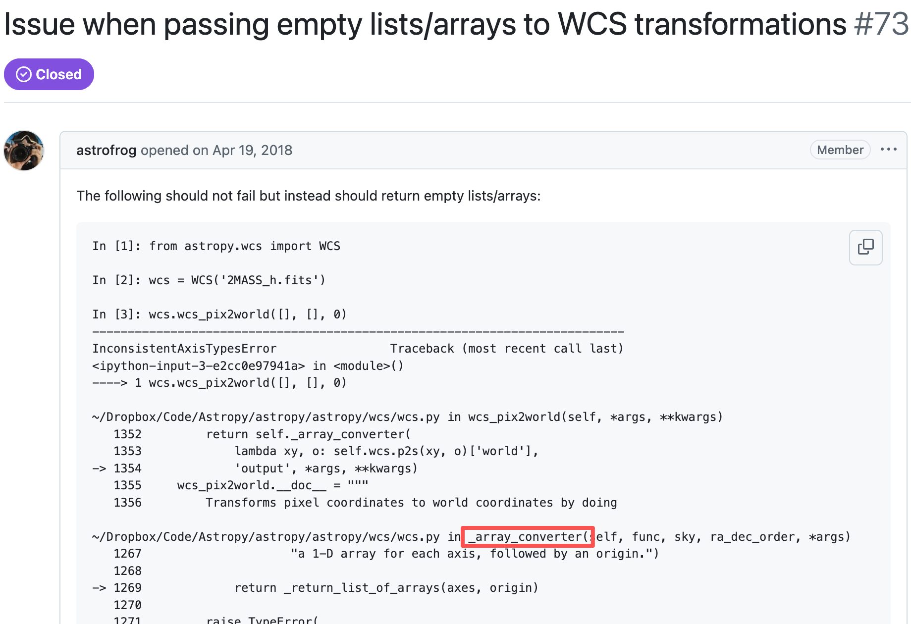
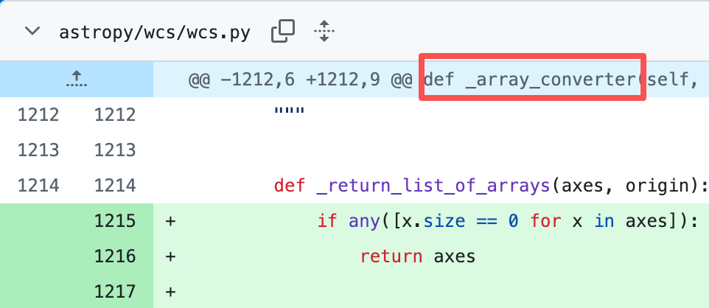
02 / DATALOC · BIAS
The hidden bias: keyword shortcut
Notes:
The current SOTA code localization agent basically uses swebench as a benchmark and reports strong results. But swebench-like benchmarks are predominantly curated from GitHub issues, many of them contain clear error traces or even verbatim code snippets.
For example, an issue may include a stack trace, a file path, a class name, a function name, or even code snippets. These keywords act as anchors. A retrieval system or an agent can use superficial lexical matching to find the target code.
We call this phenomenon the Keyword Shortcut.
The key problem is that this may make localization appear easier than it really is. The model may not be performing deep structural reasoning. It may simply be following textual clues.
Our preliminary study shows that once these keyword hints are removed, the performance of existing approaches drops sharply. This suggests that current systems are highly dependent on naming cues.

Slide 15
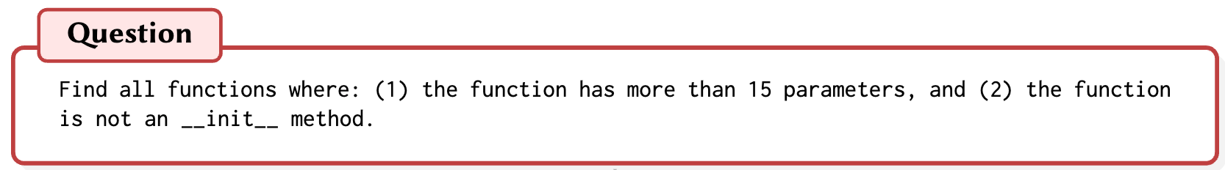
02 / DATALOC · NEW TASK
Keyword-Agnostic Logical Code Localization (KA-LCL)
KA-LCL isolates structural reasoning
No keywords—only logic and structure.
KA-LogicQuery: 225 questions across 9 repositories.
Notes:
This motivates our new task: Keyword-Agnostic Logical Code Localization, or KA-LCL.
In KA-LCL, the query does not provide direct keyword anchors. Instead, it describes logical or structural constraints over the codebase.
A simple example is: “Find all functions where the function has more than fifteen parameters, and the function is not an __init__ method.”
Toaddress this, we introduce KA-LogicQuery, a diagnostic benchmark specifically designed for Keyword-Agnostic Logical Code Localization (KA-LCL). It contains 225 high-quality from 9 open-source repositories purely logical queries with precise ground-truth locations, providing a rigorous testing ground for evaluating the structural reasoning capabilities of LLMs and AI agents.
Notice that this query does not tell us the file name, class name, or function name. A model cannot solve it by searching for a keyword. It must inspect the structure of the program and reason over function definitions and their attributes.
Its purpose is not to replace issue-driven benchmarks, but to diagnose a missing capability: whether an AI localization system can perform deterministic structural reasoning when naming hints are absent.

Slide 16
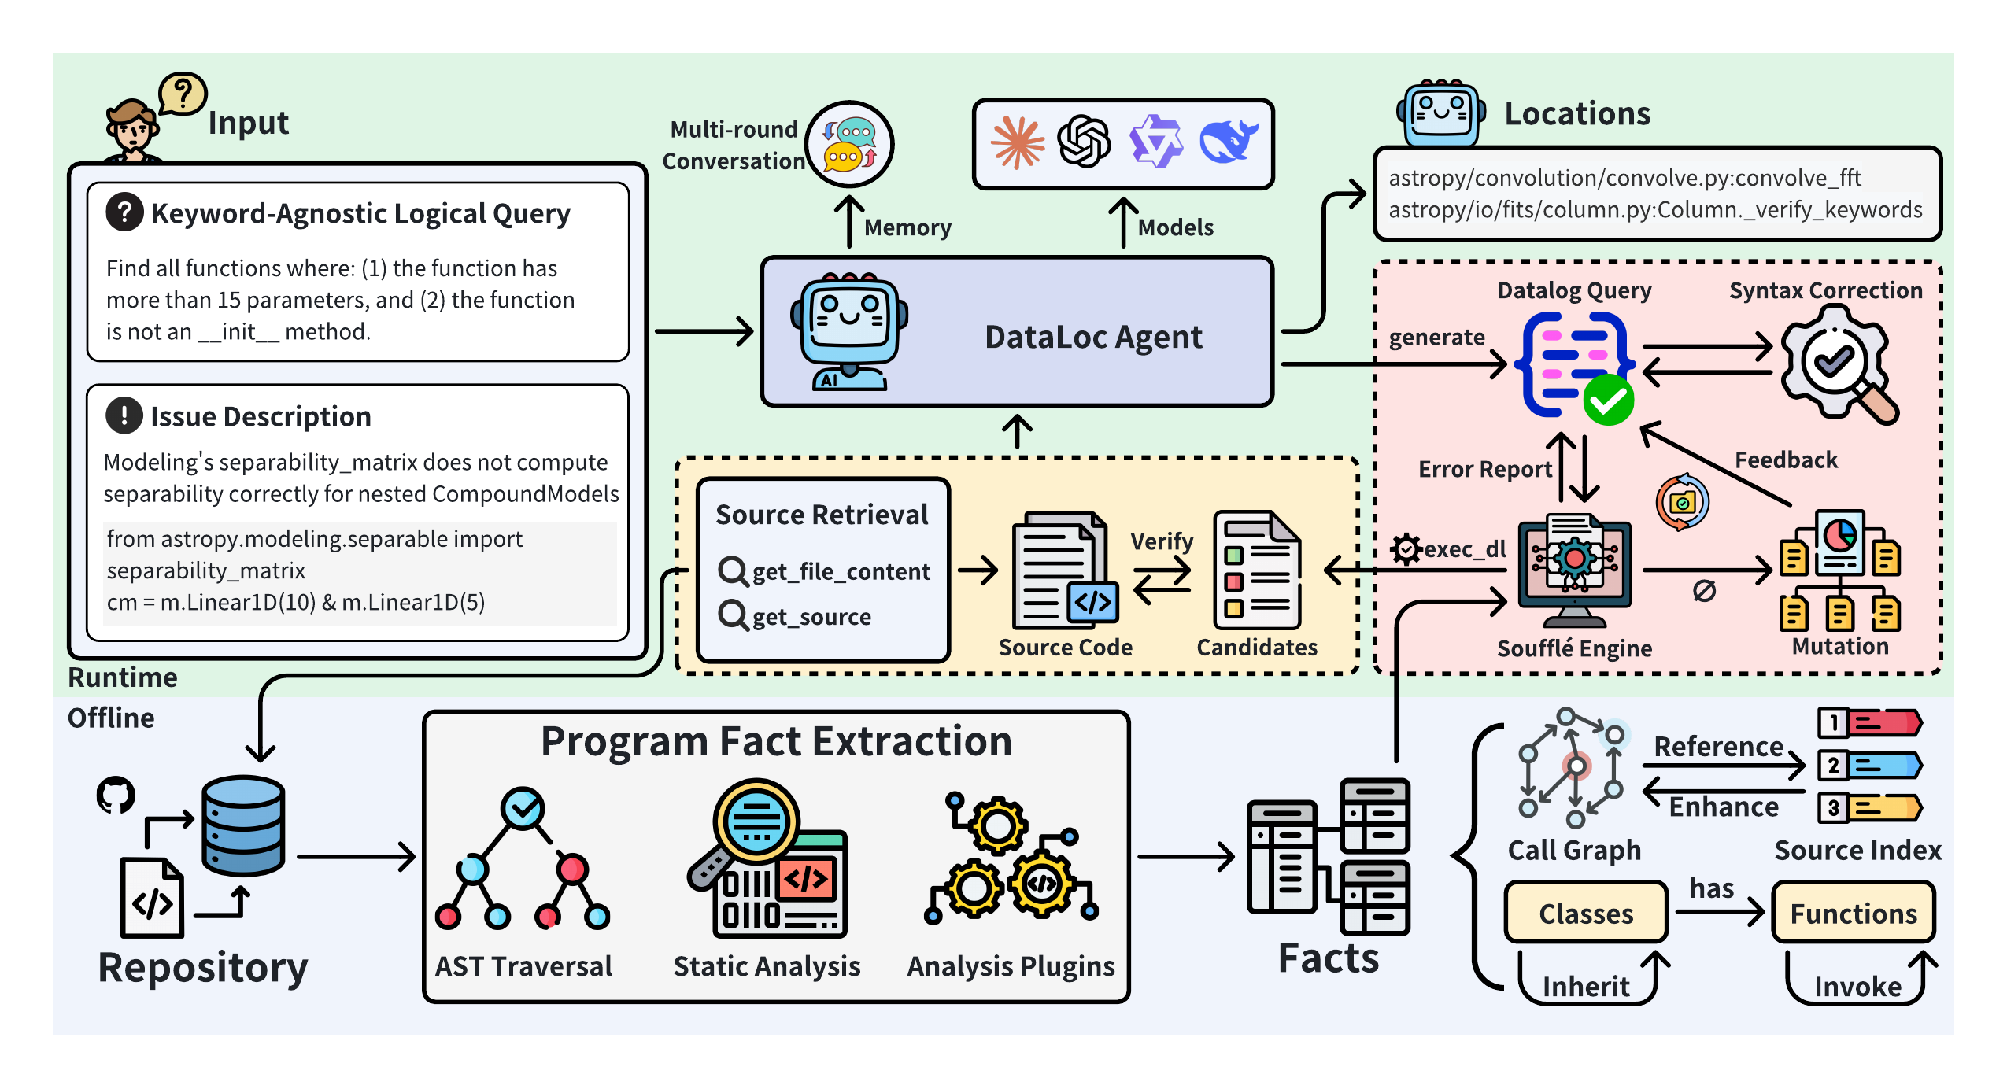
02 / DATALOC · METHOD
DataLoc translates intent into inspectable Datalog
1. Make repository structure queryable
Extract facts from the codebase.
2. Turn intent into Datalog
The LLM synthesizes an inspectable rule.
3. Derive matches deterministically
Soufflé executes the rule over the facts.
Notes:
From our perspective, an effective repository-level code localization engine requires a robust intermediate representation, or IR, that can bridge the semantic gap between natural language intent and implementation logic. This IR should be able to encode code entities, their complex inter-relationships, and structural hierarchies, while remaining interpretable and actionable for LLM-based agents.
To address this challenge, we propose **DataLoc**, a novel agentic framework that combines the symbolic reasoning capability of Datalog with the semantic understanding of large language models for precise repository-level code localization.

Slide 17
02 / DATALOC · METHOD
Program facts make repository structure queryable
Notes:
DataLoc starts with an offline program fact extraction stage. Given a software repository, the system performs static analysis to parse the source code and extract structured program facts for the purpose of automated reasoning and analysis. These facts describe code entities, like files,, classes, functions, parameters, attributes like locations, modifiers, relationships like containment or inheritence.

Slide 18
02 / DATALOC · METHOD
DataLoc accepts logical queries and issue descriptions
Notes:
At query time, the user provides a natural language localization request. Instead of directly searching through the repository, the LLM agent interprets the user’s intent and synthesizes a Datalog program that captures the corresponding logical constraints.

Slide 19
02 / DATALOC · METHOD
The agent turns intent into executable Datalog
Notes:
DataLoc starts with an offline program fact extraction stage. Given a software repository, the system performs static analysis to parse the source code and extract structured program facts for the purpose of automated reasoning and analysis. These facts describe code entities, like files,, classes, functions, parameters, attributes like locations, modifiers, relationships like containment or inheritence.
At query time, the user provides a natural language localization request. Instead of directly searching through the repository, the LLM agent interprets the user’s intent and synthesizes a Datalog program that captures the corresponding logical constraints.
However, DataLoc does not blindly trust the first generated program. It applies parser-gated validation to ensure that the generated Datalog program is syntactically valid and executable. If the parser reports an error, the system feeds this diagnostic information back to the LLM, allowing it to repair the program.
Once the program passes validation, it is executed by **Soufflé**, a high-performance Datalog engine. Soufflé evaluates the logical rules over the extracted program facts and returns candidate code locations that satisfy the query constraints.
To further improve robustness, DataLoc introduces a neuro-symbolic feedback loop with mutation-based repair. If the execution result is empty, overly broad, or inconsistent with expectations, the LLM can iteratively refine the generated Datalog rules based on execution feedback. The mutation-based repair mechanism also helps diagnose which logic clause may be responsible for producing empty or incorrect results.
Finally, DataLoc retrieves the corresponding code snippets and performs a final verification step before returning standardized localization results, such as file paths, class names, method names, and line ranges.
Overall, in this workflow, the LLM is not browsing the repository blindly. Instead, it controls a formal reasoning process over a structured representation of the codebase, enabling more precise, interpretable, and reliable repository-level localization.

Slide 20
02 / DATALOC · METHOD
Execution feedback repairs unproductive rules
Notes:
However, DataLoc does not blindly trust the first generated program. It applies parser-gated validation to ensure that the generated Datalog program is syntactically valid and executable. If the parser reports an error, the system feeds this diagnostic information back to the LLM, allowing it to repair the program.
Once the program passes validation, it is executed by **Soufflé**, a high-performance Datalog engine. Soufflé evaluates the logical rules over the extracted program facts and returns candidate code locations that satisfy the query constraints.
To further improve robustness, DataLoc introduces a neuro-symbolic feedback loop with mutation-based repair. If the execution result is empty, overly broad, or inconsistent with expectations, the LLM can iteratively refine the generated Datalog rules based on execution feedback. The mutation-based repair mechanism also helps diagnose which logic clause may be responsible for producing empty or incorrect results.
Finally, DataLoc retrieves the corresponding code snippets and performs a final verification step before returning standardized localization results, such as file paths, class names, method names, and line ranges.
Overall, in this workflow, the LLM is not browsing the repository blindly. Instead, it controls a formal reasoning process over a structured representation of the codebase, enabling more precise, interpretable, and reliable repository-level localization.

Slide 21
02 / DATALOC · METHOD
Source retrieval grounds candidate verification
Notes:
Finally, DataLoc retrieves the corresponding code snippets and performs a final verification step before returning standardized localization results, such as file paths, class names, method names, and line ranges.
Overall, in this workflow, the LLM is not browsing the repository blindly. Instead, it controls a formal reasoning process over a structured representation of the codebase, enabling more precise, interpretable, and reliable repository-level localization.

Slide 22
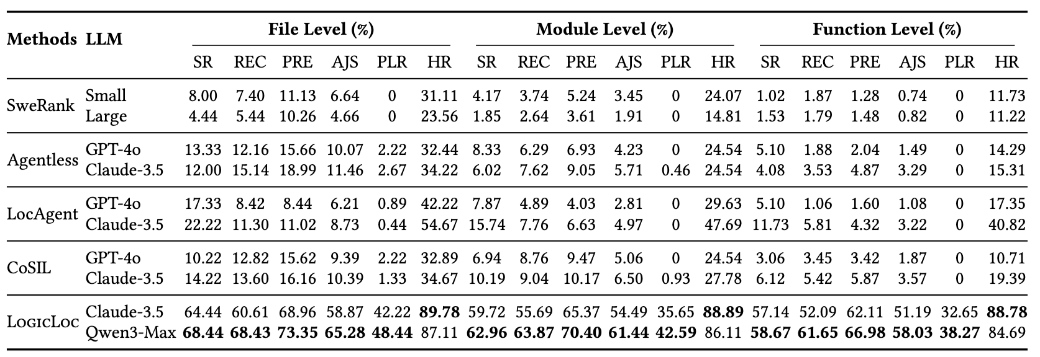
02 / DATALOC · EVALUATION
Effectiveness on KA-LogicQuery
Notes:
The first result is on KA-LogicQuery, the keyword-agnostic benchmark.
The main finding is very clear: without keyword shortcuts, existing baselines struggle significantly. This confirms that strong performance on issue-driven benchmarks does not necessarily imply strong structural reasoning ability.
On the slide, we compare the best baseline with DataLoc using Qwen3-Max. Across different granularities, DataLoc achieves much higher precision.

Slide 23
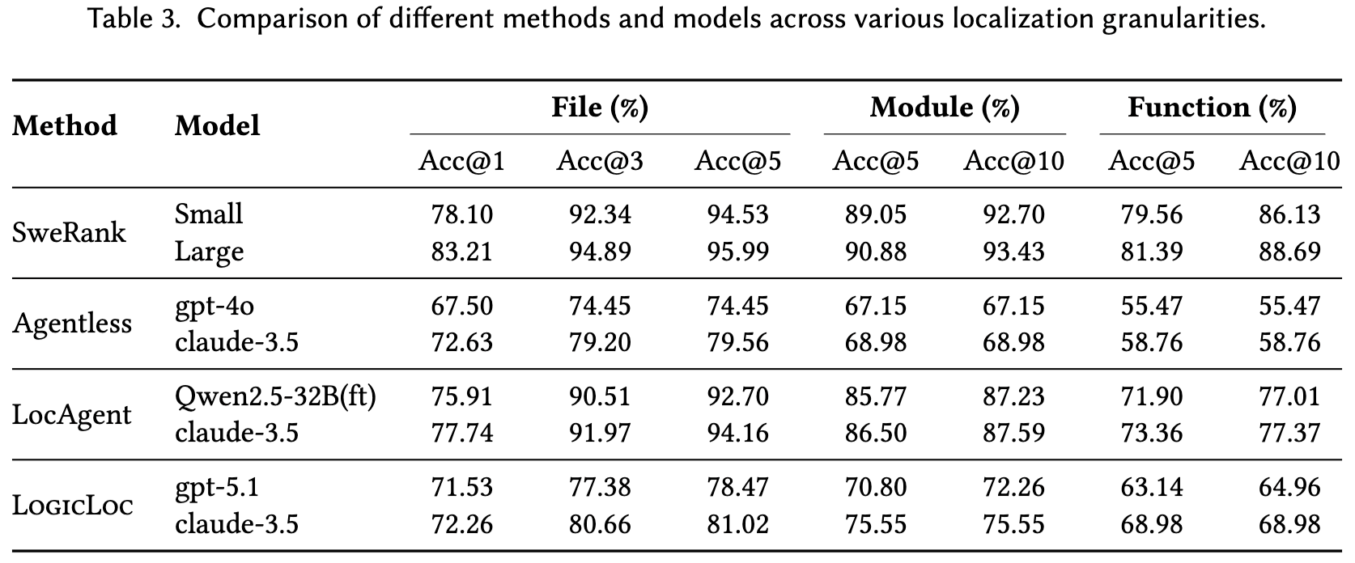
02 / DATALOC · EVALUATION
Effectiveness on Swe-Bench Lite
Notes:
The next question is whether this approach is only useful for synthetic logical queries, or whether it remains practical on standard issue benchmarks.
The answer is that DataLoc remains competitive on SWE-bench Lite while using a much more compact candidate set.
Some existing systems return top-five or even top-one-hundred candidate locations. DataLoc typically returns around two candidates per issue. This is useful because downstream repair agents benefit from concise and precise context.

Slide 24
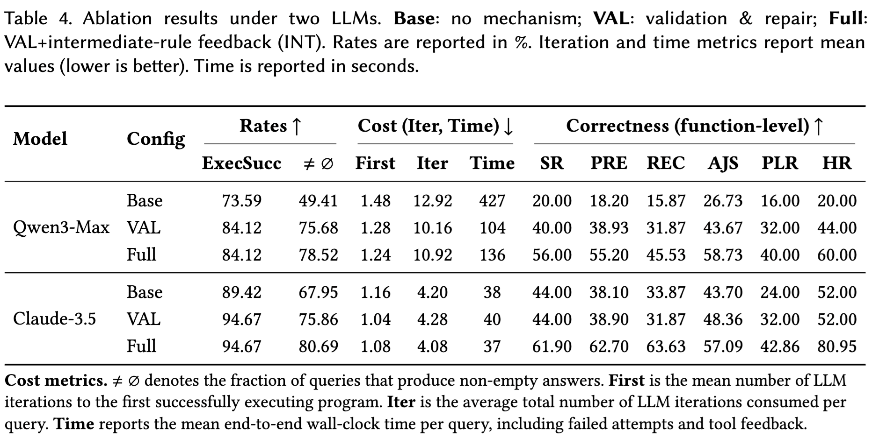
02 / DATALOC · EVALUATION
Ablation Study
Notes:
The component analysis also supports the design. Parser-gated validation, execution feedback, and mutation-based diagnostics all contribute to robustness.
Validation and repair (VAL) substantially improves the robustness of LLMgenerated Datalog, with particularly large gains for weaker models by increasing non-empty result rates and reducing execution cost. Intermediate-rule feedback (INT) complements VAL by guiding targeted revisions of logically unproductive rules, occasionally incurring additional diagnostic cost but improving final answer correctness across models.

Slide 25
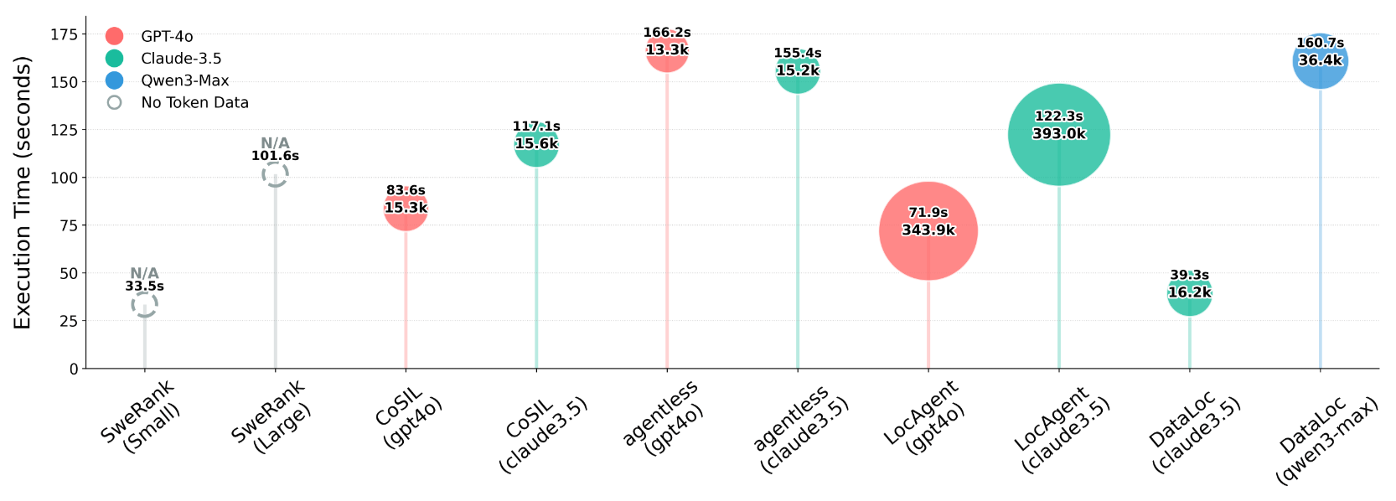
02 / DATALOC · EVALUATION
Efficiency
Notes:
DataLoc reaches competitive metrics compared with strong baselines, while offering additional advantages in token consumption and execution time.
The reason is that DataLoc offloads structural traversal to Datalog. Instead of repeatedly asking an LLM to inspect large chunks of repository text, it uses the symbolic engine to evaluate rules over compact facts.
This creates a better efficiency frontier: fewer tokens, faster execution, and more verifiable localization.
The component analysis also supports the design. Parser-gated validation, execution feedback, and mutation-based diagnostics all contribute to robustness.

Slide 26
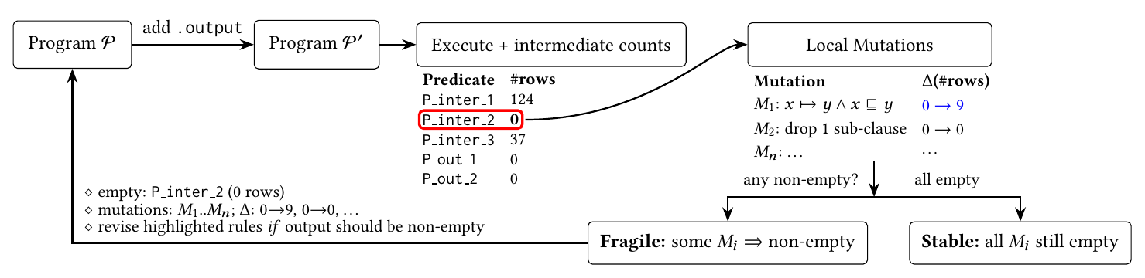
02 / DATALOC · VERIFICATION
Generated logic is checked before it is trusted
1. Reject malformed rules
Parse generated Datalog before execution.
2. Diagnose empty results
Probe intermediate relations and local mutations.
3. Verify returned locations
Check candidates against the original request.
Notes:
There is still an important neural–symbolic boundary: an LLM may generate invalid or over-constrained Datalog. DataLoc therefore uses a synthesize–check–refine loop.
First, parser-gated validation prevents malformed programs from reaching execution. Unambiguous errors, such as reserved-name collisions, are repaired conservatively; otherwise, parser diagnostics are returned to the LLM.
Second, DataLoc observes row counts for intermediate relations. If a relation is empty, small diagnostic mutations test whether the emptiness is fragile—possibly caused by one incorrect constraint—or stable under conservative relaxation. These mutations are probes, not patches; their results are never returned as final answers.
After execution, the agent retrieves candidate source snippets and verifies them against the original request. If the result is excessively broad, the query is refined. If no location satisfies a valid rule, the system can return no match rather than manufacturing a recommendation.
The inference is verifiable relative to the extracted facts and synthesized rule. End-to-end errors remain possible, but they become visible and testable rather than hidden inside free-form generation.
[Section] 02 / DATALOC · LOCATE
[Timing] 13:40–14:55
[Sources]
- PhD thesis, Chapter 5, Sections 5.3.2.2, 5.3.3, and 5.3.4.
- Figure: Figures/Chapter5/mutate.pdf.

Slide 27
02 / DATALOC · RESULTS
DataLoc improves precision—and enables abstention
38.27% vs. 0%
function-level PLR vs. all baselines · Qwen3-Max on KA-LogicQuery
73.35% file-level precision
48.44% exact file-set localization
>70% correct no-match on KA-LogicQuery-Neg
Formal execution can return no match instead of a plausible guess.
Notes:
On KA-LogicQuery, DataLoc substantially outperforms embedding-based, pipeline-based, and agent-based baselines.
Using Qwen3-Max, DataLoc reaches 73.35 percent file-level precision. Its file-level Perfect Localization Rate is 48.44 percent. This strict metric requires the predicted set to exactly equal the ground truth, without either missing or extra locations.
At function level, DataLoc still achieves a Perfect Localization Rate of 38.27 percent. Every evaluated baseline falls to zero on this metric. This matters because a long recommendation list can obtain a hit while still leaving a developer or repair agent with substantial noise.
The negative benchmark reveals another distinction. Existing systems generally continue returning top-n candidates even when no location satisfies the query. DataLoc returns a correct no-match answer for more than 70 percent of negative queries. It is not yet perfect, but it demonstrates that formal execution creates a meaningful abstention mechanism.
I also evaluated DataLoc on 274 retained SWE-bench Lite instances. On this conventional, keyword-rich benchmark, DataLoc is competitive rather than universally superior. With Claude 3.5, file-level Acc@5 is 81.02 percent, while DataLoc returns only about two candidate locations per issue on average. The trade-off is a smaller, more precise result set rather than maximal top-k coverage.
[Section] 02 / DATALOC · LOCATE
[Timing] 14:55–16:35
[Sources]
- PhD thesis, Chapter 5, Section 5.4.3.1 Effectiveness for logic query.
- PhD thesis, Chapter 5, Section 5.4.3.2 Effectiveness for general issues.

Slide 28
02 / DATALOC · TAKEAWAY
Reusable inference replaces repeated exploration
81.02% Acc@5
file-level on SWE-bench Lite · ≈2 candidates per issue
39.3 s/query Claude-3.5 on KA-LogicQuery
16.2k tokens/query same setting
Localization becomes a query that can be inspected, executed, and rejected.
Notes:
The architecture also changes the cost profile. With Claude 3.5 on KA-LogicQuery, DataLoc averages 39.3 seconds and 16.2 thousand tokens per query. On SWE-bench Lite, it reaches 81.02 percent file-level Acc@5 while returning about two candidate locations per issue on average, reducing the amount of downstream code a repair system must inspect.
The ablation study helps explain why the feedback mechanisms matter. On the representative first-25-query ablation subset, Qwen3-Max function-level precision rises from 18.20 percent in the Base configuration, to 38.93 percent with validation and repair, and to 55.20 percent in the Full configuration with intermediate-rule feedback. The exact values matter because they show that each verification layer contributes incrementally within this ablation setting.
The broader result is not simply that Datalog is fast. It is that the model is assigned a narrower role: interpret intent, synthesize a formal query, and verify candidates. Repetitive repository-scale traversal is assigned to a specialized engine.
This contribution therefore exposes a benchmark bias, supplies a diagnostic benchmark, and demonstrates that explicit intermediate reasoning can improve precision, efficiency, inspectability, and the ability to abstain.
[Section] 02 / DATALOC · LOCATE
[Timing] 16:35–17:55
[Sources]
- PhD thesis, Chapter 5, Section 5.4.3.3 Efficiency.
- PhD thesis, Chapter 5, Section 5.4.3.4 Ablation Study, Table 5.4.

Slide 29
03 / VERIFY
MPChecker
ARTIFACT DELIVERY
Does the delivered contract still agree with
the code?
Perceive → Locate → VERIFY
Notes:
DataLoc narrows the search to the logic that should change. Yet even a correct code change can be delivered with an incorrect public contract. The third core study, MPChecker, asks whether documentation still agrees with implementation.

Slide 30
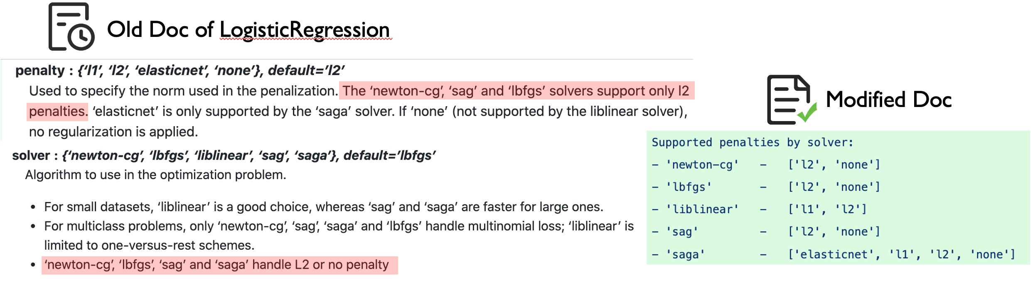
03 / MPCHECKER · PROBLEM
Code-doc inconsistencies in data science libraries
The documented configuration is ambiguous
Can newton-cg, sag, and lbfgs be used with no penalty?
A wrong configuration can cause underfitting
Misinterpreting the contract can silently degrade model quality.
Notes:
Modern AI and data-intensive software systems rely heavily on third party libraries like Scikit-Learn, NumPy, SciPy to help users focus on domain-specific problems rather than recreate wheels. The development team will provide a comprehensive documentation with dozens of APIs and configurable parameters, and there are complex constraints among these parameters that need to be followed.
An example from scikit-learn’s issue. In the doc of LogisticRegression, the "penalty" parameter states that "The ‘newton-cg’, ‘sag’ and ‘lbfgs’ solvers support only L2 penalties," while the "solver" parameter states that "‘newton-cg’, ‘lbfgs’, ‘sag’ and ‘saga’ handle L2 or no penalty". A confusion occurs here, can the solver, newton-cg, sag, lbfgs work with no penalty? In actual code execution, these three solvers support not only L2 solver but also support no penalty. So basically, if a user blindly follows inaccurate documentation and applies L2 regularization everywhere, the code won't throw any errors—but it could hurt model training performance, possibly leading to underfitting. That’s because in some cases, adding a penalty isn’t necessary.

Slide 31

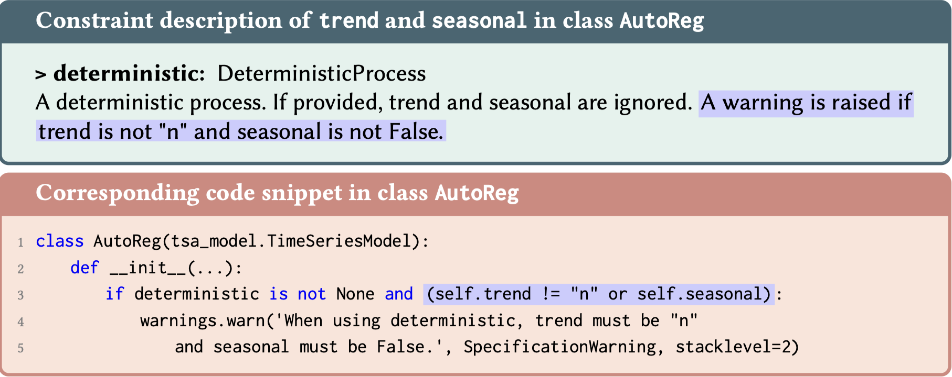


03 / MPCHECKER · PROBLEM
Code-doc inconsistencies in data science libraries
Code and documentation evolve out of sync
API behavior can change faster than its description.
Multi-parameter constraints are the blind spot
Data-science APIs contain many interacting rules that existing tools fail to check.
V1.0
❌
V1.0
V2.0
Notes:
Here’s another simple example from statsmodels, The line highlighted in purple describes a constraint about two parameters, trend and seasonal. “A warning raised if trend is not n and~! seasonal is not False ”. But, the actual code logic implements 'or' rather than ‘and’.
These inconsistencies happens because API documentation and code always evolve at different speeds. Such drift create multi-parameter Code-Documentation Inconsistencies. Even worse, there are lots of multi-parameter constraints in data science libraries, but currently there is no tool that can do a good job of checking multi-parameter code-documentation inconsistency.

Slide 32
03 / MPCHECKER · PROBLEM
Why is it challenging?
Many parameters interact
Complex dependencies emerge across parameter combinations.
Violations can fail silently
Invalid combinations may change behavior without raising exceptions.
Documentation is unstructured
Free-form prose can hide or blur constraints.
Code–documentation links stay implicit
The relevant implementation logic is hard to isolate and compare.
Notes:
Why is this challenging?
First, modern APIs often involve numerous parameters with complex interdependencies. Second, constraint violations may occur silently, leading to unexpected behaviors without triggering any explicit exceptions. Additionally, there is no fixed format for API documentation, which can result in ambiguous descriptions and unclear or hidden constraints. Lastly, the relationship between code and documentation is often implicit, making it difficult to locate relevant code segments and verify specific constraints.
That’s why rule-based tools are not good enough under this situation.

Slide 33
03 / MPCHECKER · PROBLEM
LLM may be a promising solution, but …
An LLM-only checker cannot provide a guarantee
Stochastic behavior and hallucination remain unavoidable.
Code comprehension and logical reasoning remain unreliable.
Use language models to interpret—and symbols to verify
Combine natural-language understanding with symbolic reasoning.
Notes:
Large language models (LLMs) seem to be a promising solution, but they are unlikely to serve as reliable standalone tools for detecting multi-parameter inconsistencies. This is due to their unavoidable stochastic behavior and high risk of hallucinations, as well as its unreliable code comprehension and limited logical reasoning capability. Therefore, our proposal is to combine the strengths of LLMs in natural language understanding with symbolic reasoning. Specifically, LLMs are effective at extracting constraints from natural language documentation, but they struggle with in-depth code comprehension and precise logical reasoning, and that's exactly the comfort zone of symbolic execution engines and SMT solvers. So, we came up with MPChecker by combining them all, we can take advantage of each components’ strengths to improve the overall reliability and accuracy of multi-parameter inconsistency detection.

Slide 34
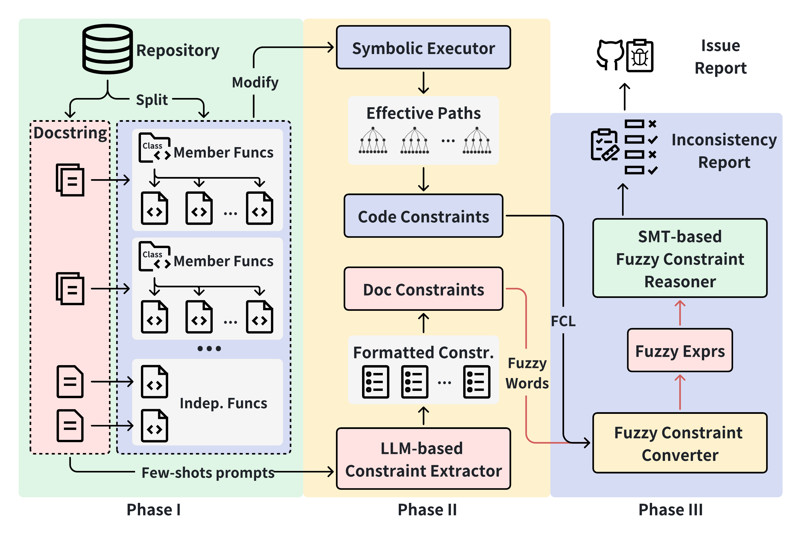
03 / MPCHECKER · METHOD
MPChecker makes text and code comparable
1. Extract the stated constraint
The LLM reads the documentation.
2. Derive the implemented paths
Symbolic execution exposes code constraints.
3. Compare the two contracts
Fuzzy logic and SMT reveal disagreements.
Notes:
Here’s the framework of MPChecker, which consists of three main phases:
In the first phase, given a repository, functions and their associated docstrings are first extracted from the code base.
In the second phase, on the one hand, doc-constraints are extracted by LLMs, and on the other hand, code-constraints are extracted by symbolic execution tools.
In the third phase, both sets of constraints are formatted into fuzzy expressions with the help of fuzzy words and fuzzy constraint logic and then pass them to the SMT solver to identify potential inconsistencies.
We‘ll go over the details.

Slide 35
03 / MPCHECKER · METHOD
Phase I: Preprocessing
Split code into analyzable function units
Extract documentation texts
  Following Google or Numpy style
Equivalent Python code transformations to support dynamic symbolic execution
  Get rid of unnecessary complications that do not affect path constraints
    E.g., external calls, complex data structures
    Translate exceptions to special symbols
  Focus on visible API parameters
Notes:
And we will also modify code to get rid of unnecessary complications like external calls or complex data structures. The purpose of this step is to help our tool focus on the visible API parameters.

Slide 36
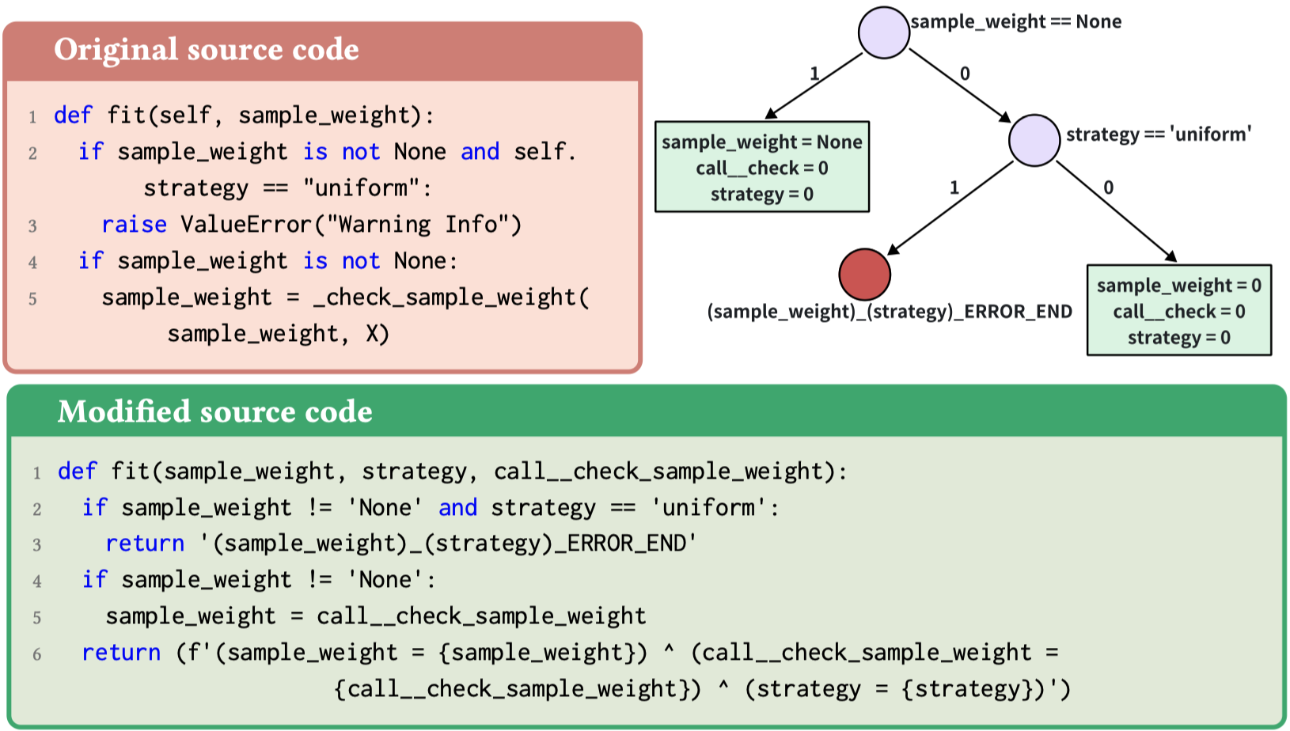
03 / MPCHECKER · METHOD
Phase II-A: Code-constraint extraction
Symbolic execution exposes the failure condition
(sample_weight ≠ None) ∧ (strategy = uniform) → ERROR
Notes:
Then, a customised concolic symbolic execution engine walks each feasible path based on modified code, capturing path constraints.
Unlike traditional symbolic execution tools, our objective is not to pursue deep path exploration but rather to more effectively capture the relationships among parameters. That's why we apply many modifications to the source code that do not affect path exploration. Let’s see the modified code snippet shown in green rectangle, we replace external calls as symbols. Finally, code constraints can be extracted, for example, an error will be raised when sample_weight is not None and strategy is uniform. The formatted constraint looks like this.
(sample_weight != None) ∧ (strategy = uniform) → ERROR

Slide 37
03 / MPCHECKER · METHOD
Phase II-B: Documentation constraints
Parameter list + Few-shots + CoT
The LLM turns prose into a logical constraint
(affinity = nearest_neighbors) → ignore(gamma)
Notes:
We provided several examples for few-shot learning and included chain-of-thought reasoning to clearly outline the step-by-step extraction process to help LLM better understand the extraction task. To further reduce hallucination, we also shared a parameter list to keep the model's output within the expected limits.
A classic doc-constraint looks like this. It is worth noting that, this is an implicit constraint with a fuzzy word, ignore.

Slide 38
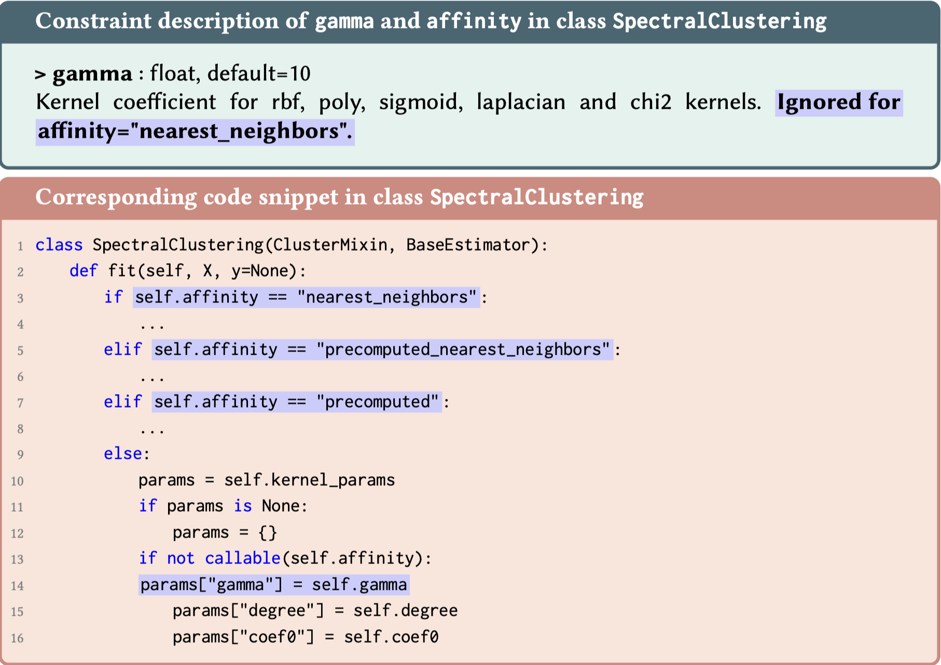
03 / MPCHECKER · METHOD
Implicit constraints and fuzzy words
Existence | Non-existence
specify, have an effect, exist, significant, etc. | ignore, have no effect, unused, override, etc.
  (affinity = nearest_neighbors) → ignore(gamma)
Notes:
Implicit constraints means such constraints are usually not clearly described or lack subjects, that is, they imply potential known information, which makes it hard for traditional rule-based tools to locate these constraints. In general, there are two categories of fuzzy words, existence and non-existence. Here are some common fuzzy words.
Let’s take a detailed example to explain how fuzzy words work.
The doc of Gamma states that Ignored for affinity = nearest_neighbors, Apparently, parameter Gamma is missing. The complete constraint description should be Gamma will be ignored when affinity equals to nearest_neighbors. The question is how to check if this implicit constraint is consistent with the code or not? We designed a special predicate, the result is true or false.
Through the def-use check, we can see that gamma is used only in the else branch — meaning it gets ignored when the other three condition hold. So this constraint is a correct but incomplete constraint, cause gamma will not only ignored when affinity is nearest_neighbors but also when affinity is precomputed_nearest_neighbors and precomputed.

Slide 39
03 / MPCHECKER · METHOD
Phase III: Inconsistency Checking
Given a document constraint c and code-path constraints P = {p}:
No path satisfies the documented constraint
∀𝑝∈𝑃, ¬𝑐∧𝑝
At least one path disagrees with the documentation
∃𝑝∈𝑃, ¬(𝑐⟺𝑝)
Notes:
In the checking phase, our reasoner offers two strategies, from relaxed to strict, to identify inconsistencies. Given a doc-constraint 𝑐 and a code-constraint set 𝑃 containing a group of path constraints 𝑝,
A relaxed strategy is to check If a doc-constraint satisfies all path constraints.
Another strict strategy is nonequivalence checking to check If equivalence holds only under specific conditions
Then, we can know the given constraint is consistent with the code or not.

Slide 40



03 / MPCHECKER · METHOD
Fuzzy Constraint Logic
Hallucination ➔ Incorrect constraints ➔ fuzzy results
LLM tends to make minor mistakes
  Look-alike names, wrong symbols ( $$< ⟶ ≤$$ ), etc.
  Unfortunately, we can’t tell whether the extracted doc-constraints are correct or not
We could mitigate the impact of hallucination on consistency checking
Correct constraint
+
?
Incorrect constraint
Notes:
So far, everything makes sense. However, there‘s still one issue that needs to be addressed. The hallucination problem for LLM is inevitable, which means the doc-constraint extracted by LLM may not correct and leads to unreliable fuzzy results. Based on our observation, LLM tends to make minor mistakes such as Look-alike names or wrong symbols.
Can we tell whether the extracted doc-constraints are correct or not? Unfortunately, we could not. But we can mitigate the impact of hallucination during consistency checking. Inspired by fuzzy logic, we introduced a new concept — fuzzy constraint logic。 Through fuzzy constraint logic, by calculating the similarity of doc-constraint and code-constraint, we quantify to what extend a given constraint is consistent with the code, factoring in potential mistakes from LLMs.

Slide 41
03 / MPCHECKER · METHOD
FCL - Expression similarity
Constraint in doc-constraint: (samples < features) $$∧$$ (dual = True)
Expression in code: n_samples >= n_features, dual = True
samples
<
features
Normalized Levenshtien Distance
$$η\left(s_{1},s_{2}\right)=NLD=1− \frac{LD(s_{1},s_{2})}{max(\left|s_{1}\right|, \left|s_{2}\right|)}$$
n_samples
>=
n_features
$$η=1 − \frac{2}{9}≈0.78$$
Notes:
Now, let us walk through an example to demonstrate how we perform the calculation.
We have an extracted doc-constraint: (samples < features) ∧ (dual = True).
Here, the LLM made a minor typo — the correct parameter names should be n_samples and n_features.
Since a constraint can be viewed as a logical combination of several expressions, we start by computing the expression similarity.
To do this, we calculate the edit distance between parameter names or value names and the cosine similarity between operators.

Slide 42

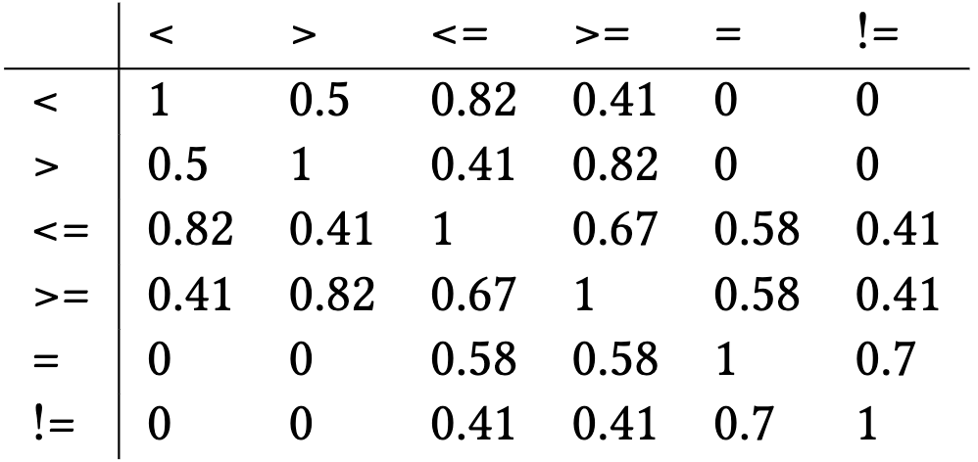
03 / MPCHECKER · METHOD
FCL - Expression similarity
Constraint in doc-constraint: (samples < features) $$∧$$ (dual = True)
Expression in code: n_samples >= n_features, dual = True
Comparison, Equality, Greater than, Less than, Negativity
samples
>
features
$$δ_{>}=(1,0,1,0,0)$$
Cosine similarity
n_samples
<=
$$δ_{≤}=(1,1,0,1,0)$$
n_features
$$cosθ=0.41$$
Notes:
To do this, we calculate the edit distance between parameter names or value names and the cosine similarity between operators.

Slide 43
03 / MPCHECKER · METHOD
FCL - Expression similarity
Constraint in doc-constraint: (samples < features) $$∧$$ (dual = True)
Expression in code: n_samples >= n_features, dual = True
samples
<
features
Normalized Levenshtien Distance
$$η\left(s_{1},s_{2}\right)=NLD=1− \frac{LD(s_{1},s_{2})}{max(\left|s_{1}\right|, \left|s_{2}\right|)}$$
n_samples
>=
n_features
$$η=1 − \frac{2}{10}=0.8$$
Notes:
To do this, we calculate the edit distance between parameter names or value names and the cosine similarity between operators.

Slide 44
03 / MPCHECKER · METHOD
FCL - Expression similarity
Equal weights combine name and operator similarity
α and β receive the same weight in this example.
Expression 1:
samples
<
features
n_samples
>=
n_features
Expression 2:
$$η=1 − \frac{2}{9}≈0.78$$
$$cosθ=0.41$$
$$η=1 − \frac{2}{10}=0.8$$
$$σ\left(e_{1},e_{2}\right)=\frac{0.778+0.41+0.8}{3}≈0.66$$
Notes:
These components together allow us to derive the overall expression similarity. In this case, it is 0.66.

Slide 45
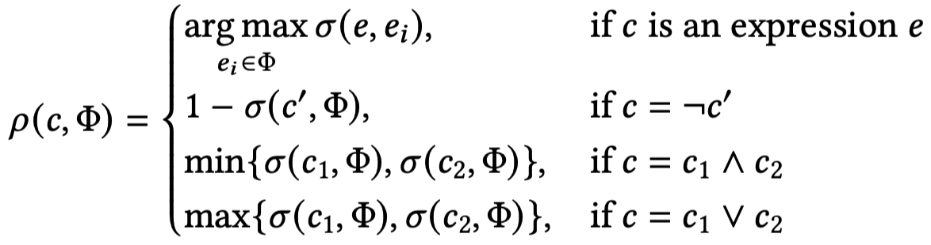
03 / MPCHECKER · METHOD
FCL - Constraint similarity
Constraint in doc-constraint: (samples < features) $$∧$$ (dual = True)
Expression in code: n_samples >= n_features, dual = True
Constraint similarity can be evaluated with the following formula:
$$ρ=\min\left\{0.66, 1\right\}=0.66$$
Notes:
Then the whole constraint similarity can be evaluated with the following formula. for example, conjunction relationship should take the minimum expression similarity. Since the remaining parts are identical, the constraint similarity is still 0.66.

Slide 46

03 / MPCHECKER · METHOD
FCL — Membership function
Constraint similarity becomes a soft membership score
ρ measures how closely a document constraint aligns with the code.
$$0.66∙True=0.33∙False$$
Aligned expressions become the SMT input
Map each document expression to its closest code counterpart, then evaluate the modified constraint.
A 0.85 threshold filters false positives
ρ > 0.85 → discard; ρ ≤ 0.85 → accept.
Notes:
Finally, constraint similarity serves as the membership function to quantify to what extend a given constraint is consistent with the code. Instead of either True or False, we can calculate a real number between 0 to 1 right now. To reduce the false positives, we set a threshold of 0.85 to accept or discard a result.

Slide 47


03 / MPCHECKER · EVALUATION
Evaluation
Dataset
72 real-world constraints from scikit-learn, SciPy, NumPy, and pandas.
Mutation yields 216 cases: 126 inconsistent and 90 consistent.
Implementation
GPT-4 with the Z3 SMT solver.
Research questions
RQ1 — How accurately are constraints extracted?
RQ2 — How well are inconsistencies detected?
RQ3 — Does MPChecker generalize to unseen issues?
[1] MPChecker artifact · doi.org/10.5281/zenodo.15202267
Notes:
Here's the evaluation part. Currently, there’s no ground truth dataset for multi-parameter code documentation inconsistency. So, to better evaluate our tool, we started by analyzing commit history of four popular libraries. We first filtered commits related to multi-parameter constraints, then manually reviewed them. In total, we collected 72 real-world constraints. We further expanded the dataset through mutation, leading to 216 constraints — 126 inconsistent constraint and 90 consistent constraint.
Our artifacts including the tool and dataset have been evaluated, and received available and functional badge.
Given this context, we propose the following three research questions.

Slide 48
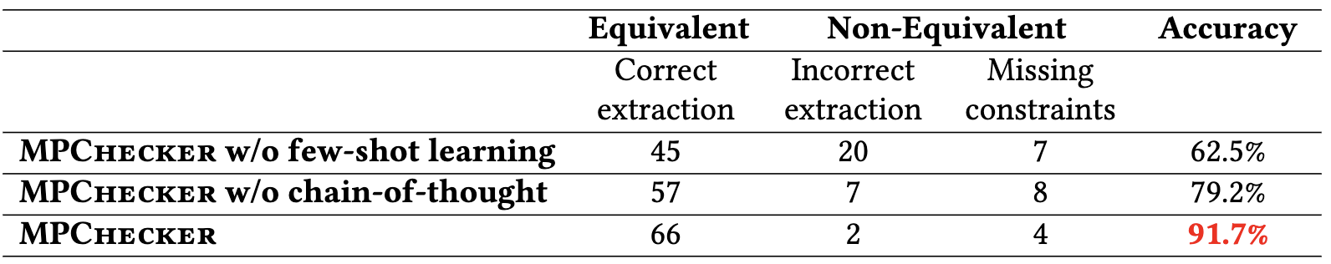
03 / MPCHECKER · EVALUATION
RQ1: How accurately does MPChecker extract API constraints?
  Few-shot learning and CoT can help LLM in this task
  66/72=91.7% demonstrates MPChecker is effective in extracting logical constraints from doc
Notes:
The first research question is how accurate is MPChecker in extracting constraints from API documentation?
The results show that few-shot learning and CoT significantly boost performance. Accuracy improves from 62.5% and 79.2% to 91.7% when both techniques are applied. Specifically, MPChecker correctly extracts 66 out of 72 constraints, showing that it is highly effective in understanding and extracting logical constraints from documentation.

Slide 49
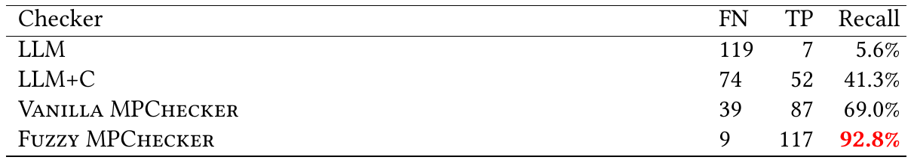
03 / MPCHECKER · EVALUATION
RQ2: How effective is MPChecker in detecting errors related to multi-parameter constraints in API documentation?
raw docs + code → LLM
doc constraint + code → LLM
doc + code constraints → Z3
doc + code constraints + fuzzy logic → Z3
  LLM performs poorly as end-to-end inconsistency checker
  LLM Results: Correct conclusion + vague / incorrect reasons
  117/126=92.8% shows MPChecker is effective in detecting inconsistent errors
  Fuzzy words and fuzzy constraint logic improve recall by 23.8%
Notes:
The second research question is how effective is MPChecker in detecting errors related to multi-parameter constraints in API documentation?
LLM-only checker means, input raw documentation and corresponding code directly, and let LLM to check whether there is an inconsistency.
LLM+C means the LLM extracts doc-constraints first and then uses them, along with the code, for inconsistency checking.
Fuzzy MPChecker is the final tool that uses Z3 solver as the inconsistency identifier, while the Vanilla MPChecker doesn't include fuzzy word and fuzzy constraint logic support.
The results align with our intuition: LLMs are not reliable as an end-to-end tool. Out of 126 inconsistent constraints, the model correctly identified only 7 — that's just a 5.6% recall. Even when we pre-extract the doc-constraints, recall only improves to 41.3%. Moreover, we observed that in some cases, even when the LLM reaches the correct conclusion, the reasons it gives are often vague or even incorrect.
Fuzzy MPChecker successfully detected 117 out of 126 inconsistent constraints, achieving a high recall of 92.8%. This demonstrates that MPChecker is highly effective, and incorporating fuzzy logic improves recall by 23.8% compared to the vanilla version.

Slide 50



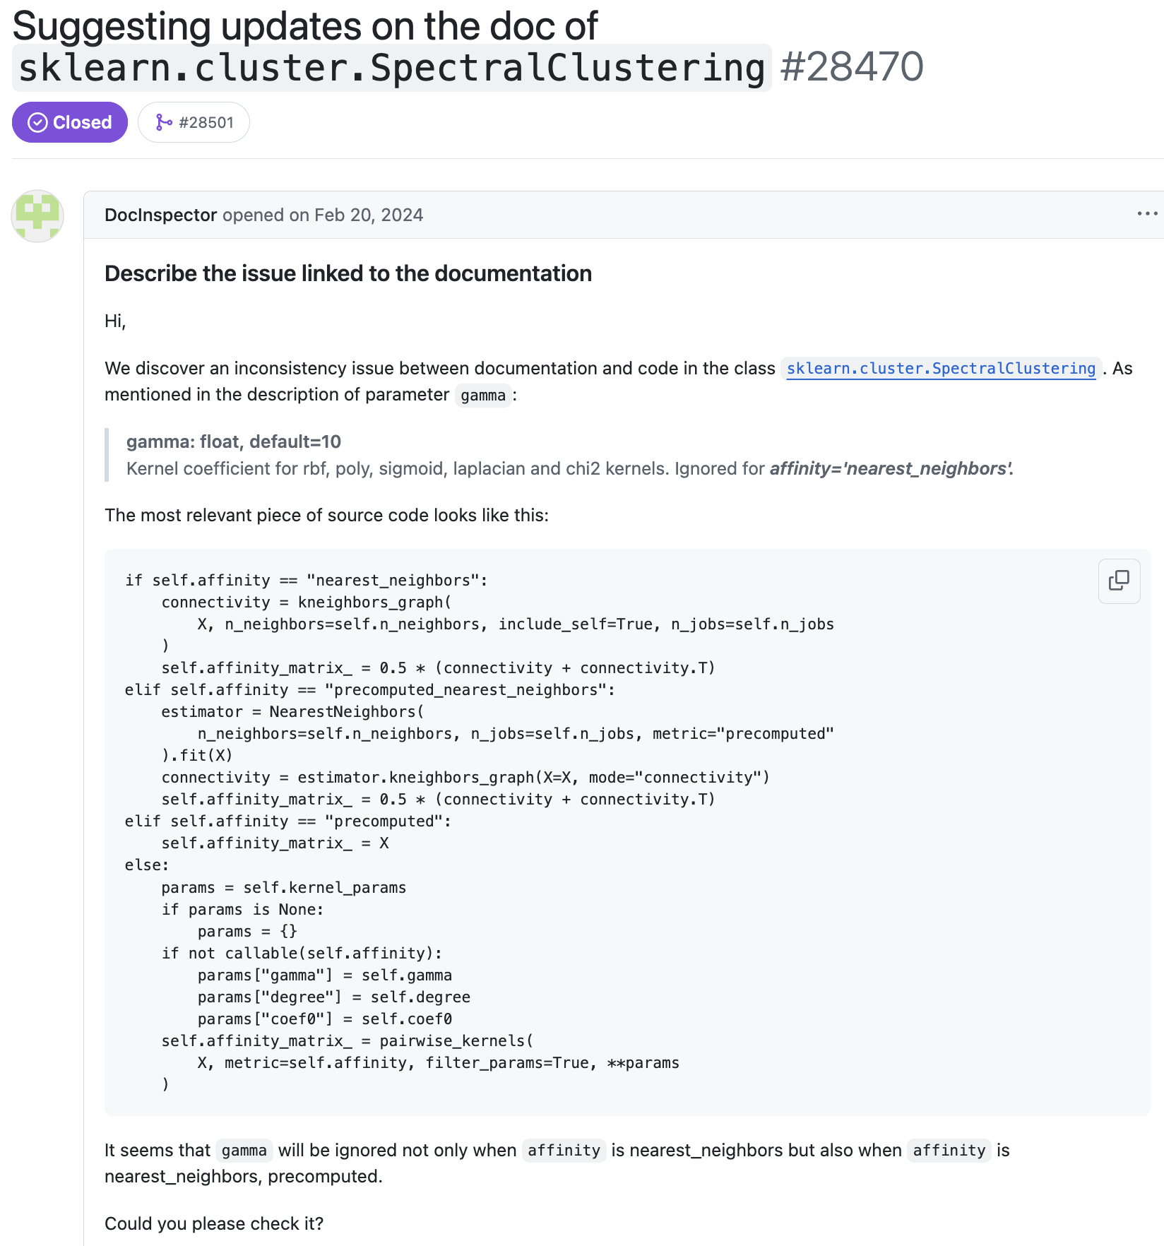
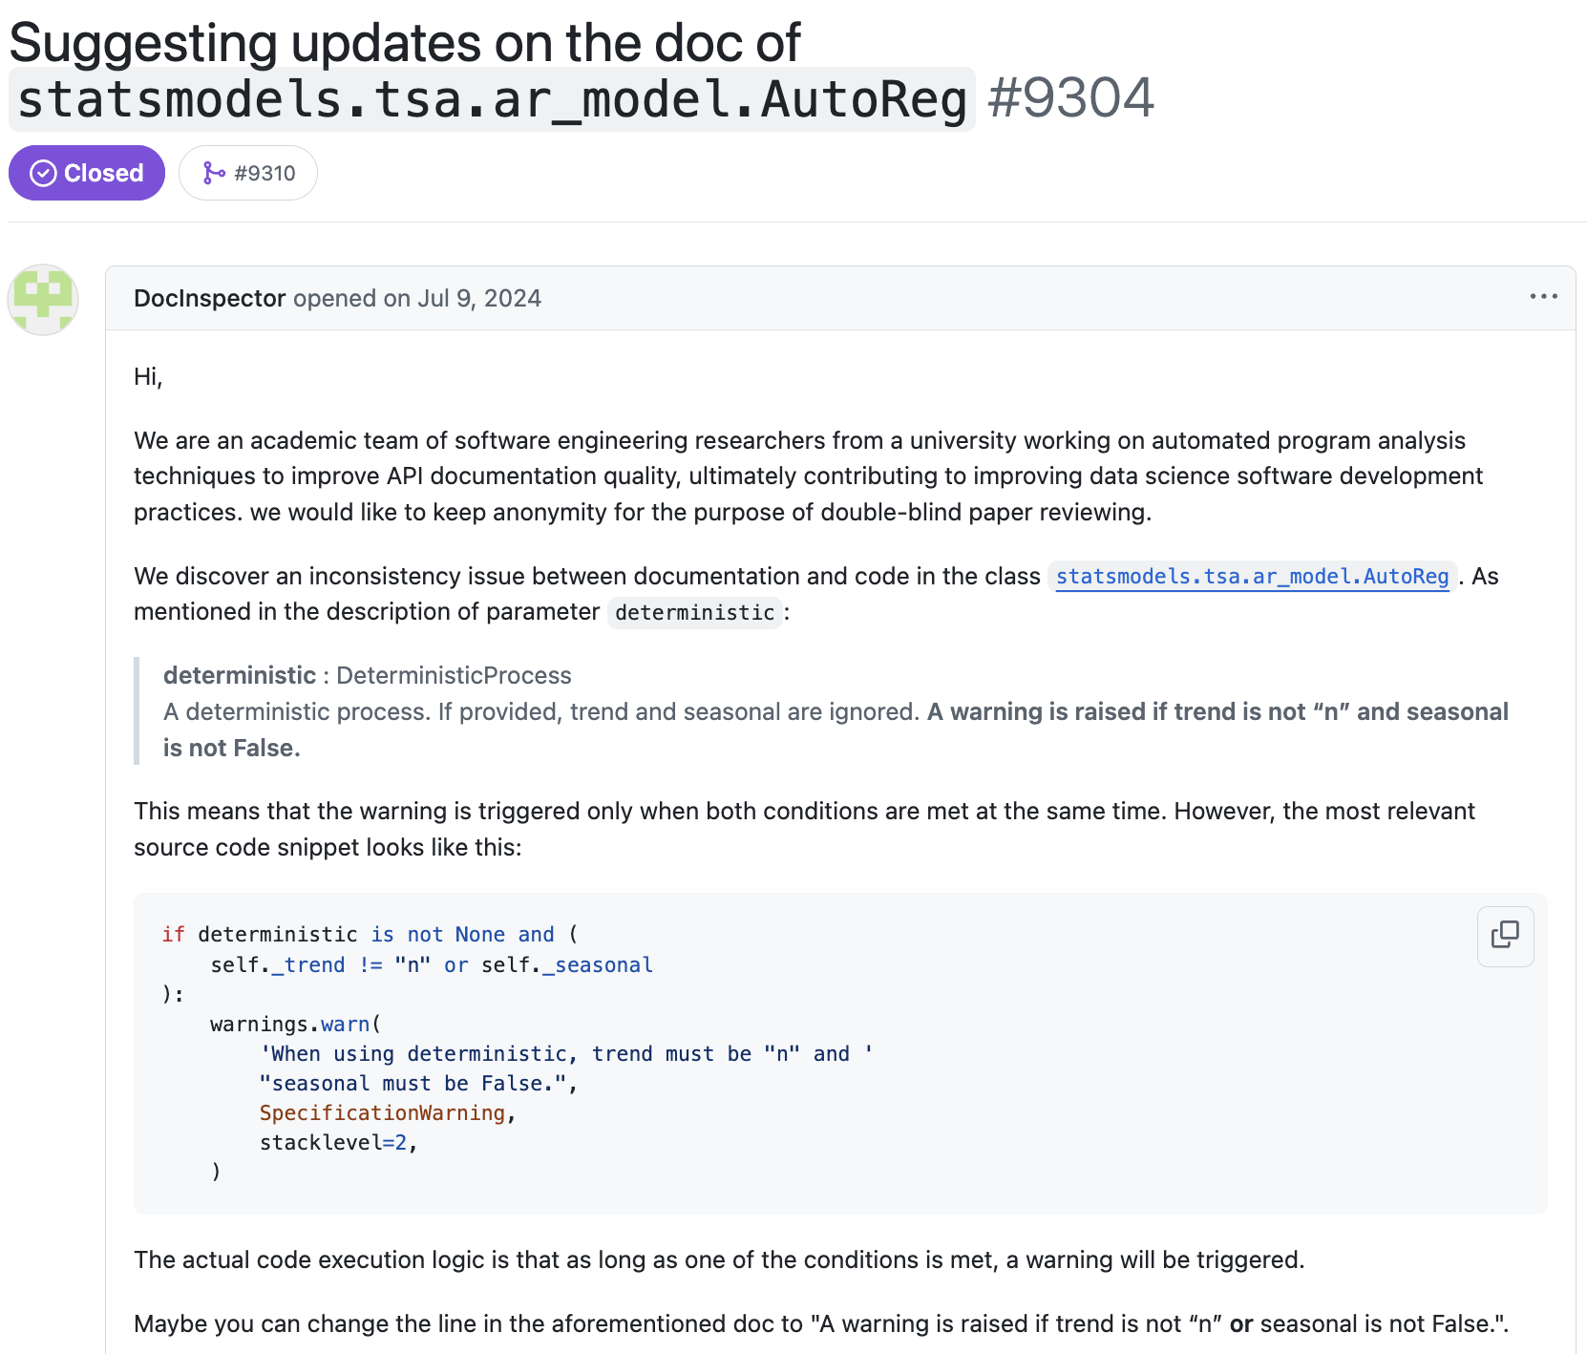
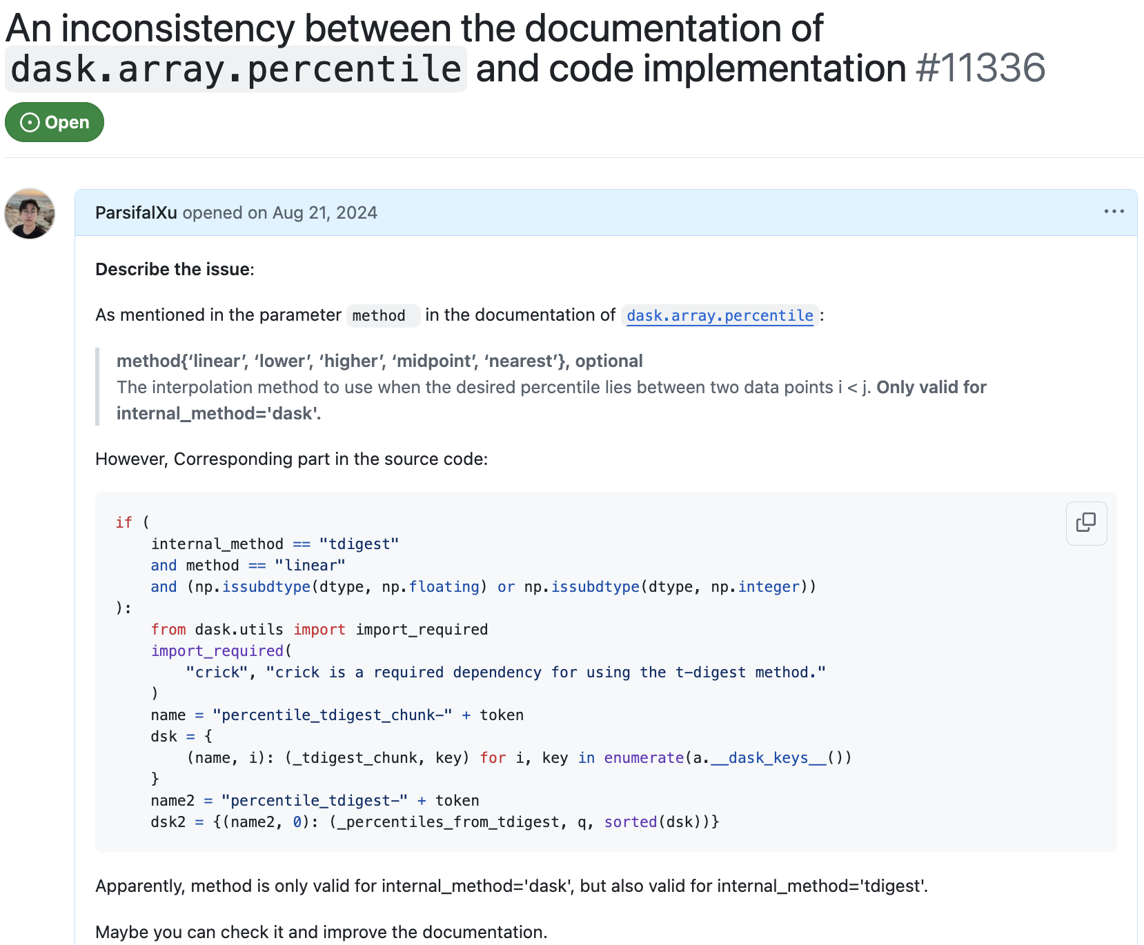
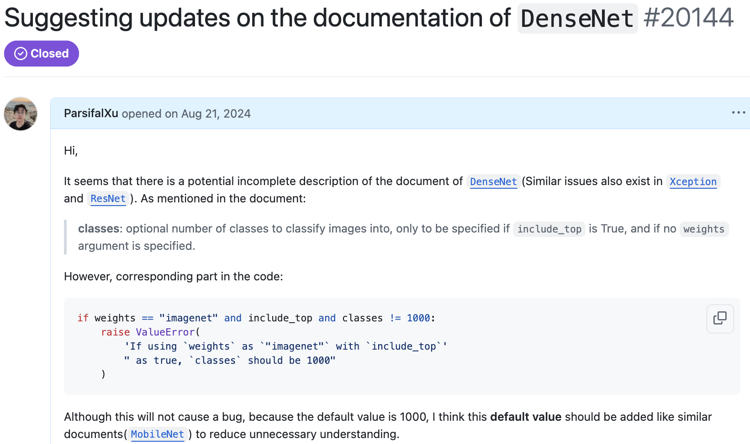
03 / MPCHECKER · EVALUATION
RQ3: Can MPChecker detect unknown inconsistencies?
Issue reports confirmed: 11/14 (78.6%).
10/11 were resolved: 7 documentation fixes; 3 code + documentation fixes.
MPChecker detects previously unknown API documentation errors.
It generalizes to unseen libraries.
Notes:
The third research question is how effective can MPChecker detect unknown inconsistency issues?
We applied our tool not only to libraries in our dataset but also to unseen libraries.
Due to the widespread use of AI detection tools, developers have become frustrated with careless issue reports, so we're cautious when submitting a new issue.
We submitted 14 issue reports generated by MPChecker, and 11 were confirmed as real issues — a 78.6% confirmation rate. Of these, 10 have already been fixed: 7 through documentation updates, while 3 that not only fix docs but also prompt developers to optimize their code.
This shows that MPChecker can detect previously unknown documentation errors, and it also works well in unseen libraries, which highlights its strong generalization.

Slide 51
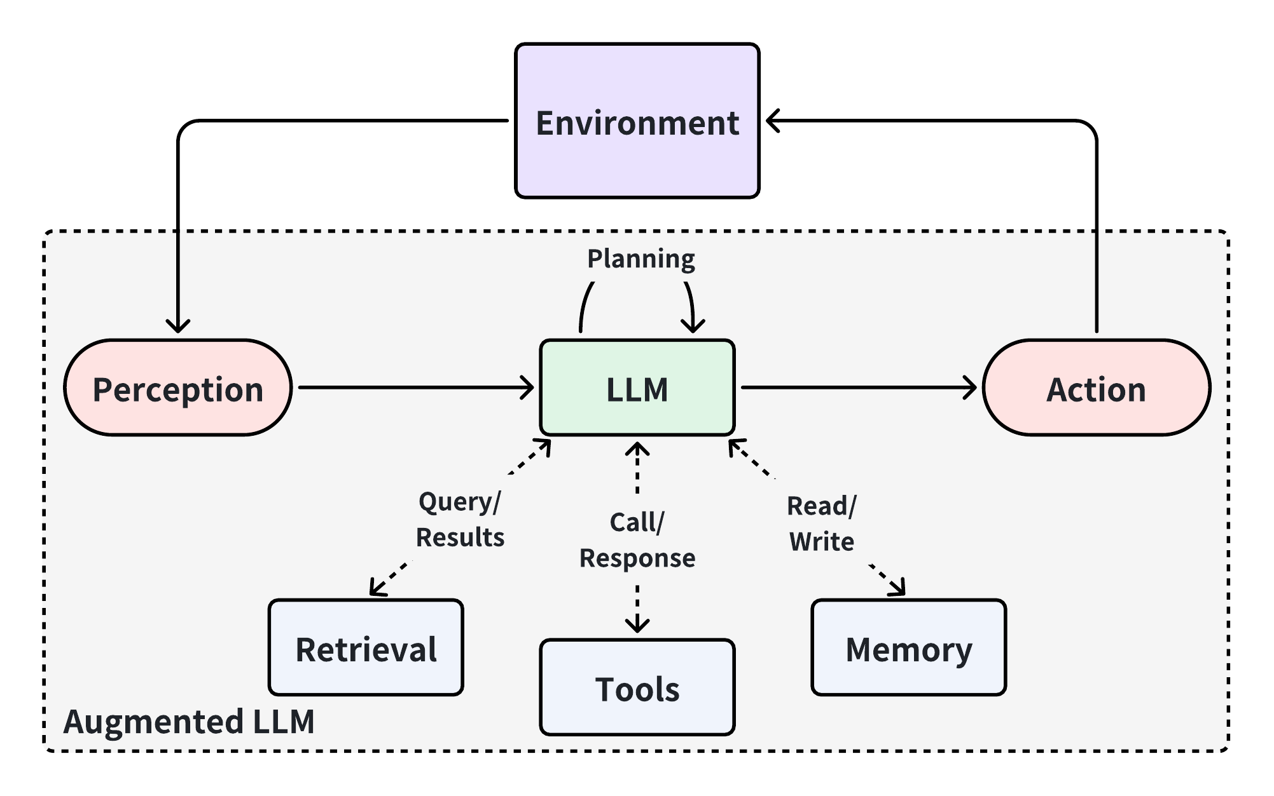
SYNTHESIS / BOUNDARIES & NEXT
The evidence is substantive—and deliberately bounded
Coverage ends where observable evidence ends
Tests, extracted fact types, and explored paths bound the guarantee.
Broader evidence can support verified repair
Extend frontends and program facts; add automatic repair, self-healing, and verifiable intermediate representations.
Notes:
There are several important limitations.
CompSuite focuses on Java projects using Maven. It upgrades one dependency at a time, relies on existing tests as behavioral oracles, and is tied to fixed historical project and dependency versions. It therefore captures only failures exercised by the selected test suites and environments.
DataLoc has so far been evaluated only on Python. KA-LogicQuery contains 25 representative query combinations across nine projects; it is a diagnostic benchmark, not a complete model of every maintenance request. The deterministic engine does not by itself validate fact extraction or query translation, so either source of error can still produce an incorrect answer.
MPChecker currently focuses on Python data-science libraries and two major docstring styles. Python symbolic execution remains incomplete, particularly for new language features, external calls, strings, and complex objects. Its similarity threshold is heuristic, and a reported inconsistency does not determine whether code or documentation is the intended source of truth.
These boundaries motivate four directions: end-to-end benchmarks for AI-assisted self-healing under dependency evolution; automated repair of code–documentation inconsistencies; additional language frontends and richer program facts; and a verifiable intermediate language that bridges human intent and generated code before implementation begins.

Slide 52
Reliable evolution needs
neural flexibility,
executable evidence, and formal logic
Xiufeng Xu
Thank you · Questions
Notes:
Conceptually, the three studies address reliability challenges around software evolution, although they are evaluated as separate contributions.
Let’s do a quick recap. CompSuite makes an external failure reproducible. DataLoc gives an AI system a structured way to find relevant logic without depending on a lucky keyword. MPChecker checks whether delivered documentation agrees with the evolved implementation.
Together, these contributions support one conclusion: reliable AI-assisted software evolution should not depend on choosing between flexible intelligence and formal rigor. It should assign each of them the role it performs best.
Thank you again for being here. And I welcome your questions.

