Slide 1
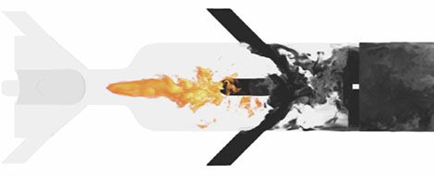


Tracking File Provenance with Parsl
Doug Friedel
National Center for Supercomputing Applications
University of Illinois at Urbana-Champaign

Slide 2
File Provenance
What is file provenance?
When a file was created
How a file was created
By what function
What input arguments were used
What environment was used (e.g. conda packages, env vars)
What other functions used the file
File provenance gives you the information needed to recreate the file exactly, and to know the entire history of a file within a workflow.

Slide 3
What Use is File Provenance?
Take an example:
You have a workflow
Dozens of tasks
Maybe it loops in time steps
It produces numerous files
You want to run it many times with different parameters
When looking at the results you want to know how a specific file was produced.
If you kept meticulous notes you could probably figure it out, but that is a lot of work.
This is were file provenance comes into play.

Slide 4
File Provenance Tracking in Parsl
How do we track file provenance?
Utilized Parsl’s existing monitoring framework to:
Identify files that were used as inputs and/or outputs
Capture information (size, timestamps, etc.) about each file
Capture what task created the file
Capture what tasks used each file
Capture the input arguments to each task
Capture the Parsl execution environment (e.g. worker_init from Provider)
The existing Parsl monitoring visualization tool was modified to be able to view the provenance information via a web interface.

Slide 5
Using File Provenance
Using file provenance is straight forward
Just add to your config
from parsl.monitoring.monitoring import MonitoringHub
config = Config(executors=[...],
Monitoring = MonitoringHub(hub_address=address_by_hostname(),
hub_port=55055,
monitoring_debug=True,
resource_monitoring_enabled=True,
resource_monitoring_interval=1,
capture_file_provenance=True
)
)

Slide 6
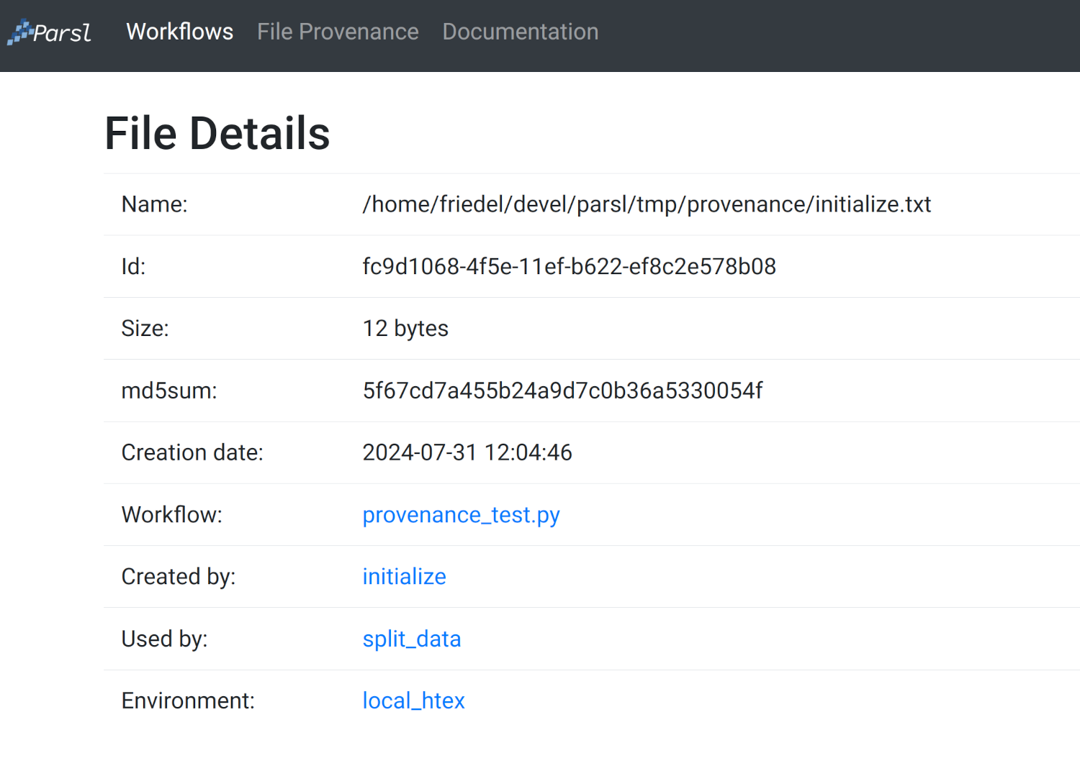
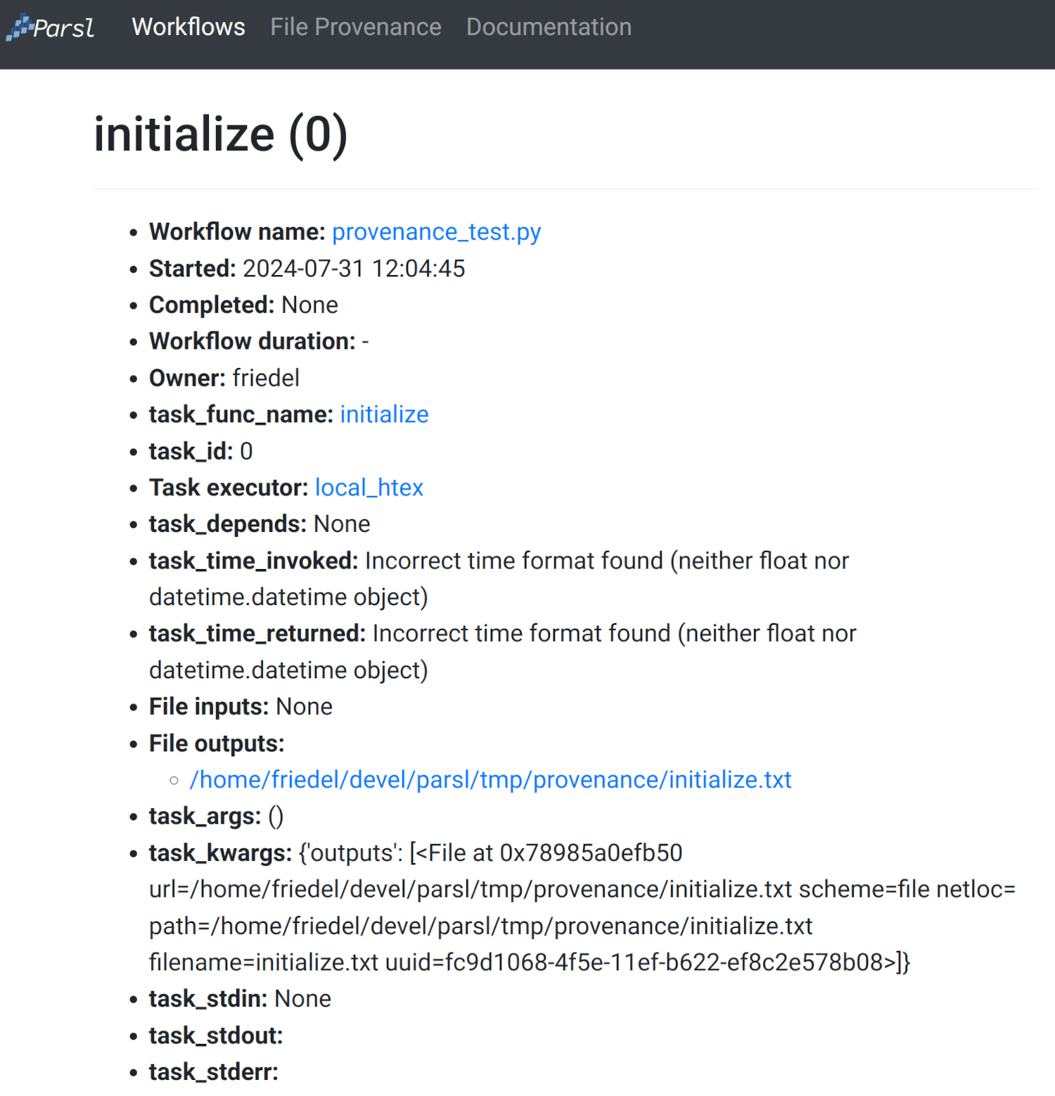
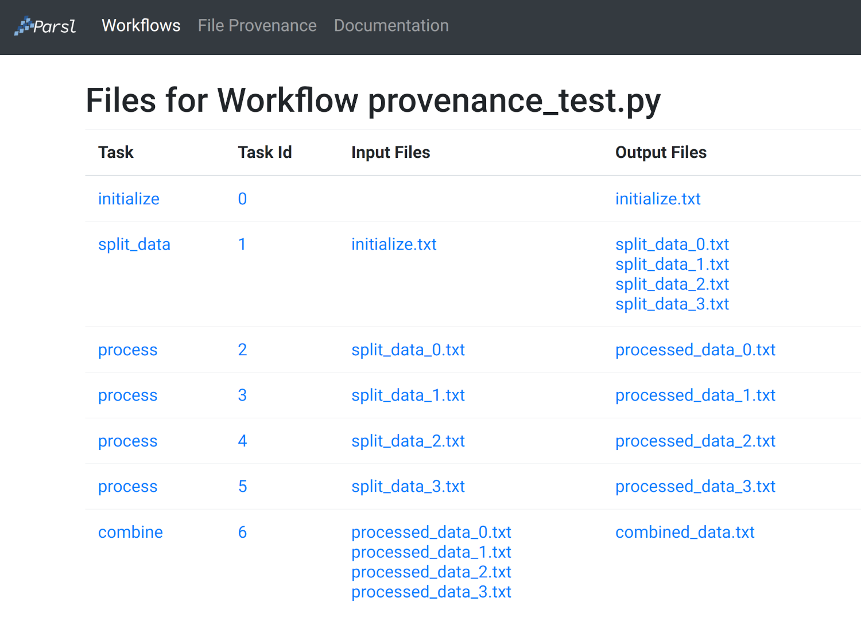
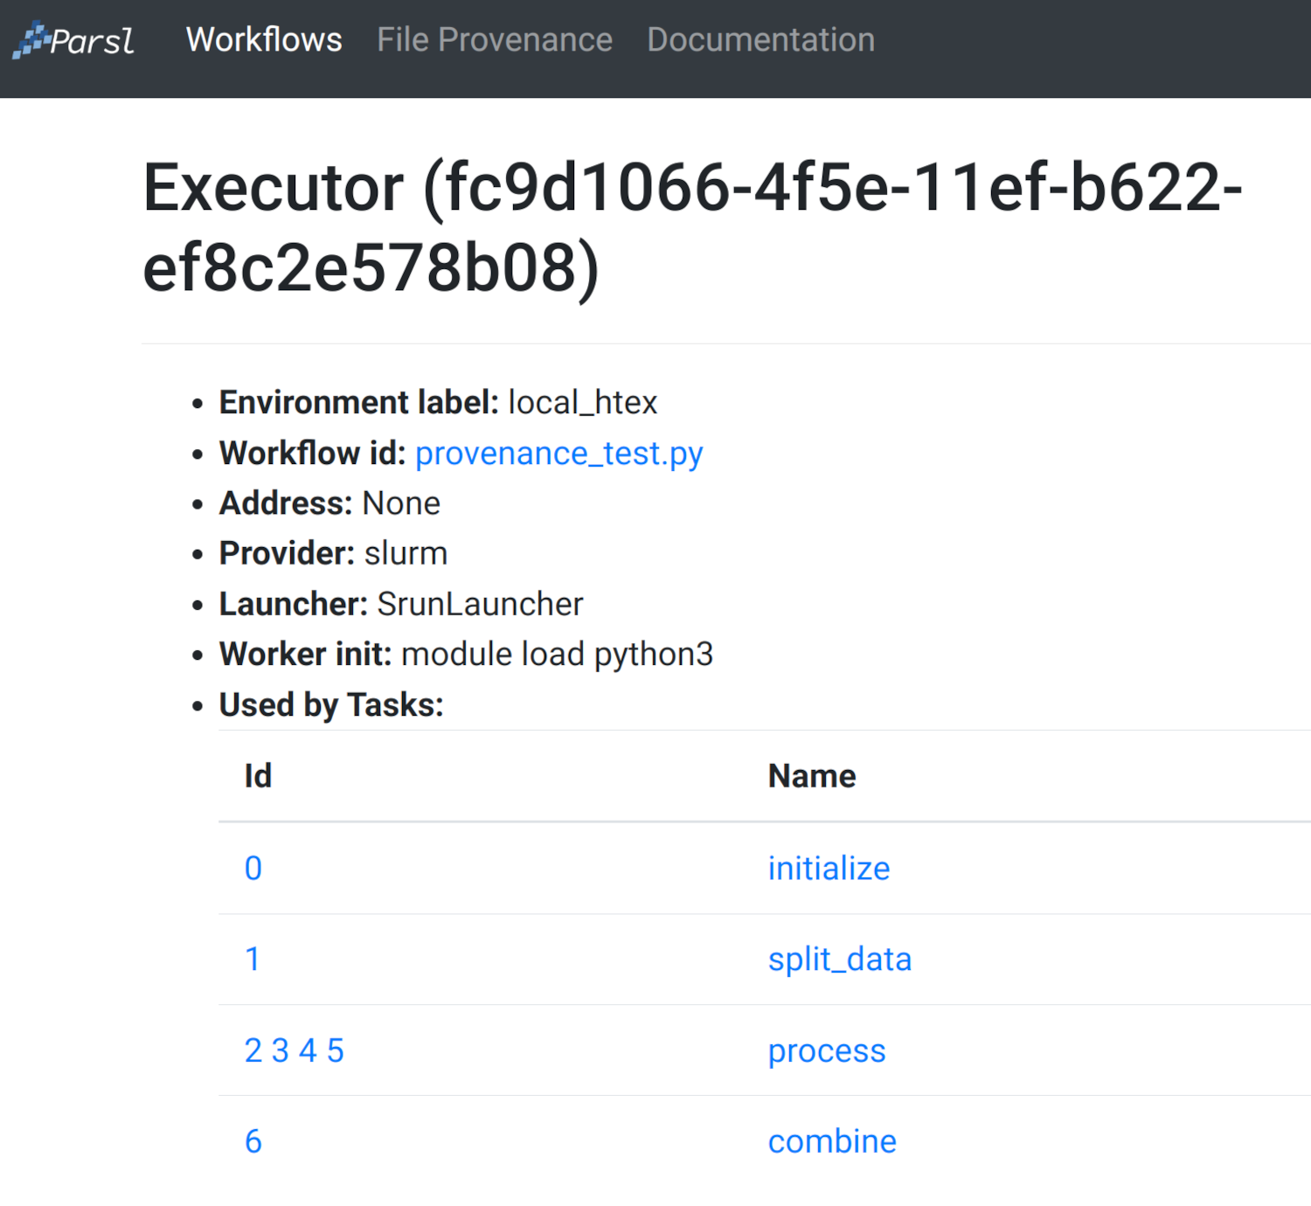
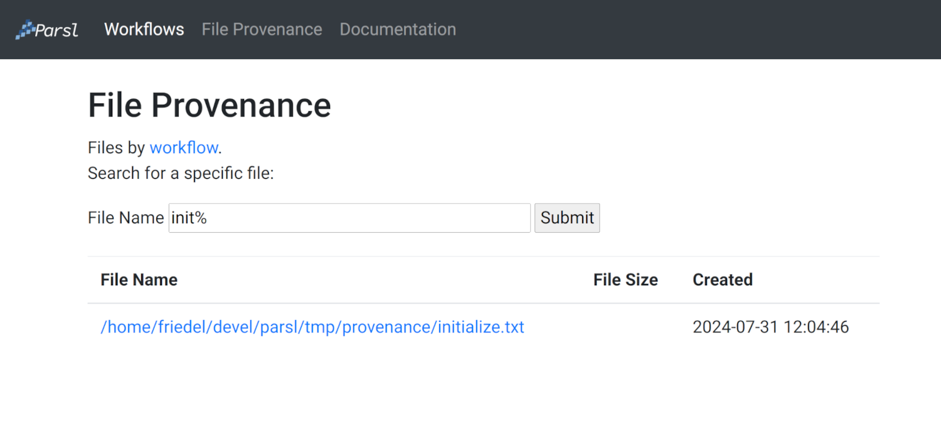
Visualizing the Data
Visualizing the output of the file provenance tracking is straight forward
It is incorporated in the parsl-visualize script from the monitoring framework

Slide 7
Dynamically Created Files
One issue we came across are dynamically created files
A File which is created in an App and appended to the outputs
This often happens when you don’t know how many files an App will produce
Unfortunately Parsl does not “know” about these files, they will not be transferred and cannot be used as inputs to another App
Our solution is the Dynamic File List
It acts just like a list, but is also a Future
It updates the Dataflow Kernel about new files
Allows for Apps to rely on files that have no references at run time

Slide 8
Dynamically Created Files
An example
@python_app def produce(outputs=[]): def analyze(i): f = File(f'file://path/to/file{i}.log}') with open(f.filepath, 'w') as out: # do some kind of anaylsis return f count = int(random() * 10) fl = File(f'file://path/to/master.log') outputs.append(fl) with open(fl.filepath, 'w') as log: log.write(f'Producing {count} files\n') for i in range(count): log.write(f"Running analysis {i}\n") outputs.append(analyze(i)) @python_app def consume(inputs=[]): for i in range(len(inputs)): with open(inputs[i].filepath, 'r') as inp: content = inp.read() # do something with the log content outp = [] f = produce(outp) r = consume(inputs=[outp[1:]]) r.result()
@python_app def produce(outputs=[]): def analyze(i): f = File(f'file://path/to/file{i}.log}') with open(f.filepath, 'w') as out: # do some kind of anaylsis return f count = int(random() * 10) fl = File(f'file://path/to/master.log') outputs.append(fl) with open(fl.filepath, 'w') as log: log.write(f'Producing {count} files\n') for i in range(count): log.write(f"Running analysis {i}\n") outputs.append(analyze(i)) @python_app def consume(inputs=[]): for i in range(len(inputs)): with open(inputs[i].filepath, 'r') as inp: content = inp.read() # do something with the log content dfl = DynamicFileList() f = produce(dfl) r = consume(inputs=[dfl[1:]]) r.result()

Slide 9
Questions?
This material is based in part upon work supported by the Department of Energy, National Nuclear Security Administration, under Award Number DE-NA0003963.

