Slide 1
CWL Workflow Generator for Parsl workflows
Mentor: Daniel S. Katz
Spin intern: Yuhang ren

Slide 2
What’s Workflow: A set of dependent programs
Echo1
.sh with one input
Echo2
.sh with multiple inputs
Untar
Command with multiple outputs
Concat
Command with multiple inputs
Concat
Command with multiple inputs
Concat
Command with multiple inputs
Result

Slide 3
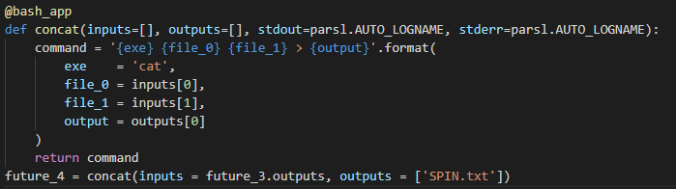
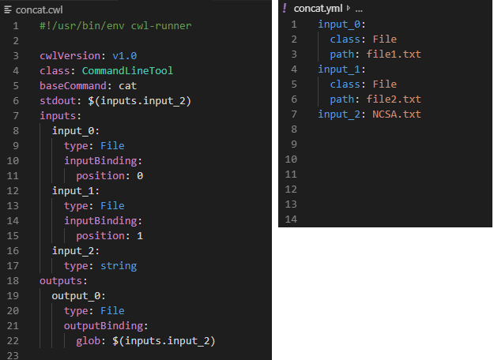
Parsl and CWL: Different language, shared purpose

Slide 4
My job: Parsl-to-CWL Workflow Generator
Parsl
Workflow
My
Generator
CWL
Workflow
Monitor
Data

