Slide 1

Modelling spatiotemporal soil moisture in Pallas
University of Oulu

Slide 2
Main idea
Model spatiotemporal dynamics of soil moisture in subarctic catchment (Pallas)
with Spatial Forest Hydrology (SpaFHy) model
Add new SpaFHy configuration with lateral groundwater flow
developed by Kersti
Check modelling results with available observations in Pallas
Q, ET, θ
Compare model configurations (with and without lateral flow etc.)
soil moisture point of view
spatial and temporal
Compare modelling results with SAR-based soil moisture estimates
developed by Manninen et al. 2021
University of Oulu

Slide 3
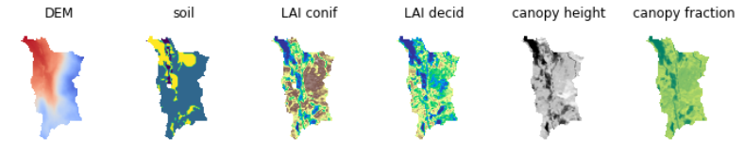
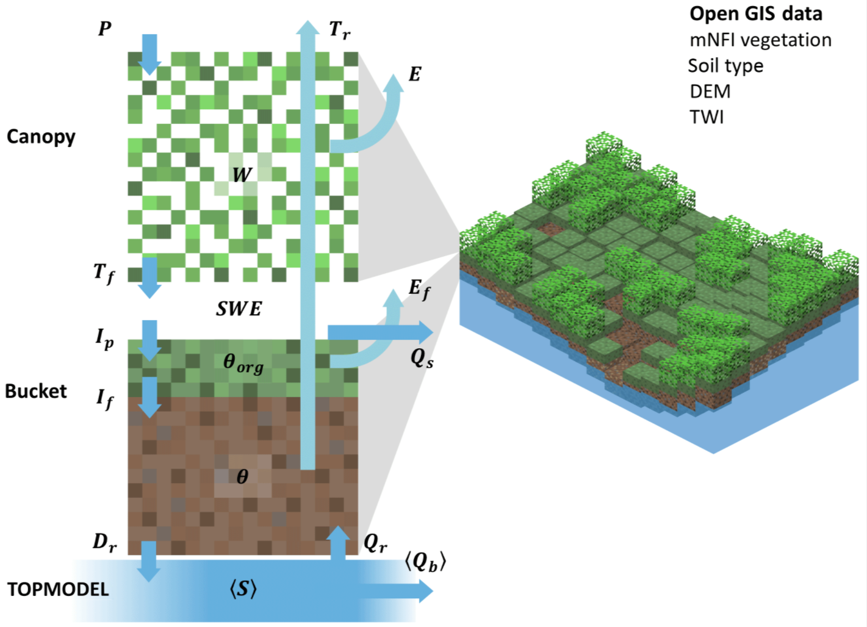
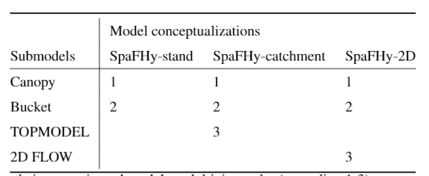

Model description(s)
DEM, soil and canopy parameters from open-access GIS raster arrays
Meteorological forcing data
time | UTC | ID | T | P | hpa | RH | Rglob | T sum
1.1.2019 | 0 | 1 | -11.0 | 2.0 | 996.5 | 90.5 | 0.1 | 0
2.1.2019 | 0 | 1 | -7.5 | 0.0 | 1019.9 | 89.1 | 0.2 | 0
3.1.2019 | 0 | 1 | -4.0 | 7.8 | 1015.1 | 89.6 | 0.1 | 0
4.1.2019 | 0 | 1 | -2.1 | 0.0 | 1010.6 | 94.0 | 0.3 | 0
5.1.2019 | 0 | 1 | 2.1 | 0.0 | 1016.8 | 94.2 | 0.3 | 0
6.1.2019 | 0 | 1 | -0.7 | 0.0 | 1008.5 | 95.0 | 0.1 | 0
7.1.2019 | 0 | 1 | -3.9 | 0.0 | 1000.8 | 84.3 | 0.4 | 0
8.1.2019 | 0 | 1 | -6.7 | 0.0 | 997.2 | 85.1 | 0.2 | 0
Spatial Forest Hydrology model (SpaFHy, Launiainen et al. 2019)
Canopy module
Hydrology in vegetation and snowpack
ET with PM equation (evaporation from canopy and forest floor and transpiration)
Snowmelt with degree-day approach
Bucket module
Moss/litter layer (interception storage)
Soil moisture between field capacity and residual water content
Rootzone layer
Porosity defines maximum water content
Drainage from rootzone when soil moisture > field capacity
GW modules
NO GW (stand)
Drainage from bucket treated as runoff
TOPMODEL (catch)
Topography based return flow and baseflow
2D GW FLOW (2D)
NO GW /
TOPMODEL /
2D GW FLOW
University of Oulu

Slide 4
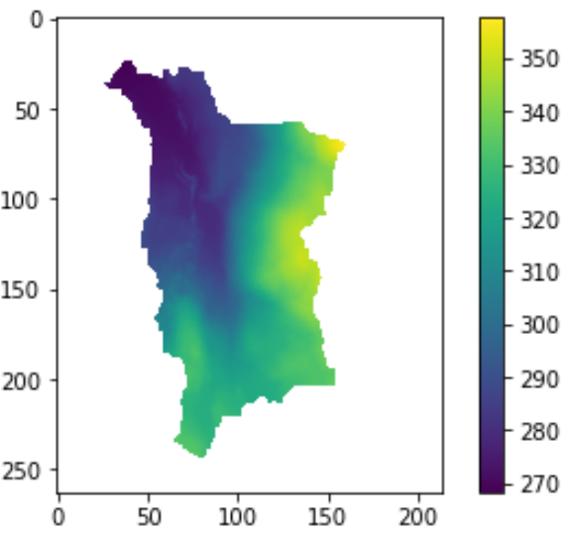
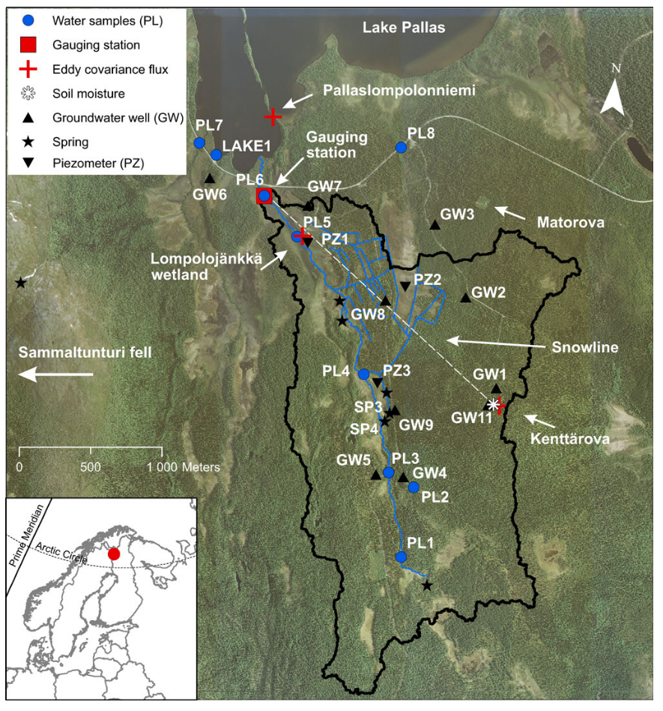
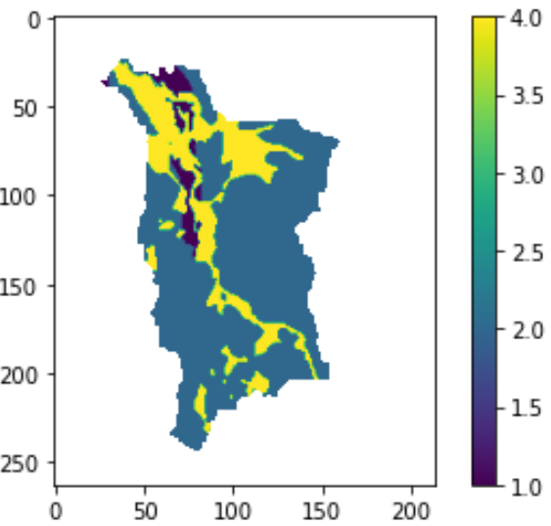
Site description
Pallas catchment
Area: ~4.5km2
Altitude: 268-364m
Climate
subarctic with persistent snow cover
Land use
mostly pristine (some manmade ditches)
Soil types
mainly gravely sand and sandy tills
Vegetation
coniferous forests, treed mires
and open mires
University of Oulu

Slide 5
Model sensibility check:
Annual water balance
SWE and runoff
ET
University of Oulu

Slide 6
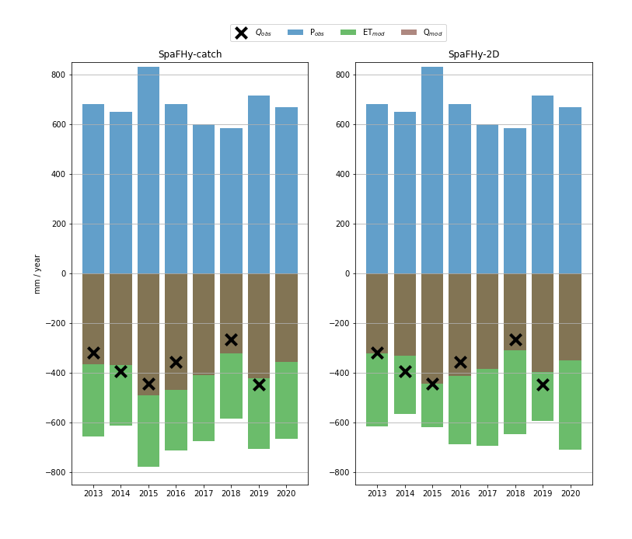
Annual partitioning of water balance
IN:
PRECIPITATION
OUT:
RUNOFF
EVAPOTRANSPIRATION
OBS RUNOFF
STAND: NO GW
CATCH: TOPOBASED GW
2D: GW FLOW EQ.
University of Oulu

Slide 7
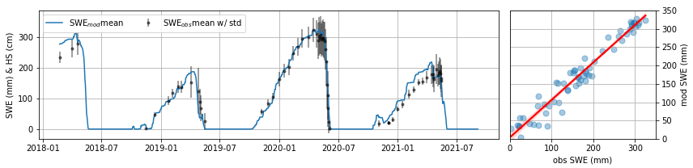
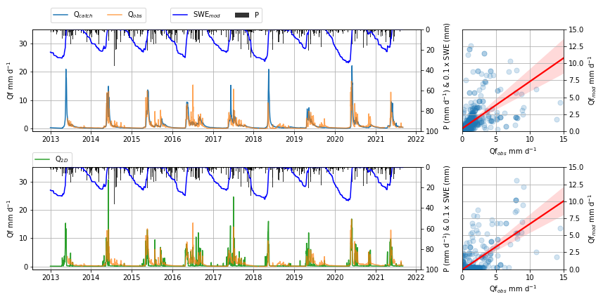
SWE and runoff
Modelled by canopy submodule
(= same in all configurations)
SpaFHy-catch
(=TOPMODEL)
SpaFHy-2D
(=2D flow)
University of Oulu

Slide 8
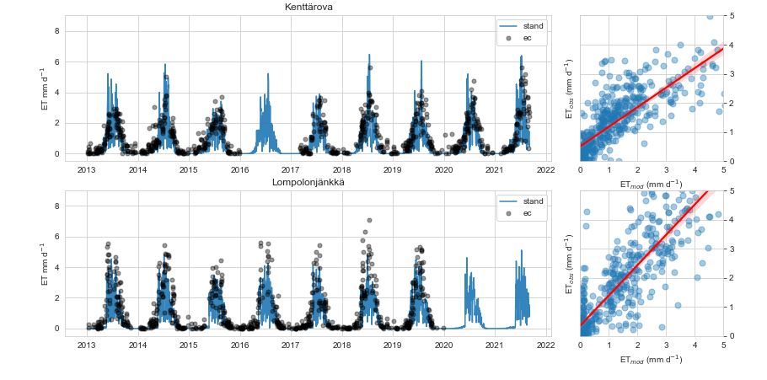
ET: point measurements vs. model simulations
University of Oulu

Slide 9
Results: Soil moisture
Temporal patterns
Spatial patterns
University of Oulu

Slide 10
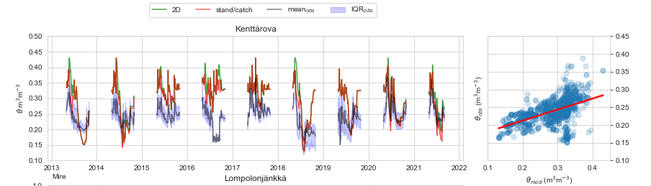
Temporal soil moisture:
point measurements vs. model simulations
Model
Poros = 0.43
Fc = 0.33
STAND: NO GW
CATCH: TOPOBASED GW
2D: GW FLOW EQ.
University of Oulu

Slide 11
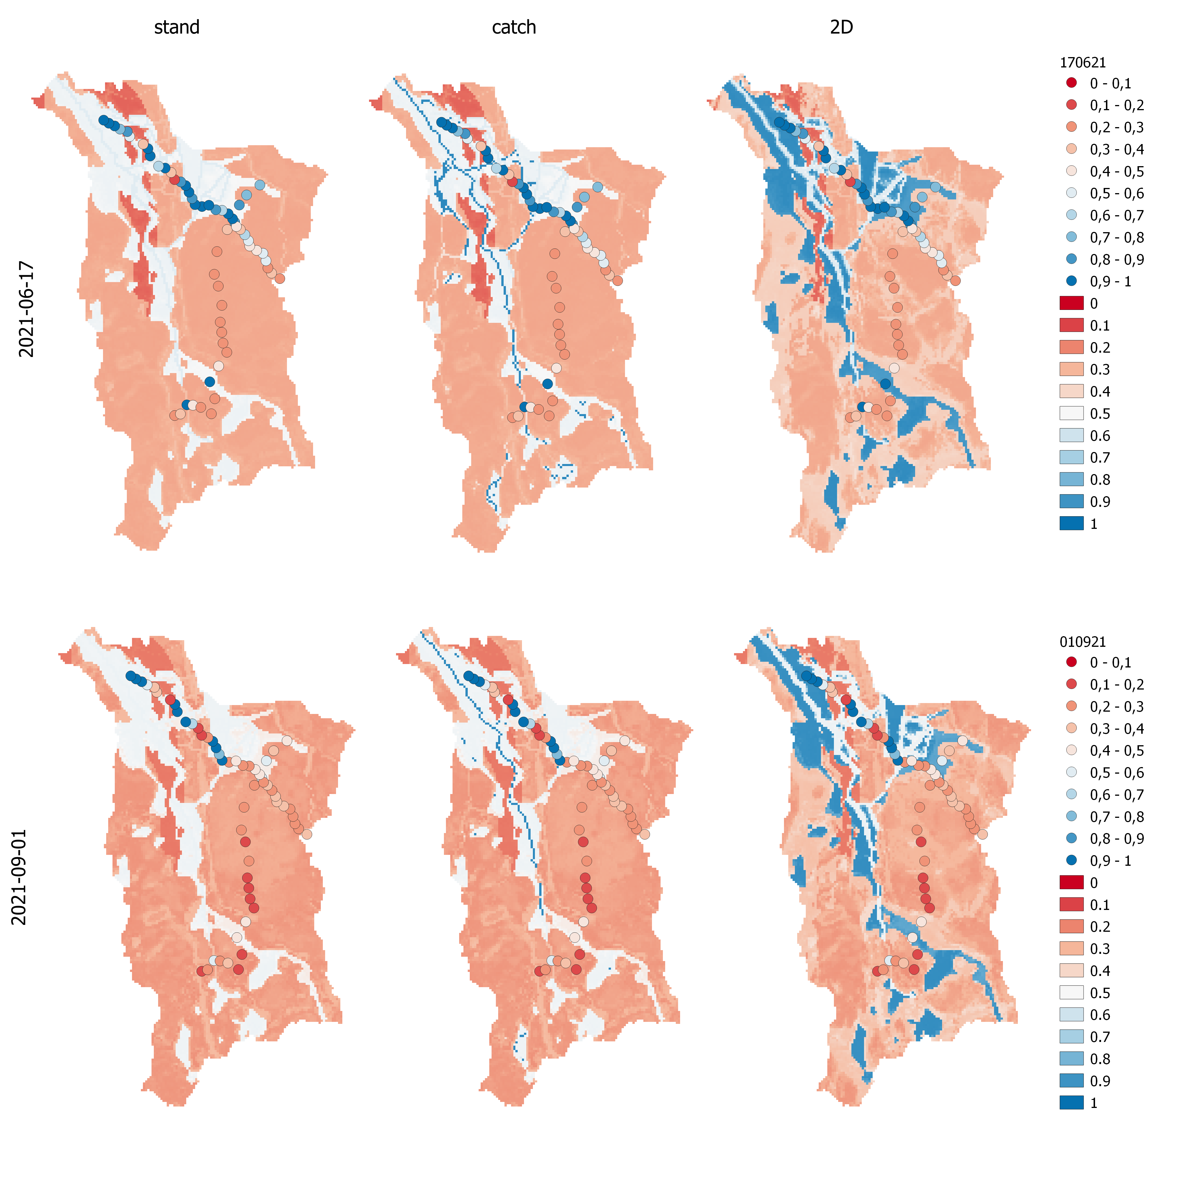
Spatial soil moisture:
distributed measurements vs. model simulations (17th JUNE 2021 ~wet)
3 SOIL TYPES
+ GW IMPACTED CELLS
3 SOIL TYPES
+ LOWLAND CELLS
3 SOIL TYPES
OBS
MOD
STAND: NO GW
CATCH: TOPOBASED GW
2D: GW FLOW EQ.
→ In these conditions, 2D flow seems necessary
University of Oulu

Slide 12
Spatial soil moisture:
distributed measurements vs. model simulations (1st SEPT 2021 ~dry)
Open mire is still saturated
Dried
Parts of the forest area
have dried
Dried
STAND: NO GW
CATCH: TOPOBASED GW
2D: GW FLOW EQ.
→ In these conditions, 2D flow is not as necessary, yet useful in some locations.
University of Oulu

Slide 13
Differences between model configurations
Temporal patterns
Spatial patterns
University of Oulu

Slide 14
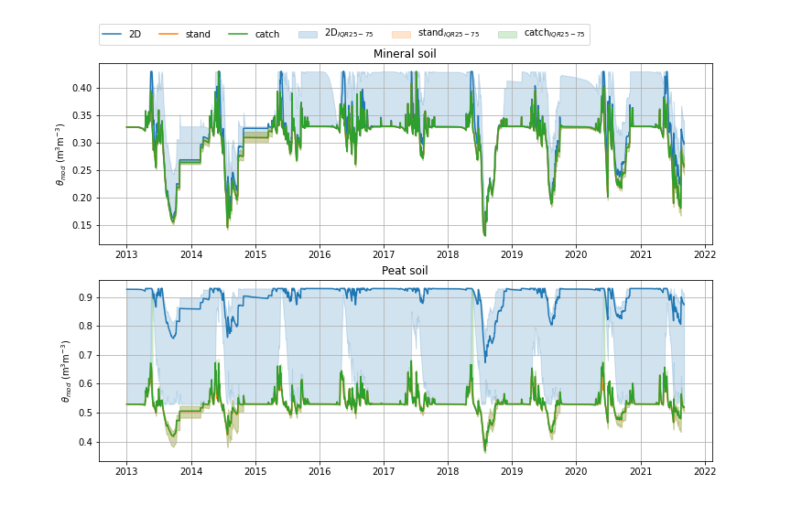
Temporal differences between model configurations
MINERAL SOILS
Medians: No large differences between models (only during very wet conditions)
IQR: big variation with 2D model
cells with GW influence
Model
Poros = 0.43
Fc = 0.33
Model
Poros = 0.93
Fc = 0.53
PEAT SOILS
Medians: LARGE difference for 2D (often GW influence)
IQR: big variation with 2D model
→ also cells without GW influence
STAND: NO GW
CATCH: TOPOBASED GW
2D: GW FLOW EQ.
University of Oulu

Slide 15
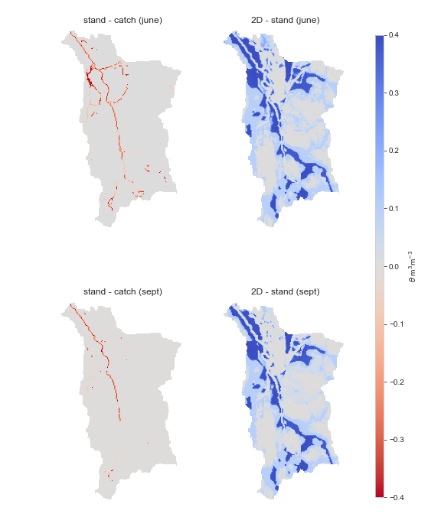
Spatial differences between model configurations
2D – STAND (2021-06-17)
Peatlands and depressions stand out
STAND – CATCH (2021-06-17)
Mostly no difference
Differences only in very high accumulation cells (streams, ditches..)
2D – STAND (2021-09-01)
Peatlands and depressions stand out(slightly less in dry conditions)
STAND – CATCH (2021-09-01)
Same as above but even less differences
STAND: NO GW
CATCH: TOPOBASED GW
2D: GW FLOW EQ.
University of Oulu

Slide 16
Spatiotemporal differences
Spatial efficiency metrics
(pearson correlation,
histogram match,
coefficient of variation)
University of Oulu

Slide 17
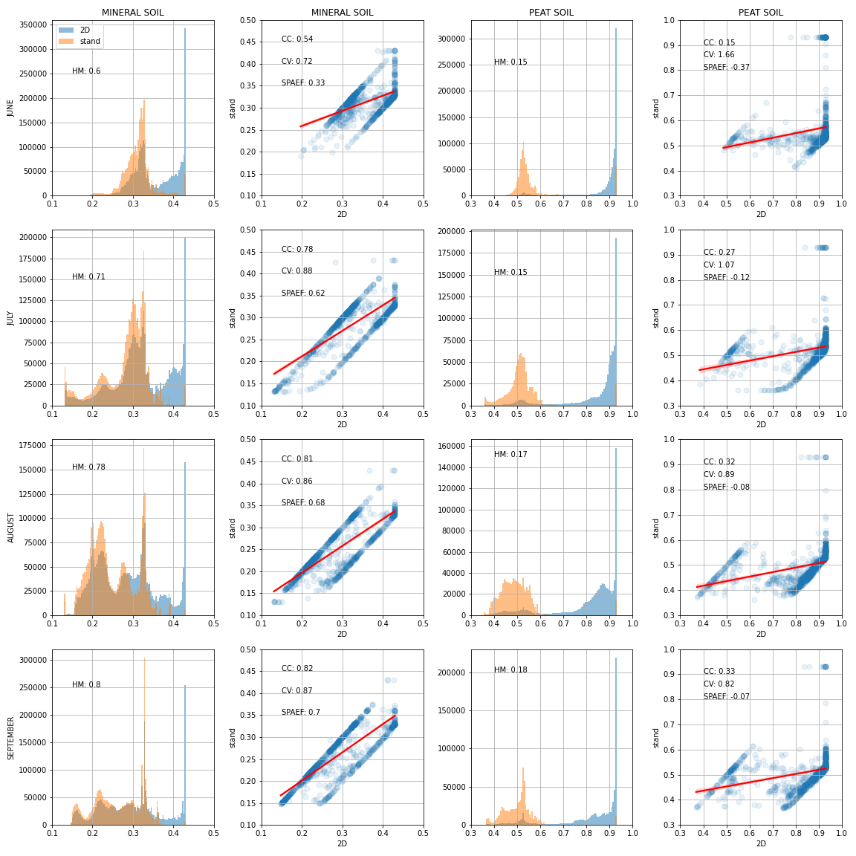
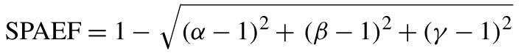
Spatiotemporal analysis with SPAEF
LESS SIMILARITY
SPAEF = Spatial Efficiency Metric
(Demirel et al. 2018)
HM = Proportion of the matching area in histograms (gamma)
CC = Pearson correlation coefficient (alpha)
CV = Coefficient of variations (beta)
Note scatterplot patterns:
One line where stand = 2D
One line where 2D > stand
Points in between
STAND: NO GW
CATCH: TOPOBASED GW
2D: GW FLOW EQ.
MORE SIMILARITY
University of Oulu
LESS SIMILARITY

Slide 18
SpaFHy 2D and SAR-based estimates
(preliminary comparisons, need to check with Terhikki)
Temporal
Spatial
Spatial efficiency metric
University of Oulu

Slide 19
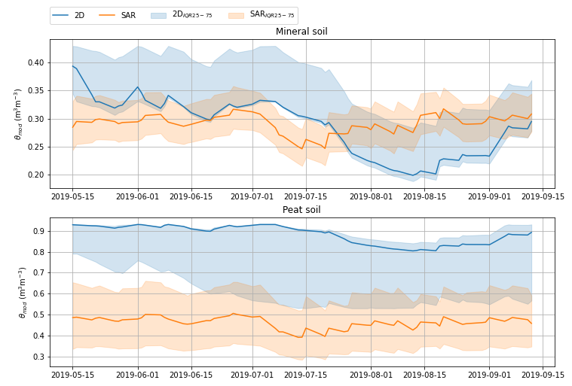
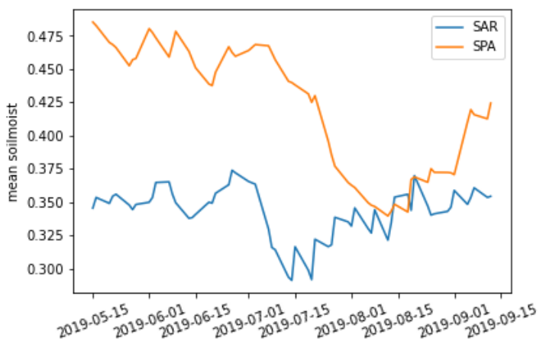
Temporal SpaFHy-2D vs. SAR
Model
Poros = 0.43
Fc = 0.33
Model
Poros = 0.93
Fc = 0.53
Ranges completely different
University of Oulu

Slide 20
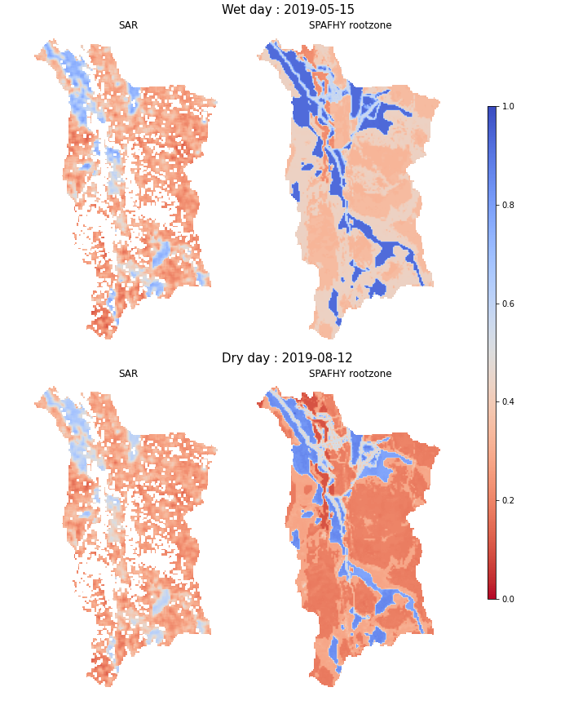
Spatial absolute values SAR vs. SpaFHy-2D
Some cells masked from SAR maps due to insufficient training data
University of Oulu

Slide 21
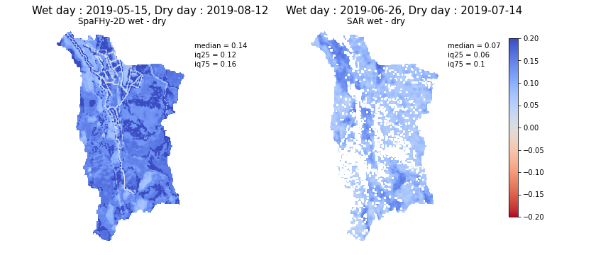
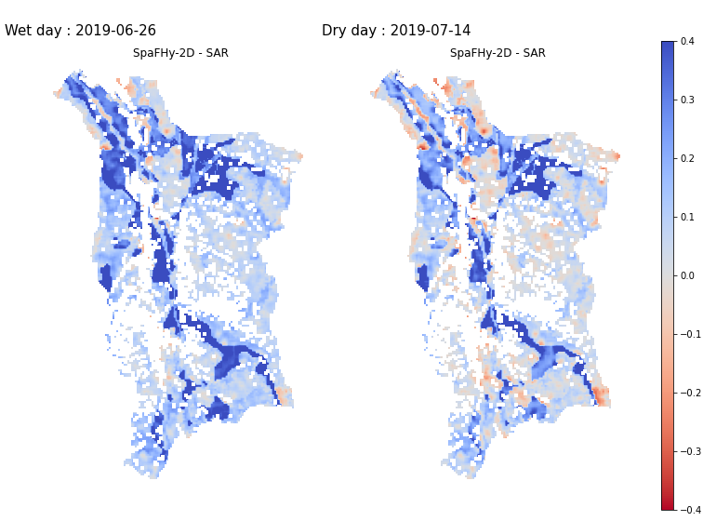
Anomalies
Absolute differences between wet and dry predictions
Challenging to
compare because
dry in model is not necessary dry in SAR
University of Oulu
Wet and dry according to SAR

Slide 22
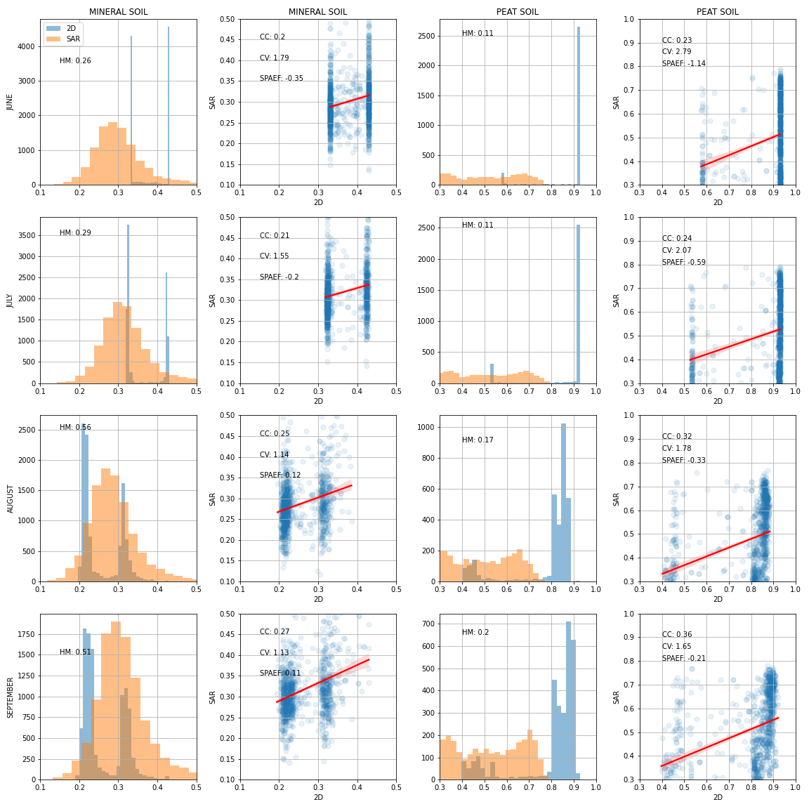
Spatiotemporal analysis with SPAEF
LESS SIMILARITY
SPAEF = Spatial Efficiency Metric
(Demirel et al. 2018)
HM = Proportion of the matching area in histograms (gamma)
CC = Pearson correlation coefficient (alpha)
CV = Coefficient of variations (beta)
Note patterns:
Model between field capacities and porosities
SAR follows normal distribution in mineral soil
SAR distribution in peatlands
MORE SIMILARITY
University of Oulu
LESS SIMILARITY

Slide 23
Thank you!
Questions?
University of Oulu

