Slide 1

Natural Language Meets Database: System Transparency and User Understanding in NL-to-SQL Translation
Parssa Jashnieh, Jacob Ortenberg, Thivyan Sivananthan

Slide 2
Have you ever had difficulties with search queries on Amazon or similar platforms when looking for products? If you did, what did this result in?
Many difficulties when searching for specific products, i.e., technical products
Switch to another platform (eBay -> Amazon)

Slide 3
Have you ever had difficulties with search queries on Amazon or similar platforms when looking for products? If you did, what did this result in?
Many difficulties when searching for specific products, i.e., technical products
Switch to another platform (eBay -> Amazon)
Where could these difficulties come from?
Search behavior is individual
~ 50/50 generic vs. specific search behavior

Slide 4
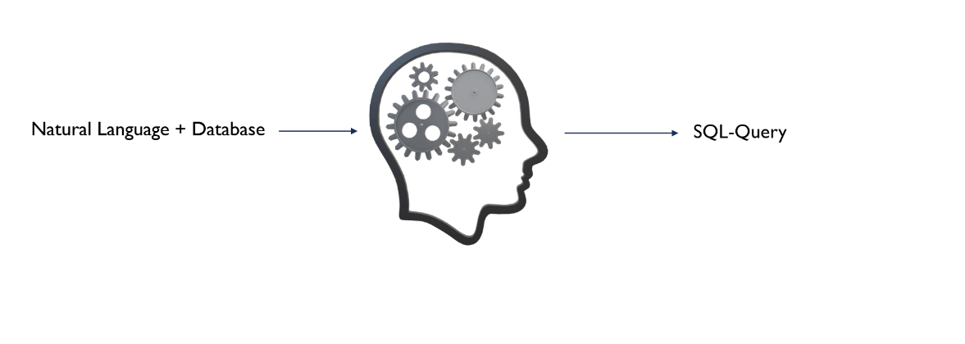
Motivation

Slide 5
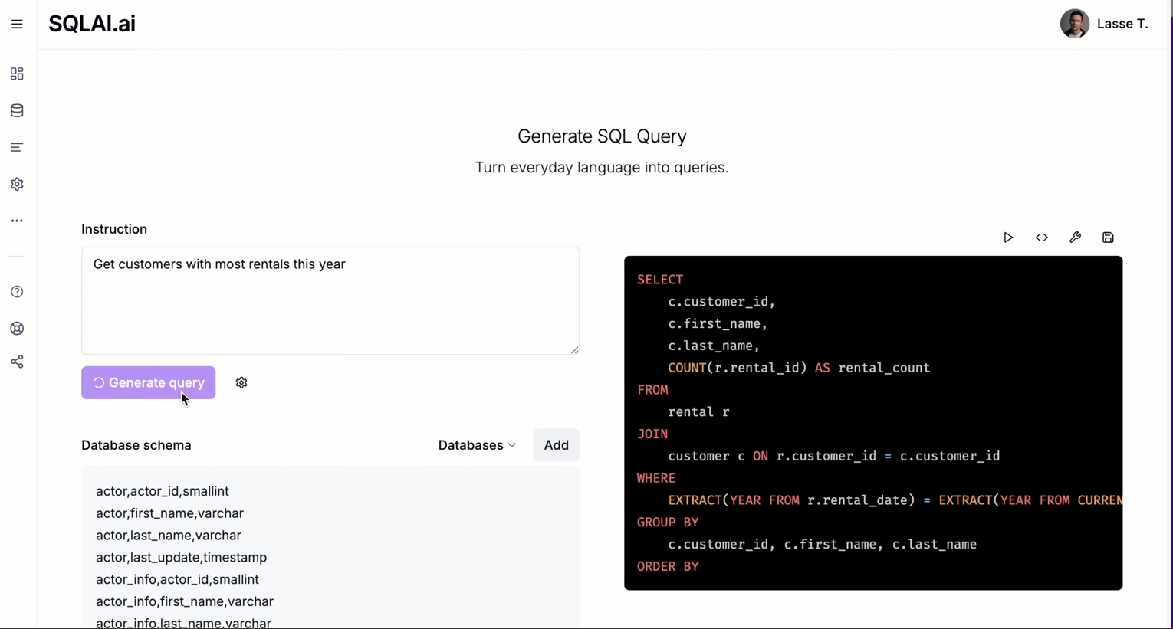

Slide 6
Developer Tool

Slide 7
Developer Tool
OUR GOAL:Better search results for Websites

Slide 8
Trial & Error
Local model + DAIL-Schema
Limited computational resources

Slide 9
Trial & Error
Local model + DAIL-Schema
Limited computational resources
Switch to Claude-API
Accuracy high enough for our project -> DAIL-Schema

Slide 10

Demo-Time

Slide 12
Possible filter bias
Notes:
Filter nicht benutzt bei statischen template
Gelb neutral tauschen
0%

Slide 15


Results
To narrow down the search results, did you use the filters or did you alter the search query more often?
Expectation: 50/50

Slide 16
Results
To narrow down the search results, did you use the filters or did you alter the search query more often?
Expectation: 50/50
Reality:
More complex
Some people still prefer the filters
Many switch entirely to AI (after trying many queries -> trust)
Some used 50/50

Slide 17
Results
Possible correction mechanisms
Highlight implicit used filter visually
Highlight features in search queries that would result in an empty set visually

Slide 18
Results
Possible correction mechanisms
Highlight implicit used filter visually
Highlight features in search queries that would result in an empty set visually
When too few search results are found, append similar results
Pop-up if the search query generates by the AI, has high uncertainty
Auto suggestions to the query

Slide 19

Closing question: Would you recommend this system to others?
Hit or miss?

Slide 20
Closing question: Would you recommend this system to others?
HIT!!!

Slide 21

Thank you for your Attention

