Slide 1

SQI: Search-Query-Interpreter
Parssa Jashnieh, Jacob Ortenberg, Thivyan Sivananthan

Slide 2
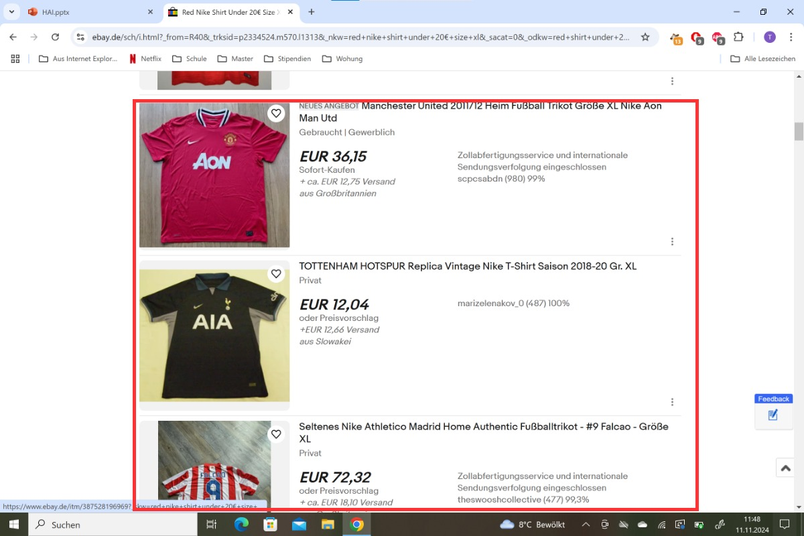
Problem
Livedemo

Slide 3
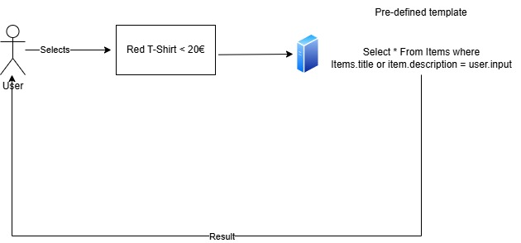
State of the Art
User searches for a product
Must use checkboxes to search specifically for products
Pre-defined template

Slide 4
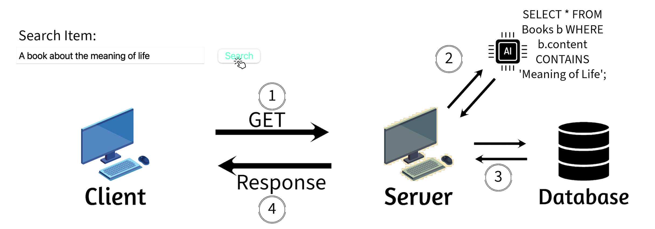
Idea
1: User enters an input only via the textbox
2: SQI outputs an sql query generated by an LLM
3: Use this query to filter correctly in the database
4: Display result to user

Slide 5
Focus of our project
instead of using already defined templates we want to create sql queries dynamically with ML and identify users needs/feedback with regards to such an AI-System
Notes:
Privacy preserving AI
Mehr vorheben

Slide 6
Focus of our project
instead of using already defined templates we want to create sql queries dynamically with ML and identify users needs/feedback with regards to such an AI-System
Applicable on real-world problems
Notes:
Privacy preserving AI
Mehr vorheben

Slide 7
Focus of our project
instead of using already defined templates we want to create sql queries dynamically with ML and identify users needs/feedback with regards to such an AI-System
Applicable on real-world problems
Privacy preserving AI
Nothing prevents the user from obtaining confidential information such as passwords, email addresses or other criteria
Like SQL injections, but even worse, because it can now be done by users with no knowledge of SQL at all
Never disclose confidential data
should not generate sql like the "select username, password from customer"
Notes:
Privacy preserving AI
Mehr vorheben

Slide 8
Spider dataset
requires the model to generalise better
various domains -> hence, the name "spider"
beats WikiSQL or other SQL datasets
More databases
Covers a wider range of domains
Notes:
beats WikiSQL or other SQL datasets etwas schwammig besser erkläre wo ist es besser

Slide 9
Natural Language Meets Database: System Transparency and User Understanding in NL-to-SQL Translation
Problem Statement
Create SQL-queries dynamically with machine learning to replace conventional template systems
Understanding user requirements and feedback
Enhancing AI system effectiveness
Improving overall user experience
https://arxiv.org/pdf/2308.15363
Notes:
Our innovative approach leverages machine learning to generate dynamic SQL queries, moving beyond conventional template-based systems. The project focuses on

Slide 10
Natural Language Meets Database: System Transparency and User Understanding in NL-to-SQL Translation
Problem Statement
Create SQL-queries dynamically with machine learning to replace conventional template systems
Understanding user requirements and feedback
Enhancing AI system effectiveness
Improving overall user experience
Related Work
Top performing Text-To-SQL: Alibaba Group
https://arxiv.org/pdf/2308.15363
Notes:
Our innovative approach leverages machine learning to generate dynamic SQL queries, moving beyond conventional template-based systems. The project focuses on

Slide 11
Natural Language Meets Database: System Transparency and User Understanding in NL-to-SQL Translation
Research Questions
Characteristics of typical user natural language queries to SQL
Common mismatches between user intent and SQL queries
Adapt SQL queries to user intent
Communicate system limitations to users
Provide understandable privacy restriction feedback
https://arxiv.org/pdf/2308.15363
Notes:
Our innovative approach leverages machine learning to generate dynamic SQL queries, moving beyond conventional template-based systems. The project focuses on
What characterizes typical user queries in natural language to SQL systems?
What are common mismatches between user intent and generated SQL queries?
How do users prefer to correct SQL queries when they don't match their intentions?
What are effective ways to communicate system limitations to users?
How can privacy restrictions be effectively communicated in natural language responses?
stichpunkte

Slide 12
Natural Language Meets Database: System Transparency and User Understanding in NL-to-SQL Translation
Expected Outcome
Insights into effective user-AI communication patterns
Integrate users feedback into interface
UI that users genuinely appreciate
https://arxiv.org/pdf/2308.15363
Notes:
Development of an AI system with enhanced accuracy and user-friendly interface
Implementation of comprehensive user surveys for feedback collection
Integration of user feedback into interface design
Pitfalls in real world environments with such an AI
Pfeil zu Ai

Slide 13
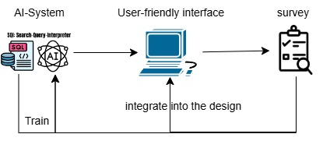
Natural Language Meets Database: System Transparency and User Understanding in NL-to-SQL Translation
Expected Outcome
Insights into effective user-AI communication patterns
Integrate users feedback into interface
UI that users genuinely appreciate
Methodology
https://arxiv.org/pdf/2308.15363
Notes:
Development of an AI system with enhanced accuracy and user-friendly interface
Implementation of comprehensive user surveys for feedback collection
Integration of user feedback into interface design
Pitfalls in real world environments with such an AI
Pfeil zu Ai

Slide 14

Thank you For your Attention

