Slide 1
DIGITAL
INDIA
Power to Empower

Slide 2
TABLE OF CONTENT
Introduction
Key Initiatives Under Digital India
01
02
Overview of Digital India and its objectives
Nine foundational pillars of the programme
Digital India Programme Pillars
Impact & Benefits
03
04
Overview of Digital India and its objectives
Long-term goals for a digitally empowered society
Vision of Digital India
Challenges & Future Trends
05
06
Major schemes and platforms driving digital transformation
Key achievements and socio-economic outcomes

Slide 3
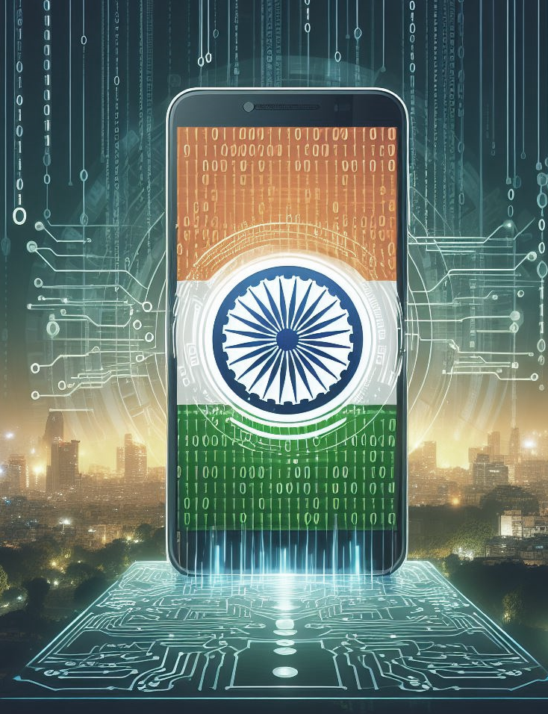
INTRODUCTION
Digital India is a flagship program launched by the Indian government to harness the power of digital technologies for comprehensive development. It envisions providing digital infrastructure, e-governance services, and digital literacy to all citizens, aiming to bridge the digital divide and promote socio-economic inclusivity and empowerment across the nation.

Slide 4
KEY INITIATIVES UNDER DIGITAL INDIA
Bharat Net
Digital Locker
E-hospital
Connecting Rural India
A Secure Platform for Document Storage
Digitalizing Healthcare Services
Aadhaar
My Gov
Bharat Bill Payment System
India's Unique Identification System
Citizen
Engagement Platform
Unified
Payment Interface

Slide 5
DIGITAL INDIA PROGRAMME PILLARS
01
03
05
07
09
Broadband Highways
Public Internet Access Program
e-Kranti (Electronic Delivery of Services)
Electronics Manufacturing
Early Harvest Programmes
02
04
06
08
Universal Access to Mobile Connectivity
e-Governance
Information
for All
IT
for Jobs

Slide 6
VISION OF DIGITAL INDIA
Infrastructure Development
Expansion of high-speed internet, data centers, and digital public infrastructure nationwide.
Digital Empowerment
Empowering citizens through digital literacy, online services, and easy access to information.
The vision of Digital India encompasses a technologically empowered nation where access to digital services is universal, bridging the urban-rural divide. It aims to foster innovation, economic growth, and inclusive development through digital empowerment across sectors.
Innovation & Entrepreneurship
Encouraging startups, technology adoption, and innovation-driven economic development.
Digital Economy
Promoting cashless transactions, e-commerce, and a strong digital marketplace.

Slide 7
IMPACT & BENEFITS
ONE
TWO
THREE
Socio-economic
Impact of Digital India
Empowerment
of Citizens & Communities
Job Creation
& Economic Growth
Boosting inclusion through access to digital services in urban and rural regions.
Enabling citizens to participate more effectively in governance and development.
Creating employment opportunities in IT, telecom, and digital service sectors.
FOUR
FIVE
Enhanced Efficiency & Transparency In Governance
Improved Access To
Services & Opportunities
Reducing delays and improving transparency through online government platforms.
Providing easier access to education, healthcare, banking, and welfare services.

Slide 8
CHALLENGES OF DIGITAL INDIA
01
Infrastructure
Upgrading and maintaining networks to support growing digital demand.
Digital Divide
02
Bridging gaps in internet access between rural and urban communities.
03
Cybersecurity
Protecting digital systems and user data from cyber threats and online fraud.
Digital Literacy
04
Improving digital skills so all citizens can confidently use online services.
05
Digital Infrastructure Maintenance
Ensuring reliable connectivity, servers, and technology infrastructure.

Slide 9
FUTURE TRENDS OF DIGITAL INDIA
Rise of Artificial Intelligence & Machine Learning
Blockchain
Integration
AI-driven solutions improving governance, healthcare, education, and industry.
Secure and transparent record management using blockchain technology.
Digital
Payments Revolution
Focus
on Cybersecurity
Continued growth of UPI and cashless transactions across India.
Advanced cybersecurity frameworks to safeguard digital infrastructure.

Slide 10
THANK YOU!
Digital India is transforming the nation through technology, connectivity, and citizen empowerment.

