Slide 1
PHM 2026 GEAR-TOOTH DEGRADATION — PROVISIONAL BASELINES
Two Models, Two Honest Negative Results
RT-DETR image damage detector & from-scratch PatchTST vibration regressor
Full performance, root-cause analysis, and what's inside the model blackbox
All targets are the provisional phm2026_image_damage_v2 pseudo-label — not organizer ground truth, not expert-reviewed.

Slide 2
ROADMAP
Two Pipelines, One Shared Ground Rule
1
RT-DETR — Image Detector
2
PatchTST — Vibration Regressor
Predicts: bounding boxes around candidate damage on post-run tooth photos Headline: mAP@0.50 = 0.0000831 on held-out EXP-F Verdict: correctly localizes damage, but regresses boxes ~7.4x too large — a scale problem, not a perception problem
Predicts: one scalar damage estimate from raw 102.4 kHz vibration spectra Headline: MAE 1.220 pp on held-out EXP-F (N=8 runs) Verdict: worse than a constant baseline and worse than the simpler LF-only model — 72 features overfit on 7 training runs
Shared ground rule: both reuse the same pinned T2.2 split (EXP-B train / EXP-A validation / EXP-F test, zero leakage) and the same provisional pseudo-label target — no split or label was invented for this analysis.
Provisional phm2026_image_damage_v2 pseudo-label — not organizer ground truth, not expert-reviewed.
1

Slide 3
1
PART 1
RT-DETR: Finding Damage in Photos
A genuine, fine-tuned Ultralytics RT-DETR-L detector — backbone, hybrid encoder, and decoder all trained — evaluated once on held-out EXP-F.

Slide 4
RT-DETR · THE TARGET
There Is No Organizer Damage Box — So What Are We Actually Scoring?
The PHM 2026 challenge archives ship no organizer damage boxes at all. Every box used here — for training and for scoring — is the provisional target phm2026_image_damage_v2: a deterministic heuristic mask built from CLAHE contrast normalization, background subtraction, a robust z-score threshold, and morphology — every parameter pinned in configs/experiments/phm2026_image_target.yaml, not invented for this analysis.
YOU CAN SAY
“The detector's raw guesses do or don't overlap with the heuristic's candidate regions.” — “This is engineering evidence the pipeline runs end-to-end.”
YOU CANNOT SAY
“The model correctly found spall damage.” — “This measures physical damage accuracy.” — “This pseudo-box standard is validated ground truth.”
Per T2_TARGET_FORMULATION_DECISION.md: a value becomes trustworthy only after a human reviews ROI acceptability, mask acceptability, and corrected values. That review has not happened yet.
Provisional phm2026_image_damage_v2 pseudo-label — not organizer ground truth, not expert-reviewed.
2

Slide 5
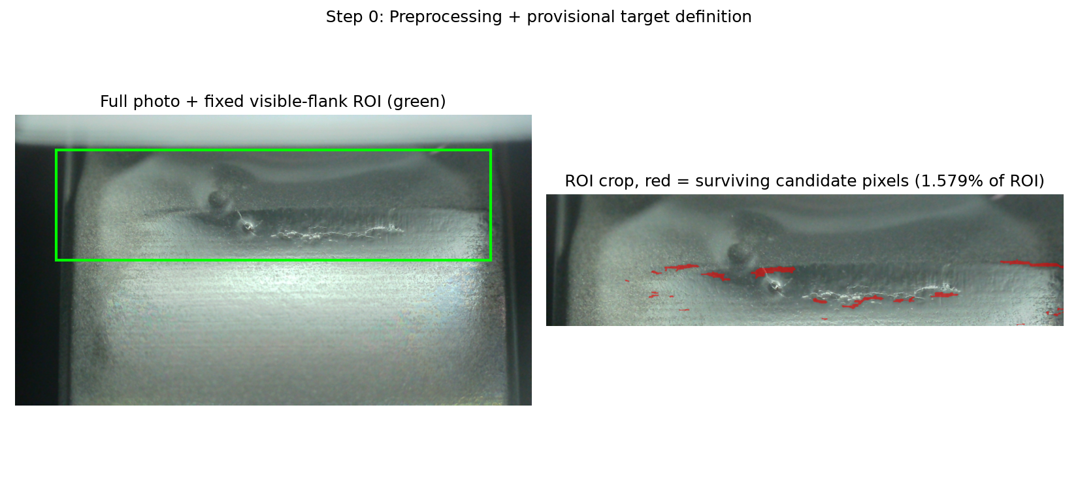
RT-DETR · DATA FLOW
How a Raw Photo Becomes a Training Box
1
2
3
Crop + Normalize
Isolate the Residual
Clean + Box
Crop a fixed “visible flank” ROI — the same normalized box on every photo — then even out brightness with CLAHE, so a dark tooth and a bright tooth are judged on the same scale.
Subtract a smooth Gaussian-blur background estimate, convert to a robust z-score (median + MAD, so outlier pixels can't skew it), and threshold.
Morphological open/close cleans the mask; only wide, flat (“horizontal”) blobs are kept — real spall reads as a streak, not a dot — and boxed as damage_candidate.
Provisional phm2026_image_damage_v2 pseudo-label — not organizer ground truth, not expert-reviewed.
3

Slide 6
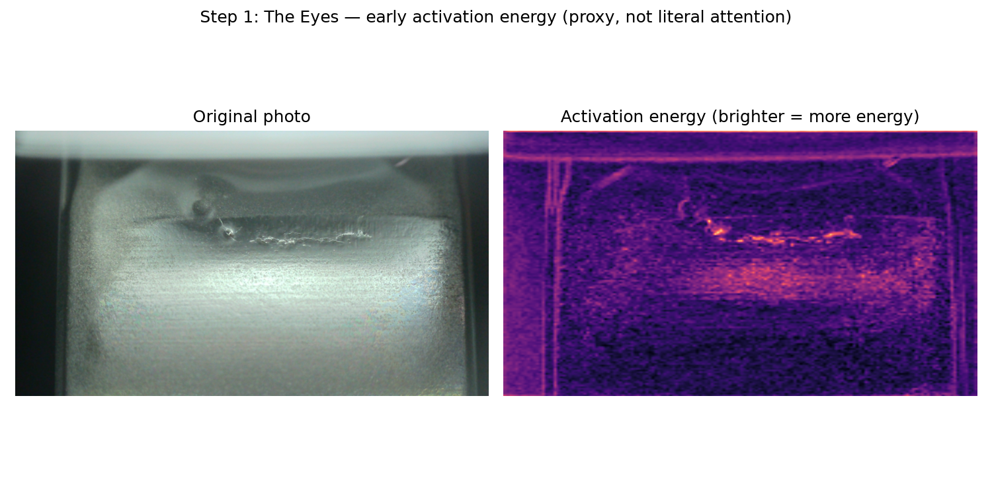
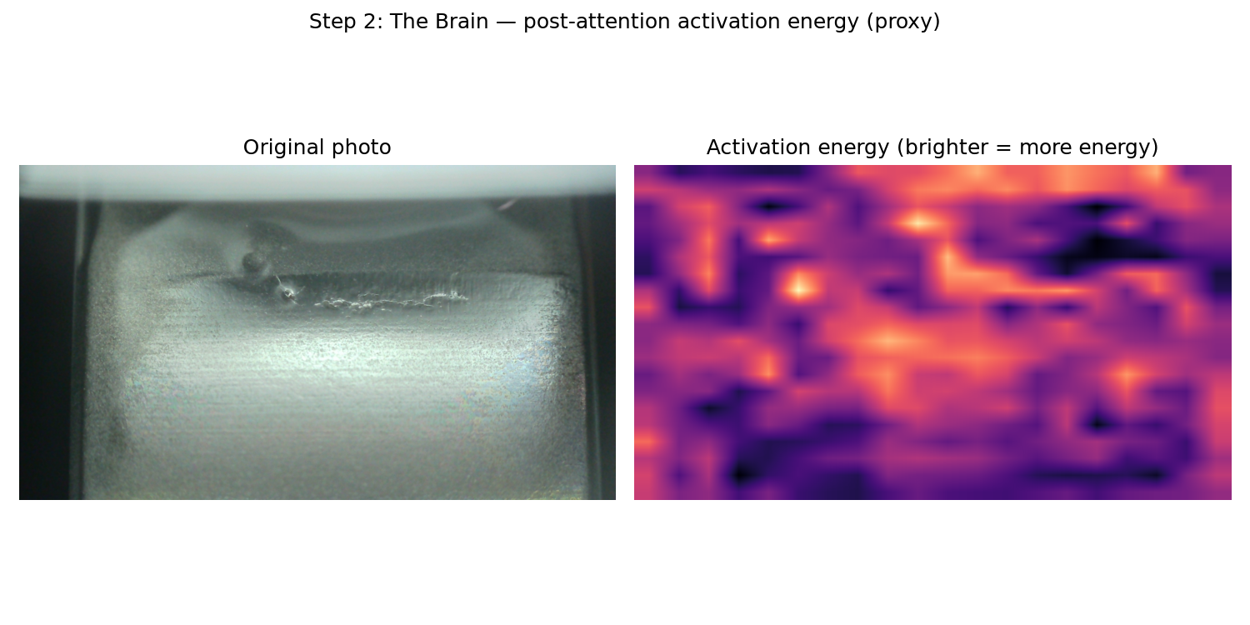
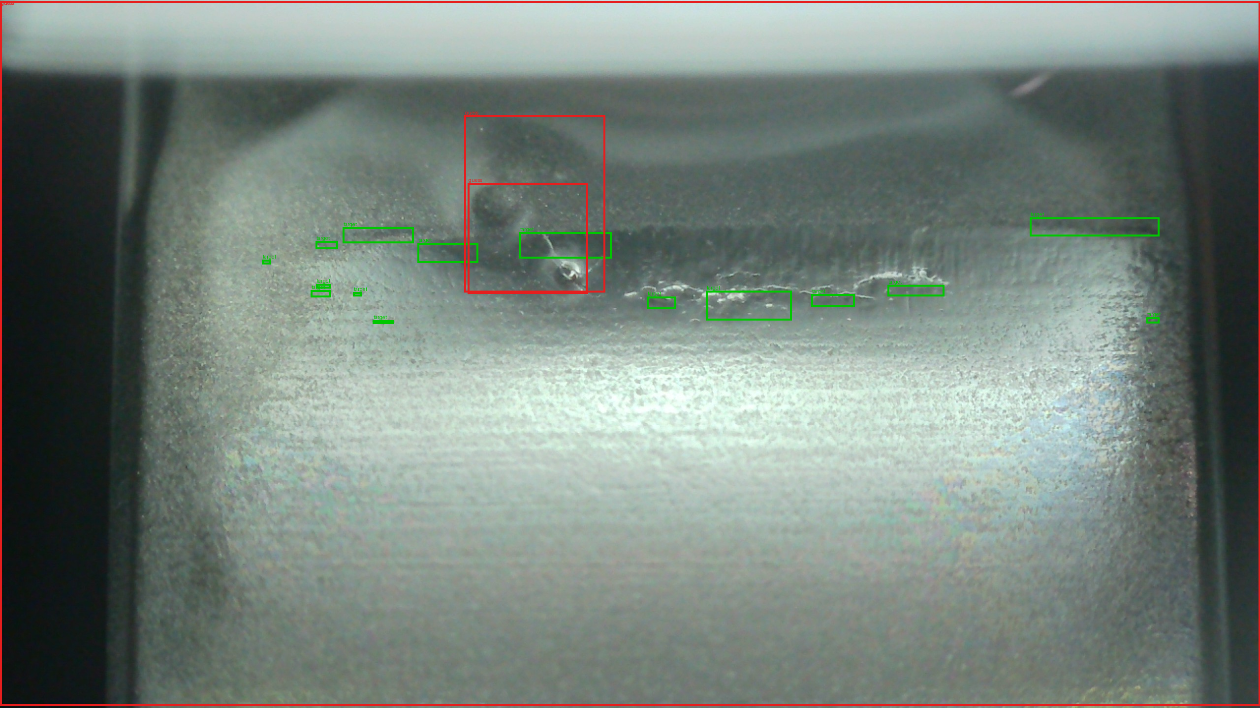
RT-DETR · INSIDE THE BLACKBOX
Eyes → Brain → Finder: What the Network Actually Does
The Eyes
The Brain
The Finder
Backbone activation energy — edges, colors, texture
AIFI encoder — lets far-apart patches “talk” before pooling
Decoder queries → final boxes: green = pseudo-label target, red = model guess
Provisional phm2026_image_damage_v2 pseudo-label — not organizer ground truth, not expert-reviewed.
4

Slide 7
RT-DETR · SETUP
Model, Split, and Provenance
Model | Genuine one-class Ultralytics RT-DETR-L — COCO-pretrained backbone, fine-tuned. Backbone, multiscale/hybrid encoder, transformer decoder/object queries, classification head, and box head all trained. Class: damage_candidate.
Train | EXP-B — 448 images (T2.2-pinned split, reused unmodified, zero leakage)
Validation | EXP-A — 323 images, used only to select the confidence threshold
Test | EXP-F — 224 images, evaluated once, fully held out
Reused as-is | Existing canonical run runs/phm2026_rtdetr_detection/...7f1e13af/ (already deterministic-seeded and complete) — no retraining; effort spent on explaining why it scored as it did.
Provisional phm2026_image_damage_v2 pseudo-label — not organizer ground truth, not expert-reviewed.
5

Slide 8
RT-DETR · HEADLINE SCORE
A Genuine, Complete Negative Result
EXP-F test set — N=224 images, 9,883 pseudo-boxes, confidence threshold 0.60 (selected on EXP-A validation), evaluated once.
0.0000
0.0000
0.0000
Precision
Recall
F1
0.0000831
0.0000159
mAP@0.50
mAP@0.50:0.95
“This is a genuine, complete negative result, and it is not dressed up here.” — a detector trained on this pipeline's pseudo-boxes does not produce usable detections at any officially-tested operating point.
Provisional phm2026_image_damage_v2 pseudo-label — not organizer ground truth, not expert-reviewed.
6

Slide 9
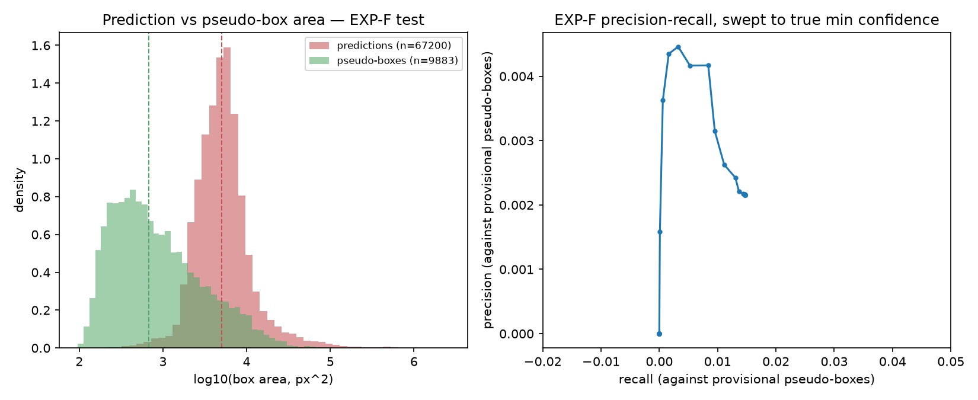
RT-DETR · WHY IT SCORED THAT WAY
1
The Threshold Never Had a Chance
Every tested confidence candidate sits far above the model's real output range.
0.01–0.60
Confidence thresholds tested on EXP-A validation
0.00124–0.00150
Model's actual observed confidence range on EXP-F — ~400x below
145 / 67,055 / 9,738
TP / FP / FN at the loosest possible threshold
1.47% / 0.216%
True recall / precision once un-thresholded
0.579
Mean IoU of the boxes that DO match — a real overlap, not noise
Provisional phm2026_image_damage_v2 pseudo-label — not organizer ground truth, not expert-reviewed.
7

Slide 10
RT-DETR · WHY IT SCORED THAT WAY
2
Boxes Are 7.4× Too Big
The dominant, quantified cause of the residual failure — confirmed by size-tercile recall.
Every single one of the 145 true positives found anywhere in the unthresholded set came from the largest third of pseudo-boxes. A perfectly-placed median prediction containing a median pseudo-box could reach at most IoU 0.135 — short of the 0.5 threshold used everywhere.
Provisional phm2026_image_damage_v2 pseudo-label — not organizer ground truth, not expert-reviewed.
8

Slide 11
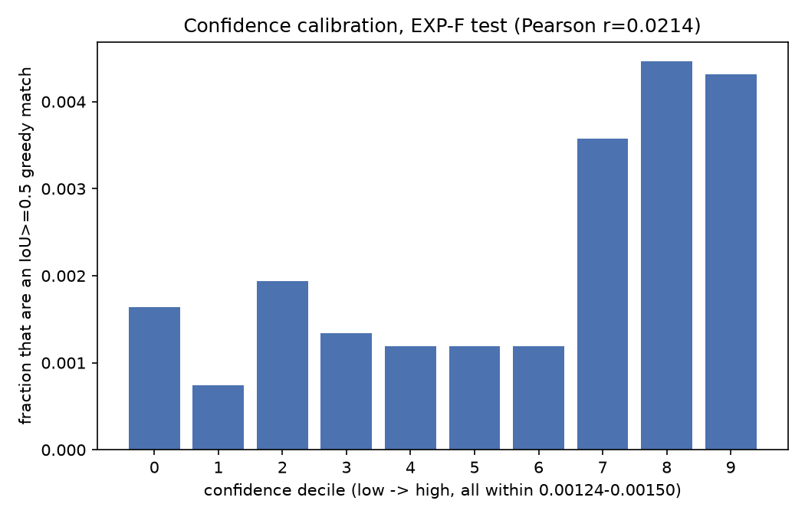
RT-DETR · WHY IT SCORED THAT WAY
3
Confidence Carries Almost No Signal
The classification head never learned to separate correct guesses from wrong ones.
r = 0.021
Pearson correlation, confidence vs. correctness
across 67,200 EXP-F predictions
Top confidence deciles do show ~2–3x the match rate of the bottom — not literally random — but the entire usable range spans only 0.00124–0.00150: far too narrow to threshold on in practice.
Why: the canonical training run lasted 234 total seconds, early-stopped at fine-tune epoch 1 of 4 — not enough time for the classification head to separate its outputs.
Provisional phm2026_image_damage_v2 pseudo-label — not organizer ground truth, not expert-reviewed.
9

Slide 12
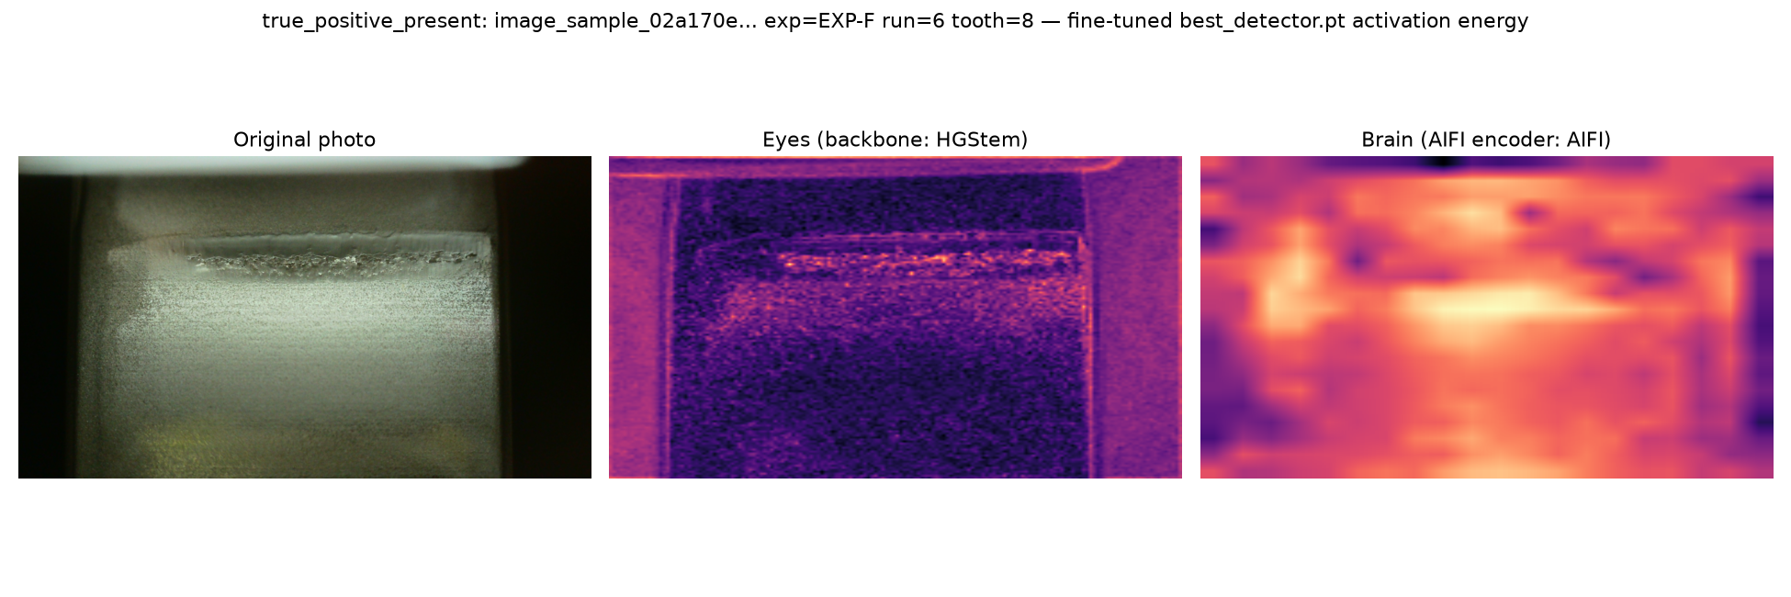
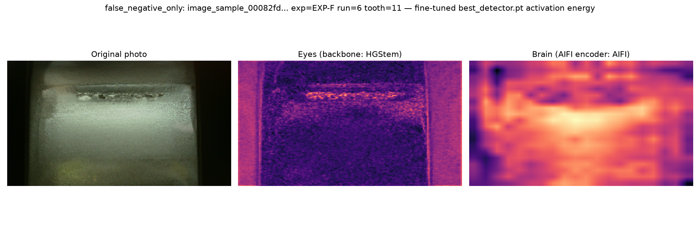
RT-DETR · WHY IT SCORED THAT WAY
4
It's Looking in the Right Place
Backbone activations localize the damage streak whether or not a box ever lands there.
True-positive example — a match was recorded
False-negative example — no match, but the Eyes still find the streak
Provisional phm2026_image_damage_v2 pseudo-label — not organizer ground truth, not expert-reviewed.
10

Slide 13
RT-DETR · WHY IT SCORED THAT WAY
5
Test Data Looks Different on Three Axes at Once
EXP-F compounds the scale mismatch rather than existing independently of it.
Mean boxes / image
Median box area (px²)
% canonical_tooth (wide) view
Provisional phm2026_image_damage_v2 pseudo-label — not organizer ground truth, not expert-reviewed.
11

Slide 14
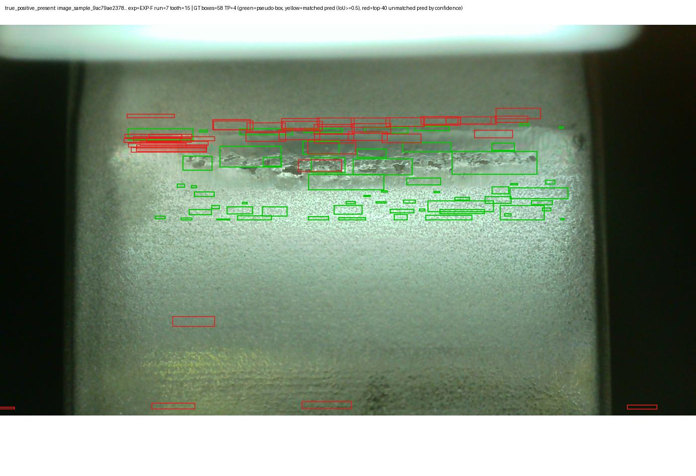
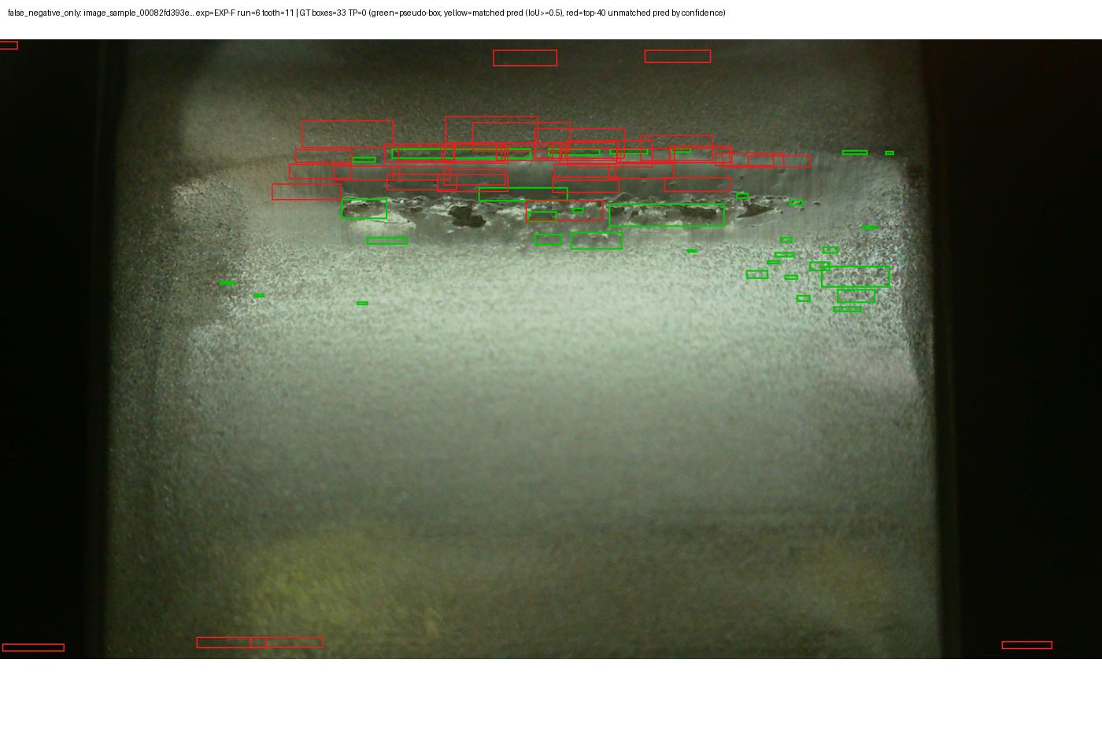
RT-DETR · QUALITATIVE CHECK
Good vs. Missed: What the Cases Look Like
105/224 (46.9%) EXP-F images have at least one match — the small signal is spread thin, consistent with a systematic scale problem, not a handful of anomalous images.
58 pseudo-boxes, 4 matches — real, but rare and partial
Dense pseudo-boxes, zero matches at any threshold
Provisional phm2026_image_damage_v2 pseudo-label — not organizer ground truth, not expert-reviewed.
12

Slide 15
RT-DETR · NEXT STEPS
Five Evidence-Backed Changes — Not a Generic Checklist
1
Redefine pseudo-boxes at coarser granularity
Follows Finding 2: recall is monotonically tied to box size. Merge adjacent components before boxing.
2
Train substantially longer before judging architecture fit
Follows Finding 3: 234 seconds, early-stopped at epoch 1 — undertraining, not an RT-DETR ceiling.
3
Re-select confidence thresholds from the model's real output range
Follows Finding 1: a fixed 0.01–0.60 list will silently reproduce a TP=0 artifact again.
4
Rebalance validation toward EXP-F's view-role composition
Follows Finding 5: EXP-A validation (62% close-up) doesn't resemble EXP-F test (100% wide) at all.
5
Don't tighten IoU@0.5 before fixing scale
Follows Finding 2's area bound: max achievable IoU ≈ 0.135 for typical-sized boxes today.
Provisional phm2026_image_damage_v2 pseudo-label — not organizer ground truth, not expert-reviewed.
13

Slide 16
2
PART 2
PatchTST: Listening to Vibration
A from-scratch PatchTST — patching, channel-independent Transformer encoder, regression head — trained on raw 102.4 kHz spectral features the earlier LF baseline never touched.

Slide 17
PATCHTST · THE TASK
The LF Baseline Left a Known Gap — This Tests It Directly
“This initial LF representation omits raw vibration spectral information and does not prove sensors lack damage information.”
— P4_PATCHTST_BASELINE_CHECKPOINT.md, on the existing LF-only baseline
This tutorial tests that gap directly — from scratch, no repo imports — on the raw 102,400 Hz Accel 1 / Accel 2 waveforms the LF baseline never touched. The only reuse is the pinned T2.2 split and the pinned run-level targets, both read as data — not code.
Provisional phm2026_image_damage_v2 pseudo-label — not organizer ground truth, not expert-reviewed.
14

Slide 18
PATCHTST · DATA FLOW
How a Raw Vibration Waveform Becomes 72 Features
1
2
3
4
Raw waveform
Welch PSD
32 log bands
+ broadband stats
One HDF5 member per minute — Accel 1 & Accel 2 at 102,400 Hz. Read one member at a time, never bulk-loaded.
Power spectral density per channel: nperseg=8192, 50% overlap, Hann window, detrended.
Log-spaced 20 Hz → 51,200 Hz, log1p-compressed energy per band, per channel.
RMS, crest factor, spectral centroid per channel, + 2 missingness flags → 72 features total.
Scale actually processed: 7,124 HDF5 members across 20 runs, 117.5 minutes, one member in memory at a time, disk stable at 74.3 GB free throughout — gtc-data-experiment/ was never written to. Output: 7,123 minute-rows × 72 features (8.2 MB total) feeding a per-run sequence into PatchTST.
Provisional phm2026_image_damage_v2 pseudo-label — not organizer ground truth, not expert-reviewed.
15

Slide 19
PATCHTST · INSIDE THE BLACKBOX
A From-Scratch, Channel-Independent PatchTST
Input
Patch
Linear Embed
Shared
Encoder
Masked
Pool
MLP Head
72ch × T minutes
len 16
stride 8
d_model=32
+ position embed
2 layers · 4 heads
ff=64 (per-channel)
mean over time
→ mean over channels
64 → 1
scalar output
Channel independence is the architecture's defining idea: every one of the 72 features is patched and encoded on its own through one shared Transformer, then pooled — no cross-channel mixing until the final head.
23,905
total parameters — unit-tested on synthetic data before real training
Provisional phm2026_image_damage_v2 pseudo-label — not organizer ground truth, not expert-reviewed.
16

Slide 20
PATCHTST · HEADLINE SCORE
Worse Than Both Baselines
MAE on held-out EXP-F, N=8 runs, single evaluation pass — pp = percentage points of the phm2026_image_damage_v2 target.
MAE 95% bootstrap CI (2,000 resamples, N=8): [0.846, 1.640]
Provisional phm2026_image_damage_v2 pseudo-label — not organizer ground truth, not expert-reviewed.
17

Slide 21
PATCHTST · PER-RUN DETAIL
Predicted vs. True Damage, Run by Run on EXP-F
Run 4 is the clear outlier: predicted 1.843 against a true 4.245 — abs. error 2.402, more than double the next-worst run. Worth a targeted look at that run's raw data before treating it as generic noise.
Provisional phm2026_image_damage_v2 pseudo-label — not organizer ground truth, not expert-reviewed.
18

Slide 22
PATCHTST · WHY IT SCORED THAT WAY
The Full Model Is the Worst Variant
Every reduced-dimensionality variant beats the full model — none beats the 0.6797 constant baseline either. 72 continuous features fit from only 7 training runs overfits before it can be judged on its merits.
Provisional phm2026_image_damage_v2 pseudo-label — not organizer ground truth, not expert-reviewed.
19

Slide 23
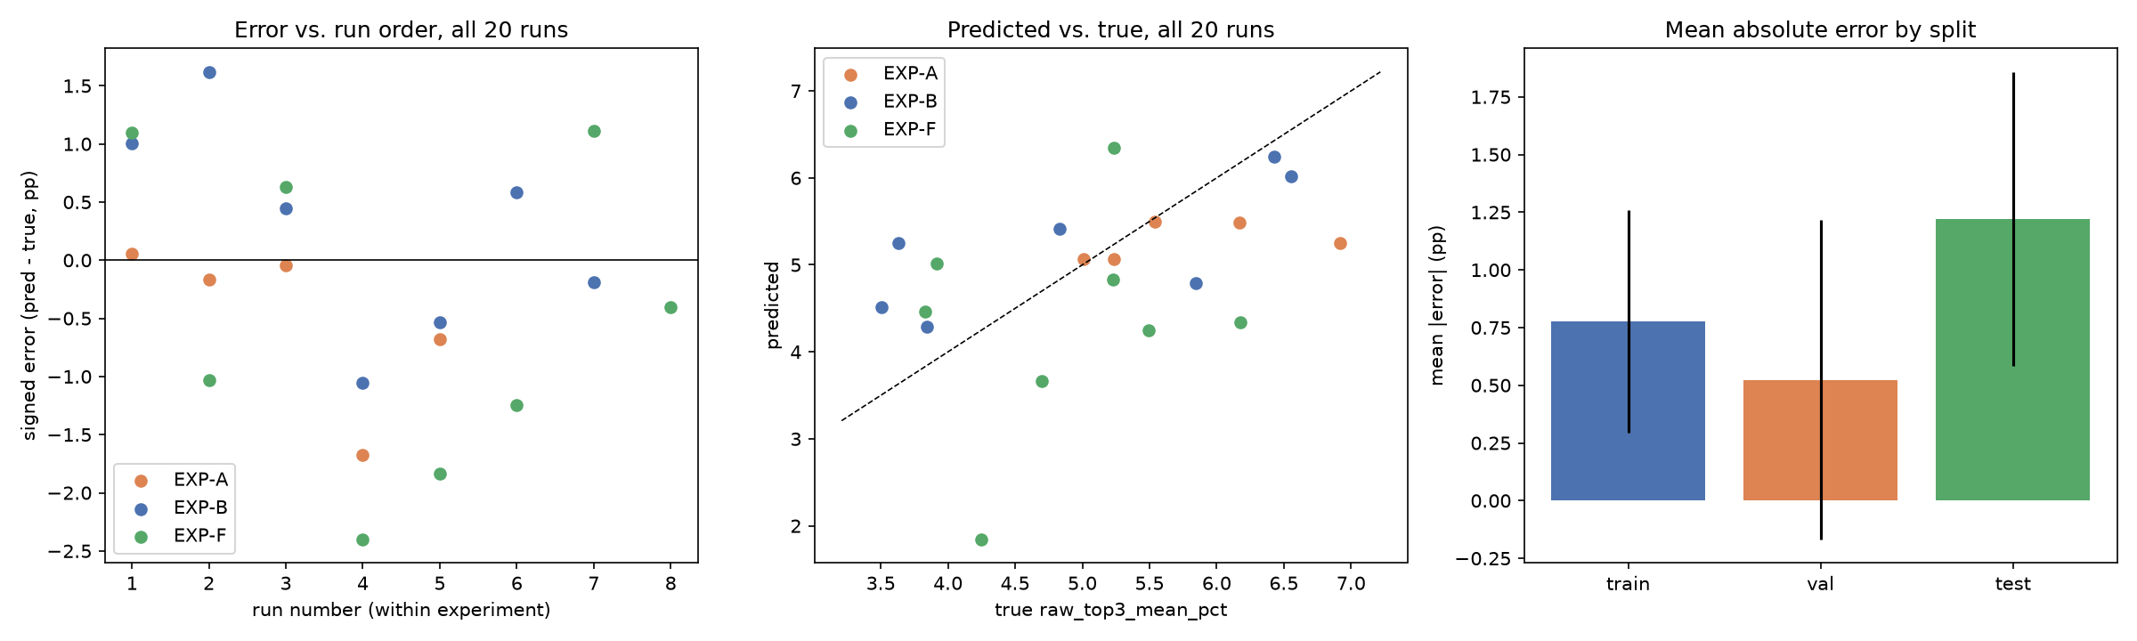
PATCHTST · RESIDUAL ANALYSIS
Where the Error Comes From
0.524 → 0.776 → 1.220
r = −0.105
r = 0.136
Error rises: validation → train → test (a symptom, not a good sign)
run-order vs. signed error, N=8 — no progressive-wear pattern
true damage vs. abs. error, N=8 — not simply failing on high-damage runs
Provisional phm2026_image_damage_v2 pseudo-label — not organizer ground truth, not expert-reviewed.
20

Slide 24
PATCHTST · AN UNPLANNED FINDING
A Real Data-Quality Bug, Found Along the Way
372 / 372
0 / 190
rows identical, all 72 features, EXP-A Run-1 vs Run-2
every other run-pair comparison overlaps not at all
EXP-A Run-1 and Run-2's entire HF archives are exact duplicates — same 149 “Run1” + 223 “Run2” member filenames, same order, same spectral content. This sharpens a concern PROJECT_STATE.md already carried as unverified: “EXP-A Run 2 stays in scope with its reported, unverified 311-file overlap warning.” The real extent, confirmed directly against spectral content, is larger — a complete, exact duplication.
Consequence: no train/test leakage (duplication is entirely inside validation) — but validation effectively provides 4 independent run-level observations, not 5, which plausibly widened the early-stopping/generalization gap seen on slide 23.
Provisional phm2026_image_damage_v2 pseudo-label — not organizer ground truth, not expert-reviewed.
21

Slide 25
PATCHTST · NEXT STEPS
Five Evidence-Backed Changes — Not a Generic Checklist
1
Reduce feature dimensionality before judging HF content
Every reduced variant beat the full 72-feature model. Try PCA/factor-reduction fit on train only.
2
Treat the 4,408–51,200 Hz band with real suspicion
The single worst individual variant (Spearman −0.357) — check for acquisition-chain noise, not signal.
3
Don't use EXP-A Run-2 as independent validation evidence
It's a confirmed exact duplicate of Run-1 — downweight it in validation-signal computations specifically.
4
Investigate EXP-F Run-4 directly
The clear residual outlier (abs. error 2.40) — check for unusual operating conditions or a sensor issue.
5
A larger N is the highest-leverage fix available
N=7/5/8 gives almost no statistical power — nothing here substitutes for more runs.
Provisional phm2026_image_damage_v2 pseudo-label — not organizer ground truth, not expert-reviewed.
22

Slide 26
CLOSING
Two Honest Negatives Beat One Unexplained Zero
 | RT-DETR (image) | PatchTST (vibration)
Headline | mAP@0.50 = 0.0000831 | MAE = 1.220 pp (worse than constant)
Root cause | Box-regression scale (~7.4× too large) + undertrained confidence head | Feature-dimensionality overfit (72 features, 7 training runs)
Localization? | Correct — backbone activations track the real damage streak | n/a — regression, not detection
Bonus finding | Test set differs on box density, size, AND view protocol simultaneously | EXP-A Run-1 ≡ Run-2, an exact archive duplication (confirmed, not just filename overlap)
Both results are fully explained with evidence, not left as unexplained zeros — and both point to the same next requirement: human review of the provisional pseudo-label before either result can mean anything physically.
Provisional phm2026_image_damage_v2 pseudo-label — not organizer ground truth, not expert-reviewed.
23

