Slide 1
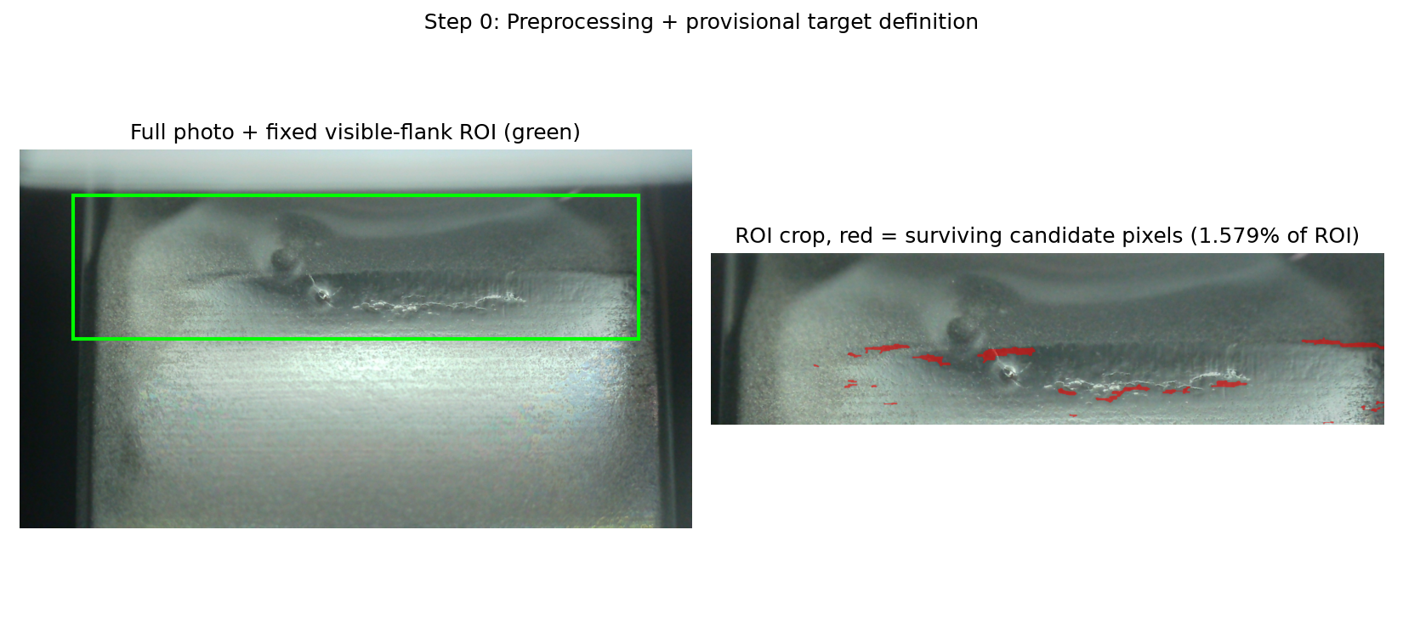
RT-DETR · DATASET PREPARATION
How an Unlabeled Photo Becomes RT-DETR Training Data
1
2
3
4
5
Raw photo
Crop + normalize
Isolate residual
Clean the mask
Box it
No label of any kind ships with it.
Fixed visible-flank ROI, CLAHE contrast.
Background-subtract → robust z-score → threshold.
Morphology; keep only wide, flat (spall-like) blobs.
Connected components → damage_candidate boxes.
Result: 995 images, 30,628 real, versioned damage_candidate boxes — a genuine dataset RT-DETR trains and is scored on, exactly like any detection dataset. But: every box is this heuristic's guess, not organizer or expert-verified ground truth — 560 boxes are still sitting in a pending human-review queue, untouched.
Source: pi_multimodal_ad.targets.image_damage.measure_damage_candidate, configs/experiments/phm2026_image_target.yaml, docs/planning/R4_PSEUDO_BOX_CHECKPOINT.md

