Slide 1

Enterprise leaders ask “why.” Analysts write SQL. Decisions wait.
Kontexa turns business questions into warehouse-proven explanations.
Founder · Parth Harduley
Investor & Enterprise Briefing
Notes:
Open with the business tension: executives need why-answers; analytics cycles delay decisions. Kontexa is warehouse-native decision intelligence — not another dashboard.

Slide 2

The enterprise problem
Every urgent “why” becomes another analytics cycle.
VP Sales · VP Marketing · CFO · COO · Strategy · PMs · Business Analysts
1
2
3
4
5
Business
question
Ticket to
analytics
SQL &
dashboards
Follow-up
questions
Delayed
decision
“Why did revenue
decline?”
Queue · priority
· wait
Queries · reports
· rebuilds
New tickets.
Same loop.
Days or weeks
later
The bottleneck is not data. It is the human analytics loop between question and decision.
Kontexa · Confidential
2 / 12
Notes:
Walk the workflow slowly. Emphasize personas asking real questions. Each new question restarts SQL/dashboard work. This is the cost center Kontexa collapses.

Slide 3
Why this matters
Time-to-decision is a P&L variable.
Revenue
Profitability
Missed interventions while teams wait for the next report.
Margin leaks persist across another analytics sprint.
Retention
Advantage
Churn drivers stay opaque until after the damage.
Competitors who decide faster set the market pace.
Kontexa · Confidential
3 / 12
Notes:
Connect decision latency to CFO/COO language. This is not an IT convenience story — it is operating performance.

Slide 4
Existing solutions
Enterprises already bought tools. The loop remains.
Approach
What it does well
Where the loop breaks
Dashboards & BI
Monitor known KPIs well
Cannot investigate new “why” questions alone
Analytics teams
Deep SQL expertise
Finite capacity; every ask becomes a ticket
Text-to-SQL chat
Faster query drafting
Brittle answers; weak evidence & governance
Generic AI assistants
Fluent explanations
No warehouse proof; risk of invented metrics
Kontexa · Confidential
4 / 12
Notes:
Do not attack customers for buying Tableau/Power BI. Acknowledge value, then show the structural gap for investigation.

Slide 5
The monitoring vs reasoning gap
Why dashboards are no longer enough
Dashboards excel at…
They struggle with…
● Tracking known KPIs in real time
● New “why / explain / investigate” asks
● Shared visibility across teams
● Competing hypotheses under test
● Trend monitoring & alerting
● Evidence tied to warehouse rows
● Operational scorecards
● Board-ready causal honesty
Kontexa is the reasoning layer that complements dashboards — and grounds AI assistants in warehouse truth.
Kontexa · Confidential
5 / 12
Notes:
Position carefully: dashboards are not obsolete. They monitor. Kontexa reasons. Together they form the modern analytics stack.

Slide 6
Enterprise decision intelligence requires more than fluency
Why not ChatGPT / generic AI?
Requirement
Generic AI
Kontexa
Warehouse connectivity
Usually absent / ad hoc
Native evidence execution
Governed business catalogue
Prompt memory ≠ semantics
Approved catalogue authority
Evidence-backed reasoning
Narrative can invent facts
Claims tied to query results
Explainable conclusions
Hard to audit
Hypotheses · purpose · unknowns
Decision-grade confidence
Sounds certain
Honest insufficiency when needed
Kontexa · Confidential
6 / 12
Notes:
Investors will ask this. Be crisp: LLMs are the interface; enterprises need a governed reasoning engine connected to their warehouse.

Slide 7
The solution
Kontexa: from business question to proven explanation.
An evidence-driven, warehouse-native decision intelligence platform.
1
2
3
4
Ask
Plan
Prove
Decide
Leaders ask in business language — no ticket required.
GPT builds an investigation with competing hypotheses.
Warehouse evidence validates or weakens each claim.
Executives get explanation, confidence, and unknowns.
Kontexa · Confidential
7 / 12
Notes:
One-liner: Kontexa collapses the analytics ticket loop into an evidence program that executives can trust.

Slide 8
Six steps from question to executive explanation
How Kontexa works
1
2
3
4
5
6
Business
question
Catalogue
understanding
Investigation
planning
Warehouse
evidence
Evidence
validation
Executive
explanation
Natural language
from the leader
Approved semantics
& definitions
Competing
hypotheses
SQL evidence
requests executed
Purpose-tagged
results packed
Confidence &
unknowns stated
GPT plans. The warehouse proves. Narrative never invents support.
Kontexa · Confidential
8 / 12
Notes:
This is the product architecture told as a business process. Emphasize hypotheses and insufficiency as trust features.

Slide 9
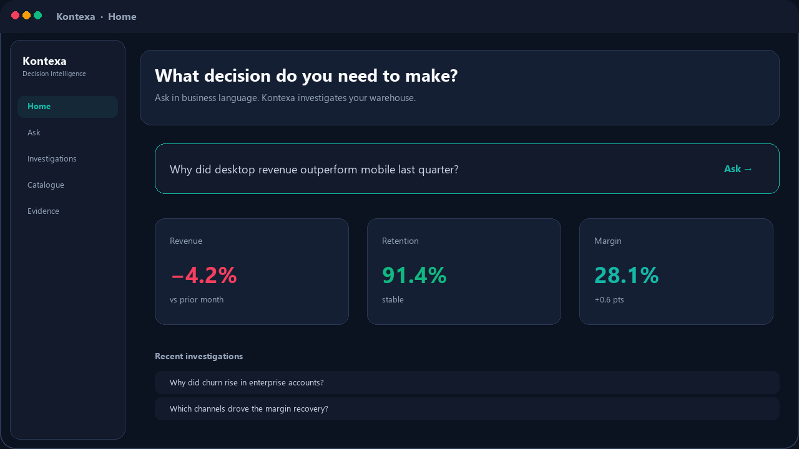
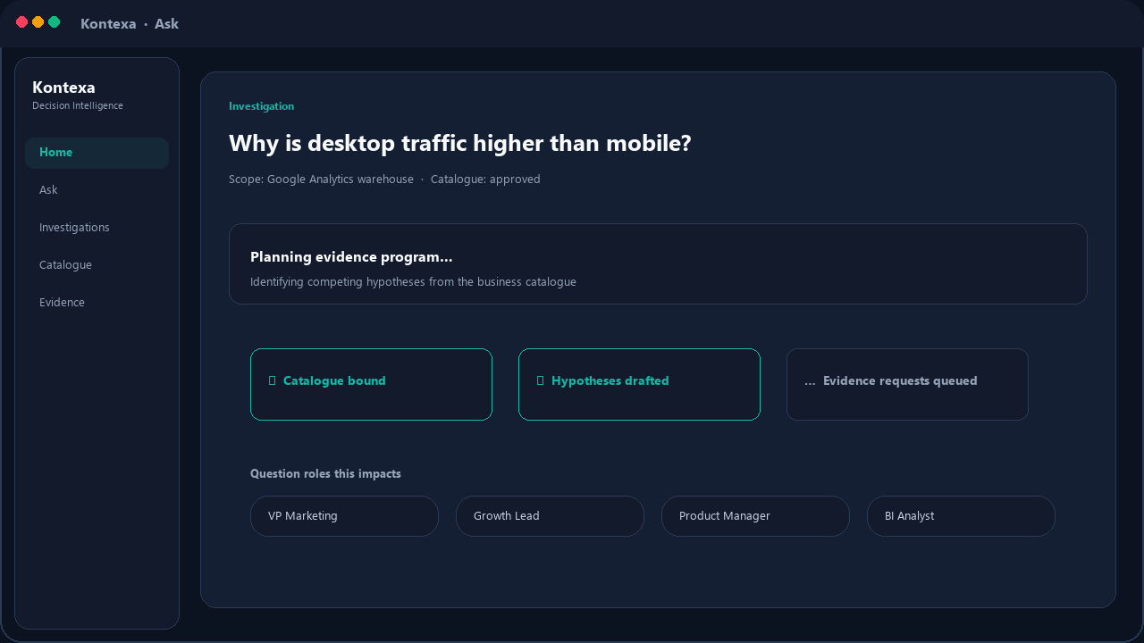
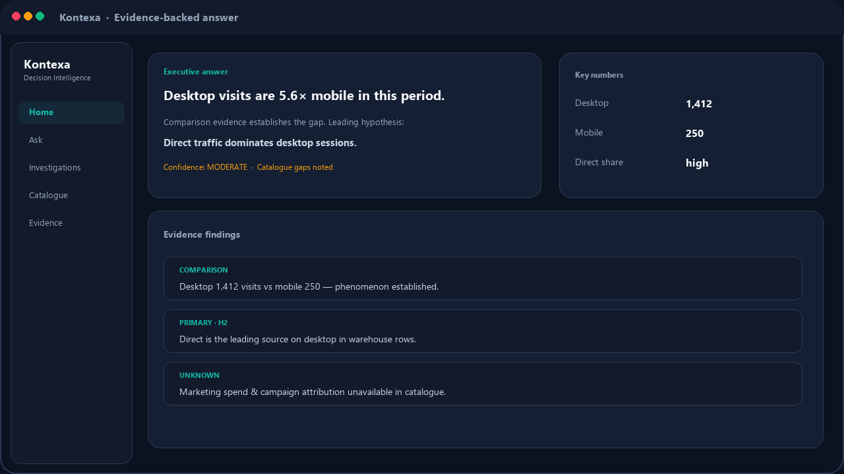
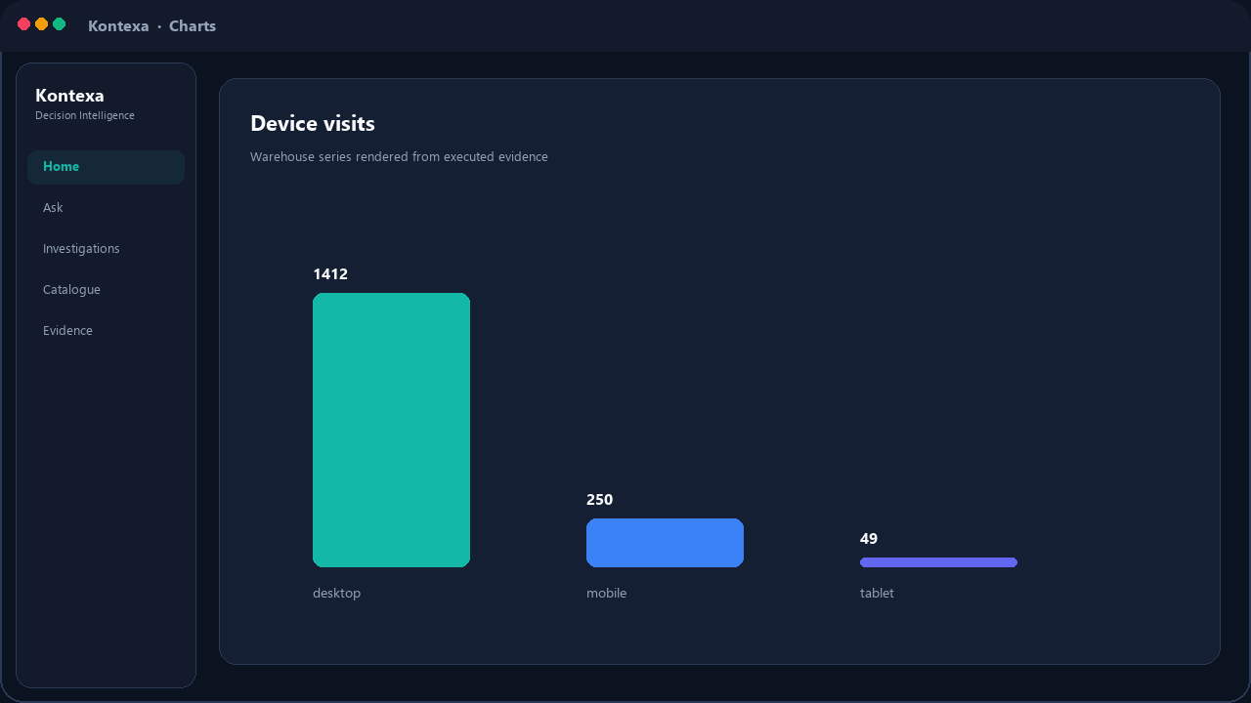
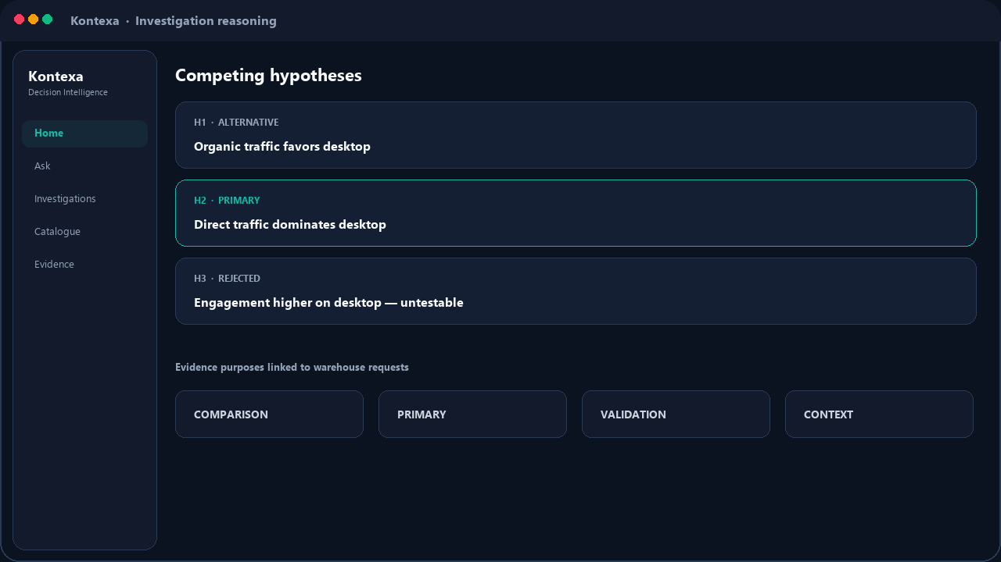
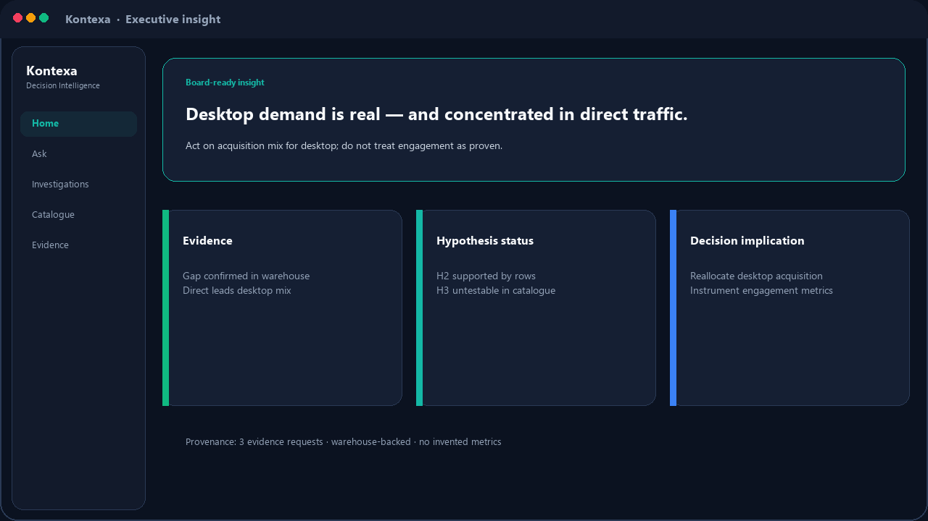
From ask to board-ready insight
Product experience
Home
Ask WHY
Evidence answer
Charts
Investigation
Executive insight
Kontexa · Confidential
9 / 12
Notes:
If presenting live, swap mockups for product screens. Story: ask → plan → evidence → charts → hypotheses → executive card.

Slide 10
The transformation that matters
What changes for the client
BEFORE
Executive
Analyst
ticket
SQL &
reports
Dashboard
Follow-ups
Decision
asks why
queued
built
shared
restart
delayed
AFTER KONTEXA
Executive
Kontexa
Warehouse
investigation
Evidence
explanation
Confident
decision
asks why
plans
runs
proven
minutes
Kontexa · Confidential
10 / 12
Notes:
Strongest visual slide. Pause here. Before = ticket factory. After = minutes to evidence-backed decision.

Slide 11
TAM · SAM · SOM
Market opportunity
TAM
$40.1B
Global BI Software (2025) → $81.5B by 2033 · CAGR 9.3% · Grand View Research
SAM
$19.4B
Decision Intelligence (2025) → $57.8B by 2032 · CAGR 16.9% · Fortune Business Insights
SOM
$0.6–1.0B
Beachhead: large-enterprise warehouse-native decision layer (5–7 yr)
Kontexa · Confidential
11 / 12
Notes:
Sources: Grand View Research BI Software Market (2025–2033); Fortune Business Insights Decision Intelligence (2025–2032); FMI Augmented Analytics adjacent; Gartner software spend ~$1.25T (2025). SOM is Kontexa bottom-up beachhead estimate.

Slide 12
Kontexa
The warehouse-native reasoning engine behind enterprise decisions.
As leaders interact through AI assistants (Claude and others), Kontexa becomes the governed evidence layer — not another standalone dashboard.
Near term
Medium term
Long term
Own WHY / EXPLAIN for cloud warehouse enterprises.
Embed decision workflows in finance, growth, and ops.
Power assistant experiences with warehouse-proven reasoning.
Business Intelligence Made Easy
Parth Harduley · Founder · Let’s collapse the distance between question and decision.
Kontexa · Confidential
12 / 12
Notes:
Close on platform vision: assistants as interface, Kontexa as reasoning engine. Ask for pilot / partnership next step.

