Slide 1

Data Analytics
Subject: Summer Internship – 2 (CS343)
Guided by: Annkit Hasija
Presented by:
Parth Adesara (20CS001)

Slide 2
CONTENT
Agenda
Technology
Technology Description
Roles and Responsibility
Screenshots of work done
Advantages of taking internship

Slide 3

Agenda
In my data analytics internship presentation, I outline the objectives and scope of my internship, emphasizing the data I analyze and the tools I use. I explain the data collection and preparation process, highlighting challenges faced. Presenting key findings and insights through visualizations, I illustrate patterns and trends. I describe the data analysis techniques applied and share relevant results. Data visualizations aid in enhancing understanding and communication.

Slide 4


Technology

Slide 5
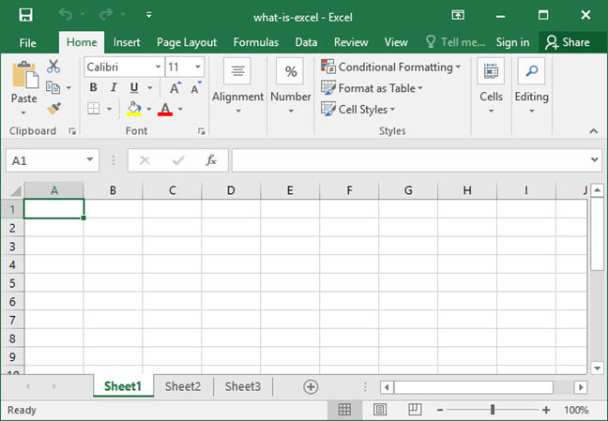
Technology Description
Microsoft Excel
Excel, a widely used spreadsheet software, has become a fundamental tool in data analytics projects. Its versatility, user-friendly interface, and powerful features make it an excellent choice for managing, analyzing and visualizing data. It offers a wide range of functions and formulas to perform data cleaning, handle missing values, remove duplicates, and format data.

Slide 6
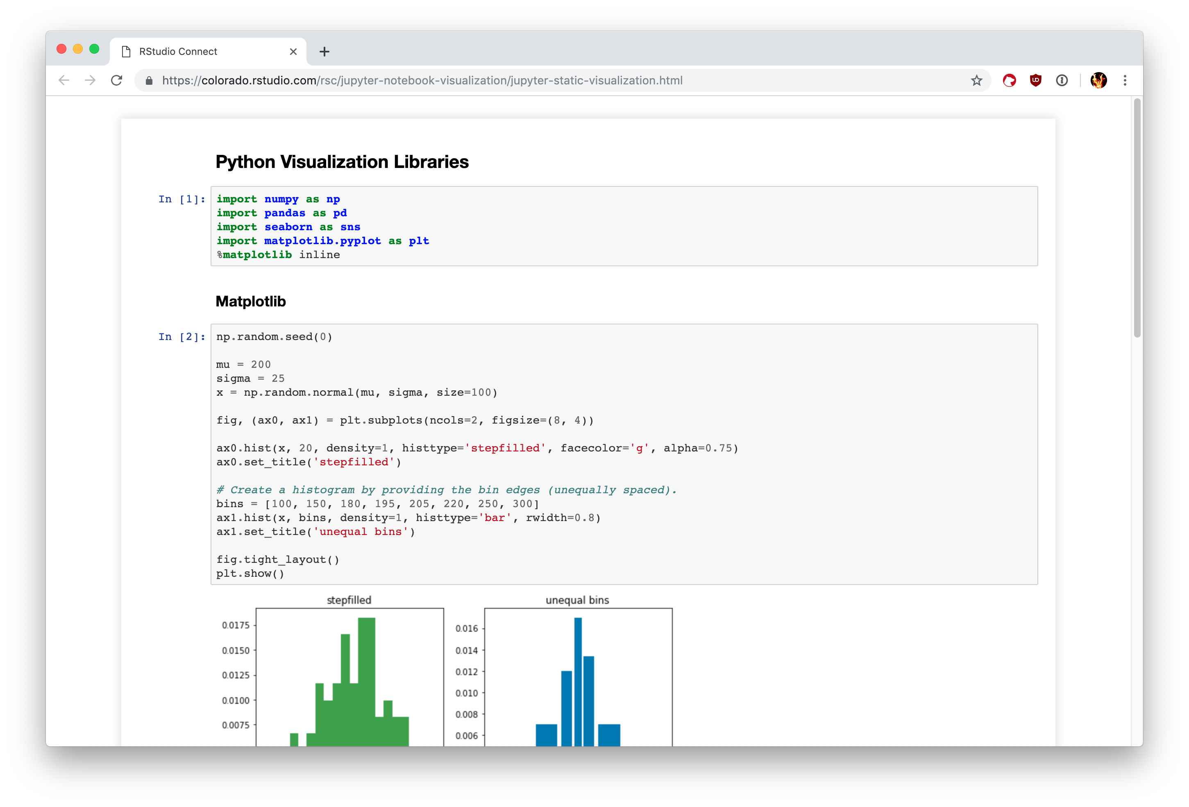
Python
Python has emerged as a leading programming language in the field of data analytics, offering a robust ecosystem of libraries and tools that enable efficient data manipulation, analysis, and visualization. Its user-friendly syntax allows analysts to write clean and concise code, making it easier to understand and maintain. Python's strength in machine learning and predictive modeling makes it a powerful tool for data analytics projects.

Slide 7
Roles and Responsibility
Introduction to technologies
Learned the analyzing tools like excel & python.
Gained knowledge about where can I use the particular features of this technologies.
Data Cleaning
Learned how to preprocess and clean dirty data.
Data visualization
Learned how to represent the given data in form of graphs, charts etc.
Data organization
Learned how to organize data in a appropriate way
Making a project on Predict blood donations by Python
Made a project on predicting blood donation behavior using historical data.

Slide 8
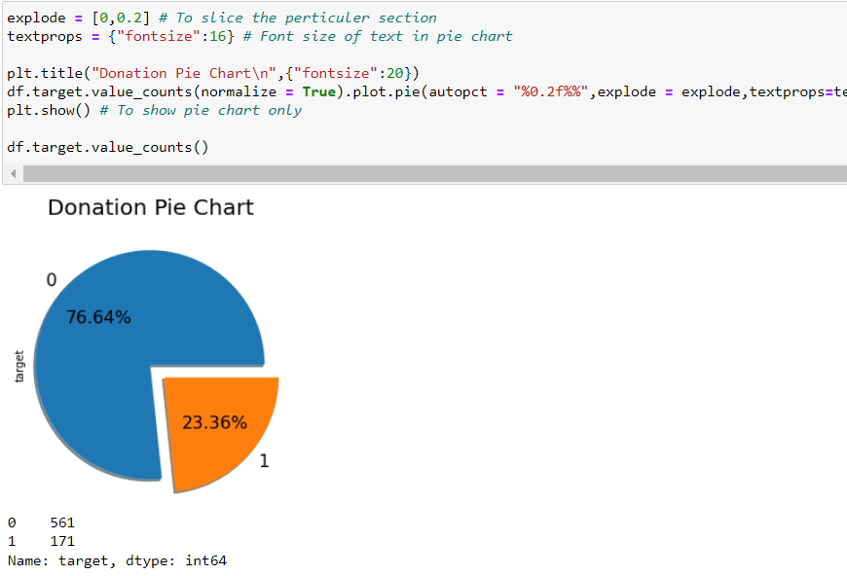
Screenshots of Work done
Pie chart of donations

Slide 9
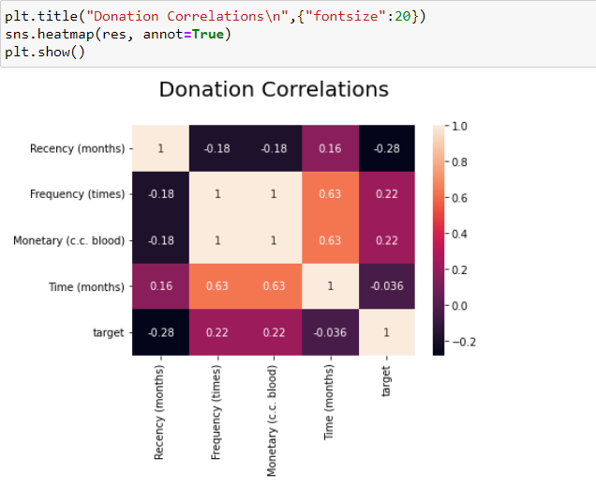
Screenshots of Work done
Heatmap for donations

Slide 10
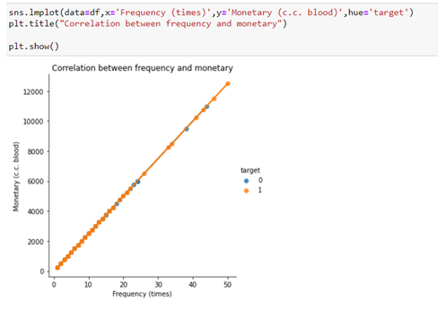
Screenshots of Work done
Correlations of frequency and monetary

Slide 11
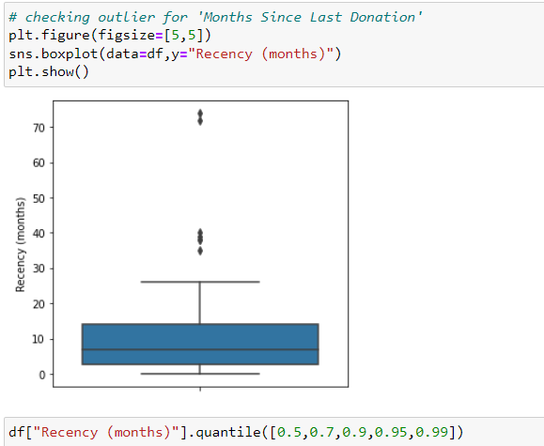
Screenshots of Work done
Handling the outliers

Slide 12
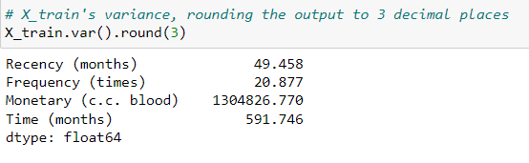
Screenshots of Work done
Checking variance

Slide 13
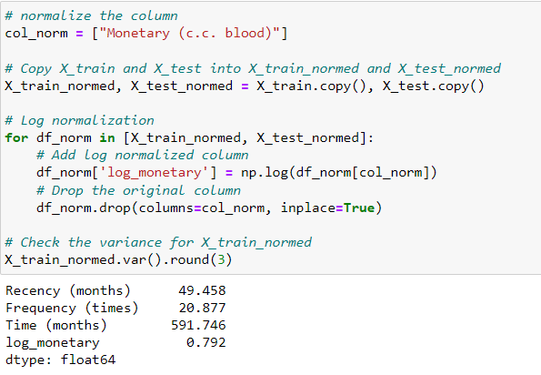
Screenshots of Work done
Log Normalization

Slide 14
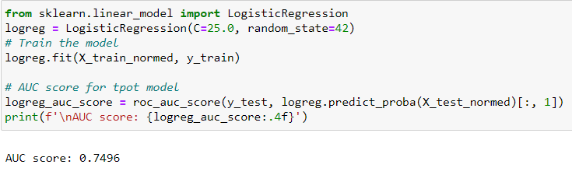
Screenshots of Work done
Training
Regression model

Slide 15
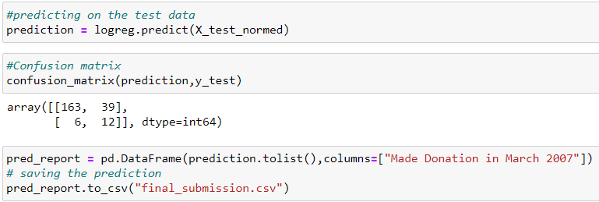
Screenshots of Work done
Saving the
prediction

Slide 16
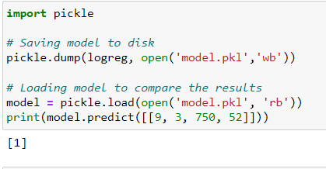
Modeling
Screenshots of Work done

Slide 17
Advantages of taking Internship
Currently there is a huge demand of data sciences in this era. There are plenty of fields like healthcare, business, education, E-Commerce and a lot of other sectors that needs a proper data management. Thus for gaining proper techniques and tools of data management skills, it is must that one needs good knowledge of data analysis.
Engaging with real-world data analytics tasks allows interns to gain practical skills and a deeper understanding of data analysis workflows. Python's versatility as a programming language is another advantage, given its extensive library and framework support for data analytics, including Pandas, NumPy etc.
Overall, an internship focusing on data analytics using Python equips individuals with the practical skills, knowledge, and confidence needed to excel in the data-driven landscape, fostering exciting career prospects in data analytics and related fields.

Slide 18
THANK YOU!

