Slide 1



Slide 2





&
HARMA
Associates

Slide 3

We Build Your vision.

Slide 4
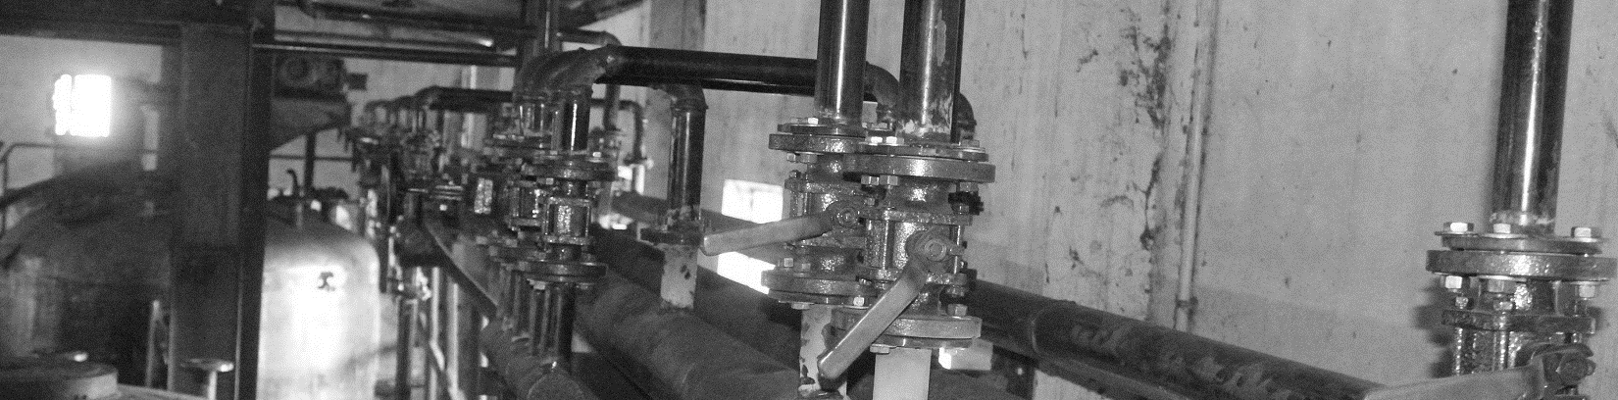



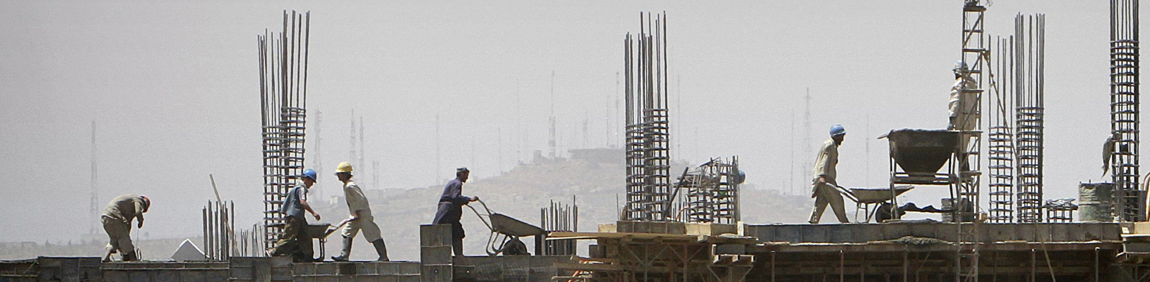

Slide 5




Slide 6


Slide 7



&
Associates
HARMA

