Slide 1
Customer Feedback Analysis for E-commerce
A comprehensive project analyzing sentiment and uncovering customer review themes
Shubham Patel
Parth Patel

Slide 2
Project Objective
Analyze customer reviews to extract sentiment and identify themes.
Provide actionable insights for e-commerce improvement.
Focus on sentiment classification and topic modeling.

Slide 3

Statement of the problem :
E-commerce platforms gather extensive customer feedback.
Insights from this unstructured data are essential for enhancing customer satisfaction and business strategies.
Challenges: Complexity of textual data analysis.

Slide 4
Why People Should Care
Timely analysis of feedback improves
Customer satisfaction
Enhances product quality
Boosts revenue.
Neglecting feedback risks losing customers to competitors and damages brand reputation.

Slide 5
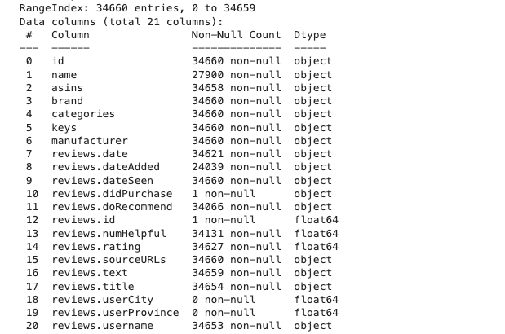
Dataset Overview
Dataset: Amazon customer reviews
Total records: 34,660
Key columns: 'reviews.text', 'reviews.rating'
Data preprocessing: Cleaning, tokenization, lemmatization.

Slide 6
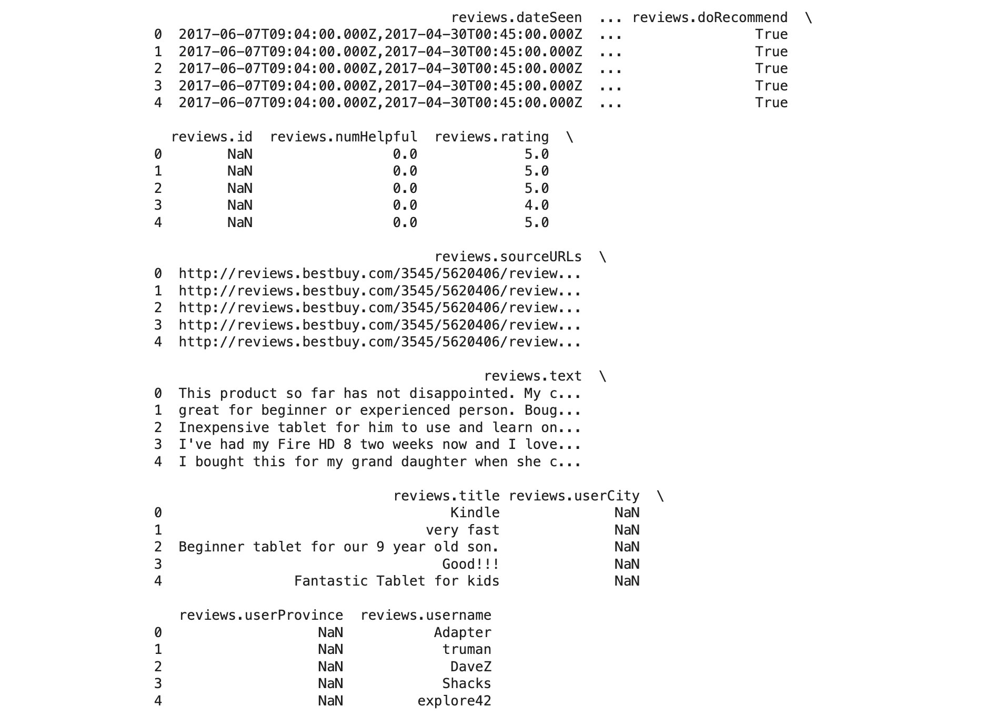
data file
Contains different data from datafile.
Import columns are
Review
Rating

Slide 7
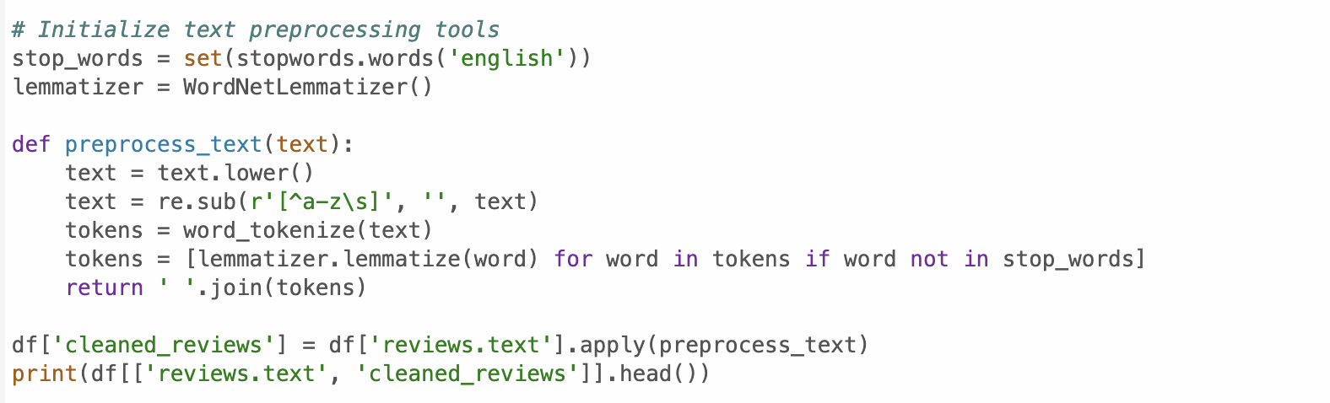
Data Preprocessing
Removed null values.
Tokenized and lemmatized text.
Removed stopwords and special characters.
Created a 'cleaned_reviews' column.

Slide 8
Sentiment Analysis
Sentiment labeling based on ratings:
Positive: Rating >= 4
Neutral: Rating = 3
Negative: Rating <= 2
Text vectorization using TF-IDF.
Classification with Naive Bayes and SVM.

Slide 9
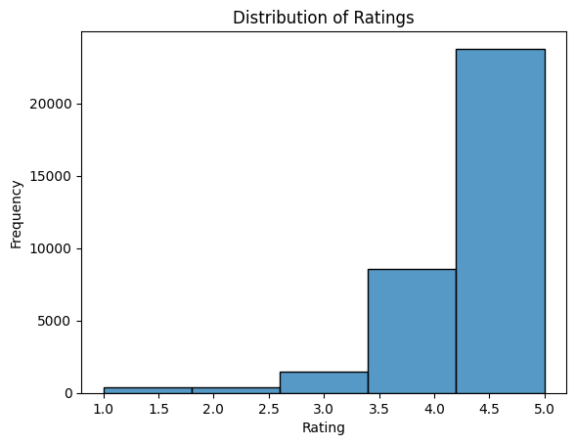
Distribution of Ratings

Slide 10
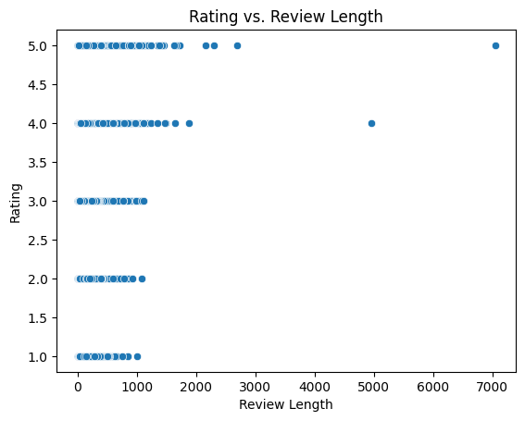

Slide 11
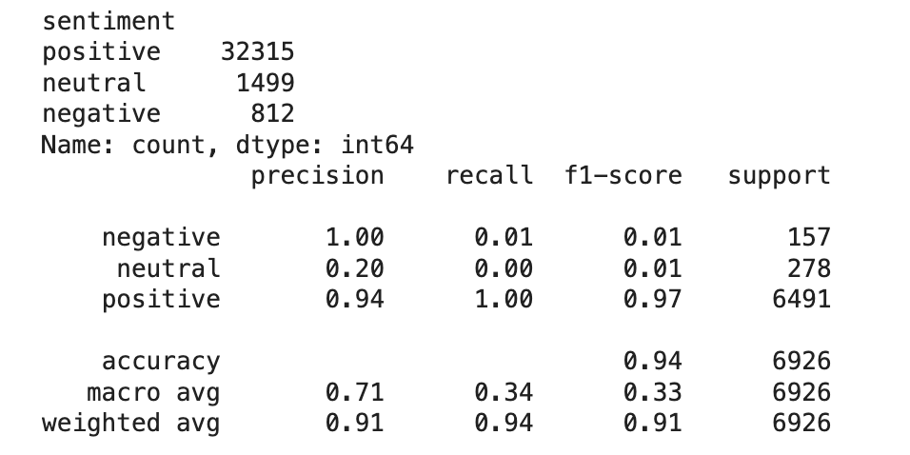
Sentiment Analysis Results
Sentiment distribution:
Positive : 32,315
Neutral : 1,499
Negative : 812
Accuracy: 94%
Positive sentiment shows the best performance (F1-score = 0.97).
Neutral and negative sentiments are underperforming due to low recall.

Slide 12
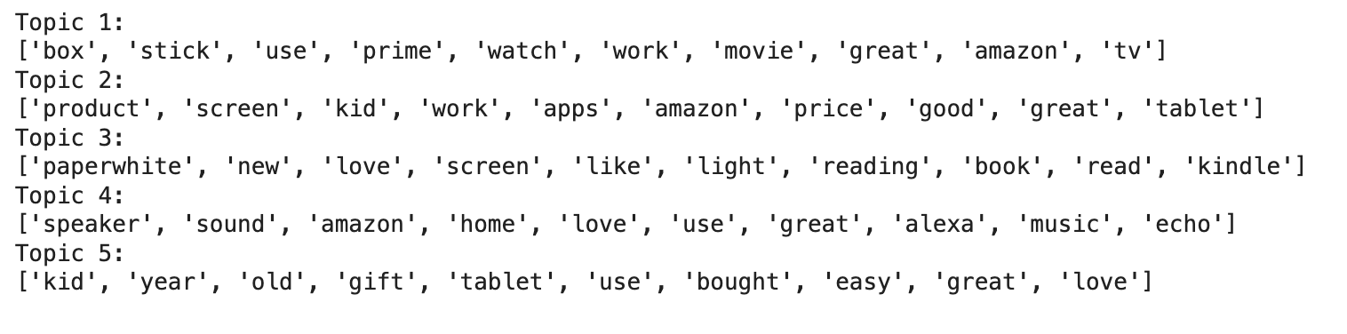
Topic Modeling
Used Latent Dirichlet Allocation (LDA).
Identified 5 key topics:
1. Amazon TV and Prime
2. Tablets and Accessories
3. Kindle and Reading
4. Alexa and Smart Devices
5. Children's Gadgets

Slide 13
Key Insights
Popular themes include affordable tablets and user-friendly devices.
Issues identified in product quality and functionality for specific items.

Slide 14
Visualizations
Sentiment distribution bar chart.
Word cloud for frequent terms.
Topic proportions bar chart.

Slide 15
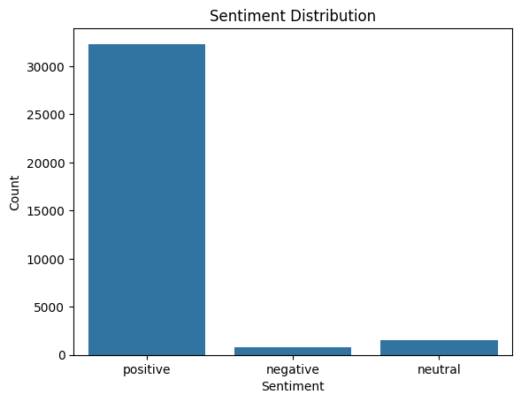
Sentiment distribution bar chart.

Slide 16
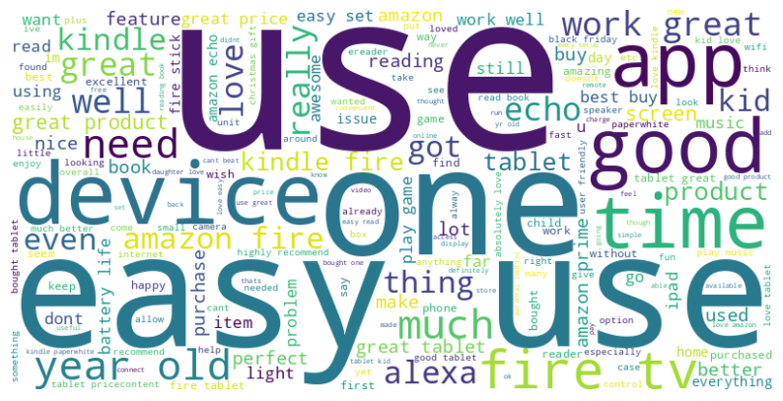
Word cloud for frequent terms.

Slide 17
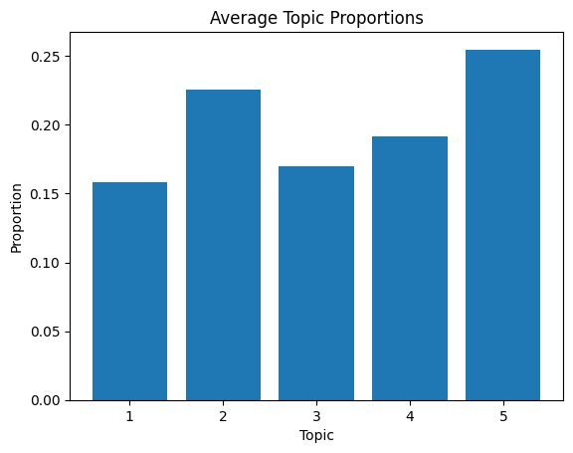
Topic proportions bar chart

Slide 18
Further Work and lesson learned
Need to address data imbalance by using different techniques.
Need to apply different techniques ex : Deep learning models (BERT)
Need to collect more diverse feedback data and recent data
Notes:
Bidirectional encoder representations from transformers (BERT)

Slide 19
Conclusion
Successfully analyzed customer feedback using sentiment analysis techniques.
Demonstrated high accuracy for the positive sentiment class, showcasing the effectiveness of the model for majority classes.
Identified challenges in handling imbalanced datasets, particularly for neutral and negative sentiments.

Slide 20
Reference
https://www.geeksforgeeks.org/what-is-sentiment-analysis/
https://www.ibm.com/topics/sentiment-analysis
https://www.kaggle.com/datasets/datafiniti/consumer-reviews-of-amazon-products

